Slide 1



/ai/ | /ee/ | /igh/ | /oa/ | /oo/ | /y-oo/ | /r/
/n/ | /m/ | /ch/ | /k/ | /sh/ | /j/ | /v/
/u/ | /e/ | /i/ | /s/ | /zh/ | /z/ | /ar/
/or/ | /ur/ | /air/ | /ear/
Review Sound Family /zh/ /z/
Lesson 65

Slide 2


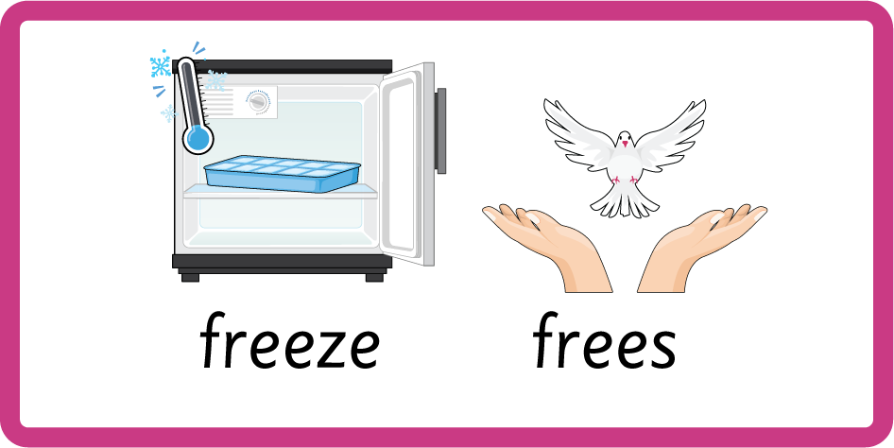

Learn and practise /zh/ and /z/ sound family spelling patterns, including homophones and Common Exception Words.
Recall all GPCs learned so far using flashcards.
Homophone Cards
Grapheme to Phoneme Cards
Phoneme Frame Cards
Alien Words
Common Exception Word Cards
JN693
JN686
JN689
JN692
JN687

Slide 3























Recall all GPCs learned so far using flashcards.

Slide 4




























Recall all GPCs learned so far using flashcards.

Slide 5









































Recall all GPCs learned so far using flashcards.

Slide 6





























Recall all GPCs learned so far using flashcards.

Slide 7














Review Phase 2 Common Exception Words as I is no go to into the put his has of pull full.

Slide 8




























Review Phase 3 Common Exception Words push they me we be he she my by looked you are there here were all sure.

Slide 9













Review Phase 4 Common Exception Words said like out have some come what was so old do little one.

Slide 10














Review Phase 5 Common Exception Words today house mouse hour because Mr Mrs Ms where should could would move use.

Slide 11
























Review Phase 5.5 Common Exception Words people wild child mind kind behind eye oh most only both though through who prove shoe beautiful climb Christmas school sugar love money any…

Slide 12






…many friend very busy pretty once please.

Slide 13

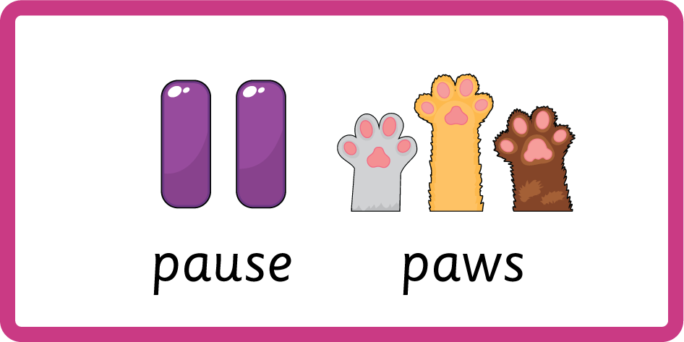


Teach Homophones within /z/ family freeze / frees, maze / maize, please / pleas, raise / rays, size / sighs.

Slide 14
Review Common Exception Words as is his has was please.

Slide 15
Review Grapheme Captions
USING JN686
FRONT

Slide 16
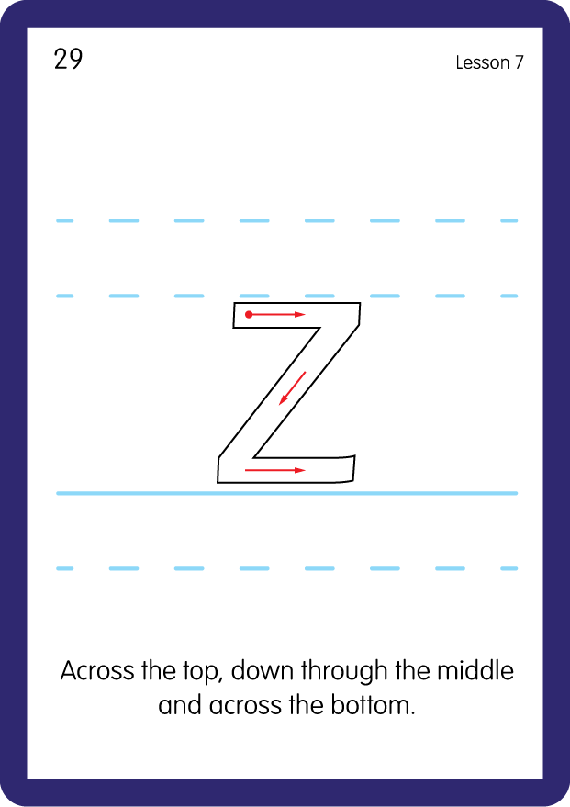


Review Grapheme Captions
USING JN686
BACK

Slide 17
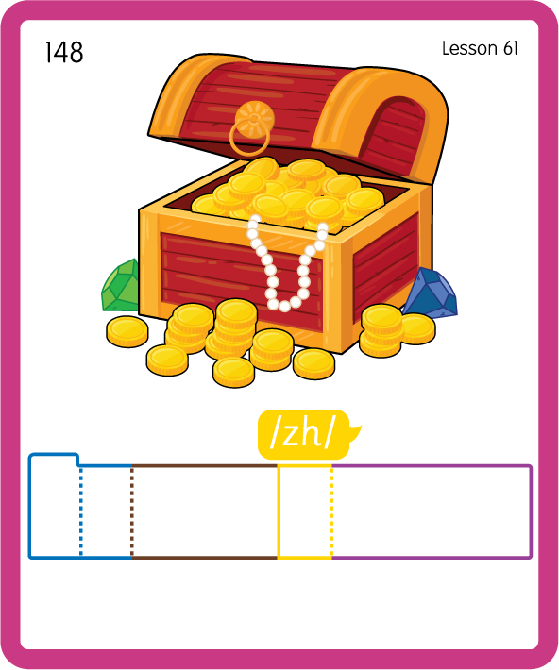
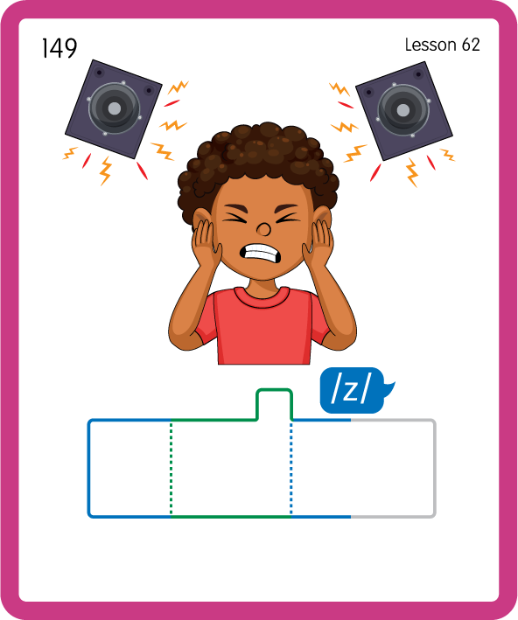
Build a Decodable Word
USING JN689
BACK

Slide 18

Build a Decodable Word
USING JN689
FRONT

Slide 19

Practise with Alien Words
USING JN692
BACK

Slide 20
Practise with Alien Words
USING JN692
FRONT

Slide 21
Practise Common Exception Words
USING JN687
FRONT

Slide 22
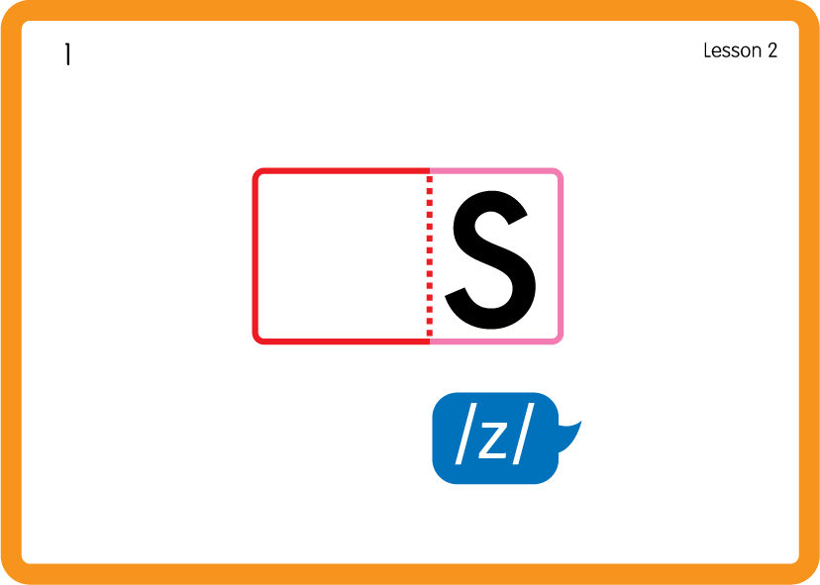
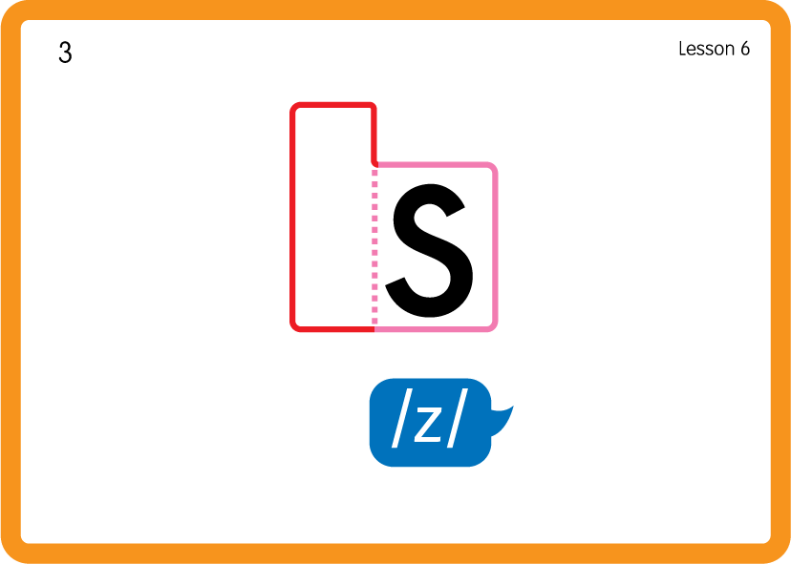
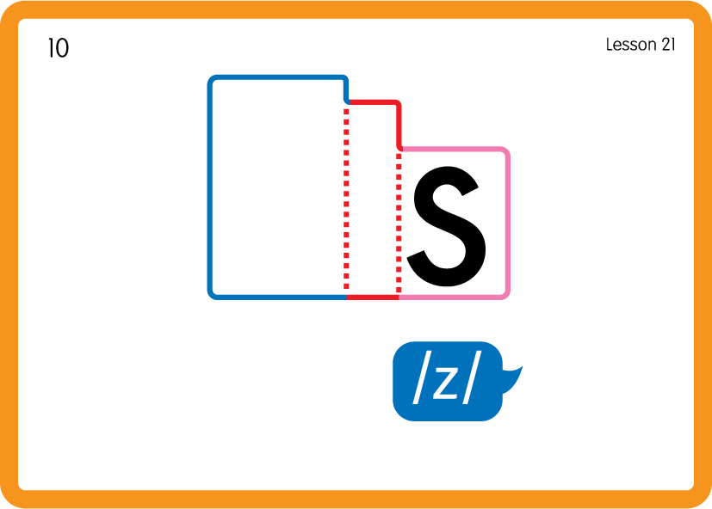
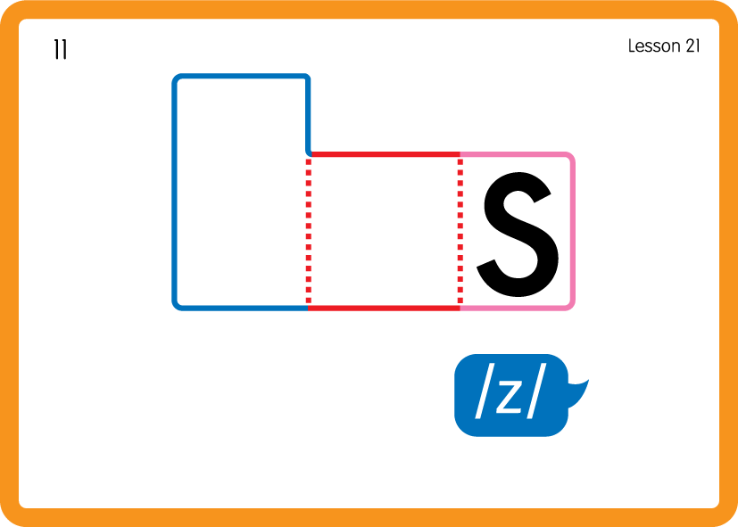
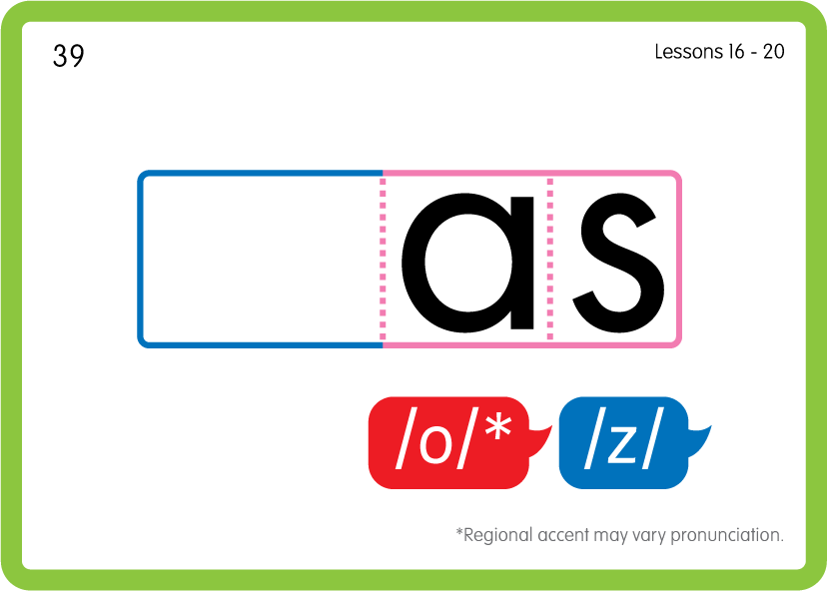
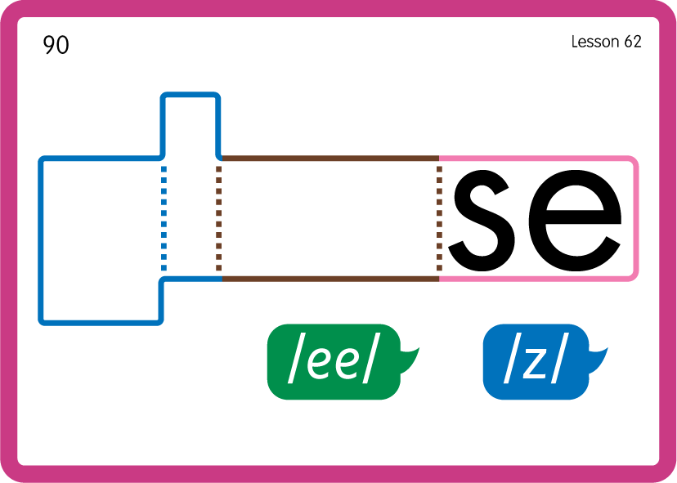
Practise Common Exception Words
USING JN687
BACK

Slide 23
Practise Common Exception Words
USING JN687
FRONT

Slide 24


