Slide 1




/ai/ | /ee/ | /igh/ | /oa/ | /oo/ | /y-oo/ | /r/
/n/ | /m/ | /ch/ | /k/ | /sh/ | /j/ | /v/
/u/ | /e/ | /i/ | /s/ | /zh/ | /z/ | /ar/
/or/ | /ur/ | /air/ | /ear/
Review Common Exception Words
Lesson 68

Slide 2




Learn and practise Common Exception Words and review sound families learned.
Recall all GPCs learned so far using flashcards.
Common Exception Word Cards Phase 2
Common Exception Word Cards Phase 3
Common Exception Word Cards Phase 4
Common Exception Word Cards Phase 5
Common Exception Word Cards Phase 5.5
JN687
JN687
JN687
JN687
JN687

Slide 3























Recall all GPCs learned so far using flashcards.

Slide 4





























Recall all GPCs learned so far using flashcards.

Slide 5









































Recall all GPCs learned so far using flashcards.

Slide 6

































Recall all GPCs learned so far using flashcards.

Slide 7













Review Phase 2 Common Exception Words as I is no go to into the put his has of pull full.

Slide 8



























Review Phase 3 Common Exception Words push they me we be he she my by looked you are there here were all sure.

Slide 9












Review Phase 4 Common Exception Words said like out have some come what was so old do little one.

Slide 10














Review Phase 5 Common Exception Words today house mouse hour because Mr Mrs Ms where should could would move use want.

Slide 11




















Review Phase 5.5 Common Exception Words people wild child mind kind behind eye oh most only both though through who prove shoe beautiful climb Christmas school sugar love money any…

Slide 12














…many friend very busy pretty once please asked bath path fast class after half.

Slide 13
Practise Common Exception Words
USING JN687
FRONT

Slide 14

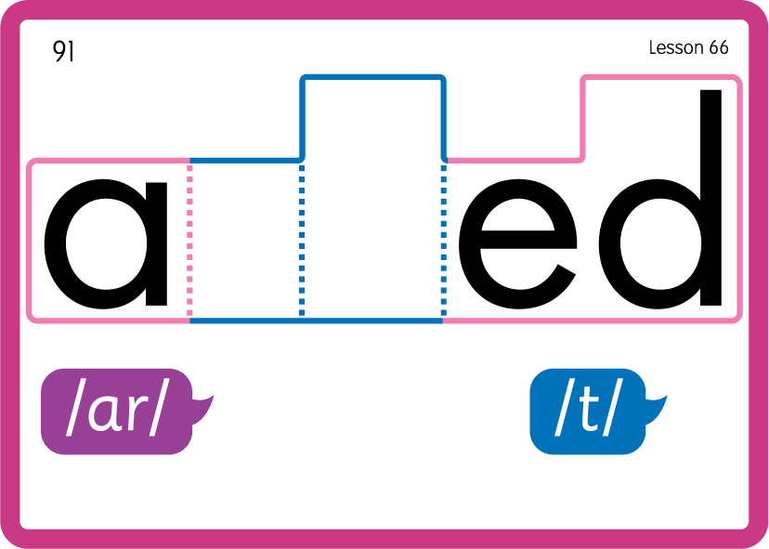
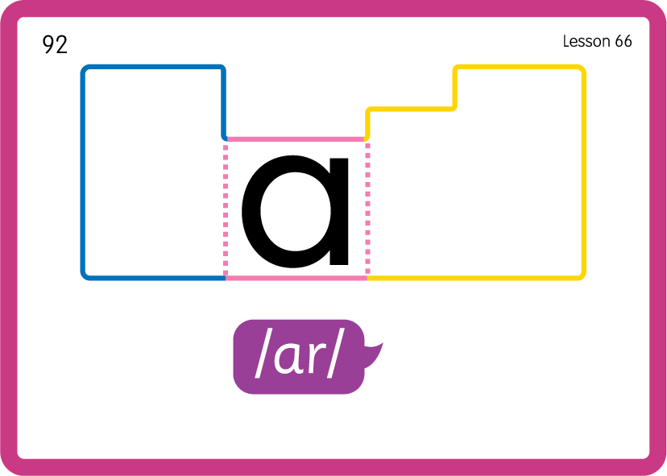
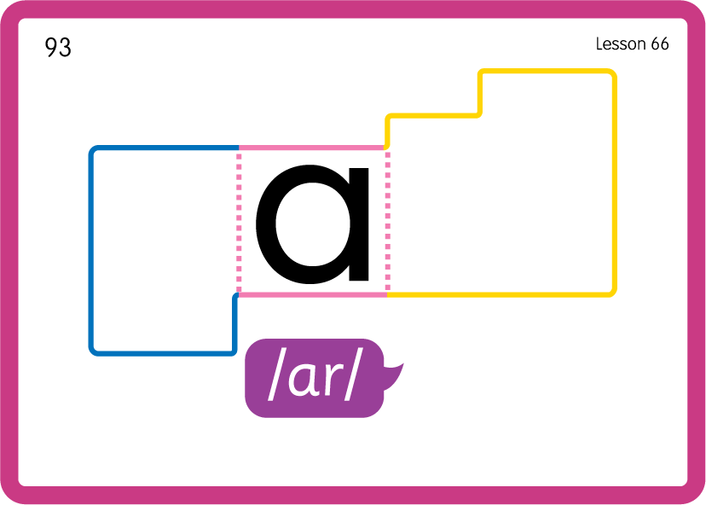
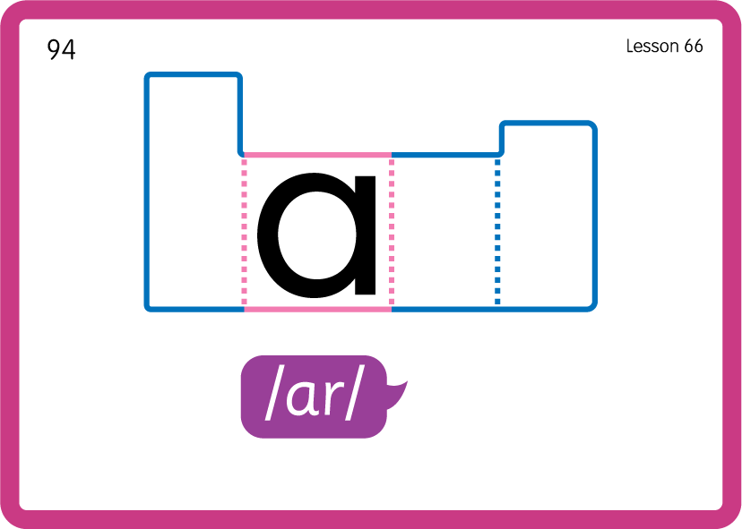
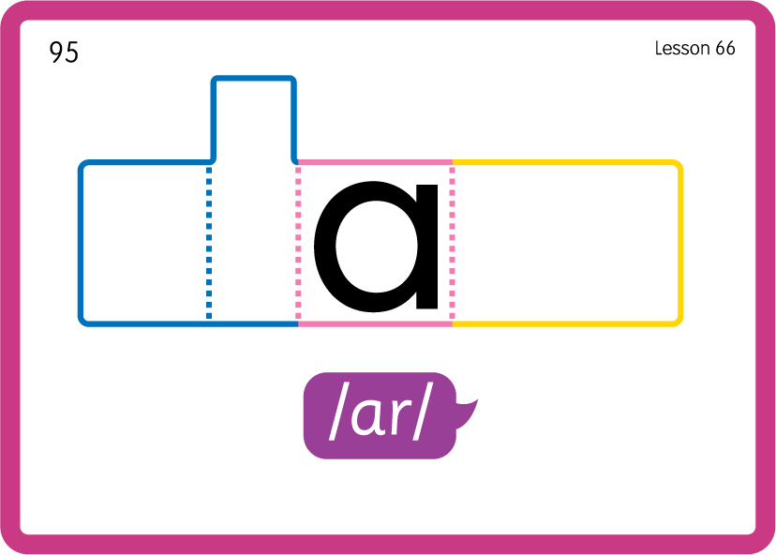
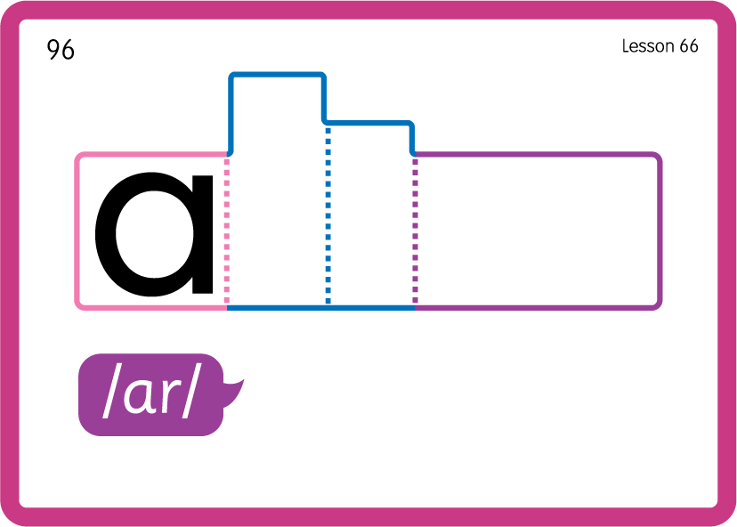
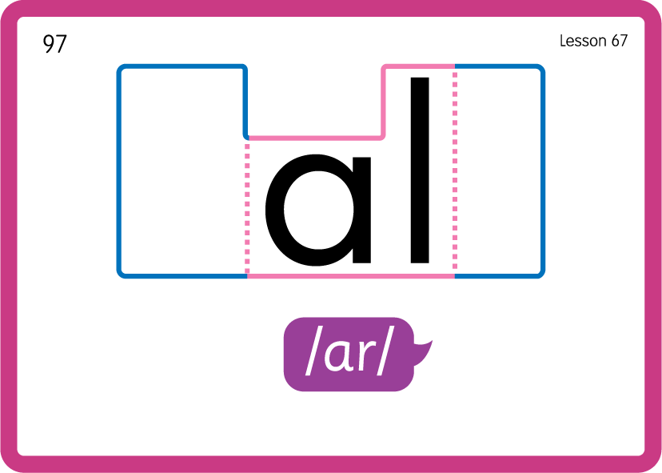
Practise Common Exception Words
USING JN687
BACK

