Slide 1



/ai/ | /ee/ | /igh/ | /oa/ | /oo/ | /y-oo/ | /r/
/n/ | /m/ | /ch/ | /k/ | /sh/ | /j/ | /v/
/u/ | /e/ | /i/ | /s/ | /zh/ | /z/ | /ar/
/or/ | /ur/ | /air/ | /ear/
Review Sound Family /ar/
Lesson 69 & 70

Slide 2




Learn and practise /ar/ sound family spelling pattern, including homophones and Common Exception Words.
Recall all GPCs learned so far using flashcards.
Homophone Cards
Grapheme to Phoneme Cards
Phoneme Frame Cards
Alien Words
Common Exception Word Cards
JN693
JN686
JN689
JN692
JN687

Slide 3























Recall all GPCs learned so far using flashcards.

Slide 4




























Recall all GPCs learned so far using flashcards.

Slide 5









































Recall all GPCs learned so far using flashcards.

Slide 6































Recall all GPCs learned so far using flashcards.

Slide 7














Review Phase 2 Common Exception Words as I is no go to into the put his has of pull full.

Slide 8



























Review Phase 3 Common Exception Words push they me we be he she my by looked you are there here were all sure.

Slide 9













Review Phase 4 Common Exception Words said like out have some come what was so old do little one.

Slide 10















Review Phase 5 Common Exception Words today house mouse hour because Mr Mrs Ms where should could would move use want.

Slide 11
























Review Phase 5.5 Common Exception Words people wild child mind kind behind eye oh most only both though through who prove shoe beautiful climb Christmas school sugar love money any…

Slide 12














…many friend very busy pretty once please asked bath path fast class after half.

Slide 13
Teach Homophones: aunt / aren’t.

Slide 14
Review Grapheme Captions
USING JN686
FRONT

Slide 15
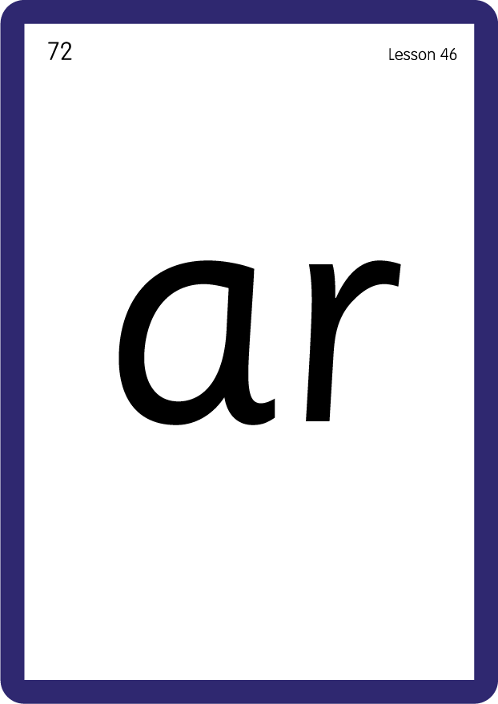
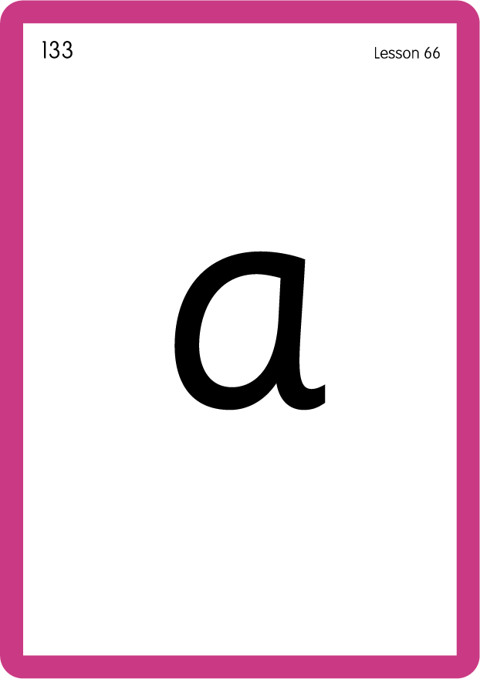
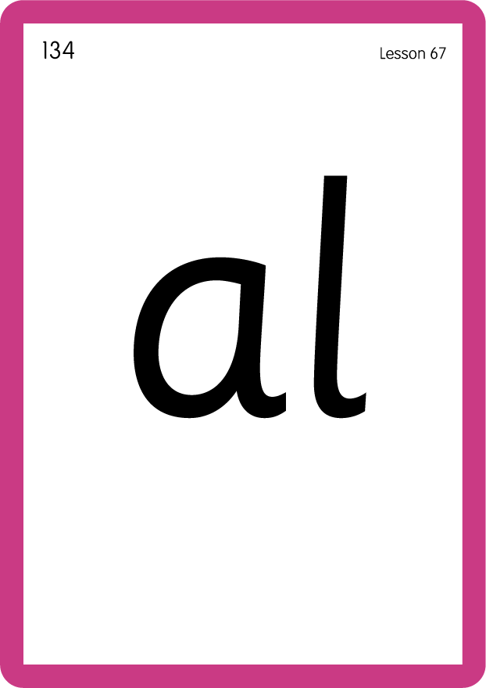
Review Grapheme Captions
USING JN686
BACK

Slide 16
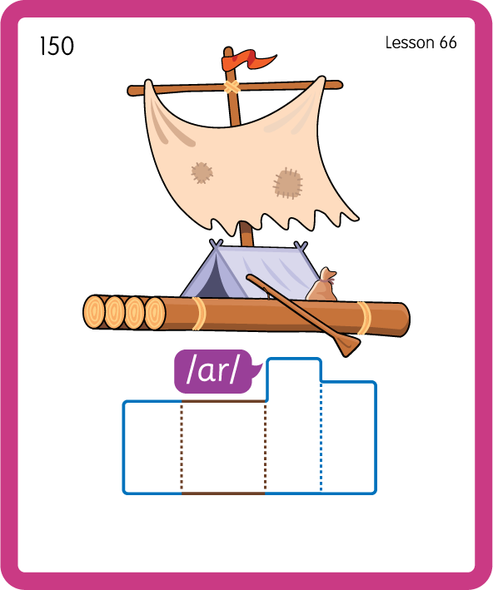
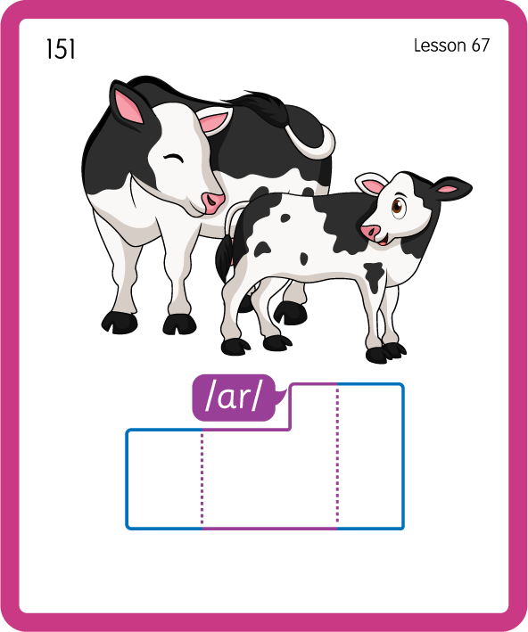
Build a Decodable Word
USING JN689
BACK

Slide 17

Build a Decodable Word
USING JN689
FRONT

Slide 18

Practise with Alien Words
USING JN692
BACK

Slide 19
Practise with Alien Words
USING JN692
FRONT

Slide 20
Practise Common Exception Words
USING JN687
FRONT

Slide 21
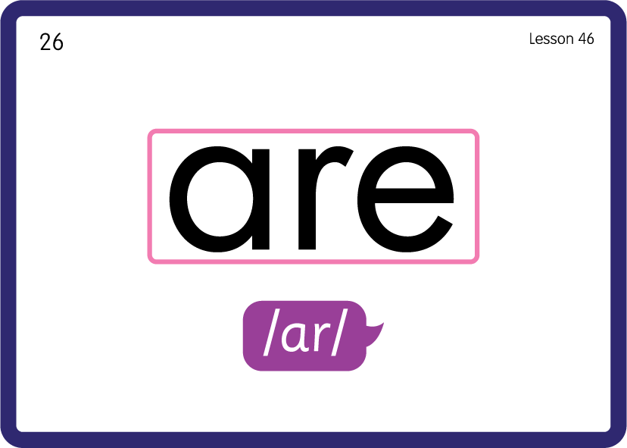
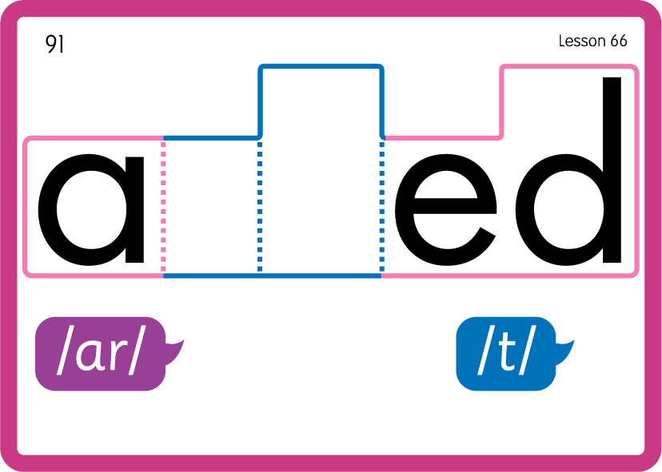
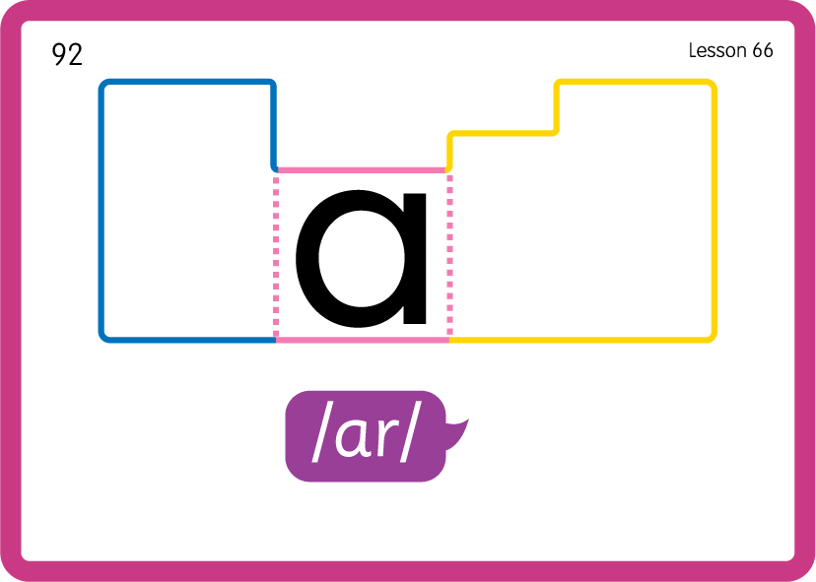
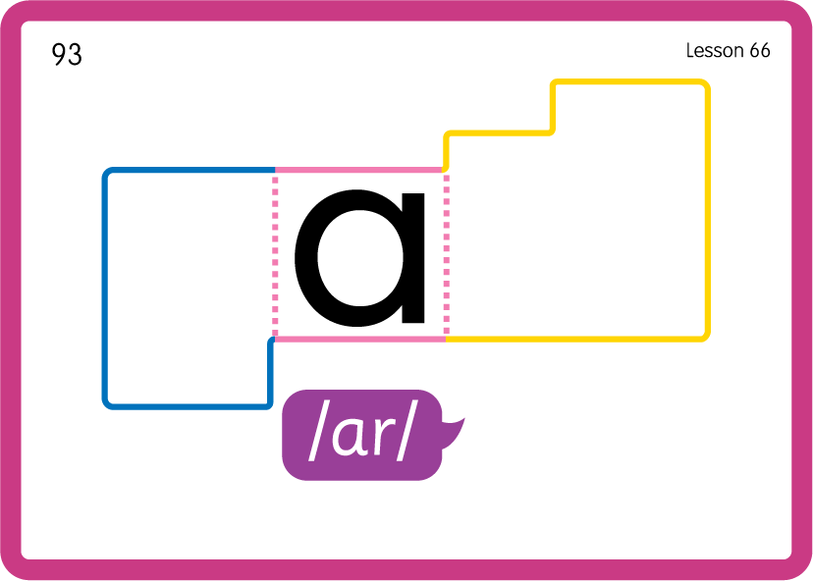
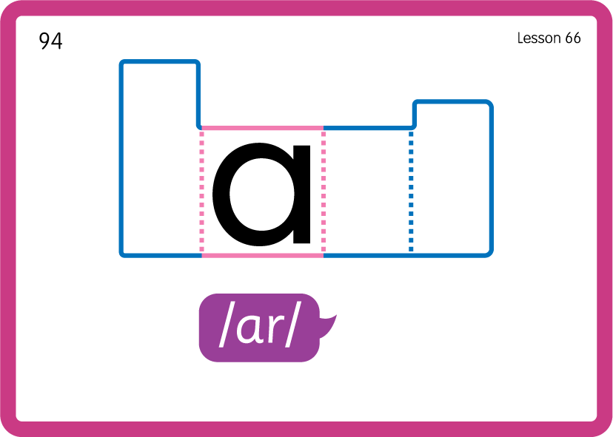
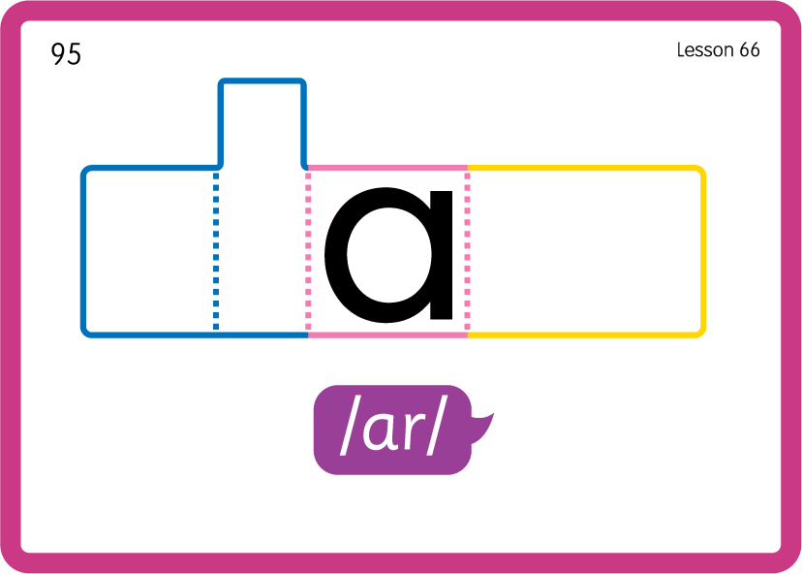
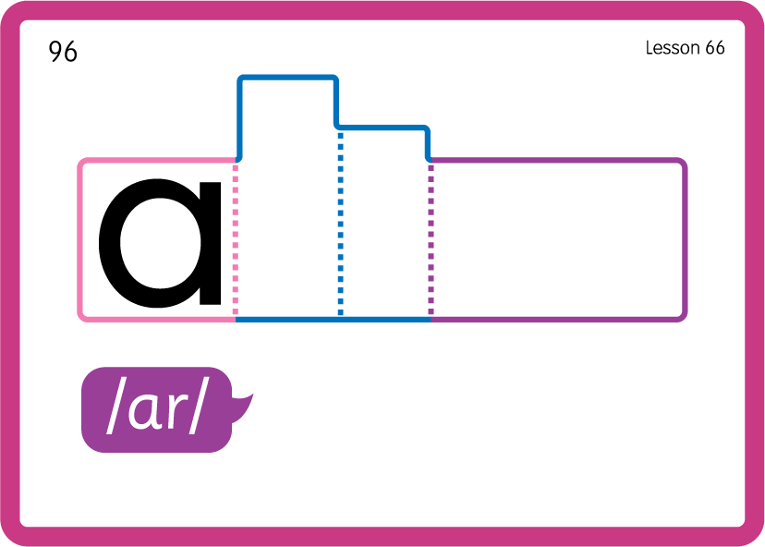
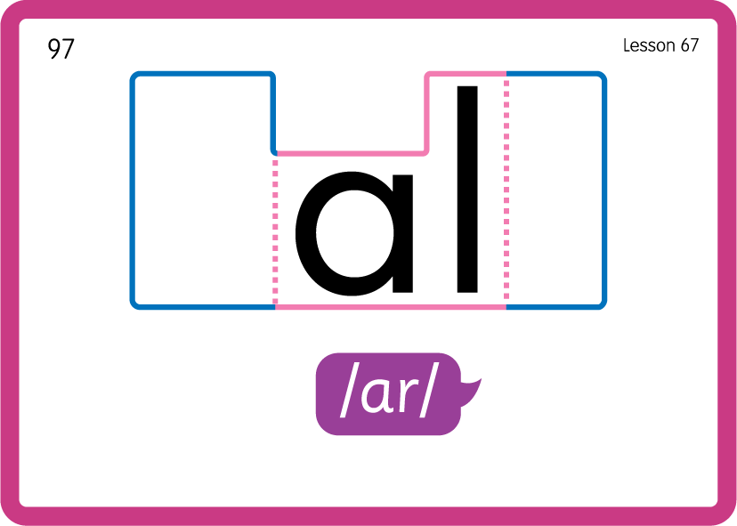
Practise Common Exception Words
USING JN687
BACK

Slide 22

Teach Common Exception Word
USING JN687

Slide 23

Teach Common Exception Word
USING JN687

Slide 24

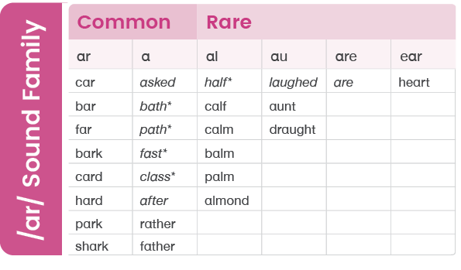
* the classification of these words is dependent on accent.

