Slide 1



/ai/ | /ee/ | /igh/ | /oa/ | /oo/ | /y-oo/ | /r/
/n/ | /m/ | /ch/ | /k/ | /sh/ | /j/ | /v/
/u/ | /e/ | /i/ | /s/ | /zh/ | /z/ | /ar/
/or/ | /ur/ | /air/ | /ear/
Sound Family /or/; or aw au
Lesson 71

Slide 2


Revise and practise /or/ sound family spelling patterns.
Recall all GPCs learned so far using flashcards.
Grapheme to Phoneme Cards
Phoneme Frame Cards
Alien Word Cards
JN686
JN689
JN692

Slide 3























Recall all GPCs learned so far using flashcards.

Slide 4




























Recall all GPCs learned so far using flashcards.

Slide 5



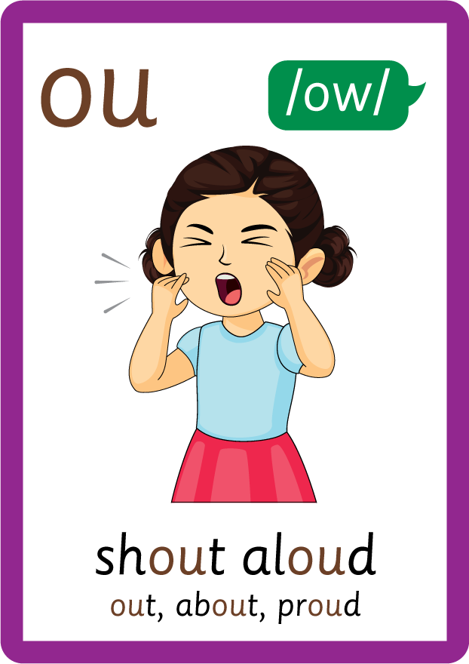















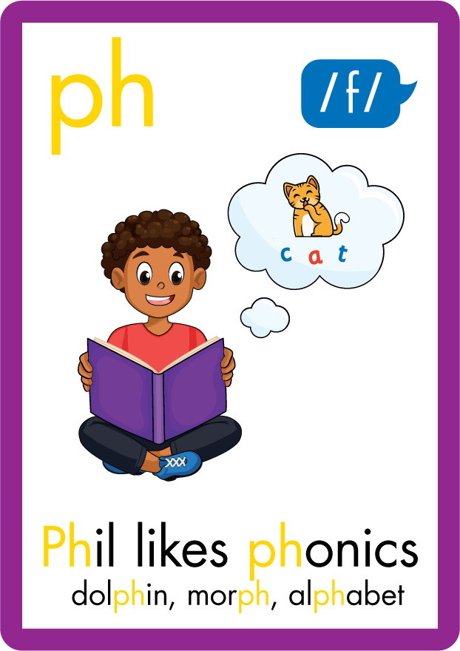



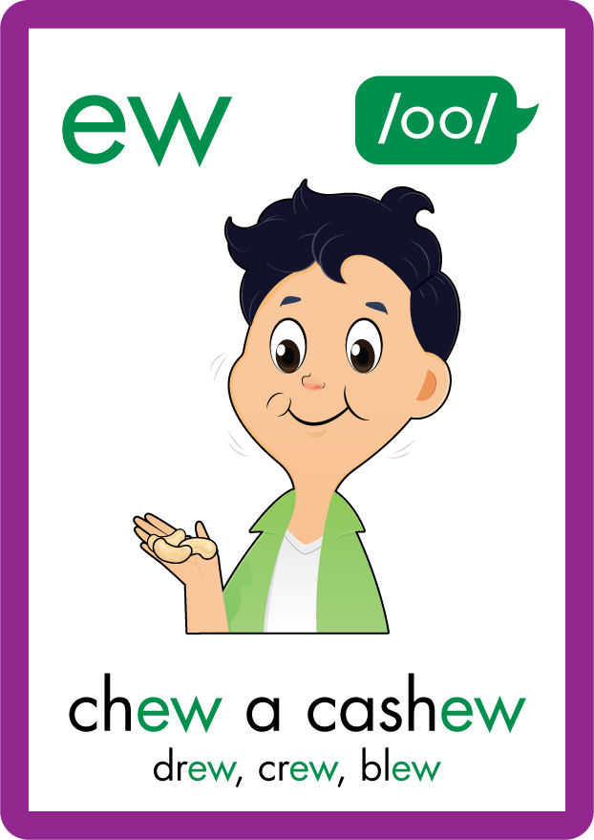















Recall all GPCs learned so far using flashcards.

Slide 6












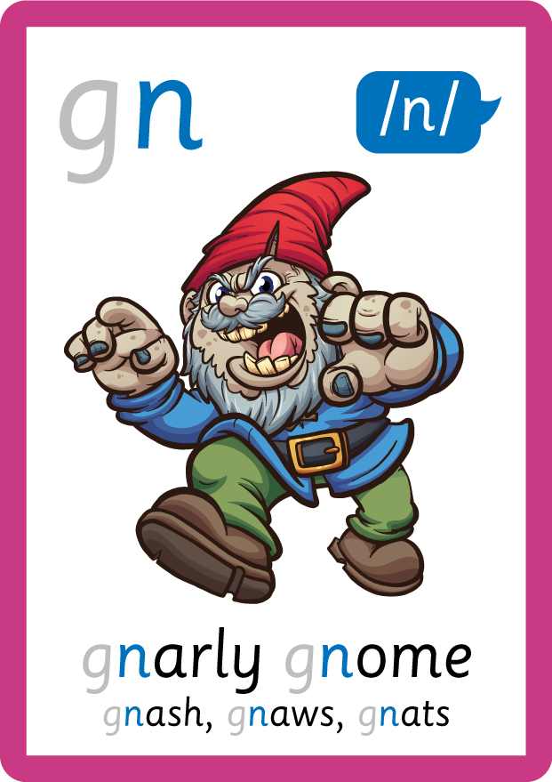










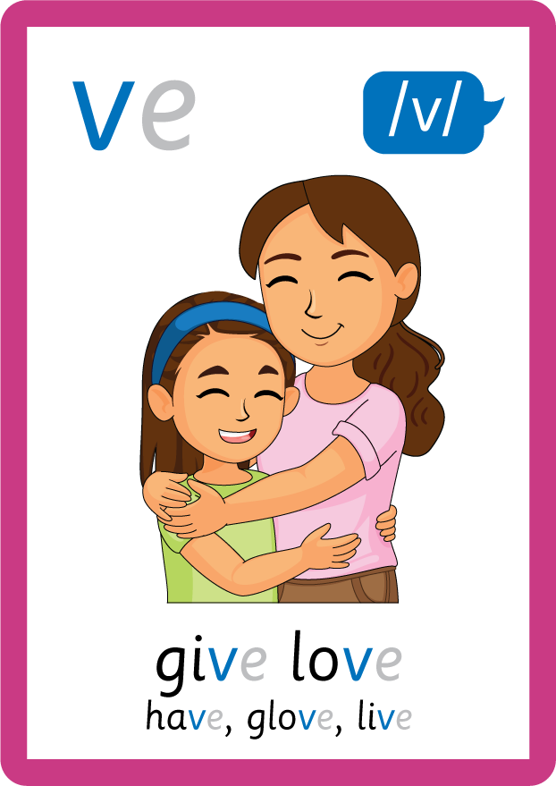
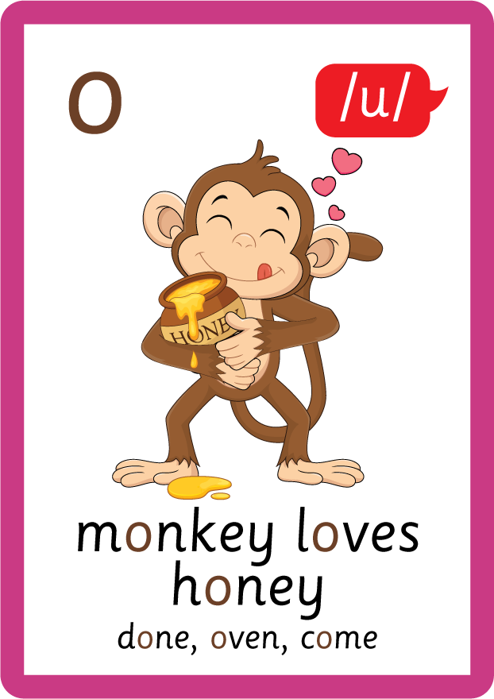





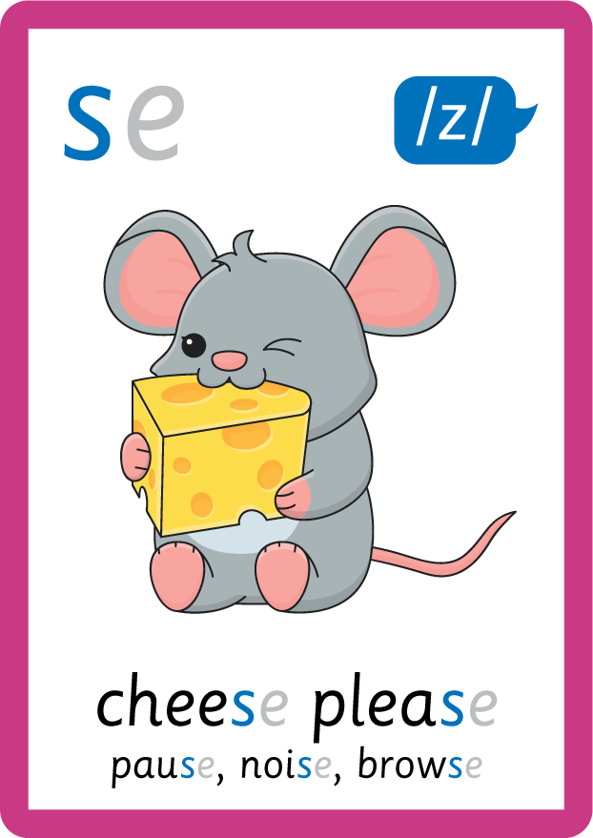


Recall all GPCs learned so far using flashcards.

Slide 7






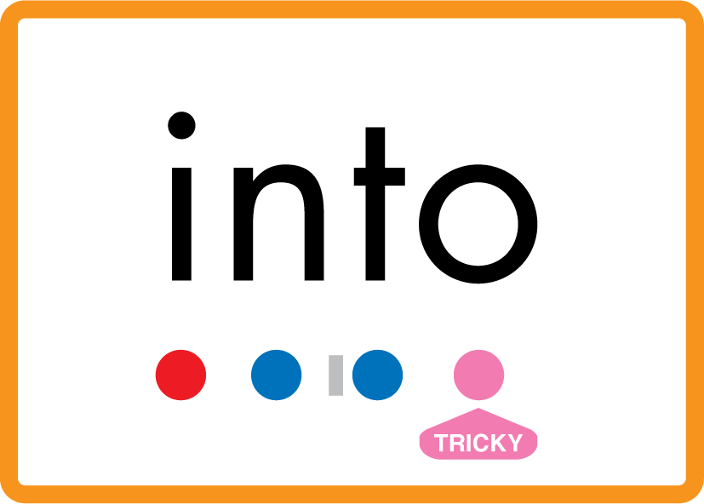
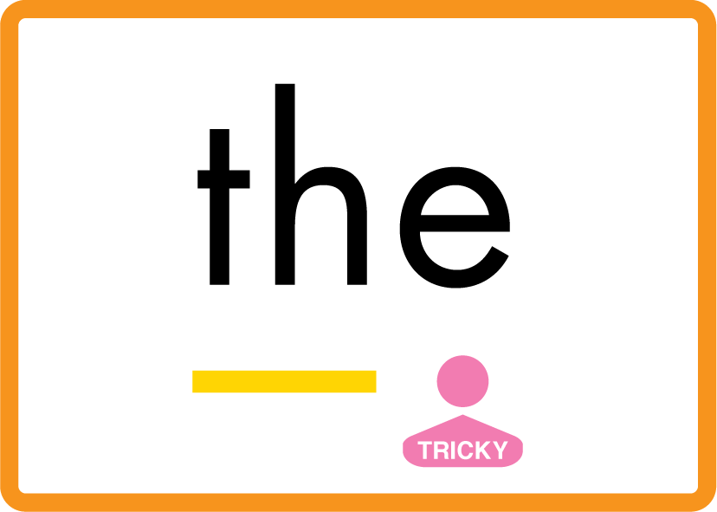

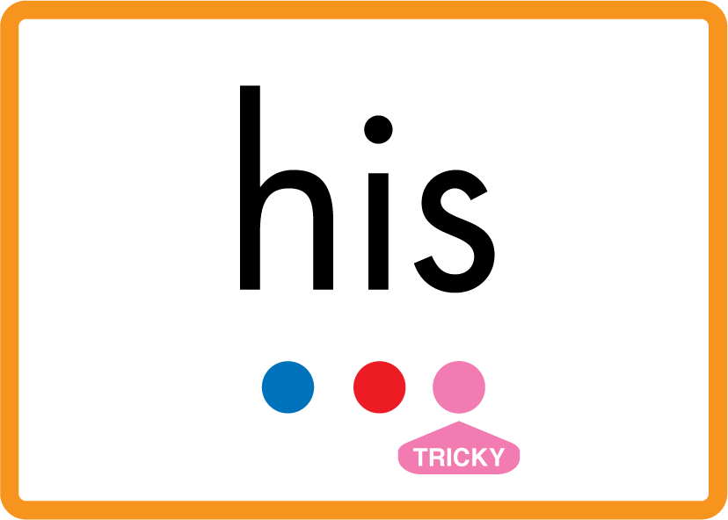



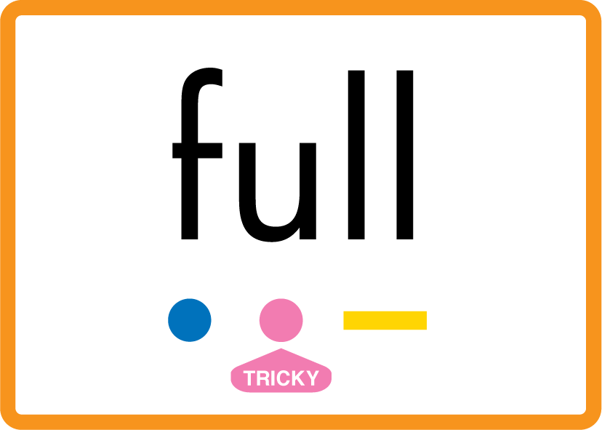
Review Phase 2 Common Exception Words as I is no go to into the put his has of pull full.

Slide 8



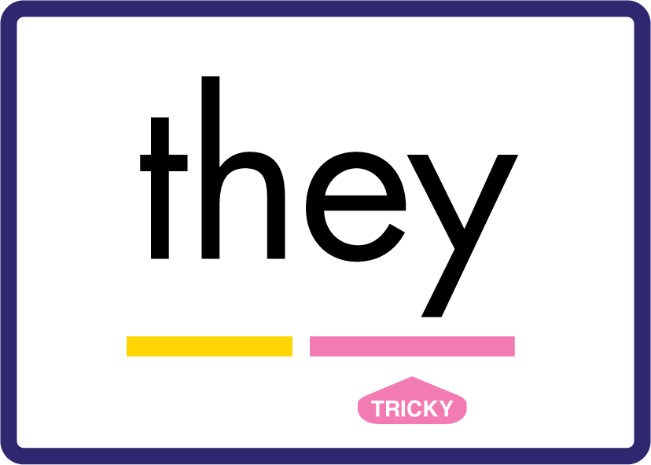



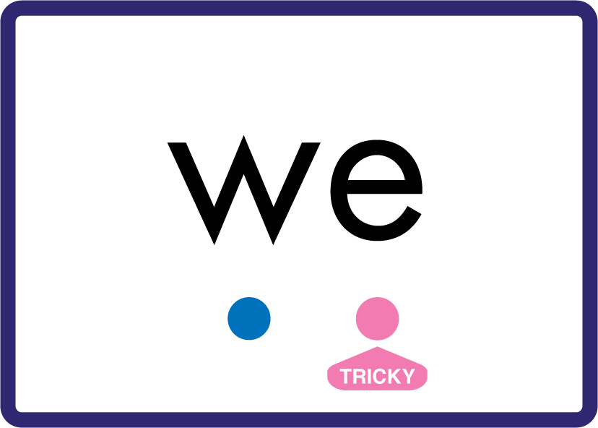






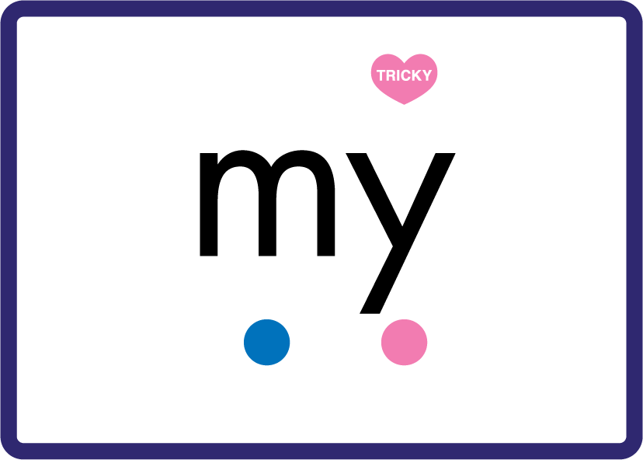






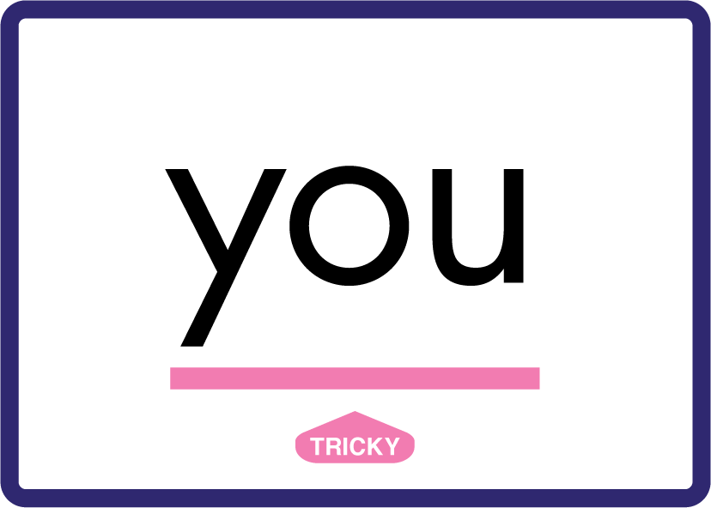






Review Phase 3 Common Exception Words push they me we be he she my by looked you are there here were all sure.

Slide 9









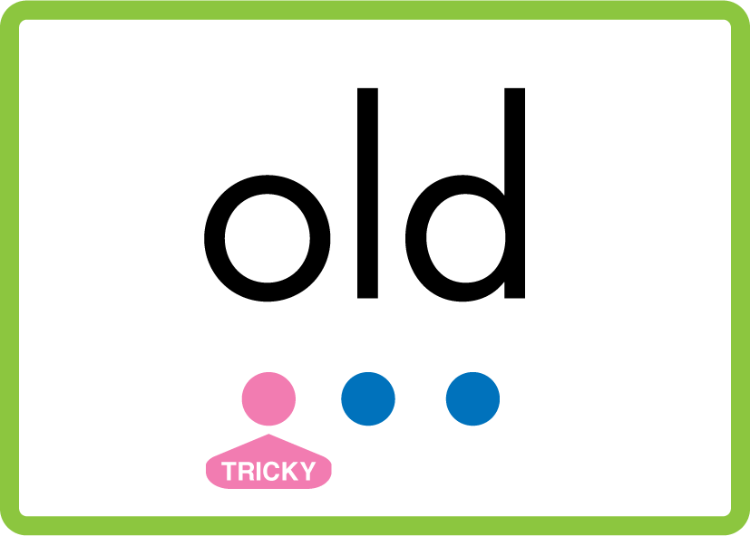
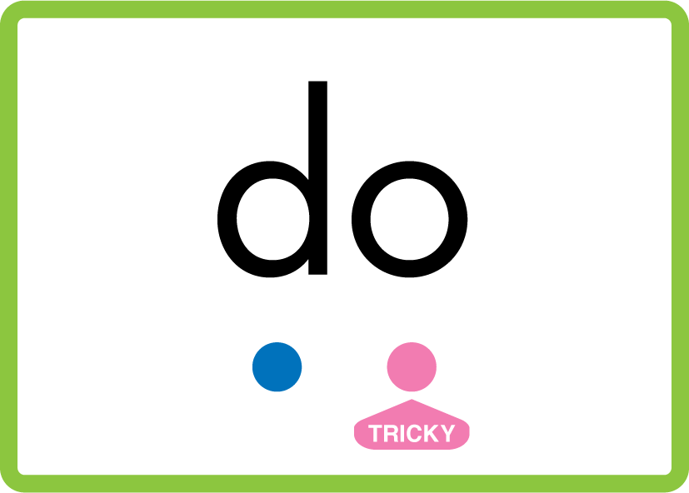


Review Phase 4 Common Exception Words said like out have some come what was so old do little one.

Slide 10

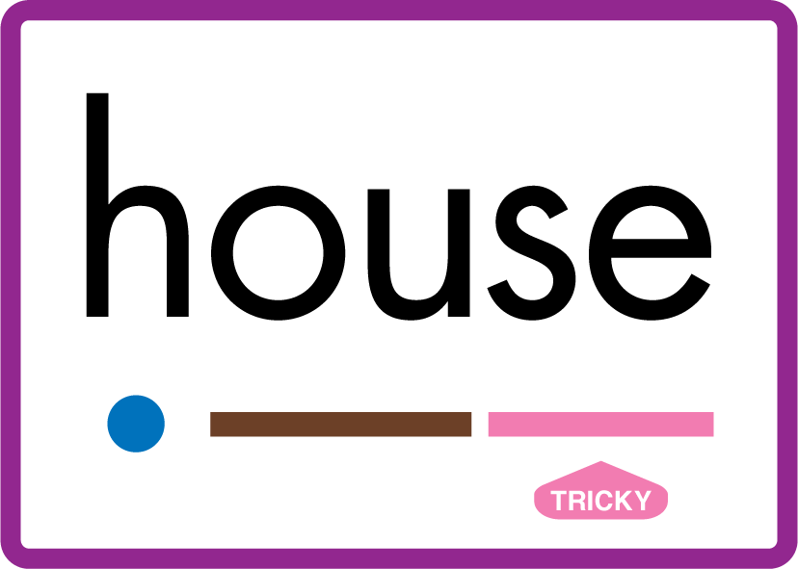

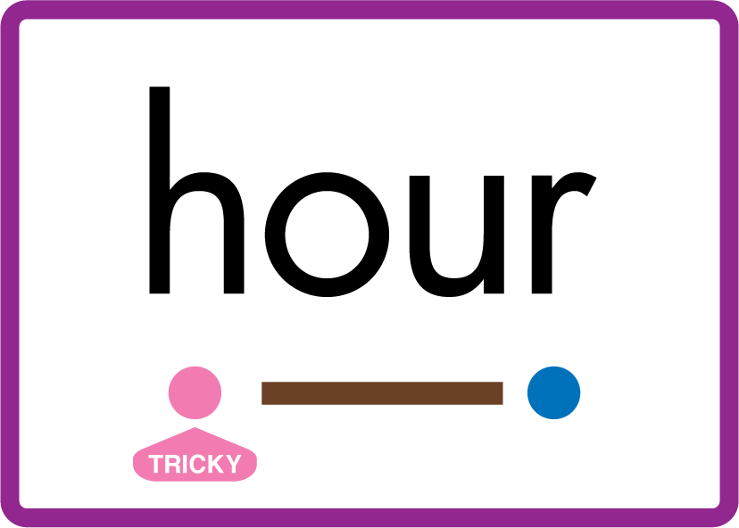











Review Phase 5 Common Exception Words today house mouse hour because Mr Mrs Ms where should could would move use want.

Slide 11



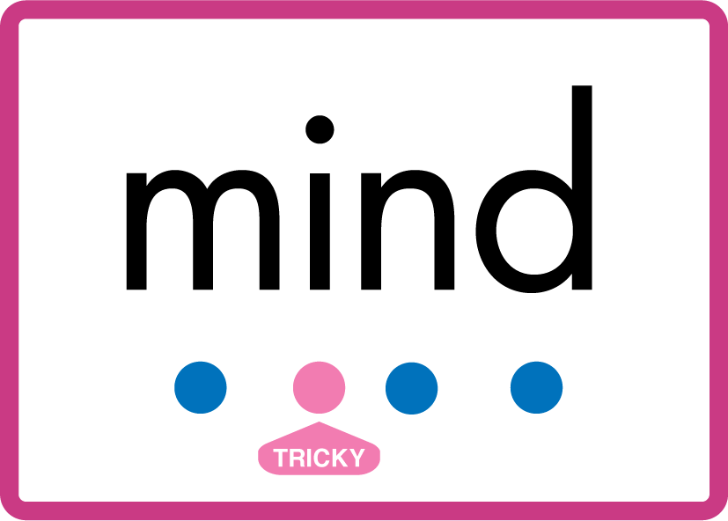


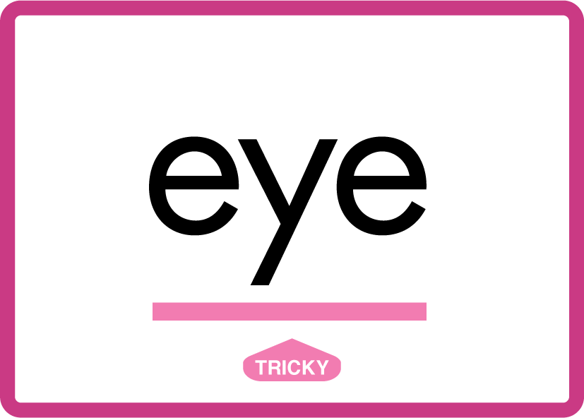





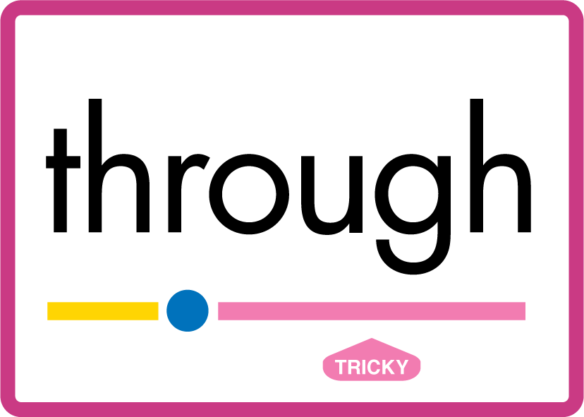


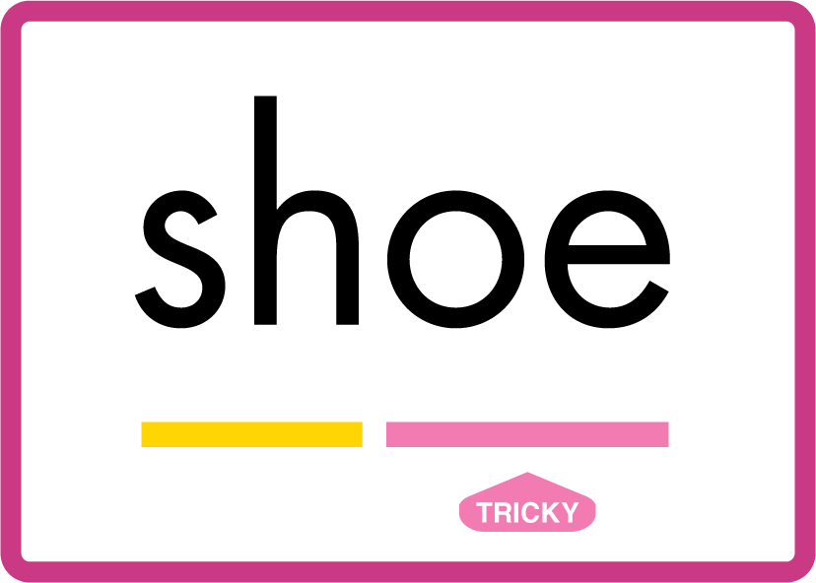






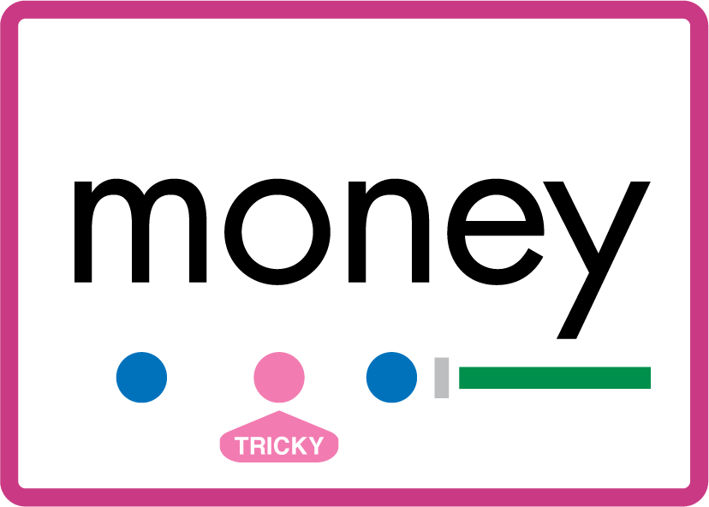

Review Phase 5.5 Common Exception Words people wild child mind kind behind eye oh most only both though through who prove shoe beautiful climb Christmas school sugar love money any…

Slide 12
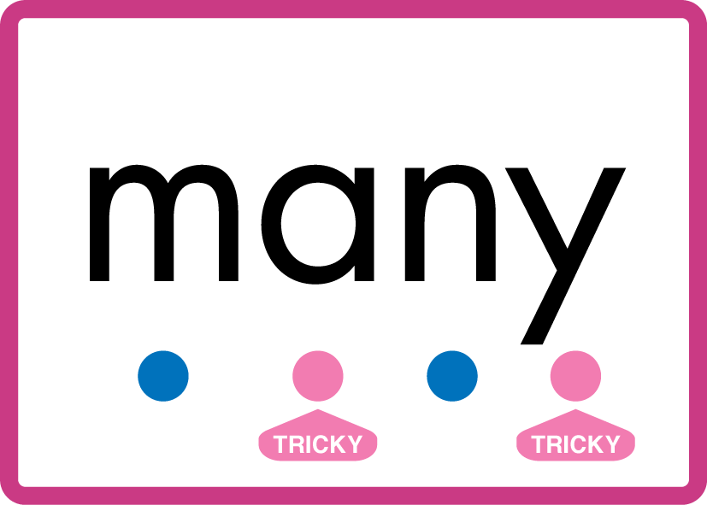


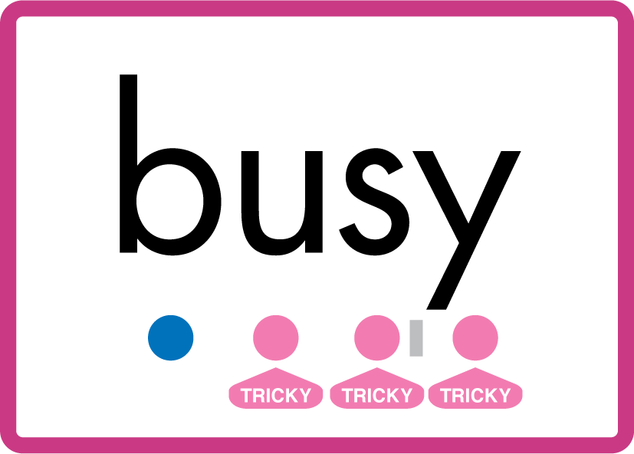
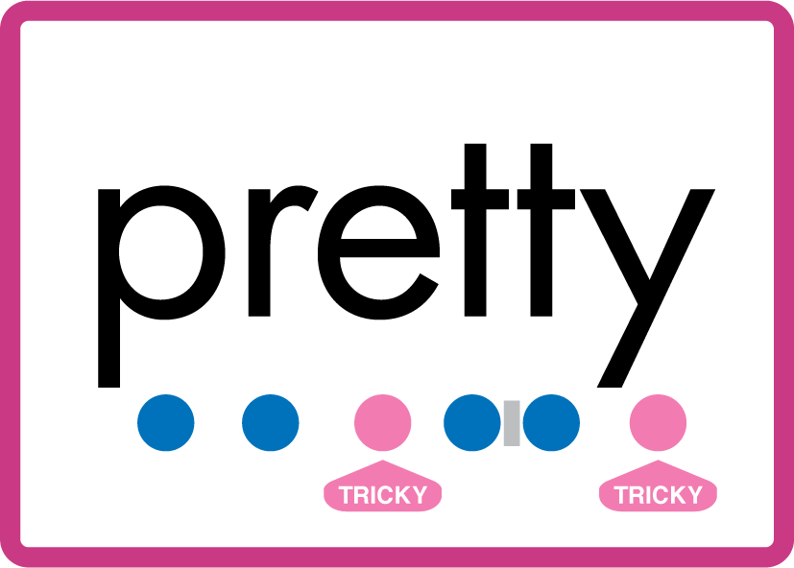


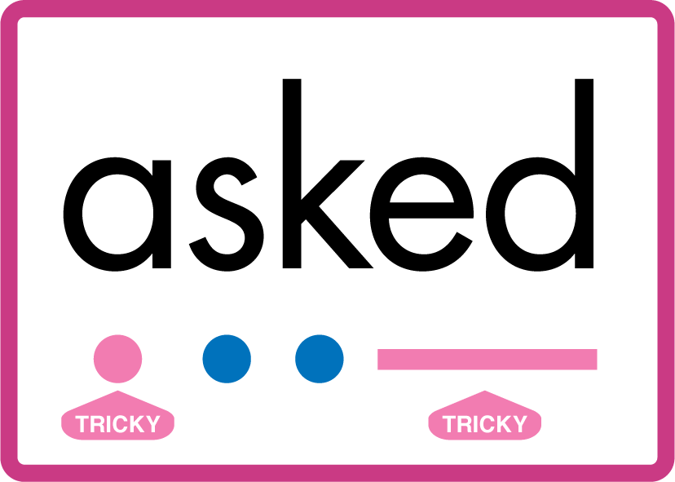


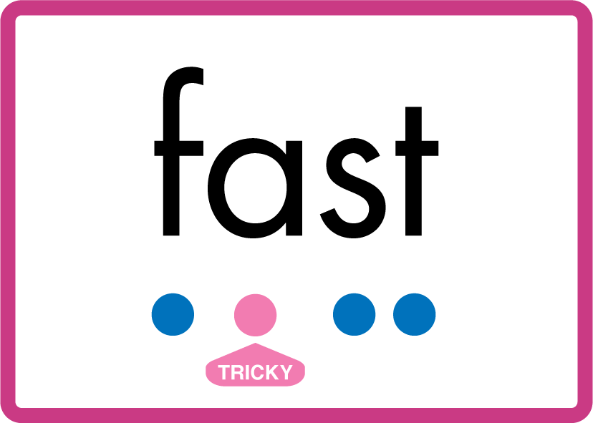

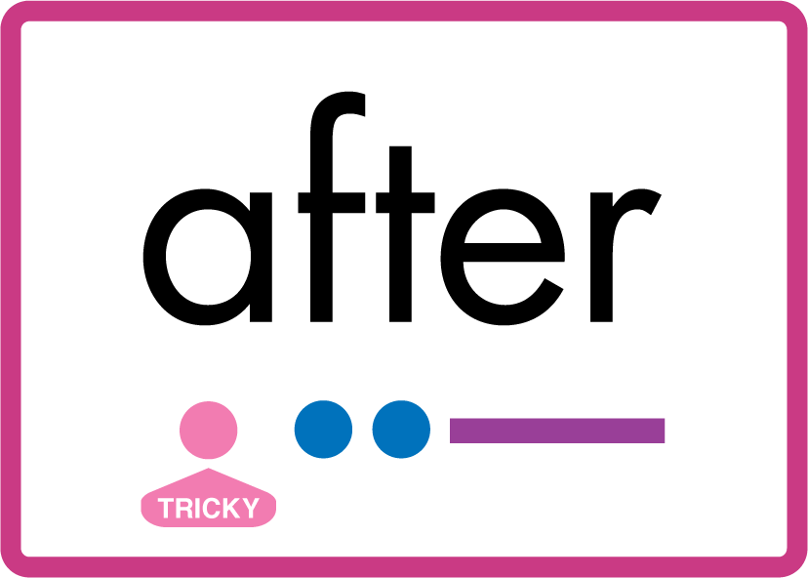
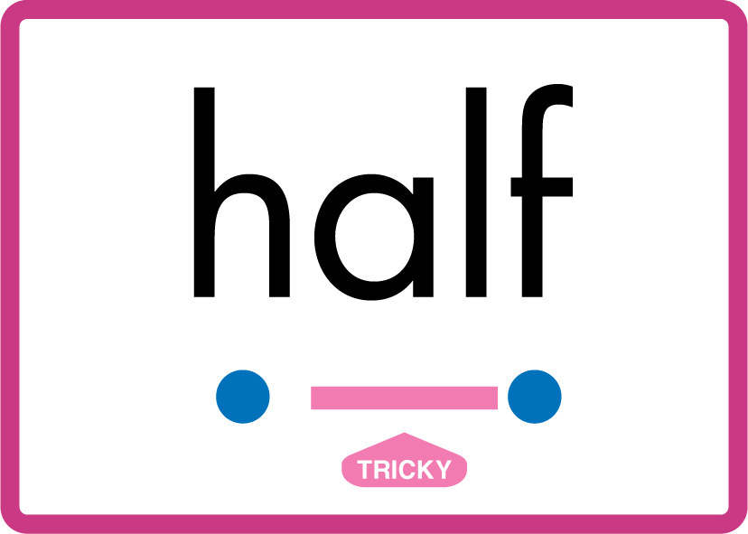
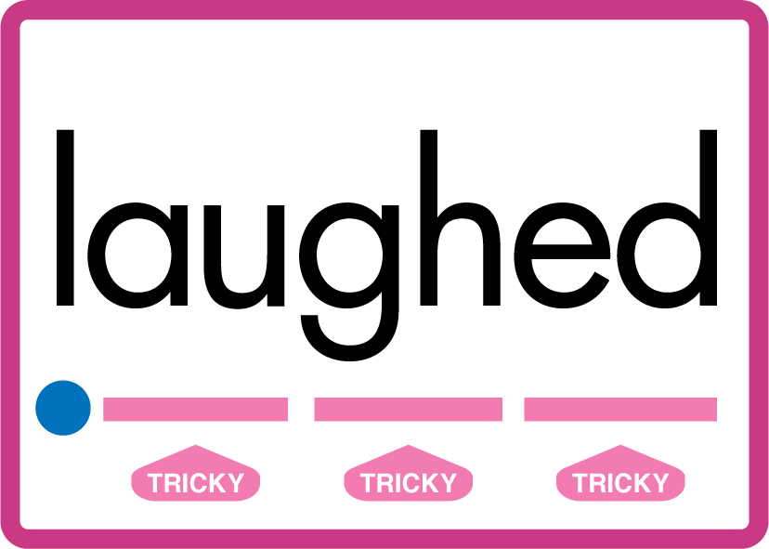
…many friend very busy pretty once please asked bath path fast class after half laughed.

Slide 13
Review Grapheme Caption
fork
corn
sword
Phase 3, Lesson 56
USING JN686
FRONT

Slide 14
Review Grapheme Caption
draw
jaw
crawl
Phase 5, Lesson 11
USING JN686
FRONT

Slide 15
Review Grapheme Caption
sauce
laundry
author
Phase 5, Lesson 18
USING JN686
FRONT

Slide 16

Explain Decoding

Slide 17
Model Blending Phonemes
h
or
n
USING SOUND BUTTONS
Sound Buttons
Vowel
Consonant
Consonant Digraph
Multi Sound
Long Vowel Sound
R-controlled Digraph
Split Digraph
Syllable / Silent Letter

Slide 18
Model Blending Phonemes
p
aw
USING SOUND BUTTONS
Sound Buttons
Vowel
Consonant
Consonant Digraph
Multi Sound
Long Vowel Sound
R-controlled Digraph
Split Digraph
Syllable / Silent Letter

Slide 19
Model Blending Phonemes
h
au
n
t
USING SOUND BUTTONS
Sound Buttons
Vowel
Consonant
Consonant Digraph
Multi Sound
Long Vowel Sound
R-controlled Digraph
Split Digraph
Syllable / Silent Letter

Slide 20

Explain Encoding

Slide 21
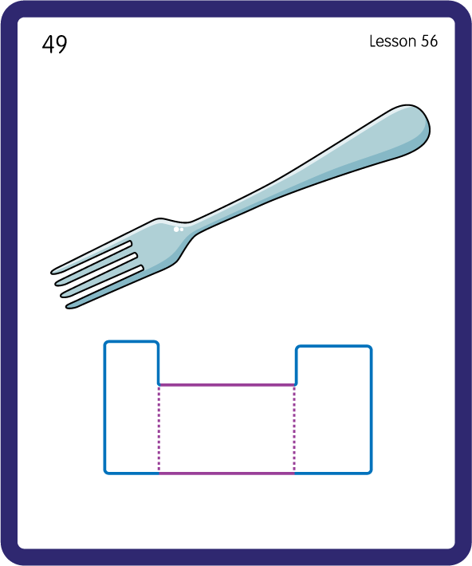
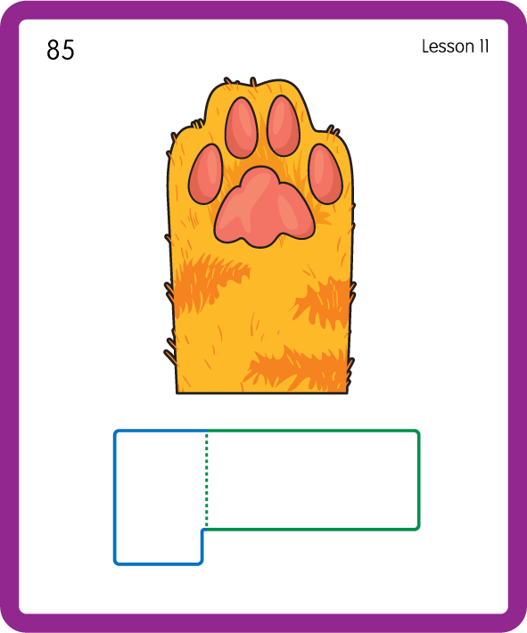
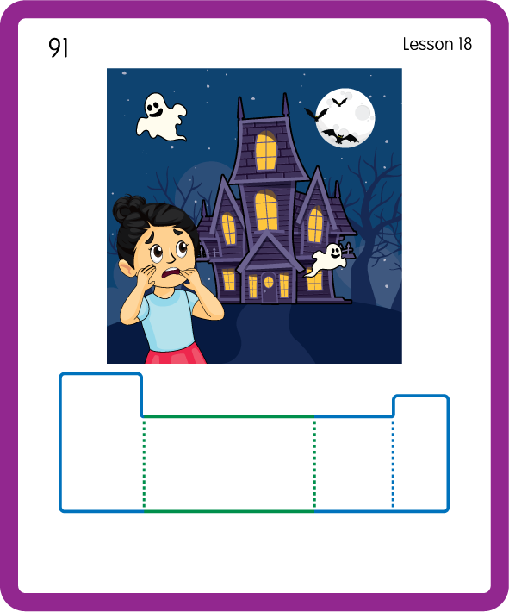
Build a Decodable Word
USING JN689
BACK

Slide 22

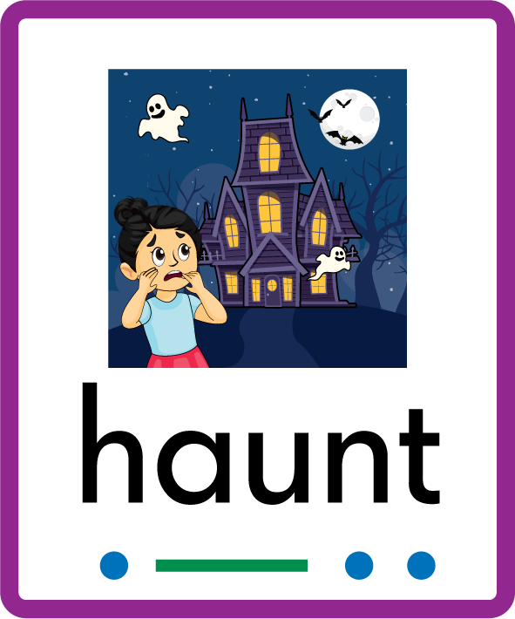
Build a Decodable Word
USING JN689
FRONT

Slide 23

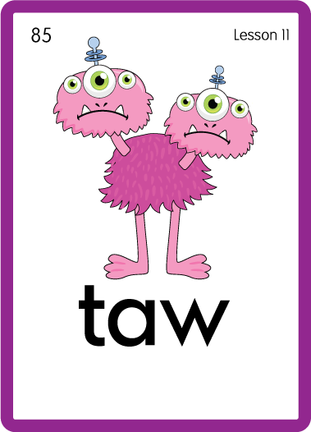
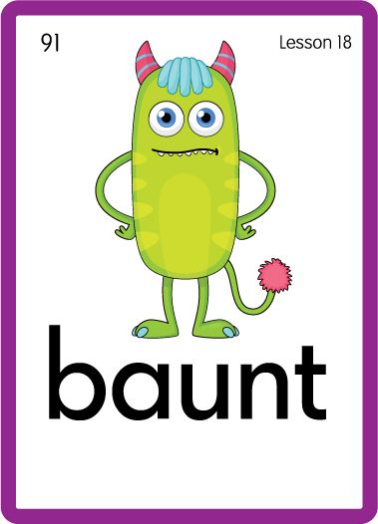
Practise with Alien Words
USING JN692
BACK

Slide 24
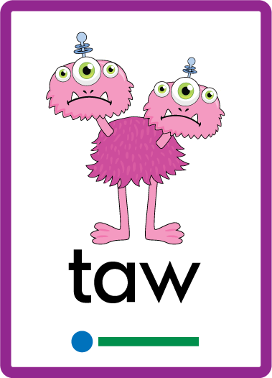

Practise with Alien Words
USING JN692
FRONT

Slide 25

Practise Building Words
PRACTISE – 10MINS
r
or
aw
c
au
h
th
s
p
l
e
d
n
USING MAGNETIC LETTERS AND A WHITEBOARD
LAYOUT A

Slide 26
Practise Building Words
PRACTISE – 10MINS
r
or
aw
c
au
h
th
s
p
l
e
d
n
cord horn north raw saw paw law sauce cause pause author
USING MAGNETIC LETTERS AND A WHITEBOARD
LAYOUT A

