Slide 1


/ai/ | /ee/ | /igh/ | /oa/ | /oo/ | /y-oo/ | /r/
/n/ | /m/ | /ch/ | /k/ | /sh/ | /j/ | /v/
/u/ | /e/ | /i/ | /s/ | /zh/ | /z/ | /ar/
/or/ | /ur/ | /air/ | /ear/
Sound Family /or/; al
Lesson 72

Slide 2



Learn and practise /or/ sound family spelling patterns.
Recall all GPCs learned so far using flashcards.
Grapheme to Phoneme Cards
Phoneme Frame Cards
Alien Word Cards
Common Exception Word Cards
JN686
JN689
JN92
JN687

Slide 3























Recall all GPCs learned so far using flashcards.

Slide 4




























Recall all GPCs learned so far using flashcards.

Slide 5









































Recall all GPCs learned so far using flashcards.

Slide 6
















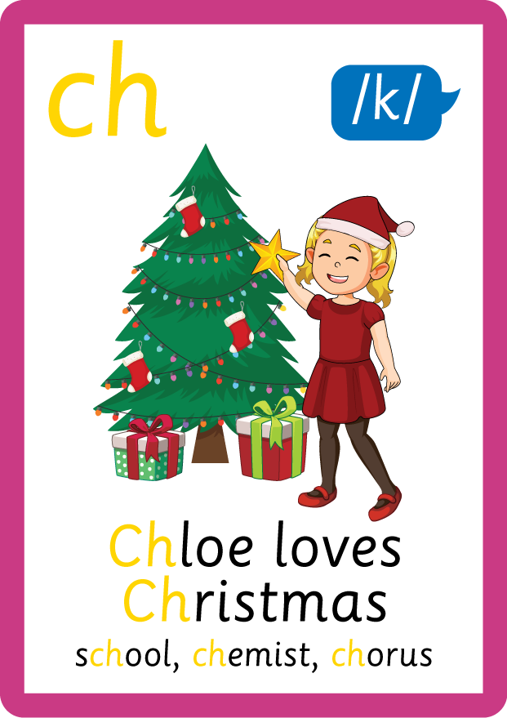













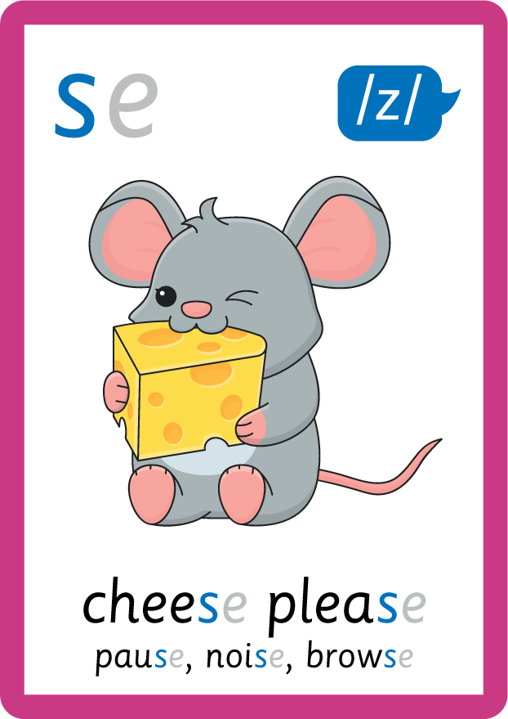


Recall all GPCs learned so far using flashcards.

Slide 7














Review Phase 2 Common Exception Words as I is no go to into the put his has of pull full.

Slide 8



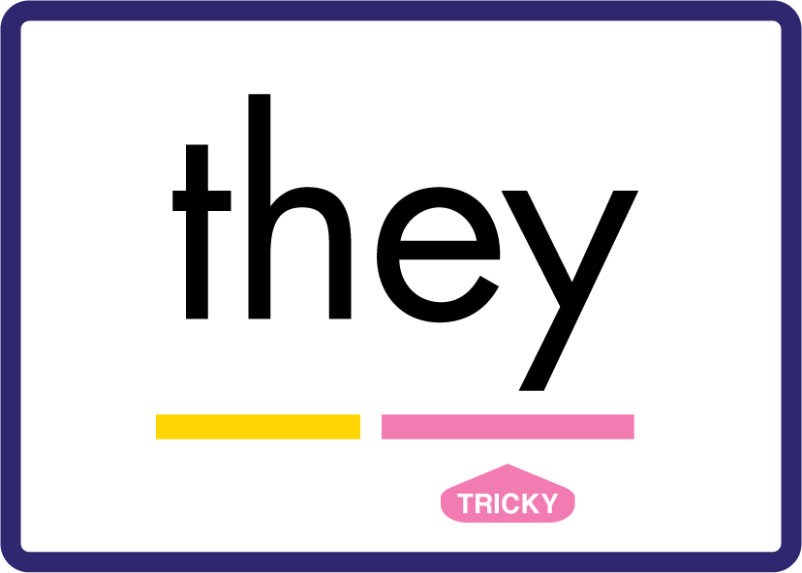

















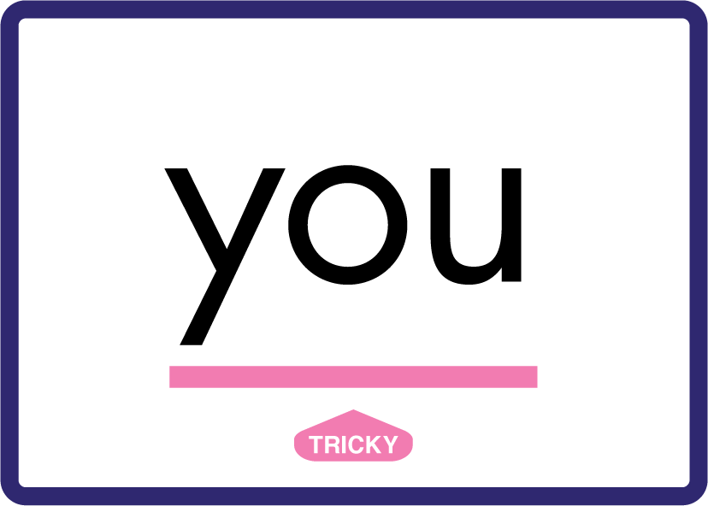





Review Phase 3 Common Exception Words push they me we be he she my by looked you are there here were all sure.

Slide 9













Review Phase 4 Common Exception Words said like out have some come what was so old do little one.

Slide 10















Review Phase 5 Common Exception Words today house mouse hour because Mr Mrs Ms where should could would move use want.

Slide 11















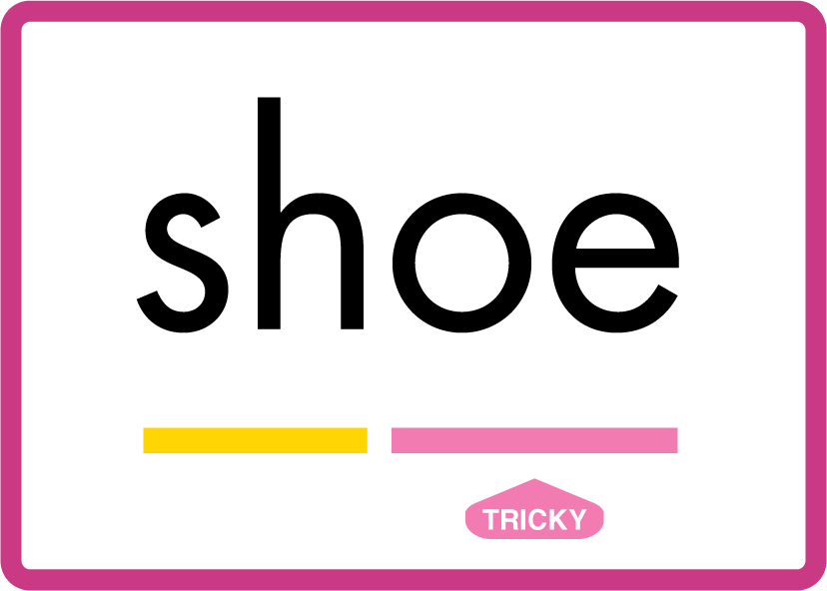








Review Phase 5.5 Common Exception Words people wild child mind kind behind eye oh most only both though through who prove shoe beautiful climb Christmas school sugar love money any…

Slide 12
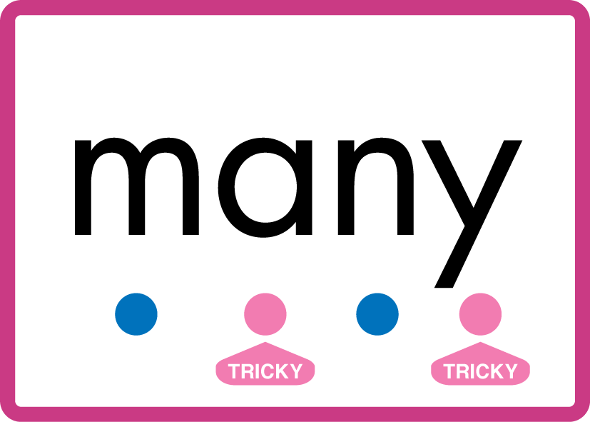


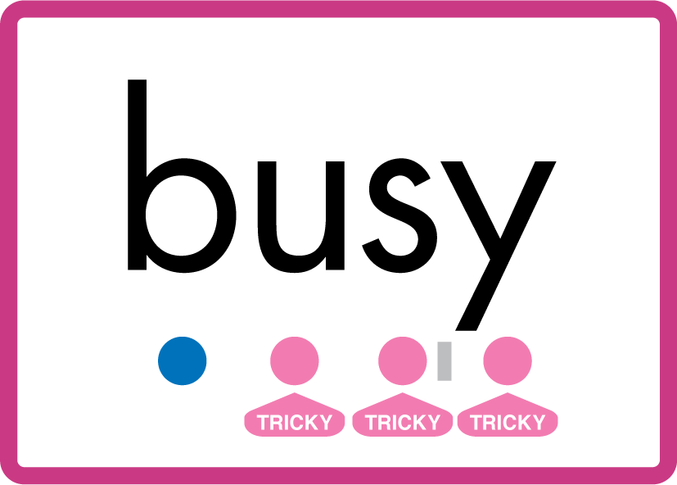
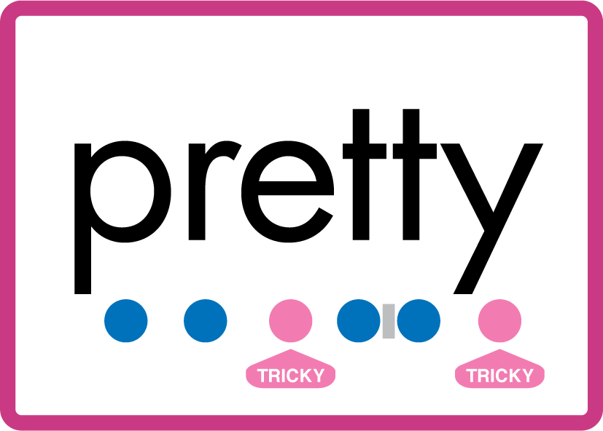


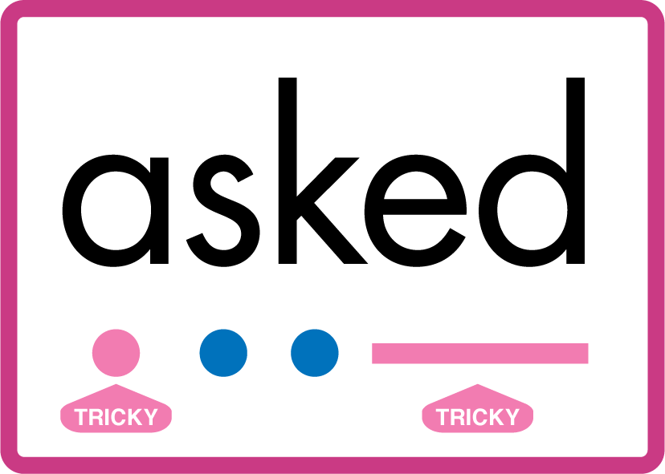


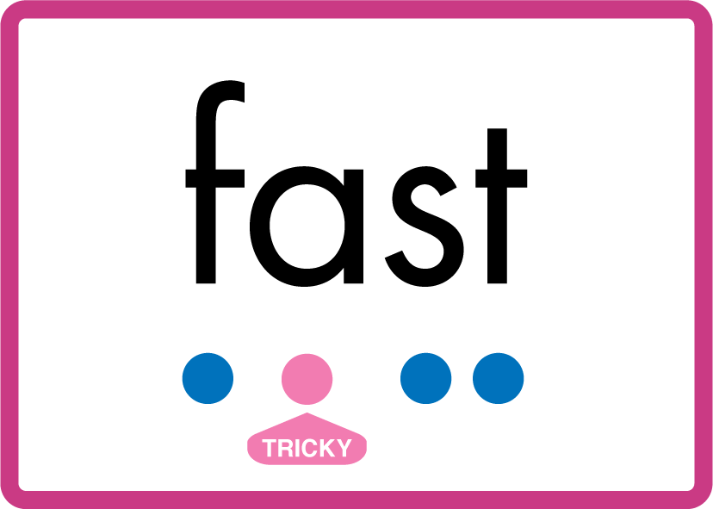


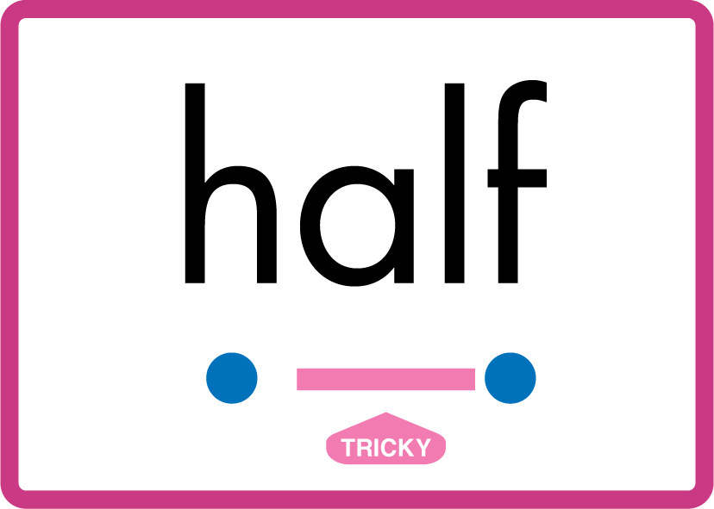

…many friend very busy pretty once please asked bath path fast class after half laughed.

Slide 13
Review Grapheme Caption
fork
corn
sword
Phase 3, Lesson 56
USING JN686
FRONT

Slide 14
Teach Grapheme Caption
talk
ball
beanstalk
Phase 5.5, Lesson 72
USING JN686
FRONT

Slide 15

Explain Decoding

Slide 16
Model Blending Phonemes
ch
al
k
USING SOUND BUTTONS
Sound Buttons
Vowel
Consonant
Consonant Digraph
Multi Sound
Long Vowel Sound
R-controlled Digraph
Split Digraph
Syllable / Silent Letter

Slide 17
Model Blending Phonemes
t
al
k
USING SOUND BUTTONS
Sound Buttons
Vowel
Consonant
Consonant Digraph
Multi Sound
Long Vowel Sound
R-controlled Digraph
Split Digraph
Syllable / Silent Letter

Slide 18

Explain Encoding

Slide 19
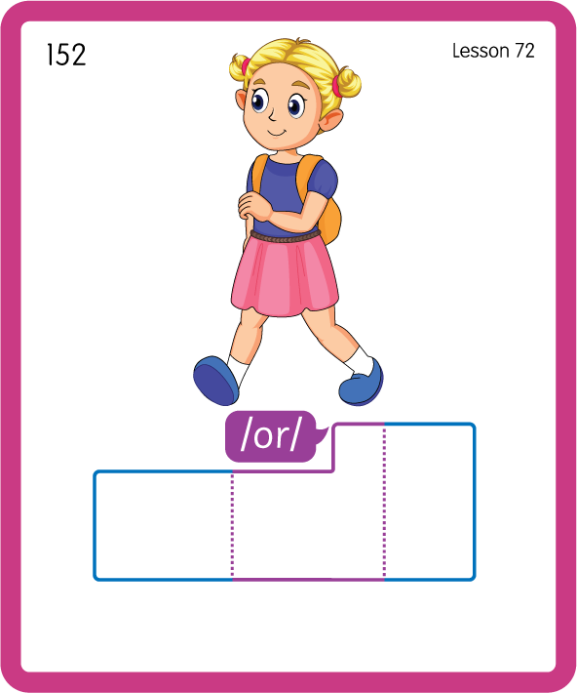
Build a Decodable Word
USING JN689
BACK

Slide 20
Build a Decodable Word
USING JN689
FRONT

Slide 21

Practise with Alien Words
USING JN692
BACK

Slide 22
Practise with Alien Words
USING JN692
FRONT

Slide 23
Practise Common Exception Words
USING JN687
FRONT

Slide 24
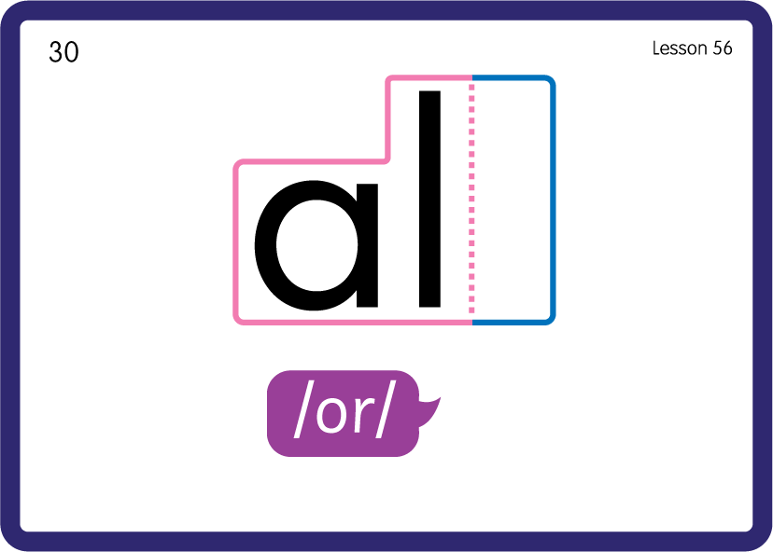
Practise Common Exception Words
USING JN687
BACK

Slide 25
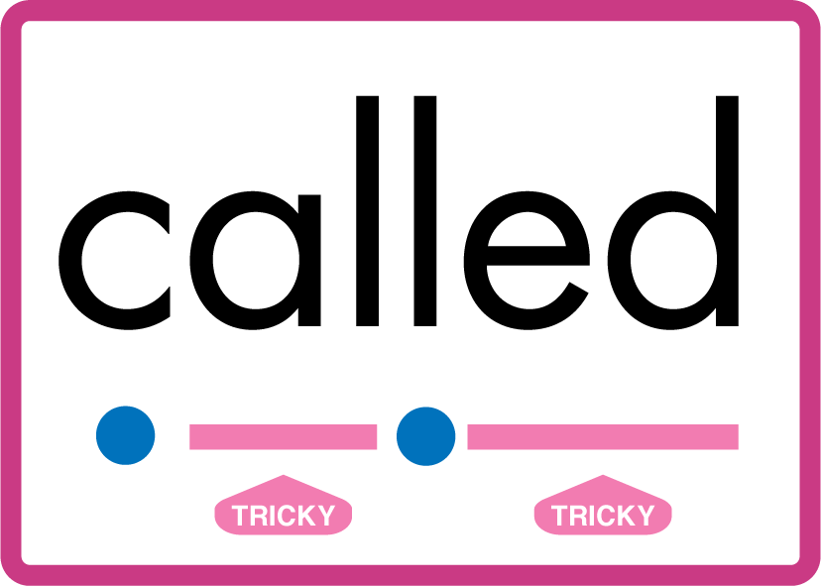

Teach Common Exception Words
USING JN687
FRONT

Slide 26
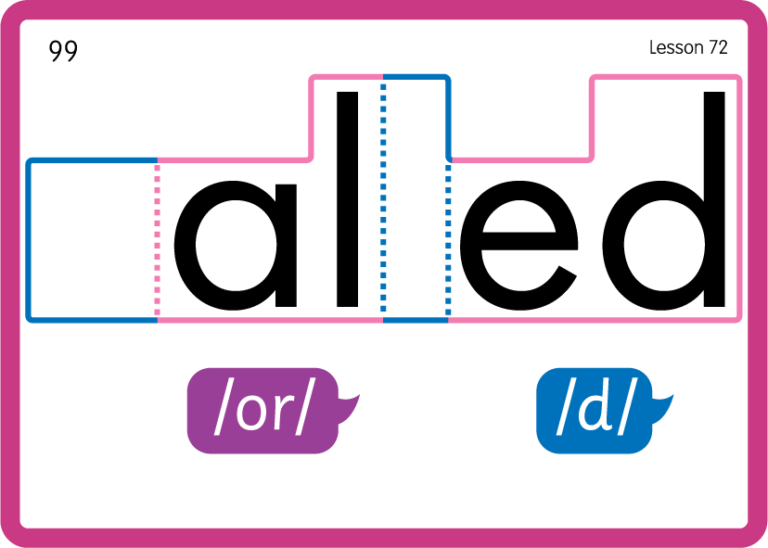
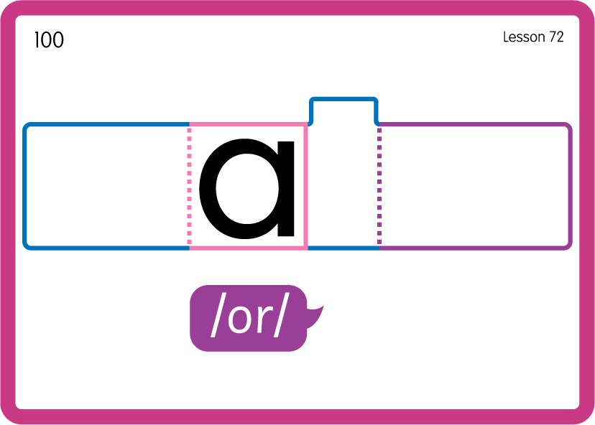
Teach Common Exception Words
USING JN687
BACK

Slide 27

Practise Building Words
PRACTISE – 10MINS
w
a
l
k
ng
i
t
ch
s
b
ea
n
USING MAGNETIC LETTERS AND A WHITEBOARD
LAYOUT A

Slide 28
Practise Building Words
PRACTISE – 10MINS
w
a
l
k
ng
i
t
ch
s
b
ea
n
walk talking chalk stalk beanstalk
USING MAGNETIC LETTERS AND A WHITEBOARD
LAYOUT A

