Slide 1



/ai/ | /ee/ | /igh/ | /oa/ | /oo/ | /y-oo/ | /r/
/n/ | /m/ | /ch/ | /k/ | /sh/ | /j/ | /v/
/u/ | /e/ | /i/ | /s/ | /zh/ | /z/ | /ar/
/or/ | /ur/ | /air/ | /ear/
Sound Family /or/; oar our
Lesson 74

Slide 2
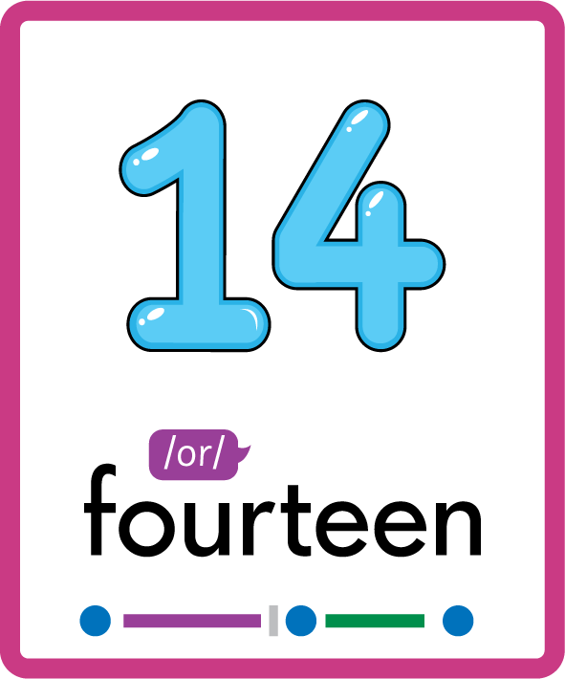
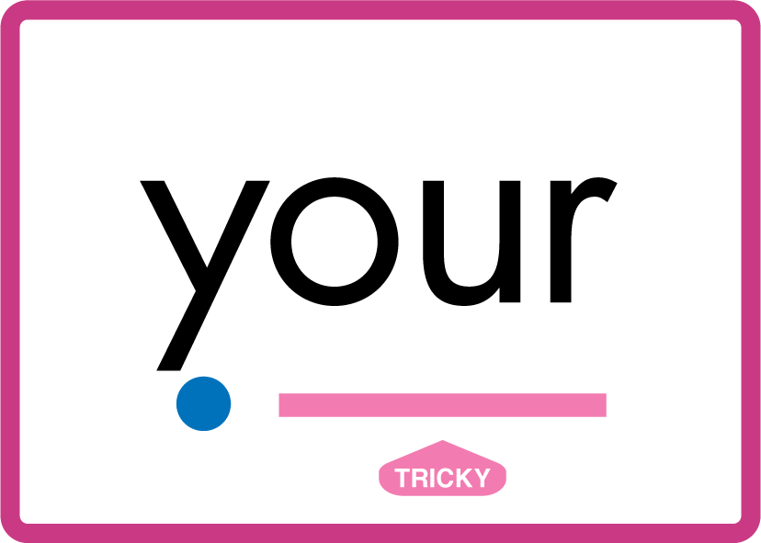
Revise and practise /or/ sound family spelling patterns.
Recall all GPCs learned so far using flashcards.
Recall Phase 3 Common Exception Words push they me we be he she my by looked you are there here were all sure.
Grapheme to Phoneme Cards
Phoneme Frame Cards
Common Exception Word Cards
JN686
JN689
JN687

Slide 3























Recall all GPCs learned so far using flashcards.

Slide 4




























Recall all GPCs learned so far using flashcards.

Slide 5



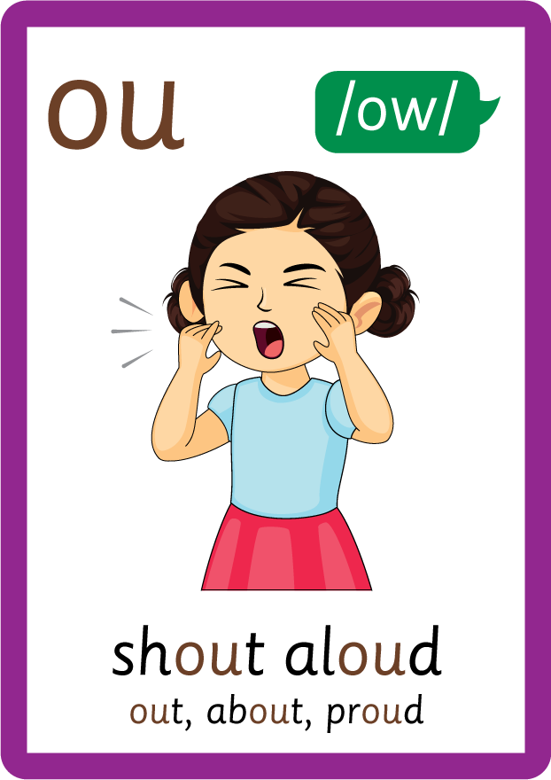





































Recall all GPCs learned so far using flashcards.

Slide 6
























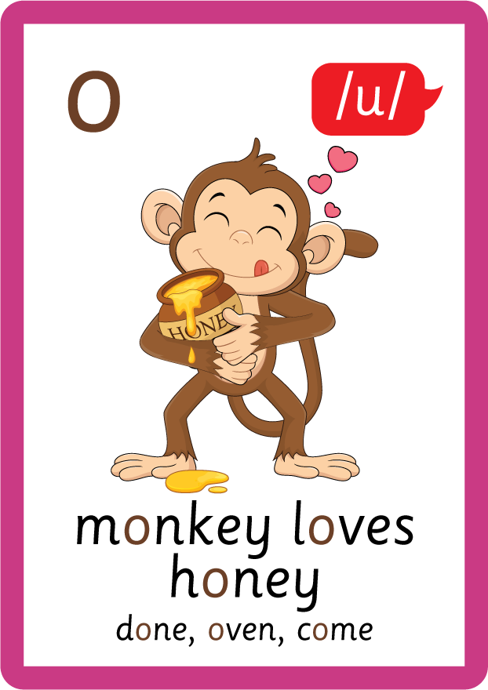
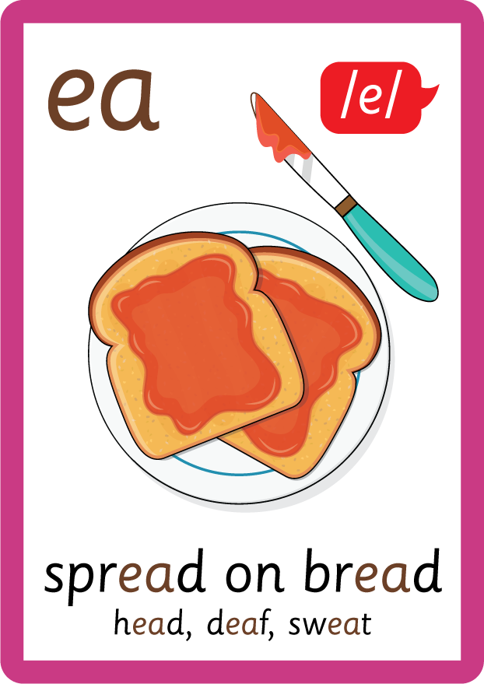




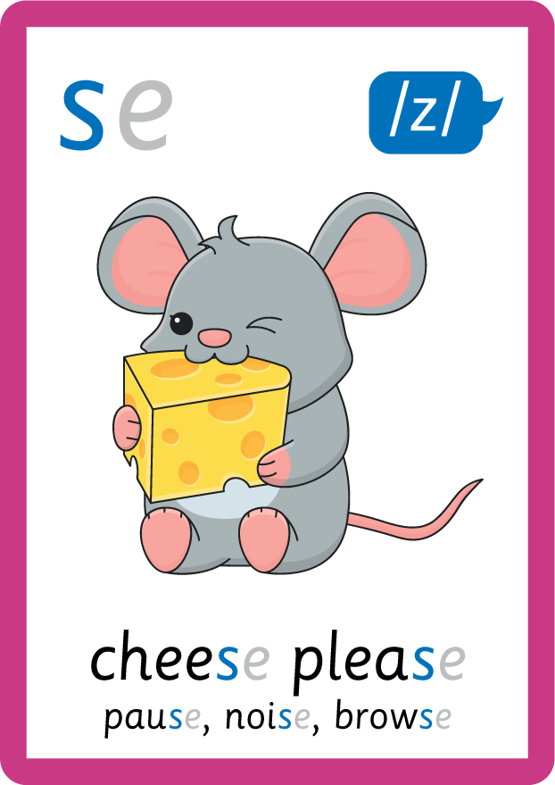



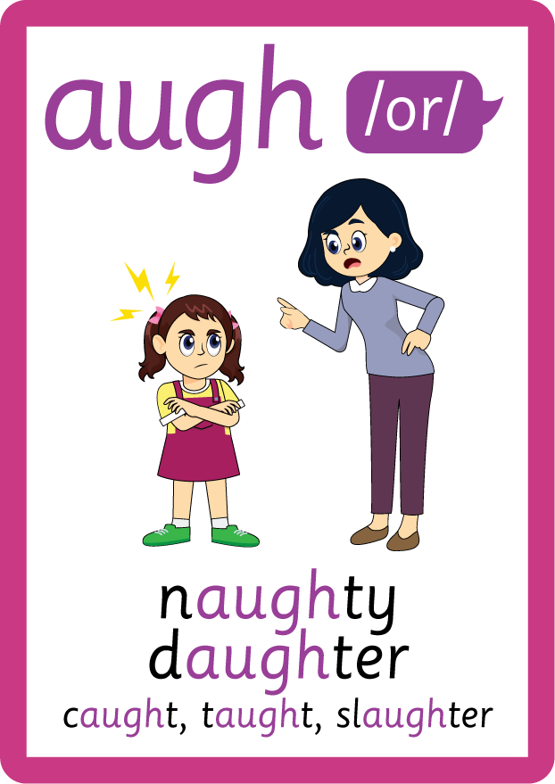
Recall all GPCs learned so far using flashcards.

Slide 7














Review Phase 2 Common Exception Words as I is no go to into the put his has of pull full.

Slide 8



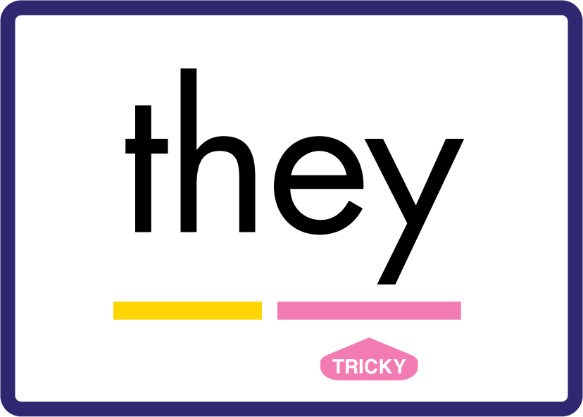

















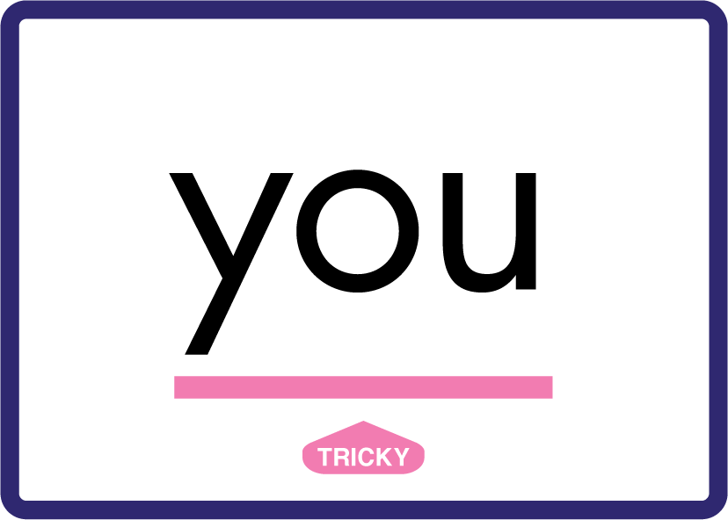






Review Phase 3 Common Exception Words push they me we be he she my by looked you are there here were all sure.

Slide 9









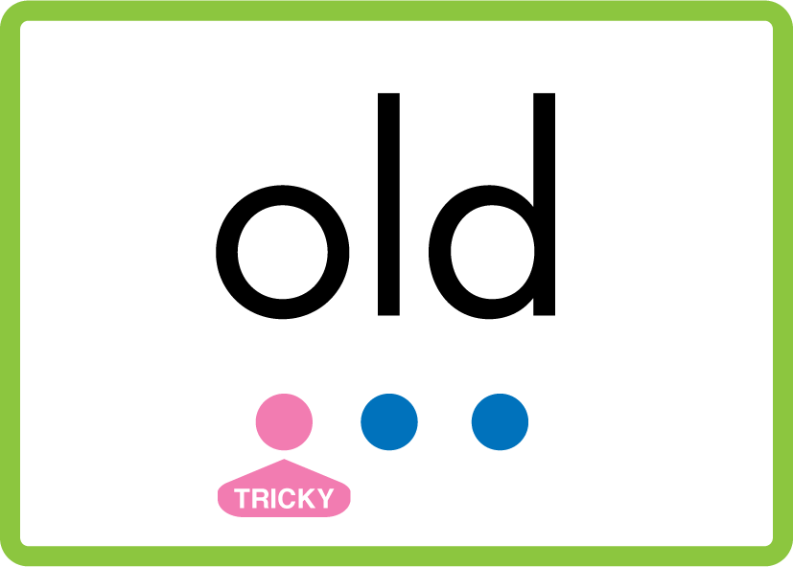



Review Phase 4 Common Exception Words said like out have some come what was so old do little one.

Slide 10















Review Phase 5 Common Exception Words today house mouse hour because Mr Mrs Ms where should could would move use want.

Slide 11



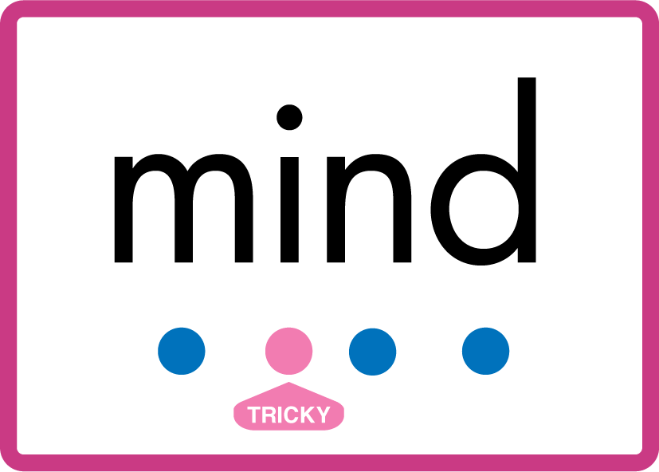


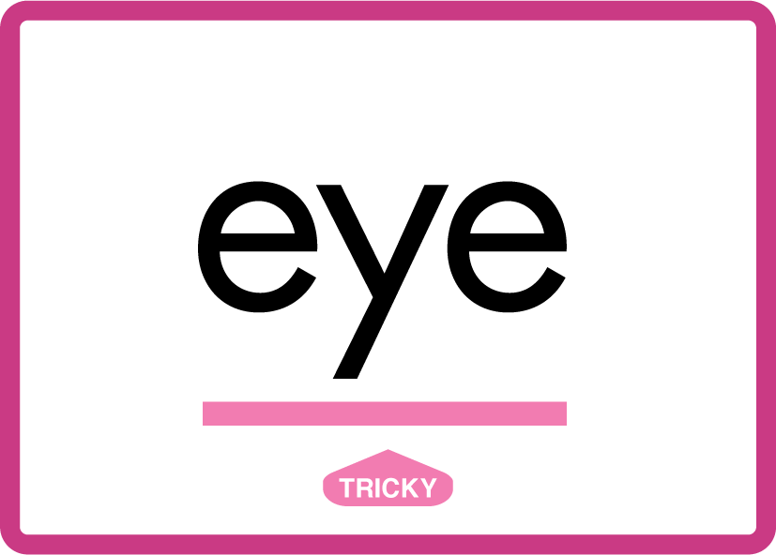








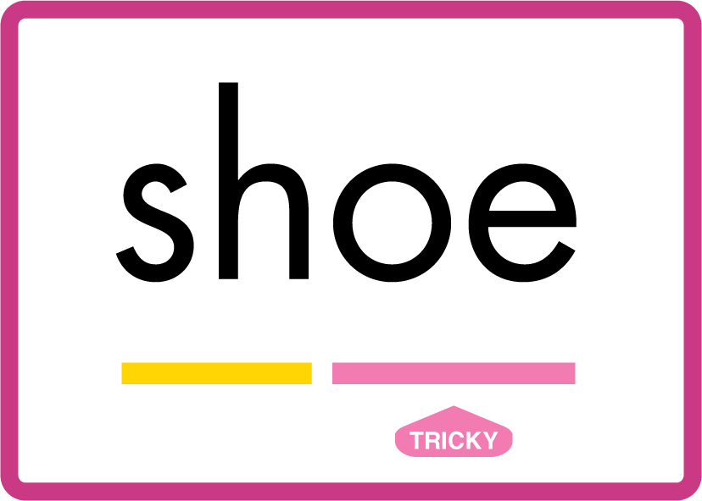






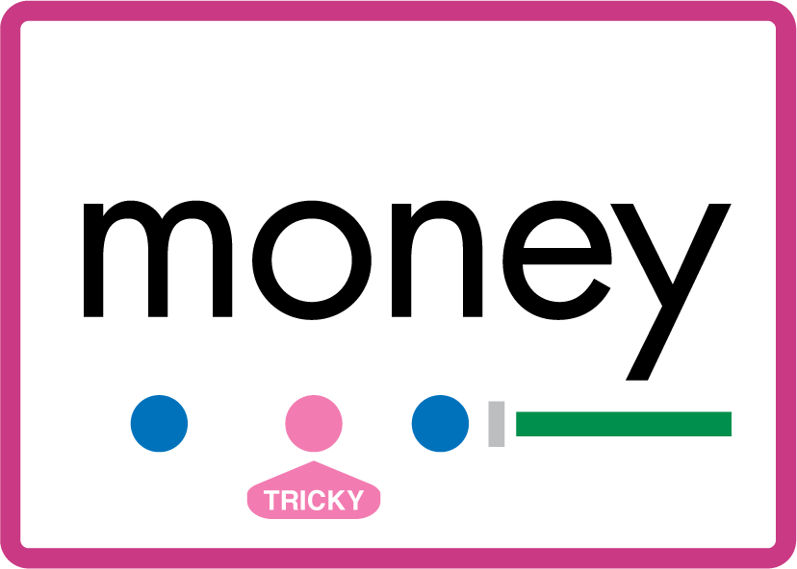

Review Phase 5.5 Common Exception Words people wild child mind kind behind eye oh most only both though through who prove shoe beautiful climb Christmas school sugar love money any…

Slide 12
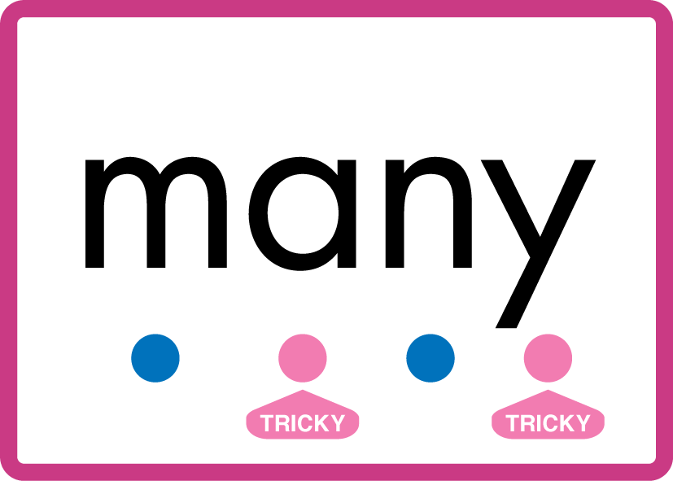


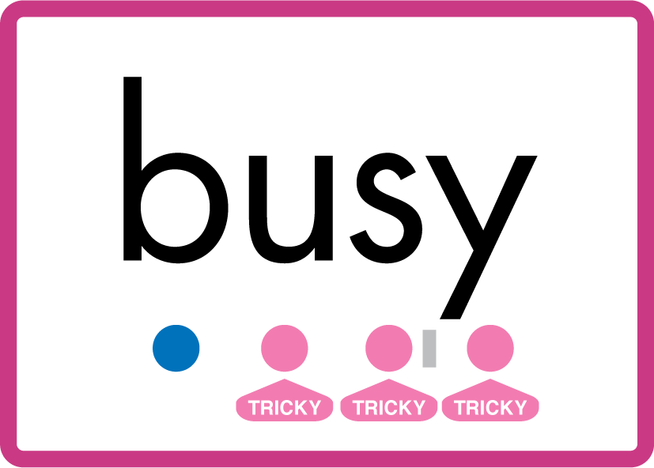
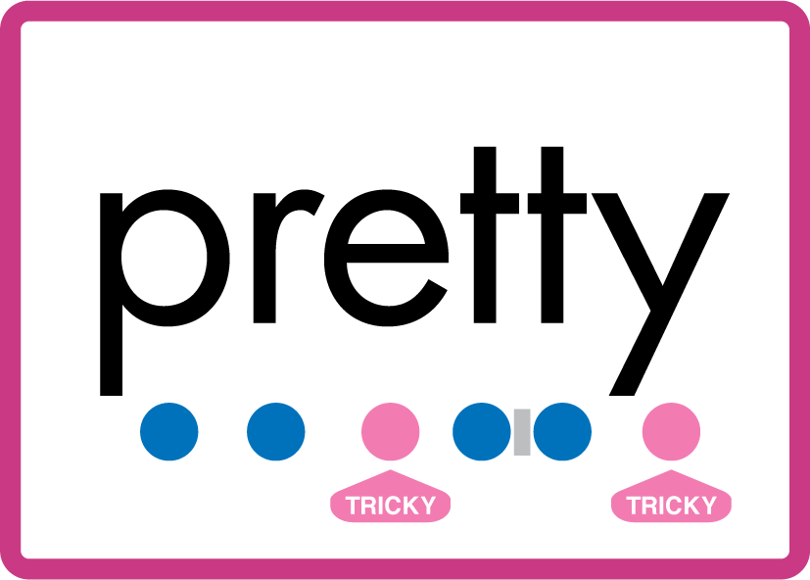


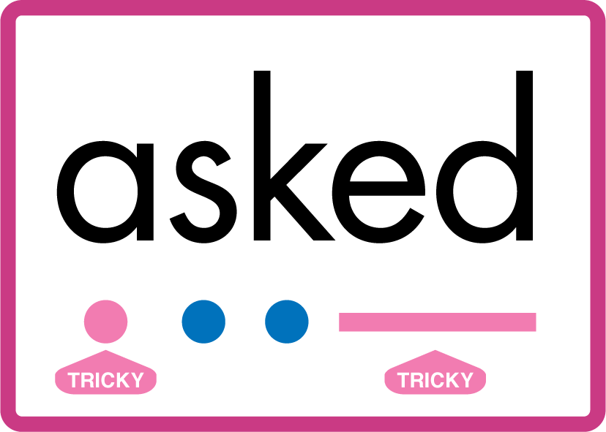


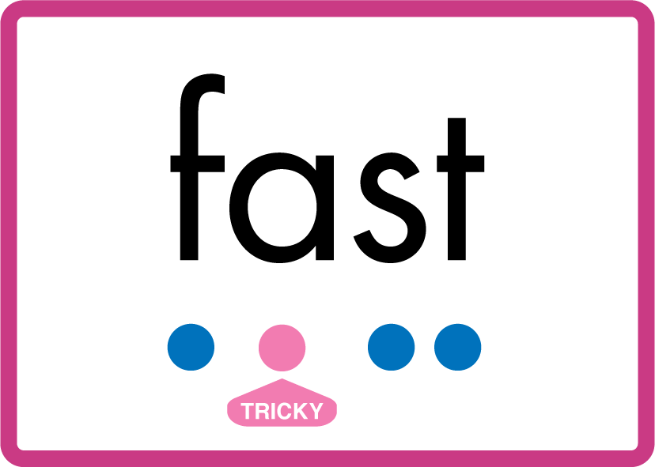


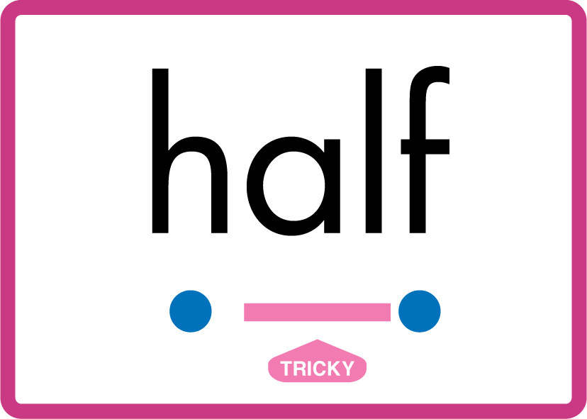
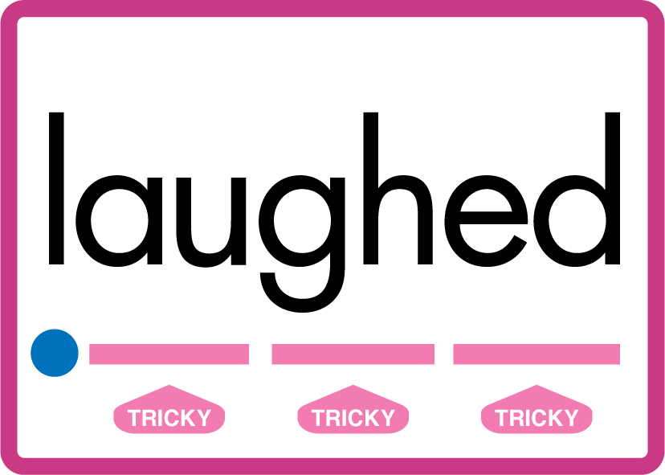
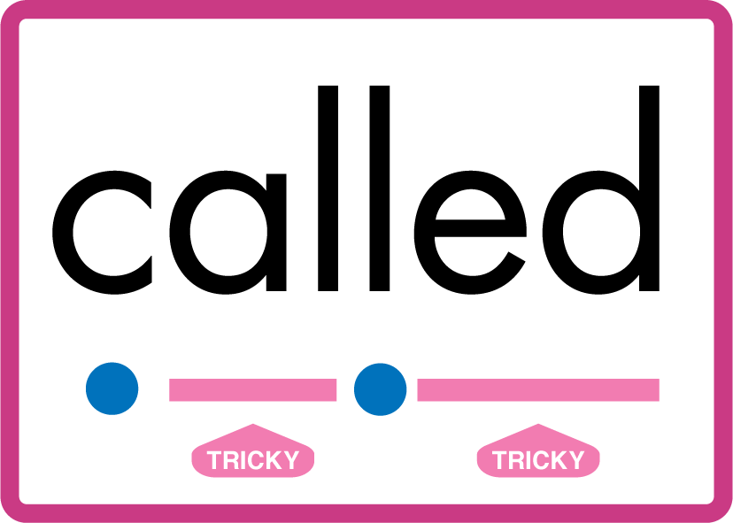

…many friend very busy pretty once please asked bath path fast class after half laughed called water.

Slide 13
Review Grapheme Caption
fork
corn
sword
Phase 3, Lesson 56
USING JN686
FRONT

Slide 14
Teach Grapheme Caption
oar
cardboard
roar
Phase 5.5, Lesson 74
USING JN686
FRONT

Slide 15
Teach Grapheme Caption
fourteen
pour
source
Phase 5.5, Lesson 74
USING JN686
FRONT

Slide 16

Explain Decoding

Slide 17
Model Blending Phonemes
b
oar
d
USING SOUND BUTTONS
Sound Buttons
Vowel
Consonant
Consonant Digraph
Multi Sound
Long Vowel Sound
R-controlled Digraph
Split Digraph
Syllable / Silent Letter

Slide 18
Model Blending Phonemes
f
our
USING SOUND BUTTONS
Sound Buttons
Vowel
Consonant
Consonant Digraph
Multi Sound
Long Vowel Sound
R-controlled Digraph
Split Digraph
Syllable / Silent Letter

Slide 19

Explain Encoding

Slide 20
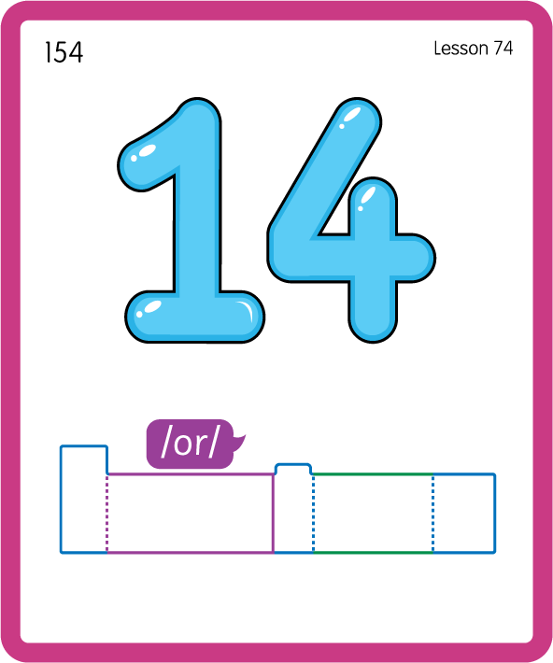
Build a Decodable Word
USING JN689
BACK

Slide 21
Build a Decodable Word
USING JN689
FRONT

Slide 22
Teach Common Exception Words
USING JN687
FRONT

Slide 23
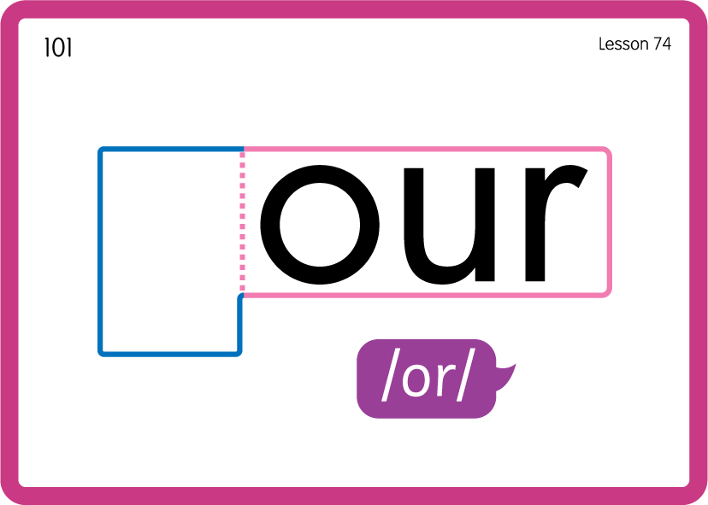
Teach Common Exception Words
USING JN687
BACK

Slide 24

Practise Building Words
PRACTISE – 10MINS
r
b
s
d
n
f
c
t
ee
our
oar
USING MAGNETIC LETTERS AND A WHITEBOARD
LAYOUT A

Slide 25
Practise Building Words
PRACTISE – 10MINS
r
b
s
d
n
f
c
t
ee
our
oar
oar roar boar soar board four court fourteen
USING MAGNETIC LETTERS AND A WHITEBOARD
LAYOUT A

