Slide 1



/ai/ | /ee/ | /igh/ | /oa/ | /oo/ | /y-oo/ | /r/
/n/ | /m/ | /ch/ | /k/ | /sh/ | /j/ | /v/
/u/ | /e/ | /i/ | /s/ | /zh/ | /z/ | /ar/
/or/ | /ur/ | /air/ | /ear/
Sound Family /or/; ore oor
Lesson 75

Slide 2
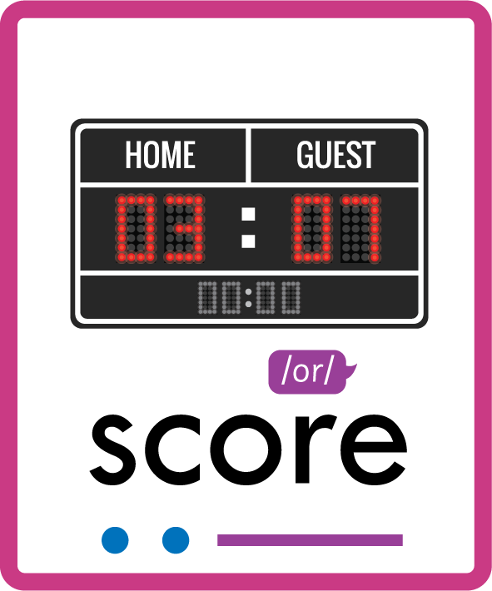

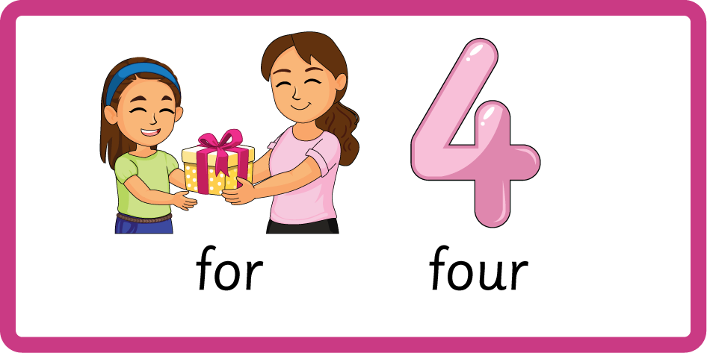

Revise and practise /or/ sound family spelling patterns.
Recall all GPCs learned so far using flashcards.
Practise Homophones within /or/ family for / four, bored / board.
Homophone Cards
Grapheme to Phoneme Cards
Phoneme Frame Cards
Alien Word Cards
Common Exception Word Cards
JN693
JN686
JN689
JN692
JN687

Slide 3























Recall all GPCs learned so far using flashcards.

Slide 4




























Recall all GPCs learned so far using flashcards.

Slide 5









































Recall all GPCs learned so far using flashcards.

Slide 6






























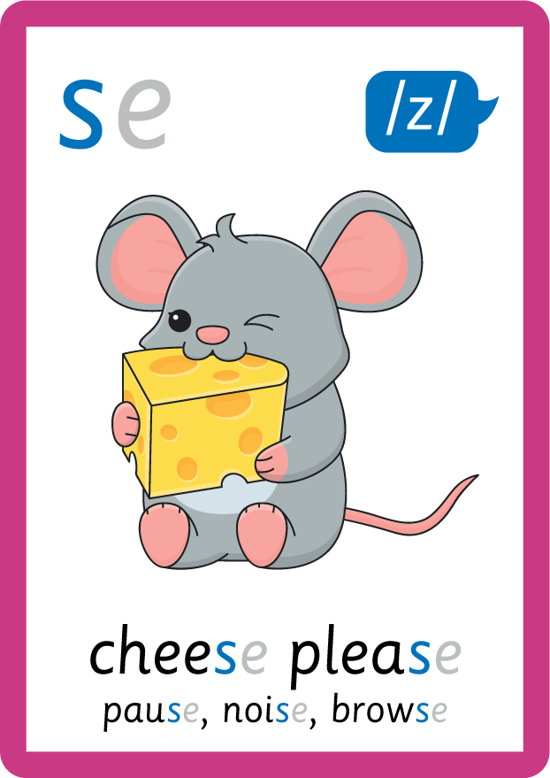






Recall all GPCs learned so far using flashcards.

Slide 7














Review Phase 2 Common Exception Words as I is no go to into the put his has of pull full.

Slide 8



























Review Phase 3 Common Exception Words push they me we be he she my by looked you are there here were all sure.

Slide 9













Review Phase 4 Common Exception Words said like out have some come what was so old do little one.

Slide 10















Review Phase 5 Common Exception Words today house mouse hour because Mr Mrs Ms where should could would move use want.

Slide 11






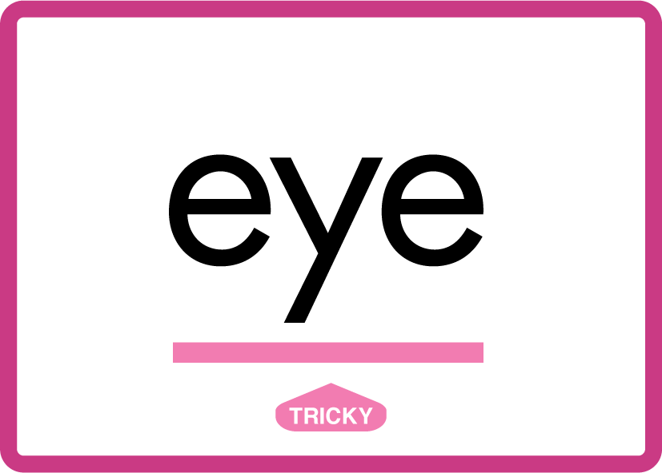

















Review Phase 5.5 Common Exception Words people wild child mind kind behind eye oh most only both though through who prove shoe beautiful climb Christmas school sugar love money any…

Slide 12



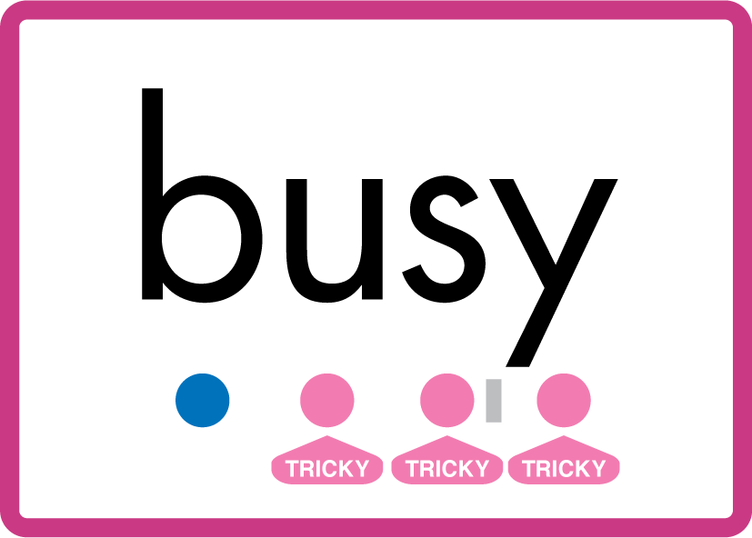






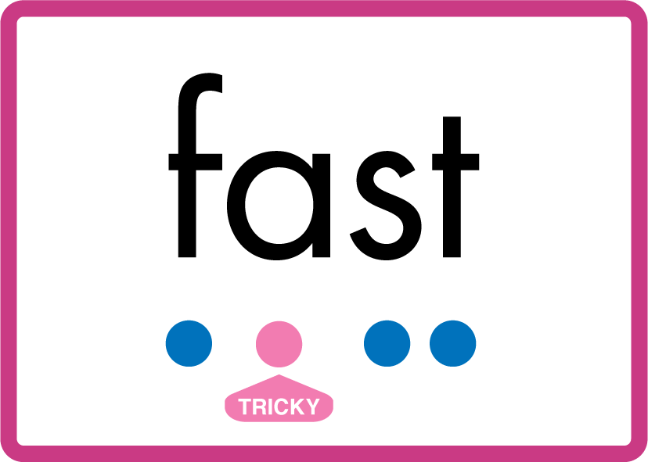




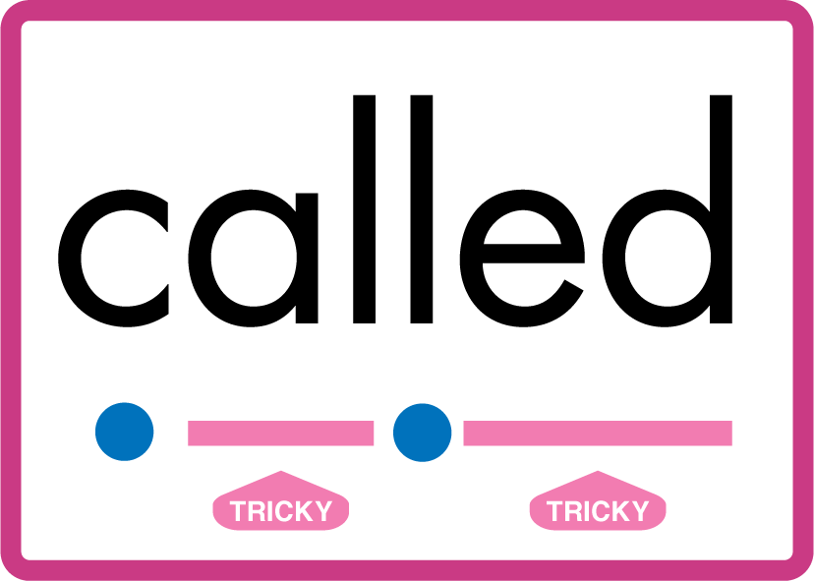


…many friend very busy pretty once please asked bath path fast class after half laughed called water your.

Slide 13
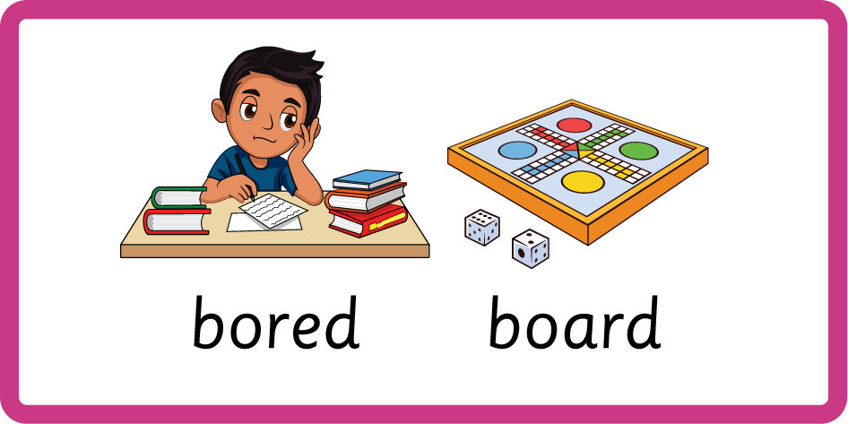
Teach Homophones: for / four, bored / board.

Slide 14
Review Grapheme Caption
fork
corn
sword
Phase 3, Lesson 56
USING JN686
FRONT

Slide 15
Teach Grapheme Caption
snore
store
core
Phase 5.5, Lesson 75
USING JN686
FRONT

Slide 16
Teach Grapheme Caption
door
poor
floor
Phase 5.5, Lesson 75
USING JN686
FRONT

Slide 17

Explain Decoding

Slide 18
Model Blending Phonemes
b
ore
USING SOUND BUTTONS
Sound Buttons
Vowel
Consonant
Consonant Digraph
Multi Sound
Long Vowel Sound
R-controlled Digraph
Split Digraph
Syllable / Silent Letter

Slide 19
Model Blending Phonemes
f
l
oor
USING SOUND BUTTONS
Sound Buttons
Vowel
Consonant
Consonant Digraph
Multi Sound
Long Vowel Sound
R-controlled Digraph
Split Digraph
Syllable / Silent Letter

Slide 20

Explain Encoding

Slide 21
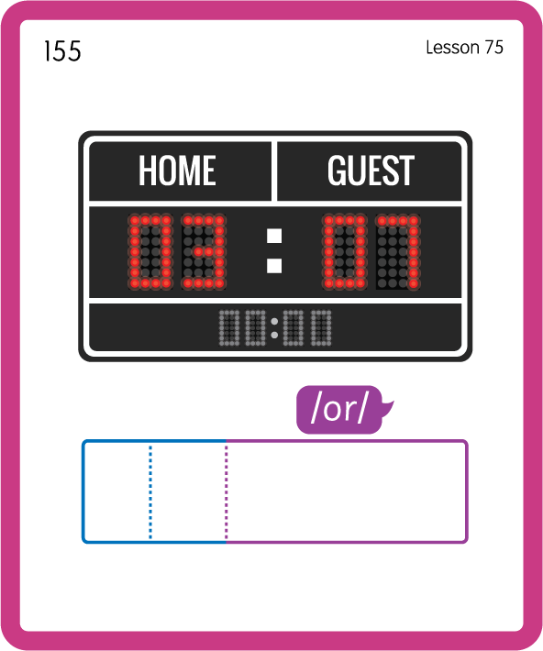
Build a Decodable Word
USING JN689
BACK

Slide 22
Build a Decodable Word
USING JN689
FRONT

Slide 23
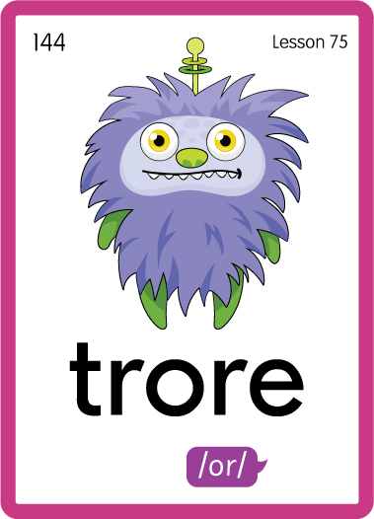
Practise with Alien Words
USING JN692
BACK

Slide 24
Practise with Alien Words
USING JN692
FRONT

Slide 25
Practise Common Exception Words
USING JL687
FRONT

Slide 26
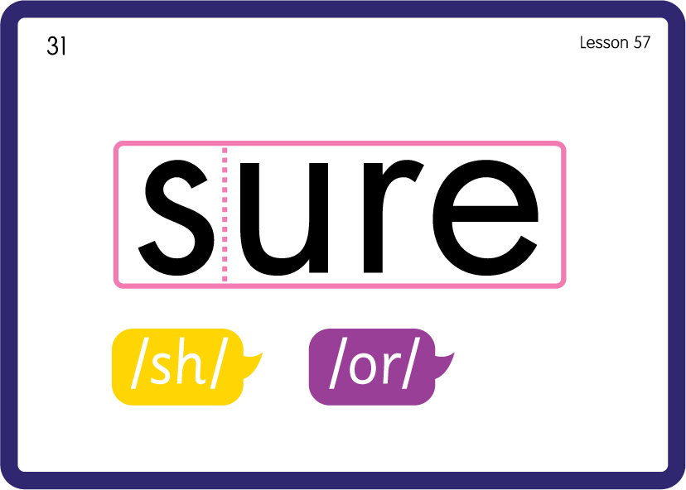
Practise Common Exception Words
USING JN687
BACK

Slide 27




Teach Common Exception Words
USING JN687
FRONT

Slide 28
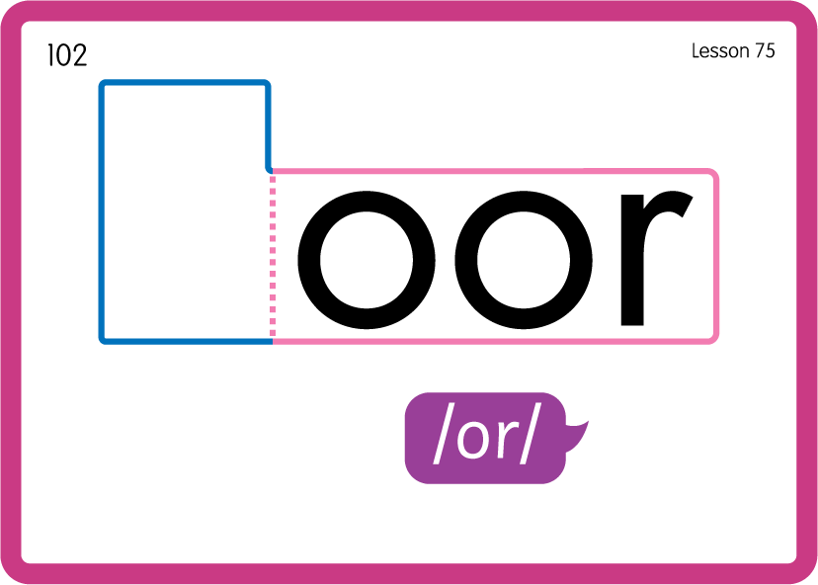
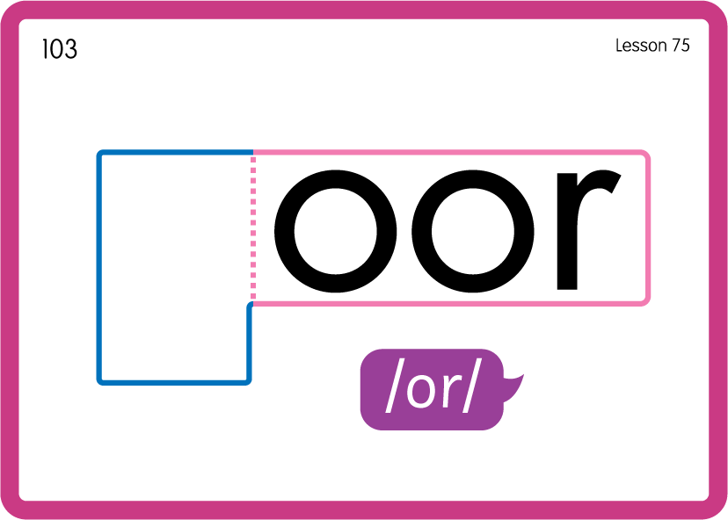
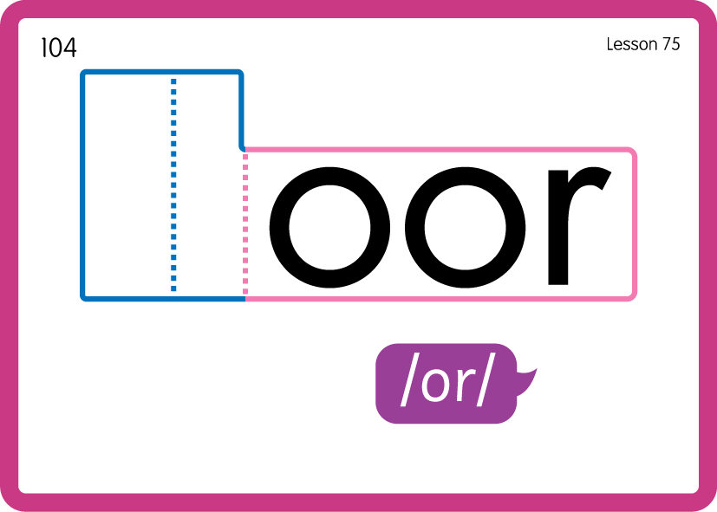
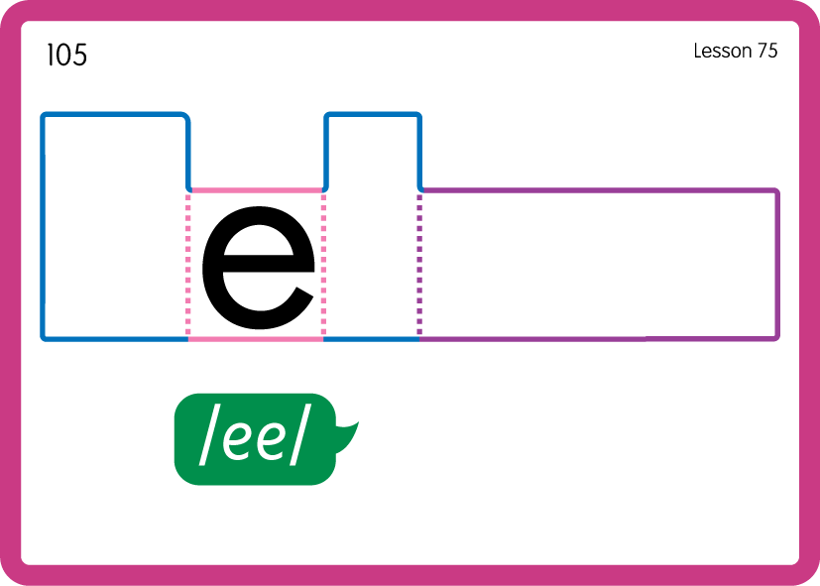
Teach Common Exception Words
USING JN687
BACK

Slide 29

Practise Building Words
PRACTISE – 10MINS
b
ore
c
e
x
p
l
ch
s
d
oor
f
USING MAGNETIC LETTERS AND A WHITEBOARD
LAYOUT A

Slide 30
Practise Building Words
PRACTISE – 10MINS
b
ore
c
e
x
p
l
ch
s
d
oor
f
bore core explore chore sore door poor floor
USING MAGNETIC LETTERS AND A WHITEBOARD
LAYOUT A

Slide 31

