Slide 1


/ai/ | /ee/ | /igh/ | /oa/ | /oo/ | /y-oo/ | /r/
/n/ | /m/ | /ch/ | /k/ | /sh/ | /j/ | /v/
/u/ | /e/ | /i/ | /s/ | /zh/ | /z/ | /ar/
/or/ | /ur/ | /air/ | /ear/
Sound Family /ee/; y
Lesson 8

Slide 2
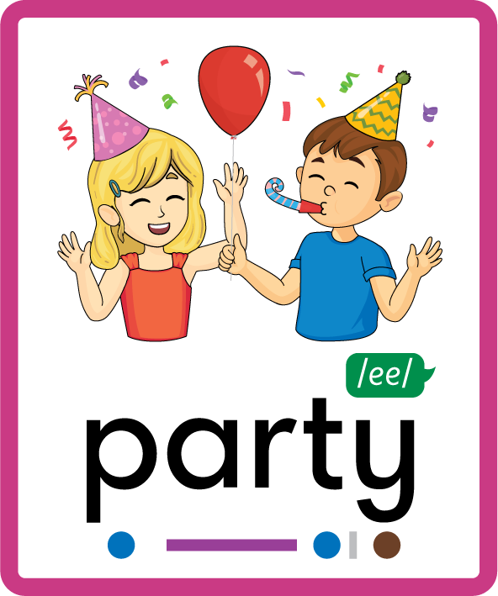

Learn and practise /ee/ sound family spelling patterns.
Recall all GPCs learned so far using flashcards.
Grapheme to Phoneme Cards
Phoneme Frame Cards
Alien Word Cards
JN686
JN689
JN692

Slide 3























Recall all GPCs learned so far using flashcards.

Slide 4





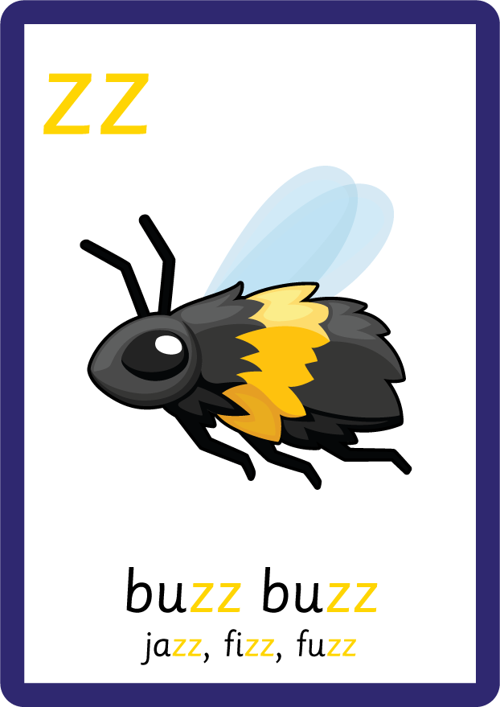





















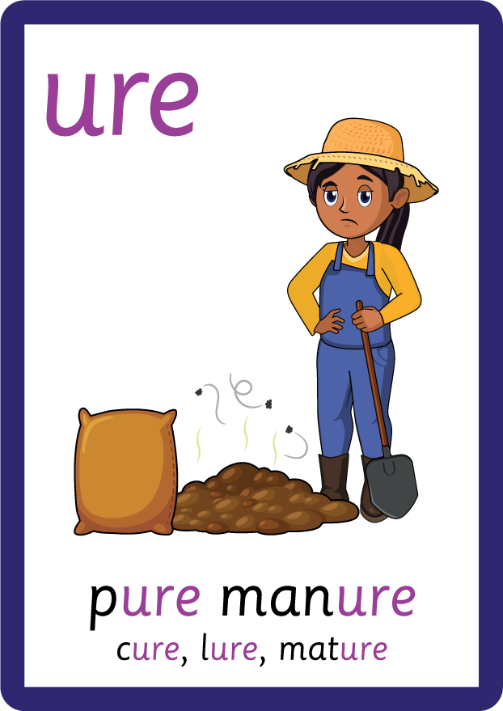
Recall all GPCs learned so far using flashcards.

Slide 5


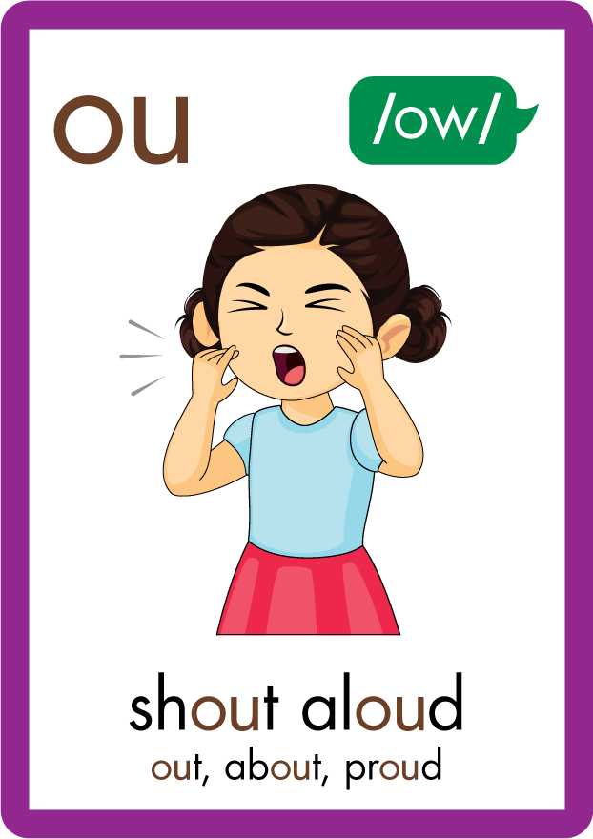
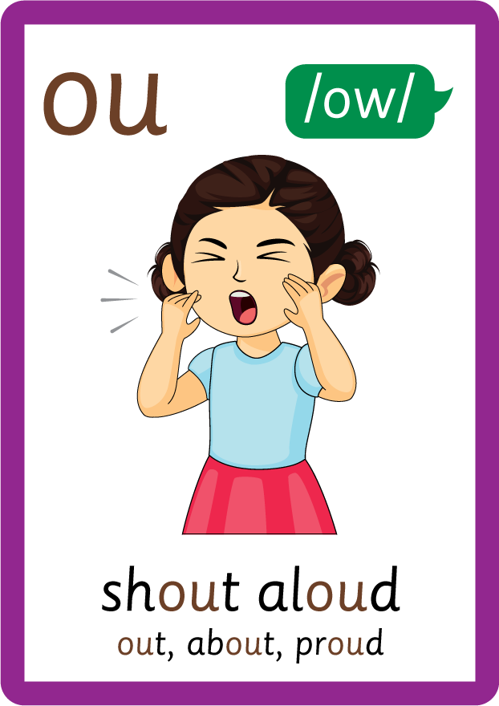
















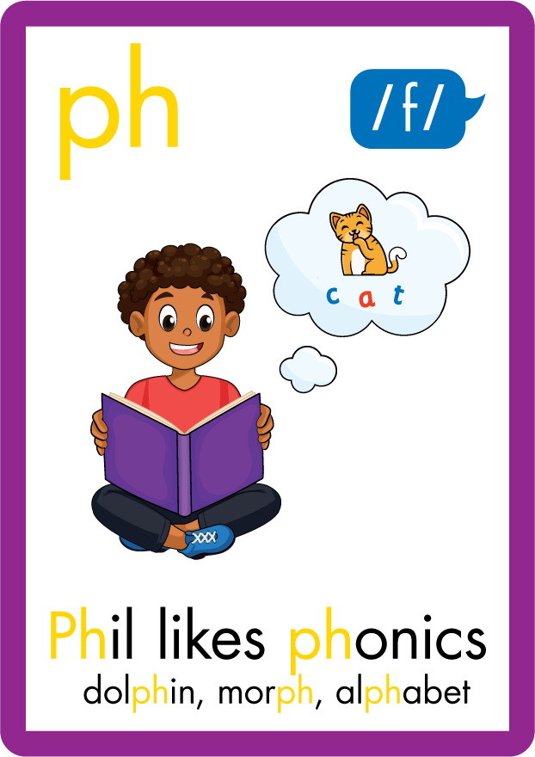



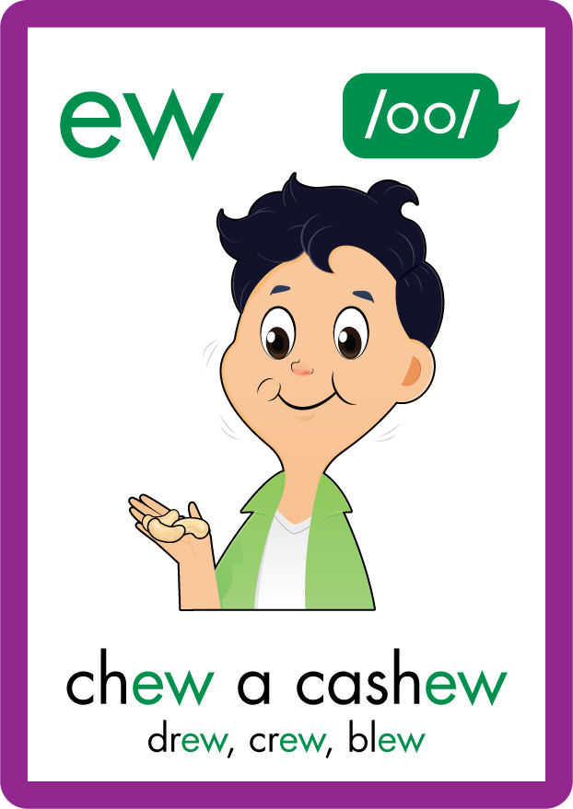









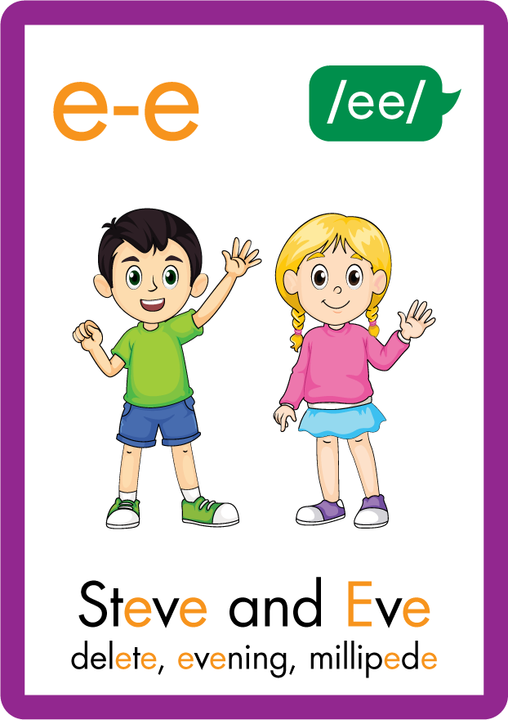






Recall all GPCs learned so far using flashcards.

Slide 6
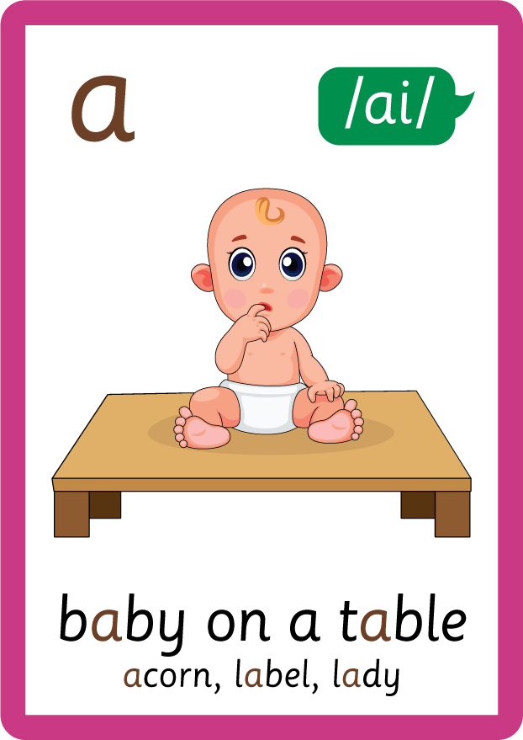


Recall all GPCs learned so far using flashcards.

Slide 7






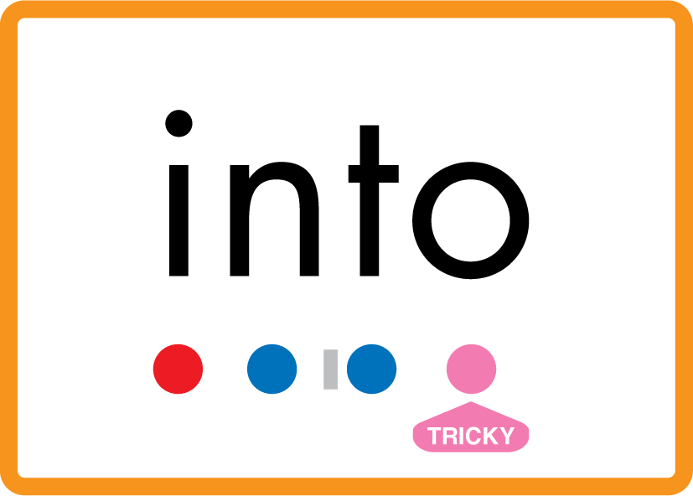

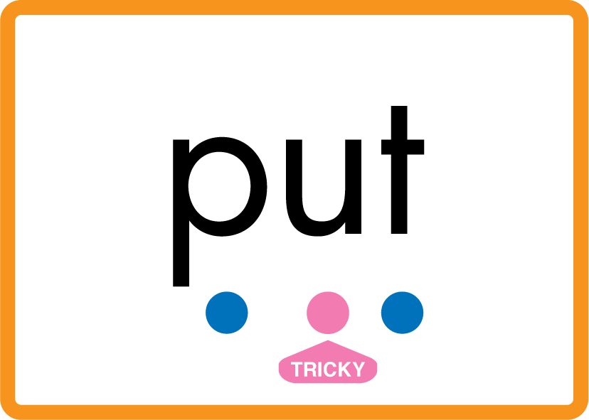
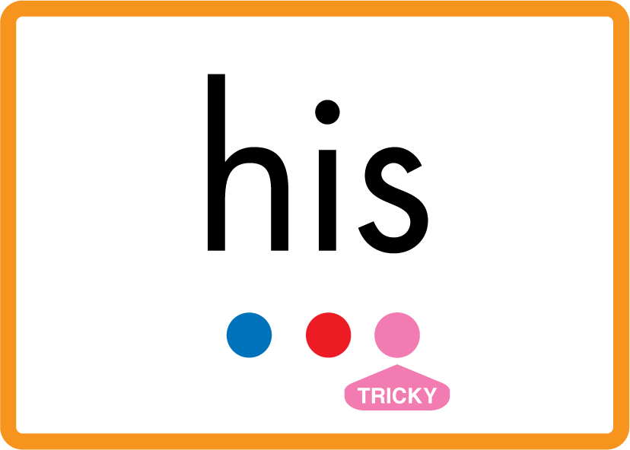



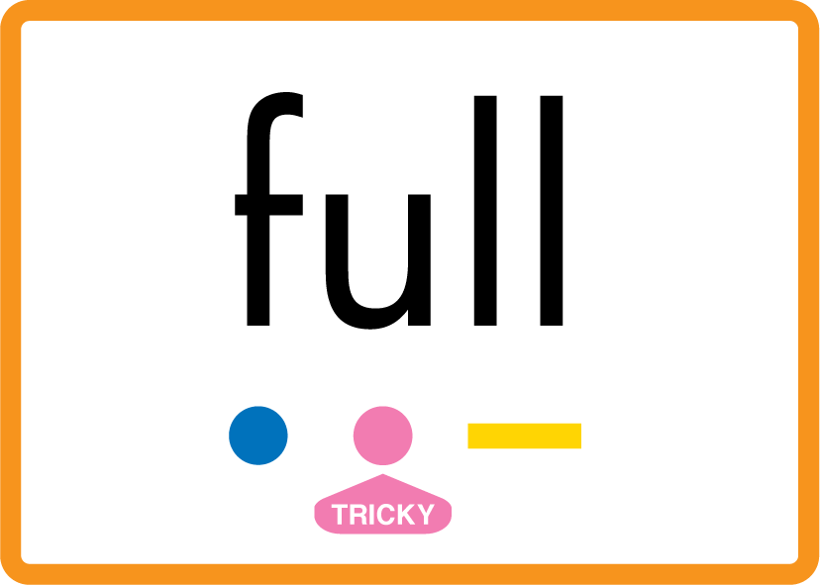
Review Phase 2 Common Exception Words as I is no go to into the put his has of pull full.

Slide 8



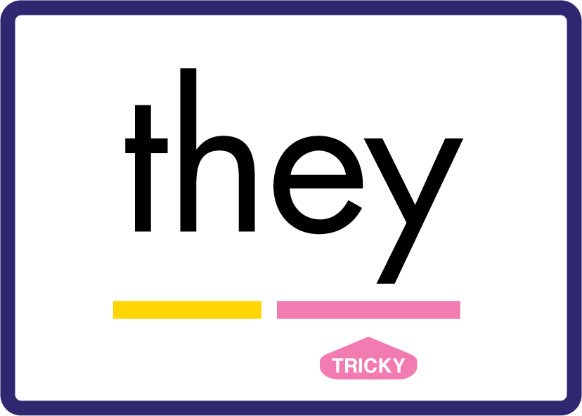


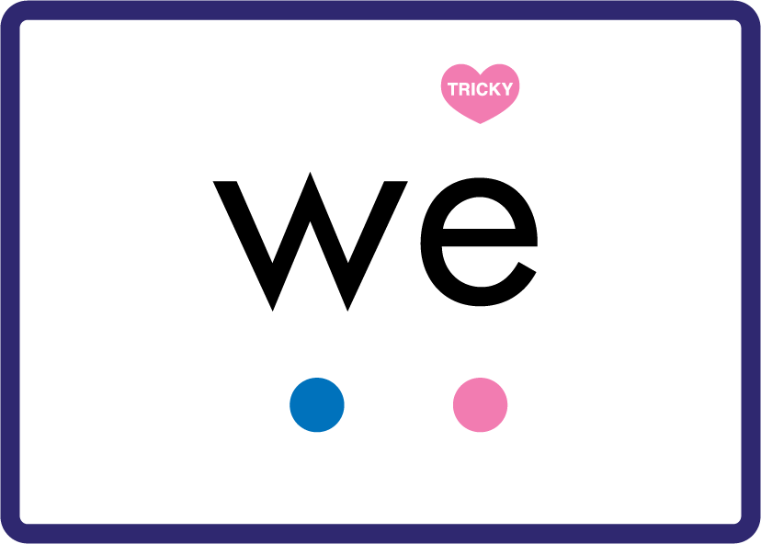
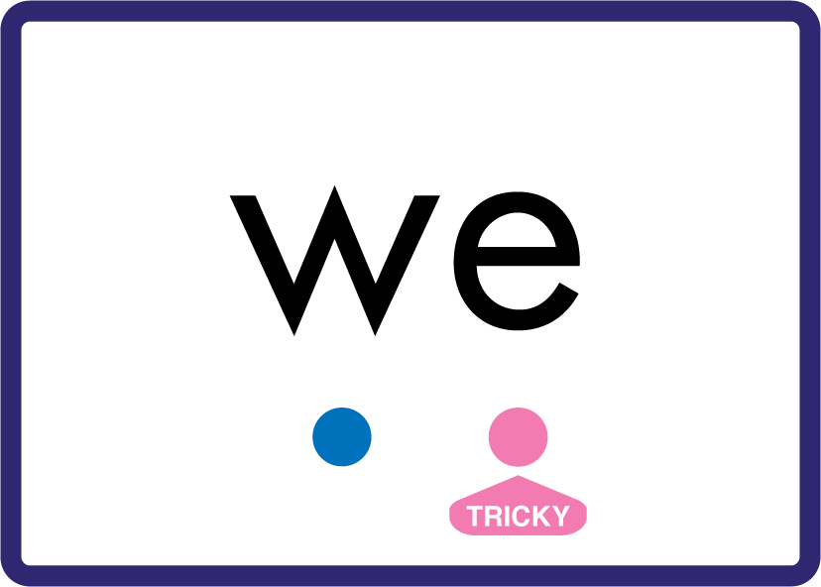
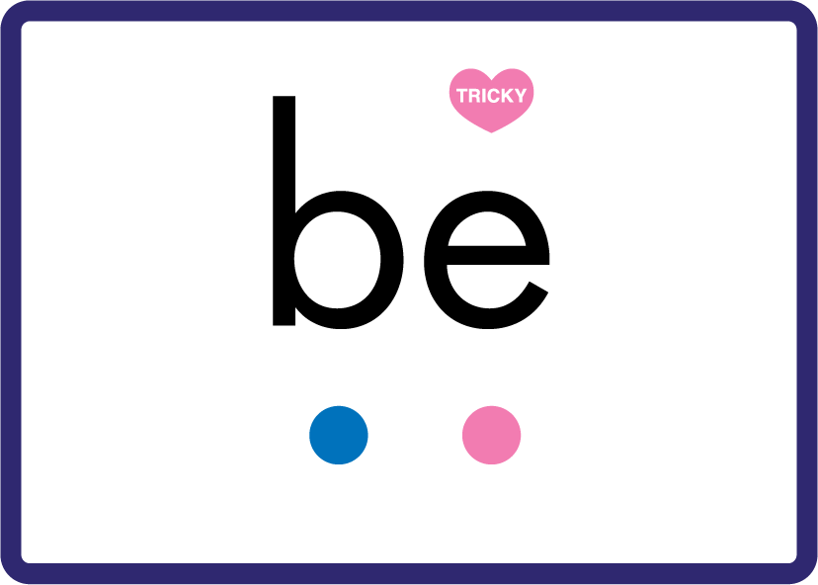

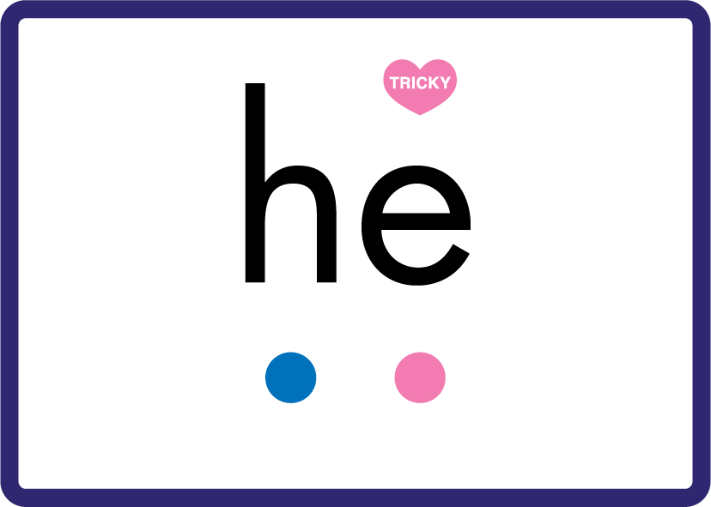

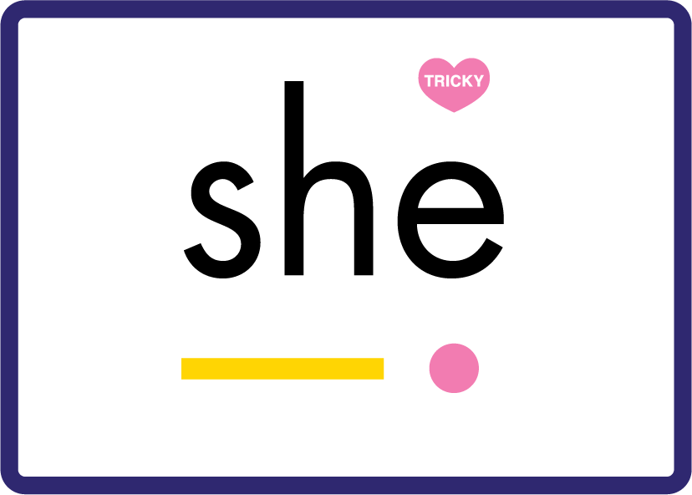
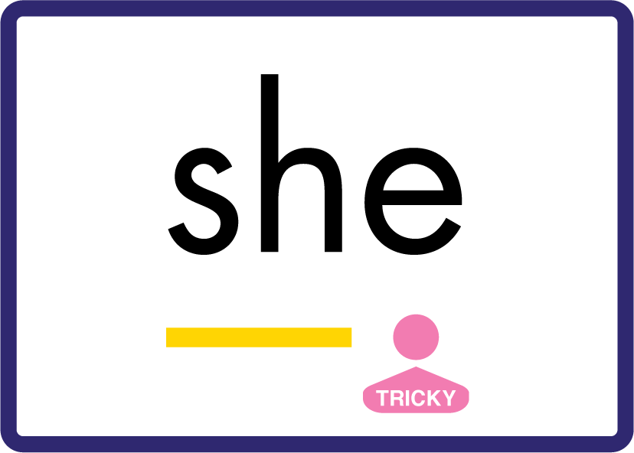
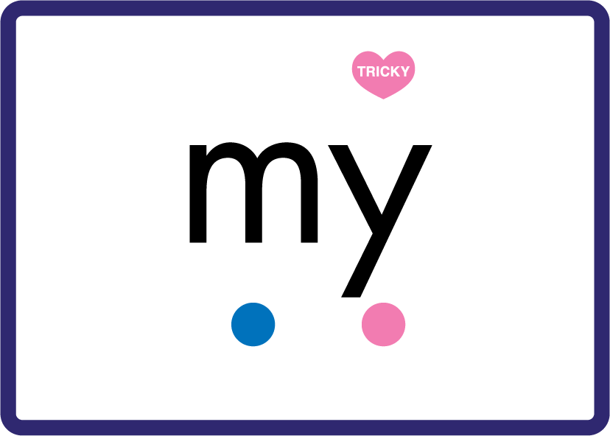

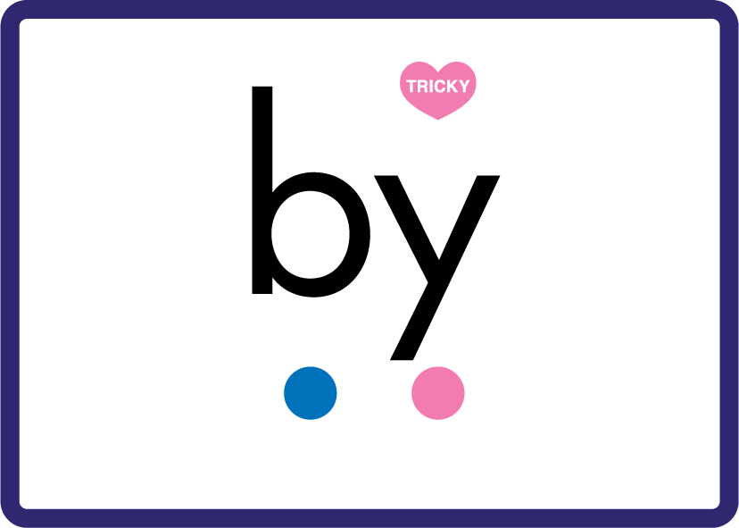




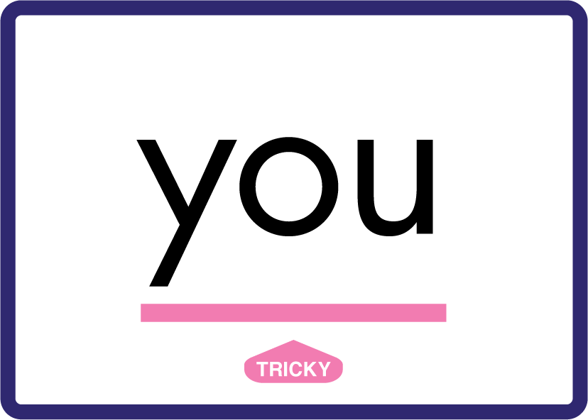






Review Phase 3 Common Exception Words push they me we be he she my by looked you are there here were all sure.

Slide 9









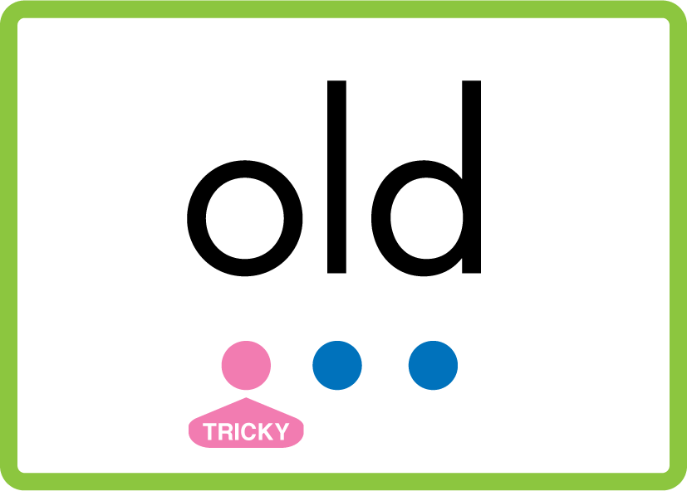
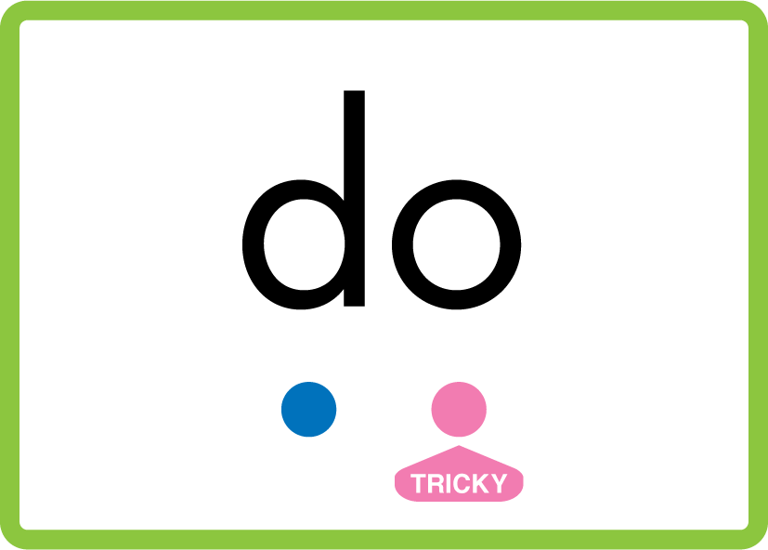


Review Phase 4 Common Exception Words said like out have some come what was so old do little one.

Slide 10


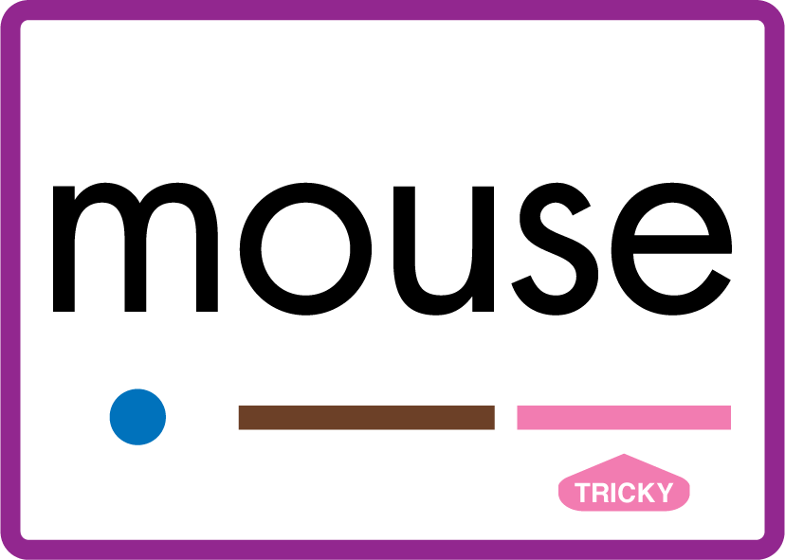
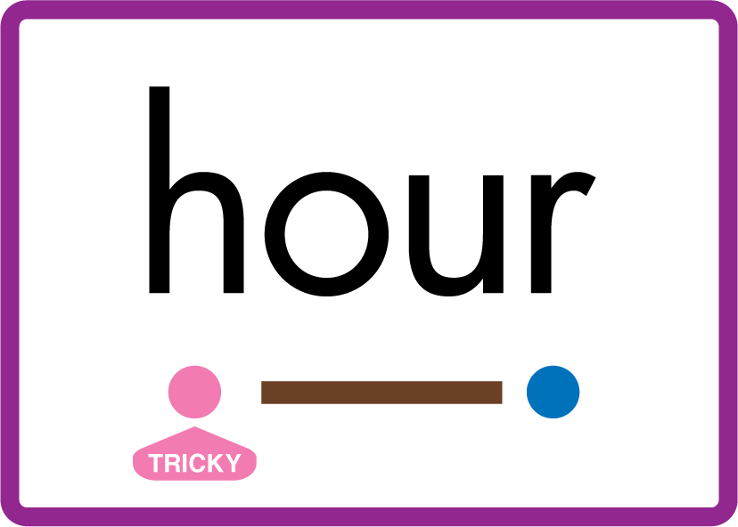










Review Phase 5 Common Exception Words today house mouse hour because Mr Mrs Ms where should could would move use.

Slide 11
Review Grapheme Caption
yet
yak
yes
Phase 3, Lesson 6
USING JN686
FRONT

Slide 12
Teach Grapheme Caption
happy
copy
bunny
Phase 5.5, Lesson 8
USING JN686
FRONT

Slide 13

Explain Decoding

Slide 14
Model Blending Phonemes
l
d
y
a
USING SOUND BUTTONS
Sound Buttons
Vowel
Consonant
Consonant Digraph
Multi Sound
Long Vowel Sound
R-controlled Digraph
Split Digraph
Syllable / Silent Letter

Slide 15
Model Blending Phonemes
c
r
u
n
ch
y
USING SOUND BUTTONS
Sound Buttons
Vowel
Consonant
Consonant Digraph
Multi Sound
Long Vowel Sound
R-controlled Digraph
Split Digraph
Syllable / Silent Letter

Slide 16

Explain Encoding

Slide 17
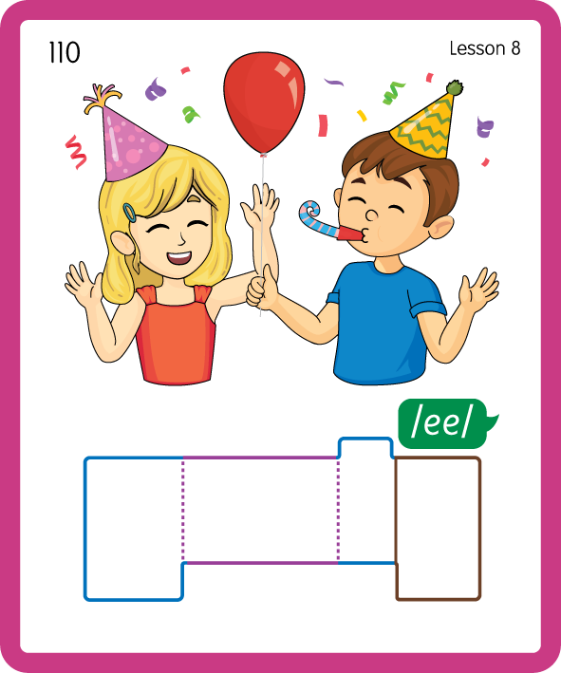
Build a Decodable Word
USING JN689
BACK

Slide 18
Build a Decodable Word
USING JN689
FRONT

Slide 19
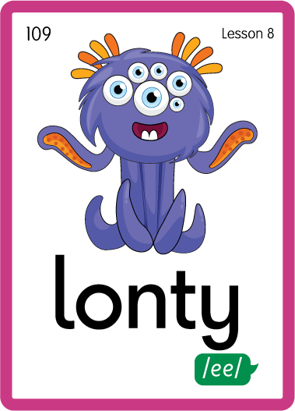
Practise with Alien Words
USING NL692
BACK

Slide 20
Practise with Alien Words
USING JN692
FRONT

Slide 21

Practise Building Words
PRACTISE – 10MINS
b
a
b
y
p
u
p
p
s
t
d
l
ee
e
n
n
h
m
ss
USING MAGNETIC LETTERS AND A WHITEBOARD
LAYOUT B

Slide 22
Practise Building Words
PRACTISE – 10MINS
b
a
b
y
p
u
p
p
s
t
d
l
ee
e
n
n
h
m
ss
baby puppy study sleepy penny happy bunny messy
USING MAGNETIC LETTERS AND A WHITEBOARD
LAYOUT B

