Slide 1


/ai/ | /ee/ | /igh/ | /oa/ | /oo/ | /y-oo/ | /r/
/n/ | /m/ | /ch/ | /k/ | /sh/ | /j/ | /v/
/u/ | /e/ | /i/ | /s/ | /zh/ | /z/ | /ar/
/or/ | /ur/ | /air/ | /ear/
Sound Family /ee/; ie
Lesson 9

Slide 2
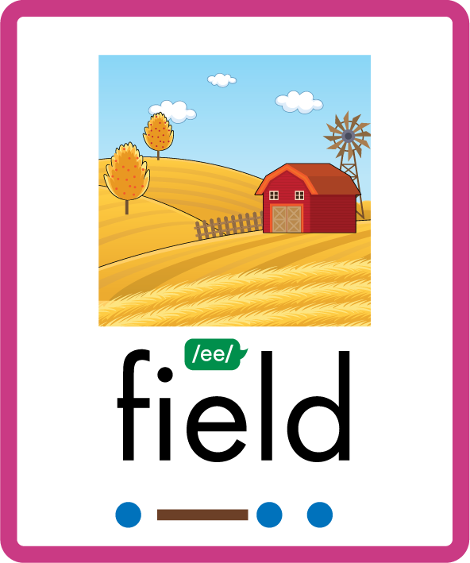

Learn and practise /ee/ sound family spelling patterns.
Recall all GPCs learned so far using flashcards.
Recall Phase 3 Common Exception Words push they me we be he she my by looked you are there here were all sure.
Grapheme to Phoneme Cards
Phoneme Frame Cards
Alien Word Cards
JN686
JN689
JN692

Slide 3























Recall all GPCs learned so far using flashcards.

Slide 4





























Recall all GPCs learned so far using flashcards.

Slide 5








































Recall all GPCs learned so far using flashcards.

Slide 6




Recall all GPCs learned so far using flashcards.

Slide 7














Review Phase 2 Common Exception Words as I is no go to into the put his has of pull full.

Slide 8














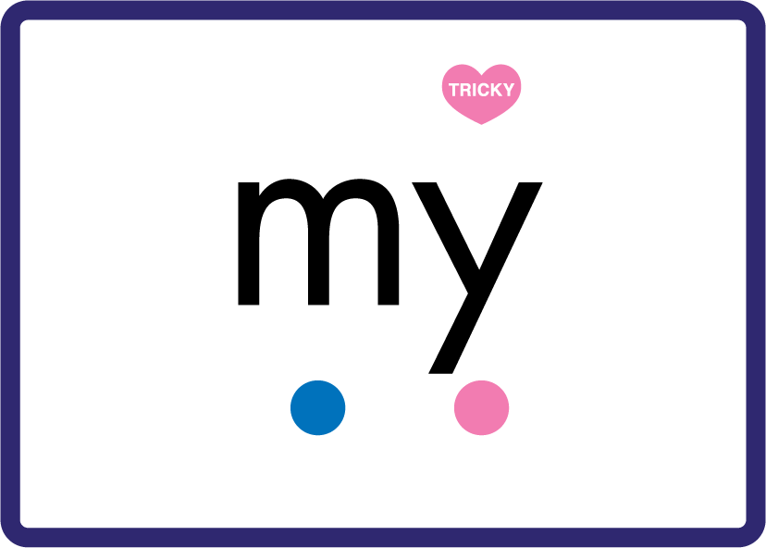













Review Phase 3 Common Exception Words push they me we be he she my by looked you are there here were all sure.

Slide 9













Review Phase 4 Common Exception Words said like out have some come what was so old do little one.

Slide 10














Review Phase 5 Common Exception Words today house mouse hour because Mr Mrs Ms where should could would move use.

Slide 11
Review Grapheme Caption
spied
tie
die
Phase 5, Lesson 3
USING JN686
FRONT

Slide 12
Teach Grapheme Caption
priest
thief
niece
Phase 5.5, Lesson 9
USING JN686
FRONT

Slide 13

Explain Decoding

Slide 14
Model Blending Phonemes
p
ie
c
e
USING SOUND BUTTONS
Sound Buttons
Vowel
Consonant
Consonant Digraph
Multi Sound
Long Vowel Sound
R-controlled Digraph
Split Digraph
Syllable / Silent Letter

Slide 15
Model Blending Phonemes
ch
ie
f
USING SOUND BUTTONS
Sound Buttons
Vowel
Consonant
Consonant Digraph
Multi Sound
Long Vowel Sound
R-controlled Digraph
Split Digraph
Syllable / Silent Letter

Slide 16

Explain Encoding

Slide 17
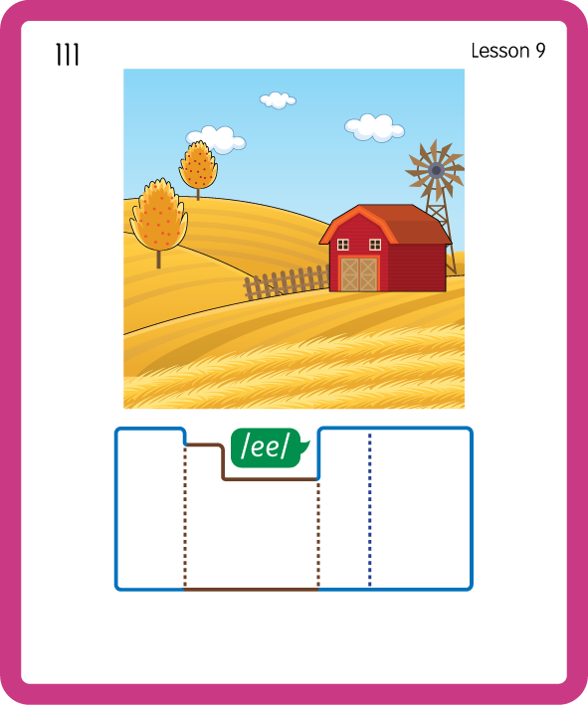
Build a Decodable Word
USING JN689
BACK

Slide 18

Build a Decodable Word
USING JN689
FRONT

Slide 19

Practise with Alien Words
USING JN692
BACK

Slide 20

Practise with Alien Words
USING JN692
FRONT

Slide 21

Practise Building Words
PRACTISE – 10MINS
ch
ie
f
b
r
p
c
e
n
g
k
l
d
th
sh
USING MAGNETIC LETTERS AND A WHITEBOARD
LAYOUT B

Slide 22
Practise Building Words
PRACTISE – 10MINS
ch
ie
f
b
r
p
c
e
n
g
k
l
d
th
sh
chief brief piece niece grief field tier shriek
USING MAGNETIC LETTERS AND A WHITEBOARD
LAYOUT B

