Slide 1
-s and -es |  |  |  | -ing
-ed |  |  |  | -er
-est |  |  |  | un-
-s suffix (plural)
Lesson 1

Slide 2
Learn and practise suffix -s.
Recall all GPCs learned so far using flashcards.
Recall Phase 5 Common Exception Words today house mouse hour because Mr Mrs Ms where should could would move use want.

Slide 3























Recall all GPCs learned so far using flashcards.

Slide 4






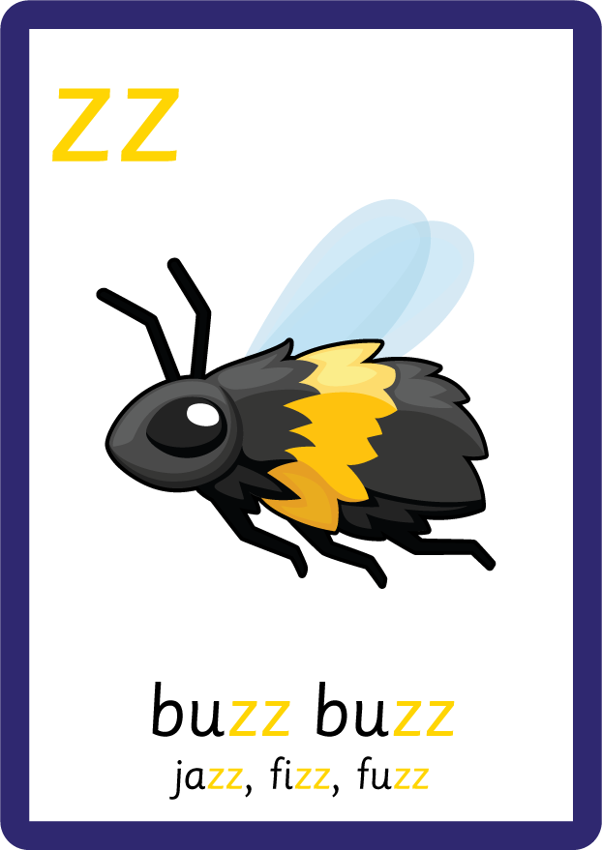











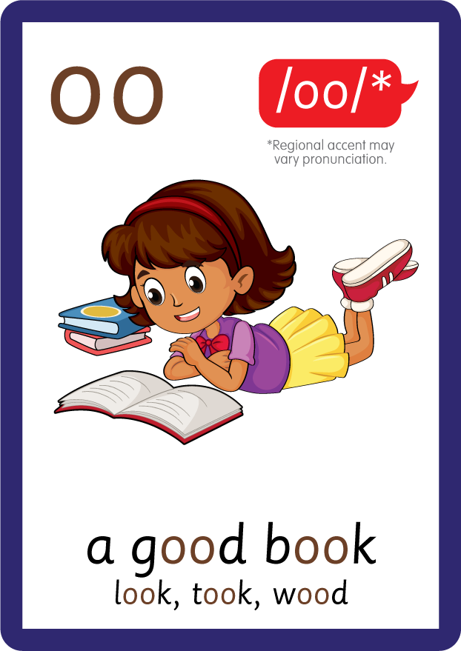









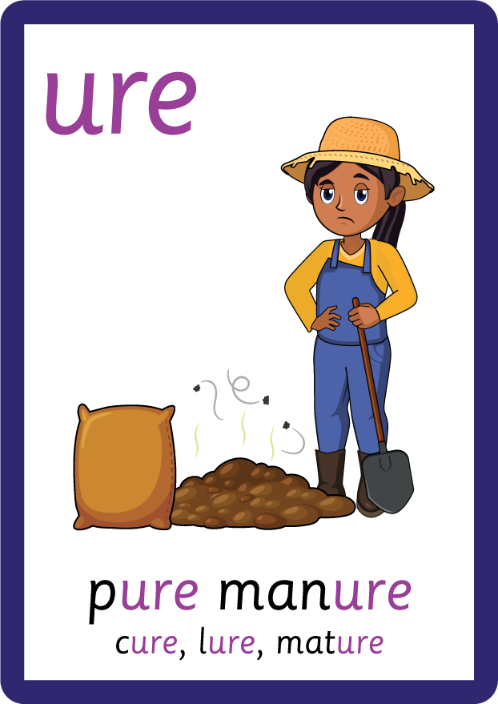
Recall all GPCs learned so far using flashcards.

Slide 5


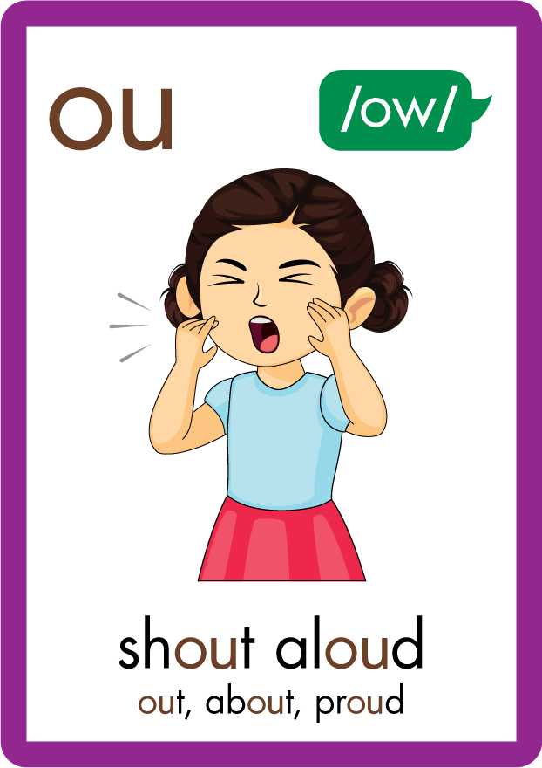







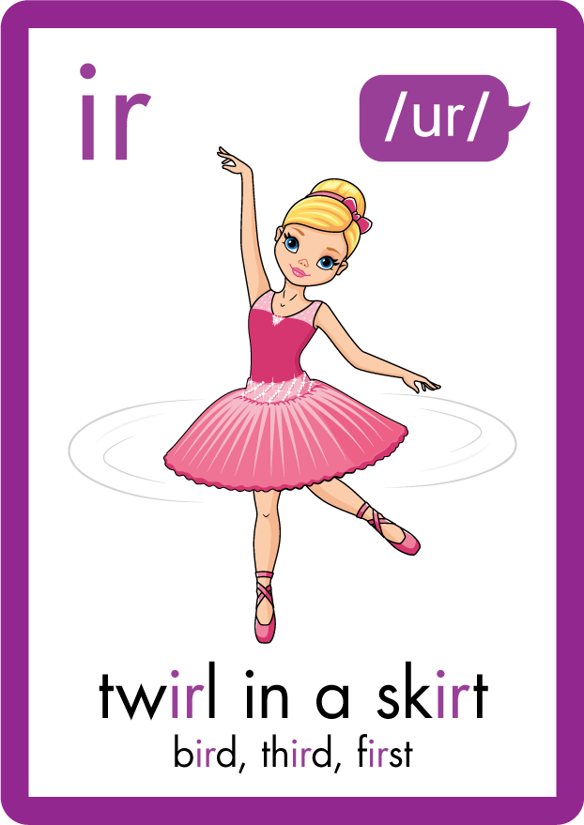
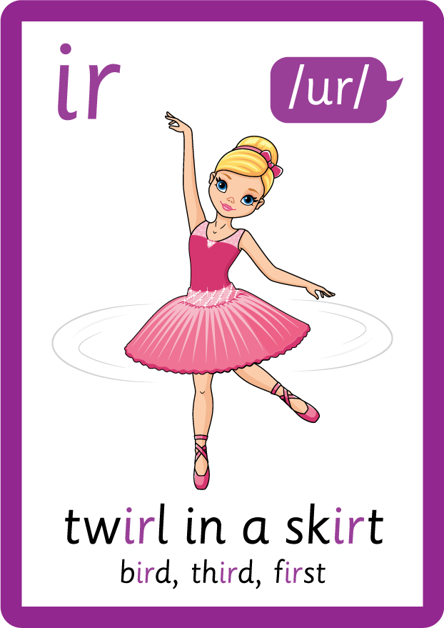








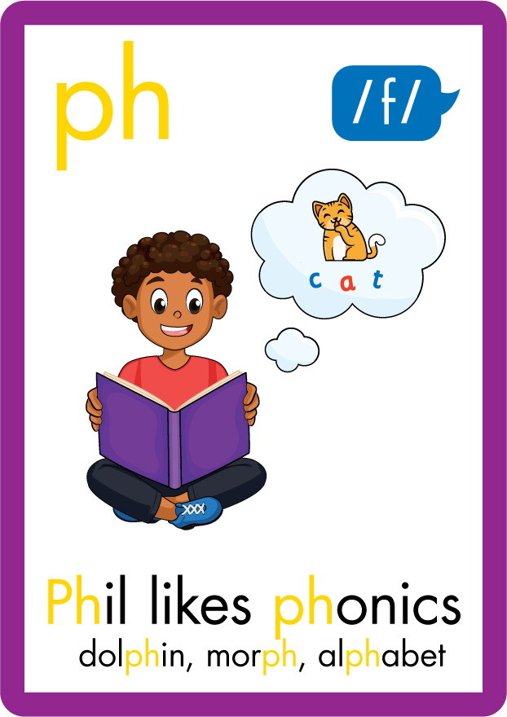



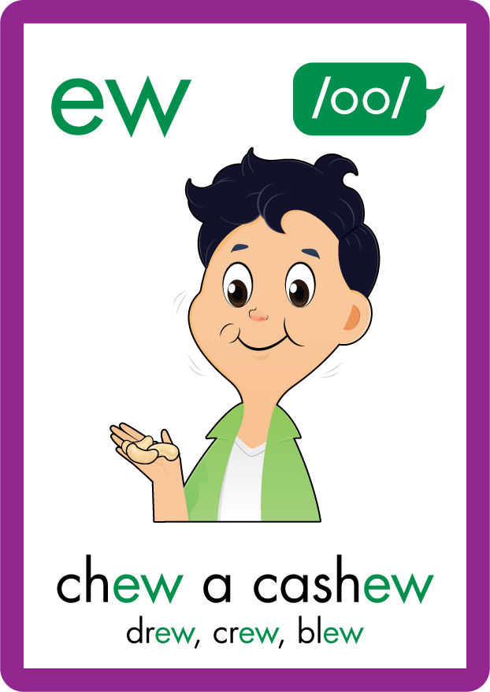





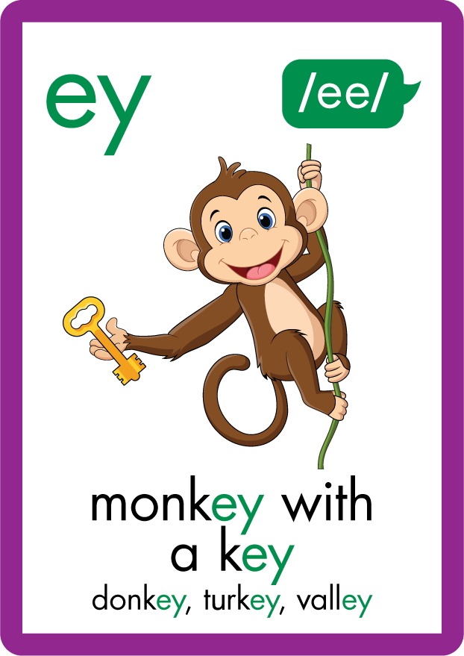
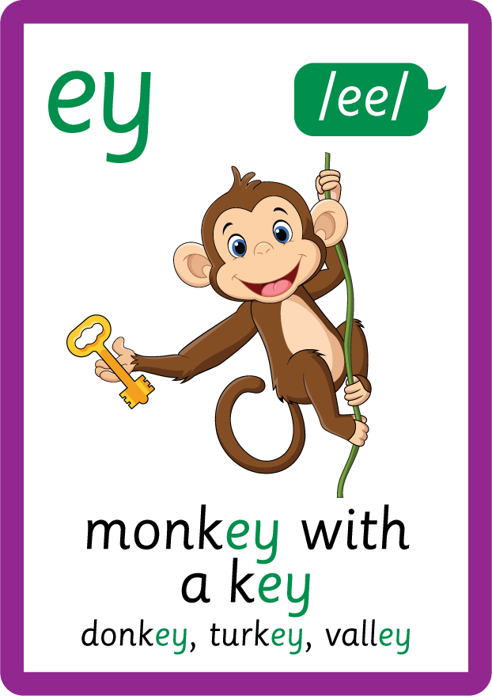


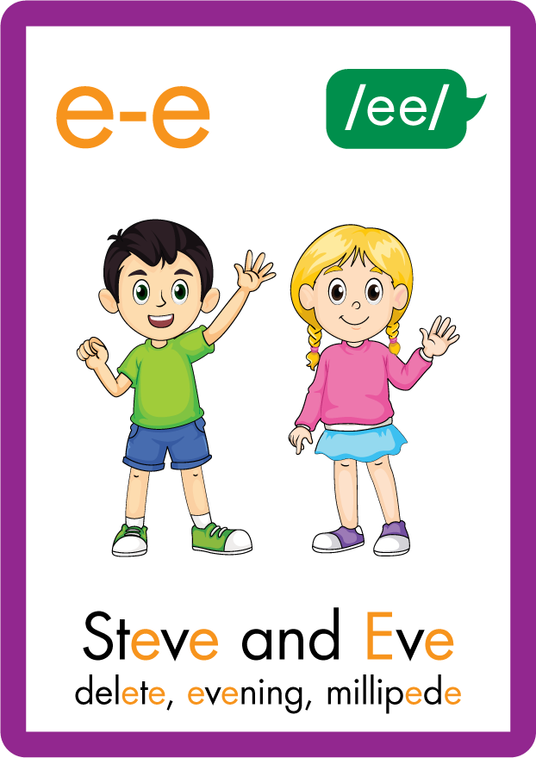






Recall all GPCs learned so far using flashcards.

Slide 6
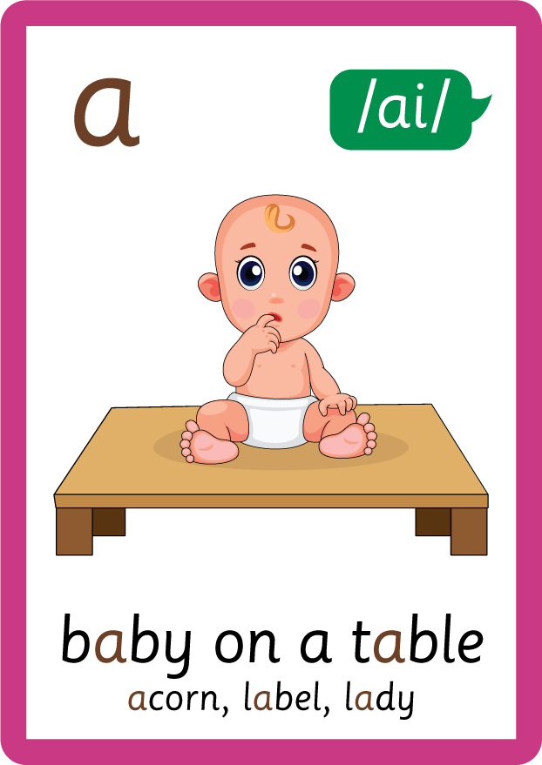



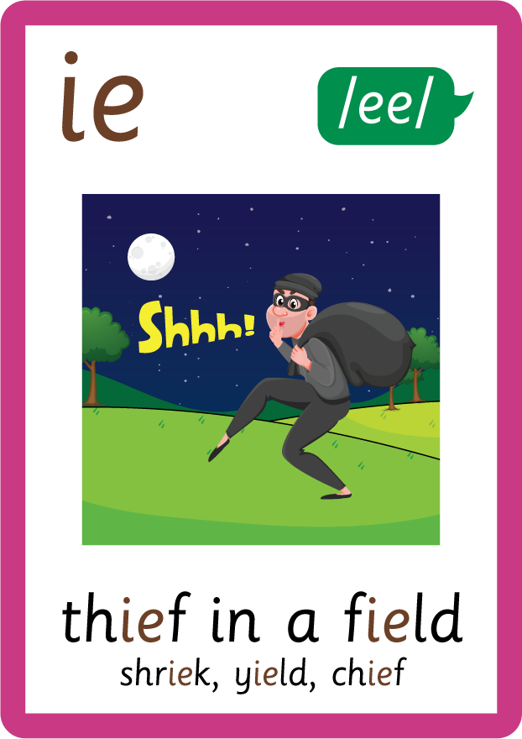
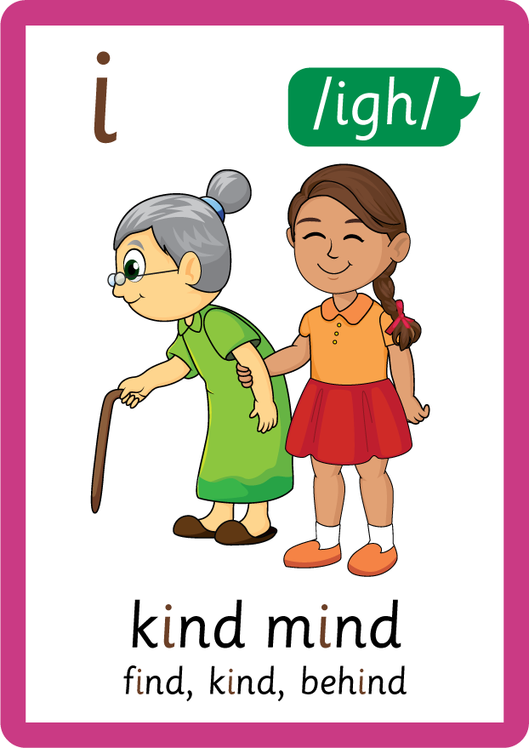






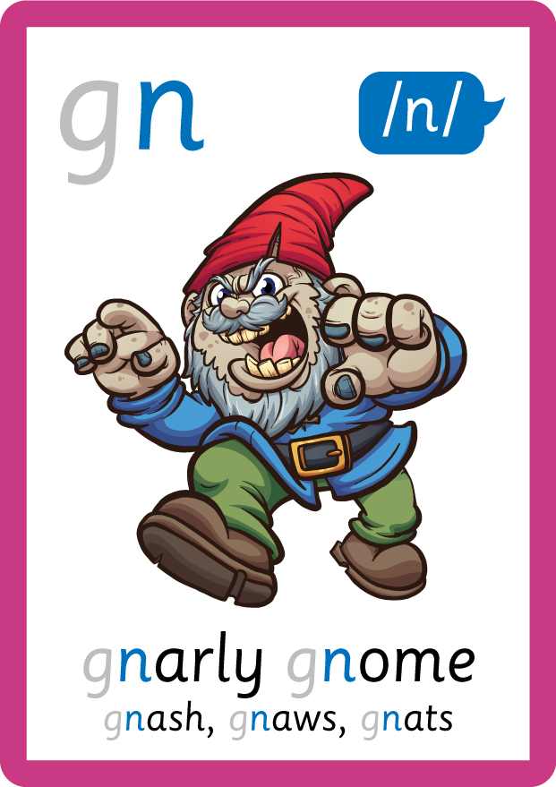
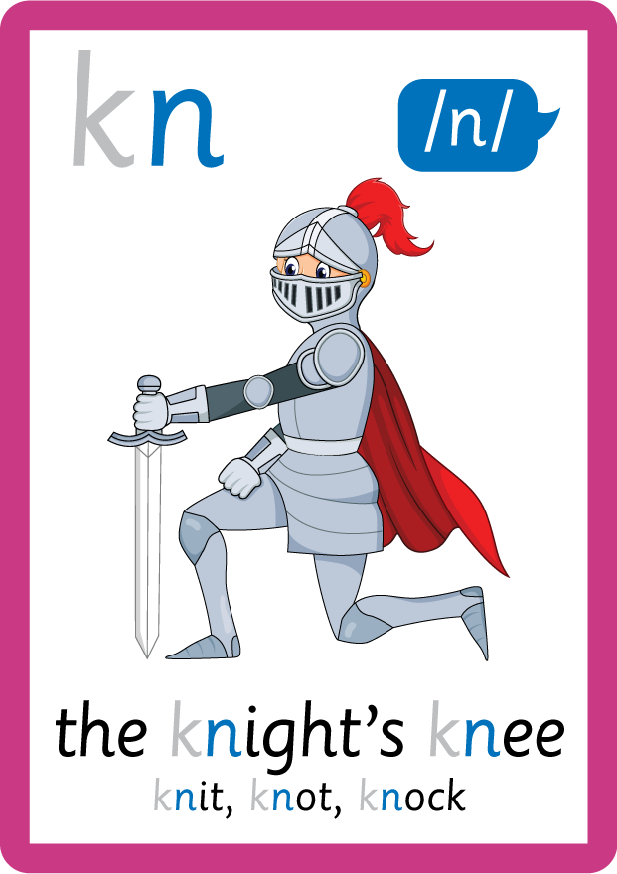

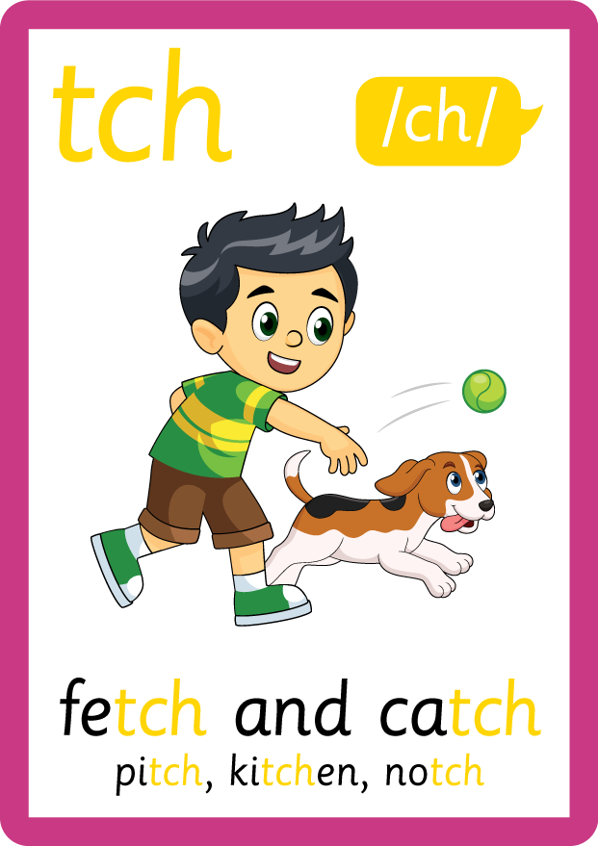
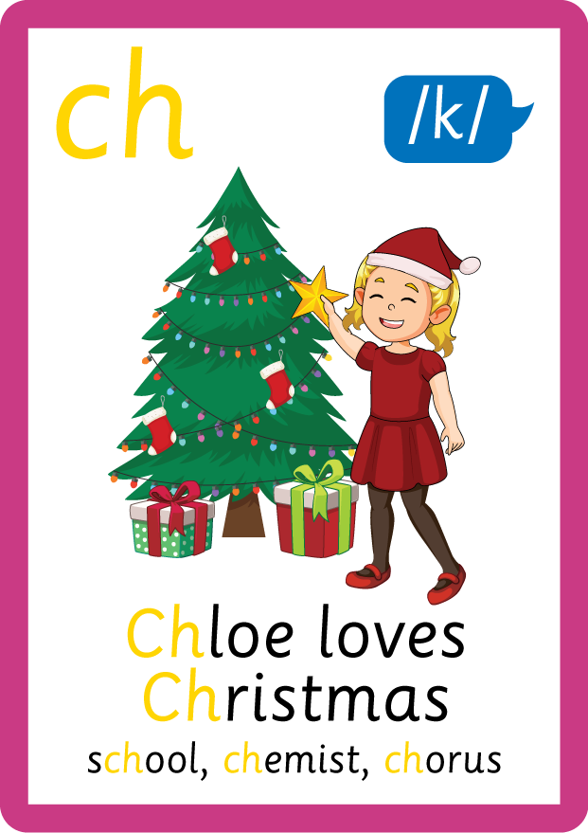
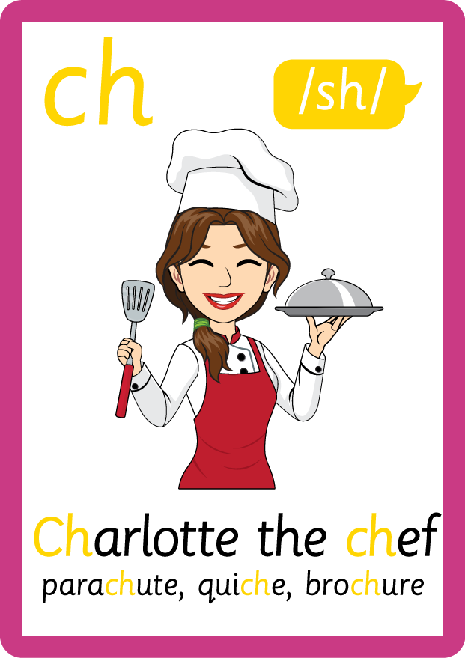
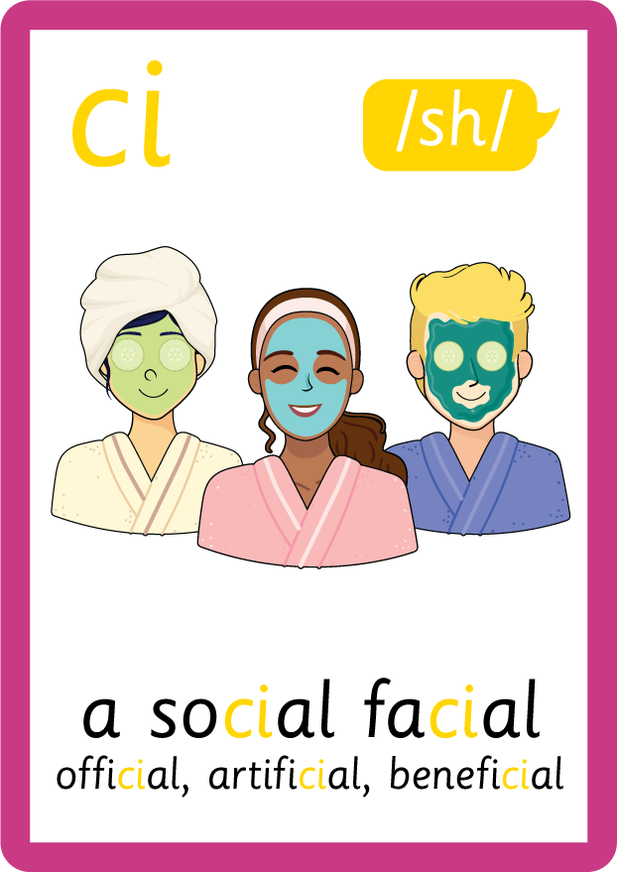





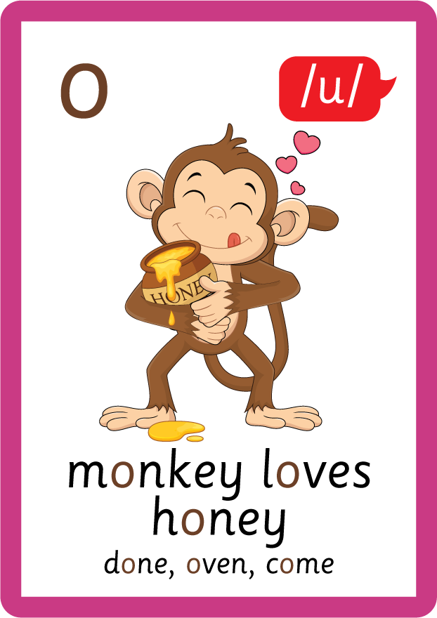
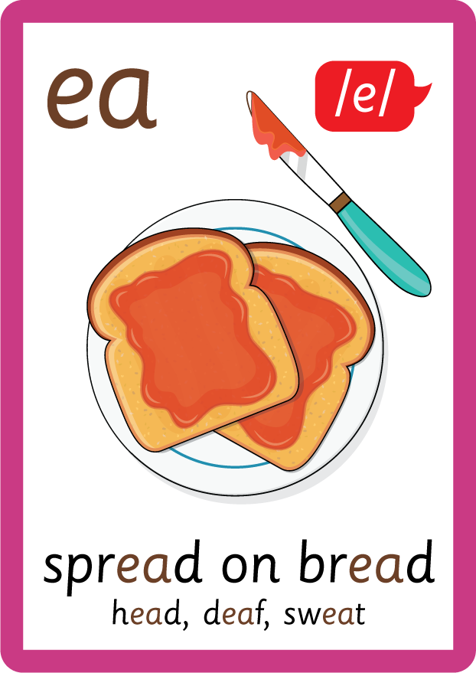




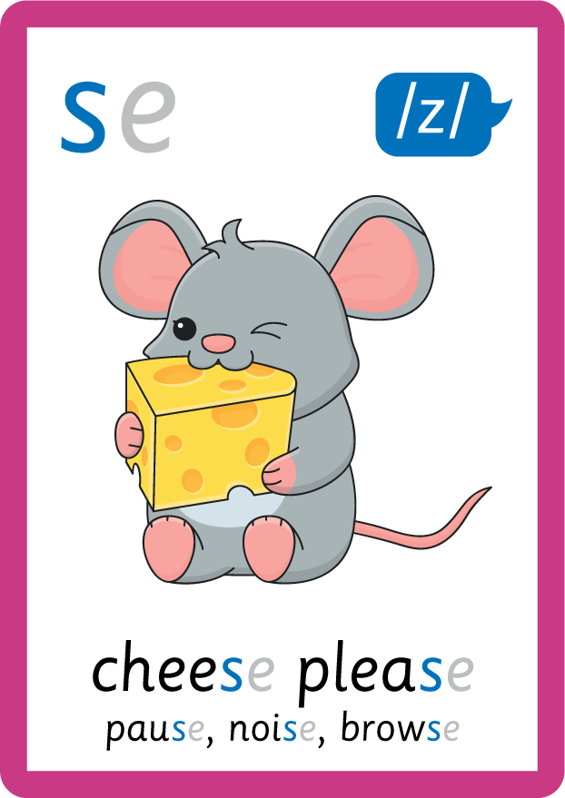
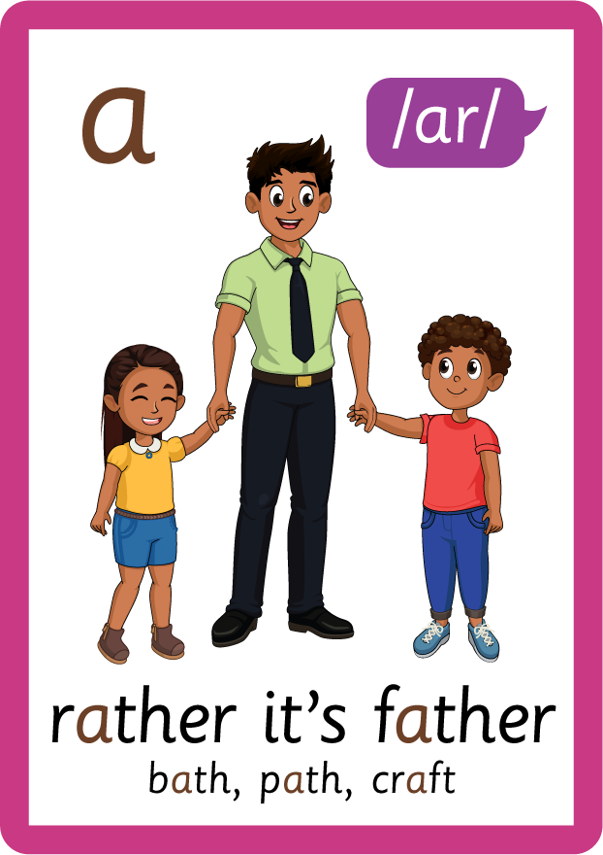


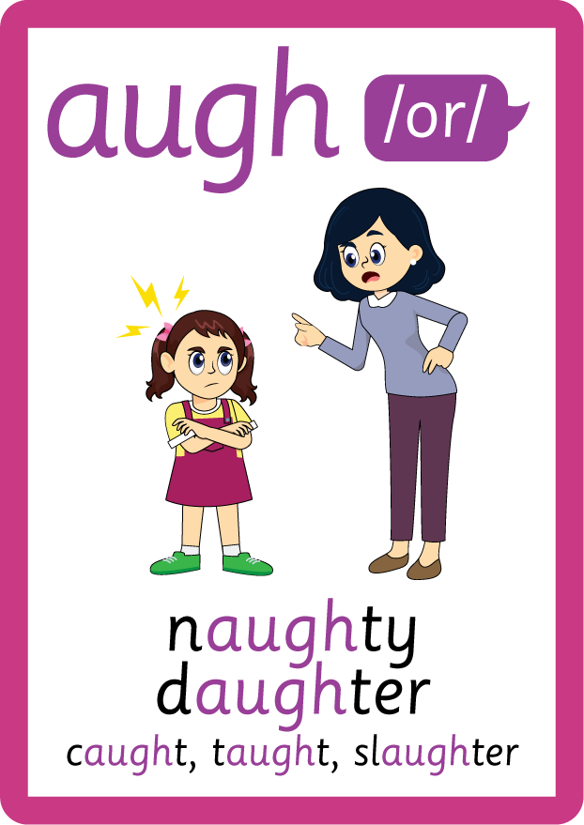
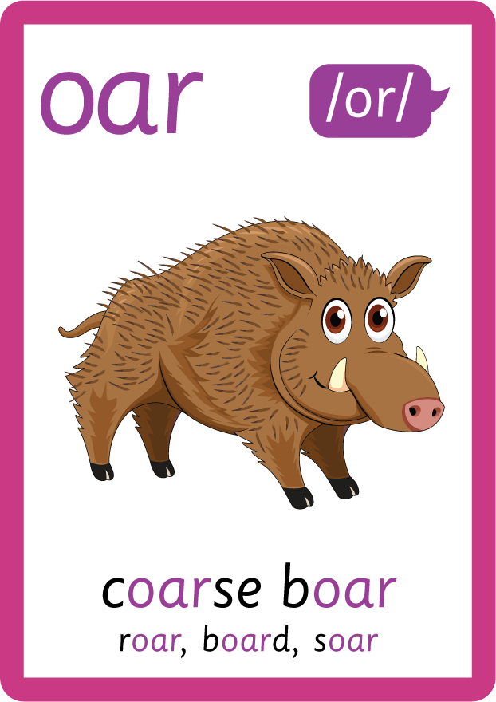

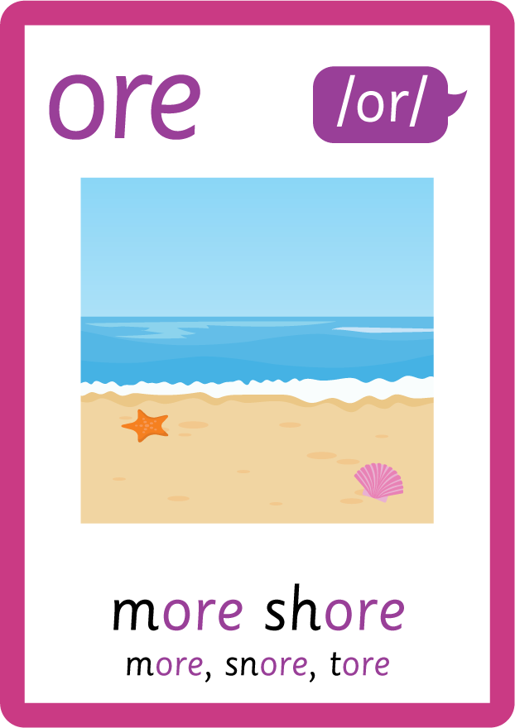


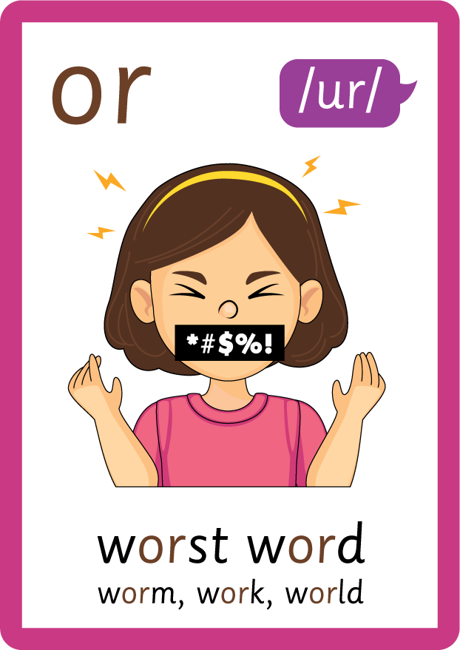

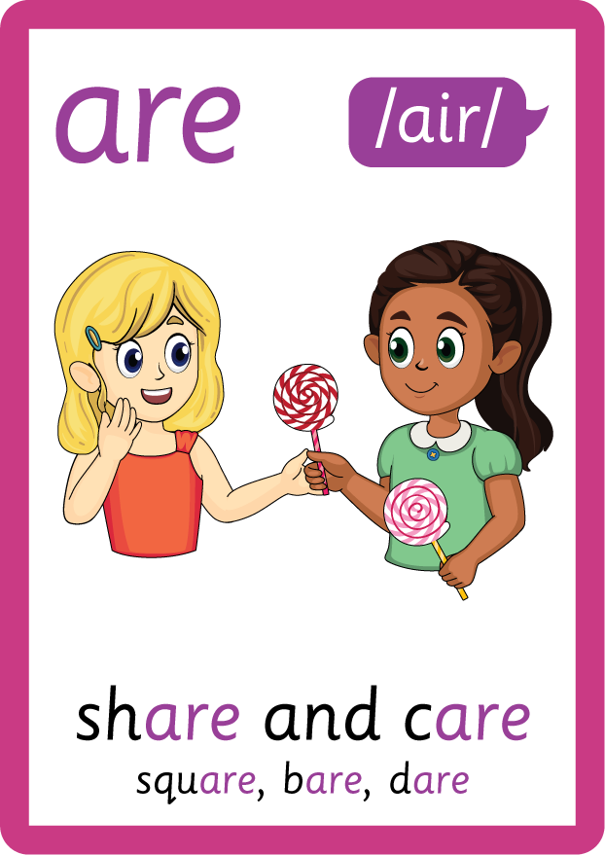
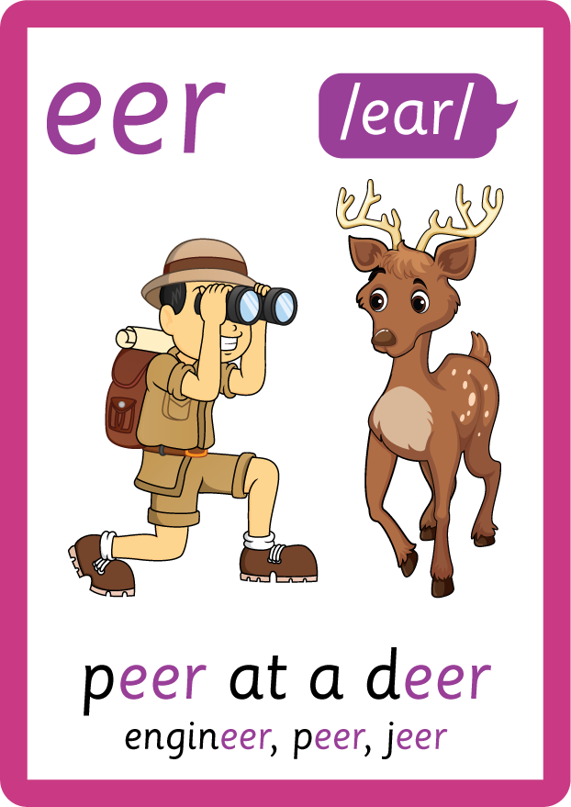

Recall all GPCs learned so far using flashcards.

Slide 7

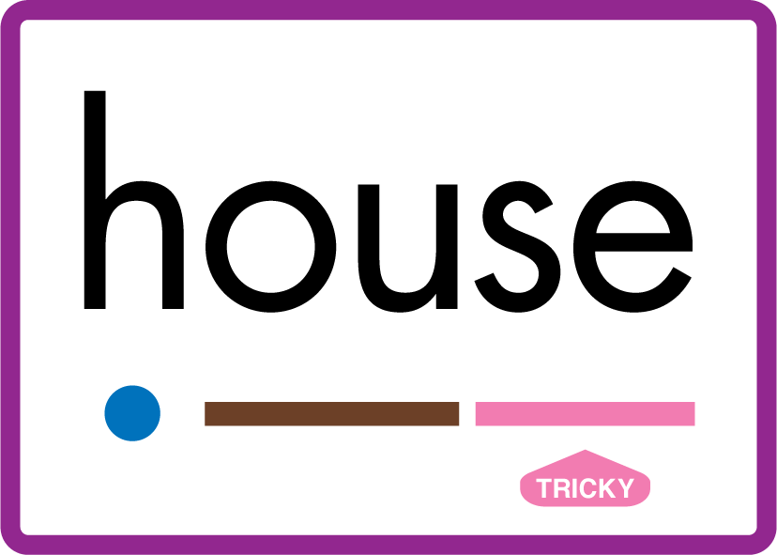

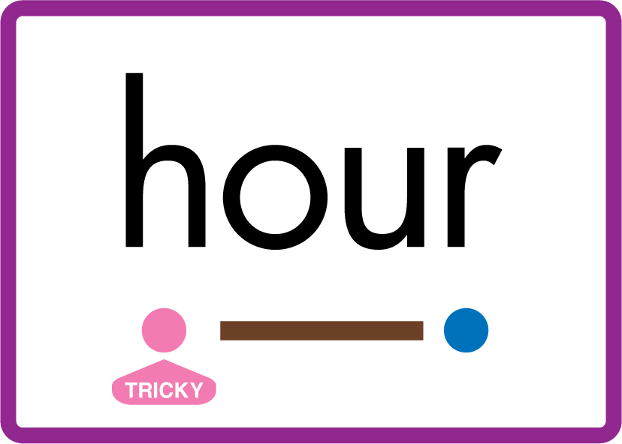










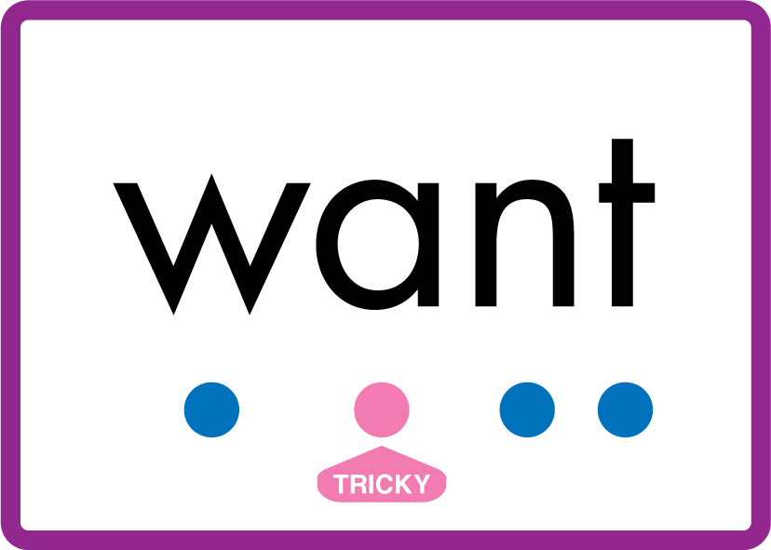
Review Phase 5 Common Exception Words today house mouse hour because Mr Mrs Ms where should could would move use want.

Slide 8
Teach Suffix Rule
When suffix -s is added to the end of a noun, it changes from singular to plural form.

Slide 9
Demonstrate Using Examples
one cup
add suffix -s to make plural form
two cups

Slide 10
Demonstrate Using Examples
one hat
add suffix -s to make plural form
two hats

Slide 11
Demonstrate Using Examples
one bird
add suffix -s to make plural form
two birds

Slide 12

Explain Decoding

Slide 13
Model Blending Phonemes
1
c
u
p
USING SOUND BUTTONS
Sound Buttons
Vowel
Consonant
Consonant Digraph
Long Vowel Sound
R-controlled Digraph
Split Digraph
Syllable / Silent Letter

Slide 14
Model Blending Phonemes
2
c
u
p
s
USING SOUND BUTTONS
Sound Buttons
Vowel
Consonant
Consonant Digraph
Long Vowel Sound
R-controlled Digraph
Split Digraph
Syllable / Silent Letter

Slide 15

Explain Encoding

Slide 16


Practise Adding Affixes
PRACTISE – 10MINS
c
u
p
USING A PHONEME FRAME

Slide 17
Practise Adding Affixes
PRACTISE – 10MINS
c
u
p
s
USING A PHONEME FRAME

Slide 18
Practise Building Words
PRACTISE – 10MINS
c
a
t
s
k
ey
d
o
g
b
p
i
l
r
f
USING MAGNETIC LETTERS AND A WHITEBOARD

Slide 19
Practise Building Words
PRACTISE – 10MINS
c
a
t
s
k
ey
d
o
g
b
p
i
l
r
f
cats keys dogs bats pigs logs rats frogs
USING MAGNETIC LETTERS AND A WHITEBOARD

