Slide 1
-s and -es |  |  |  | -ing
-ed |  |  |  | -er
-est |  |  |  | un-
-ed suffix (past tense)
Lesson 11

Slide 2
Learn and practise suffix -ed.
Recall all GPCs learned so far using flashcards.
Recall Phase 5 Common Exception Words today house mouse hour because Mr Mrs Ms where should could would move use want.

Slide 3























Recall all GPCs learned so far using flashcards.

Slide 4





























Recall all GPCs learned so far using flashcards.

Slide 5









































Recall all GPCs learned so far using flashcards.

Slide 6
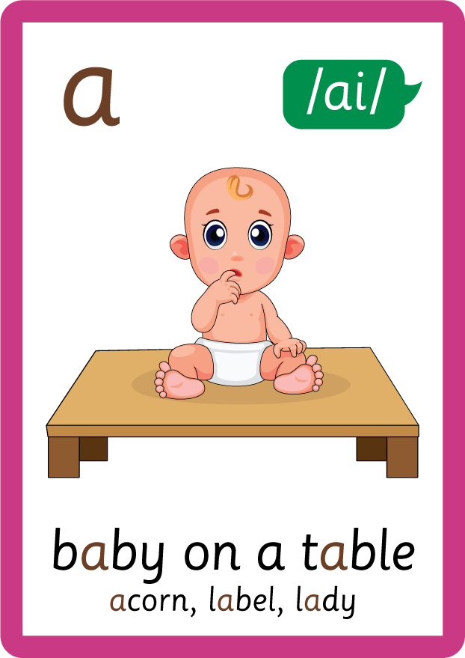







































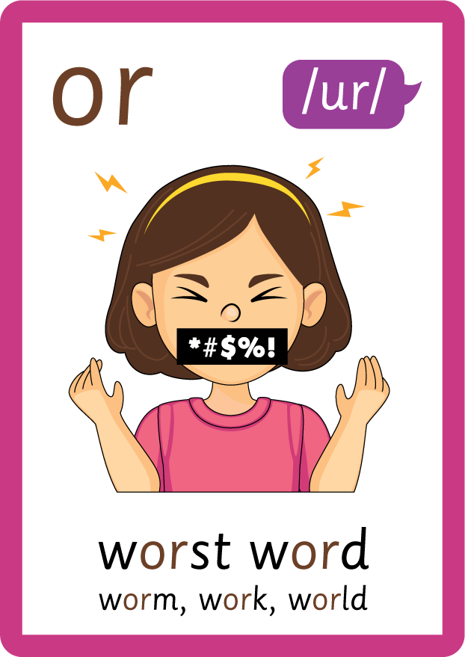




Recall all GPCs learned so far using flashcards.

Slide 7















Review Phase 5 Common Exception Words today house mouse hour because Mr Mrs Ms where should could would move use want.

Slide 8
Teach Suffix Rule
When suffix -ed is added to the end of a verb, the verb changes to past tense form.

Slide 9
Demonstrate Using Examples
jump
add suffix -ed
jumped

Slide 10

Explain Decoding

Slide 11
Model Blending Phonemes
j
u
m
p
USING SOUND BUTTONS
Sound Buttons
Vowel
Consonant
Consonant Digraph
Multi Sound
Long Vowel Sound
R-controlled Digraph
Split Digraph
Syllable / Silent Letter

Slide 12
Model Blending Phonemes
j
u
m
p
e
d
/t/
USING SOUND BUTTONS
Sound Buttons
Vowel
Consonant
Consonant Digraph
Multi Sound
Long Vowel Sound
R-controlled Digraph
Split Digraph
Syllable / Silent Letter

Slide 13
Model Blending Phonemes
p
u
sh
USING SOUND BUTTONS
Sound Buttons
Vowel
Consonant
Consonant Digraph
Multi Sound
Long Vowel Sound
R-controlled Digraph
Split Digraph
Syllable / Silent Letter

Slide 14
Model Blending Phonemes
p
u
sh
e
d
/t/
USING SOUND BUTTONS
Sound Buttons
Vowel
Consonant
Consonant Digraph
Multi Sound
Long Vowel Sound
R-controlled Digraph
Split Digraph
Syllable / Silent Letter

Slide 15

Explain Encoding

Slide 16


Practise Adding Affixes
PRACTISE – 10MINS
s
t
o
p
USING A PHONEME FRAME

Slide 17
Practise Adding Affixes
PRACTISE – 10MINS
s
t
o
p
p
ed
USING A PHONEME FRAME

Slide 18
Practise Building Words
PRACTISE – 10MINS
w
a
n
t
e
d
sh
ou
s
or
USING MAGNETIC LETTERS AND A WHITEBOARD

Slide 19
Practise Building Words
PRACTISE – 10MINS
w
a
n
t
e
d
sh
ou
s
or
wanted shouted sorted
USING MAGNETIC LETTERS AND A WHITEBOARD

