Slide 1
-s and -es |  |  |  | -ing
-ed |  |  |  | -er
-est |  |  |  | un-
-ed suffix (double consonant)
Lesson 12

Slide 2
Learn and practise suffix -ed.
Recall all GPCs learned so far using flashcards.
Recall Phase 5 Common Exception Words today house mouse hour because Mr Mrs Ms where should could would move use want.

Slide 3























Recall all GPCs learned so far using flashcards.

Slide 4





























Recall all GPCs learned so far using flashcards.

Slide 5










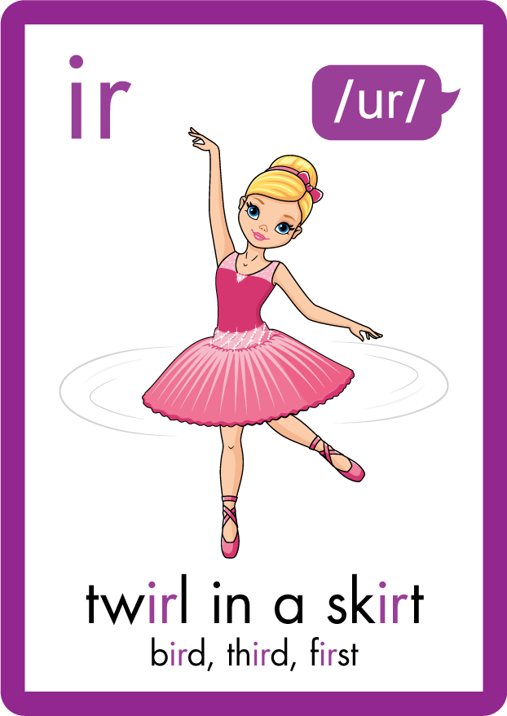













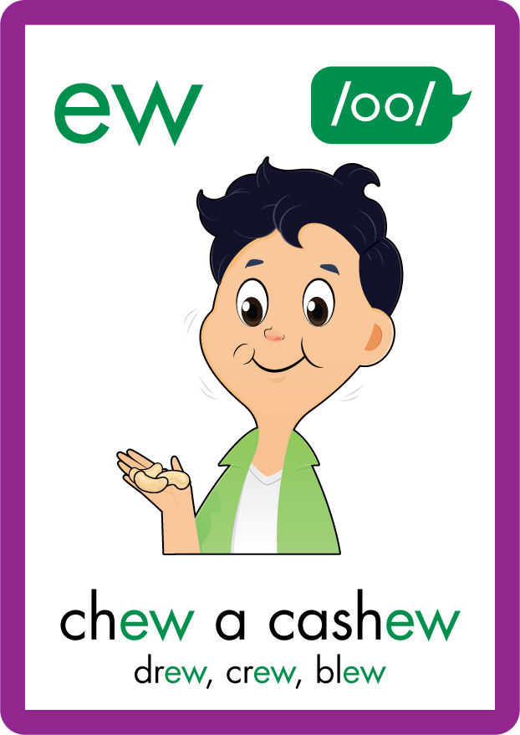
















Recall all GPCs learned so far using flashcards.

Slide 6
















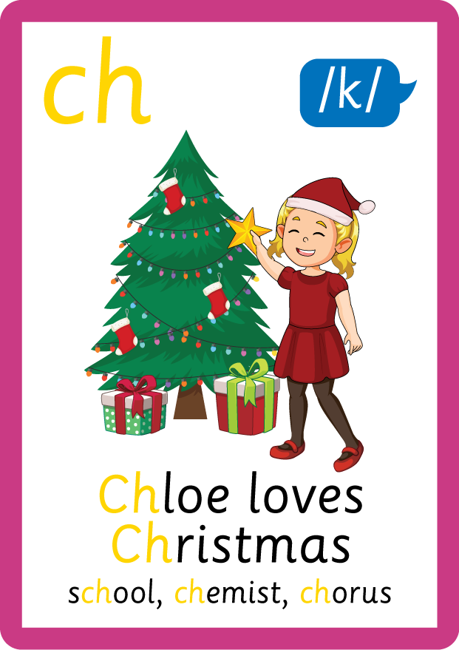














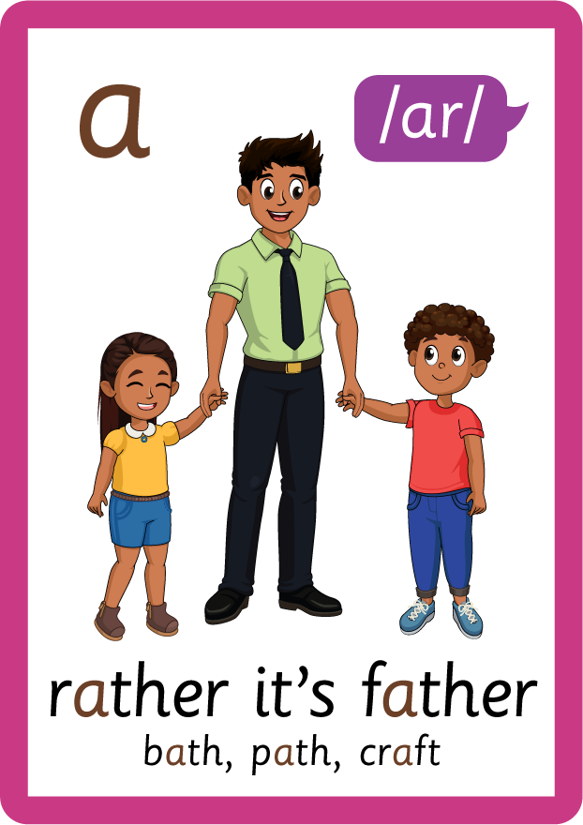








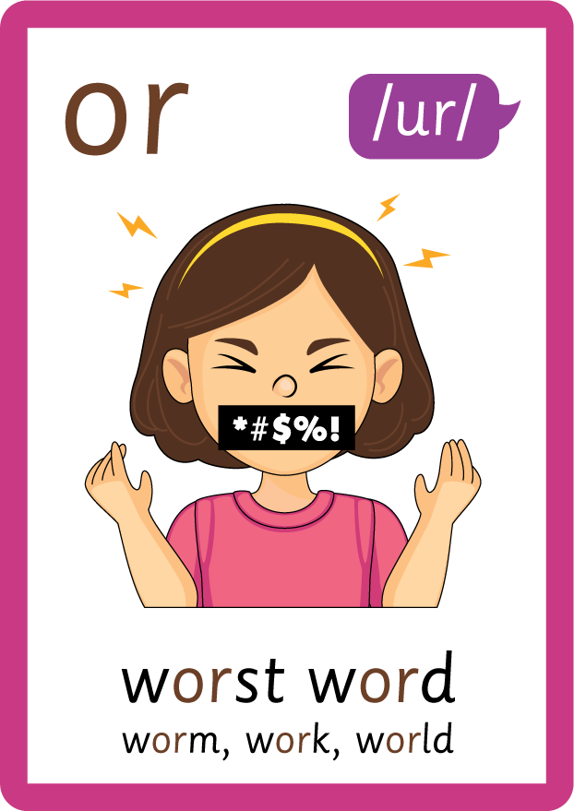


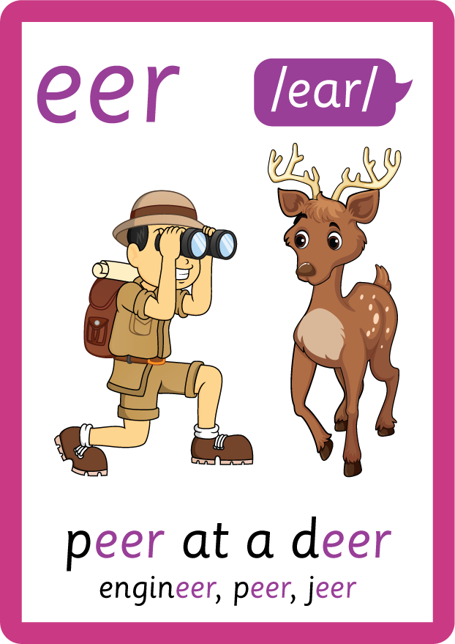

Recall all GPCs learned so far using flashcards.

Slide 7















Review Phase 5 Common Exception Words today house mouse hour because Mr Mrs Ms where should could would move use want.

Slide 8
Teach Suffix Rule
When suffix -ed is added to the end of a verb, the verb changes to past tense form.
Spelling Rule: When the root word ends in a short vowel followed by a consonant, the consonant is doubled and -ed is added.

Slide 9
Demonstrate Using Examples
I hop.
double consonant and add suffix -ed
I hopped.

Slide 10
Demonstrate Using Examples
I skip.
double consonant and add suffix -ed
I skipped.

Slide 11
Demonstrate Using Examples
I clap.
double consonant and add suffix -ed
I clapped.

Slide 12

Explain Decoding

Slide 13
Model Blending Phonemes
h
o
p
USING SOUND BUTTONS
Sound Buttons
Vowel
Consonant
Consonant Digraph
Multi Sound
Long Vowel Sound
R-controlled Digraph
Split Digraph
Syllable / Silent Letter

Slide 14
Model Blending Phonemes
h
o
p
p
e
d
/t/
USING SOUND BUTTONS
Sound Buttons
Vowel
Consonant
Consonant Digraph
Multi Sound
Long Vowel Sound
R-controlled Digraph
Split Digraph
Syllable / Silent Letter

Slide 15
Model Blending Phonemes
s
k
i
p
USING SOUND BUTTONS
Sound Buttons
Vowel
Consonant
Consonant Digraph
Multi Sound
Long Vowel Sound
R-controlled Digraph
Split Digraph
Syllable / Silent Letter

Slide 16
Model Blending Phonemes
s
k
i
p
p
e
d
/t/
USING SOUND BUTTONS
Sound Buttons
Vowel
Consonant
Consonant Digraph
Multi Sound
Long Vowel Sound
R-controlled Digraph
Split Digraph
Syllable / Silent Letter

Slide 17

Explain Encoding

Slide 18


Practise Adding Affixes
PRACTISE – 10MINS
c
l
a
p
USING A PHONEME FRAME

Slide 19
Practise Adding Affixes
PRACTISE – 10MINS
c
l
a
p
p
ed
USING A PHONEME FRAME

Slide 20
Practise Building Words
PRACTISE – 10MINS
n
o
d
d
e
d
r
p
p
h
t
i
USING MAGNETIC LETTERS AND A WHITEBOARD

Slide 21
Practise Building Words
PRACTISE – 10MINS
n
o
d
d
e
d
r
p
p
h
t
i
nodded dropped hopped tipped
USING MAGNETIC LETTERS AND A WHITEBOARD

