Slide 1
-s and -es |  |  |  | -ing
-ed |  |  |  | -er
-est |  |  |  | un-
-ed suffix (drop y, add i)
Lesson 13

Slide 2
Learn and practise suffix -ed.
Recall all GPCs learned so far using flashcards.
Recall Phase 5 Common Exception Words today house mouse hour because Mr Mrs Ms where should could would move use want.

Slide 3























Recall all GPCs learned so far using flashcards.

Slide 4





























Recall all GPCs learned so far using flashcards.

Slide 5









































Recall all GPCs learned so far using flashcards.

Slide 6































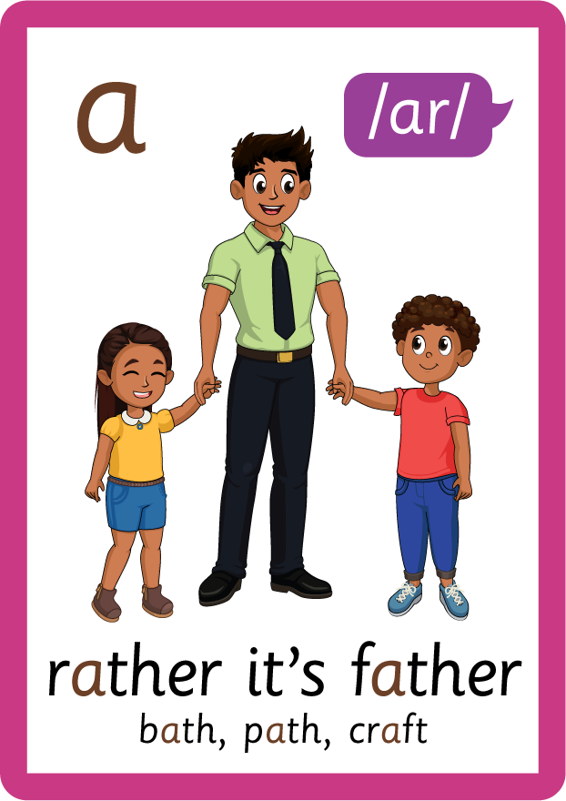








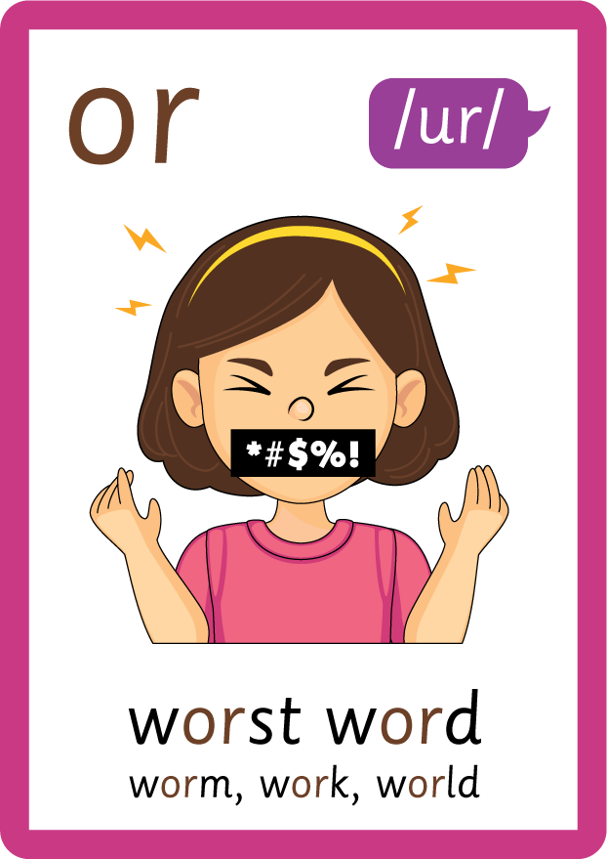




Recall all GPCs learned so far using flashcards.

Slide 7















Review Phase 5 Common Exception Words today house mouse hour because Mr Mrs Ms where should could would move use want.

Slide 8
Teach Suffix Rule
When suffix -ed is added to the end of a verb, the verb changes to past tense form.
Spelling Rule: When the root word ends in letter ‘y’, the ‘y’ is changed to an ‘i’ and the suffix -ed is added.

Slide 9
Demonstrate Using Examples
I try.
drop ‘y’ and add ‘i’, then add suffix -ed
I tried.

Slide 10
Demonstrate Using Examples
I cry.
drop ‘y’ and add ‘i’, then add suffix -ed
I cried.

Slide 11
Demonstrate Using Examples
I worry.
drop ‘y’ and add ‘i’, then add suffix -ed
I worried.

Slide 12

Explain Decoding

Slide 13
Model Blending Phonemes
t
r
y
USING SOUND BUTTONS
Sound Buttons
Vowel
Consonant
Consonant Digraph
Multi Sound
Long Vowel Sound
R-controlled Digraph
Split Digraph
Syllable / Silent Letter

Slide 14
Model Blending Phonemes
t
r
i
e
d
/d/
USING SOUND BUTTONS
Sound Buttons
Vowel
Consonant
Consonant Digraph
Multi Sound
Long Vowel Sound
R-controlled Digraph
Split Digraph
Syllable / Silent Letter

Slide 15
Model Blending Phonemes
c
r
y
USING SOUND BUTTONS
Sound Buttons
Vowel
Consonant
Consonant Digraph
Multi Sound
Long Vowel Sound
R-controlled Digraph
Split Digraph
Syllable / Silent Letter

Slide 16
Model Blending Phonemes
c
r
i
e
d
/d/
USING SOUND BUTTONS
Sound Buttons
Vowel
Consonant
Consonant Digraph
Multi Sound
Long Vowel Sound
R-controlled Digraph
Split Digraph
Syllable / Silent Letter

Slide 17

Explain Encoding

Slide 18


Practise Adding Affixes
PRACTISE – 10MINS
w
or
r
y
USING A PHONEME FRAME

Slide 19
Practise Adding Affixes
PRACTISE – 10MINS
w
or
r
i
ed
USING A PHONEME FRAME

Slide 20
Practise Building Words
PRACTISE – 10MINS
f
l
ie
d
c
r
s
u
p
p
USING MAGNETIC LETTERS AND A WHITEBOARD

Slide 21
Practise Building Words
PRACTISE – 10MINS
f
l
ie
d
c
r
s
u
p
p
flies cried fried supplied
USING MAGNETIC LETTERS AND A WHITEBOARD

