Slide 1
-s and -es |  |  |  | -ing
-ed |  |  |  | -er
-est |  |  |  | un-
-ed suffix (drop e)
Lesson 14

Slide 2
Learn and practise suffix -ed.
Recall all GPCs learned so far using flashcards.
Recall Phase 5 Common Exception Words today house mouse hour because Mr Mrs Ms where should could would move use want.

Slide 3























Recall all GPCs learned so far using flashcards.

Slide 4





























Recall all GPCs learned so far using flashcards.

Slide 5









































Recall all GPCs learned so far using flashcards.

Slide 6








































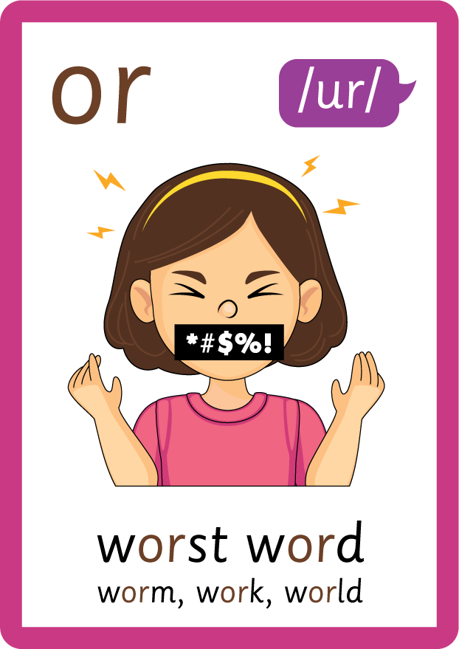




Recall all GPCs learned so far using flashcards.

Slide 7















Review Phase 5 Common Exception Words today house mouse hour because Mr Mrs Ms where should could would move use want.

Slide 8
Teach Suffix Rule
When suffix -ed is added to the end of a verb, the verb changes to past tense form.
Spelling Rule: When the root word ends in letter ‘e’, 'e' is removed and the suffix -ed is added.

Slide 9
Demonstrate Using Examples
I like.
drop ‘e’ and add -ed
I liked.

Slide 10
Demonstrate Using Examples
I race.
drop ‘e’ and add -ed
I raced.

Slide 11
Demonstrate Using Examples
I trade.
drop ‘e’ and add -ed
I traded.

Slide 12

Explain Decoding

Slide 13
Model Blending Phonemes
t
r
a
d
e
USING SOUND BUTTONS
Sound Buttons
Vowel
Consonant
Consonant Digraph
Multi Sound
Long Vowel Sound
R-controlled Digraph
Split Digraph
Syllable / Silent Letter

Slide 14
Model Blending Phonemes
t
r
a
d
e
d
/d/
USING SOUND BUTTONS
Sound Buttons
Vowel
Consonant
Consonant Digraph
Multi Sound
Long Vowel Sound
R-controlled Digraph
Split Digraph
Syllable / Silent Letter

Slide 15
Model Blending Phonemes
d
a
n
c
e
USING SOUND BUTTONS
Sound Buttons
Vowel
Consonant
Consonant Digraph
Multi Sound
Long Vowel Sound
R-controlled Digraph
Split Digraph
Syllable / Silent Letter

Slide 16
Model Blending Phonemes
d
a
n
c
e
d
/t/
USING SOUND BUTTONS
Sound Buttons
Vowel
Consonant
Consonant Digraph
Multi Sound
Long Vowel Sound
R-controlled Digraph
Split Digraph
Syllable / Silent Letter

Slide 17

Explain Encoding

Slide 18


Practise Adding Affixes
PRACTISE – 10MINS
t
r
a
d
e
USING A PHONEME FRAME

Slide 19
Practise Adding Affixes
PRACTISE – 10MINS
t
r
a
d
ed
USING A PHONEME FRAME

Slide 20
Practise Building Words
PRACTISE – 10MINS
s
a-e
v
d
h
t
r
d
r
k
USING MAGNETIC LETTERS AND A WHITEBOARD

Slide 21
Practise Building Words
PRACTISE – 10MINS
s
a-e
v
d
h
t
r
d
r
k
skated hated traded raked
USING MAGNETIC LETTERS AND A WHITEBOARD

