Slide 1
-s and -es |  |  |  | -ing
-ed |  |  |  | -er
-est |  |  |  | un-
-er suffix
(agent nouns)
Lesson 16

Slide 2
Learn and practise suffix -er.
Recall all GPCs learned so far using flashcards.
Recall Phase 5 Common Exception Words today house mouse hour because Mr Mrs Ms where should could would move use want.

Slide 3























Recall all GPCs learned so far using flashcards.

Slide 4





























Recall all GPCs learned so far using flashcards.

Slide 5









































Recall all GPCs learned so far using flashcards.

Slide 6
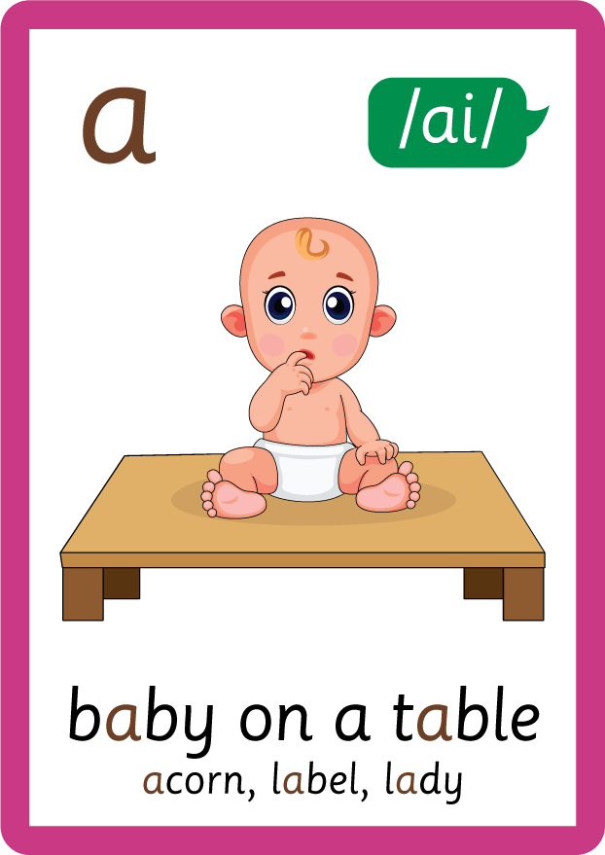























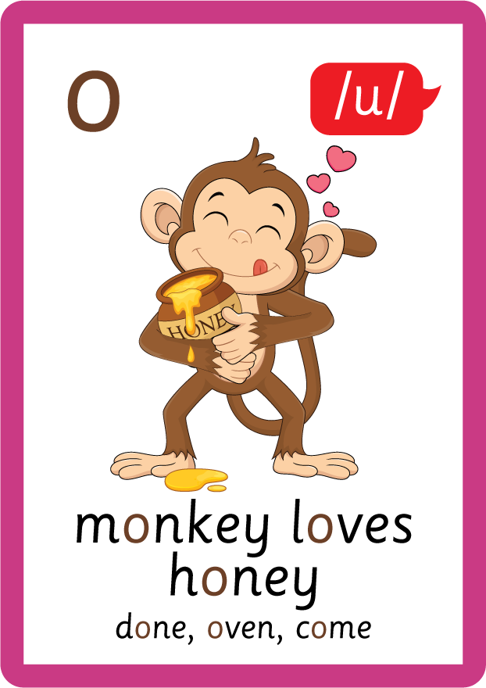









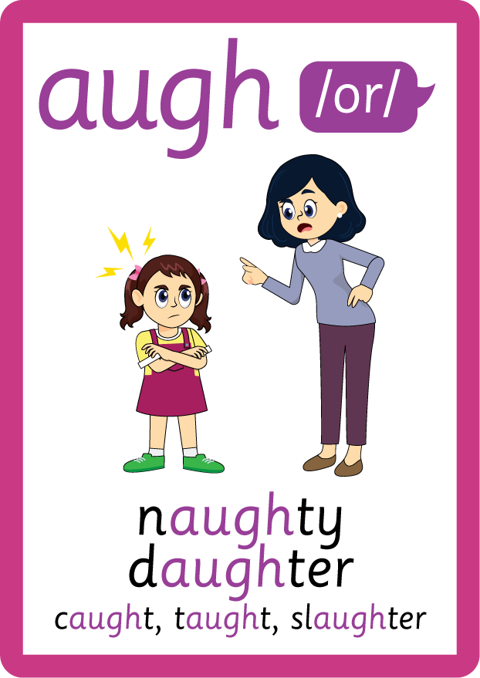





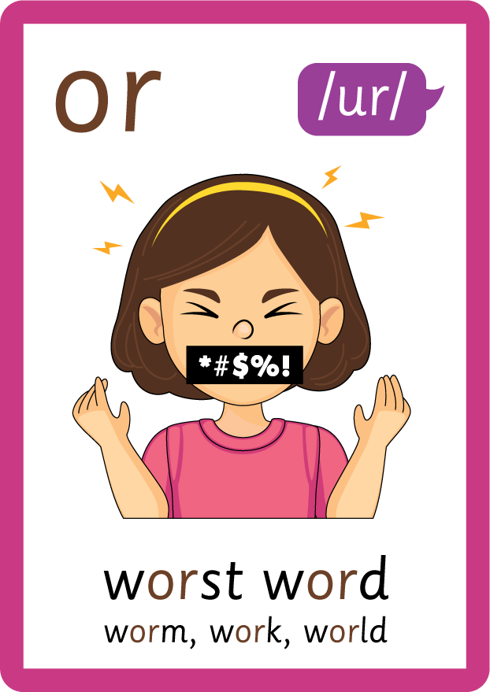




Recall all GPCs learned so far using flashcards.

Slide 7















Review Phase 5 Common Exception Words today house mouse hour because Mr Mrs Ms where should could would move use want.

Slide 8
Teach Suffix Rule
When suffix -er is added to the end of a noun, the noun changes to an agent noun.

Slide 9
Demonstrate Using Examples
read
add suffix -er
reader

Slide 10
Demonstrate Using Examples
speak
add suffix -er
speaker

Slide 11
Demonstrate Using Examples
teach
add suffix -er
teacher

Slide 12

Explain Decoding

Slide 13
Model Blending Phonemes
r
ea
d
USING SOUND BUTTONS
Sound Buttons
Vowel
Consonant
Consonant Digraph
Multi Sound
Long Vowel Sound
R-controlled Digraph
Split Digraph
Syllable / Silent Letter

Slide 14
Model Blending Phonemes
r
ea
d
er
USING SOUND BUTTONS
Sound Buttons
Vowel
Consonant
Consonant Digraph
Multi Sound
Long Vowel Sound
R-controlled Digraph
Split Digraph
Syllable / Silent Letter

Slide 15
Model Blending Phonemes
s
p
ea
k
USING SOUND BUTTONS
Sound Buttons
Vowel
Consonant
Consonant Digraph
Multi Sound
Long Vowel Sound
R-controlled Digraph
Split Digraph
Syllable / Silent Letter

Slide 16
Model Blending Phonemes
s
p
ea
k
er
USING SOUND BUTTONS
Sound Buttons
Vowel
Consonant
Consonant Digraph
Multi Sound
Long Vowel Sound
R-controlled Digraph
Split Digraph
Syllable / Silent Letter

Slide 17

Explain Encoding

Slide 18

Practise Adding Affixes
t
ea
ch
USING A PHONEME FRAME

Slide 19
Practise Adding Affixes
t
ea
ch
er
USING A PHONEME FRAME

Slide 20

Practise Building Words
PRACTISE – 10MINS
a
s
i
ng
er
m
r
e
or
t
p
USING MAGNETIC LETTERS AND A WHITEBOARD
Sound Buttons
Vowel
Consonant
Consonant Digraph
Multi Sound
Long Vowel Sound
R-controlled Digraph
Split Digraph
Syllable / Silent Letter

Slide 21
Practise Building Words
PRACTISE – 10MINS
a
s
i
ng
er
m
r
e
or
t
p
singer camper reporter
USING MAGNETIC LETTERS AND A WHITEBOARD
Sound Buttons
Vowel
Consonant
Consonant Digraph
Multi Sound
Long Vowel Sound
R-controlled Digraph
Split Digraph
Syllable / Silent Letter

