Slide 1
-s and -es |  |  |  | -ing
-ed |  |  |  | -er
-est |  |  |  | un-
-er suffix (double consonant)
Lesson 17

Slide 2
Learn and practise suffix -er.
Recall all GPCs learned so far using flashcards.
Recall Phase 5 Common Exception Words today house mouse hour because Mr Mrs Ms where should could would move use want.

Slide 3























Recall all GPCs learned so far using flashcards.

Slide 4





























Recall all GPCs learned so far using flashcards.

Slide 5









































Recall all GPCs learned so far using flashcards.

Slide 6































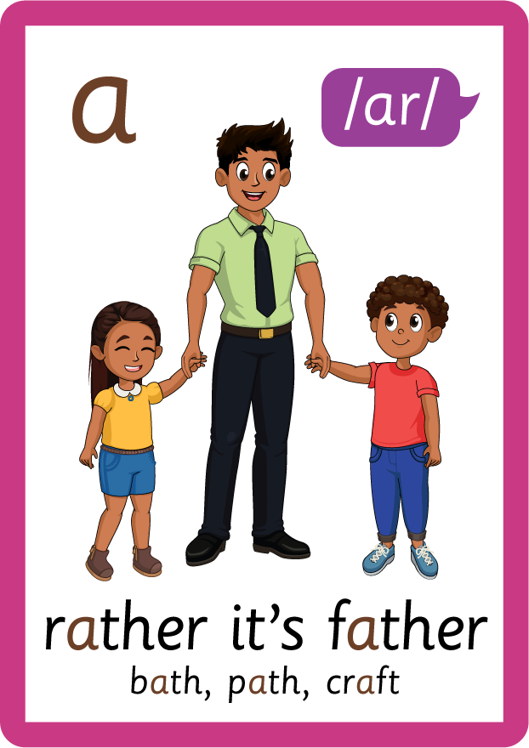













Recall all GPCs learned so far using flashcards.

Slide 7















Review Phase 5 Common Exception Words today house mouse hour because Mr Mrs Ms where should could would move use want.

Slide 8
Teach Suffix Rule
When suffix -er is added to the end of a noun, the noun changes to an agent noun.
Spelling Rule: When the root word ends in a short vowel followed by a consonant, the consonant is doubled and -er is added.

Slide 9
Demonstrate Using Examples
swim
double consonant and add suffix -er
swimmer

Slide 10
Demonstrate Using Examples
run
double consonant and add suffix -er
runner

Slide 11
Demonstrate Using Examples
skip
double consonant and add suffix -er
skipper

Slide 12

Explain Decoding

Slide 13
Model Blending Phonemes
s
w
i
m
USING SOUND BUTTONS
Sound Buttons
Vowel
Consonant
Consonant Digraph
Multi Sound
Long Vowel Sound
R-controlled Digraph
Split Digraph
Syllable / Silent Letter

Slide 14
Model Blending Phonemes
s
w
i
m
m
er
USING SOUND BUTTONS
Sound Buttons
Vowel
Consonant
Consonant Digraph
Multi Sound
Long Vowel Sound
R-controlled Digraph
Split Digraph
Syllable / Silent Letter

Slide 15
Model Blending Phonemes
r
u
n
USING SOUND BUTTONS
Sound Buttons
Vowel
Consonant
Consonant Digraph
Multi Sound
Long Vowel Sound
R-controlled Digraph
Split Digraph
Syllable / Silent Letter

Slide 16
Model Blending Phonemes
r
u
n
n
er
USING SOUND BUTTONS
Sound Buttons
Vowel
Consonant
Consonant Digraph
Multi Sound
Long Vowel Sound
R-controlled Digraph
Split Digraph
Syllable / Silent Letter

Slide 17

Explain Encoding

Slide 18

Practise Adding Affixes
s
k
i
p
USING A PHONEME FRAME

Slide 19
Practise Adding Affixes
s
k
i
p
p
er
USING A PHONEME FRAME

Slide 20

Practise Building Words
PRACTISE – 10MINS
r
u
n
n
er
s
w
i
m
m
s
k
p
p
USING MAGNETIC LETTERS AND A WHITEBOARD
Sound Buttons
Vowel
Consonant
Consonant Digraph
Multi Sound
Long Vowel Sound
R-controlled Digraph
Split Digraph
Syllable / Silent Letter

Slide 21
Practise Building Words
PRACTISE – 10MINS
r
u
n
n
er
s
w
i
m
m
s
k
p
p
runner swimmer skipper
USING MAGNETIC LETTERS AND A WHITEBOARD
Sound Buttons
Vowel
Consonant
Consonant Digraph
Multi Sound
Long Vowel Sound
R-controlled Digraph
Split Digraph
Syllable / Silent Letter

