Slide 1
-s and -es |  |  |  | -ing
-ed |  |  |  | -er
-est |  |  |  | un-
-er suffix (drop e)
Lesson 18

Slide 2
Learn and practise suffix -er.
Recall all GPCs learned so far using flashcards.
Recall Phase 5 Common Exception Words today house mouse hour because Mr Mrs Ms where should could would move use want.

Slide 3























Recall all GPCs learned so far using flashcards.

Slide 4





























Recall all GPCs learned so far using flashcards.

Slide 5










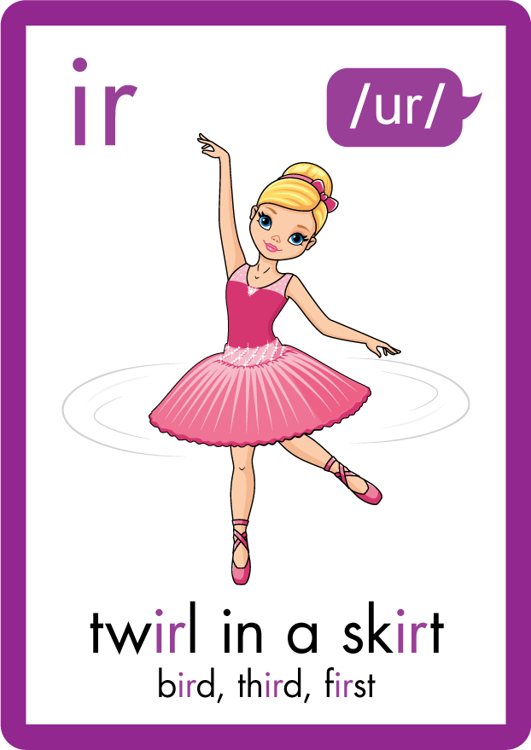






























Recall all GPCs learned so far using flashcards.

Slide 6































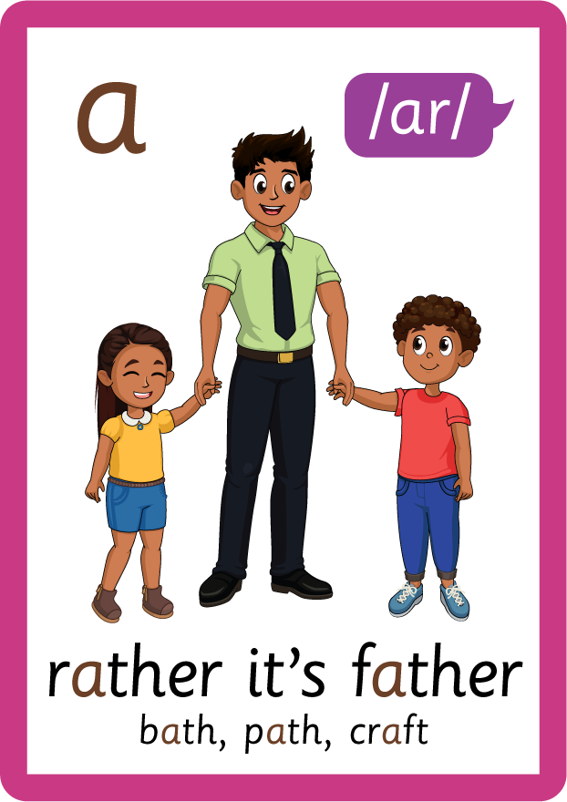








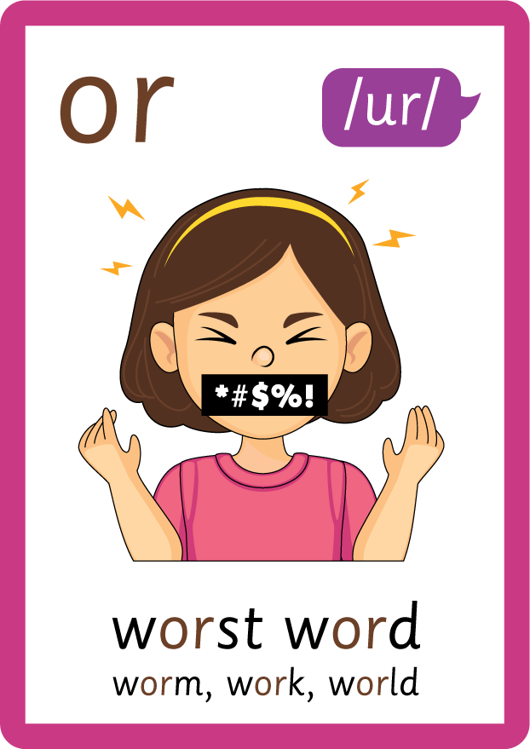




Recall all GPCs learned so far using flashcards.

Slide 7















Review Phase 5 Common Exception Words today house mouse hour because Mr Mrs Ms where should could would move use want.

Slide 8
Teach Suffix Rule
When suffix -er is added to the end of a noun, the noun changes to an agent noun.
Spelling Rule: When the root word ends in letter ‘e’, 'e' is removed and the suffix -er is added.

Slide 9
Demonstrate Using Examples
bake
drop ‘e’ and add -er
baker

Slide 10
Demonstrate Using Examples
shake
drop ‘e’ and add -er
shaker

Slide 11
Demonstrate Using Examples
dance
drop ‘e’ and add -er
dancer

Slide 12

Explain Decoding

Slide 13
Model Blending Phonemes
b
a
k
e
USING SOUND BUTTONS
Sound Buttons
Vowel
Consonant
Consonant Digraph
Multi Sound
Long Vowel Sound
R-controlled Digraph
Split Digraph
Syllable / Silent Letter

Slide 14
Model Blending Phonemes
b
a
k
er
USING SOUND BUTTONS
Sound Buttons
Vowel
Consonant
Consonant Digraph
Multi Sound
Long Vowel Sound
R-controlled Digraph
Split Digraph
Syllable / Silent Letter

Slide 15
Model Blending Phonemes
sh
a
k
e
USING SOUND BUTTONS
Sound Buttons
Vowel
Consonant
Consonant Digraph
Multi Sound
Long Vowel Sound
R-controlled Digraph
Split Digraph
Syllable / Silent Letter

Slide 16
Model Blending Phonemes
sh
a
k
er
USING SOUND BUTTONS
Sound Buttons
Vowel
Consonant
Consonant Digraph
Multi Sound
Long Vowel Sound
R-controlled Digraph
Split Digraph
Syllable / Silent Letter

Slide 17

Explain Encoding

Slide 18

Practise Adding Affixes
d
a
n
c
e
USING A PHONEME FRAME

Slide 19
Practise Adding Affixes
d
a
n
c
er
USING A PHONEME FRAME

Slide 20

Practise Building Words
PRACTISE – 10MINS
b
a
k
er
sh
n
c
d
USING MAGNETIC LETTERS AND A WHITEBOARD
Sound Buttons
Vowel
Consonant
Consonant Digraph
Multi Sound
Long Vowel Sound
R-controlled Digraph
Split Digraph
Syllable / Silent Letter

Slide 21
Practise Building Words
PRACTISE – 10MINS
b
a
k
er
sh
n
c
d
baker shaker dancer
USING MAGNETIC LETTERS AND A WHITEBOARD
Sound Buttons
Vowel
Consonant
Consonant Digraph
Multi Sound
Long Vowel Sound
R-controlled Digraph
Split Digraph
Syllable / Silent Letter

