Slide 1
-s and -es |  |  |  | -ing
-ed |  |  |  | -er
-est |  |  |  | un-
-er suffix (comparative adjective)
Lesson 19

Slide 2
Learn and practise suffix -er.
Recall all GPCs learned so far using flashcards.
Recall Phase 5 Common Exception Words today house mouse hour because Mr Mrs Ms where should could would move use want.

Slide 3























Recall all GPCs learned so far using flashcards.

Slide 4





























Recall all GPCs learned so far using flashcards.

Slide 5










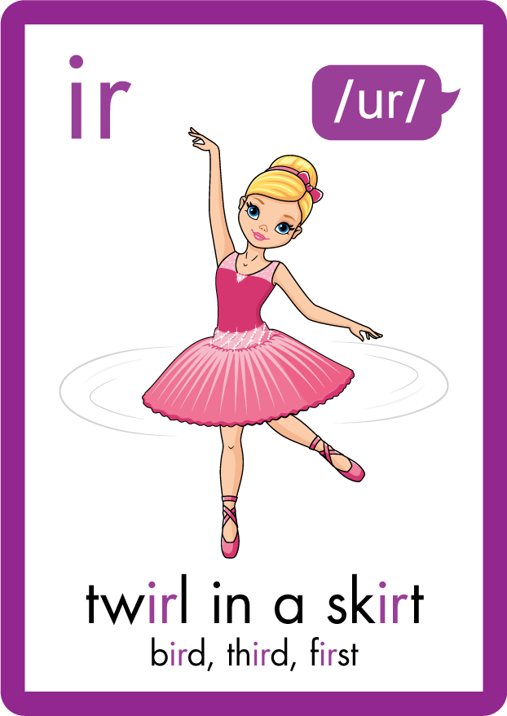
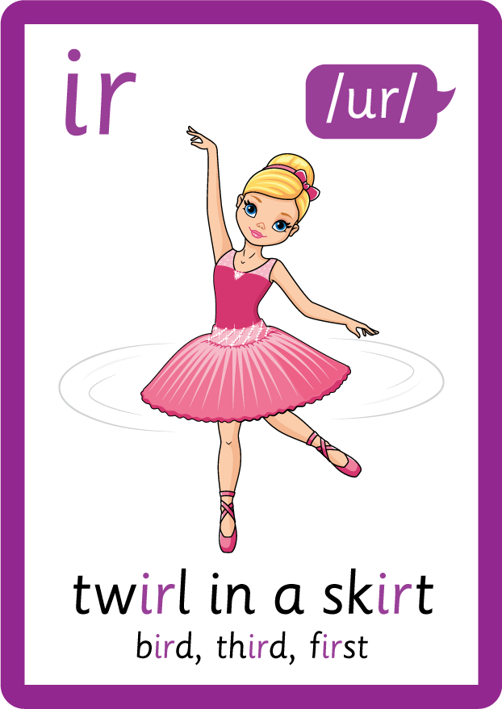












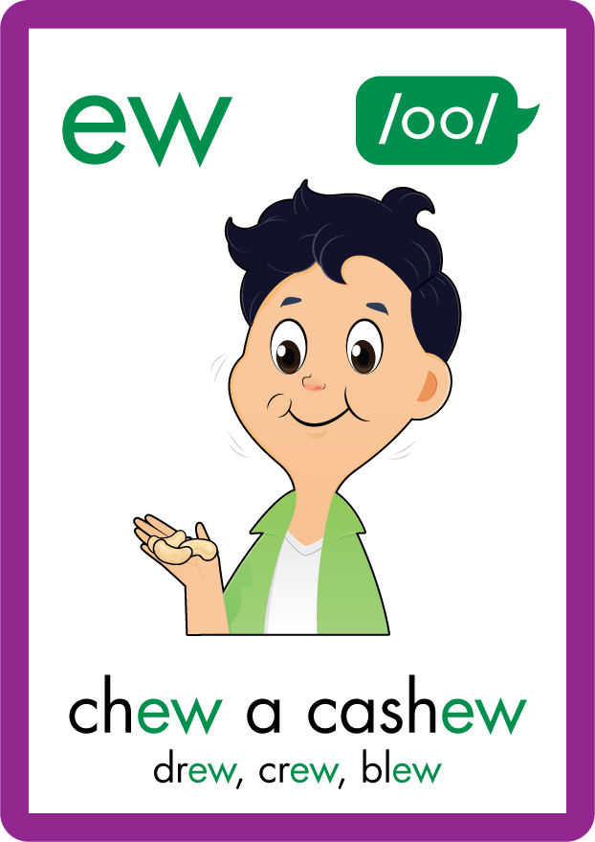









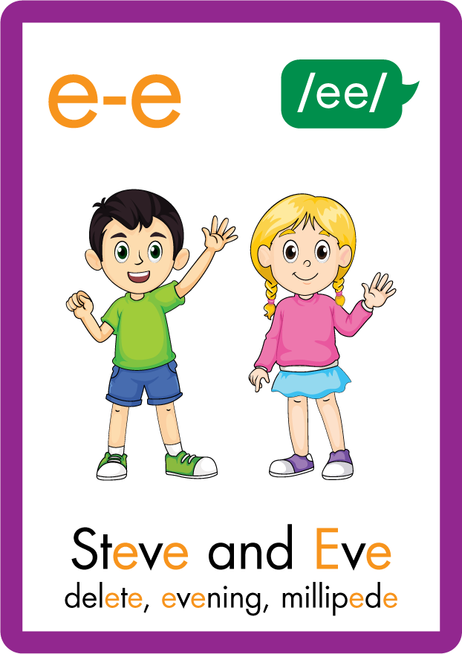






Recall all GPCs learned so far using flashcards.

Slide 6
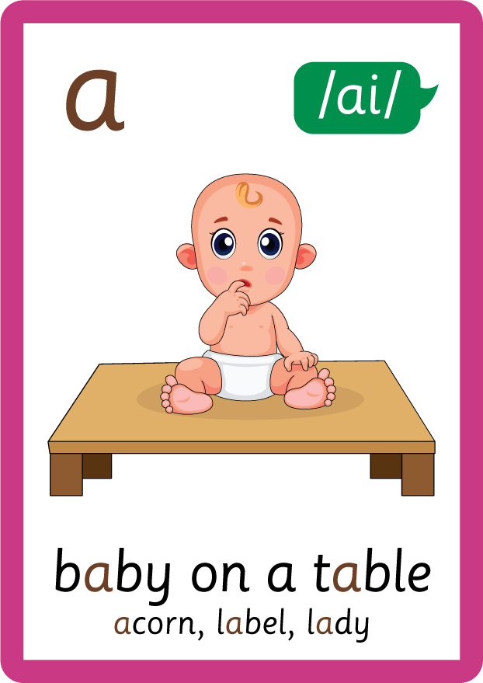



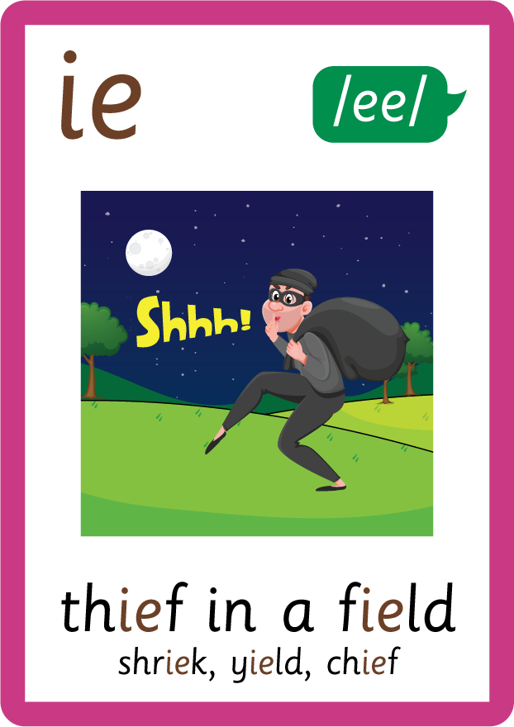
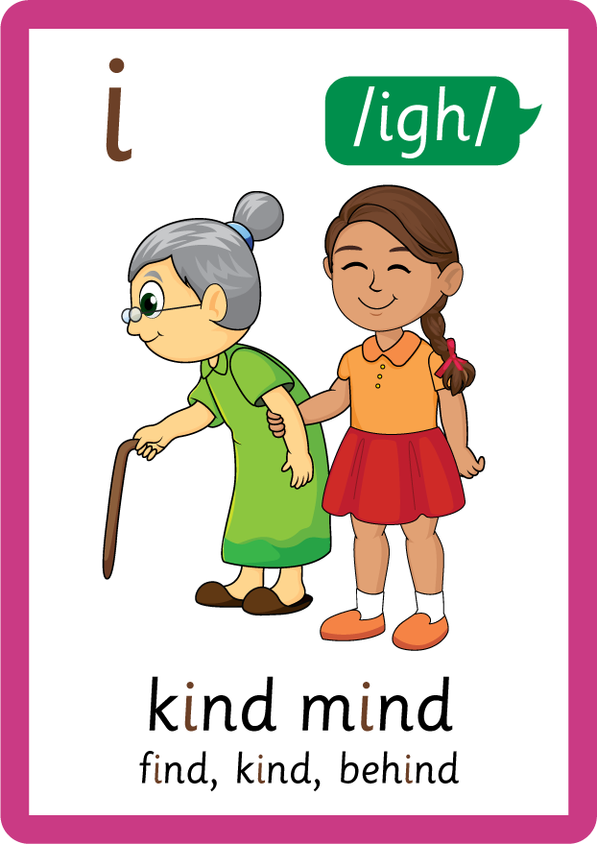






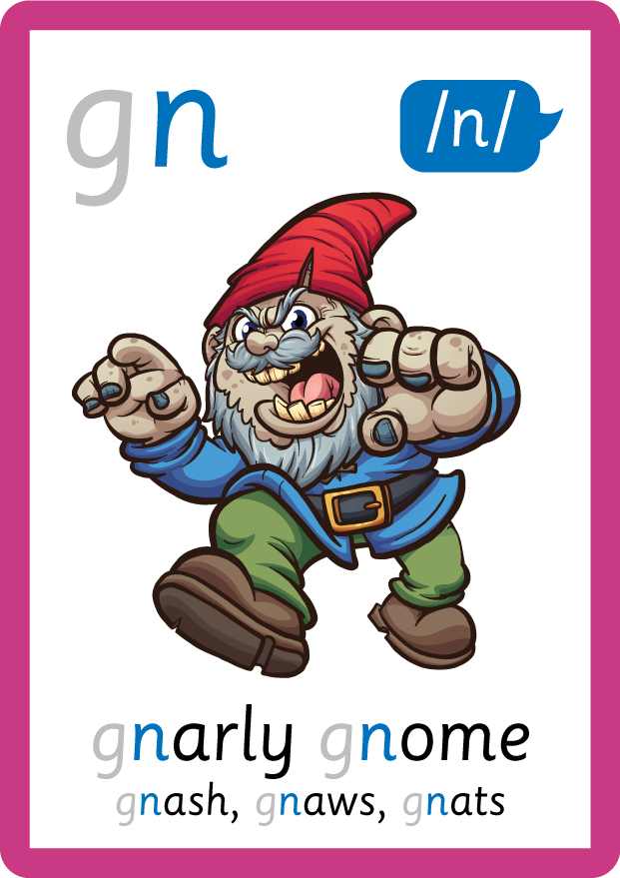
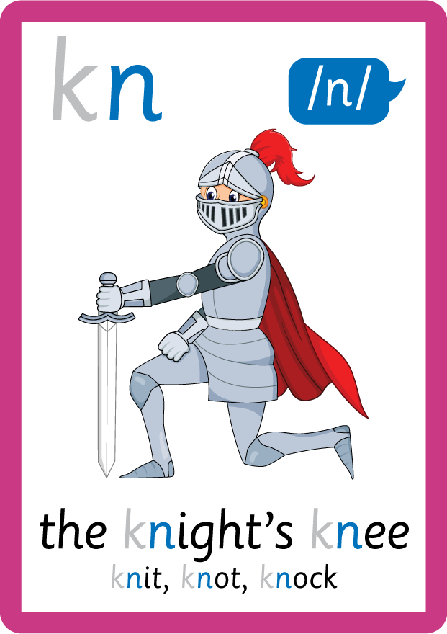

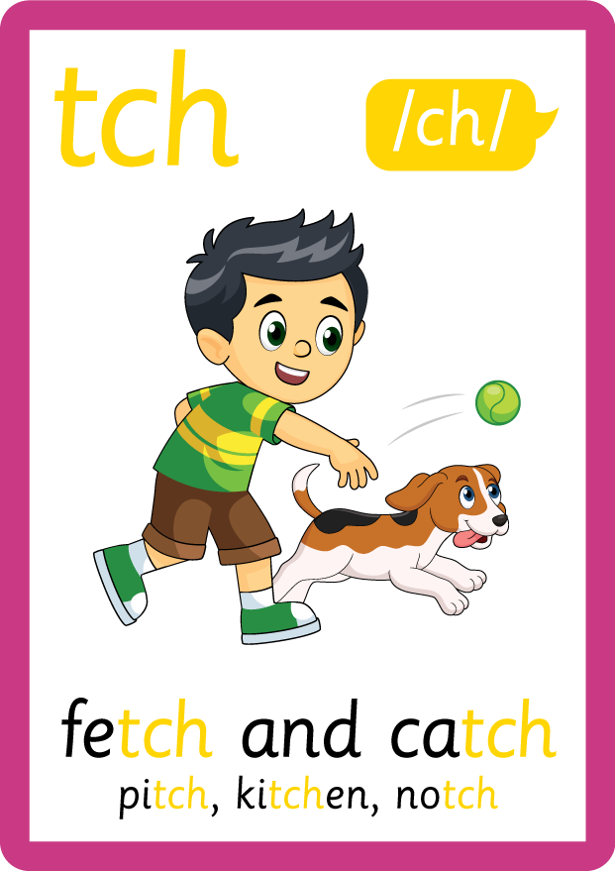
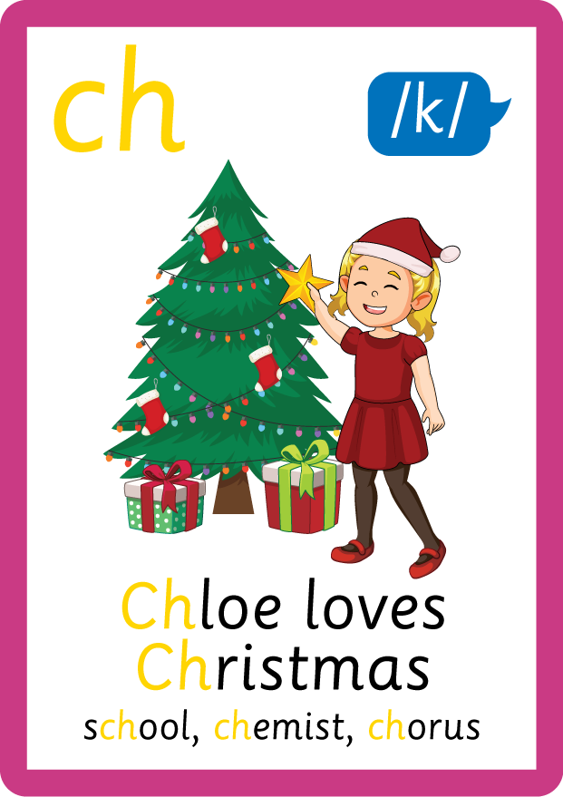

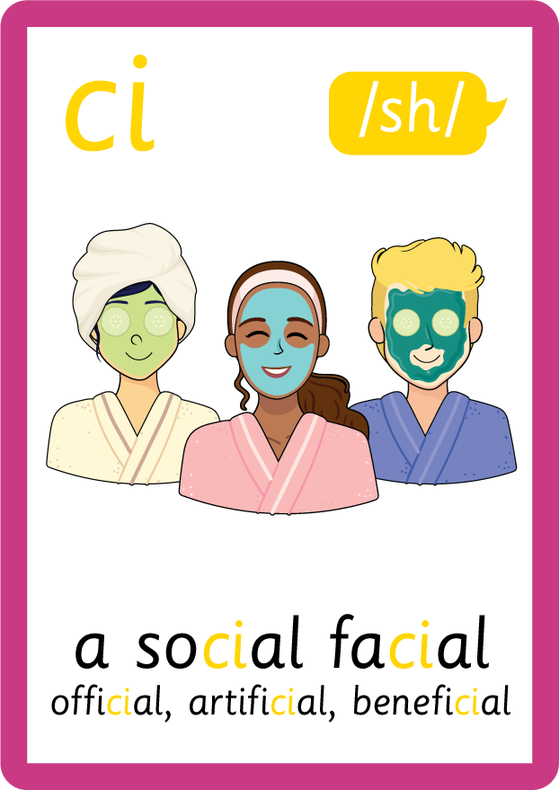






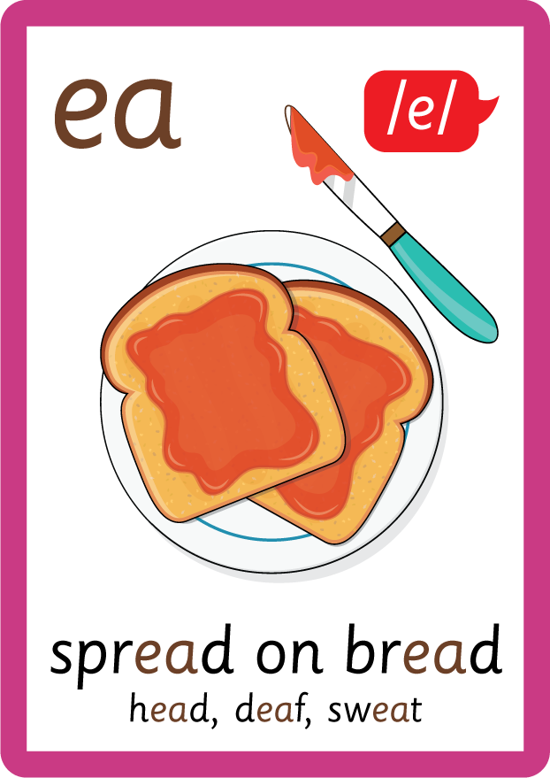




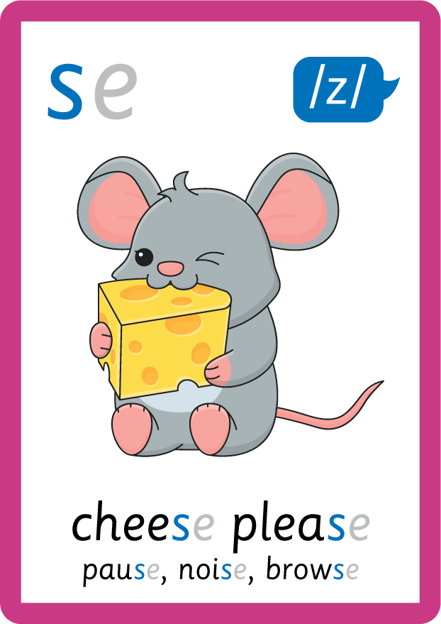
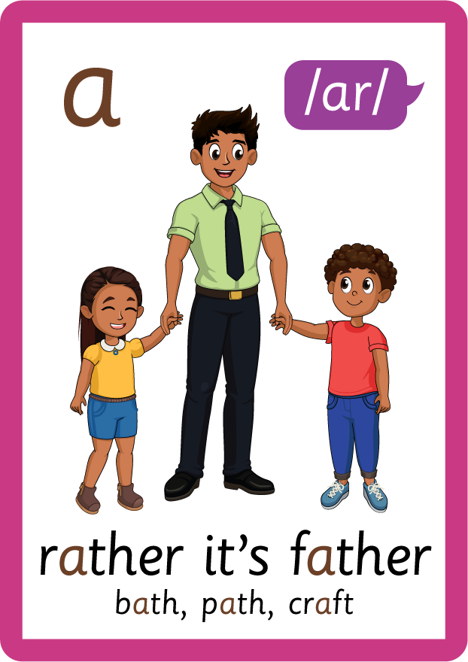


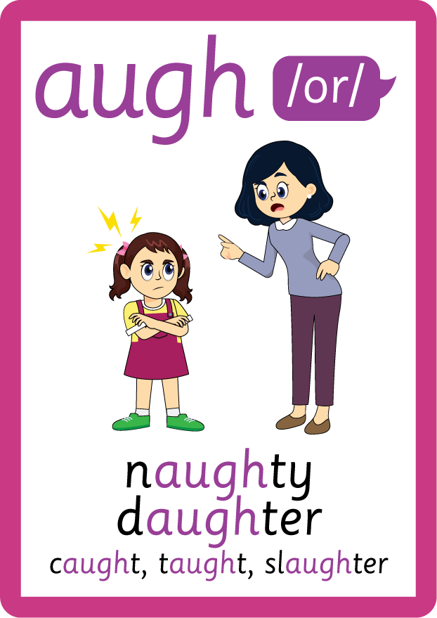





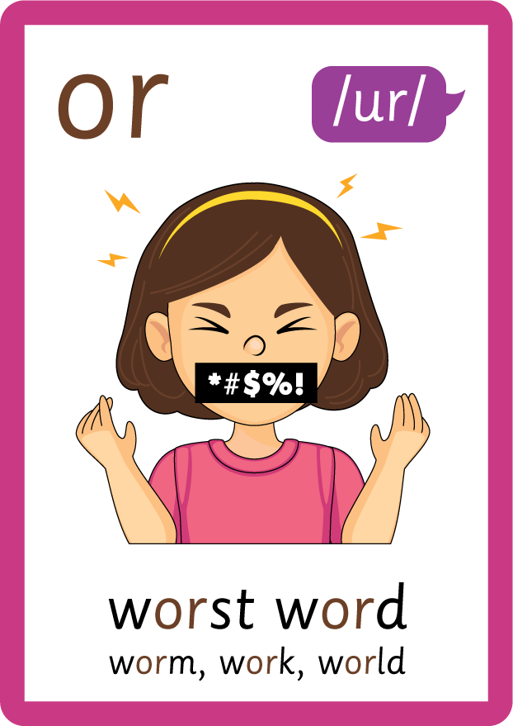


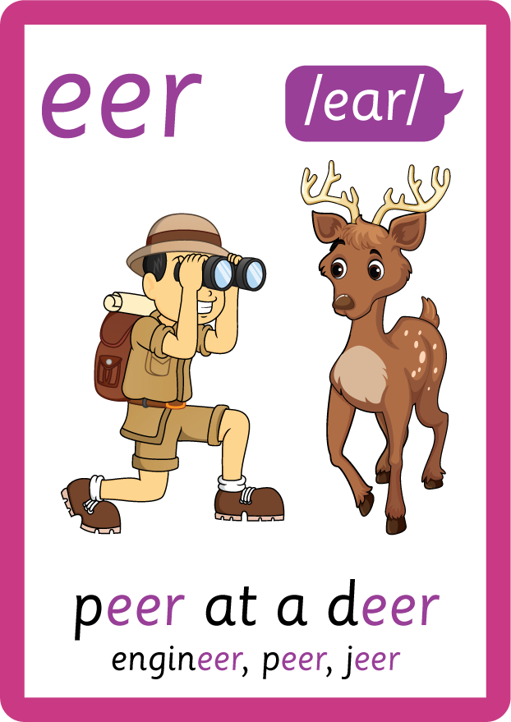

Recall all GPCs learned so far using flashcards.

Slide 7

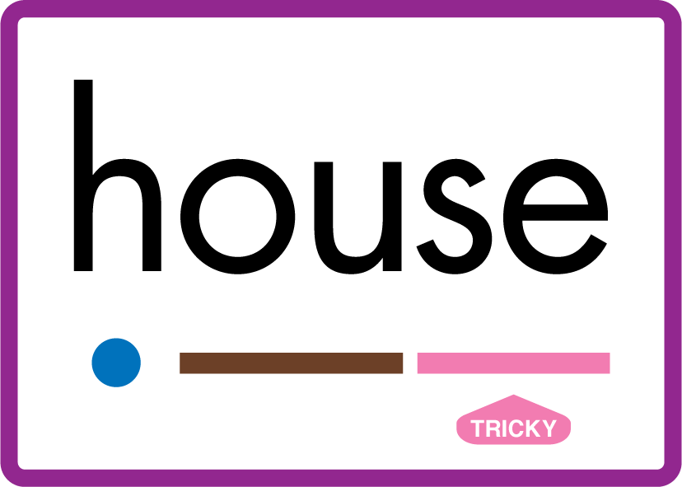
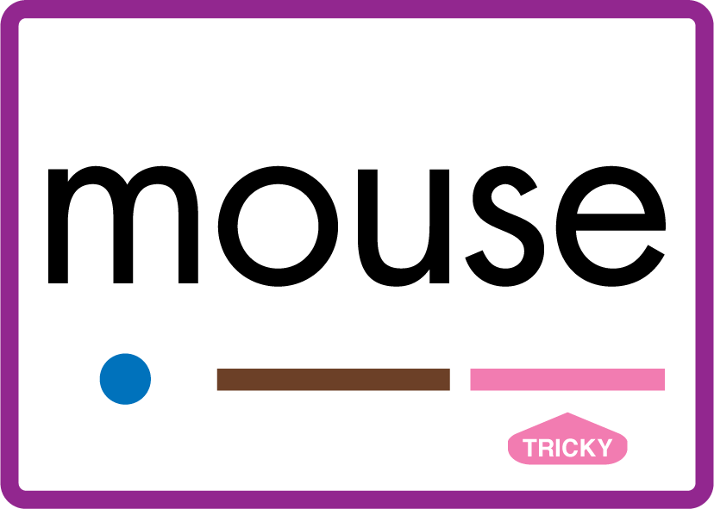











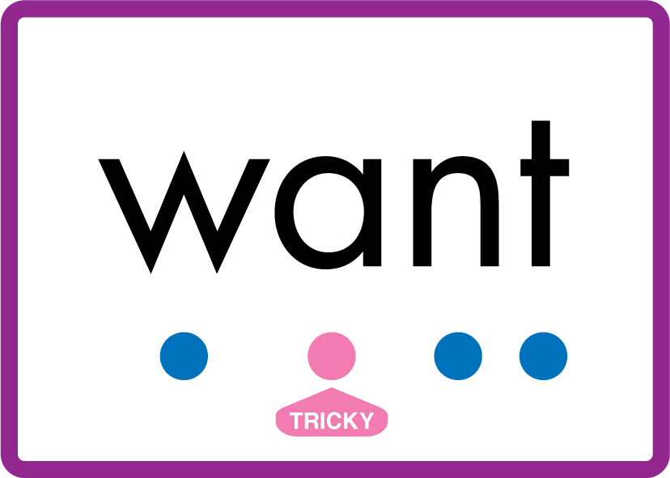
Review Phase 5 Common Exception Words today house mouse hour because Mr Mrs Ms where should could would move use want.

Slide 8
Teach Suffix Rule
When suffix -er is added to the end of an adjective, the adjective changes to a comparative adjective.
A comparative adjective is used to say that something is more of a certain quality / adjective than something else.

Slide 9
Demonstrate Using Examples
long
add suffix -er
longer

Slide 10

Explain Decoding

Slide 11
Model Blending Phonemes
b
i
g
USING SOUND BUTTONS
Sound Buttons
Vowel
Consonant
Consonant Digraph
Multi Sound
Long Vowel Sound
R-controlled Digraph
Split Digraph
Syllable / Silent Letter

Slide 12
Model Blending Phonemes
b
i
g
g
er
USING SOUND BUTTONS
Sound Buttons
Vowel
Consonant
Consonant Digraph
Multi Sound
Long Vowel Sound
R-controlled Digraph
Split Digraph
Syllable / Silent Letter

Slide 13
Model Blending Phonemes
r
i
ch
USING SOUND BUTTONS
Sound Buttons
Vowel
Consonant
Consonant Digraph
Multi Sound
Long Vowel Sound
R-controlled Digraph
Split Digraph
Syllable / Silent Letter

Slide 14
Model Blending Phonemes
r
i
ch
er
USING SOUND BUTTONS
Sound Buttons
Vowel
Consonant
Consonant Digraph
Multi Sound
Long Vowel Sound
R-controlled Digraph
Split Digraph
Syllable / Silent Letter

Slide 15

Explain Encoding

Slide 16
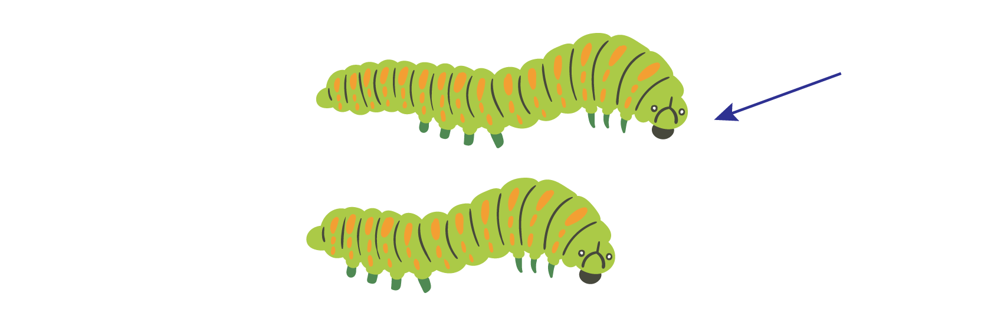
Practise Adding Affixes
l
o
ng
USING A PHONEME FRAME

Slide 17
Practise Adding Affixes
l
o
ng
er
USING A PHONEME FRAME

Slide 18

Practise Building Words
PRACTISE – 10MINS
b
i
g
g
er
f
a
t
t
l
o
ng
USING MAGNETIC LETTERS AND A WHITEBOARD
Sound Buttons
Vowel
Consonant
Consonant Digraph
Multi Sound
Long Vowel Sound
R-controlled Digraph
Split Digraph
Syllable / Silent Letter

Slide 19
Practise Building Words
PRACTISE – 10MINS
b
i
g
g
er
f
a
t
t
l
o
ng
big bigger fat fatter long longer
USING MAGNETIC LETTERS AND A WHITEBOARD
Sound Buttons
Vowel
Consonant
Consonant Digraph
Multi Sound
Long Vowel Sound
R-controlled Digraph
Split Digraph
Syllable / Silent Letter

