Slide 1
-s and -es |  |  |  | -ing
-ed |  |  |  | -er
-est |  |  |  | un-
Plural Exceptions
Lesson 2

Slide 2
Learn and practise plural exceptions.
Recall all GPCs learned so far using flashcards.

Slide 3























Recall all GPCs learned so far using flashcards.

Slide 4





























Recall all GPCs learned so far using flashcards.

Slide 5









































Recall all GPCs learned so far using flashcards.

Slide 6
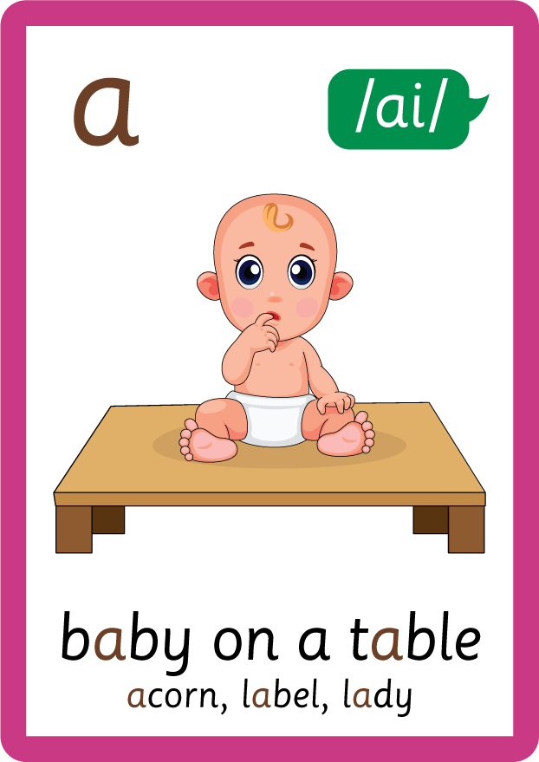












































Recall all GPCs learned so far using flashcards.

Slide 7















Review Phase 5 Common Exception Words today house mouse hour because Mr Mrs Ms where should could would move use want.

Slide 8
Teach Suffix Rule
Some nouns do not follow the -s suffix plural rule, these are known as uncountable nouns. These nouns remain the same even when there is more than one, and do not require a suffix.

Slide 9
Demonstrate Using Examples
one sheep
no spelling change needed
two sheep

Slide 10
Demonstrate Using Examples
one fish
no spelling change needed
two fish

Slide 11

Explain Decoding

Slide 12
Model Blending Phonemes
1
sh
ee
p
USING SOUND BUTTONS
Sound Buttons
Vowel
Consonant
Consonant Digraph
Multi Sound
Long Vowel Sound
R-controlled Digraph
Split Digraph
Syllable / Silent Letter

Slide 13
Model Blending Phonemes
2
sh
ee
p
USING SOUND BUTTONS
Sound Buttons
Vowel
Consonant
Consonant Digraph
Multi Sound
Long Vowel Sound
R-controlled Digraph
Split Digraph
Syllable / Silent Letter

Slide 14

Explain Encoding

Slide 15

Practise Adding Affixes
sh
ee
p
USING A PHONEME FRAME

Slide 16
Practise Adding Affixes
sh
ee
p
USING A PHONEME FRAME

Slide 17

Practise Building Words
PRACTISE – 10MINS
f
i
sh
ee
p
USING MAGNETIC LETTERS AND A WHITEBOARD

Slide 18
Practise Building Words
PRACTISE – 10MINS
f
i
sh
ee
p
fish sheep
USING MAGNETIC LETTERS AND A WHITEBOARD

