Slide 1
-s and -es |  |  |  | -ing
-ed |  |  |  | -er
-est |  |  |  | un-
-est suffix (superlative adjectives)
Lesson 21

Slide 2
Learn and practise suffix -est.
Recall all GPCs learned so far using flashcards.
Recall Phase 5 Common Exception Words today house mouse hour because Mr Mrs Ms where should could would move use want.

Slide 3























Recall all GPCs learned so far using flashcards.

Slide 4





























Recall all GPCs learned so far using flashcards.

Slide 5


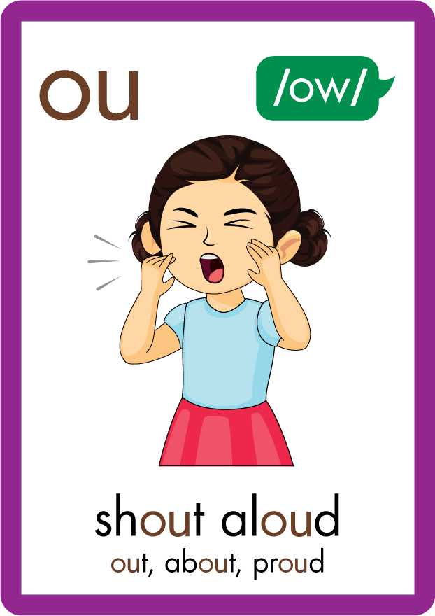
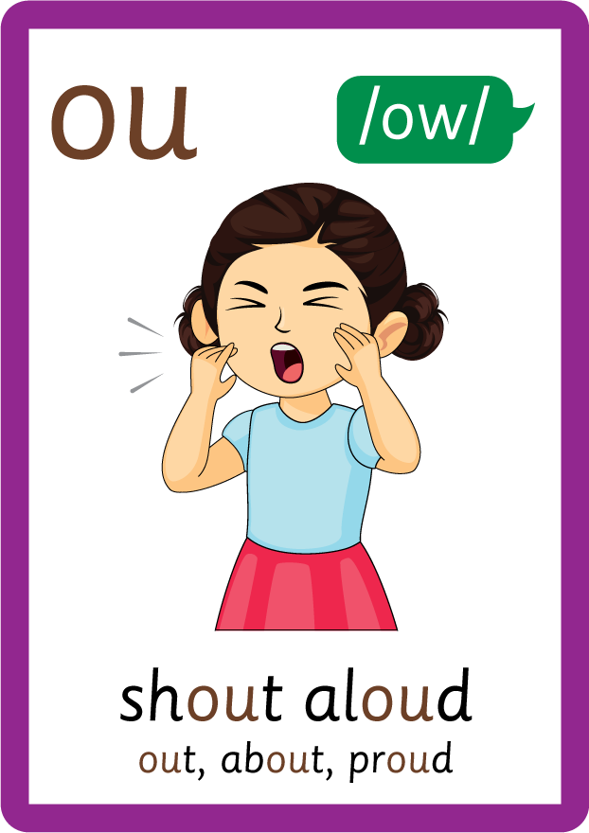






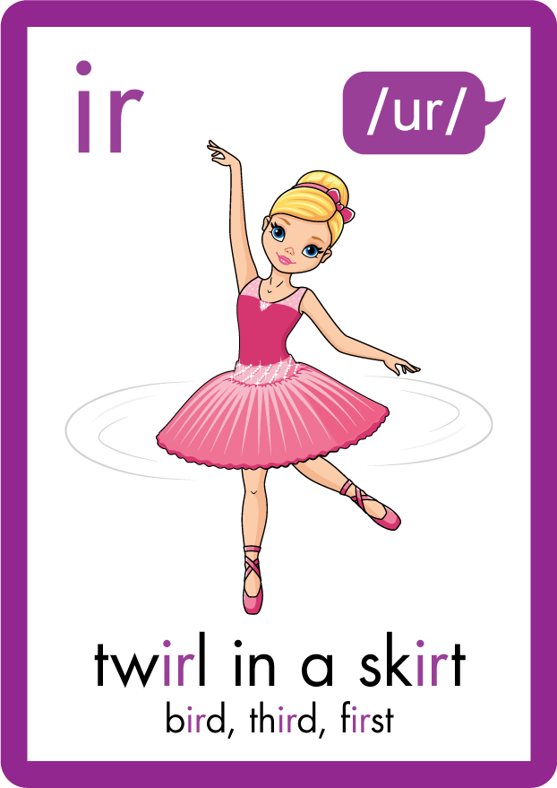
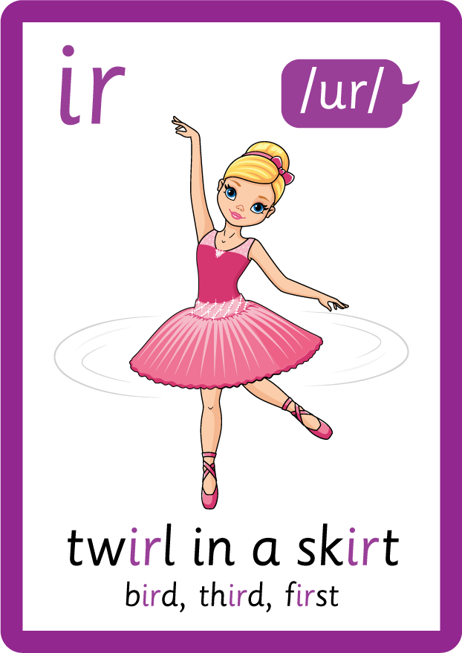












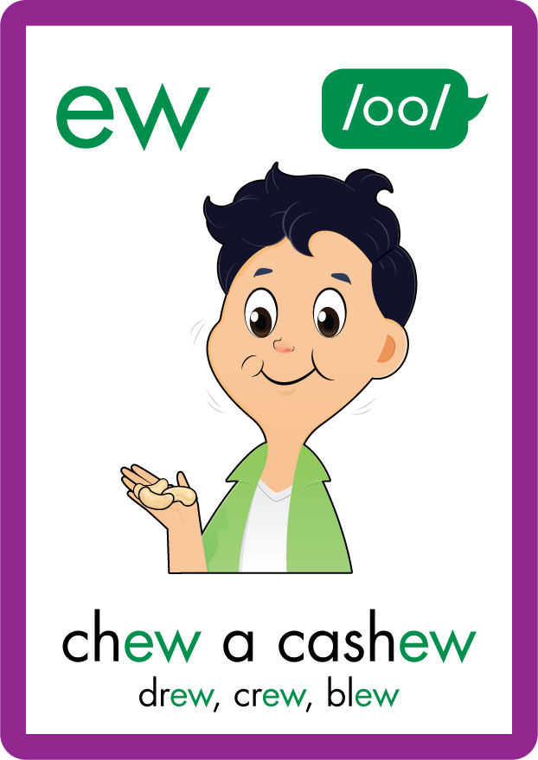
















Recall all GPCs learned so far using flashcards.

Slide 6
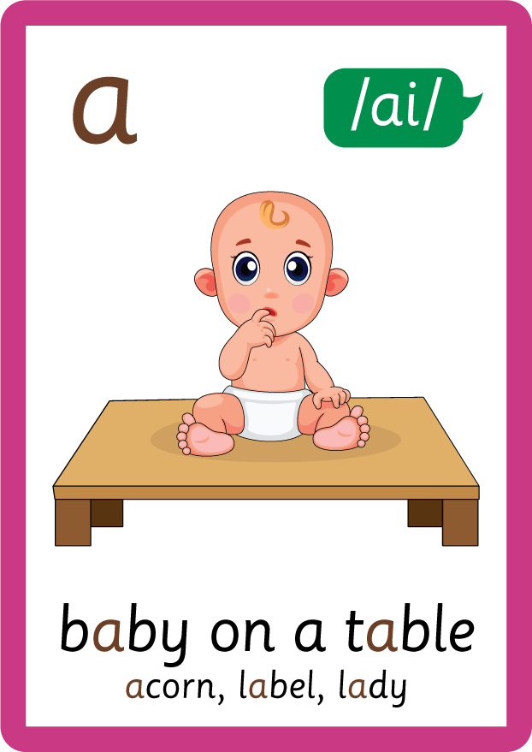



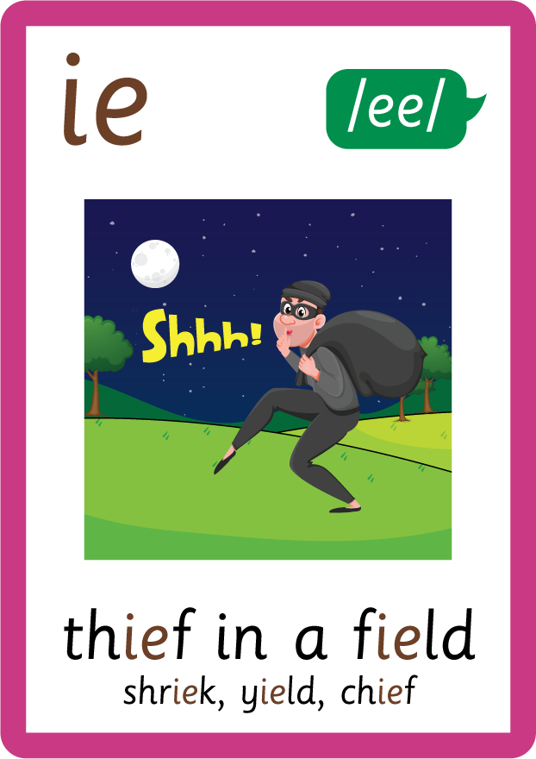
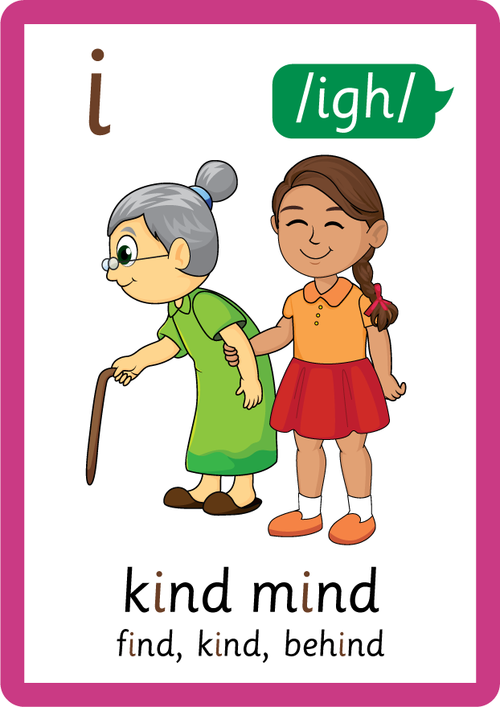






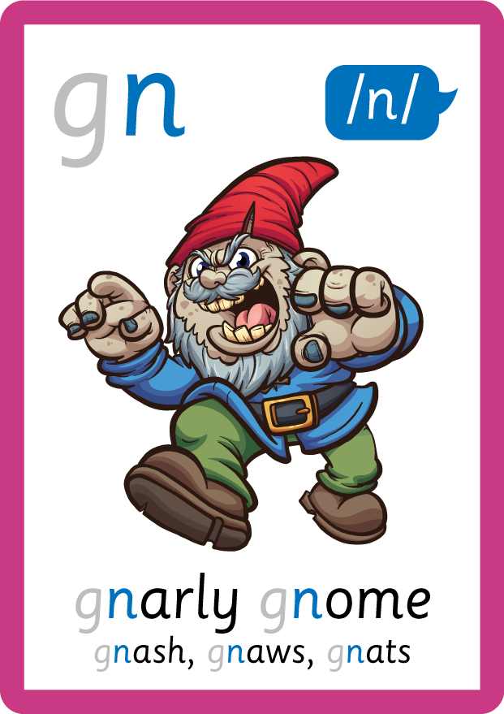
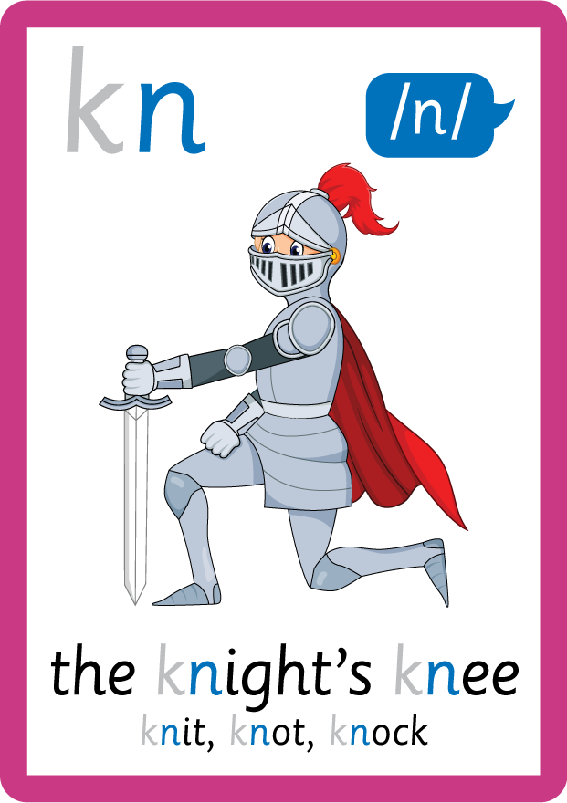

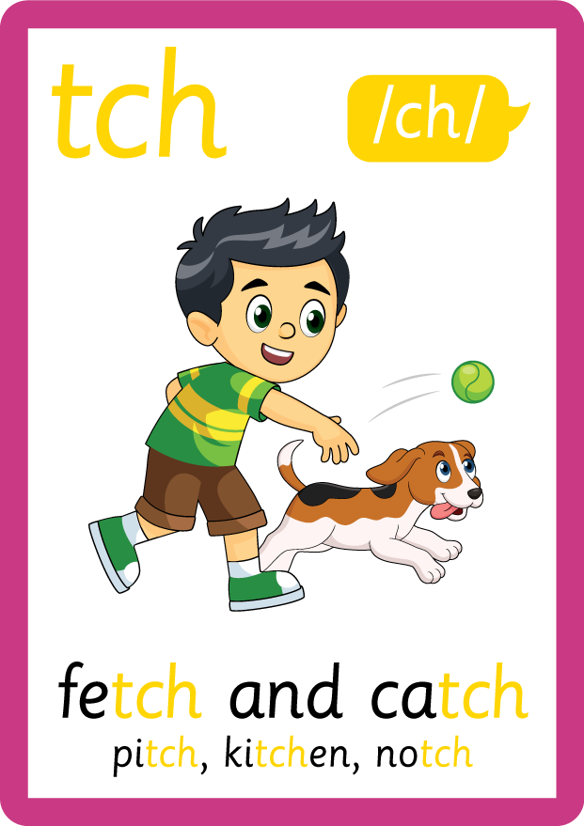
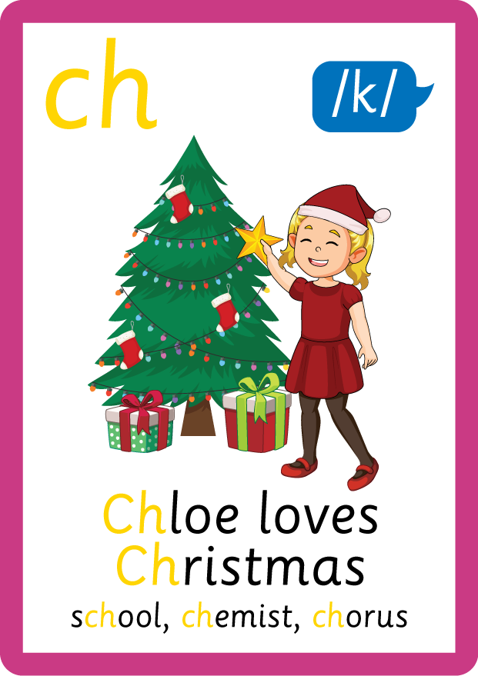
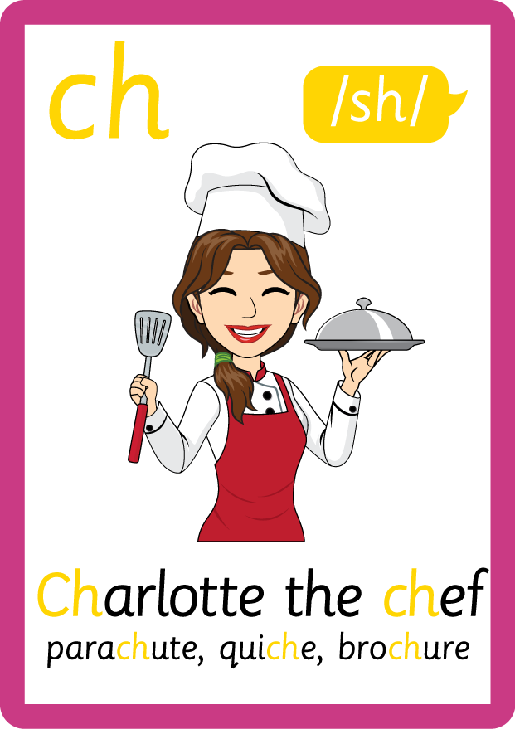
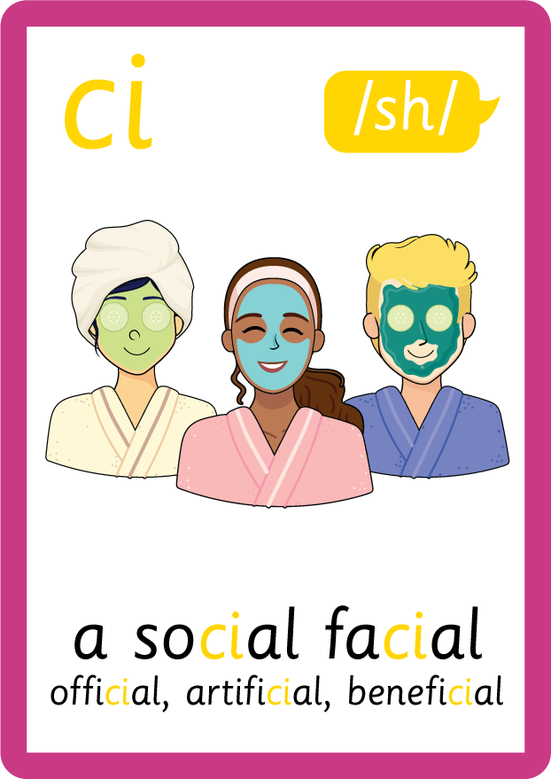





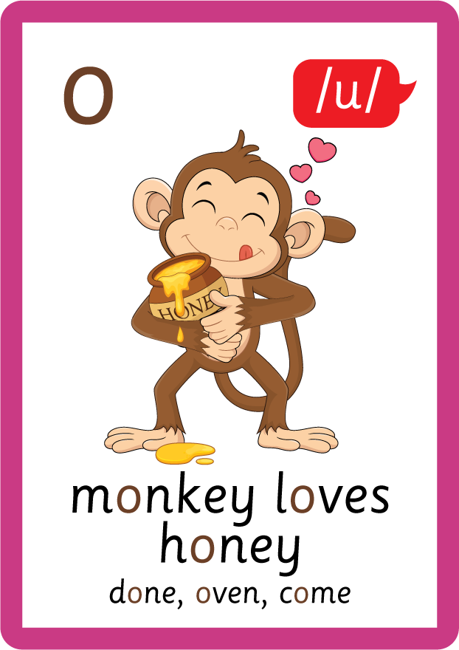
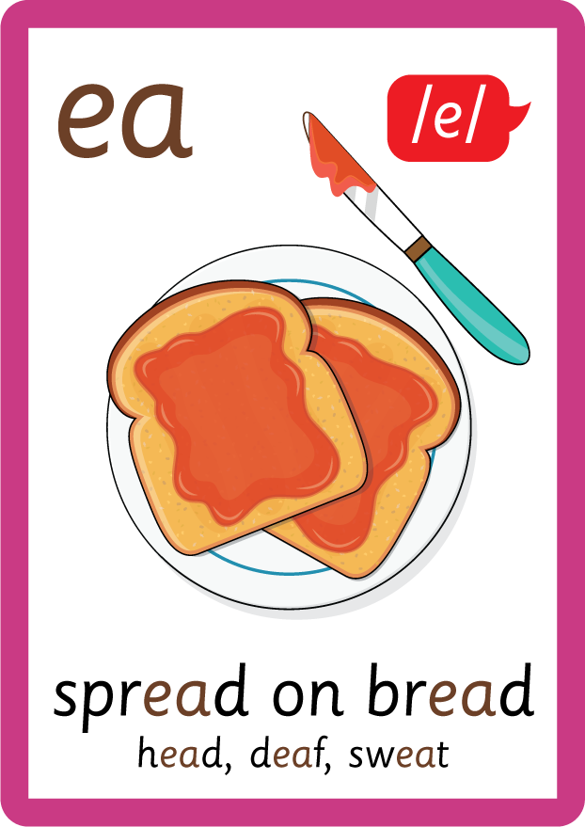




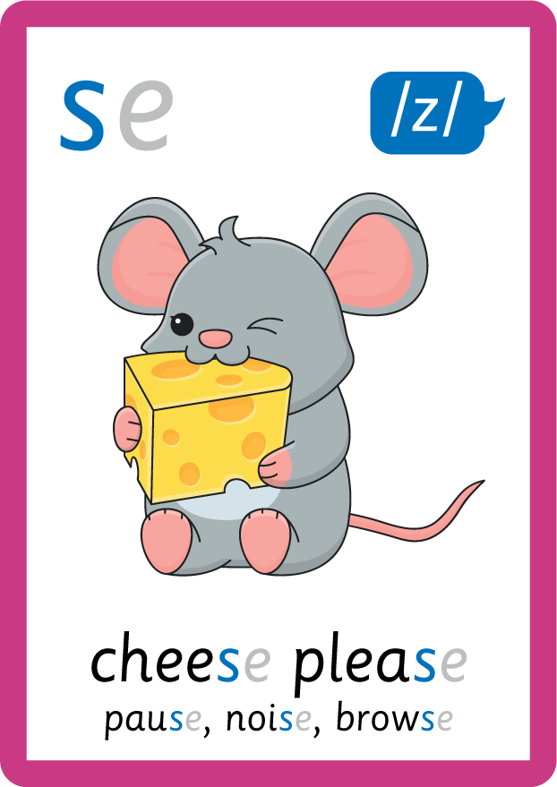
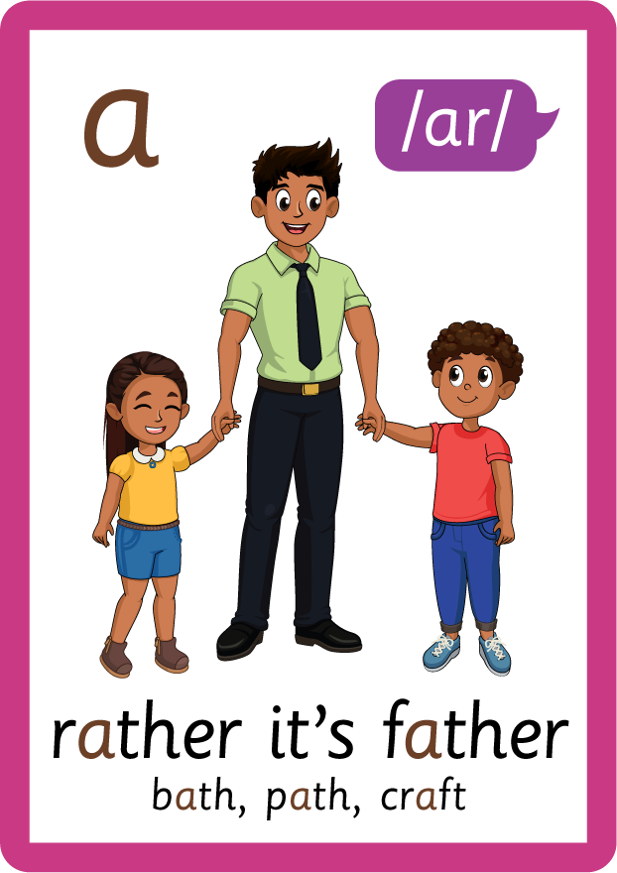


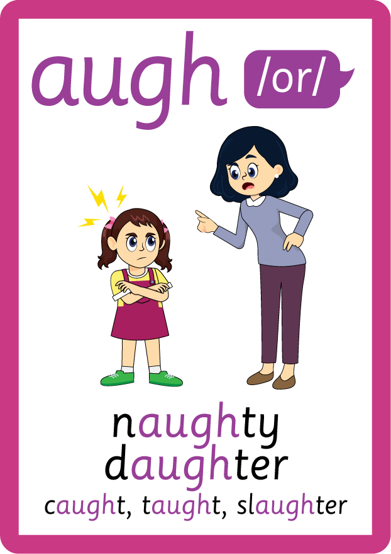





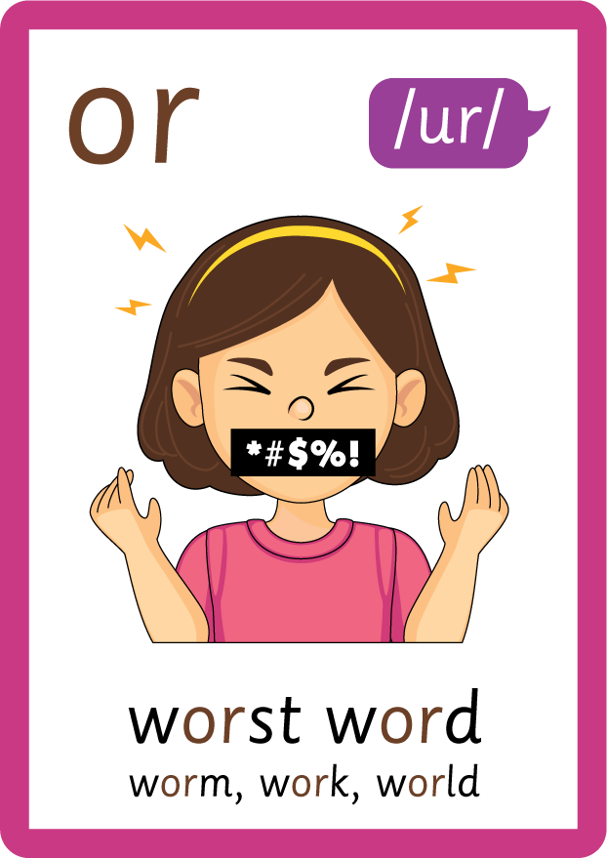


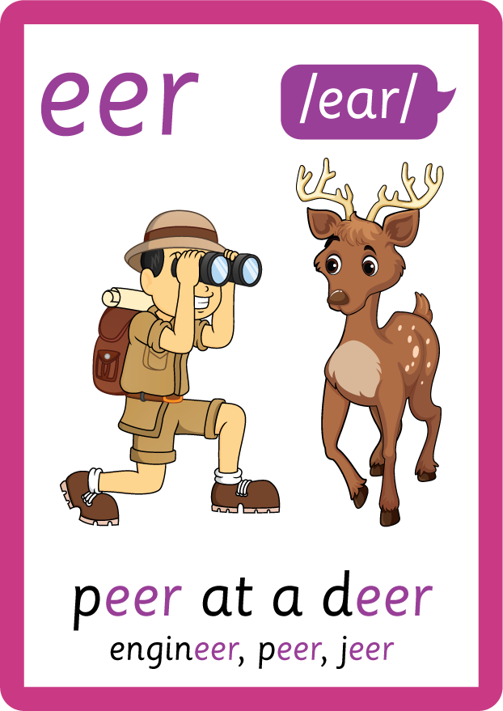

Recall all GPCs learned so far using flashcards.

Slide 7

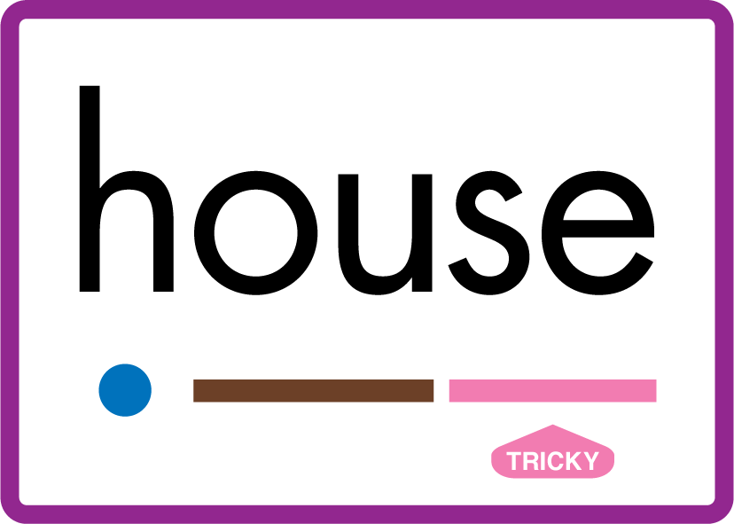












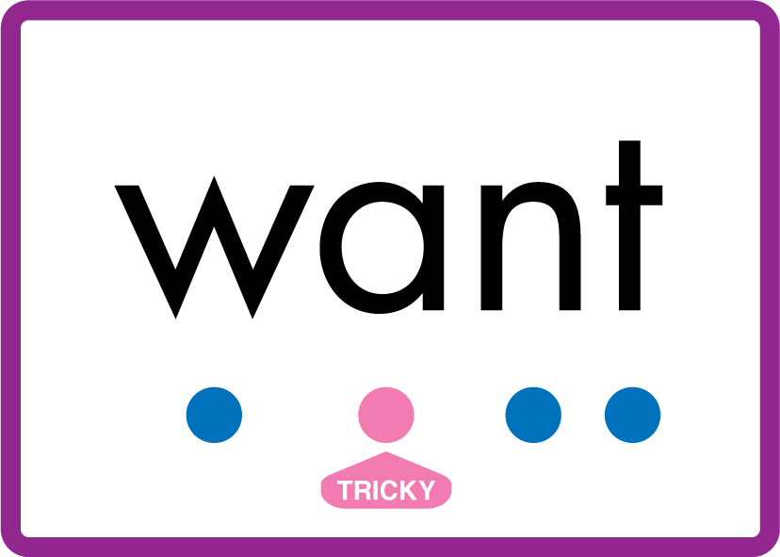
Review Phase 5 Common Exception Words today house mouse hour because Mr Mrs Ms where should could would move use want.

Slide 8
Teach Suffix Rule
When suffix -est is added to the end of an adjective, the adjective changes to a superlative adjective.
A superlative adjective is an adjective used to say that something is the most of a certain quality / adjective than something else.

Slide 9
Demonstrate Using Examples
slow
add suffix -est
slowest

Slide 10

Explain Decoding

Slide 11
Model Blending Phonemes
h
igh
USING SOUND BUTTONS
Sound Buttons
Vowel
Consonant
Consonant Digraph
Multi Sound
Long Vowel Sound
R-controlled Digraph
Split Digraph
Syllable / Silent Letter

Slide 12
Model Blending Phonemes
h
igh
e
s
t
USING SOUND BUTTONS
Sound Buttons
Vowel
Consonant
Consonant Digraph
Multi Sound
Long Vowel Sound
R-controlled Digraph
Split Digraph
Syllable / Silent Letter

Slide 13
Model Blending Phonemes
s
l
ow
USING SOUND BUTTONS
Sound Buttons
Vowel
Consonant
Consonant Digraph
Multi Sound
Long Vowel Sound
R-controlled Digraph
Split Digraph
Syllable / Silent Letter

Slide 14
Model Blending Phonemes
s
l
ow
e
s
t
USING SOUND BUTTONS
Sound Buttons
Vowel
Consonant
Consonant Digraph
Multi Sound
Long Vowel Sound
R-controlled Digraph
Split Digraph
Syllable / Silent Letter

Slide 15

Explain Encoding

Slide 16

Practise Adding Affixes
c
oo
l
USING A PHONEME FRAME

Slide 17
Practise Adding Affixes
c
oo
l
e
s
t
USING A PHONEME FRAME

Slide 18

Practise Building Words
PRACTISE – 10MINS
o
e
i
a
oo
l
s
w
t
s
h
g
h
t
f
t
c
USING MAGNETIC LETTERS AND A WHITEBOARD
Sound Buttons
Vowel
Consonant
Consonant Digraph
Multi Sound
Long Vowel Sound
R-controlled Digraph
Split Digraph
Syllable / Silent Letter

Slide 19
Practise Building Words
PRACTISE – 10MINS
o
e
i
a
oo
l
s
w
t
s
h
g
h
t
f
t
c
slowest highest fattest coolest
USING MAGNETIC LETTERS AND A WHITEBOARD
Sound Buttons
Vowel
Consonant
Consonant Digraph
Multi Sound
Long Vowel Sound
R-controlled Digraph
Split Digraph
Syllable / Silent Letter

