Slide 1
-s and -es |  |  |  | -ing
-ed |  |  |  | -er
-est |  |  |  | un-
-er and -est
suffixes
Lesson 22

Slide 2
Review and practise suffix -est and -er.
Recall all GPCs learned so far using flashcards.
Recall Phase 5 Common Exception Words today house mouse hour because Mr Mrs Ms where should could would move use want.

Slide 3























Recall all GPCs learned so far using flashcards.

Slide 4





























Recall all GPCs learned so far using flashcards.

Slide 5










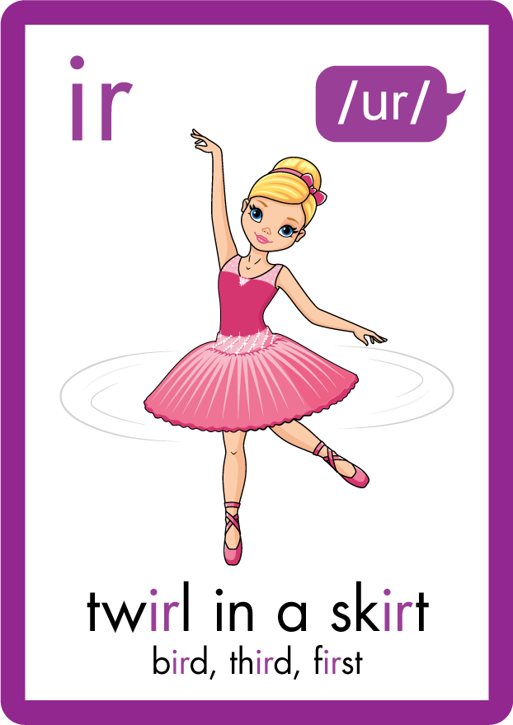













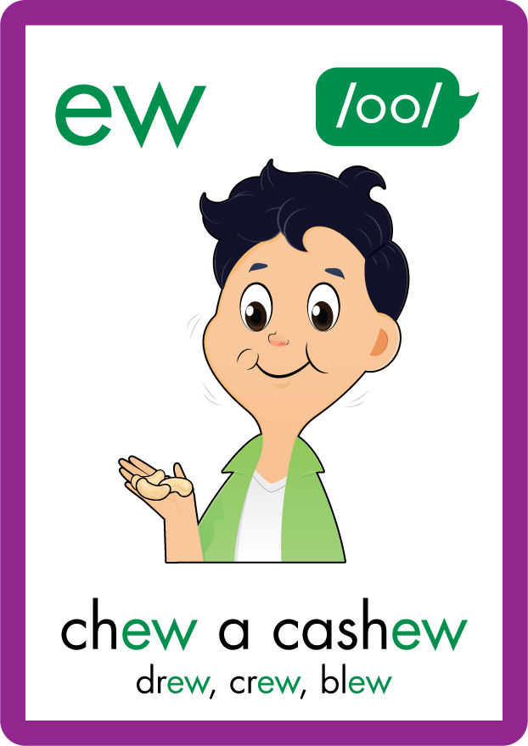
















Recall all GPCs learned so far using flashcards.

Slide 6












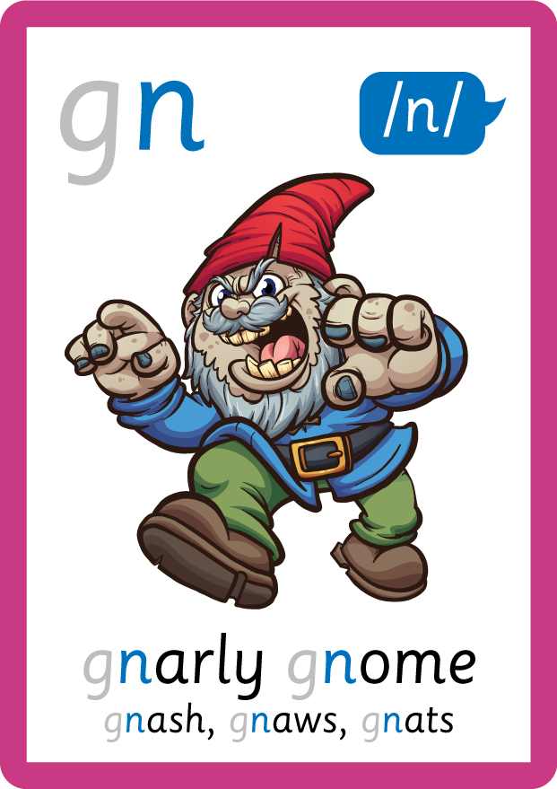
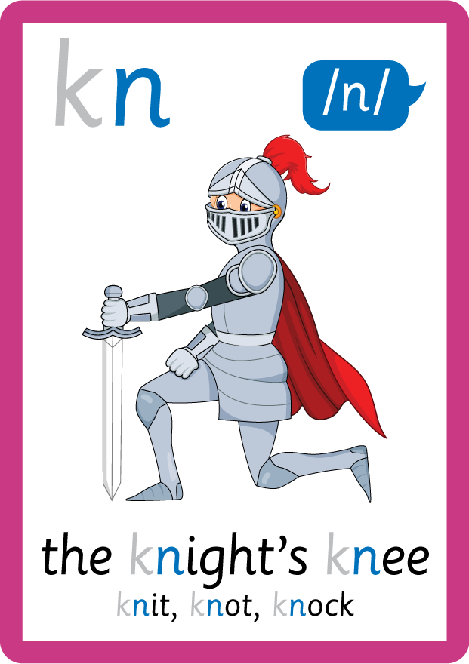

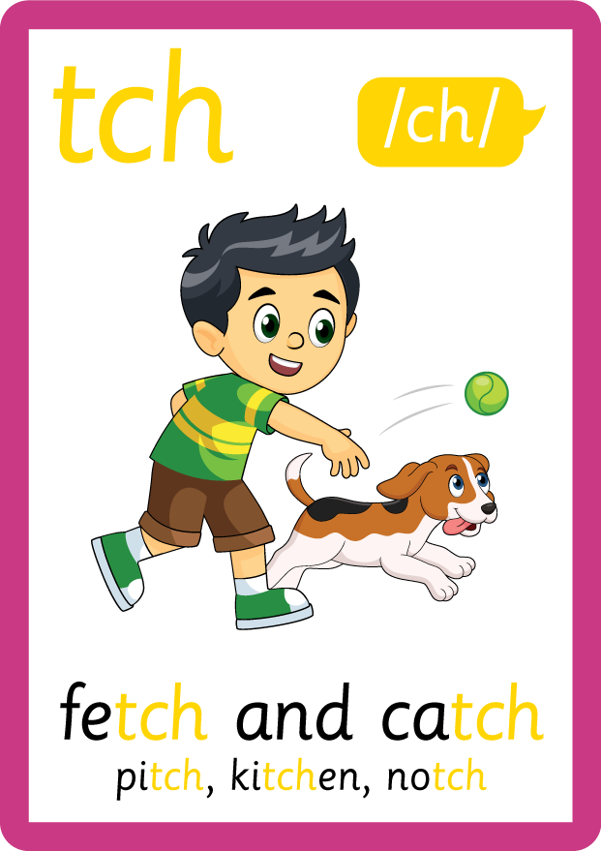
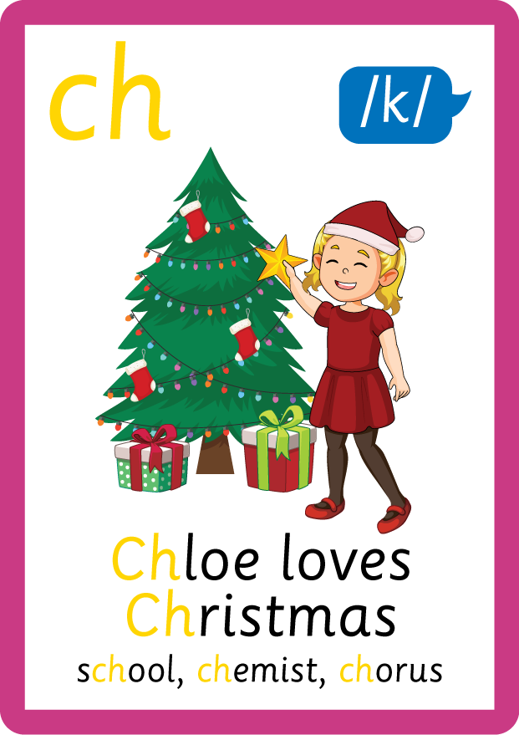














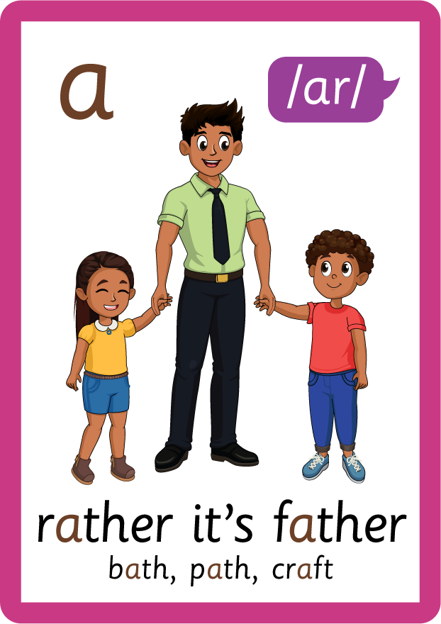








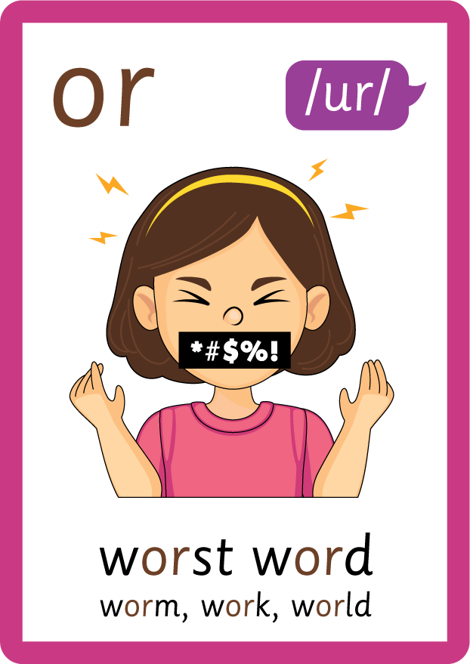


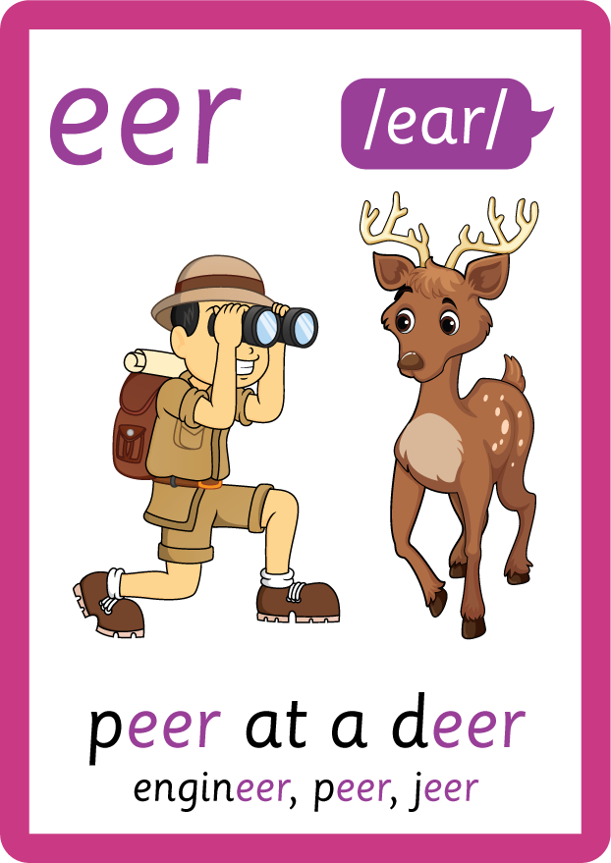

Recall all GPCs learned so far using flashcards.

Slide 7

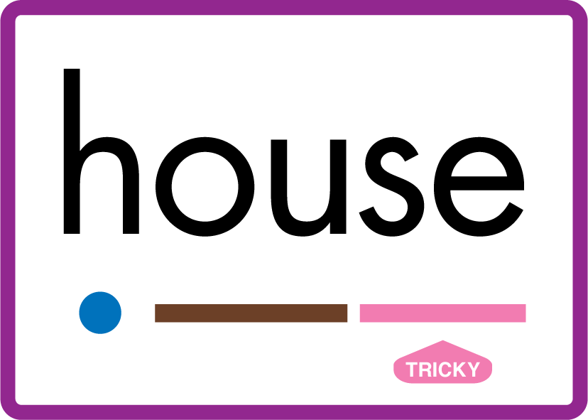













Review Phase 5 Common Exception Words today house mouse hour because Mr Mrs Ms where should could would move use want.

Slide 8
Teach Suffix Rule
When suffix -est is added to the end of an adjective, the adjective changes to a superlative adjective.
Review comparative adjectives using suffix -er and illustrate the differences between suffixes.

Slide 9
Demonstrate Using Examples
fat
add suffix -er to make a comparative adjective
fatter
add suffix -est to make a superlative adjective
fattest

Slide 10
Demonstrate Using Examples
big
add suffix -er to make a comparative adjective
bigger
add suffix -est to make a superlative adjective
biggest

Slide 11
Demonstrate Using Examples
hot
add suffix -er to make a comparative adjective
hotter
add suffix -est to make a superlative adjective
hottest

Slide 12

Explain Decoding

Slide 13
Model Blending Phonemes
f
a
t
USING SOUND BUTTONS
Sound Buttons
Vowel
Consonant
Consonant Digraph
Multi Sound
Long Vowel Sound
R-controlled Digraph
Split Digraph
Syllable / Silent Letter

Slide 14
Model Blending Phonemes
f
a
t
t
e
s
t
USING SOUND BUTTONS
Sound Buttons
Vowel
Consonant
Consonant Digraph
Multi Sound
Long Vowel Sound
R-controlled Digraph
Split Digraph
Syllable / Silent Letter

Slide 15
Model Blending Phonemes
h
o
t
USING SOUND BUTTONS
Sound Buttons
Vowel
Consonant
Consonant Digraph
Multi Sound
Long Vowel Sound
R-controlled Digraph
Split Digraph
Syllable / Silent Letter

Slide 16
Model Blending Phonemes
h
o
t
t
e
s
t
USING SOUND BUTTONS
Sound Buttons
Vowel
Consonant
Consonant Digraph
Multi Sound
Long Vowel Sound
R-controlled Digraph
Split Digraph
Syllable / Silent Letter

Slide 17

Explain Encoding

Slide 18

Practise Adding Affixes
b
i
g
USING A PHONEME FRAME

Slide 19
Practise Adding Affixes
b
i
g
g
e
s
t
USING A PHONEME FRAME

Slide 20

Practise Building Words
PRACTISE – 10MINS
b
i
g
g
er
e
s
t
r
o
ng
s
t
USING MAGNETIC LETTERS AND A WHITEBOARD
Sound Buttons
Vowel
Consonant
Consonant Digraph
Multi Sound
Long Vowel Sound
R-controlled Digraph
Split Digraph
Syllable / Silent Letter

Slide 21
Practise Building Words
PRACTISE – 10MINS
b
i
g
g
er
e
s
t
r
o
ng
s
t
big bigger biggest strong stronger strongest
USING MAGNETIC LETTERS AND A WHITEBOARD
Sound Buttons
Vowel
Consonant
Consonant Digraph
Multi Sound
Long Vowel Sound
R-controlled Digraph
Split Digraph
Syllable / Silent Letter

