Slide 1
-s and -es |  |  |  | -ing
-ed |  |  |  | -er
-est |  |  |  | un-
-est suffix (drop y, add i)
Lesson 23

Slide 2
Learn and practise suffix -est.
Recall all GPCs learned so far using flashcards.
Recall Phase 5 Common Exception Words today house mouse hour because Mr Mrs Ms where should could would move use want.

Slide 3




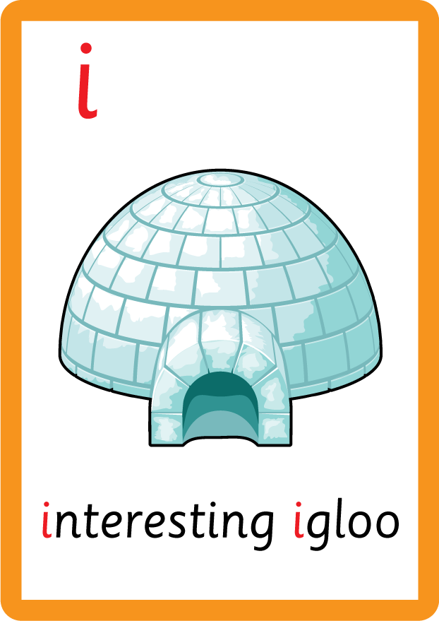









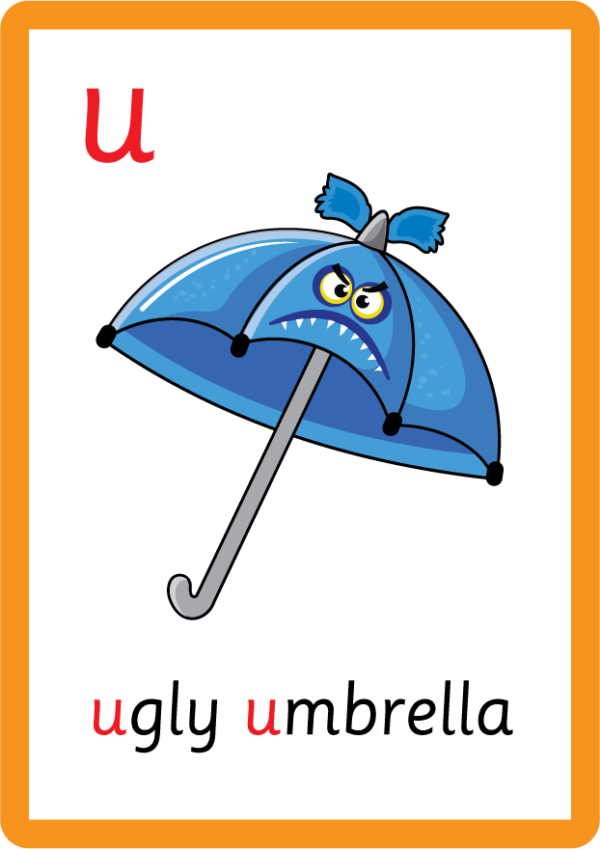
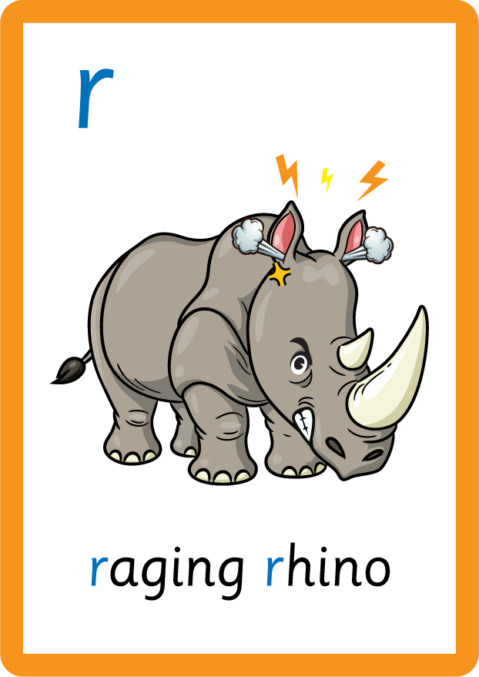







Recall all GPCs learned so far using flashcards.

Slide 4






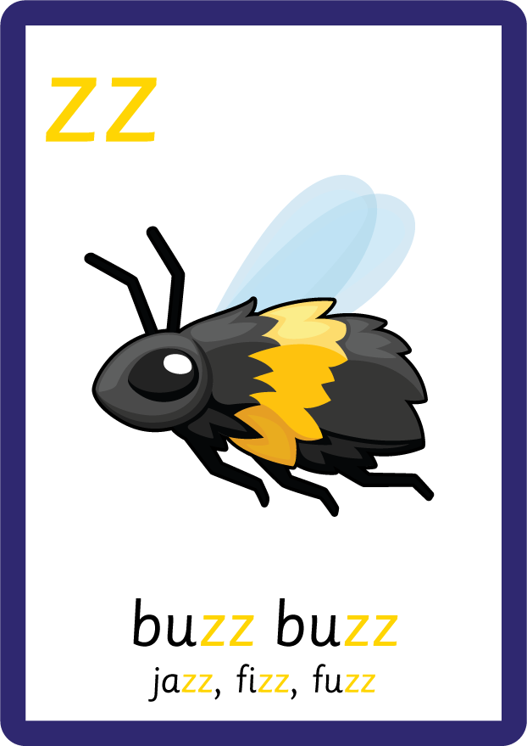











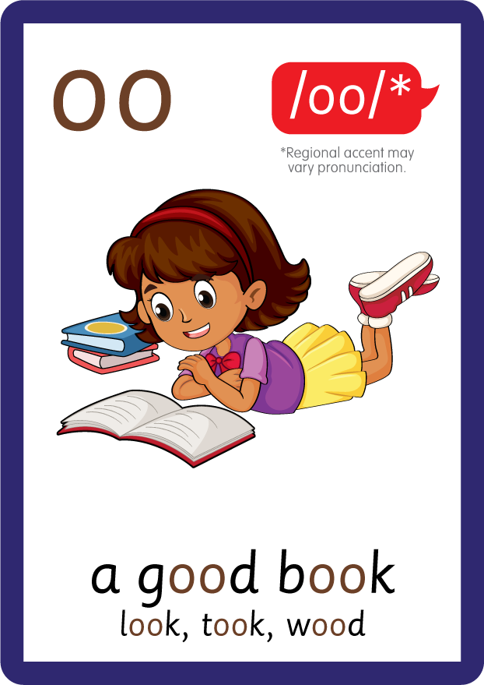









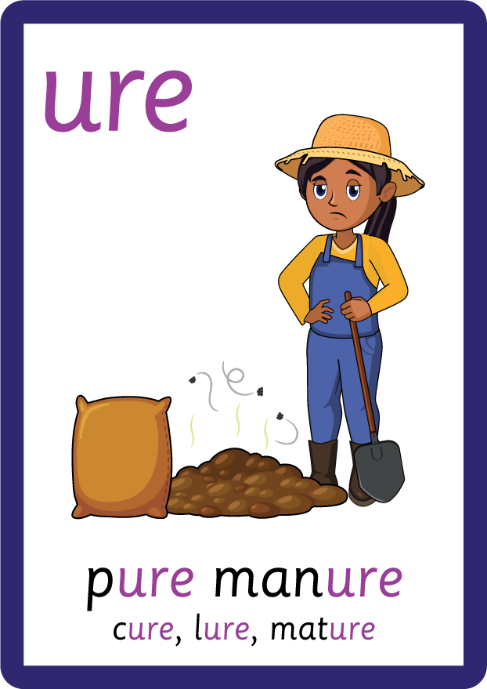
Recall all GPCs learned so far using flashcards.

Slide 5


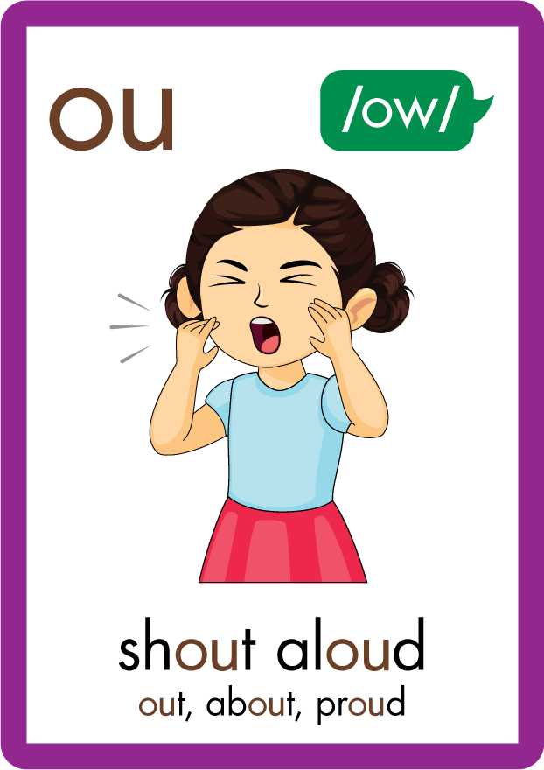
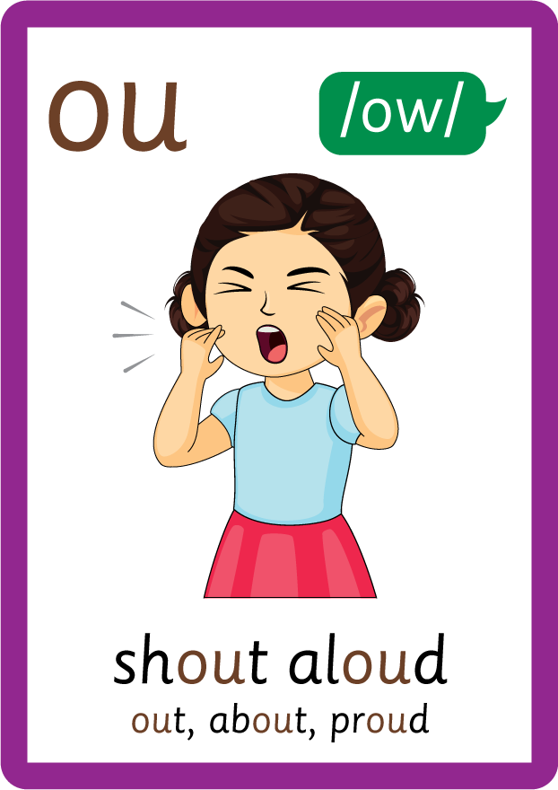




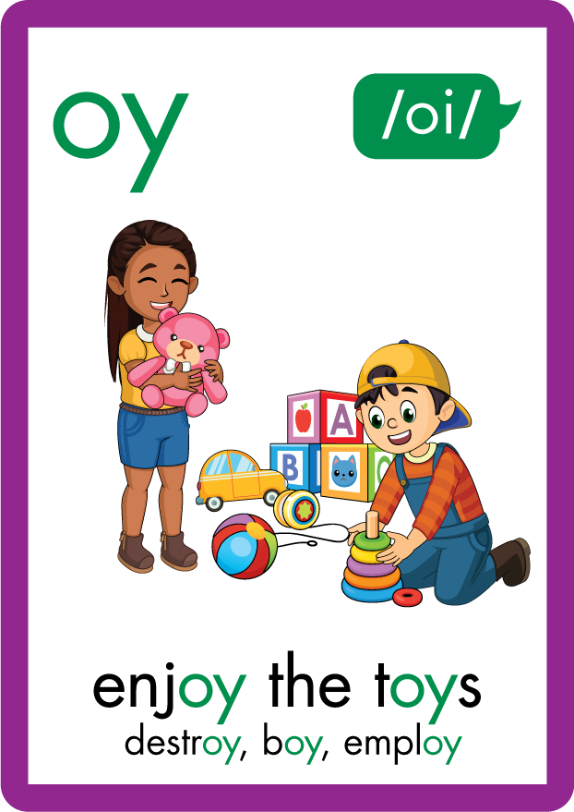
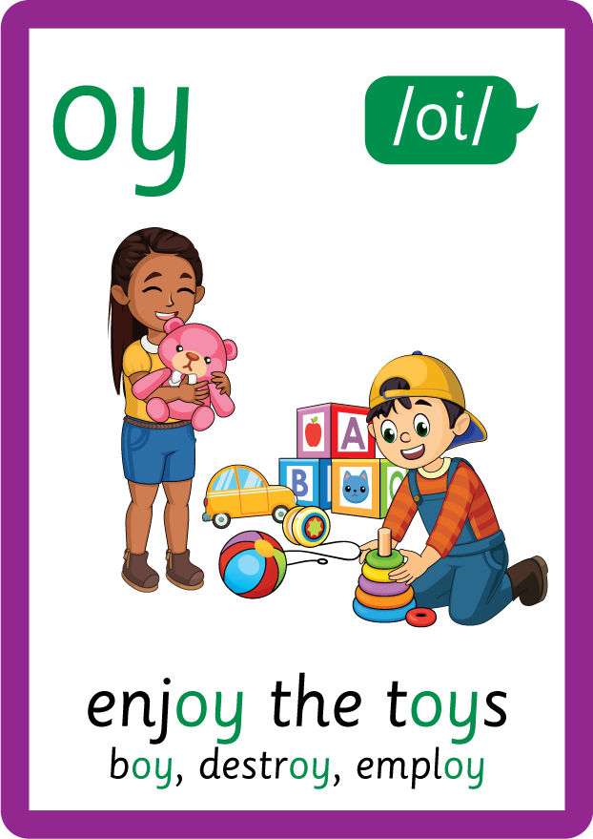
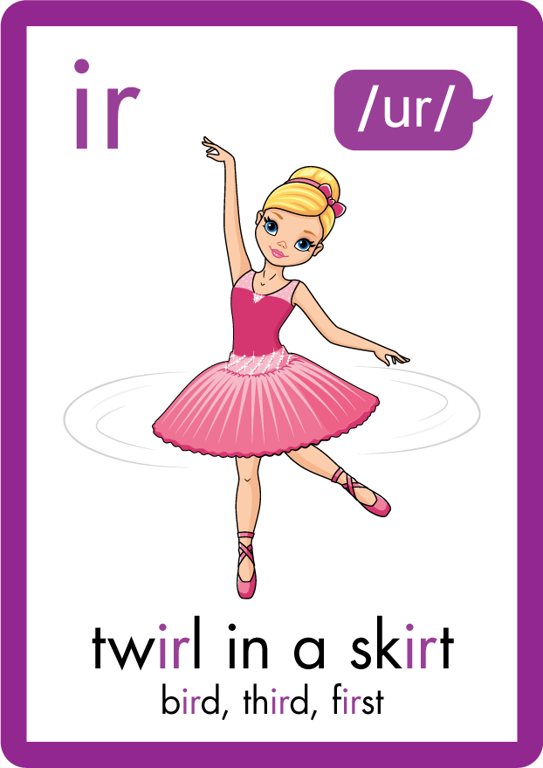
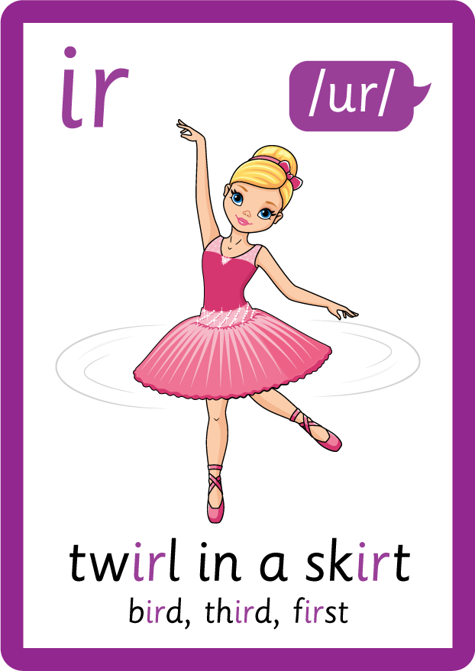








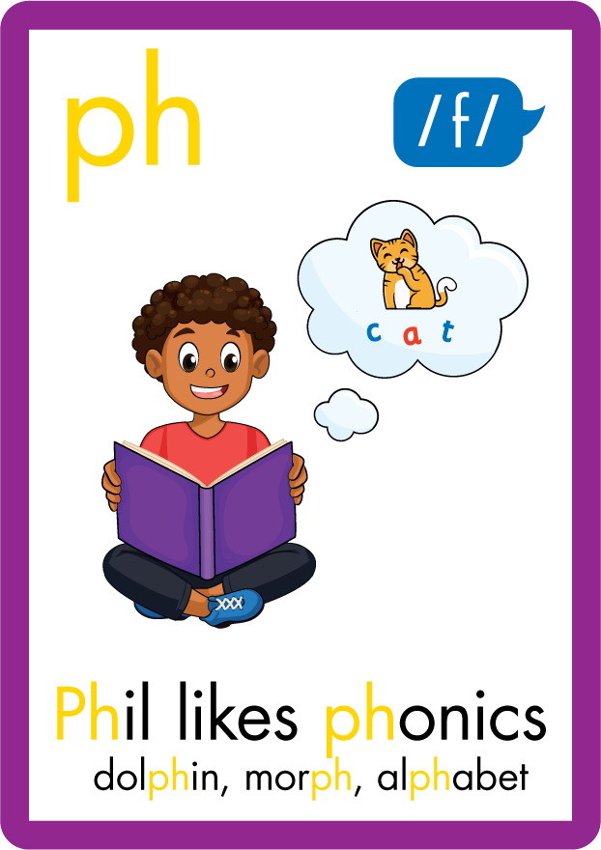



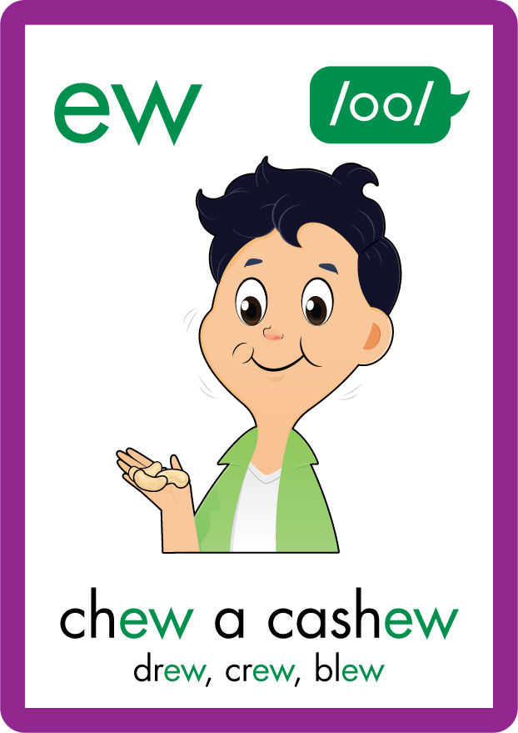






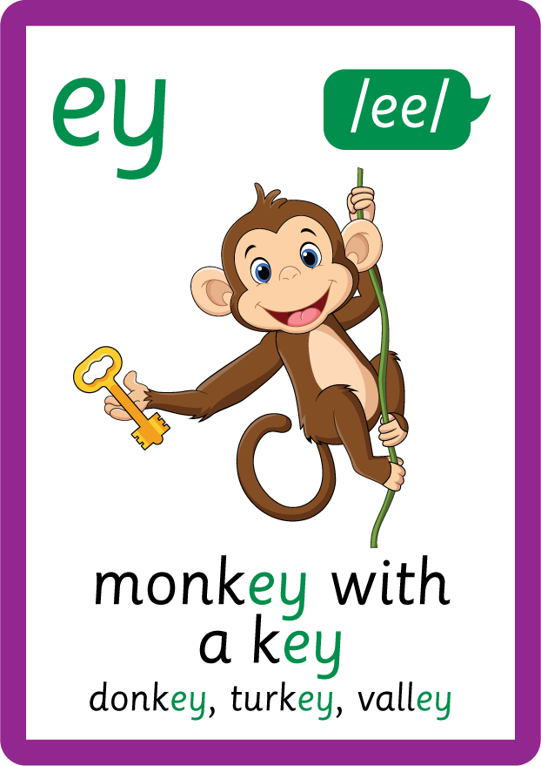


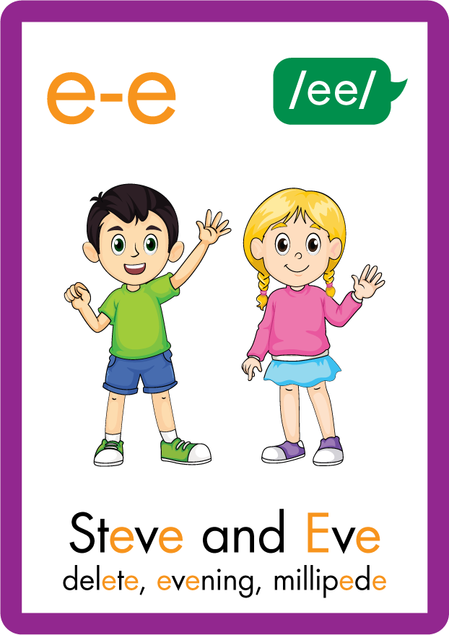






Recall all GPCs learned so far using flashcards.

Slide 6
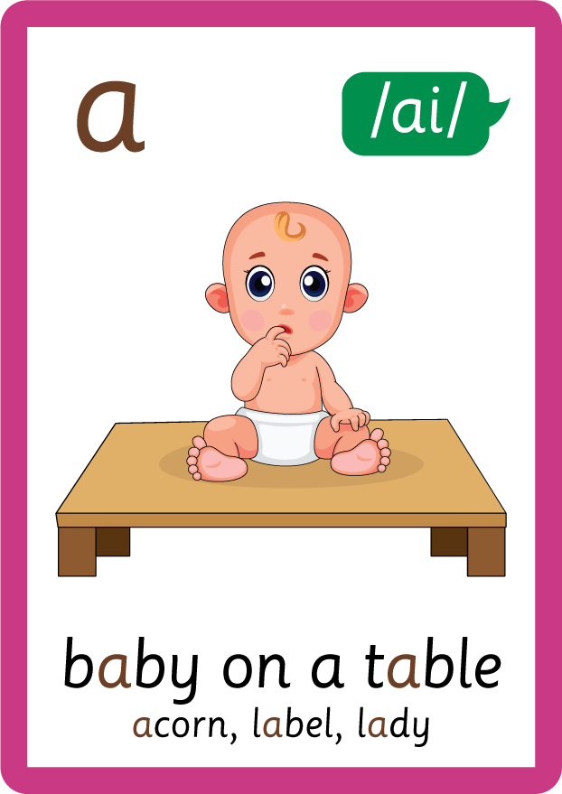


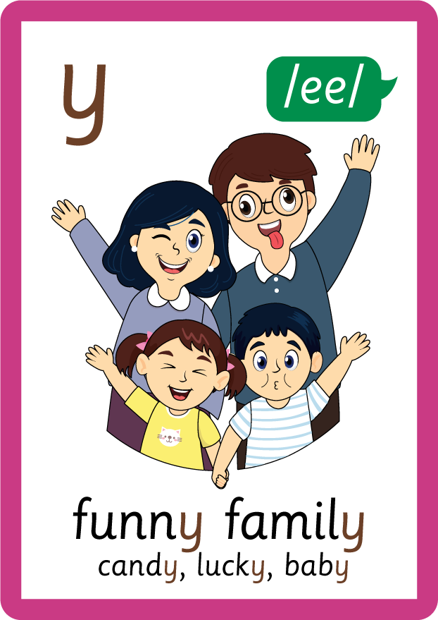
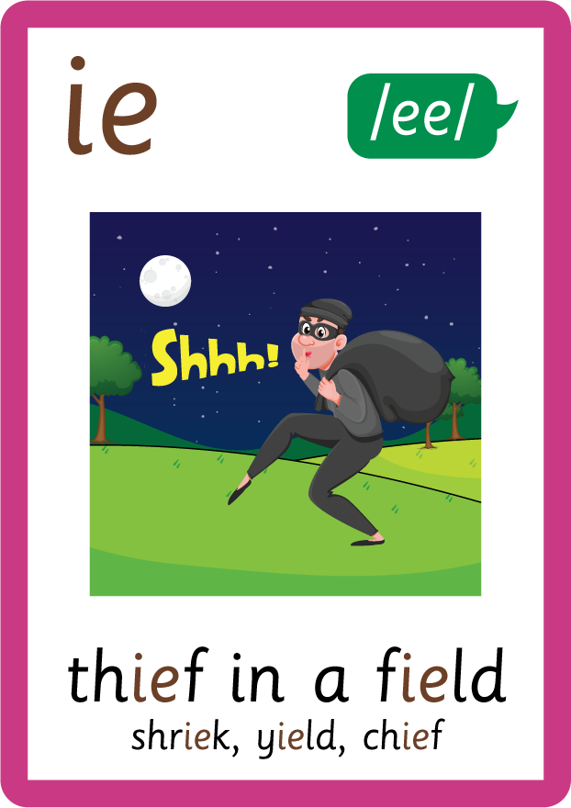
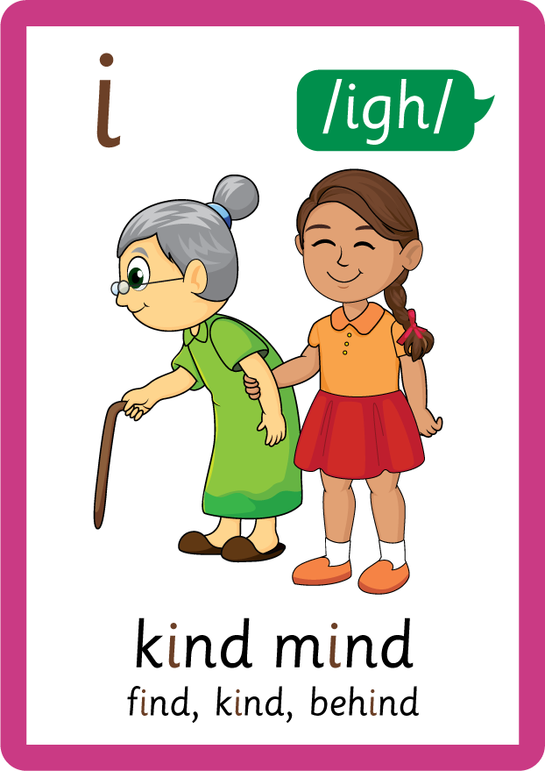






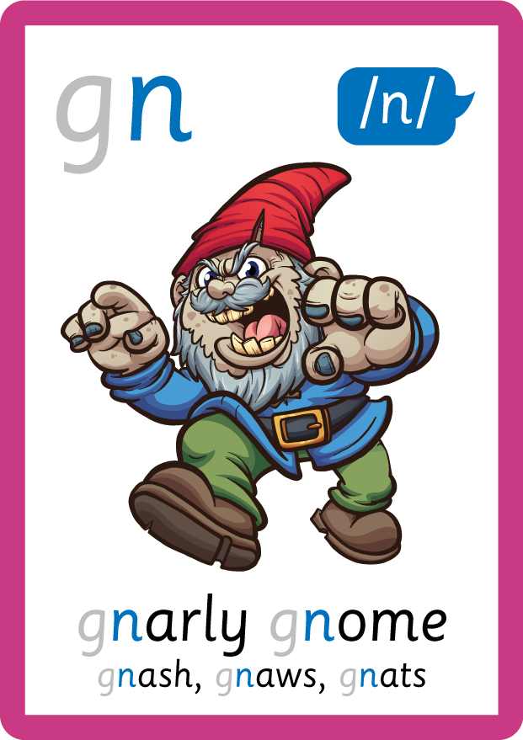
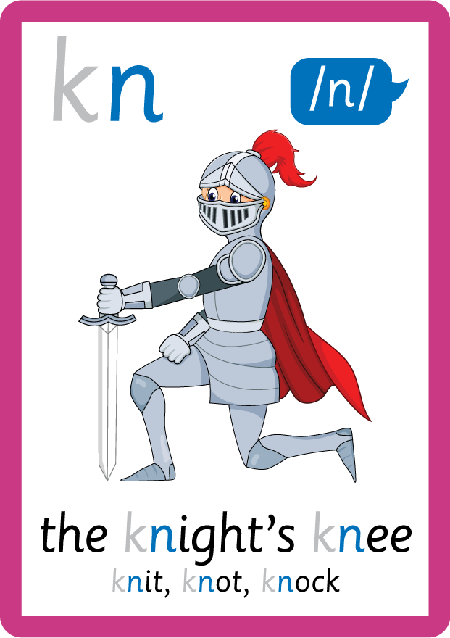

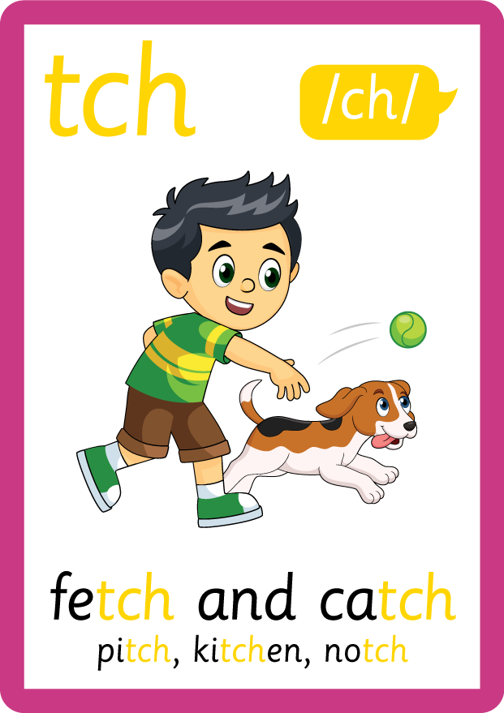
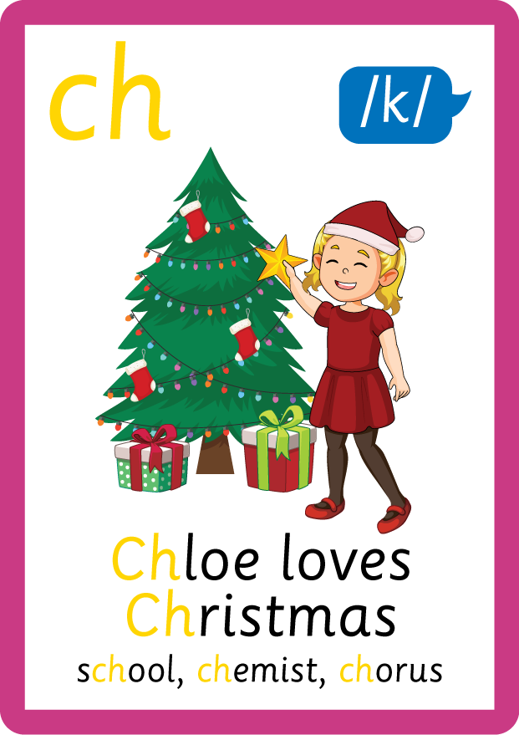
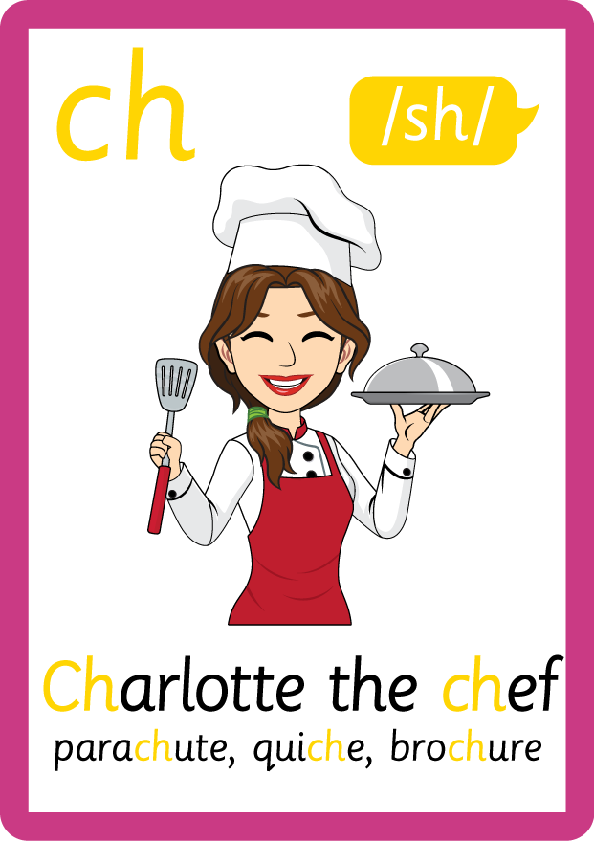
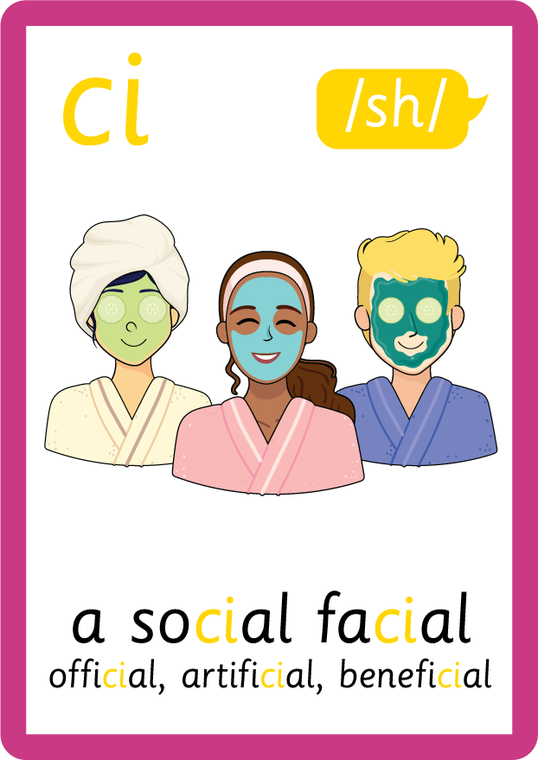
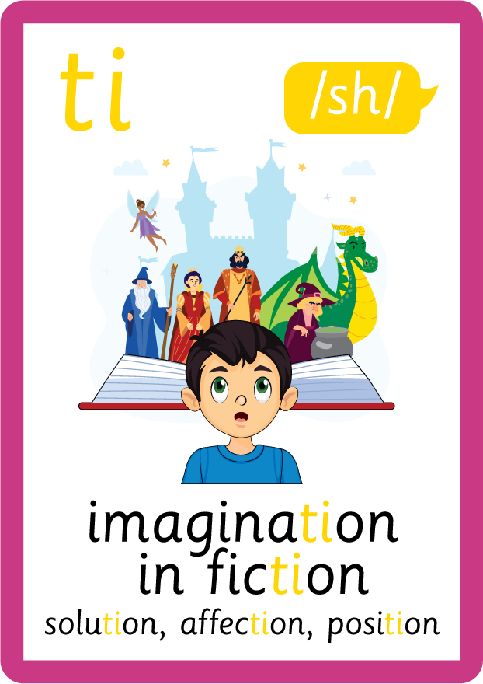



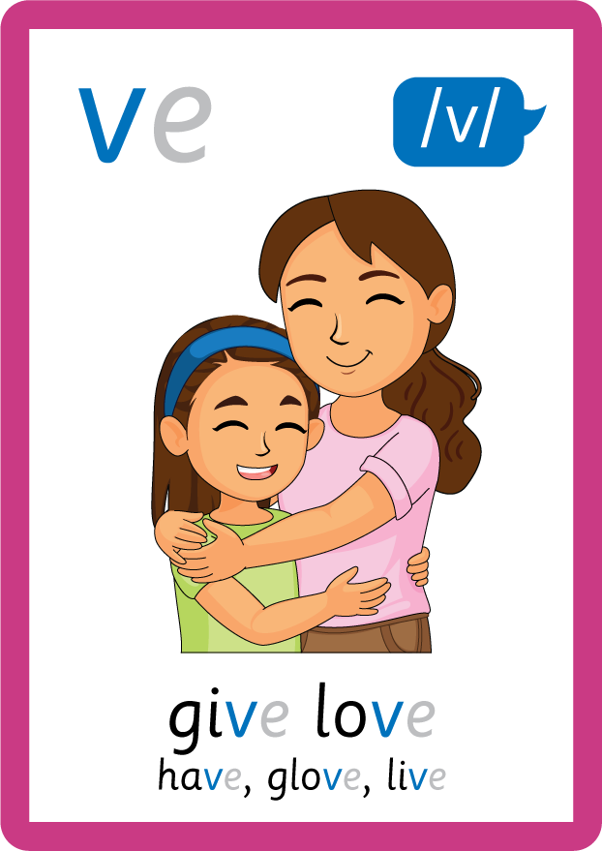
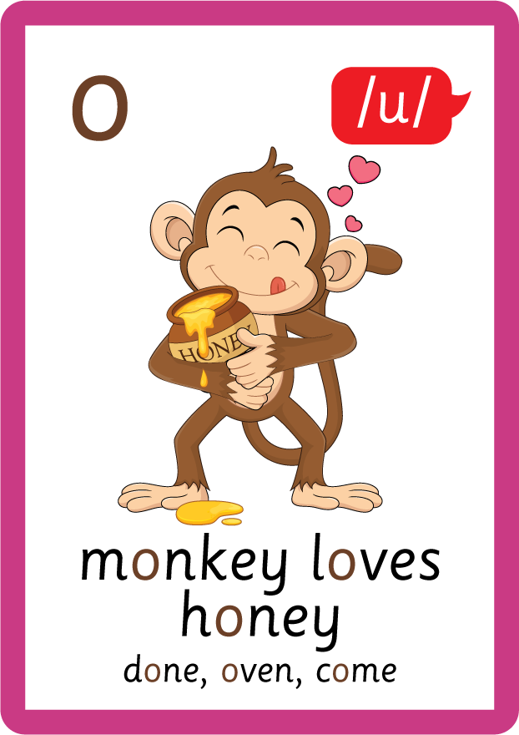
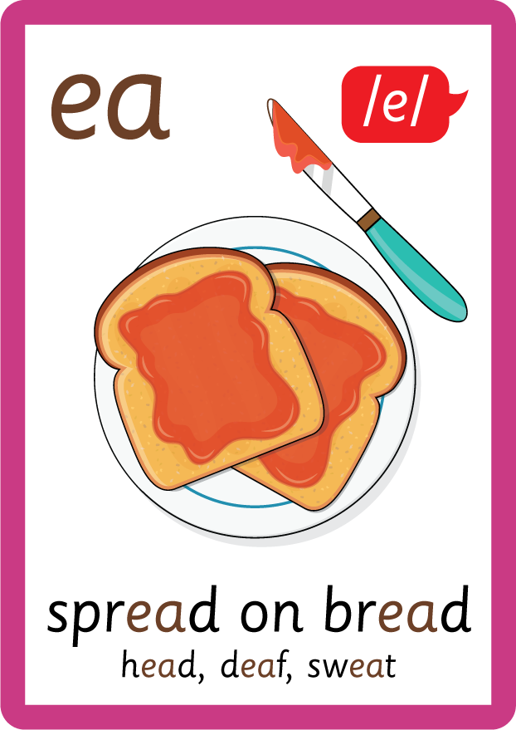




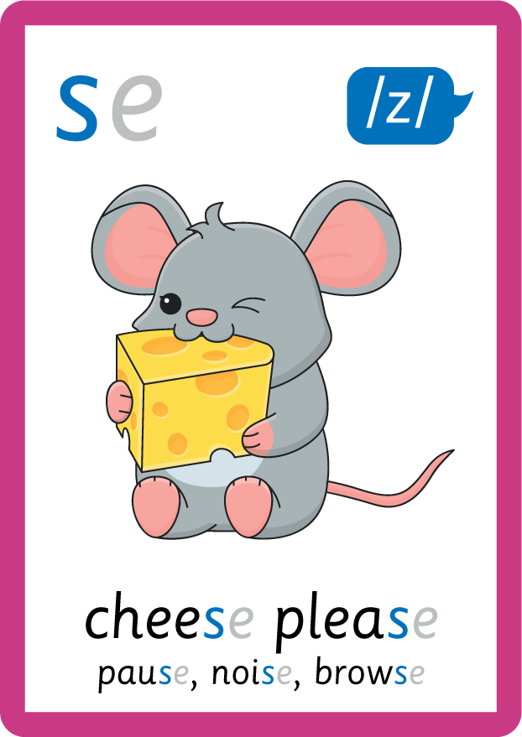
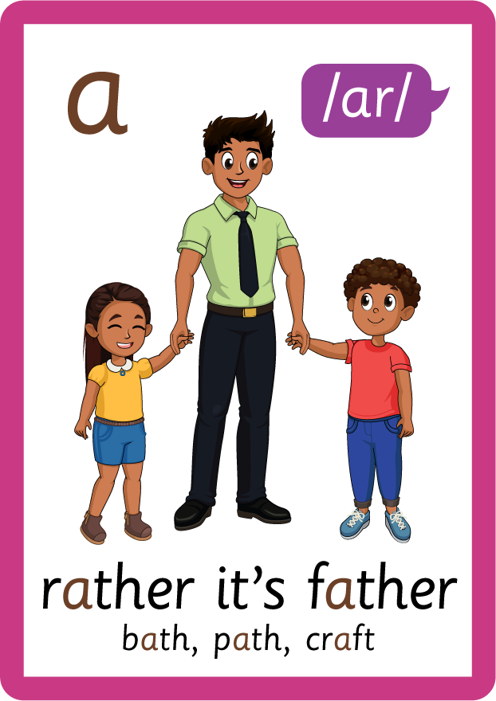


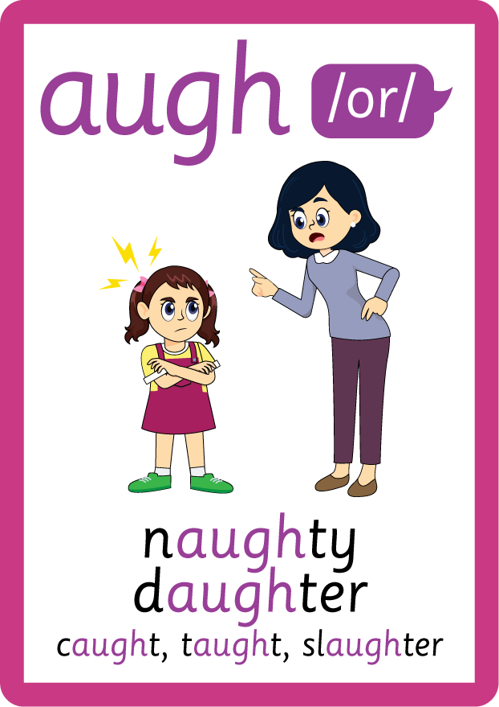
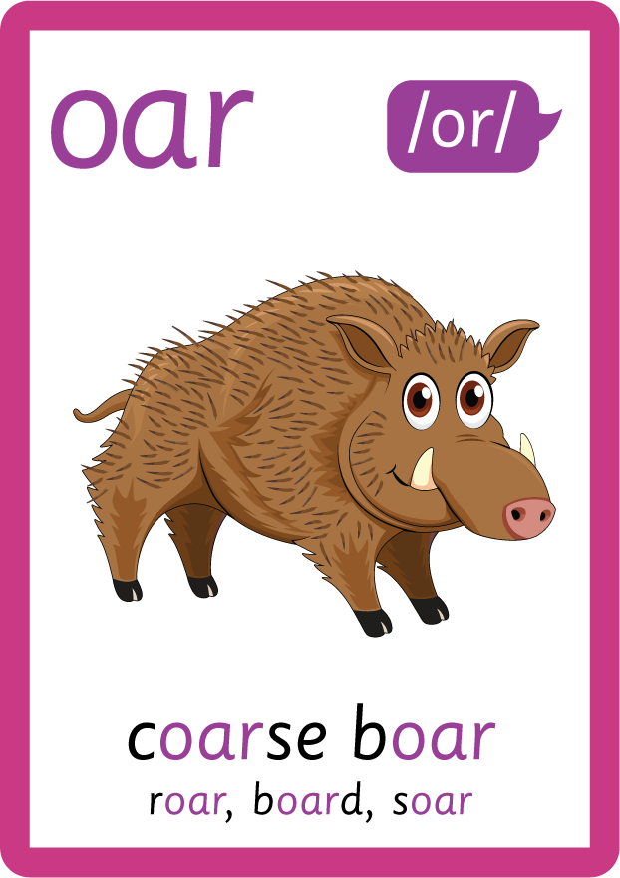




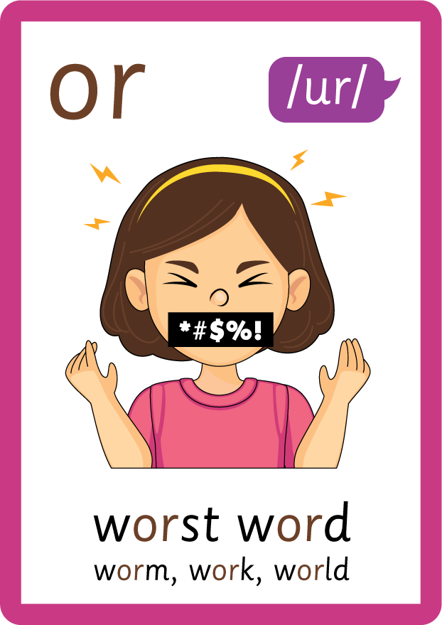
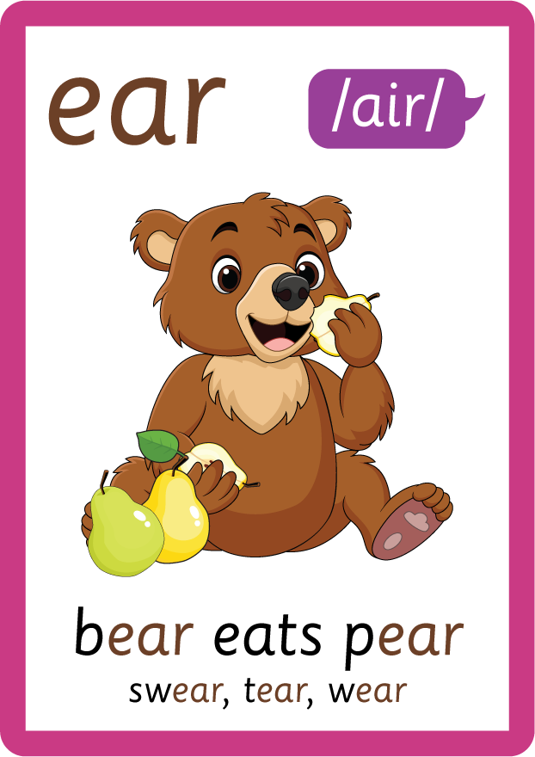
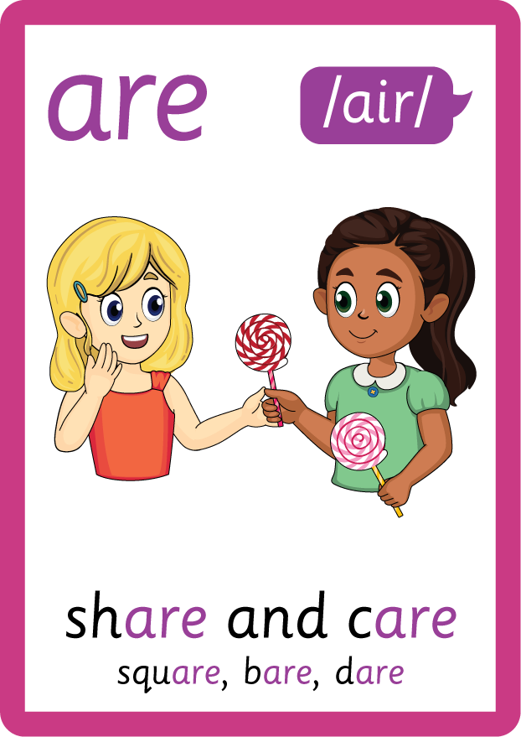
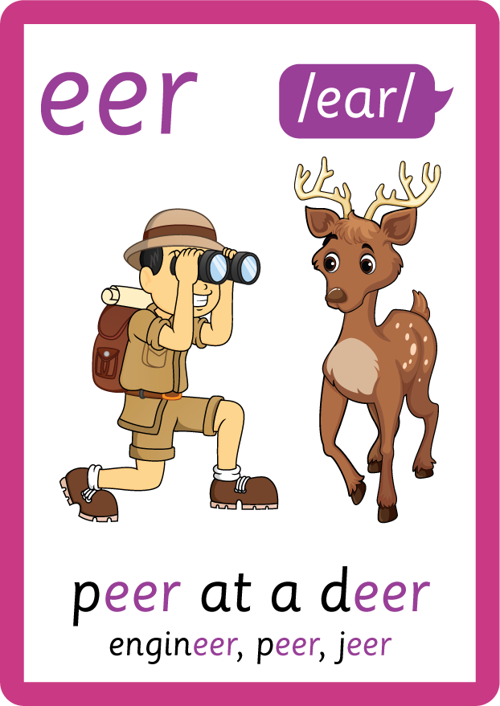

Recall all GPCs learned so far using flashcards.

Slide 7

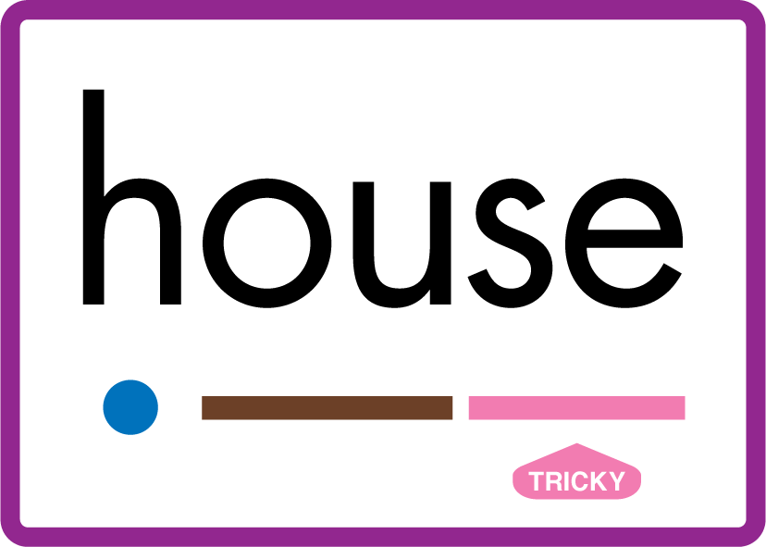
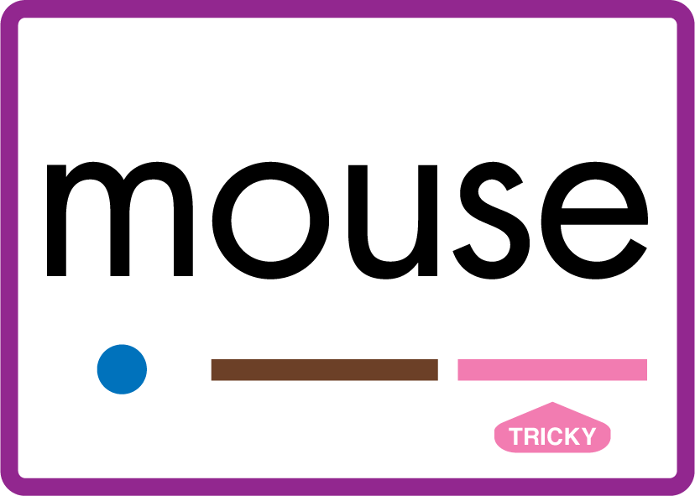
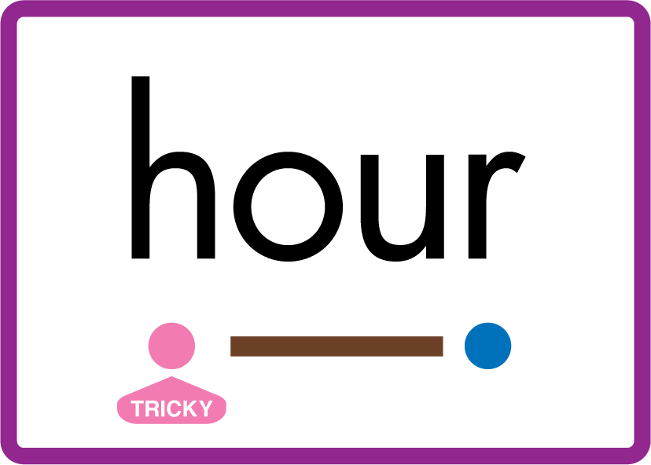










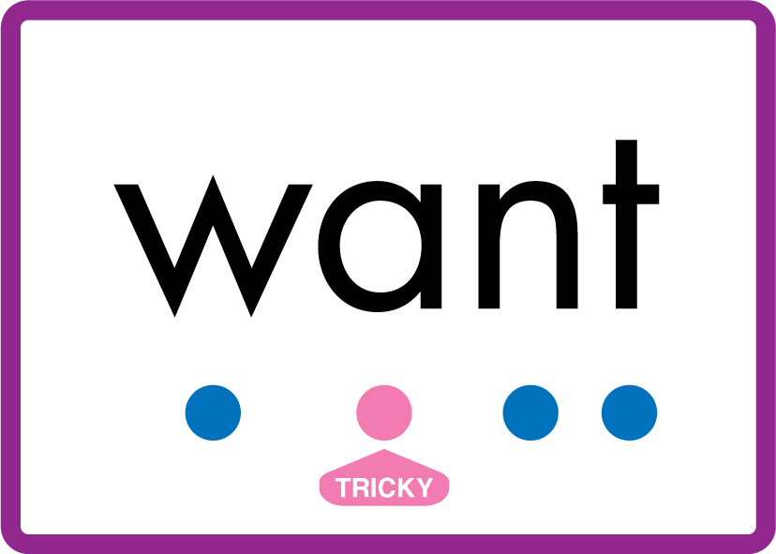
Review Phase 5 Common Exception Words today house mouse hour because Mr Mrs Ms where should could would move use want.

Slide 8
Teach Suffix Rule
When suffix -est is added to the end of an adjective, the adjective changes to a superlative adjective. A superlative adjective is an adjective used to say that something is the most of a certain quality / adjective than something else.
Spelling Rule: When the root word ends in letter ‘y’, the ‘y’ is changed to an ‘i’ and the suffix -est is added.

Slide 9
Demonstrate Using Examples
happy
drop ‘y’ and add ‘i’, then add suffix -est
happiest

Slide 10
Demonstrate Using Examples
grumpy
drop ‘y’ and add ‘i’, then add suffix -est
grumpiest

Slide 11
Demonstrate Using Examples
lonely
drop ‘y’ and add ‘i’, then add suffix -est
loneliest

Slide 12

Explain Decoding

Slide 13
Model Blending Phonemes
h
a
p
p
y
USING SOUND BUTTONS
Sound Buttons
Vowel
Consonant
Consonant Digraph
Multi Sound
Long Vowel Sound
R-controlled Digraph
Split Digraph
Syllable / Silent Letter

Slide 14
Model Blending Phonemes
h
a
p
p
i
e
s
t
USING SOUND BUTTONS
Sound Buttons
Vowel
Consonant
Consonant Digraph
Multi Sound
Long Vowel Sound
R-controlled Digraph
Split Digraph
Syllable / Silent Letter

Slide 15
Model Blending Phonemes
l
o
n
e
l
y
USING SOUND BUTTONS
Sound Buttons
Vowel
Consonant
Consonant Digraph
Multi Sound
Long Vowel Sound
R-controlled Digraph
Split Digraph
Syllable / Silent Letter

Slide 16
Model Blending Phonemes
l
o
n
e
i
e
s
l
t
USING SOUND BUTTONS
Sound Buttons
Vowel
Consonant
Consonant Digraph
Multi Sound
Long Vowel Sound
R-controlled Digraph
Split Digraph
Syllable / Silent Letter

Slide 17

Explain Encoding

Slide 18

Practise Adding Affixes
g
r
u
m
p
y
USING A PHONEME FRAME

Slide 19
Practise Adding Affixes
g
r
u
m
p
i
e
s
t
USING A PHONEME FRAME

Slide 20

Practise Building Words
PRACTISE – 10MINS
h
a
p
p
i
e
s
t
g
r
u
m
l
o-e
n
USING MAGNETIC LETTERS AND A WHITEBOARD
Sound Buttons
Vowel
Consonant
Consonant Digraph
Multi Sound
Long Vowel Sound
R-controlled Digraph
Split Digraph
Syllable / Silent Letter

Slide 21
Practise Building Words
PRACTISE – 10MINS
h
a
p
p
i
e
s
t
g
r
u
m
l
o-e
n
happiest grumpiest loneliest
USING MAGNETIC LETTERS AND A WHITEBOARD
Sound Buttons
Vowel
Consonant
Consonant Digraph
Multi Sound
Long Vowel Sound
R-controlled Digraph
Split Digraph
Syllable / Silent Letter

