Slide 1
-s and -es |  |  |  | -ing
-ed |  |  |  | -er
-est |  |  |  | un-
-est suffix
Lesson 24

Slide 2
Review and practise suffix -est.
Recall all GPCs learned so far using flashcards.
Recall Phase 5 Common Exception Words today house mouse hour because Mr Mrs Ms where should could would move use want.

Slide 3























Recall all GPCs learned so far using flashcards.

Slide 4





























Recall all GPCs learned so far using flashcards.

Slide 5









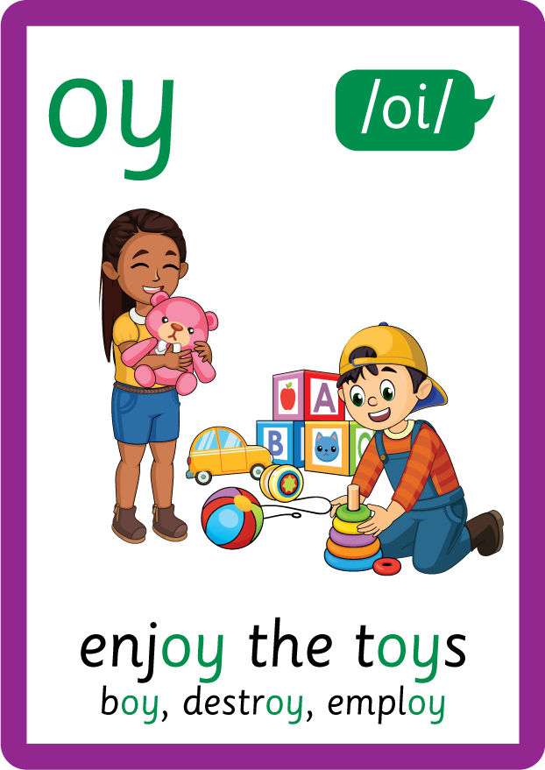
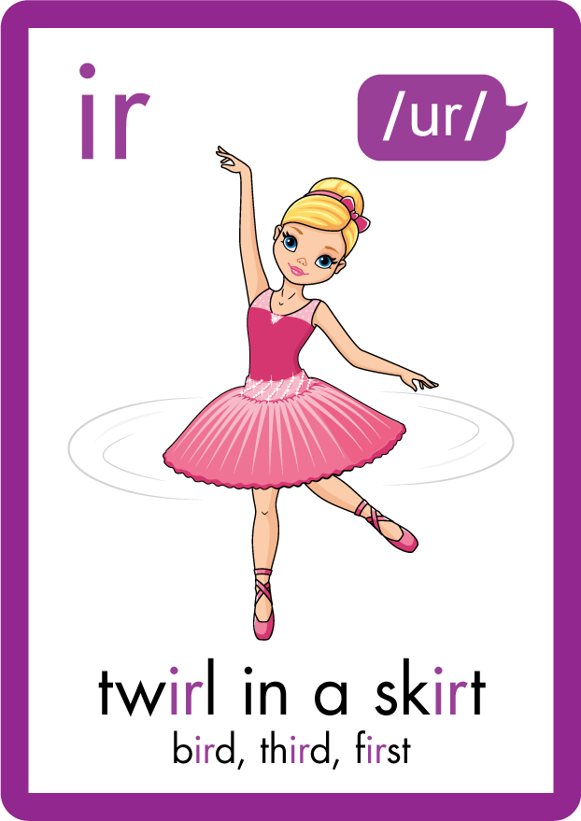
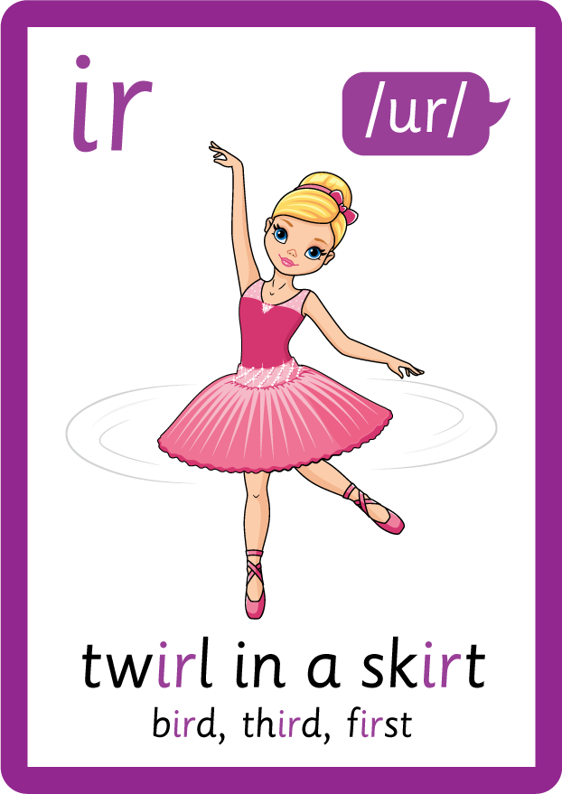












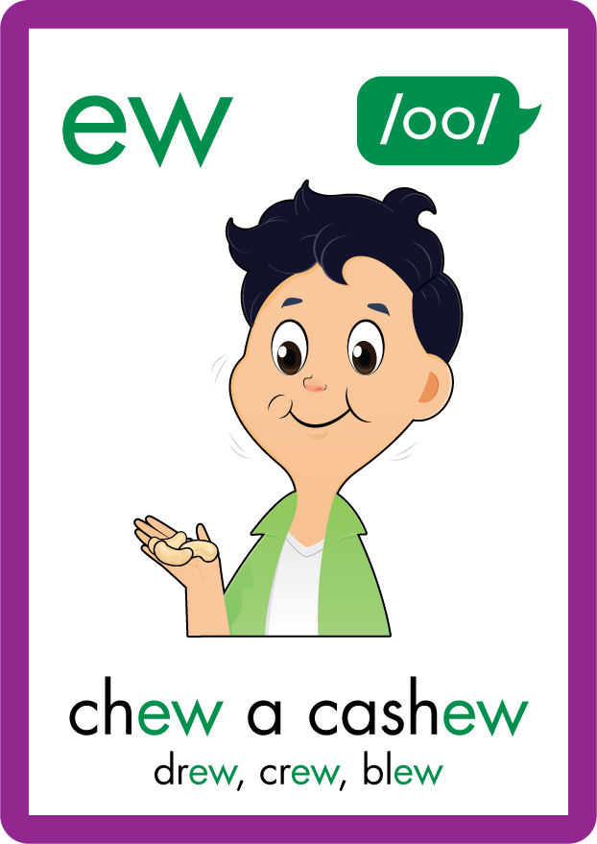









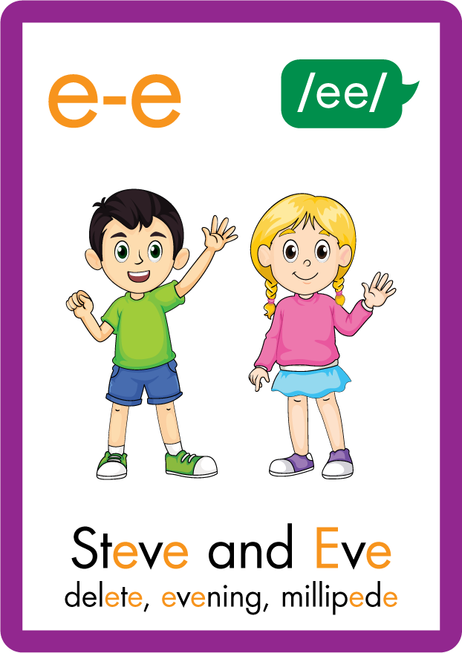






Recall all GPCs learned so far using flashcards.

Slide 6



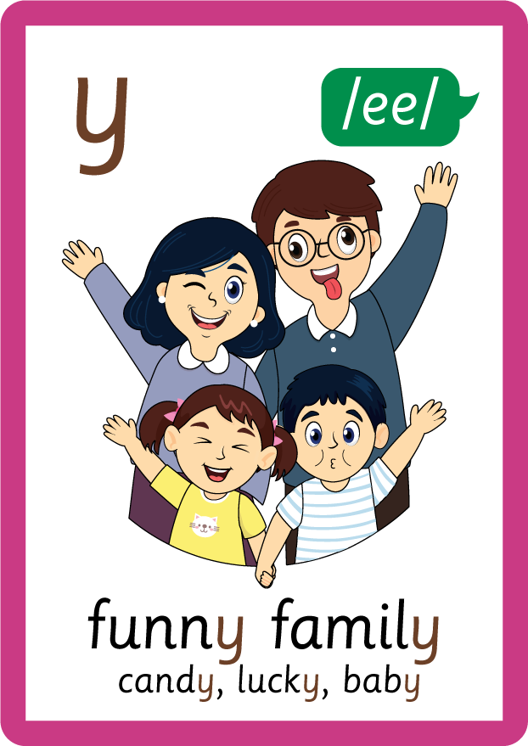
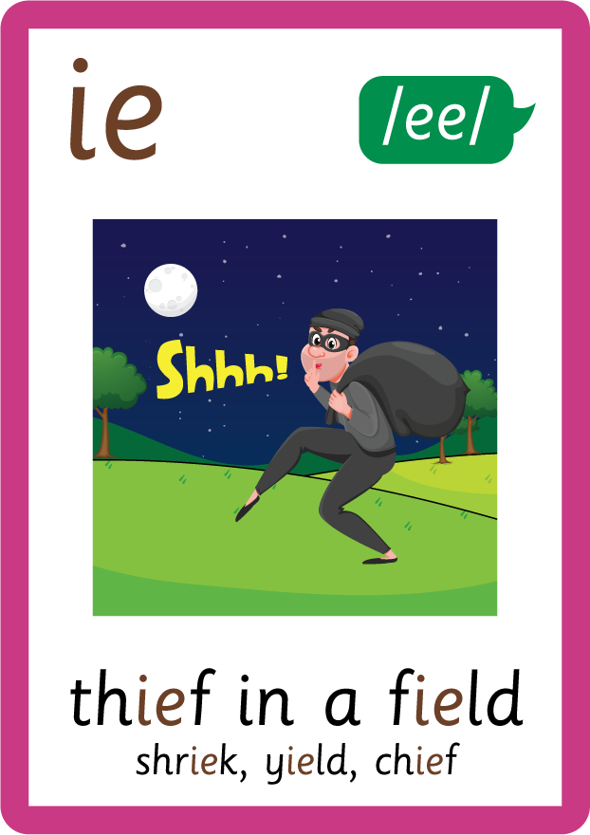





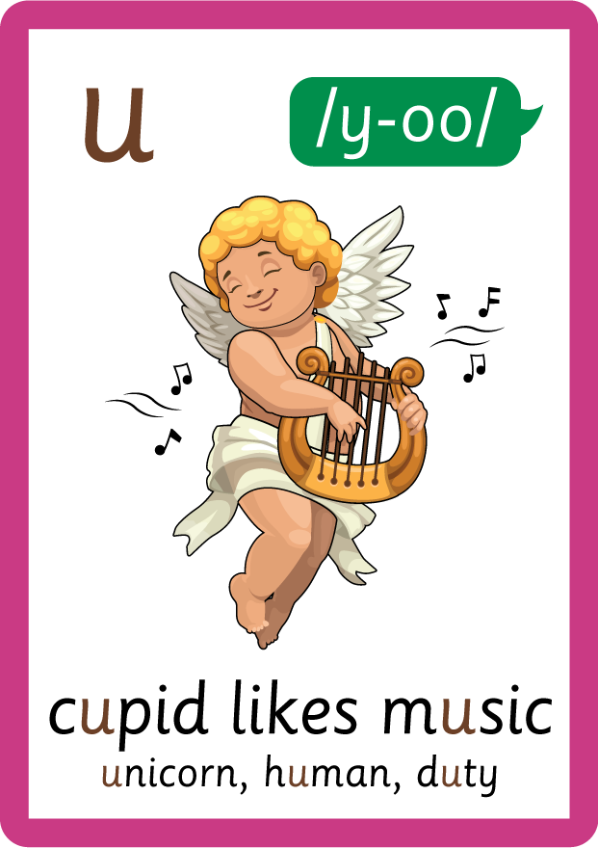

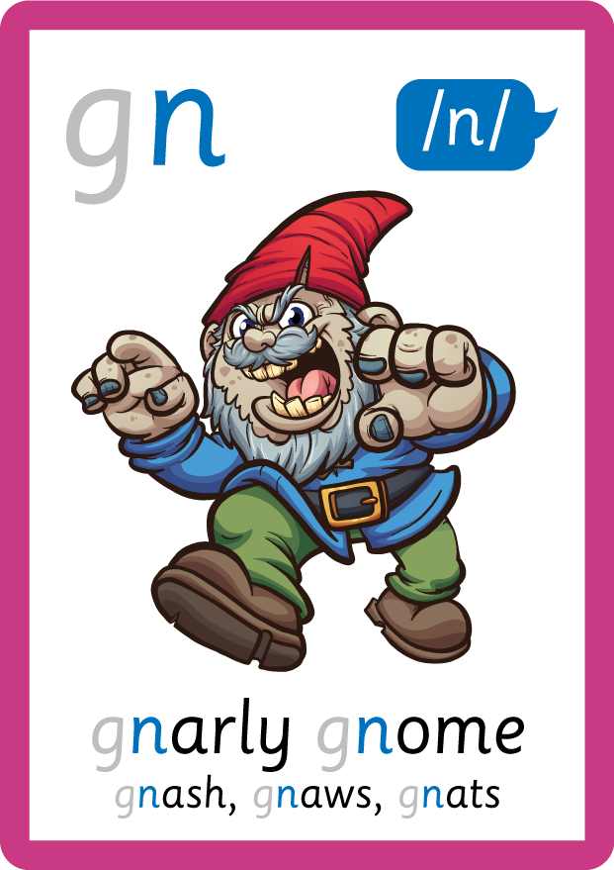
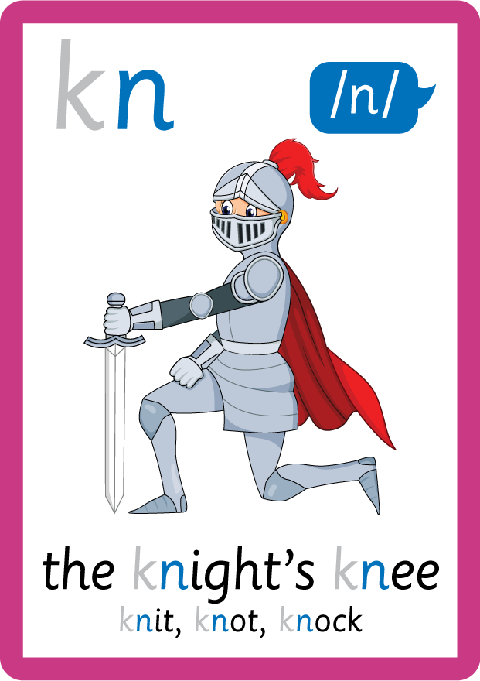

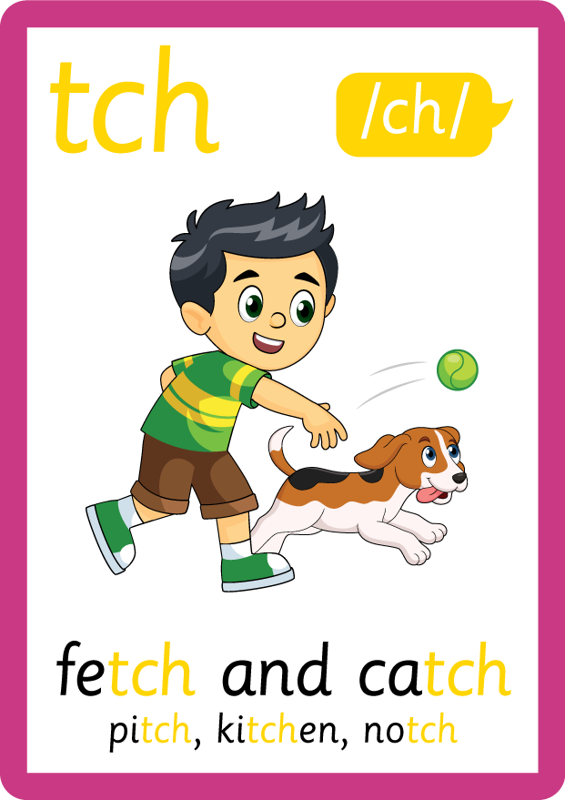
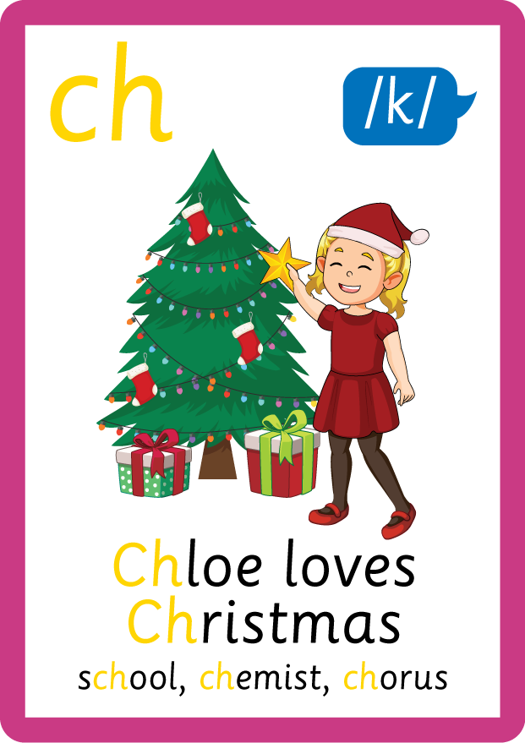

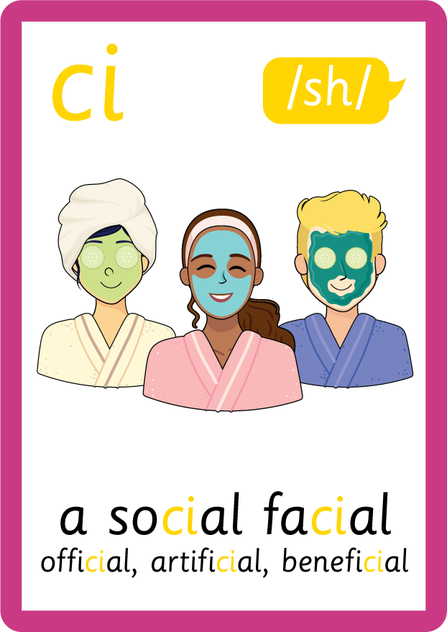
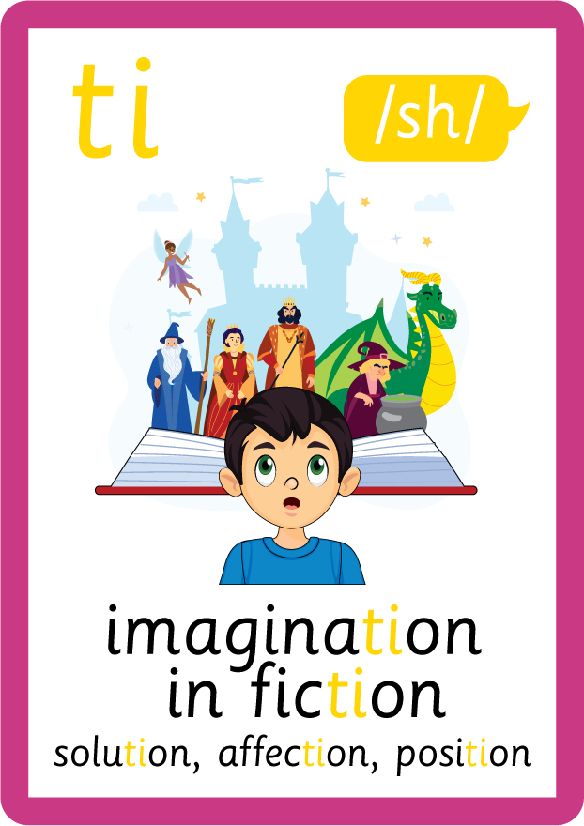



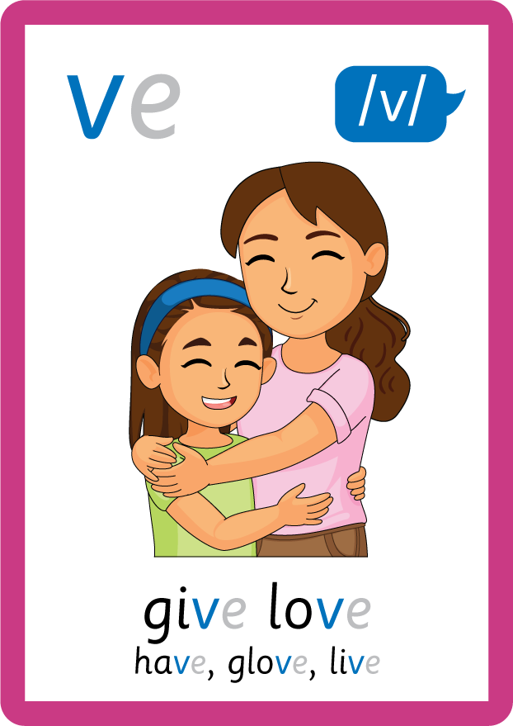

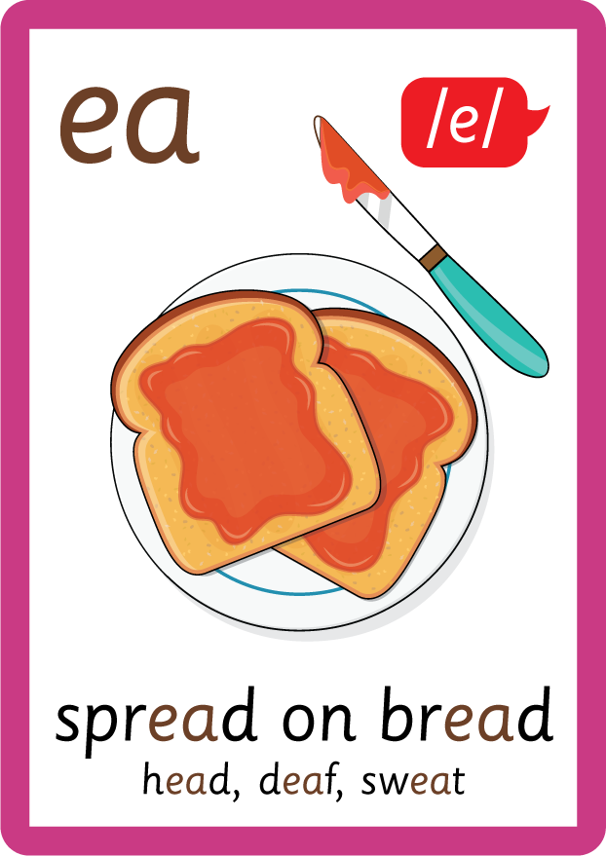




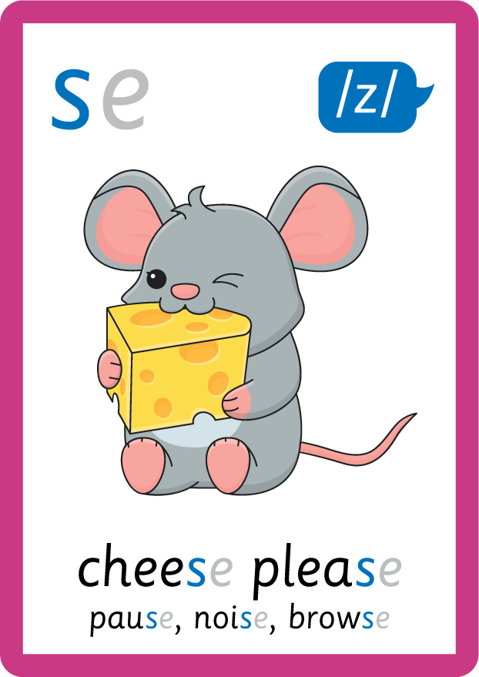
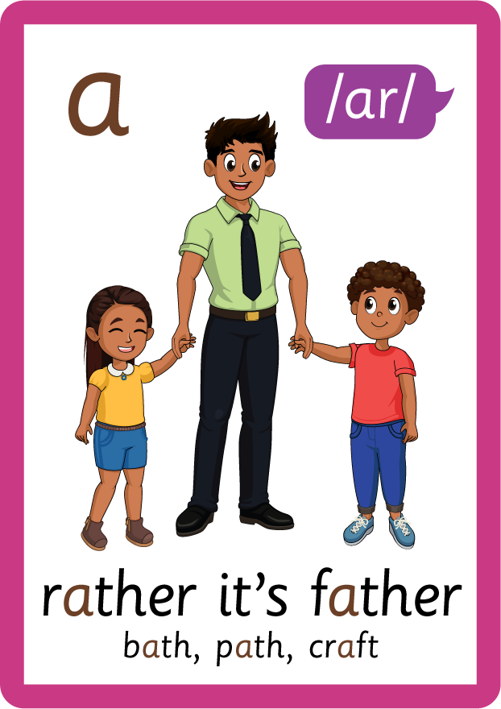


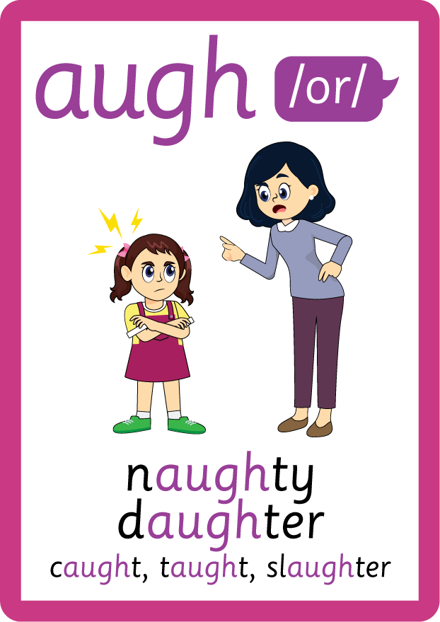
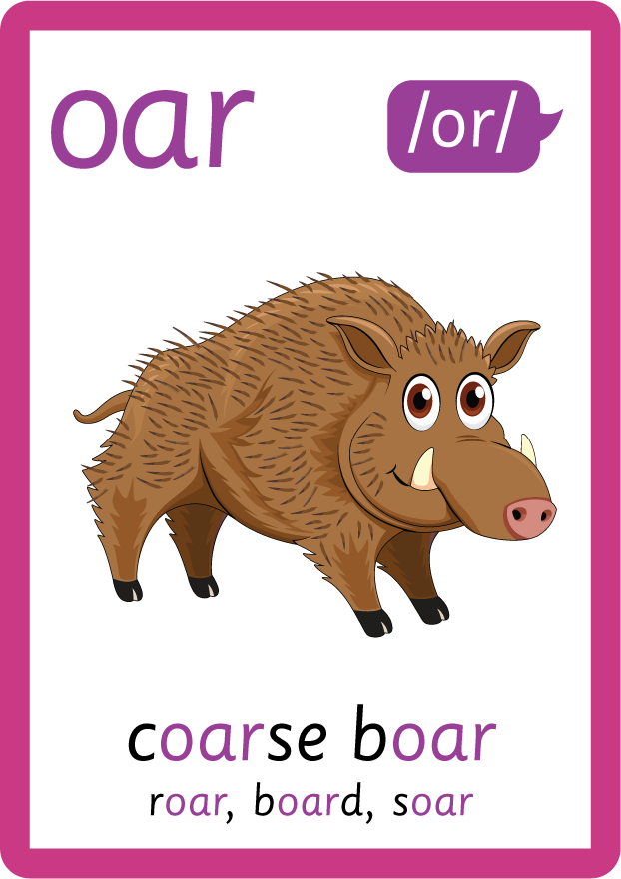




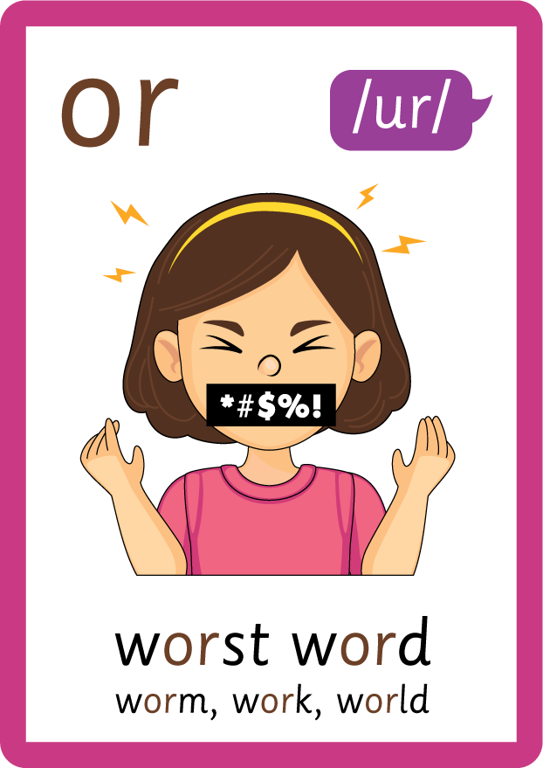
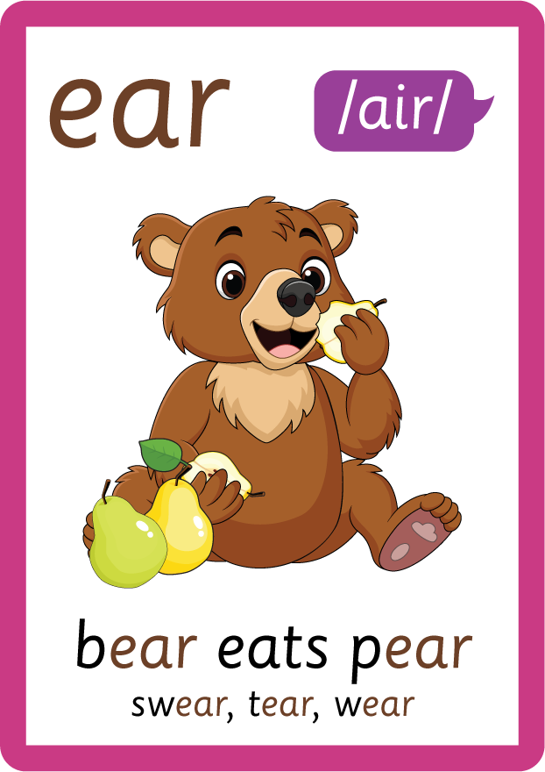

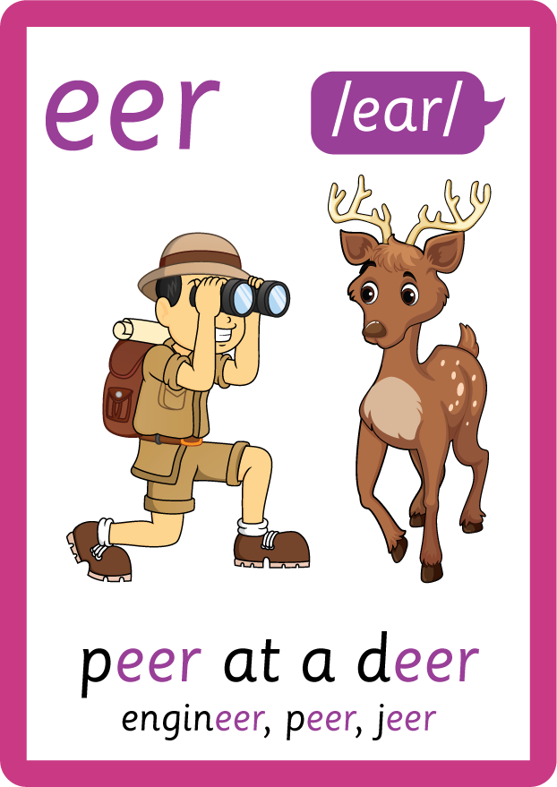

Recall all GPCs learned so far using flashcards.

Slide 7

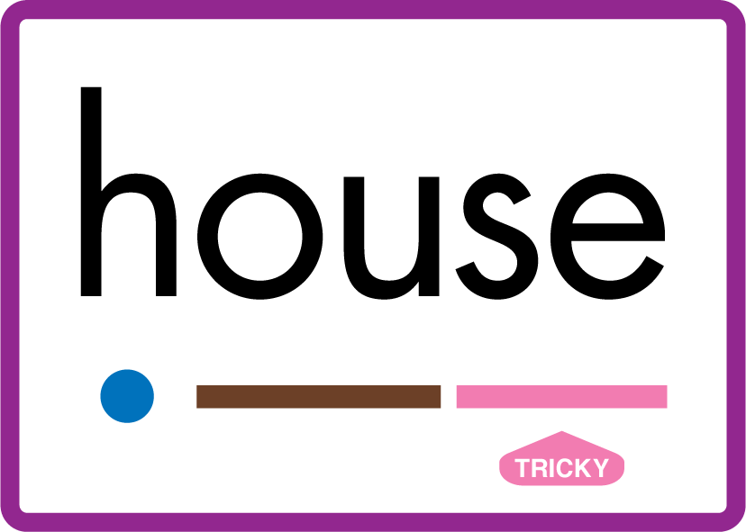












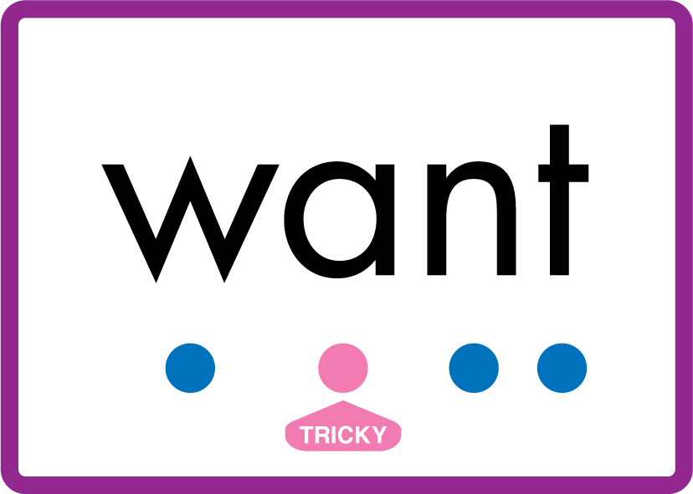
Review Phase 5 Common Exception Words today house mouse hour because Mr Mrs Ms where should could would move use want.

Slide 8
Teach Suffix Rule
When suffix -est is added to the end of an adjective, the adjective changes to a superlative adjective.
A superlative adjective is an adjective used to say that something is the most of a certain quality / adjective than something else.

Slide 9
Demonstrate Using Examples
long
either just add suffix, double consonant, drop y add i, or drop e
longest

Slide 10
Demonstrate Using Examples
weak
either just add suffix, double consonant, drop y add i, or drop e
weakest

Slide 11
Demonstrate Using Examples
mean
either just add suffix, double consonant, drop y add i, or drop e
meanest

Slide 12

Explain Decoding

Slide 13
Model Blending Phonemes
s
t
r
o
ng
USING SOUND BUTTONS
Sound Buttons
Vowel
Consonant
Consonant Digraph
Multi Sound
Long Vowel Sound
R-controlled Digraph
Split Digraph
Syllable / Silent Letter

Slide 14
Model Blending Phonemes
s
t
r
o
ng
e
s
t
USING SOUND BUTTONS
Sound Buttons
Vowel
Consonant
Consonant Digraph
Multi Sound
Long Vowel Sound
R-controlled Digraph
Split Digraph
Syllable / Silent Letter

Slide 15
Model Blending Phonemes
w
ea
k
USING SOUND BUTTONS
Sound Buttons
Vowel
Consonant
Consonant Digraph
Multi Sound
Long Vowel Sound
R-controlled Digraph
Split Digraph
Syllable / Silent Letter

Slide 16
Model Blending Phonemes
w
ea
k
e
s
t
USING SOUND BUTTONS
Sound Buttons
Vowel
Consonant
Consonant Digraph
Multi Sound
Long Vowel Sound
R-controlled Digraph
Split Digraph
Syllable / Silent Letter

Slide 17

Explain Encoding

Slide 18

Practise Adding Affixes
m
ea
n
USING A PHONEME FRAME

Slide 19
Practise Adding Affixes
m
ea
n
e
s
t
USING A PHONEME FRAME

Slide 20

Practise Building Words
PRACTISE – 10MINS
t
n
e
s
t
w
ea
k
b
r
igh
USING MAGNETIC LETTERS AND A WHITEBOARD
Sound Buttons
Vowel
Consonant
Consonant Digraph
Multi Sound
Long Vowel Sound
R-controlled Digraph
Split Digraph
Syllable / Silent Letter

Slide 21
Practise Building Words
PRACTISE – 10MINS
t
n
e
s
t
w
ea
k
b
r
igh
neatest weakest brightest
USING MAGNETIC LETTERS AND A WHITEBOARD
Sound Buttons
Vowel
Consonant
Consonant Digraph
Multi Sound
Long Vowel Sound
R-controlled Digraph
Split Digraph
Syllable / Silent Letter

