Slide 1
-s and -es |  |  |  | -ing
-ed |  |  |  | -er
-est |  |  |  | un-
un- prefix (verb)
Lesson 28

Slide 2
Learn and practise un- prefix.
Recall all GPCs learned so far using flashcards.
Recall Phase 5 Common Exception Words today house mouse hour because Mr Mrs Ms where should could would move use want.

Slide 3























Recall all GPCs learned so far using flashcards.

Slide 4





























Recall all GPCs learned so far using flashcards.

Slide 5









































Recall all GPCs learned so far using flashcards.

Slide 6
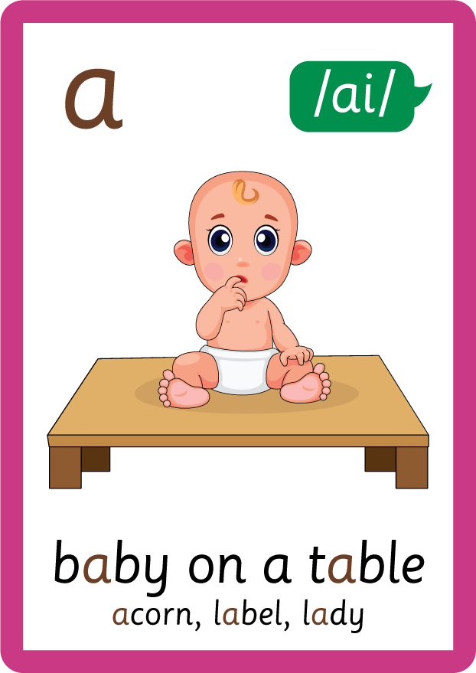





























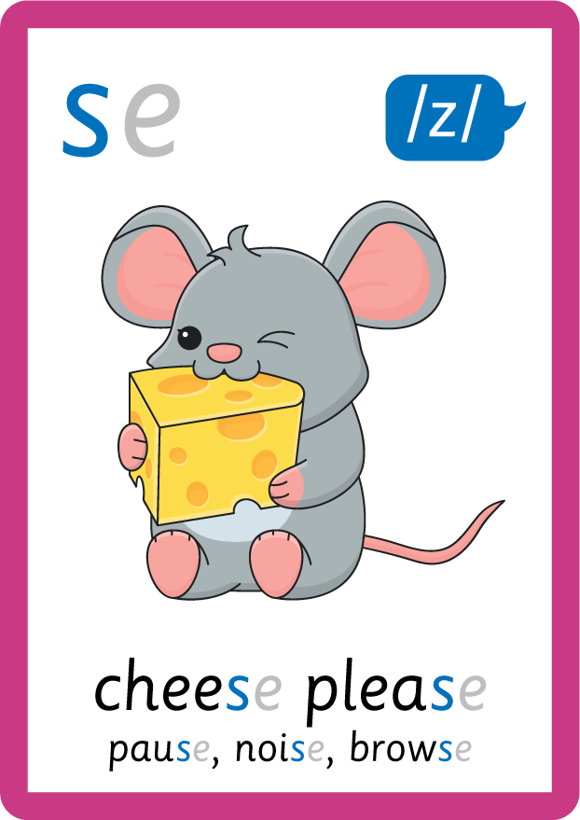









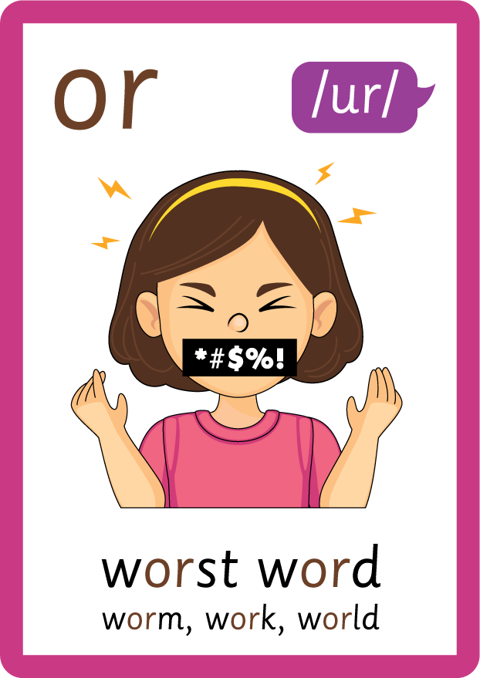




Recall all GPCs learned so far using flashcards.

Slide 7















Review Phase 5 Common Exception Words today house mouse hour because Mr Mrs Ms where should could would move use want.

Slide 8
Teach Suffix Rule
When prefix un- is added before a root word, it changes the meaning to the opposite or reverse of the root word.

Slide 9
Demonstrate Using Examples
pack
add prefix un- before root word
unpack

Slide 10

Explain Decoding

Slide 11
Model Blending Phonemes
p
a
ck
USING SOUND BUTTONS
Sound Buttons
Vowel
Consonant
Consonant Digraph
Multi Sound
Long Vowel Sound
R-controlled Digraph
Split Digraph
Syllable / Silent Letter

Slide 12
Model Blending Phonemes
u
n
p
a
ck
USING SOUND BUTTONS
Sound Buttons
Vowel
Consonant
Consonant Digraph
Multi Sound
Long Vowel Sound
R-controlled Digraph
Split Digraph
Syllable / Silent Letter

Slide 13
Model Blending Phonemes
b
o
x
USING SOUND BUTTONS
Sound Buttons
Vowel
Consonant
Consonant Digraph
Multi Sound
Long Vowel Sound
R-controlled Digraph
Split Digraph
Syllable / Silent Letter

Slide 14
Model Blending Phonemes
u
n
b
o
x
USING SOUND BUTTONS
Sound Buttons
Vowel
Consonant
Consonant Digraph
Multi Sound
Long Vowel Sound
R-controlled Digraph
Split Digraph
Syllable / Silent Letter

Slide 15

Explain Encoding

Slide 16


Practise Adding Affixes
PRACTISE – 10MINS
f
o
l
d
USING A PHONEME FRAME

Slide 17
Practise Adding Affixes
PRACTISE – 10MINS
u
n
f
o
l
d
USING A PHONEME FRAME

Slide 18
Practise Building Words
PRACTISE – 10MINS
u
n
r
f
l
d
z
i
o
p
ll
USING MAGNETIC LETTERS AND A WHITEBOARD

Slide 19
Practise Building Words
PRACTISE – 10MINS
u
n
r
f
l
d
z
i
o
p
ll
unroll unfold unzip
USING MAGNETIC LETTERS AND A WHITEBOARD

