Slide 1
-s and -es |  |  |  | -ing
-ed |  |  |  | -er
-est |  |  |  | un-
Plural Exceptions
Lesson 3

Slide 2
Learn and practise plural exceptions (e.g. children).
Recall all GPCs learned so far using flashcards.

Slide 3


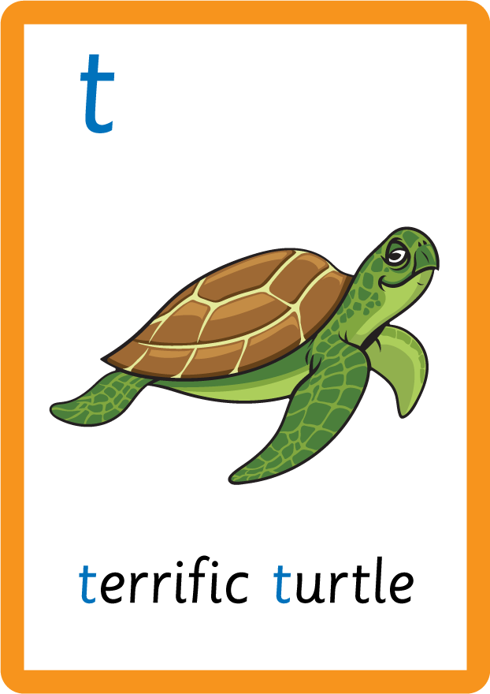

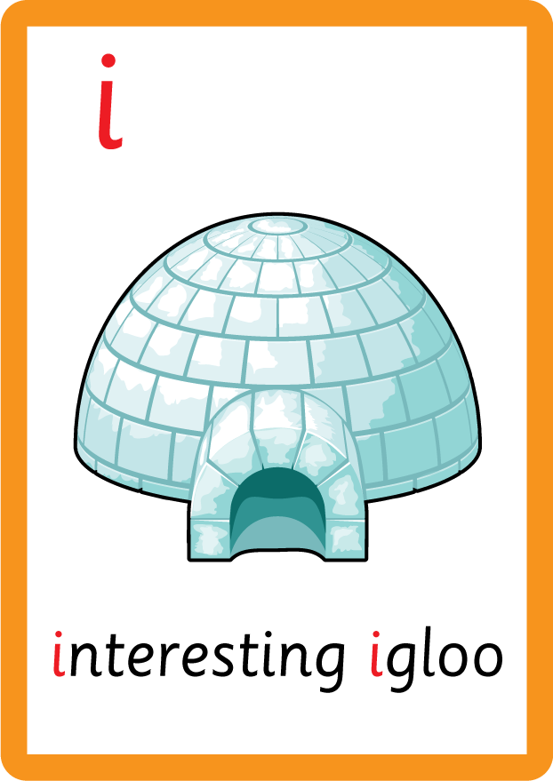









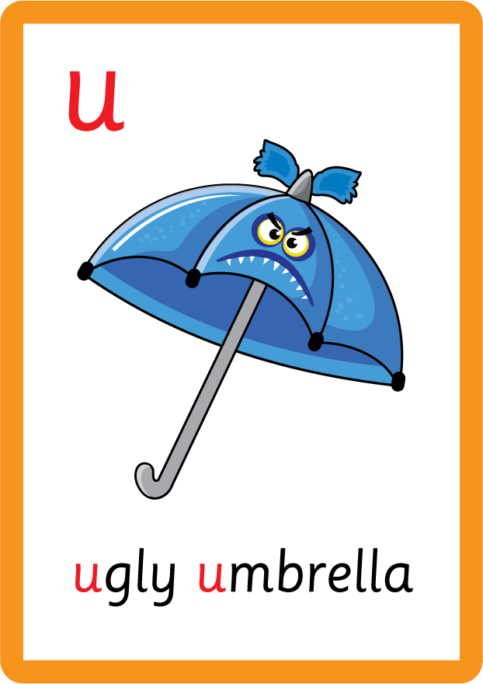
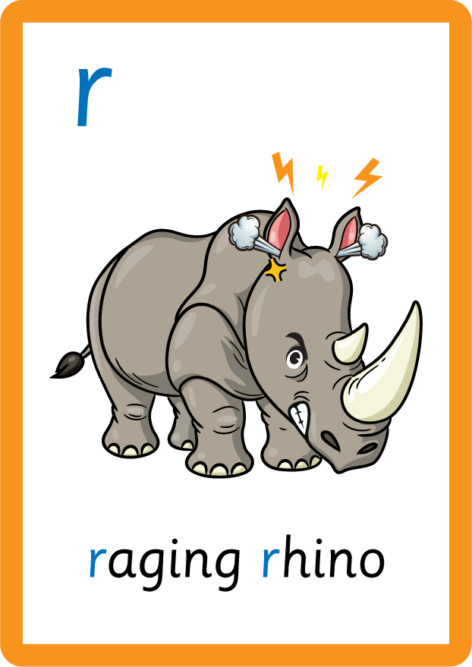







Recall all GPCs learned so far using flashcards.

Slide 4






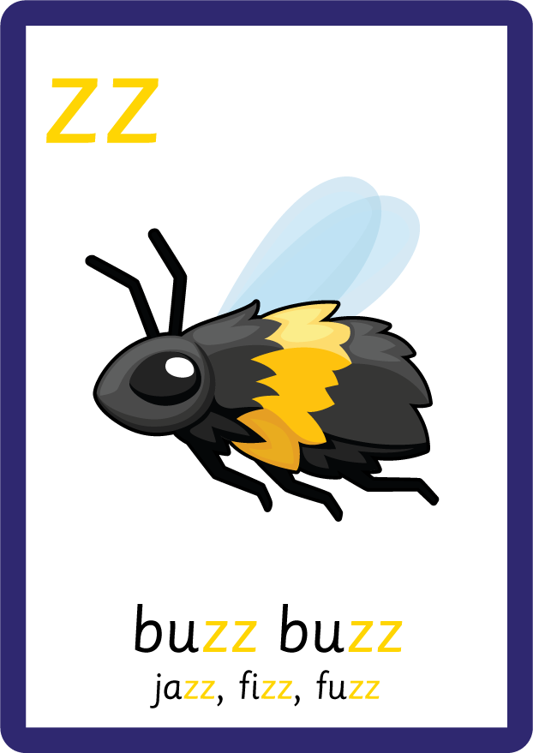











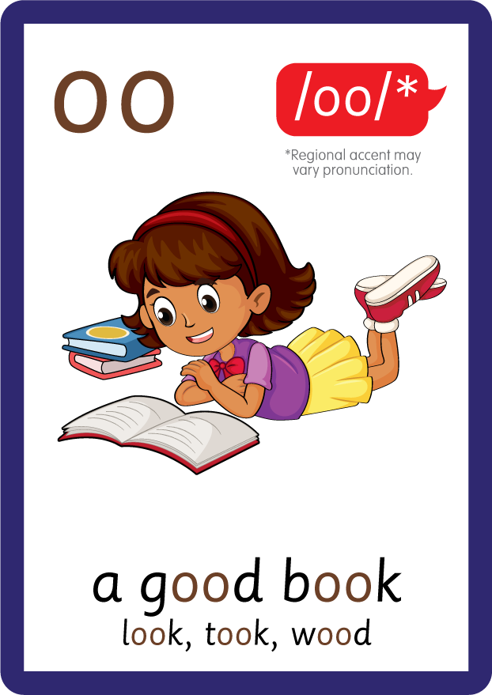









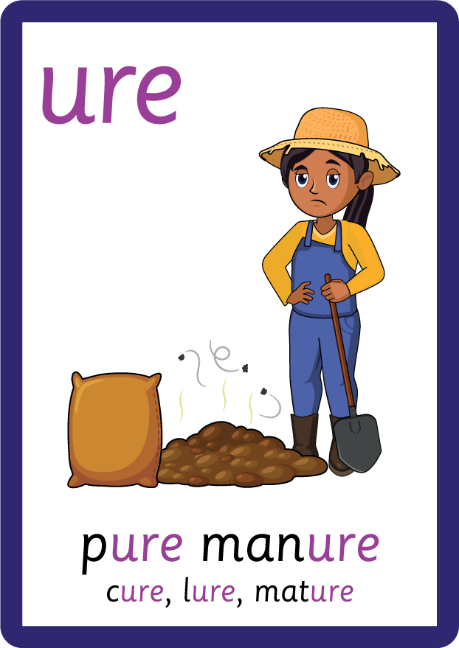
Recall all GPCs learned so far using flashcards.

Slide 5


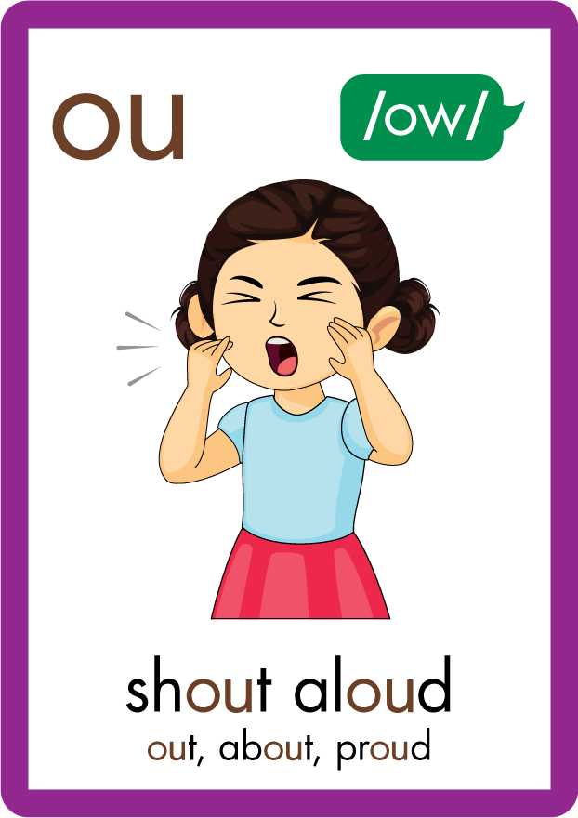
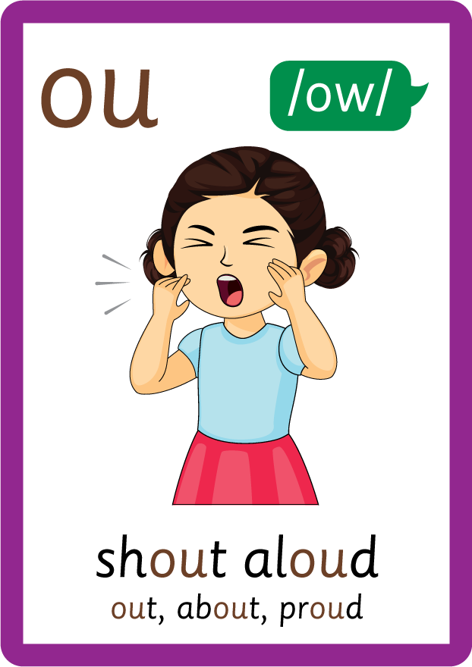




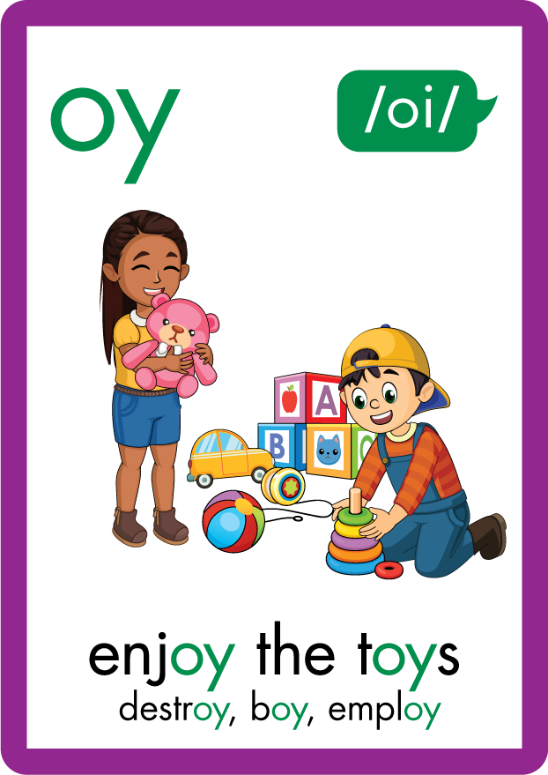
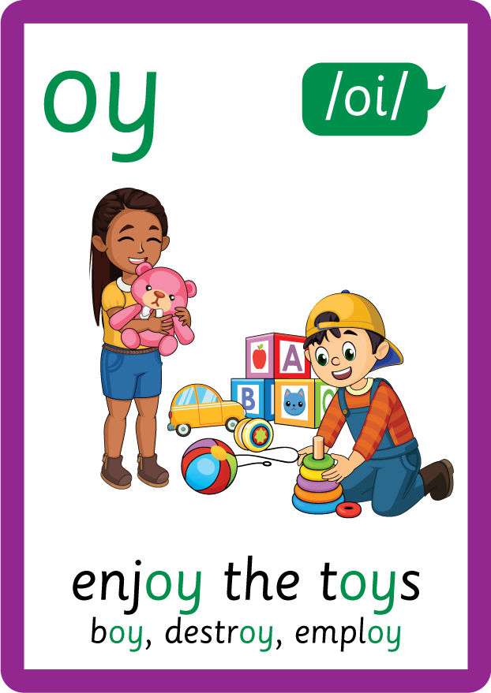
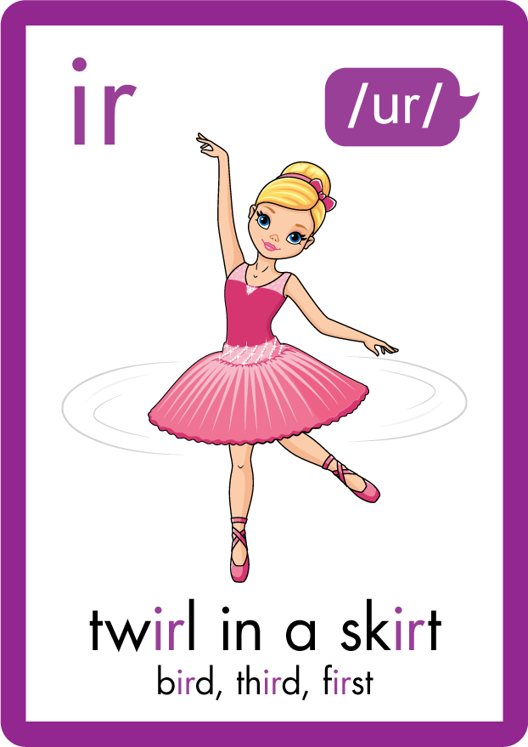
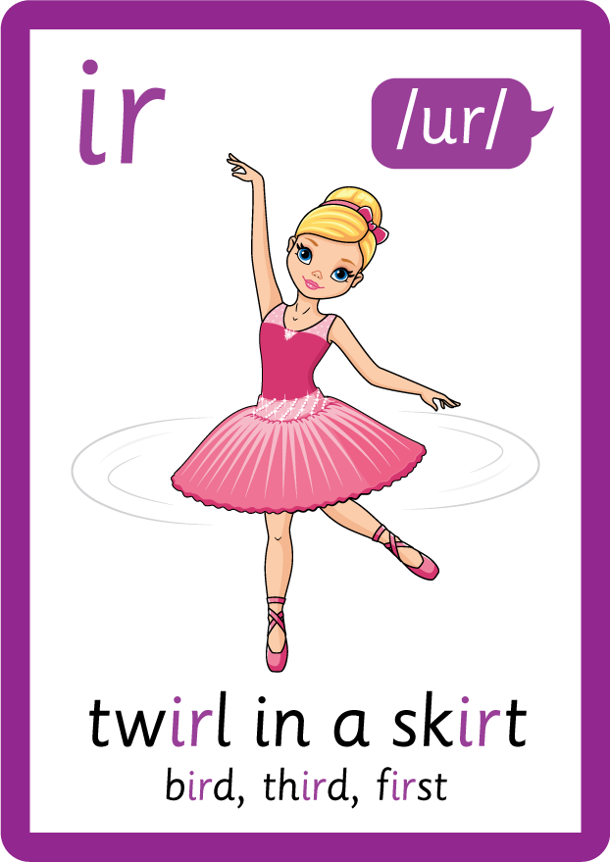








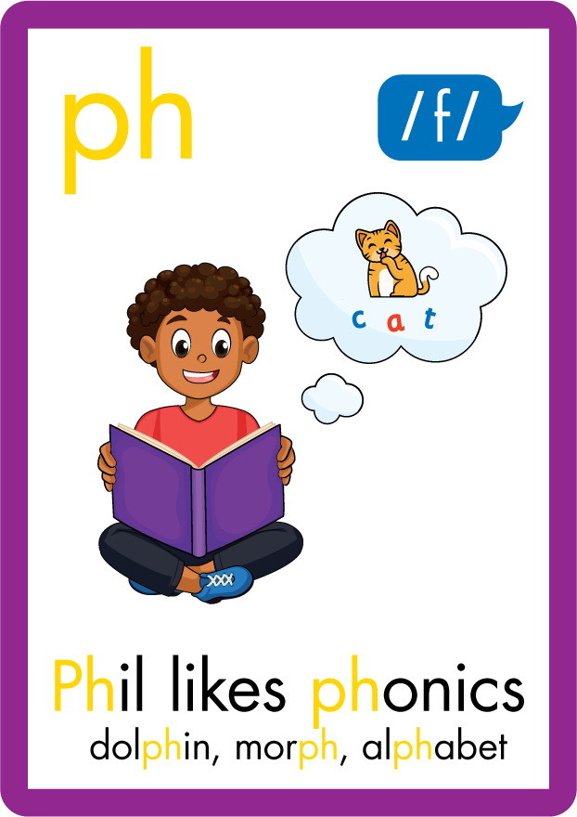



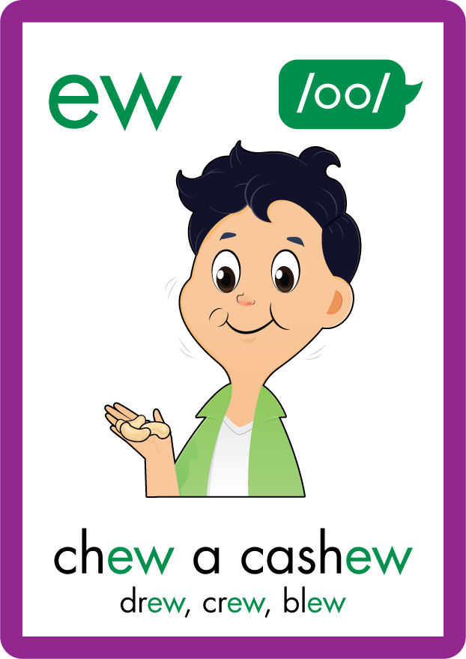





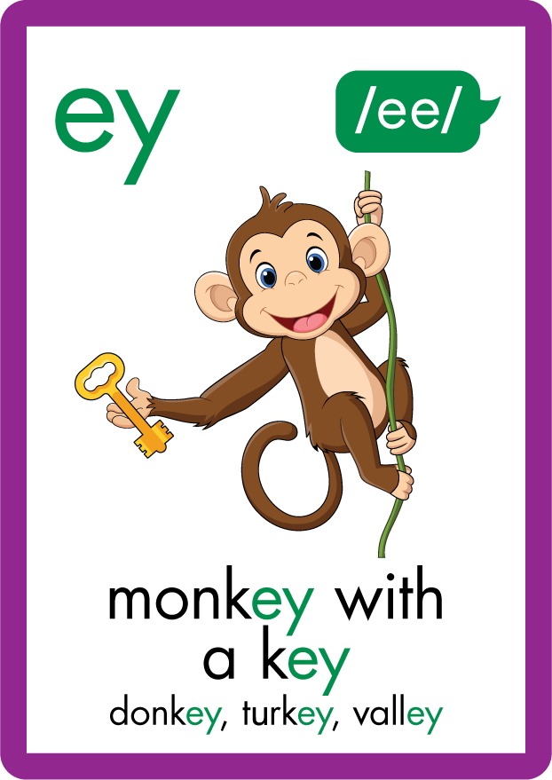
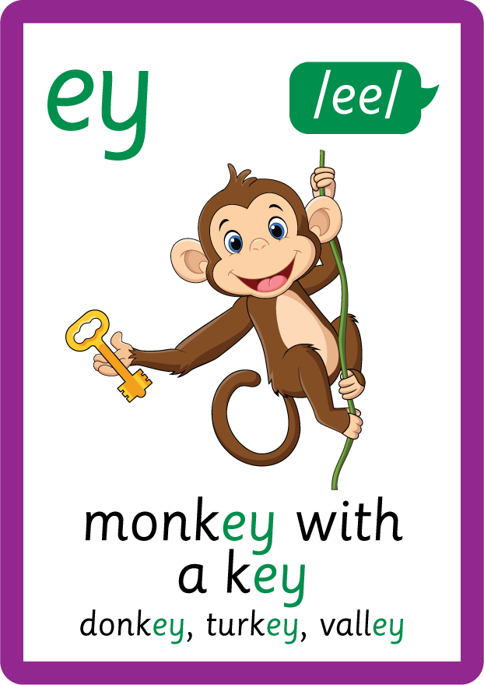


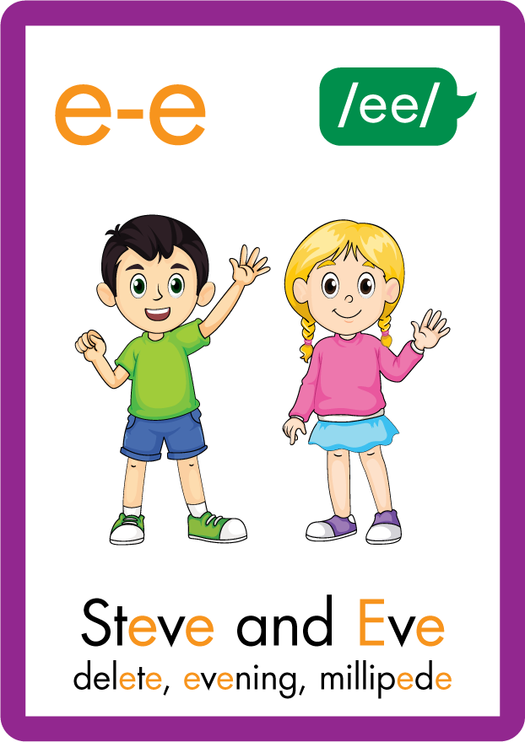





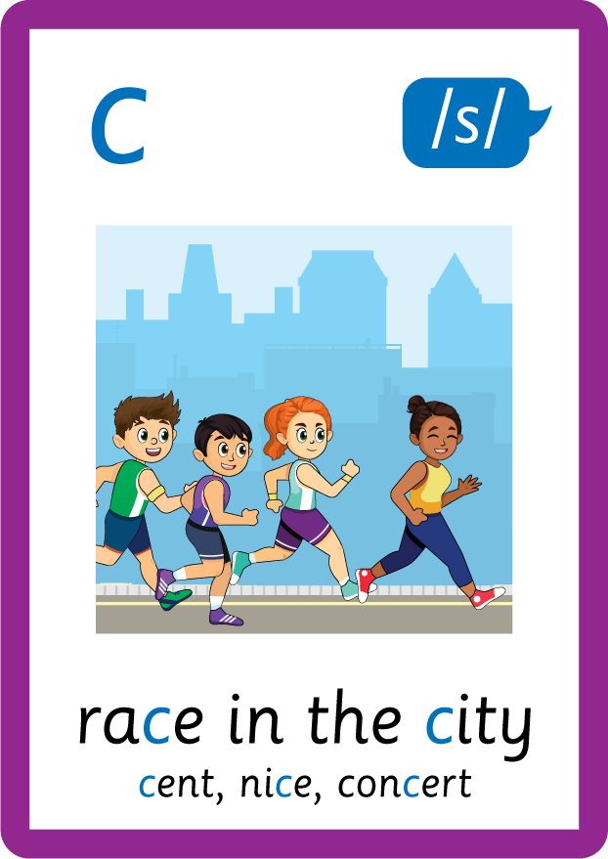
Recall all GPCs learned so far using flashcards.

Slide 6
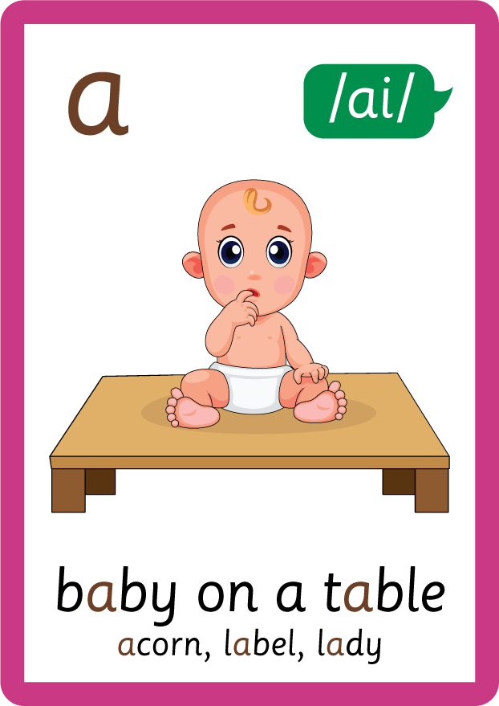
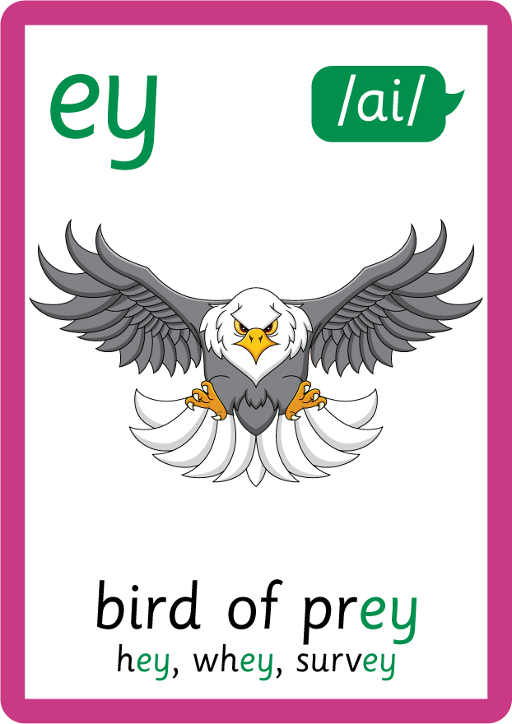

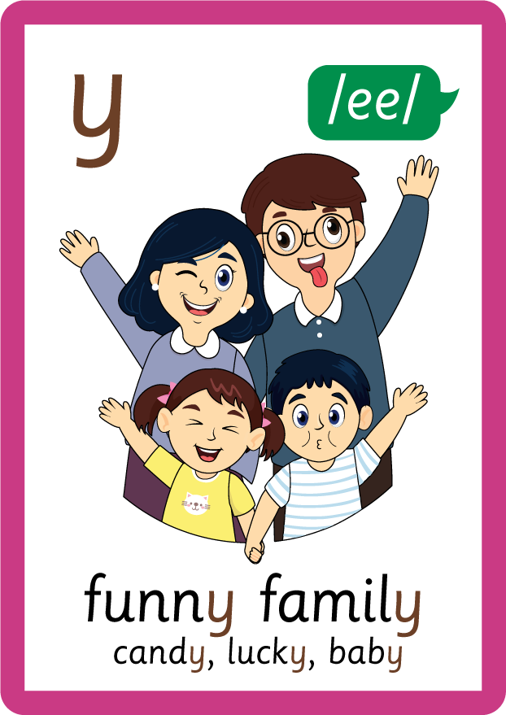
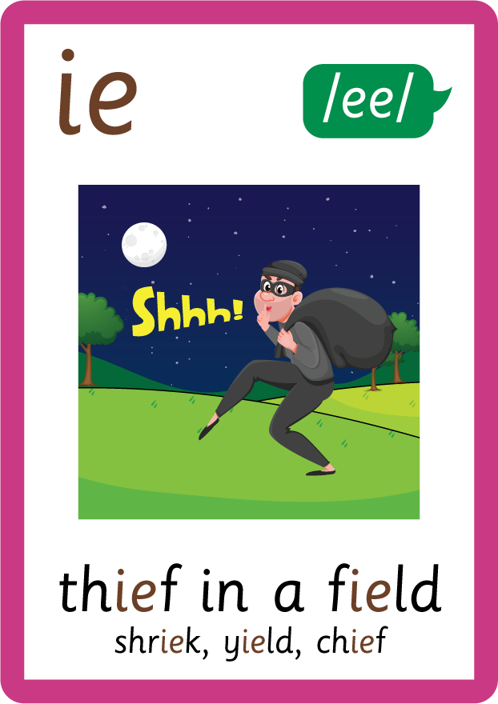
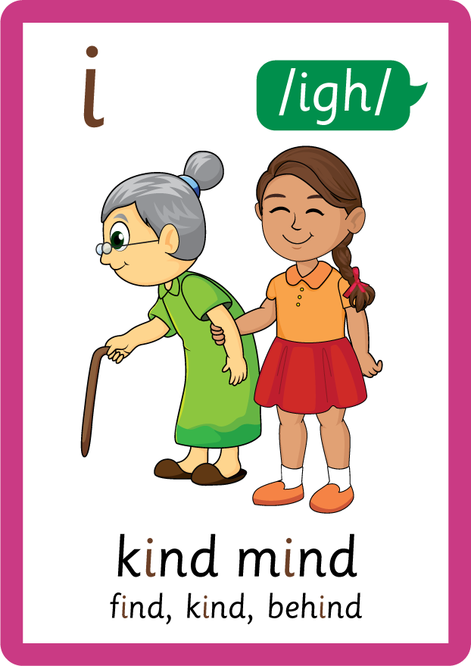




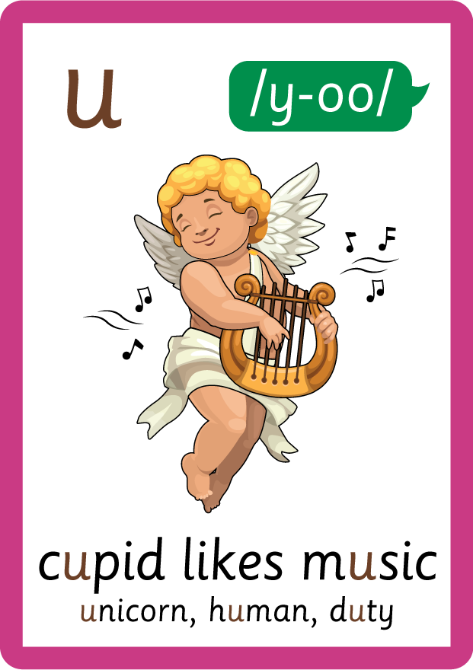

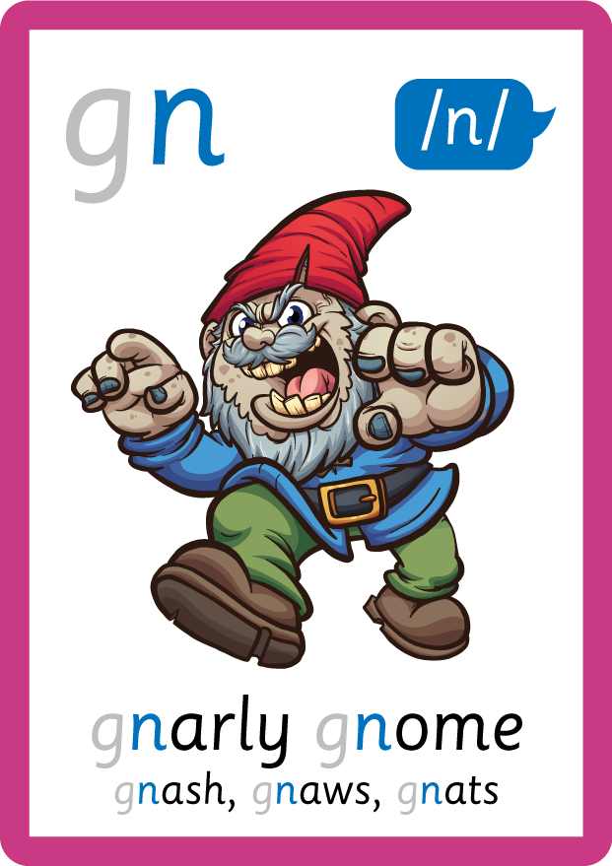
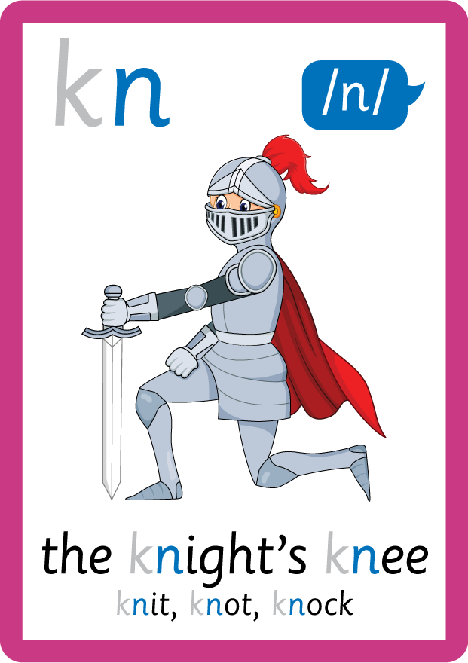

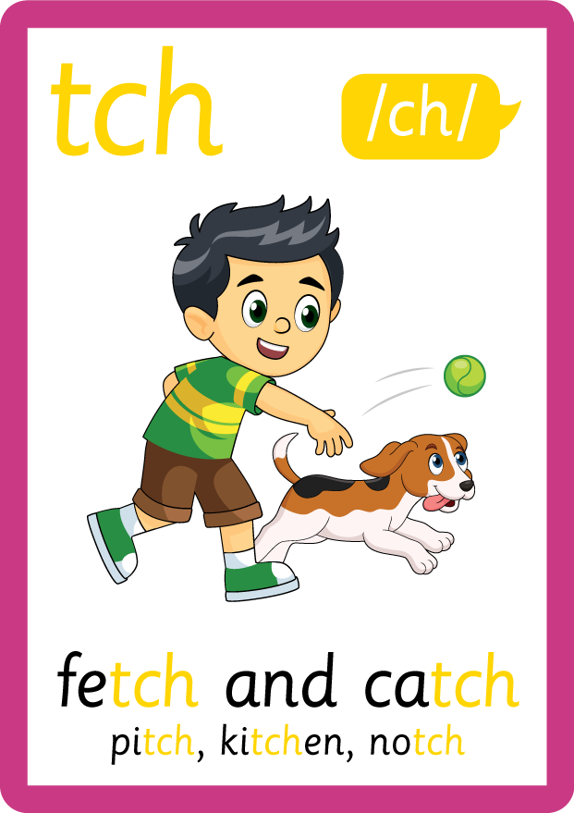
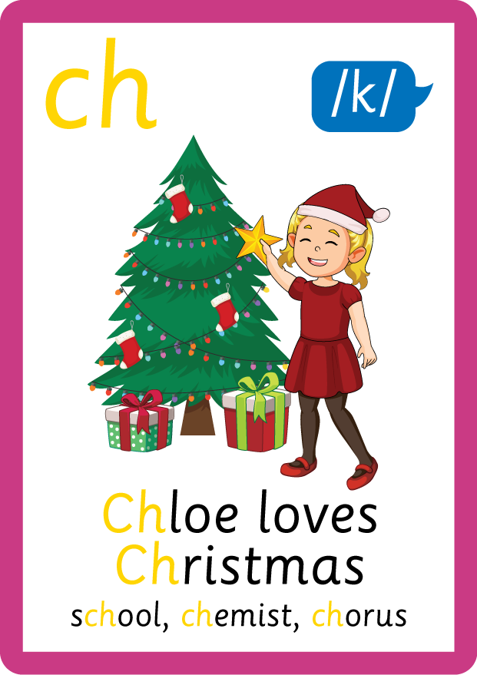
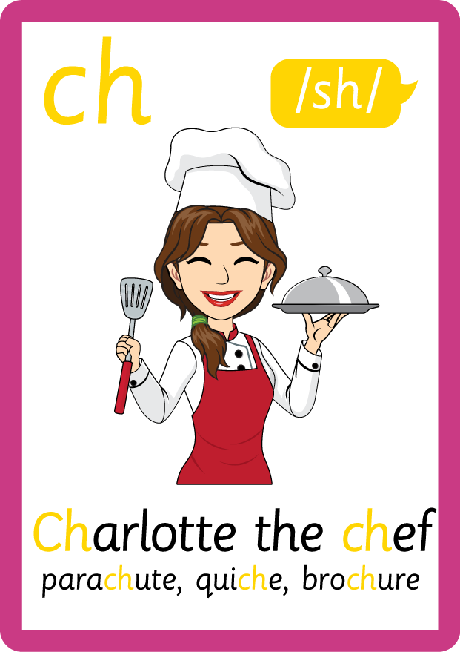
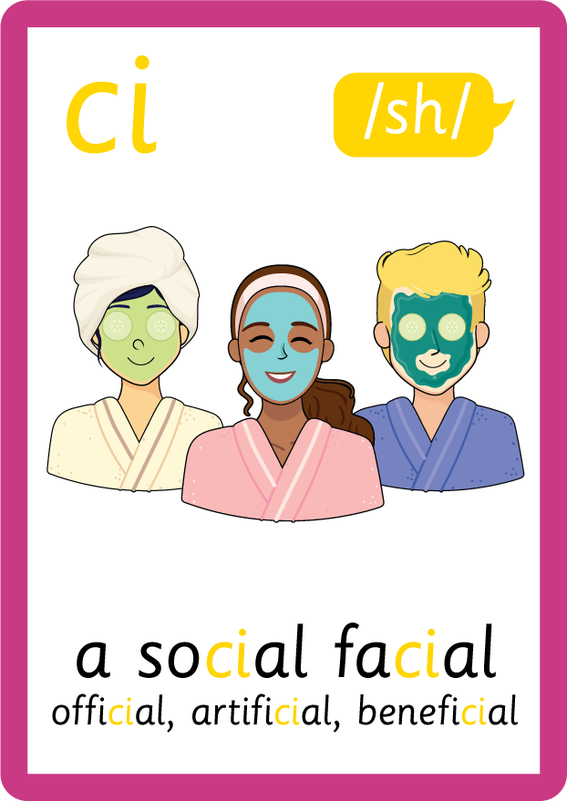
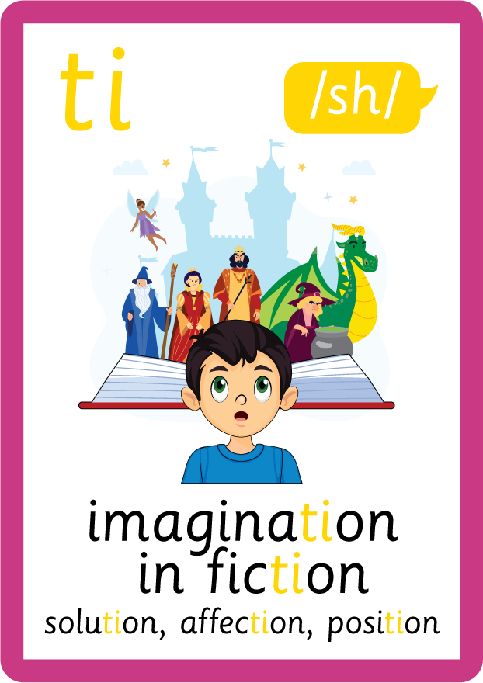



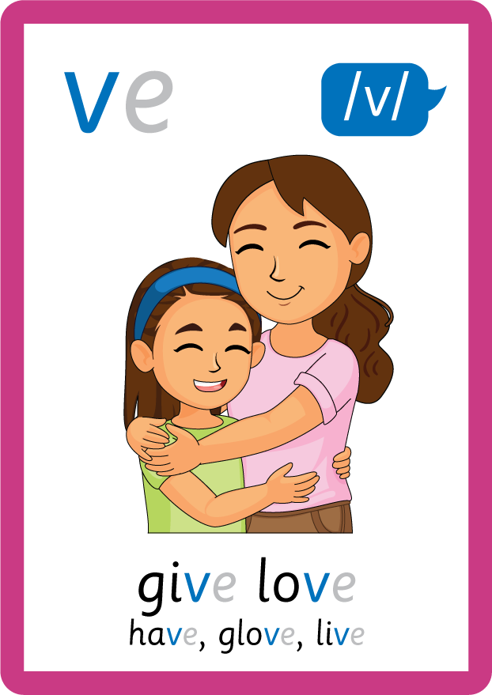
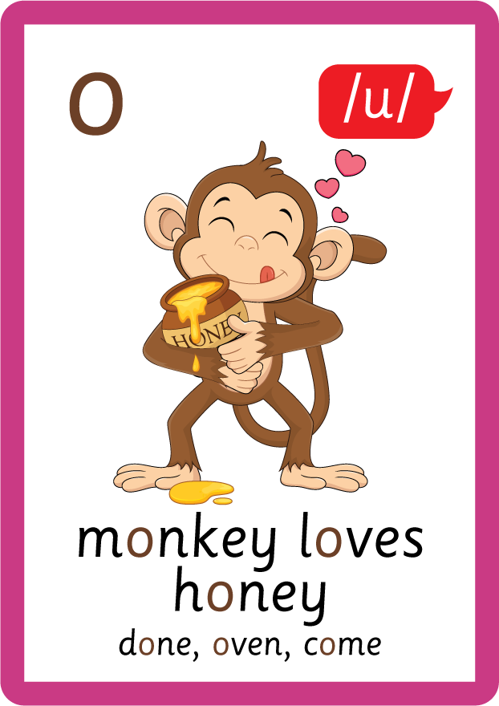
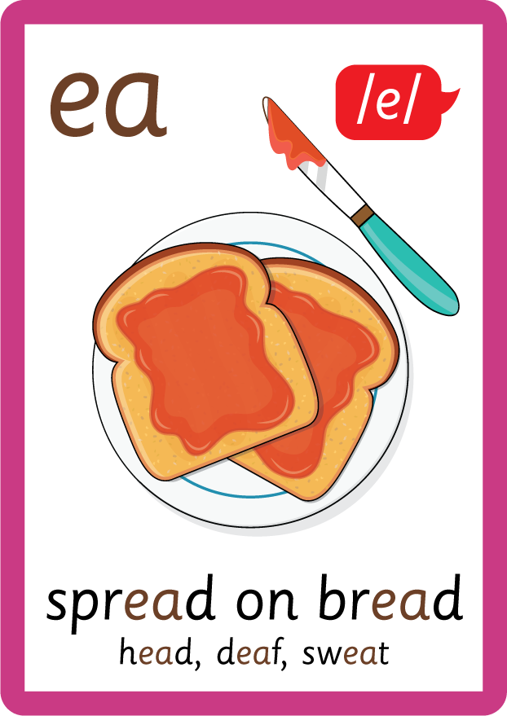




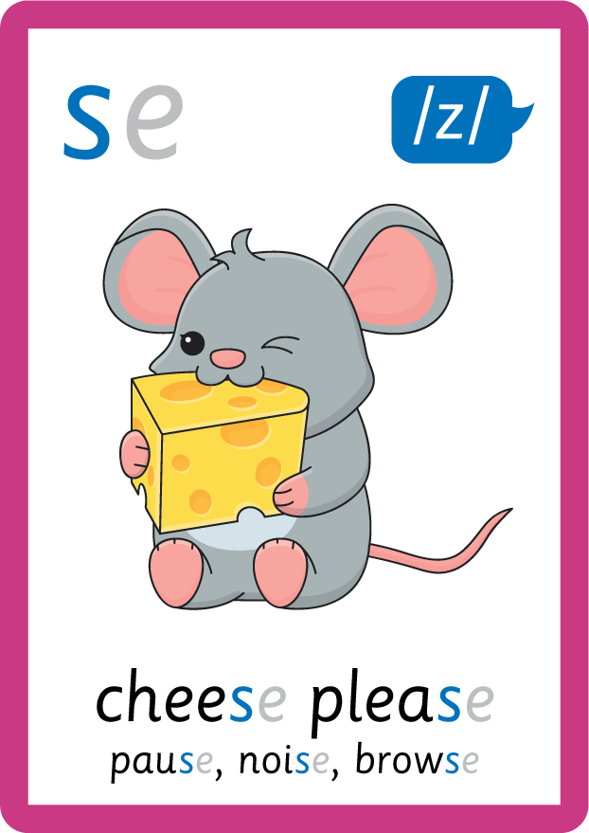
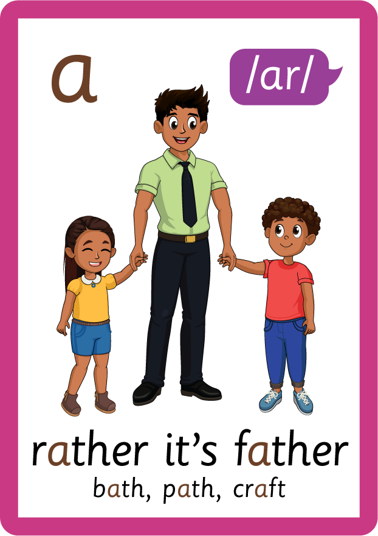


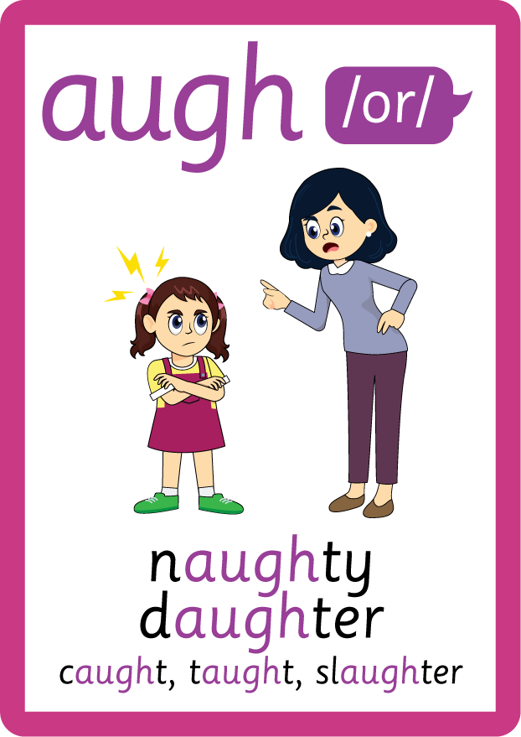
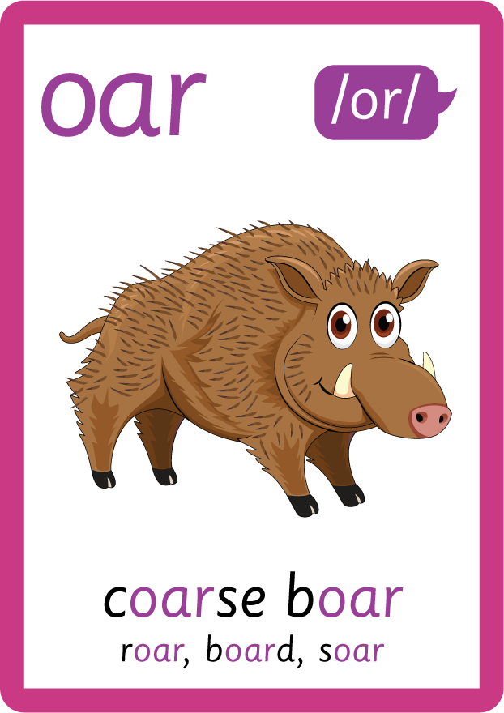

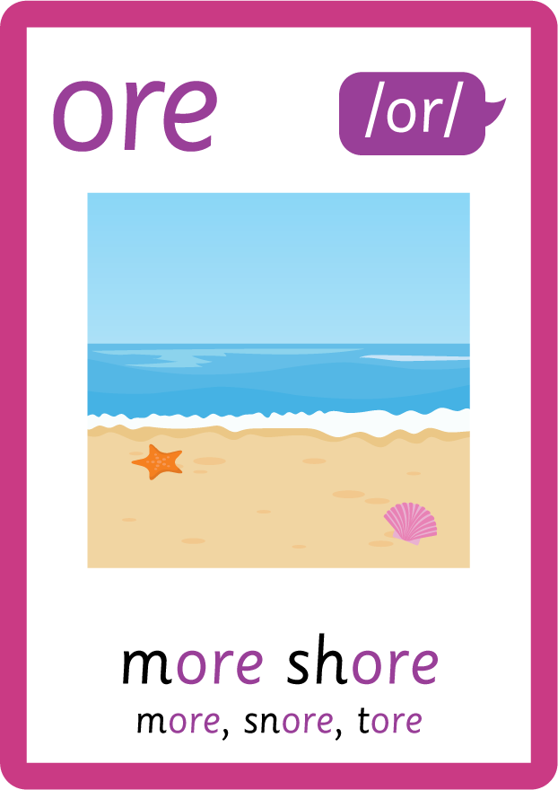


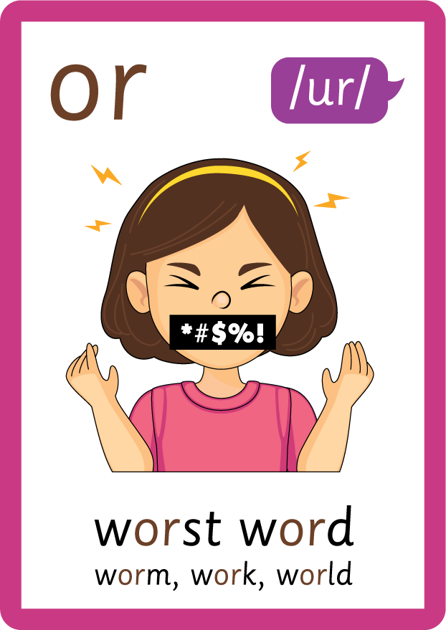
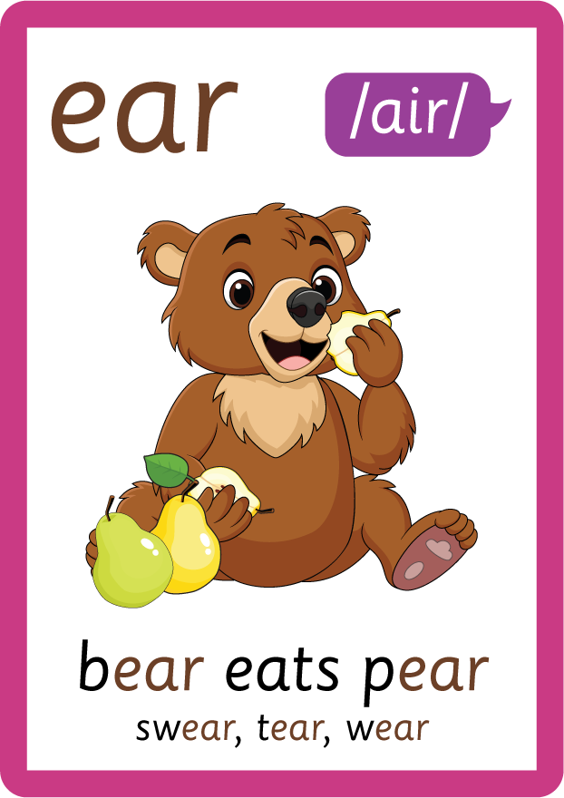
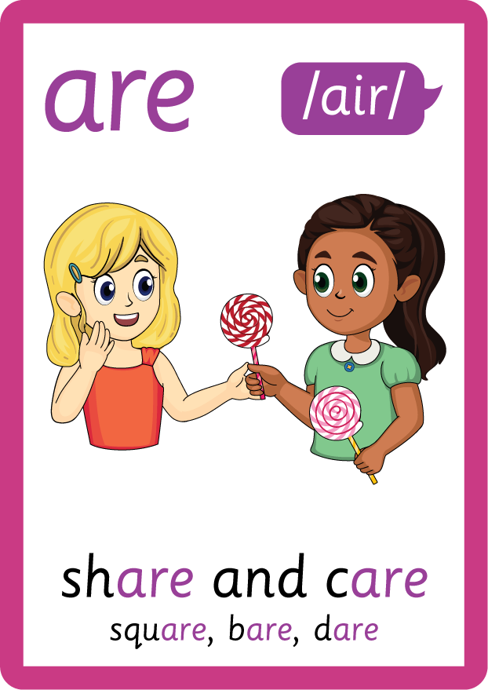
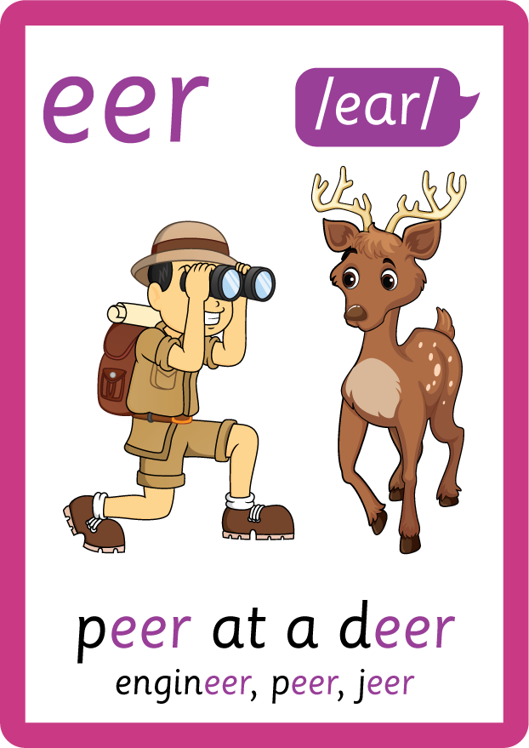

Recall all GPCs learned so far using flashcards.

Slide 7

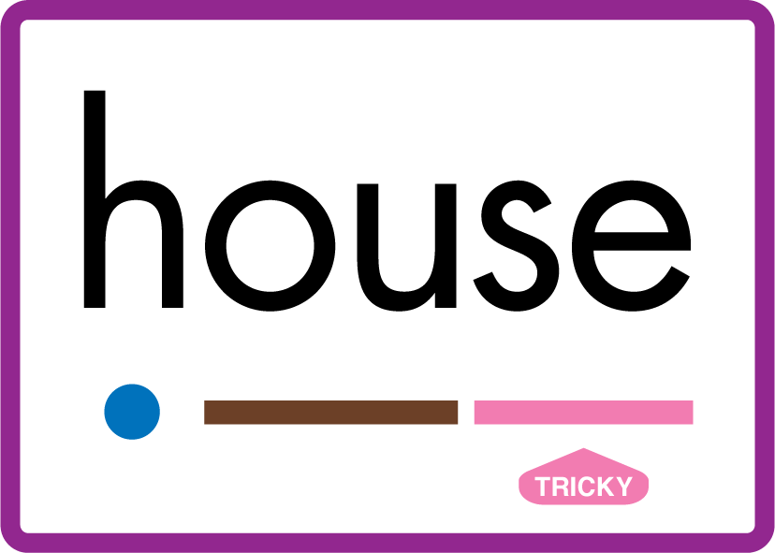
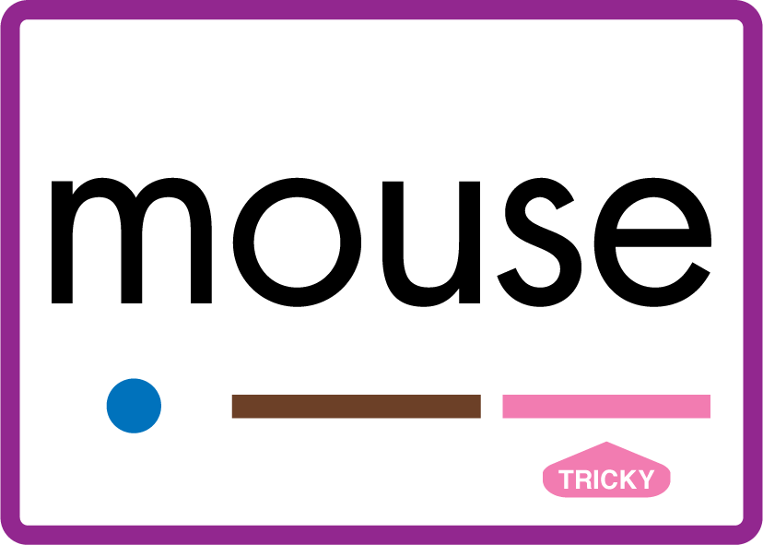
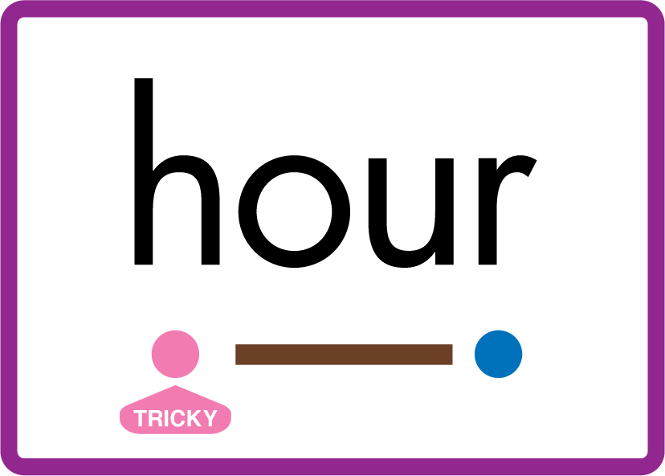




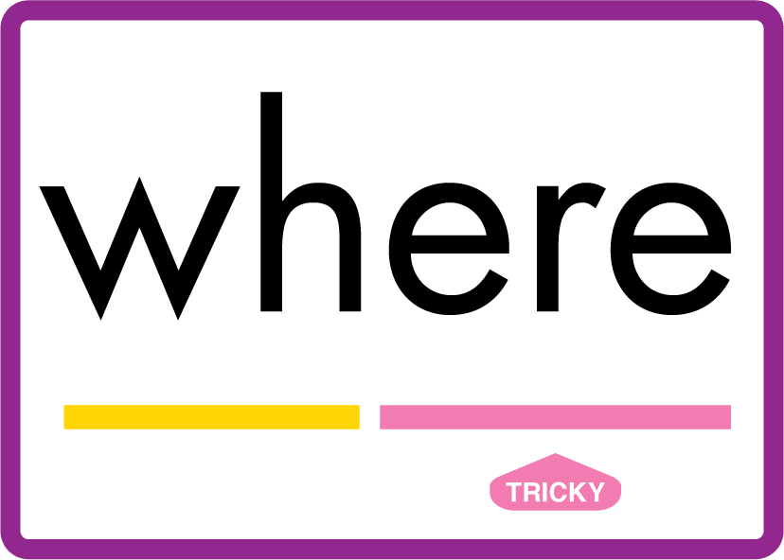





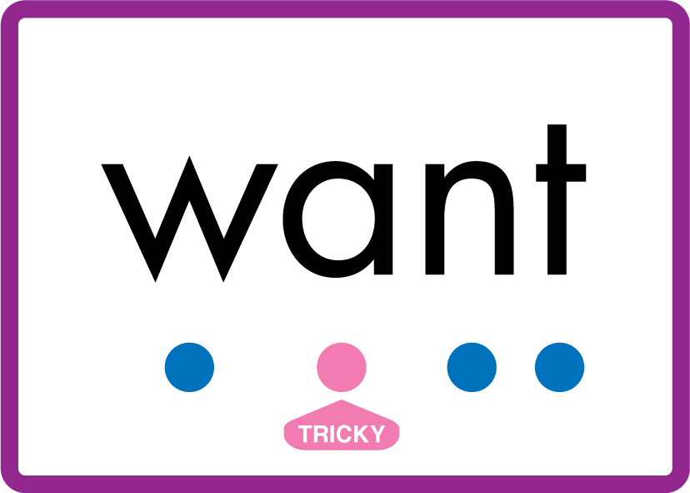
Review Phase 5 Common Exception Words today house mouse hour because Mr Mrs Ms where should could would move use want.

Slide 8
Teach Suffix Rule
Some nouns change spelling altogether when they are in plural form, and do not require a suffix. These are known as irregular plurals.

Slide 9
Demonstrate Using Examples
one child
examples must be memorised
two children

Slide 10
Demonstrate Using Examples
one person
examples must be memorised
two people

Slide 11

Explain Decoding

Slide 12
Model Blending Phonemes
1
ch
i
l
d
USING SOUND BUTTONS
Sound Buttons
Vowel
Consonant
Consonant Digraph
Multi Sound
Long Vowel Sound
R-controlled Digraph
Split Digraph
Syllable / Silent Letter

Slide 13
Model Blending Phonemes
2
ch
i
l
d
r
e
n
USING SOUND BUTTONS
Sound Buttons
Vowel
Consonant
Consonant Digraph
Multi Sound
Long Vowel Sound
R-controlled Digraph
Split Digraph
Syllable / Silent Letter

Slide 14

Explain Encoding

Slide 15
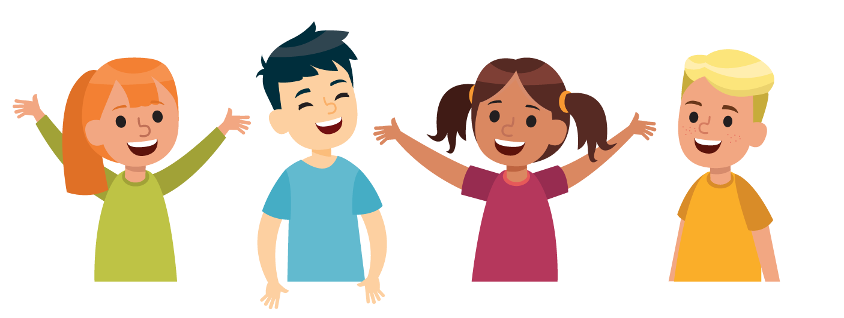
Practise Adding Affixes
USING A PHONEME FRAME

Slide 16
Practise Adding Affixes
ch
i
l
d
r
e
n
USING A PHONEME FRAME

Slide 17

Practise Building Words
PRACTISE – 10MINS
m
e
n
i-e
ch
i
l
d
r
t
ee
th
USING MAGNETIC LETTERS AND A WHITEBOARD
Sound Buttons
Vowel
Consonant
Consonant Digraph
Multi Sound
Long Vowel Sound
R-controlled Digraph
Split Digraph
Syllable / Silent Letter

Slide 18
Practise Building Words
PRACTISE – 10MINS
m
e
n
i-e
ch
i
l
d
r
t
ee
th
men mice children teeth
USING MAGNETIC LETTERS AND A WHITEBOARD
Sound Buttons
Vowel
Consonant
Consonant Digraph
Multi Sound
Long Vowel Sound
R-controlled Digraph
Split Digraph
Syllable / Silent Letter

