Slide 1
-s and -es |  |  |  | -ing
-ed |  |  |  | -er
-est |  |  |  | un-
-s and -es |  |  |  | -ing
-ed |  |  |  | -er
-est |  |  |  | un-
-es suffixes (plural)
Lesson 4

Slide 2
Learn and practise suffix -es.
Recall all GPCs learned so far using flashcards.

Slide 3




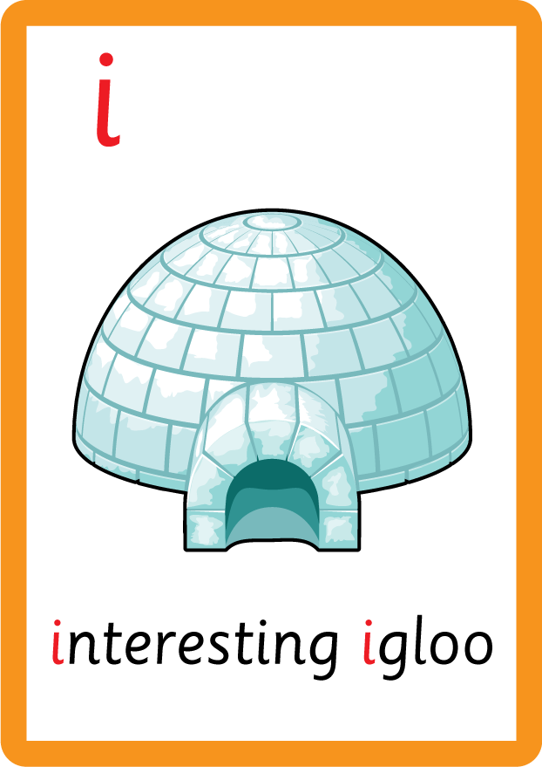


















Recall all GPCs learned so far using flashcards.

Slide 4






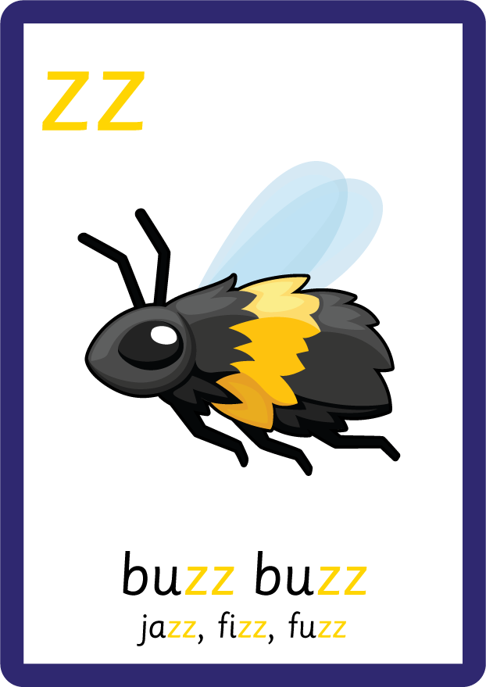






















Recall all GPCs learned so far using flashcards.

Slide 5



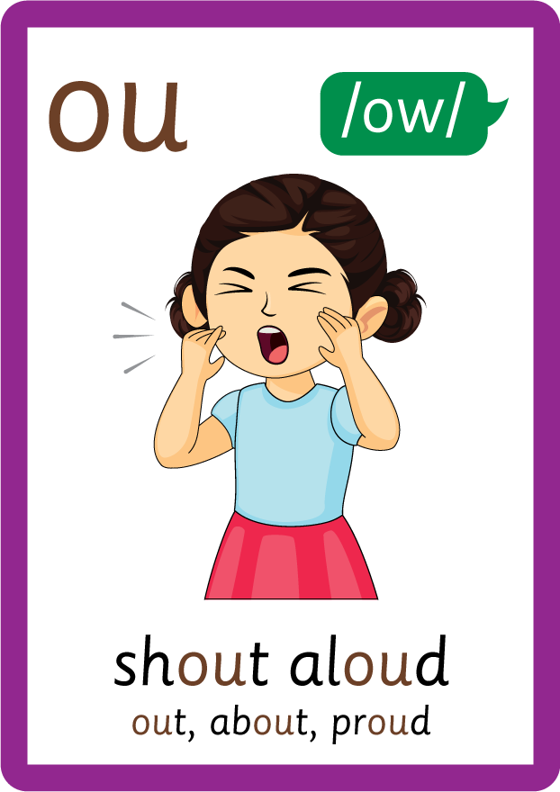




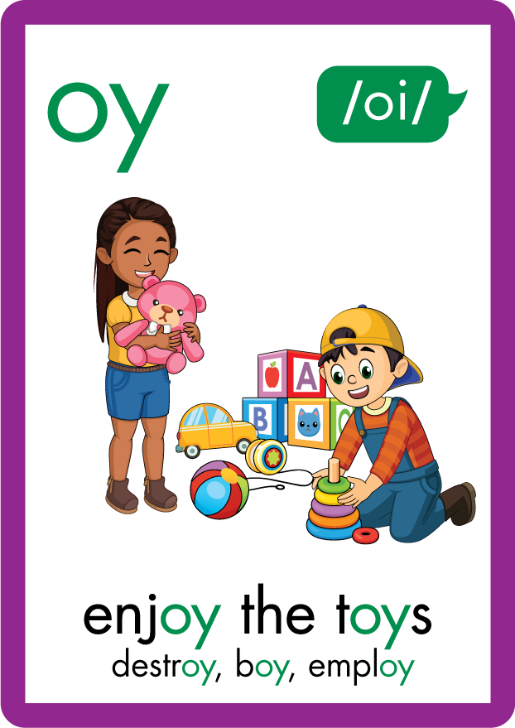
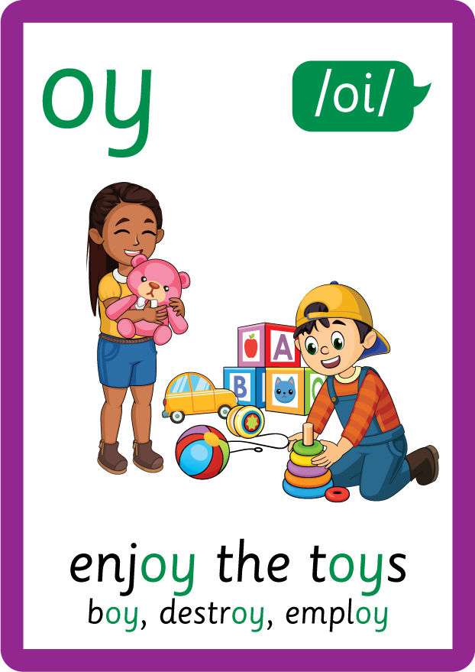
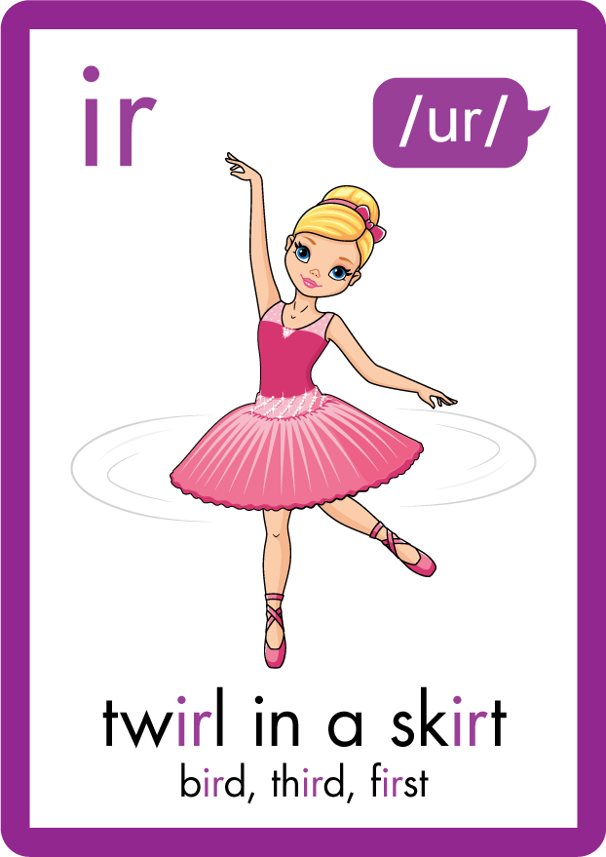
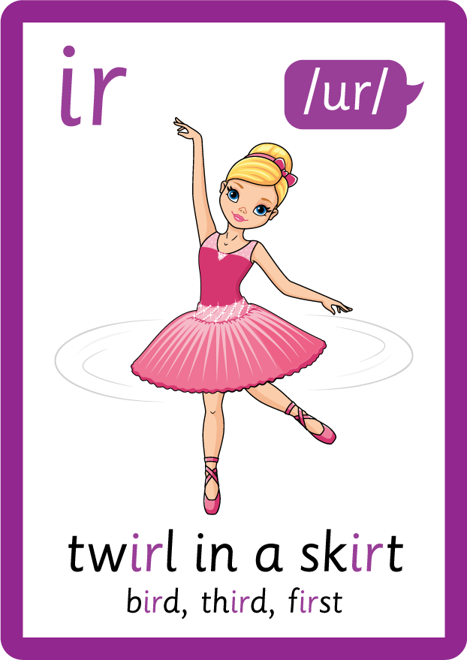








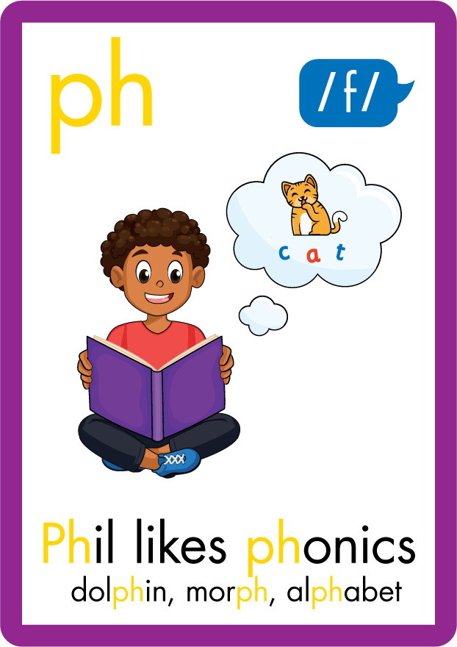



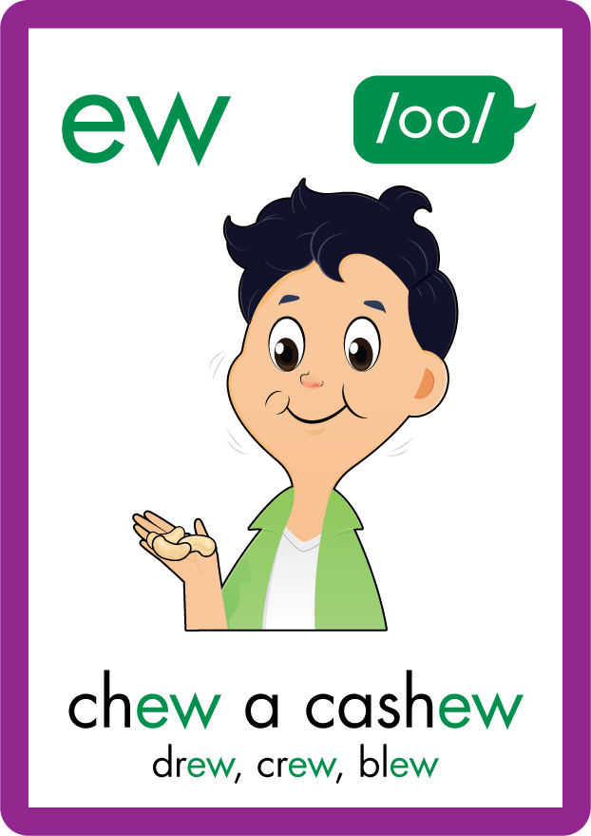









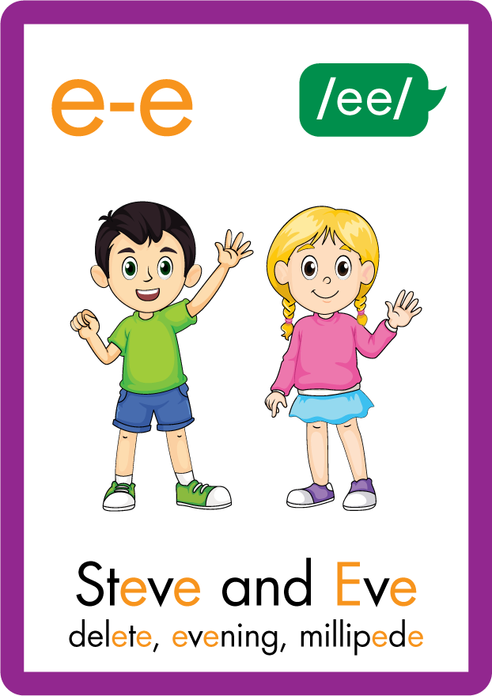





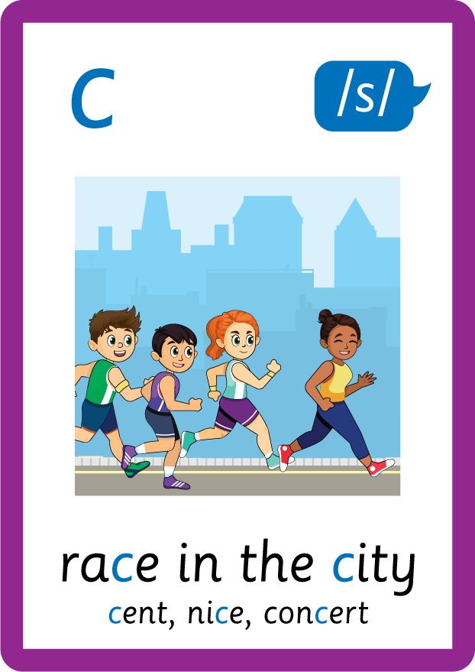
Recall all GPCs learned so far using flashcards.

Slide 6
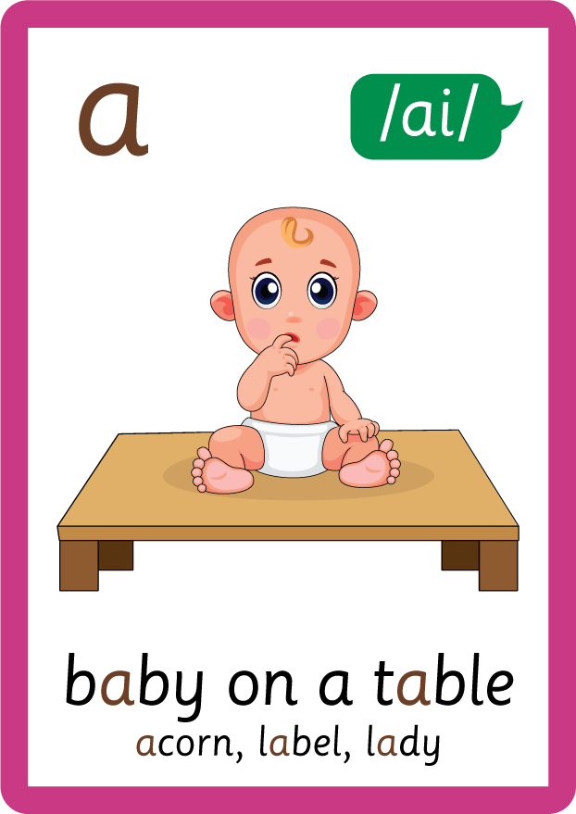


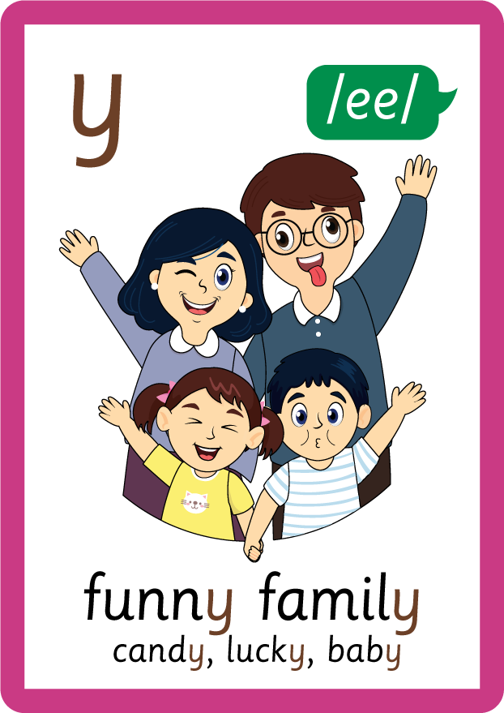
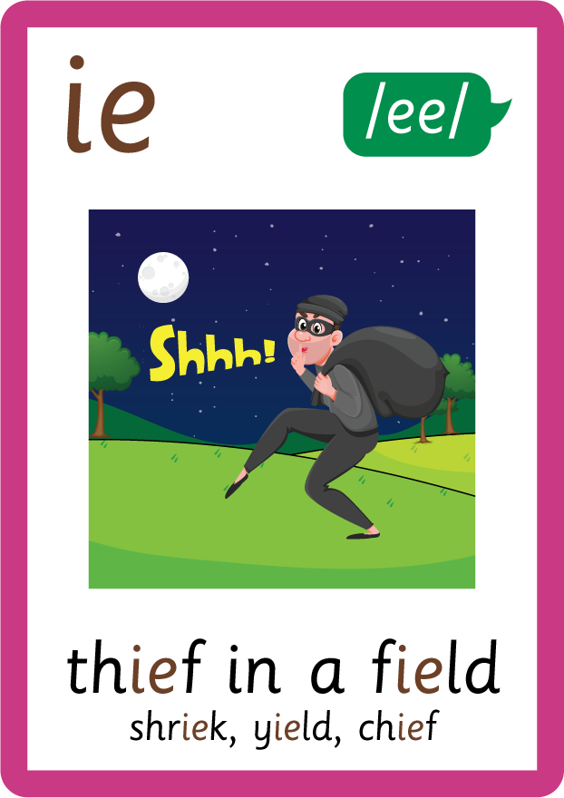
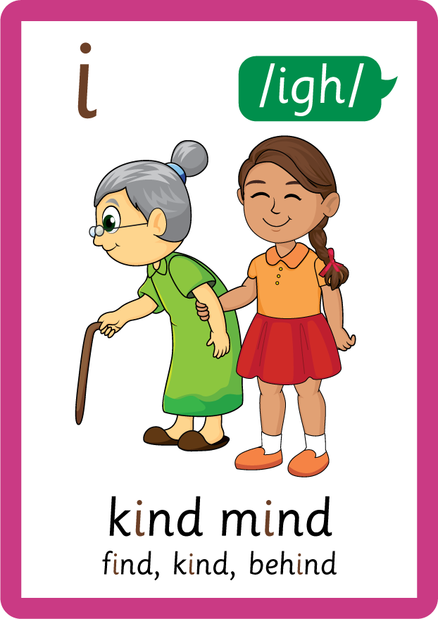






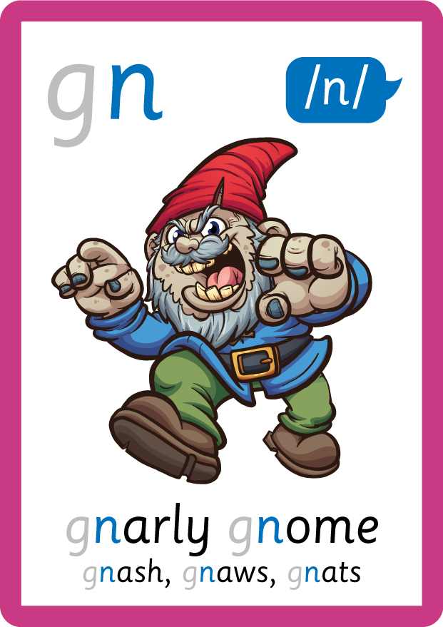
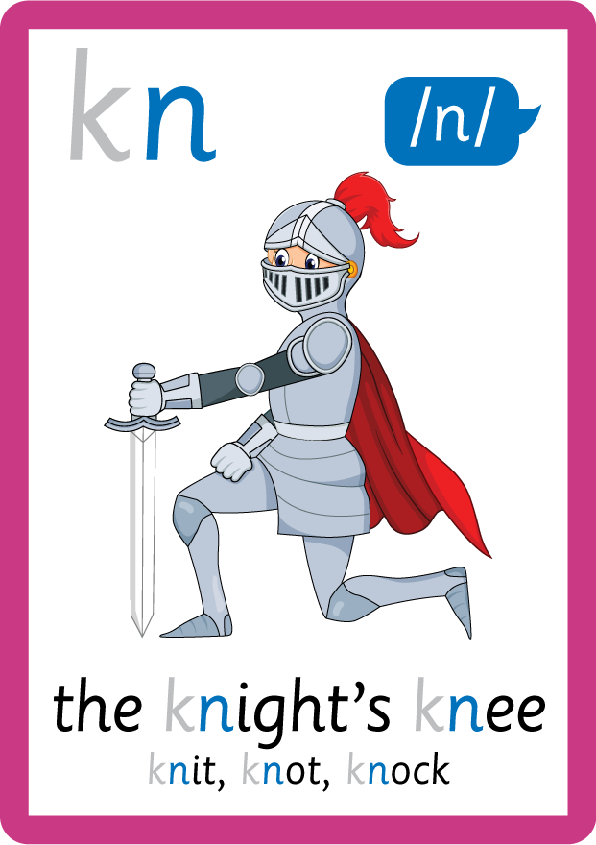

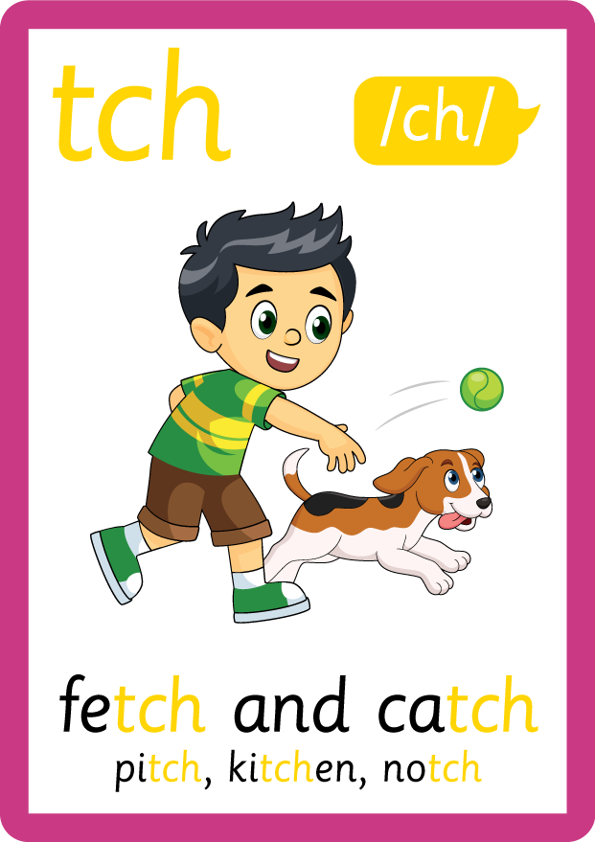
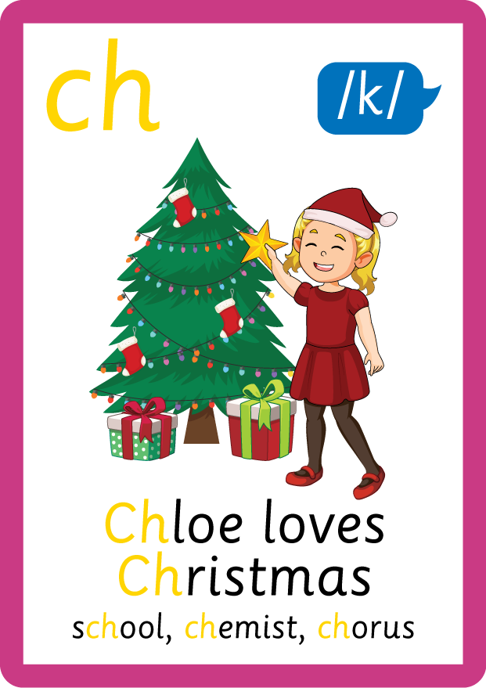

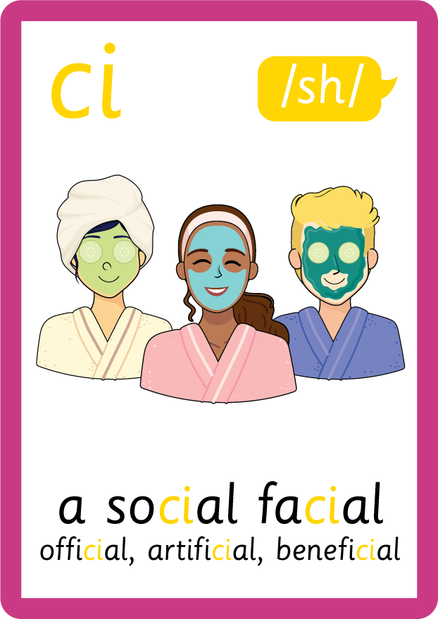
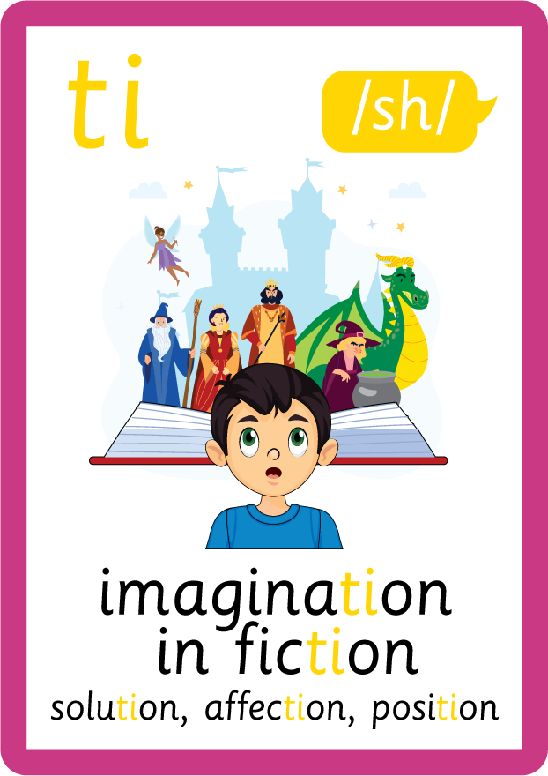





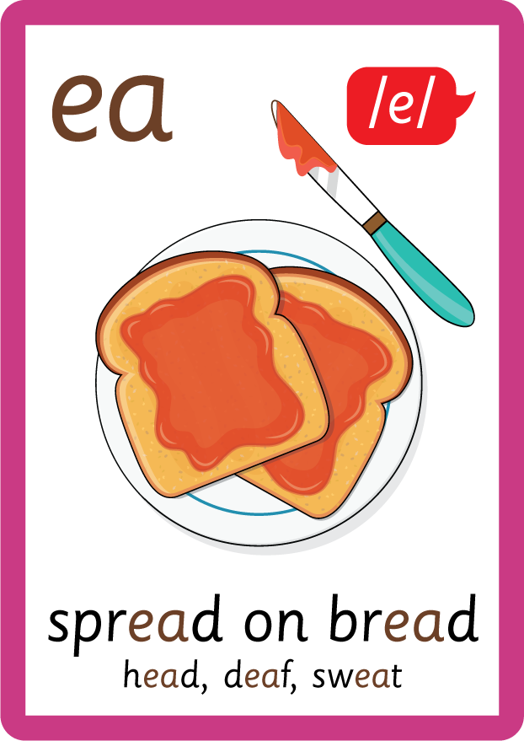




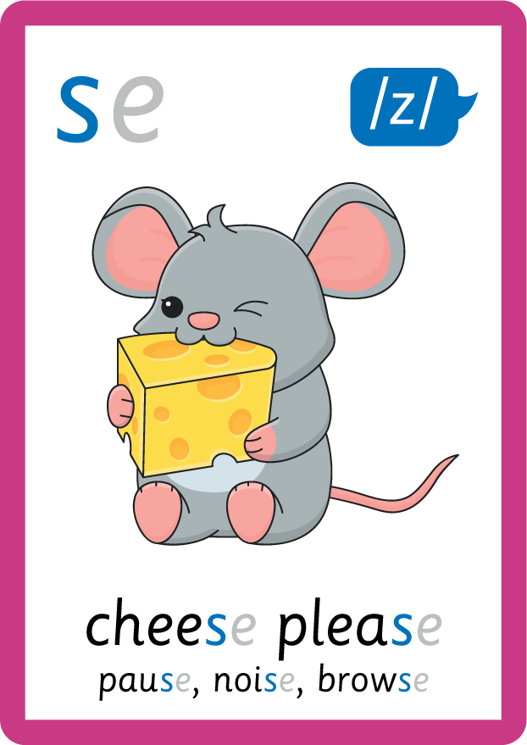
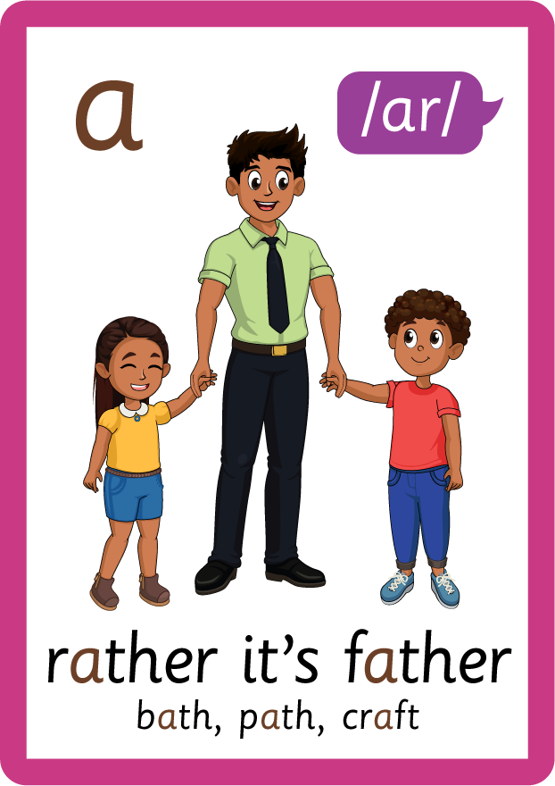


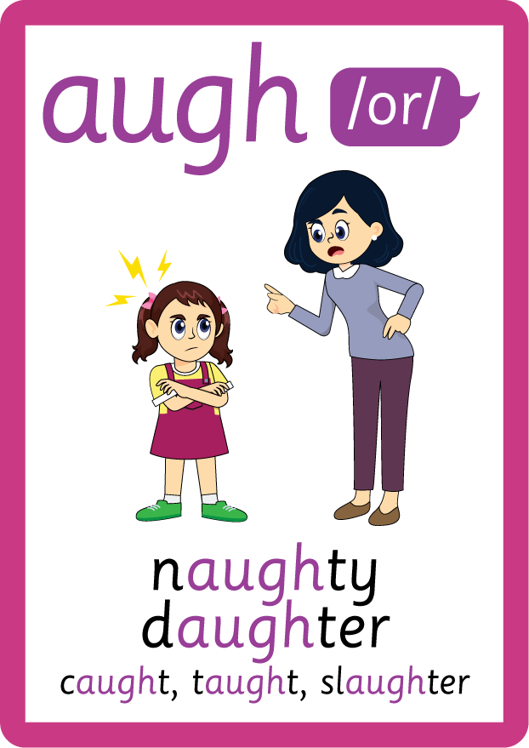





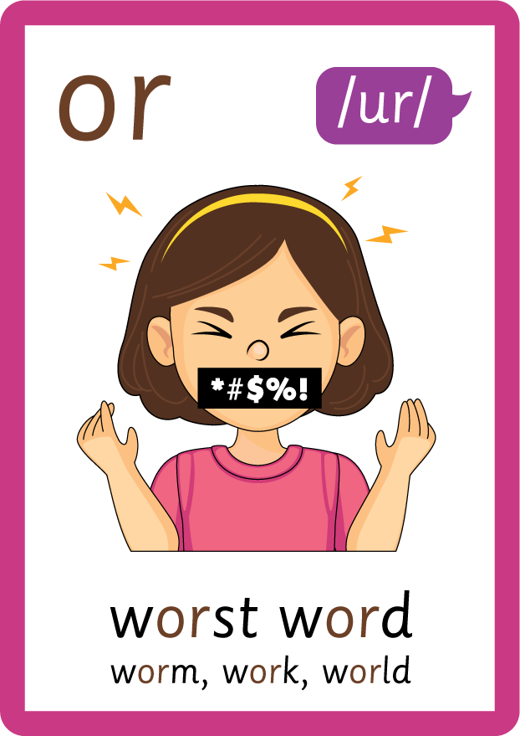


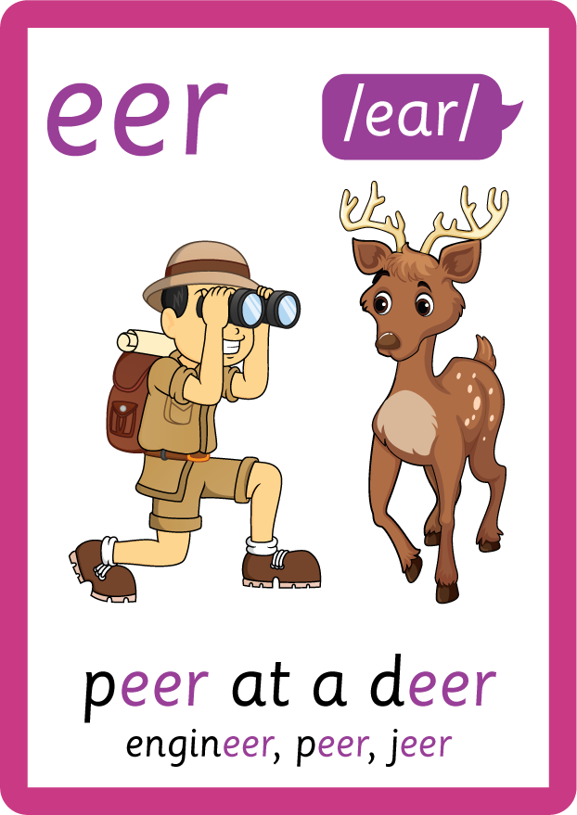
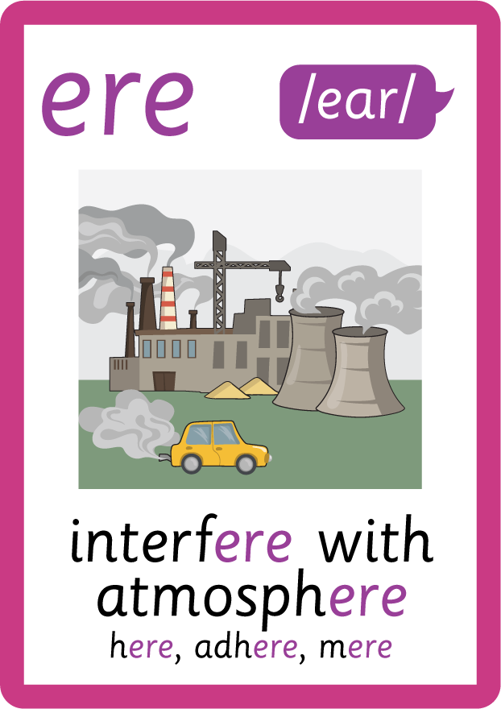
Recall all GPCs learned so far using flashcards.

Slide 7

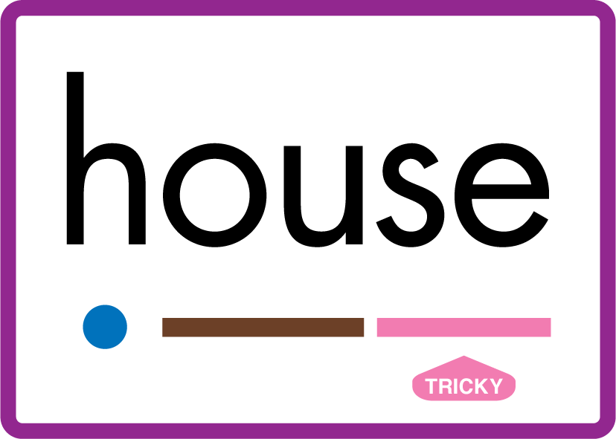
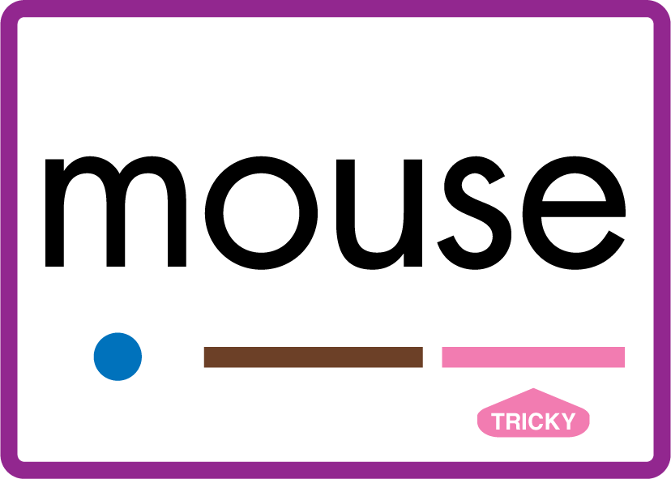
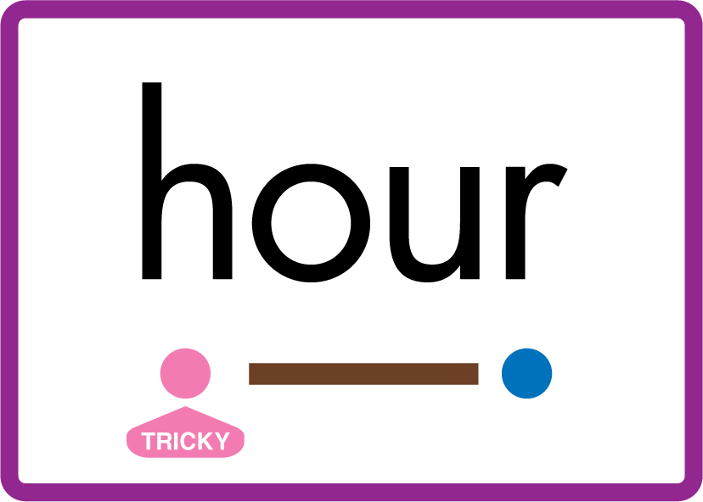










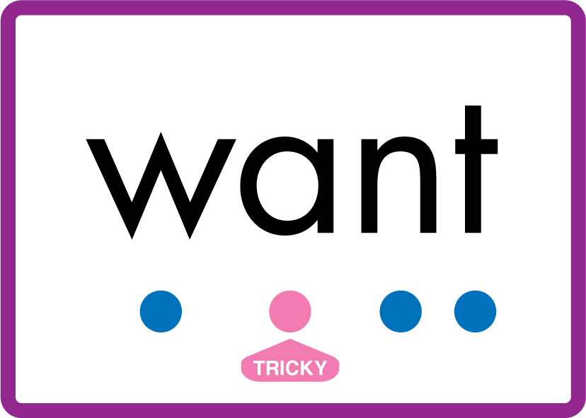
Review Phase 5 Common Exception Words today house mouse hour because Mr Mrs Ms where should could would move use want.

Slide 8
Teach Suffix Rule
When a noun ends in the letters s ss sh ch x z, use suffix -es to change from singular to plural form.

Slide 9
Demonstrate Using Examples
one church
add suffix -es to change to plural form
two churches

Slide 10

Explain Decoding

Slide 11
Model Blending Phonemes
1
ch
ur
ch
USING SOUND BUTTONS
Sound Buttons
Vowel
Consonant
Consonant Digraph
Multi Sound
Long Vowel Sound
R-controlled Digraph
Split Digraph
Syllable / Silent Letter

Slide 12
Model Blending Phonemes
2
ch
ur
ch
e
s
USING SOUND BUTTONS
Sound Buttons
Vowel
Consonant
Consonant Digraph
Multi Sound
Long Vowel Sound
R-controlled Digraph
Split Digraph
Syllable / Silent Letter

Slide 13

Explain Encoding

Slide 14

Practise Adding Affixes
ch
ur
ch
USING A PHONEME FRAME

Slide 15
Practise Adding Affixes
ch
ur
ch
e
s
USING A PHONEME FRAME

Slide 16

Practise Building Words
PRACTISE – 10MINS
w
i
sh
e
s
ch
ss
ur
l
u
e
n
b
s
d
r
USING MAGNETIC LETTERS AND A WHITEBOARD
Sound Buttons
Vowel
Consonant
Consonant Digraph
Multi Sound
Long Vowel Sound
R-controlled Digraph
Split Digraph
Syllable / Silent Letter

Slide 17
Practise Building Words
PRACTISE – 10MINS
w
i
sh
e
s
ch
ss
ur
l
u
e
n
b
s
d
r
wishes churches lunches buses dresses
USING MAGNETIC LETTERS AND A WHITEBOARD
Sound Buttons
Vowel
Consonant
Consonant Digraph
Multi Sound
Long Vowel Sound
R-controlled Digraph
Split Digraph
Syllable / Silent Letter

