Slide 1
-s and -es |  |  |  | -ing
-ed |  |  |  | -er
-est |  |  |  | un-
-ing suffix (continuous verb)
Lesson 6

Slide 2
Learn and practise suffix -ing.
Recall all GPCs learned so far using flashcards.
Recall Phase 5 Common Exception Words today house mouse hour because Mr Mrs Ms where should could would move use want.

Slide 3























Recall all GPCs learned so far using flashcards.

Slide 4





























Recall all GPCs learned so far using flashcards.

Slide 5









































Recall all GPCs learned so far using flashcards.

Slide 6
























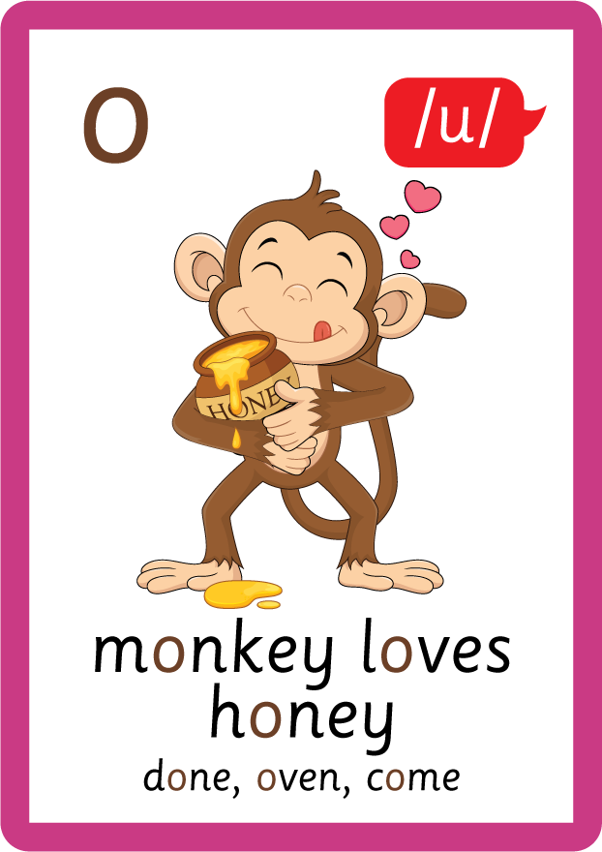









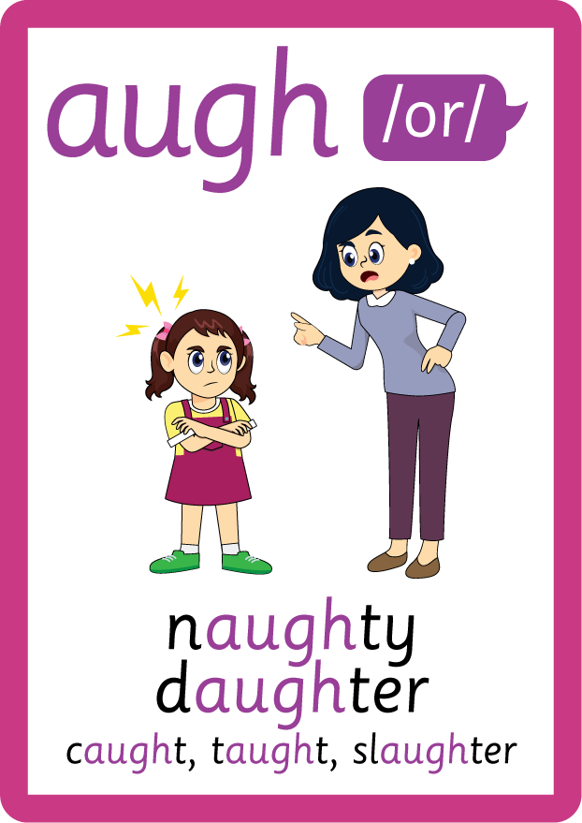










Recall all GPCs learned so far using flashcards.

Slide 7















Review Phase 5 Common Exception Words today house mouse hour because Mr Mrs Ms where should could would move use want.

Slide 8
Teach Suffix Rule
When suffix -ing is added to the end of a verb, the verb changes to present-continuous form.

Slide 9
Demonstrate Using Examples
I meet my friend.
add suffix -ing
I am meeting my friend.

Slide 10
Demonstrate Using Examples
I eat my dinner.
add suffix -ing
I am eating my dinner.

Slide 11

Explain Decoding

Slide 12
Model Blending Phonemes
m
ee
t
USING SOUND BUTTONS
Sound Buttons
Vowel
Consonant
Consonant Digraph
Multi Sound
Long Vowel Sound
R-controlled Digraph
Split Digraph
Syllable / Silent Letter

Slide 13
Model Blending Phonemes
m
ee
t
i
ng
USING SOUND BUTTONS
Sound Buttons
Vowel
Consonant
Consonant Digraph
Multi Sound
Long Vowel Sound
R-controlled Digraph
Split Digraph
Syllable / Silent Letter

Slide 14
Model Blending Phonemes
ea
t
USING SOUND BUTTONS
Sound Buttons
Vowel
Consonant
Consonant Digraph
Multi Sound
Long Vowel Sound
R-controlled Digraph
Split Digraph
Syllable / Silent Letter

Slide 15
Model Blending Phonemes
ea
t
i
ng
USING SOUND BUTTONS
Sound Buttons
Vowel
Consonant
Consonant Digraph
Multi Sound
Long Vowel Sound
R-controlled Digraph
Split Digraph
Syllable / Silent Letter

Slide 16

Explain Encoding

Slide 17

Practise Adding Affixes
f
i
sh
USING A PHONEME FRAME

Slide 18
Practise Adding Affixes
f
i
sh
i
ng
USING A PHONEME FRAME

Slide 19

Practise Building Words
PRACTISE – 10MINS
ea
t
i
ng
r
ow
f
p
sh
ck
s
i
a
ng
USING MAGNETIC LETTERS AND A WHITEBOARD
Sound Buttons
Vowel
Consonant
Consonant Digraph
Multi Sound
Long Vowel Sound
R-controlled Digraph
Split Digraph
Syllable / Silent Letter

Slide 20
Practise Building Words
PRACTISE – 10MINS
ea
t
i
ng
r
ow
f
p
sh
ck
s
i
a
ng
eating packing rowing fishing singing
USING MAGNETIC LETTERS AND A WHITEBOARD
Sound Buttons
Vowel
Consonant
Consonant Digraph
Multi Sound
Long Vowel Sound
R-controlled Digraph
Split Digraph
Syllable / Silent Letter

