Slide 1
-s and -es |  |  |  | -ing
-ed |  |  |  | -er
-est |  |  |  | un-
Compound Words
Lesson 9

Slide 2
Learn and practise compound words.
Recall all GPCs learned so far using flashcards.

Slide 3


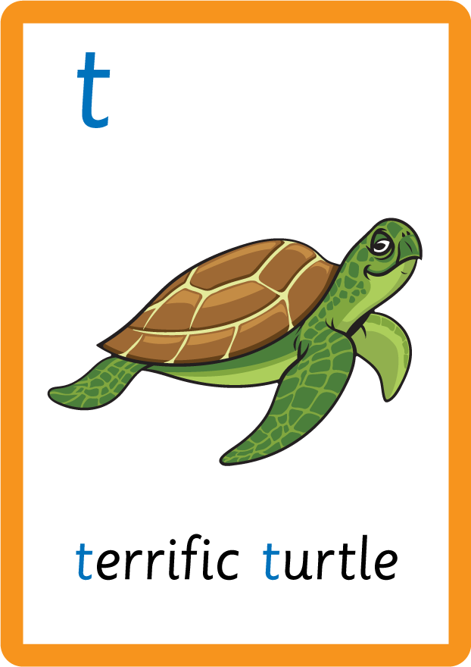

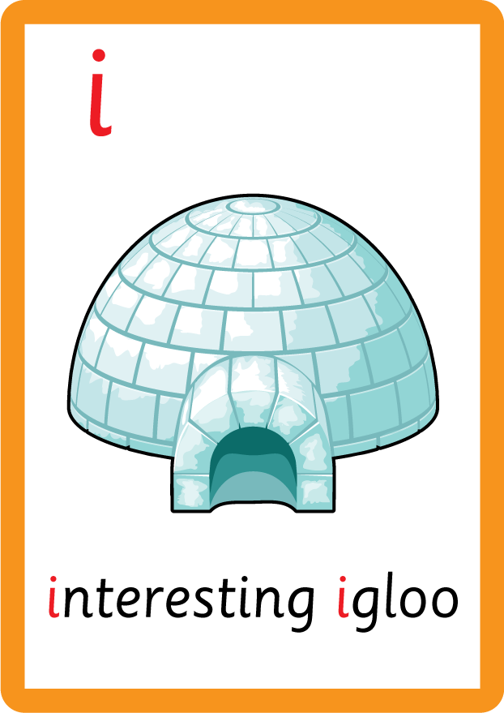









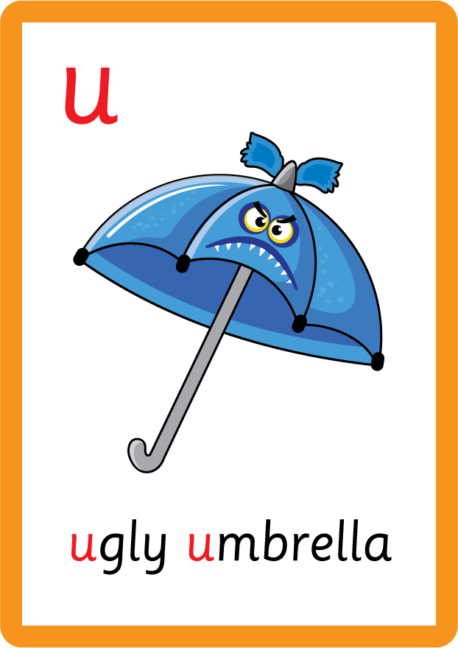








Recall all GPCs learned so far using flashcards.

Slide 4






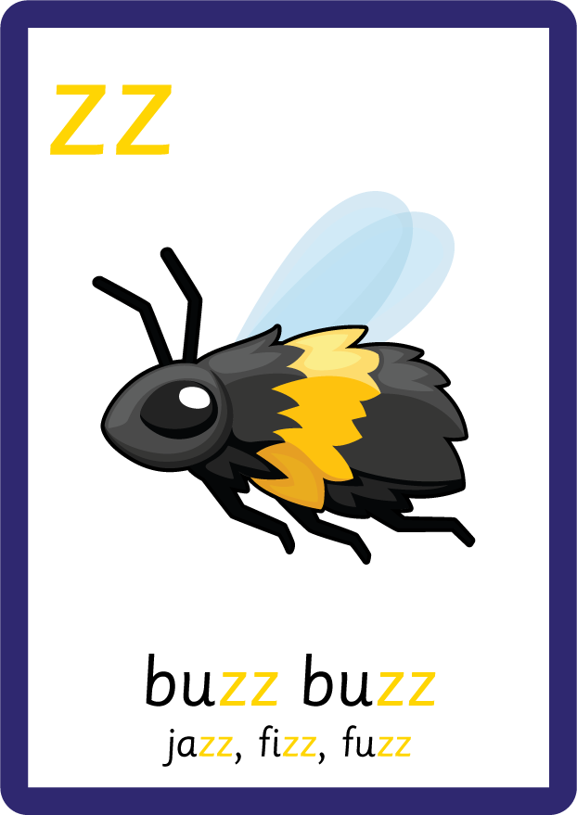











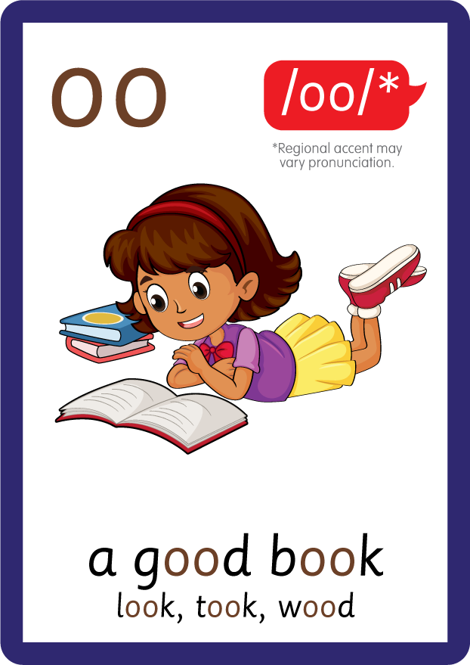










Recall all GPCs learned so far using flashcards.

Slide 5








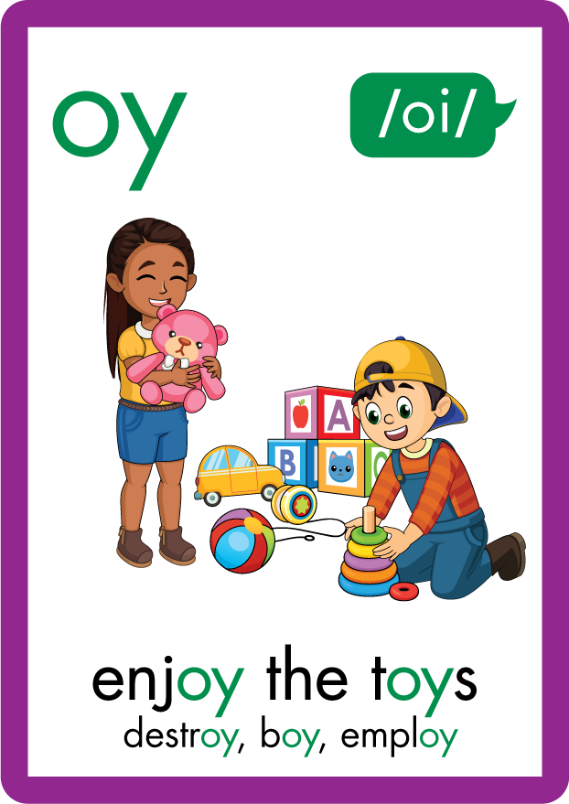
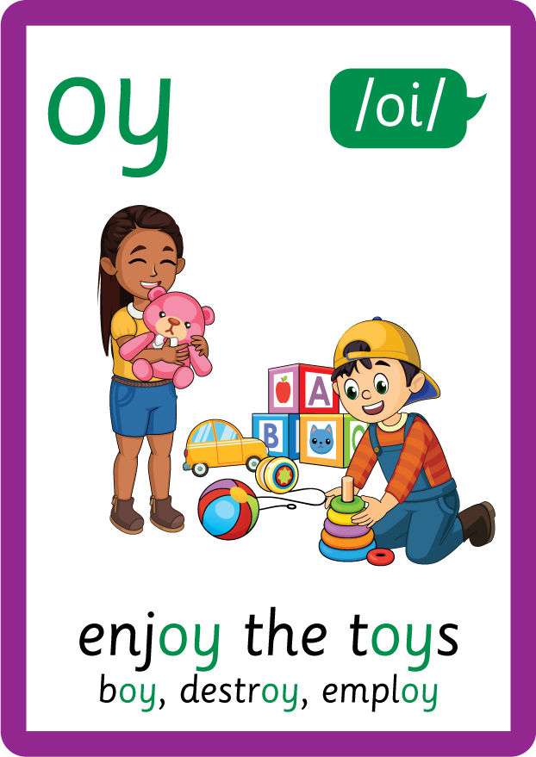
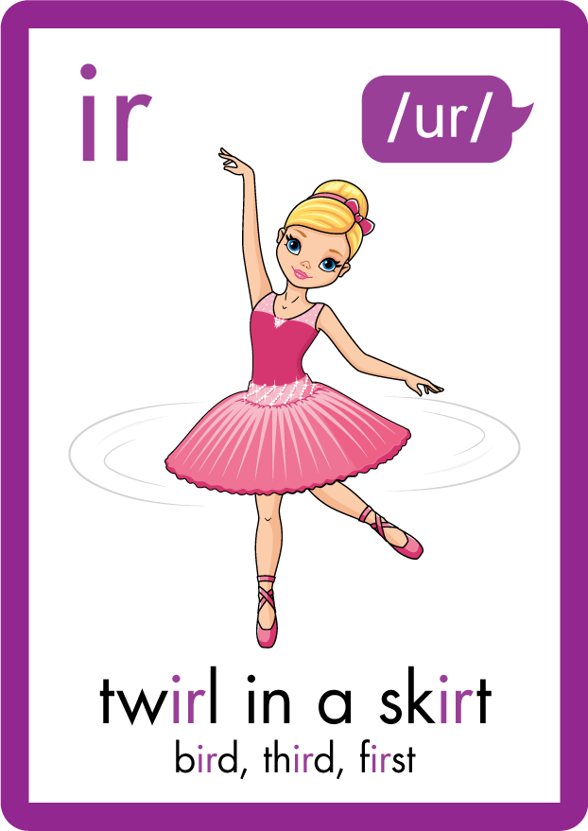
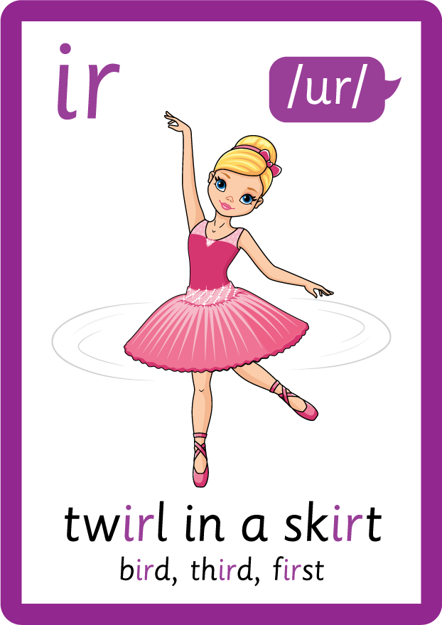








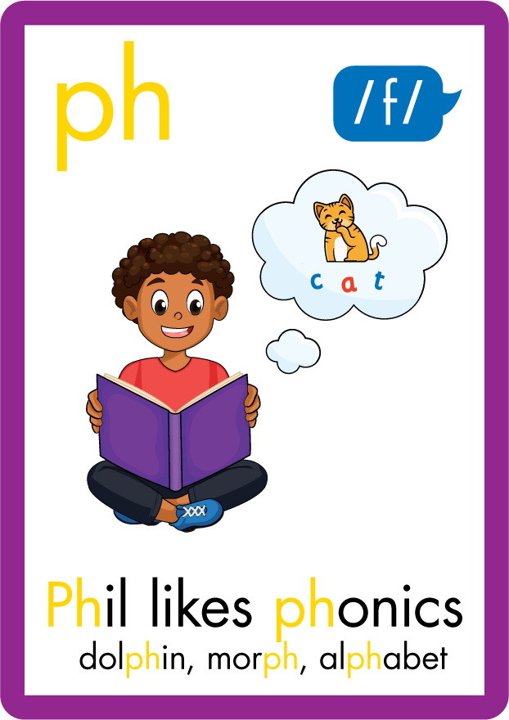










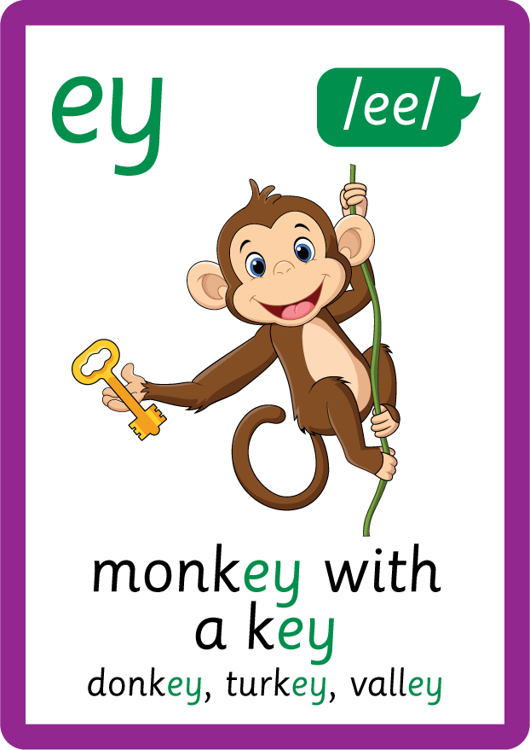


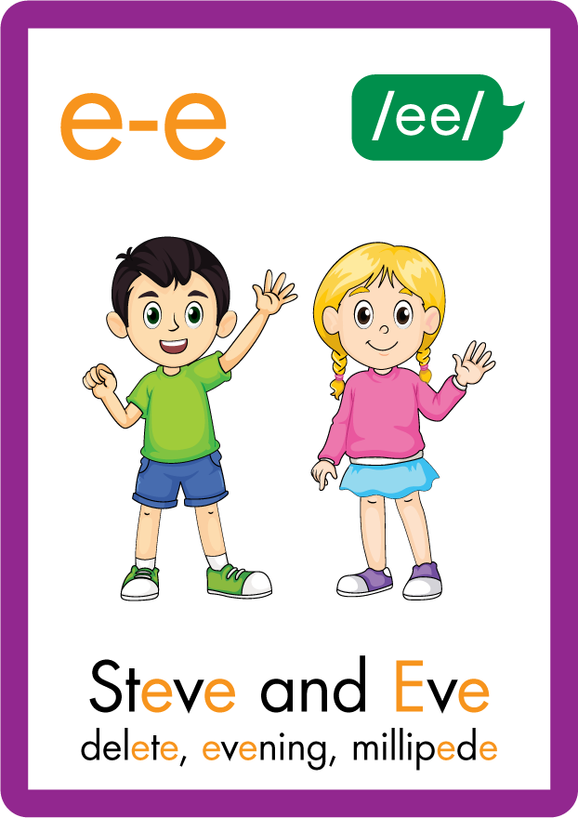






Recall all GPCs learned so far using flashcards.

Slide 6
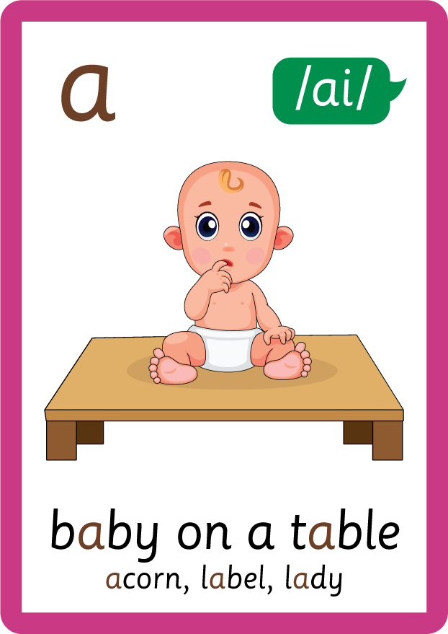



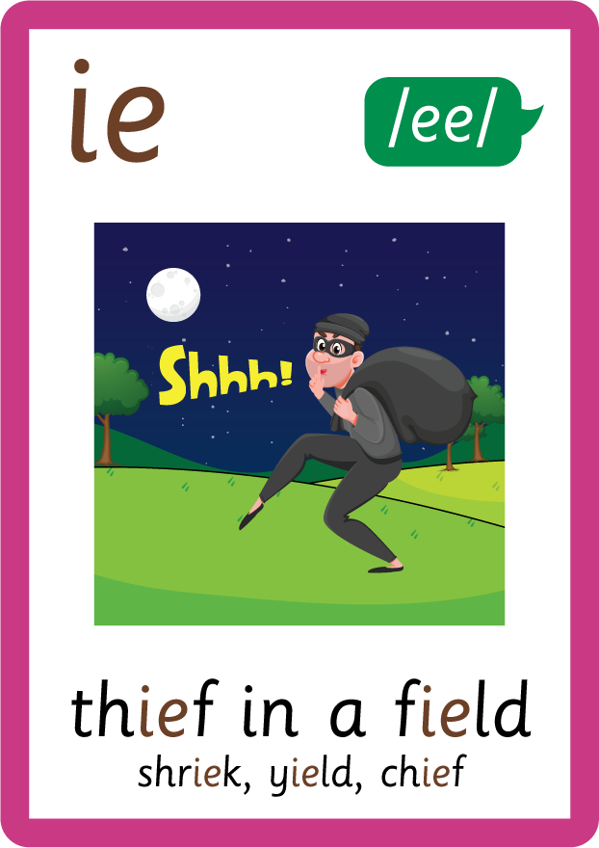








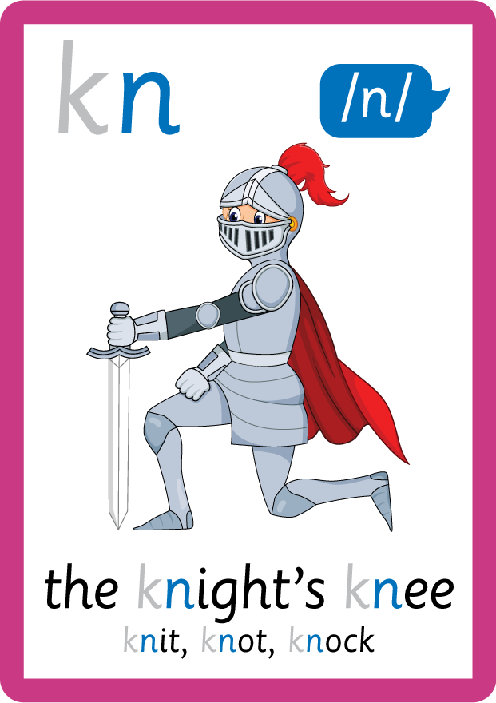

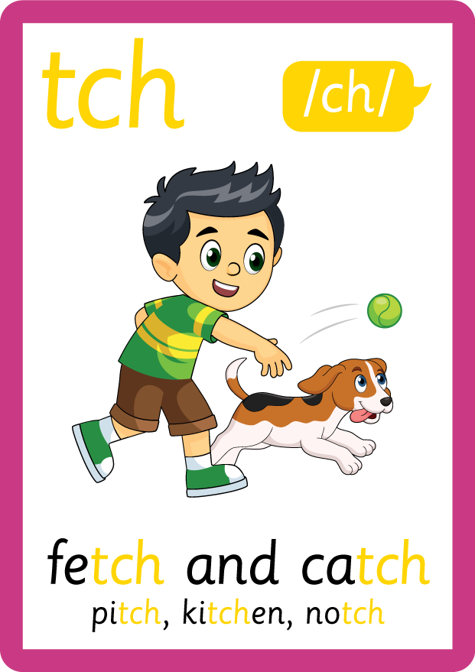
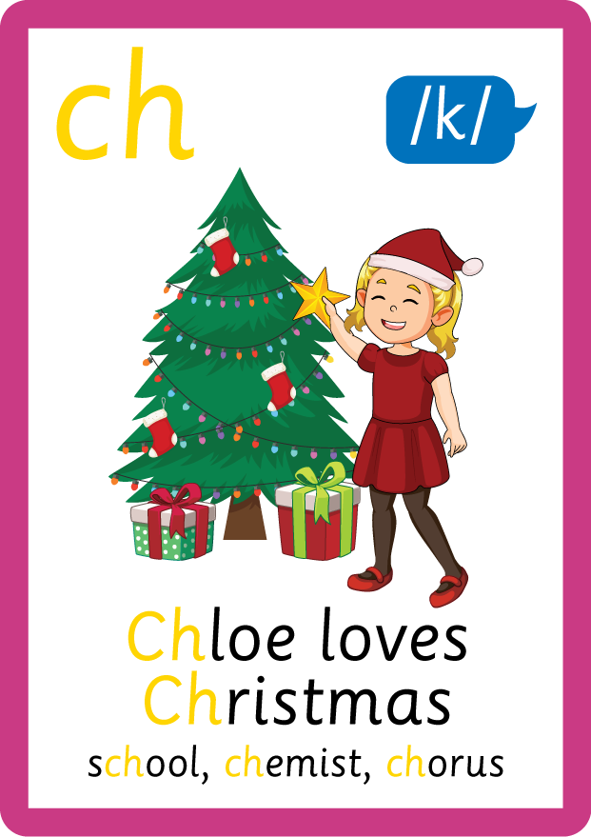


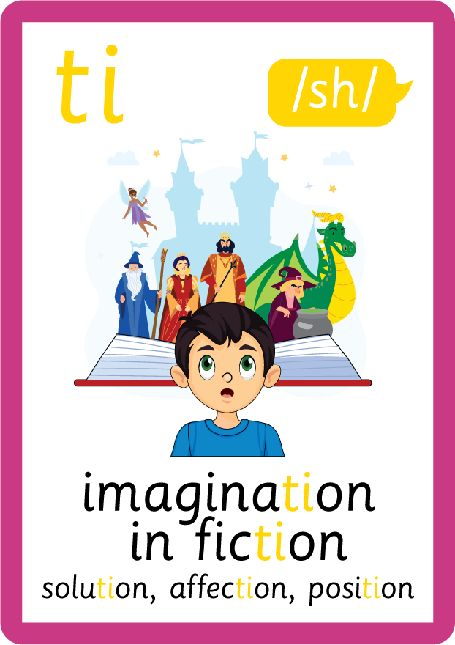




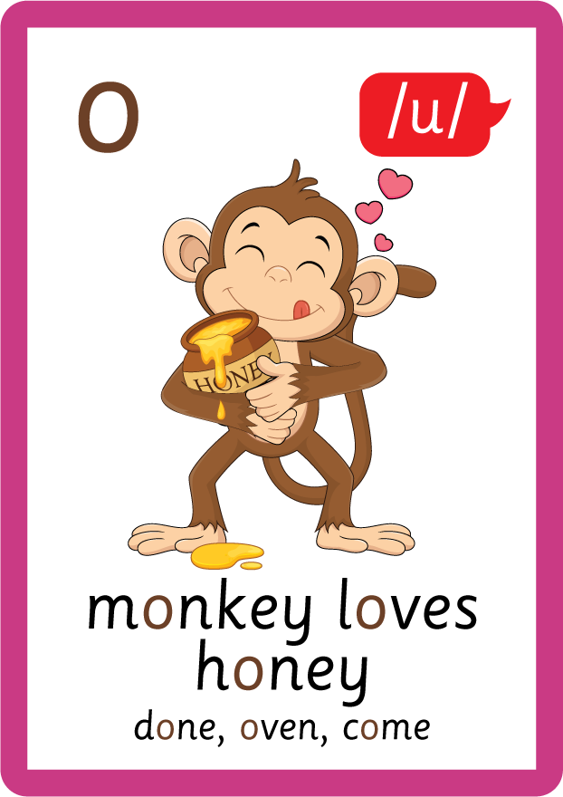
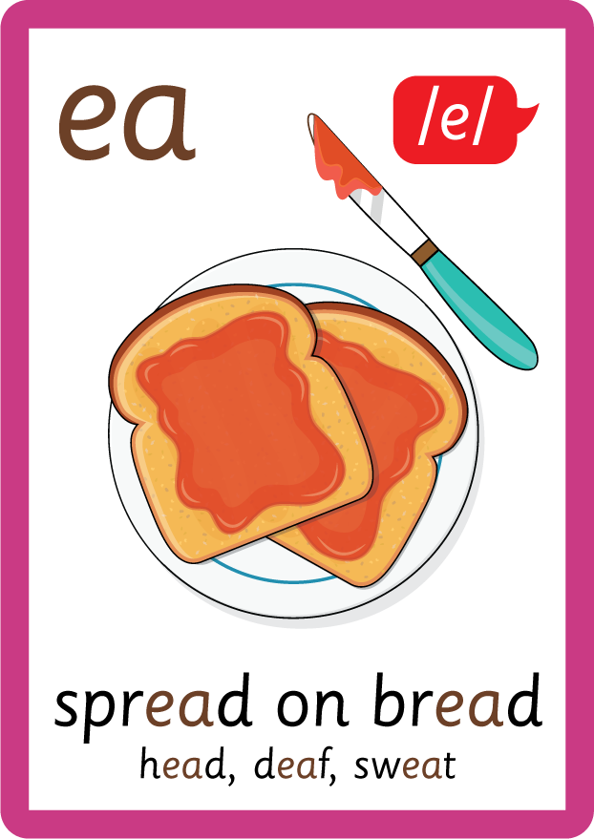




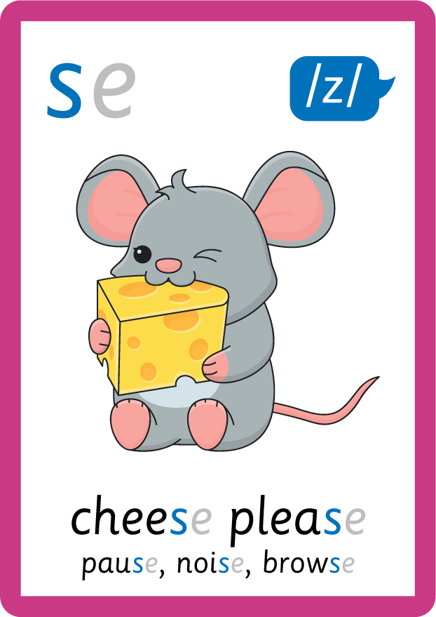



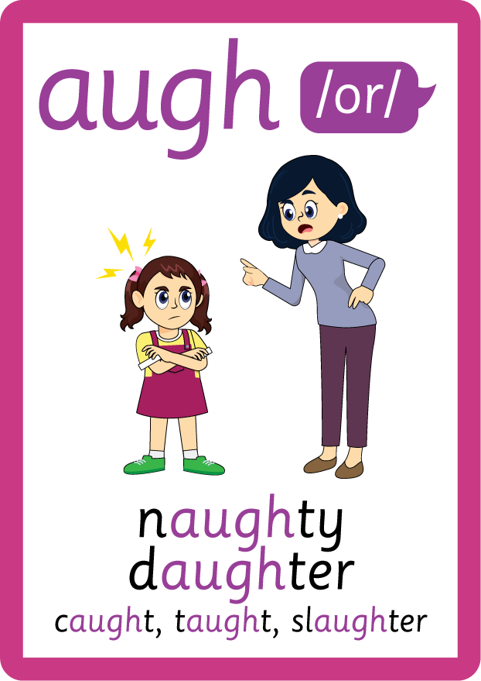


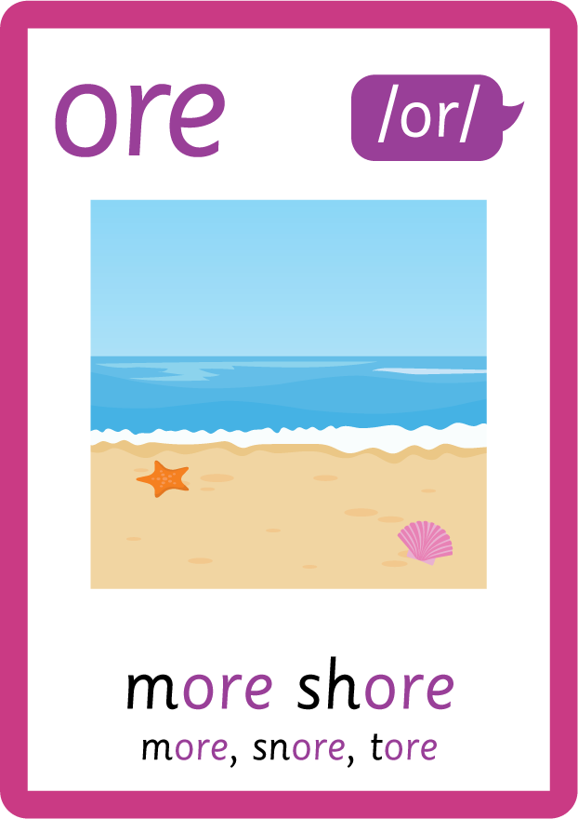


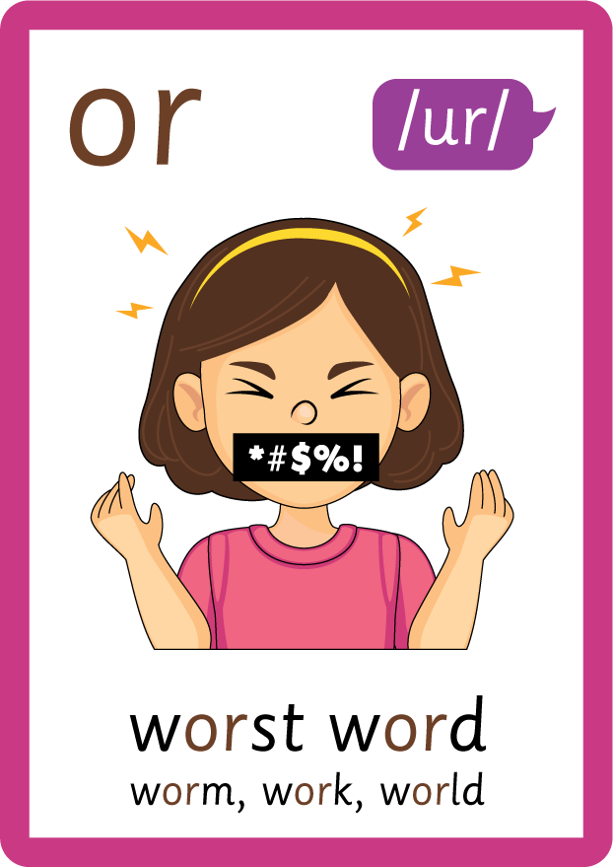


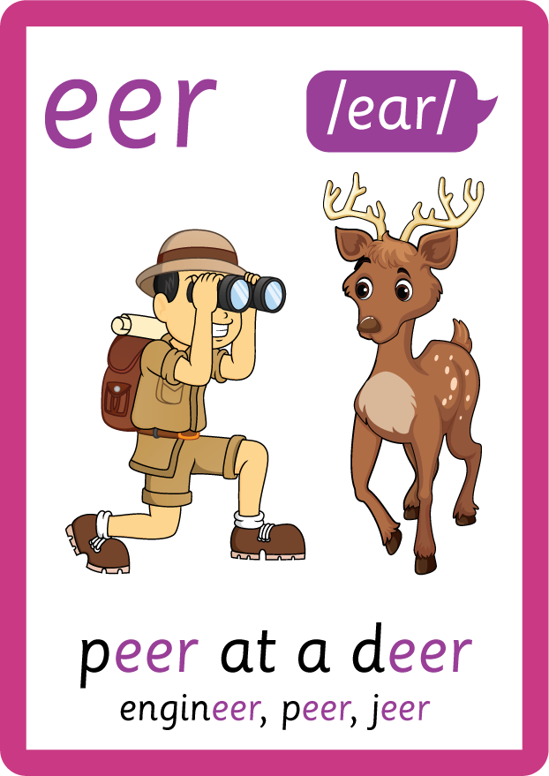

Recall all GPCs learned so far using flashcards.

Slide 7















Review Phase 5 Common Exception Words today house mouse hour because Mr Mrs Ms where should could would move use want.

Slide 8

Explain Decoding

Slide 9
Model Blending Phonemes
s
p
r
i
ng
USING SOUND BUTTONS
Sound Buttons
Vowel
Consonant
Consonant Digraph
Multi Sound
Long Vowel Sound
R-controlled Digraph
Split Digraph
Syllable / Silent Letter

Slide 10
Model Blending Phonemes
t
m
e
i
USING SOUND BUTTONS
Sound Buttons
Vowel
Consonant
Consonant Digraph
Multi Sound
Long Vowel Sound
R-controlled Digraph
Split Digraph
Syllable / Silent Letter

Slide 11
Model Blending Phonemes
s
p
r
m
e
i
t
ng
i
USING SOUND BUTTONS
Sound Buttons
Vowel
Consonant
Consonant Digraph
Multi Sound
Long Vowel Sound
R-controlled Digraph
Split Digraph
Syllable / Silent Letter

Slide 12

Explain Encoding

Slide 13

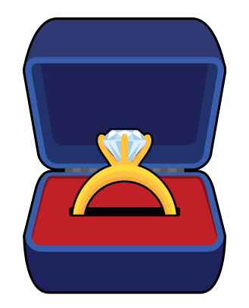
Practise Adding Affixes
ear
r
i
ng
USING A PHONEME FRAME

Slide 14

Practise Adding Affixes
ear
r
i
ng
USING A PHONEME FRAME

Slide 15

Practise Building Words
PRACTISE – 10MINS
s
t
ar
f
i
sh
p
o
p
n
or
h
c
a
d
b
g
USING MAGNETIC LETTERS AND A WHITEBOARD
Sound Buttons
Vowel
Consonant
Consonant Digraph
Multi Sound
Long Vowel Sound
R-controlled Digraph
Split Digraph
Syllable / Silent Letter

Slide 16
Practise Building Words
PRACTISE – 10MINS
s
t
ar
f
i
sh
p
o
p
n
or
h
c
a
d
b
g
starfish popcorn handbag
USING MAGNETIC LETTERS AND A WHITEBOARD
Sound Buttons
Vowel
Consonant
Consonant Digraph
Multi Sound
Long Vowel Sound
R-controlled Digraph
Split Digraph
Syllable / Silent Letter

