Slide 1
DGCA GUIDE LINES

Slide 2
DGCA GUIDE LINES
ELIGIBILITY FOR A LICENSE
AGE = 18 - 65 YEARS
QUALIFICATION = 10th
NATIONALITY = INDIAN
TRAINING :
      Remote Pilot Training Organisation ( RPTO ) se trg leni padti hai.
      Training ke baad theory + practical test hota hai.
      Pass hone ke baad RPC milta hai.
      Uske baad DGCA ki site pper apply karke RPL milta hai.

Slide 3
DGCA GUIDE LINES
Register Your Drone
  DGCA Ki site per ( DIGITAL SKY ) Plateform per register kiya jata hai.
  Iske baad apko ek UIN ( unique identification number ) milta hai.
  yeh no drone per chipkana hota hai.
Classify Your Drone : Categorize Your Drone As Per Its Weight And Purpose.
Nano = Less Than 250gm
Micro = 250g To 2kg
Small = 2kg To 25kg
Medium = 25kg To 150kg
Large = More Than 150kg

Slide 4
DGCA GUIDE LINES
LICENSE REQUIRMENT
Small category ke drone ke lie license ki zarurat nahi hoti.
Medium category ke lie registration ki zarurat hoti hai. private jagah per fly ke lie license ki zarurat nahi hai.
Baki sabhi category ke lie license ki zarurat hoti hai.
Three Zones Has Been Categorized For Air Traffic Norms
Red Zone
Yellow Zone
Green Zone

Slide 5
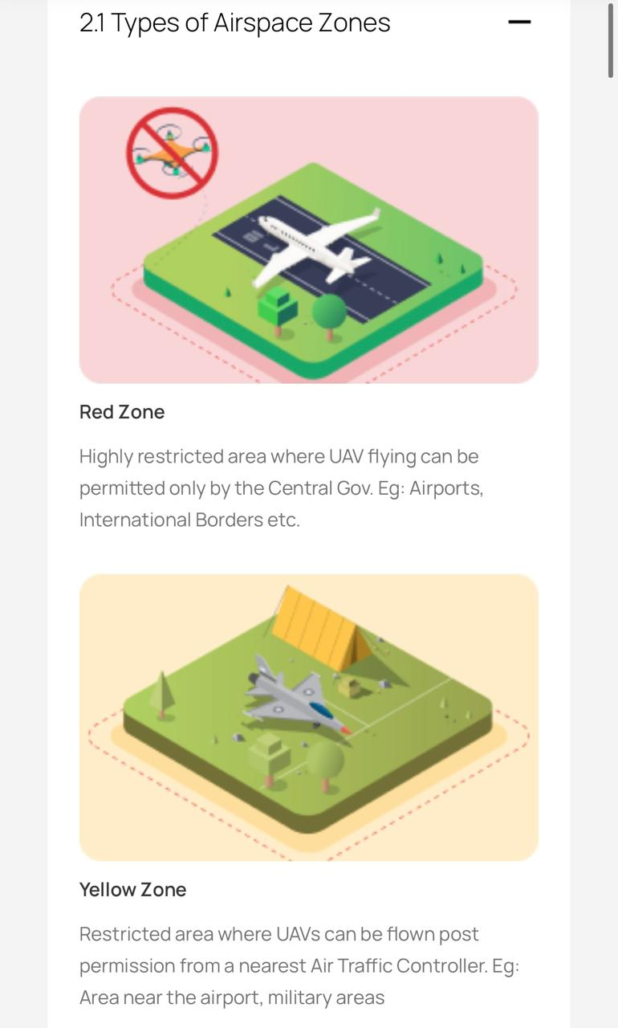
DGCA GUIDE LINES
Red Zone
Red Zone fly ke lie banned hota hai.
Ager apko red zone mai flying karni hai to central govt se permission leni hogi .
Red zone 05 km tak hota hai .

Slide 6
DGCA GUIDE LINES
Yellow Zone
Yellow Zone flying ke lie restricted hota hai.
Esko 02 bhago mai banta gaia hai .
Inner and outer zone
Inner zone 05 se 08 km tak hoti hai .
Outer zone 08 se 12 km tak hota hai .
Inner zone mai 200 ft tak fly ker sakte hai . Lekin uske lie permission cahie hoti hai .
Outer zone mai 200 ft tak fly ker sakte hai .
Isse upper ke lie lie permission leni padhti hai .

Slide 7
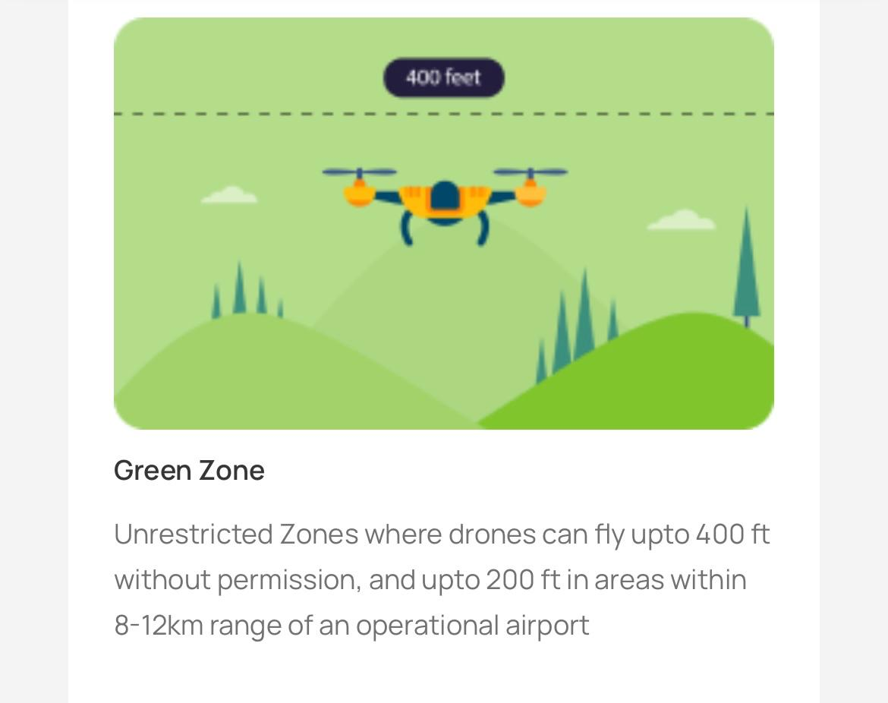
DGCA GUIDE LINES
Green Zone
. Green zone 12 km se upper hota hai .
. Isme app 400 ft tak fly ker sakte ho .
. Jiske lie kisi tarah ki koi permission lene ki zaeurat nahi hoti hai .
. India mai drone ko isse upper fly karne ki permission nahi hai .

Slide 8

Temprory Red zone
Govt ise kahi bhi laga sakti hai,
Kisi VIP ja kisi function ke ilaqe mai laga sakti hai.
Yeh 96 hrs tak ke lie lagai jati hai.
Is ilaqe mai fly karne ke lie upto SP ki permission leni padhti hai.
Yeh airspace map per show hoti hai.

Slide 9
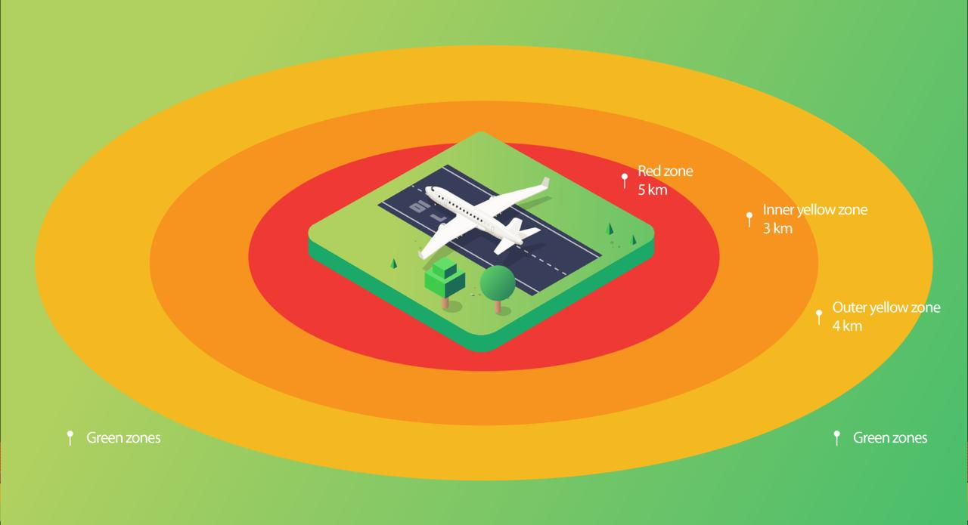
DGCA GUIDE LINES

Slide 10
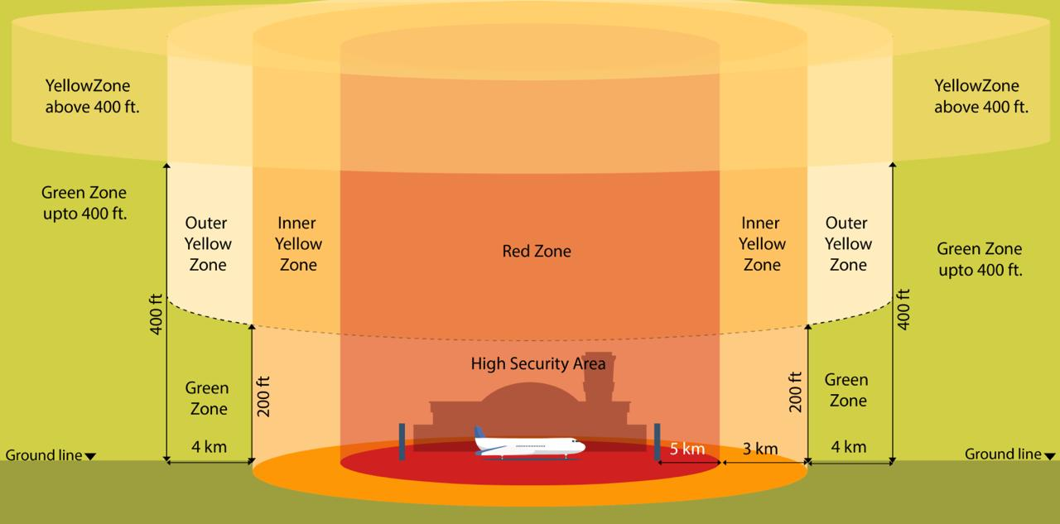
DGCA GUIDE LINES
Follow Altitude Restriction.

Slide 11
DGCA GUIDE LINES
Keep Visual Line Of Sight
Always Keep Your Drone Within Your Visual Line Of Sight While Flying
No Fly Zones : Avoid Flying Over Crowds, Public Gathering And Other No Fly Zones.
Adhere To Privacy : Respect People Privacy And Do Not Capture Images Or Videos Of Individual Without Their Consent.
Comply With Equipment : Ensure Your Drone Has A Compliant Id Plate, Gps & Is Equipped With No Spyware Software.

Slide 12
DGCA GUIDE LINES
Insurance : Get Insurance Coverage For Your Drone To Protect Against Potential Accidents Or Damage.
Renewal : Renew Your Drone Registration And Operator Id As Required.
Report Incidents : Report Your Drone Related Incidents Or Accidents To DGCA As Per Their Guidelines.
Stay Updated : Regular Check DGCA Website For Updated Regulations And Guidelines.

