Slide 1

G-9
Guided by:
Mr. Shivshankar Rajput
Submitted by:
Aditya Deshmukh
Aman Pratap Singh
Chetan Aleria

Slide 2
IDEA OVERVIEW
What Kitchenkart is all about
From table booking to menu , continuation of order to payment
Menu from the app, customize or add further orders in real time. No longer needed to guess the dish. Get info about dishes.
Know about today's specials, discounts, coupon codes & premium services info and apply them and never miss a chance to save money
Secured Delivery of food to location by a modified vehicle.
Idea Overview

Slide 3
Introduction
This project proposes a food ordering system using QR Code named as Kitchenkart.
The customers will be using a mobile application.
The customers need to use their phone with the application that has been installed to scan the QR code from the menu.
Then, the customers must submit the order to make a confirmation and it will directly send to the kitchen.

Slide 4
Motivation and Need
Sometimes the customer needs to face with the problem that need to wait for quite a long time for the waiter to come and take the order .
In another restaurant they were low on staff & therefore no waiters were there to serve and take orders. So, everything just got disturbed.
Also, sometimes the waiters take order by using the paper and the paper will be passed to the kitchen and it might get misplaced sometimes then one customer will get the order that he didn’t order.
Waiter tends to make human error such as miscommunication with customers. Because of this miscommunication, it will affect the process of preparing the food.
That time I got an idea to create an app that can resolve all these issues and customer get complete satisfaction from the restaurant .

Slide 5

AIM AND OBJECTIVE :-
To analyze the current system features and problems before developing the new proposed system.
To design a user-friendly system that will surely satisfy the customer service.
To develop system using QR Code as a sensor feature to receive customer order.
To study the functionality of each existing food ordering system owned by the restaurants.
To develop food ordering system using QR code to avoid any mistake happen while ordering the food.

Slide 6
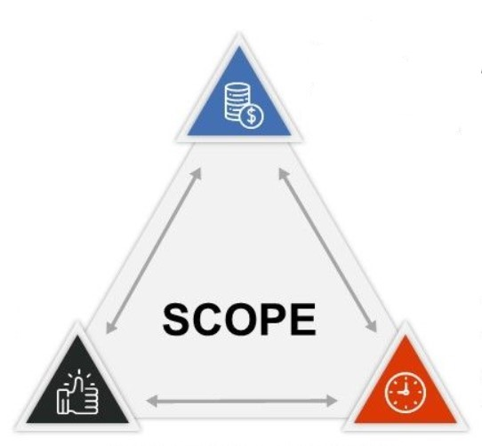
Scope of Project
The system is proposed and will be used by the restaurants that are located in nearby places.
The food ordering system will be divided into two parts which is the mobile application.
The user of this system is divided into two category which are:
• The customer of that restaurant who will order the food.
• The staff that work at the restaurant who will manage this system.

Slide 7

How do QR Codes for restaurants work?
Scan QR Code,
View Menu,
Order,
Pay
& Get Bill
on your Mobile
Perfect for all types of food businesses whether its restaurants or small food shops.
1. DEPLOY: Place the QR Codes menus on table toppers, on curbside posters.
2. SCAN: When a consumer scans the QR Code, they will be able to view the entire menu on their smartphones, avoiding unnecessary contact with the staff members or waiter.
3. VIEW MENU & ORDER: They can use this digital menu to place orders.
4. FOOD PREPARATION: Restaurant gets order confirmation message & starts preparing food.
5. PICKUP ORDER: Once the order is ready the customer is notified & they can proceed to pickup the order.

Slide 8
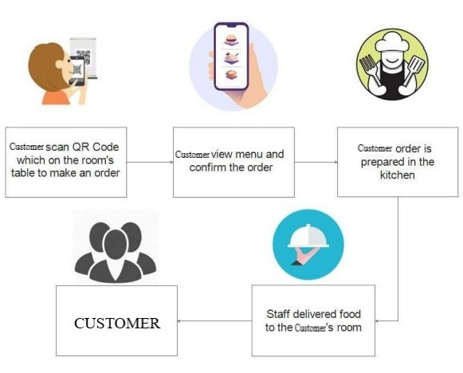
Flowchart of how do QR Codes
for restaurants work?

Slide 9

COMPETITIVE ANALYSIS
OUR APPROACH
Realtime and continuation orders
Menu is interactive and will show only available items in the quantity that can be produced
Automatic updation of billing whenever you further order
Delivery will be made by modified vehicle
A Safe & Smart way for customers to place orders at your restaurants or food shops
COMPETITION-ZOMATO
Orders are either pickup or home delivery
Just the image of menu card (Sometimes in disabled form if not available)
No such feature exist for inhouse food system in a restaurant
Food package may be distorted or stolen

Slide 10

DEVELOPMENT AND METHODOLOGY
For the development of our Android App we are using “AGILE DEVELOPMENT PROCESS”.
Because, Agile mobile app development methodology is one of the most effective approaches to all the software development

Slide 11




Tools And Technologies
REACT NATIVE(ANDROID/IOS)
JAVASCRIPT
Node JS
DATABASE-Firebase
Visual studio

Slide 12

Features
QR CODE:
TABLE BOOKING
DIRECT ORDERS
REALTIME:
AUTOMATIC UPDATION IN BILLING
NO ASSISTANCE REQUIRED
OFFERS:
FOR TODAY’S SPECIAL
FOR PREMIUM CUSTOMERS

Slide 13




Marketing Plan
PRICE
Everything is charged on the minute basis. And fully online payment.
App
User friendly, Secure, Easy payments.
Never forget anything.
History and live monitoring.
PLACE
Start with metropolis city then every city in India.
PROMOTION
Advertisement
Offers on daily basis
Special discounts for premium customers

Slide 14
CONCLUSION
QR Code menu is a crucial piece in the contactless puzzle at a restaurant. As we march towards a digital and contactless world, restaurants need to use QR Codes or other similar contactless technologies with their traditional processes. Making dining safe and contactless will not just bring in diners but also win restaurant loyalty.
Building an Android Application.
Work thoroughly on Agile Development Process.
Opportunity of teamwork.

Slide 15
TIME FOR QUERIES
FEEDBACK AND
SUGGESTIONS

