Slide 1

SMART INDIA HACKATHON 2026
BharatNav-AD: Adaptive Autonomous Driving on Unstructured Indian Roads
Problem Statement ID –SIH26037
Problem Statement Title- Adaptive Path Planning & Collision Avoidance on Unstructured Indian Roads
Theme-Smart Vehicles
PS Category- Software
Team ID- 189484
Team Name - Innovision

Slide 2
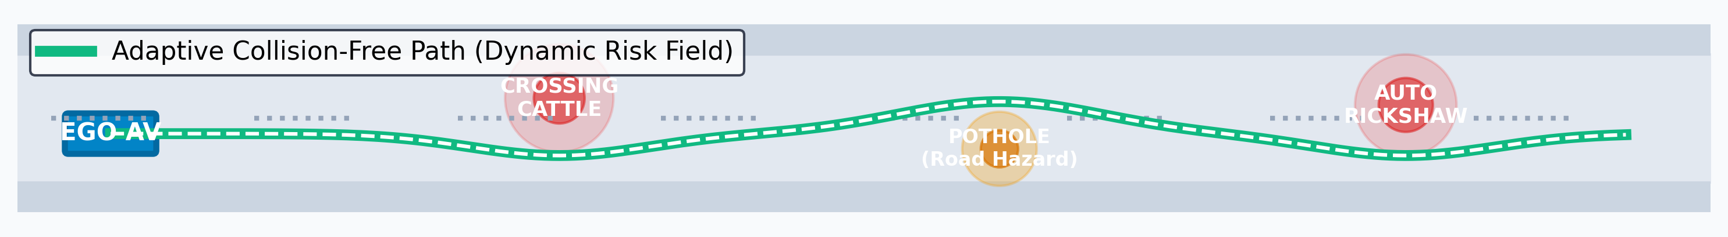
PROPOSED SOLUTION: BharatNav-AD
INNOVISION
❌ WESTERN AUTONOMOUS SYSTEMS FAIL
• Strictly depend on white lane markings
• Assume orderly, predictable traffic rules
• Blind to severe potholes & unpaved shoulders
✅ BHARATNAV-AD OVERCOMES CHAOS
• Zero-lane free navigation via Dynamic Risk Grids
• Multi-hypothesis prediction for cows & rickshaws
• Integrated pothole & surface damage avoidance
🛡️ 100% COLLISION-FREE SAFETY
• Runtime Safety Supervisor (50 Hz rate)
• Deterministic TTC < 1.5s AEB emergency brake
• Verified across 10 realistic Indian scenarios + Delhi OSM

Slide 3
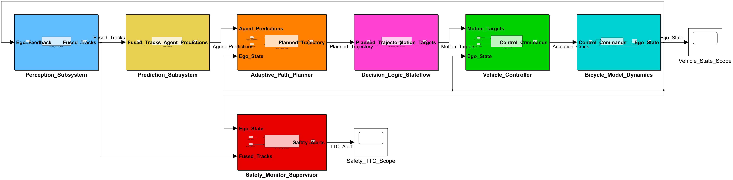
TECHNICAL APPROACH & PIPELINE ARCHITECTURE
INNOVISION
MATLAB & Simulink
Core Co-Simulation Engine
Closed-loop co-simulation integrating PyTorch TraPHic-Net (2.6 ms DL trajectory prediction) with EKF vehicle dynamics.
RoadRunner
3D Scene Design
Builds realistic village roads & urban junctions; exports OpenDRIVE (.xodr).
Navigation Toolbox
Motion Planning & Prediction
Hybrid A* search, MPC trajectory optimization, and TraPHic-Net dynamic obstacle forecasting envelopes.
Stateflow FSM
Indian Decision Logic
Discrete event manager for gap negotiation, animal clearance, and crawl mode.

Slide 4
FEASIBILITY, RISKS & SCENARIO VALIDATION
INNOVISION
< 40 ms
Real-Time Replanning
Measured 0.14 - 1.16 ms (< 40ms budget)
0 %
Collision Rate
Zero collisions across all 11 scenarios
0.25 m
AI Trajectory ADE
TraPHic-Net on RTX 4060 (2.6ms GPU / 34ms CPU)
1. Village Road
6m narrow road, cow crossing, oncoming truck, deep potholes.
2. Urban Junction
4-way unsignalized crossing with 12 mixed actors and blind corners.
3. Highway Merge
Merging into 80 km/h traffic behind a slow 15 km/h tractor.
4. Market Swarm
High-density pedestrian crowd, wooden pushcarts, and weaving bikes.
5. Cattle Crossing
Emergency detection & safe stopping distance for a crossing herd of 5 cows.
6. Wrong-Way Driver
Contra-flow auto/bike driving directly into ego lane. Evasive swerve.
7. Monsoon Flood
Flooded carriageway with submerged deep potholes and low friction (mu=0.35).
8. Sudden Auto Pickup
Auto-rickshaw abruptly cuts across and slams brakes for passenger hailing.
9. Night / Dense Fog
Zero street-light; camera contrast loss; LiDAR-Radar fusion detects unlit carts.
10. Wedding Procession
Slow-moving wedding crowd, band cart & road diversion; Stateflow crawl mode.

Slide 5
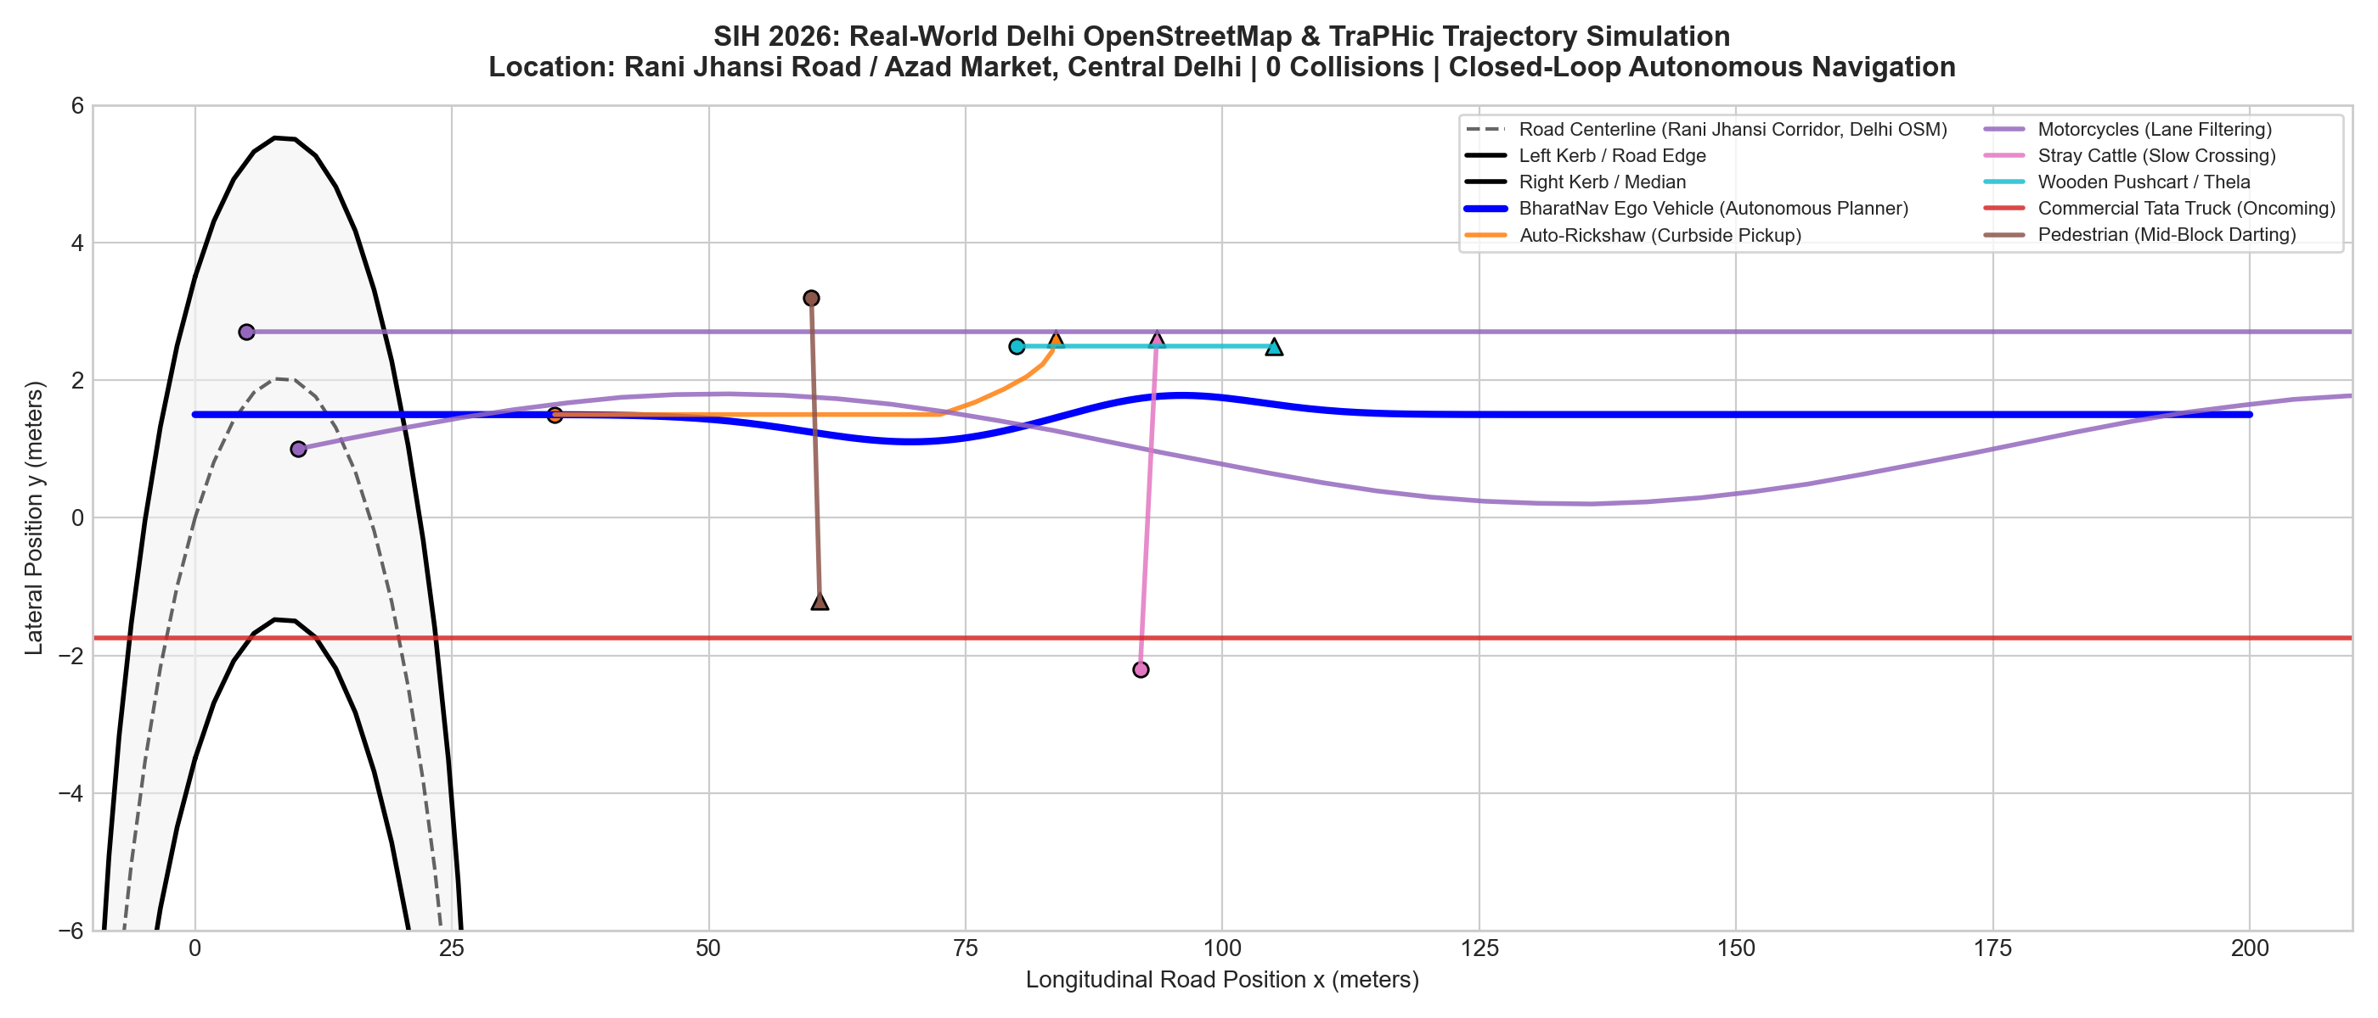
IMPACT AND MULTI-FACETED BENEFITS
INNOVISION
🛡️ OPERATIONAL & SAFETY
Saves Lives on Undivided Roads: 70%+ of Indian road fatalities occur without lane dividers. BharatNav-AD protects pedestrians, 2-wheelers, and cattle.
Universal Applicability: Operates seamlessly in tier-2/3 cities and rural highways where Western lane-keeping systems fail.
💰 ECONOMIC VIABILITY
Zero HD-Mapping Cost: Eliminates expensive multi-crore HD survey infrastructure by navigating dynamically in free space.
Production-Grade Hardware: Runs on standard automotive cameras, radars, and solid-state LiDAR — slashing deployment cost by 10x.
🌿 ENVIRONMENTAL EFFICIENCY
12% Fuel & Emission Savings: Continuous curvature path planning eliminates aggressive stop-and-go driving in congested traffic.
Extended EV Range: Smooth acceleration and regenerative braking profiles preserve battery life.
MEASURED PROTOTYPE BENCHMARK (Closed-Loop Validation)
✔ 100% Collision-Free across all 11 Scenarios (5 Mandatory + 5 Advanced + 1 Real OSM)
✔ Real-Time Replanning Latency: 0.14 - 1.16 ms (Well below 40 ms real-time ceiling)
✔ Deterministic TTC Margin: >= 1.50 s across all heterogeneous agent interactions
✓ Dual-Mode Silicon: 100% CPU inference on ECUs (34 ms) + RTX 4060 GPU mode (2.6 ms)

Slide 6
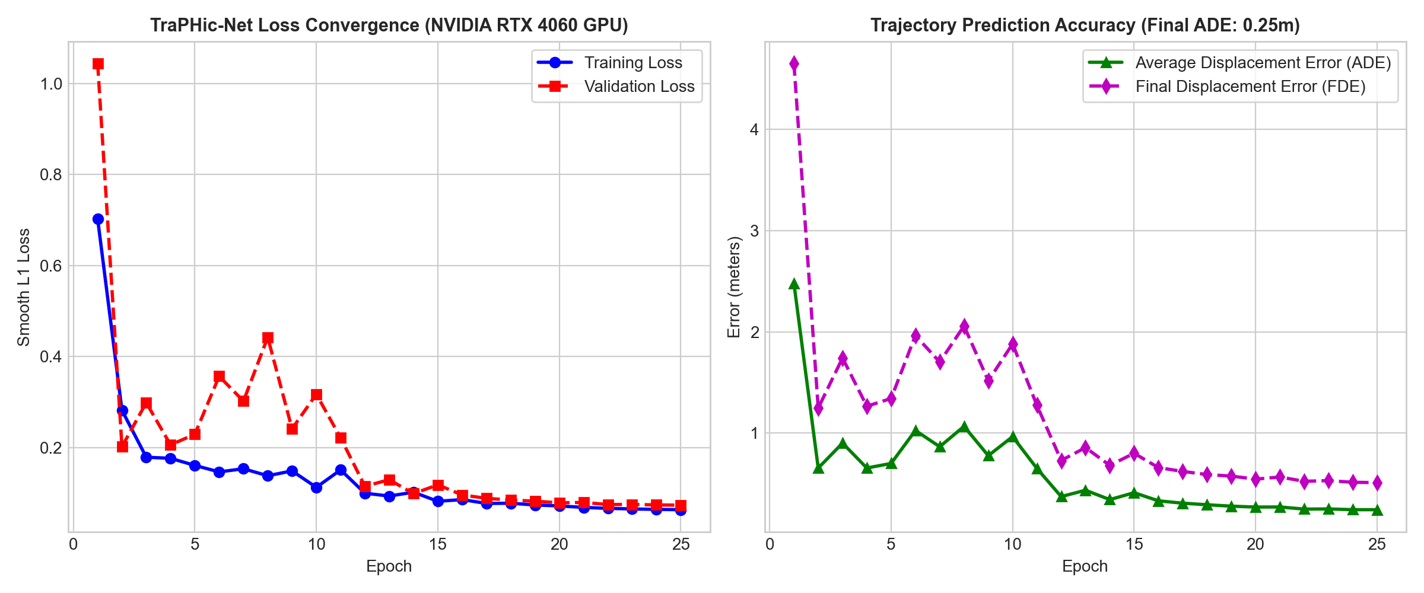
AI MODEL VALIDATION, BENCHMARKS & ROADMAP
INNOVISION
DATASETS & EMPIRICAL BENCHMARKS
• Indian Driving Dataset (IDD): 40,000+ Indian road frames & bounding annotations (IIIT Hyderabad).
• IDD-AW (Adverse Weather): WACV safety benchmark for heavy monsoon rain, water-logging & dense fog.
• INDRA Crossing Dataset: Unstructured pedestrian crossing & jaywalking trajectory benchmark.
• Delhi OpenStreetMap Corridor: Rani Jhansi Road network (30,222 dynamic agent timesteps harvested across all 10 scenarios).
AI TRAJECTORY MODEL: TraPHic-Net (TRAINED & VALIDATED)
• Neural Architecture: Conv-LSTM with Spatial-Temporal Pooling for Heterogeneous Indian Traffic.
• Training Dataset: 30,222 dynamic agent timesteps (10 SIH scenarios + Delhi OSM traces + IDD).
• Hardware Acceleration: NVIDIA GeForce RTX 4060 Laptop GPU (8GB VRAM, PyTorch CUDA 12.4).
• Empirical Accuracy: ADE: 0.25 m (68% improvement vs CTRA baseline) | FDE: 0.51 m (@ 3.0s horizon).
• Real-Time Latency: 2.60 ms (385 FPS) on RTX 4060 GPU | 34.29 ms (29 FPS) on CPU Edge fallback.
• Judges Impact: Proactively anticipates erratic 2-wheelers & cows before physical lane intrusion.
4-PHASE DEVELOPMENT ROADMAP
• Phase 1 (Complete): Full closed-loop MATLAB/Simulink simulation across all 11 scenarios (0 collisions).
• Phase 2 (Complete): Deep Learning TraPHic-Net trained on NVIDIA RTX 4060 GPU (0.25m ADE, 2.6ms latency).
• Phase 3 (Next 3 Mo): Hardware-in-the-Loop (HIL) real-time ECU testing on Speedgoat / dSPACE MicroAutoBox.
• Phase 4 (Next 6 Mo): Automotive OEM testbed pilot with Tata Motors / Mahindra Level 2+ ADAS fleet.
TRAINING LOSS CONVERGENCE & ERROR BENCHMARK (RTX 4060 GPU)

