Slide 1

Team Extroverts, Pune

Slide 2
Problem Statement : After Death Care
Mortuary Vans are largely not available across states and it becomes extremely disappointing if the vans are not available to take dead bodies from hospitals to their respective homes.
Though there are vans which are available in private space however there is no single point of contact through which services of these vans could be requested when in need.
It is expected that technology can bring all that data in once place and help users and health system to request these services whenever a death is reported in the hospital. The service could be accessed by various means such as miss call, mobile app, sms or call to a central number

Slide 3


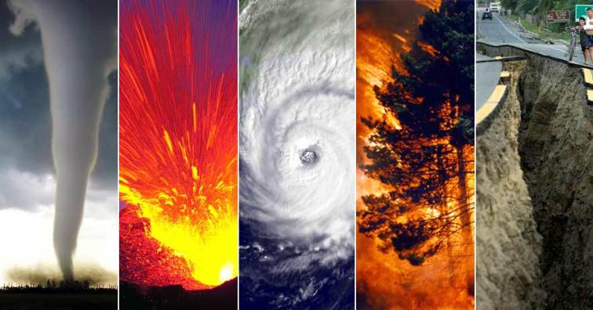
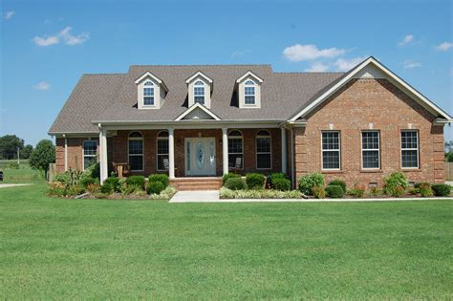
Use Cases
Use Case Code | Use Case | Description | Symbol
UC01IH | ADC-InsideHospital | This use-case covers a scenario when a death happens inside the hospital, may it be a long term treatment or last minute emergency admission.
UC02OHa | ADC-OH-MedicalLegalCase | This use-case covers a scenario when a death happens outside of a hospital in a road accident, terrorist attack, murder etc.
UC02OHb | ADC-OH-NaturalDisaster | This use-case covers a scenario when a death happens during and because of a natural disaster may it flood, earthquake etc.
UC02OHc | ADC-OH-Home | This use-case covers a scenario when a death happens at home. May it be accidental or because of illness.

Slide 4
Pre-requisite
Sr. No. | Pre-requisite
1 | Mortuary Van Registration
2 | Hospital Registration

Slide 5
Architecture:
User Interface
Text
Call
Web
App
IVR/CC
App
DB

Slide 6
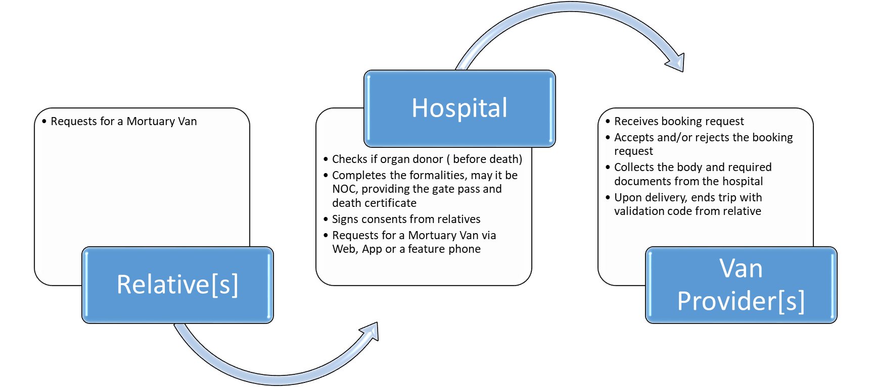
UC01IH: In hospital after death care

Slide 7





UC02OHa: Out hospital after death care MLC
Completes formalities
Calls ambulance
Accepts or
rejects request
Collects and delivers the body
Estimates fare
Reports the incident to Police
OR
Calls ambulance
Receives body
Provide security code
Payment
Police
Mortuary Van
Incident Reporter
Calls police
Take the injured /dead to hospital
Complete formalities
Request Mortuary Van via Web, App
or feature phone
Provide security code
Destination
Ambulance
Hospital

Slide 8
UC02OHb: Out hospital after death care ND
Calls DM team
Completes formalities
Calls ambulance
Accepts or
rejects request
Collects and delivers the body
Estimates fare
Reports the incident to Police
OR
Calls ambulance
Receives body
Provide security code
Payment
Police
Mortuary Van
Incident Reporter
Calls police
Take the injured /dead to hospital
Complete formalities
Request Mortuary Van via Web, App
or feature phone
Provide security code
Destination
Ambulance
Hospital

