Slide 1
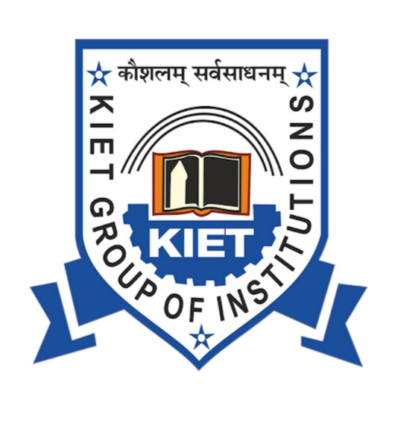

STUDENT MANAGEMENT SYSTEM (SMS)
Presented By:
DEEPAK KUMAR
AMAN KUMAR
ANAS

Slide 2
INTRODUCTION
The project “ Student Bio Data System “ is developed in C++ language . Which mainly focuses on basis operation of an institute’s student information system . Like Inserting, Deleting , Editing student information and results . Using this application a user can get every information about student’s of an Institute.

Slide 3
OBJECTIVE
It provides “better and efficient” service.
Reduce the workload of an institute .
Faster way to get information about the students.
Provide facility for proper monitoring , reduce paper work and provide data security .
All details will be available on a click for both user and admin.

Slide 4
Key Benefits of Student Information Management Systems
Increases Productivity
Deploying the right student management system means spending less time maintaining records and more time focused on the school. Improved data accuracy and organization only further enhance productivity and efficiency.
Access to Information
A student management system makes it possible for parents to gain total visibility into their children’s school activities, assignments, attendance, and performance .

Slide 5
Student Tracking
School activity goes beyond the wall of the classroom. It also includes extracurriculars such as sports and clubs, in addition to details about a student’s home life. With a student management system, this information is all kept in one place, making it far simpler for teachers to keep track of their students and identify when one is struggling.
Reduced Workload
The cost incurred from manually managing students and school activities is often staggering from not only a budgetary standpoint, but also in terms of time. With a student management system, teachers can spend less time holding up the foundation of the student experience, and more time in the classroom
Access from Anywhere
To the right people, student management software is accessible from anywhere and at any time. All a stakeholder requires is a smartphone, tablet, or PC to immediately look up relevant student information

Slide 6
ADVANTAGES
Preserved Times of Teachers And Administration
Bridge communication gaps
Student lifetime data
Safety of students
Library management
Inventory management
Report marking

Slide 7
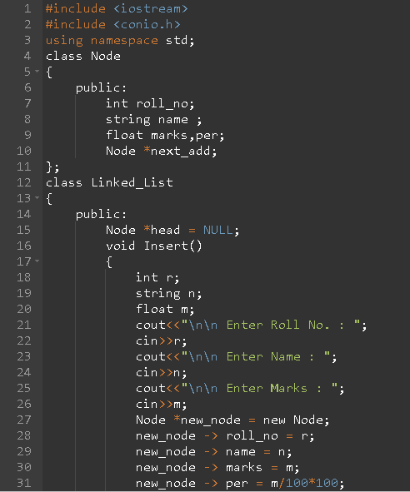
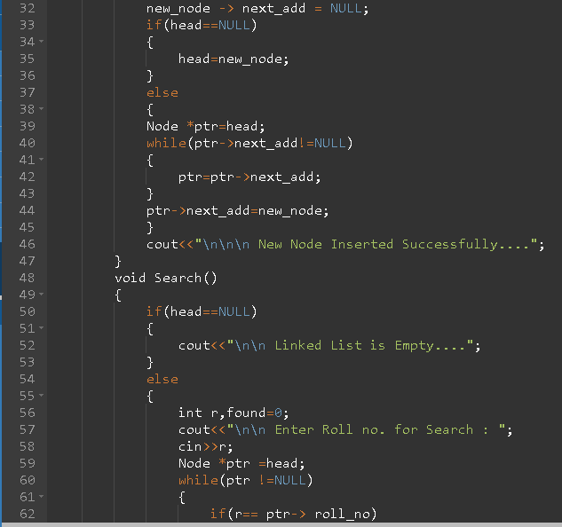
Source code :

Slide 8
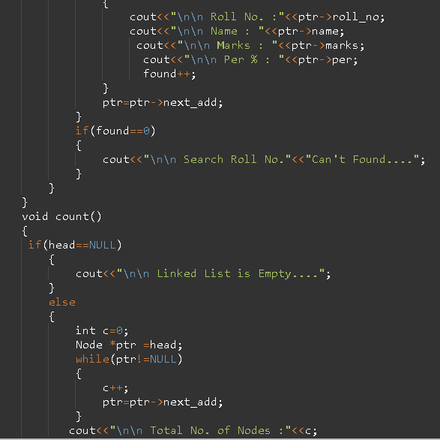
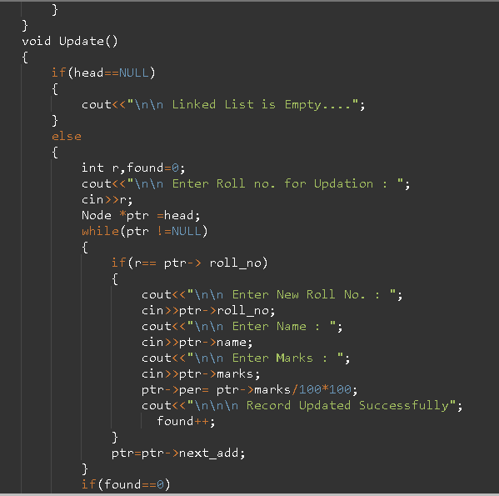

Slide 9
CONCLUSION
It is a wonderful and learning experience for us while working on this project .
SMS is used for making the process of managing information easier and to also make it accessible
This idea is to create a scenario that makes the lives of administration and teachers easier.

Slide 10
THANK
YOU

