Slide 1

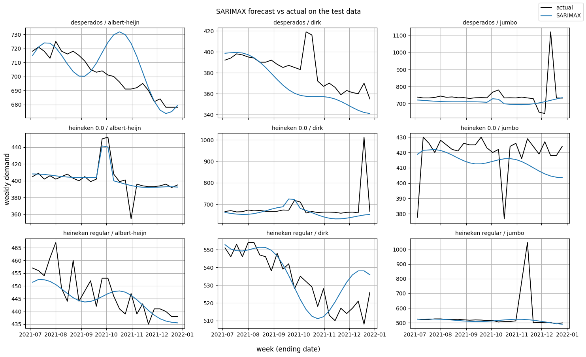
8-week-ahead Demand Forecast for the Demand Planning Team
Target week: 2022-02-20 · Model: SARIMAX · MAPE(test data): 2.92% · MAE(test data): ~19 units/week · Training wk range: 2019-01-03 -> 2021-06-27 · Test wk range: 2021-07-04 -> 2021-12-26
SKU | Supermarket | Predicted (2022-02-20)
desperados | albert-heijn | 691 (620–761)
desperados | dirk | 361 (329–393)
desperados | jumbo | 749 (657–840)
heineken 0.0 | albert-heijn | 396 (372–420)
heineken 0.0 | dirk | 687 (633–742)
heineken 0.0 | jumbo | 414 (388–439)
heineken regular | albert-heijn | 432 (382–482)
heineken regular | dirk | 509 (465–553)
heineken regular | jumbo | 517 (450–583)
Predicted weekly units with 80% interval. Assumes no promotions in the window.
Recommendation:
Training vs Test: SARIMAX (blue) tracks actual demand (black) across all 9 series.
On the test data, the model is within ±2.9% of actual demand on a typical week (MAE ~19 units/week) - tight enough to drive weekly orders directly. Have marketing publish the 8-week promo schedule so the model can add promo lift onto each future week instead of treating them all as non-promo.
Key findings:
• Demand is mostly stable (week-to-week CV of 6–11%) with mild year-on-year growth of 1–6%. (CV = std/mean)
• Promotions are the biggest single demand mover, lifting weekly demand by 5–11% on the 7 of 9 pairs that run them.
• Yearly seasonality is present but modest - only the desperados family shows a noticeable summer rise.
• Model: SARIMAX (1, 1, 1) with Fourier annual seasonality + promotion calendar as forward inputs.

