Slide 1
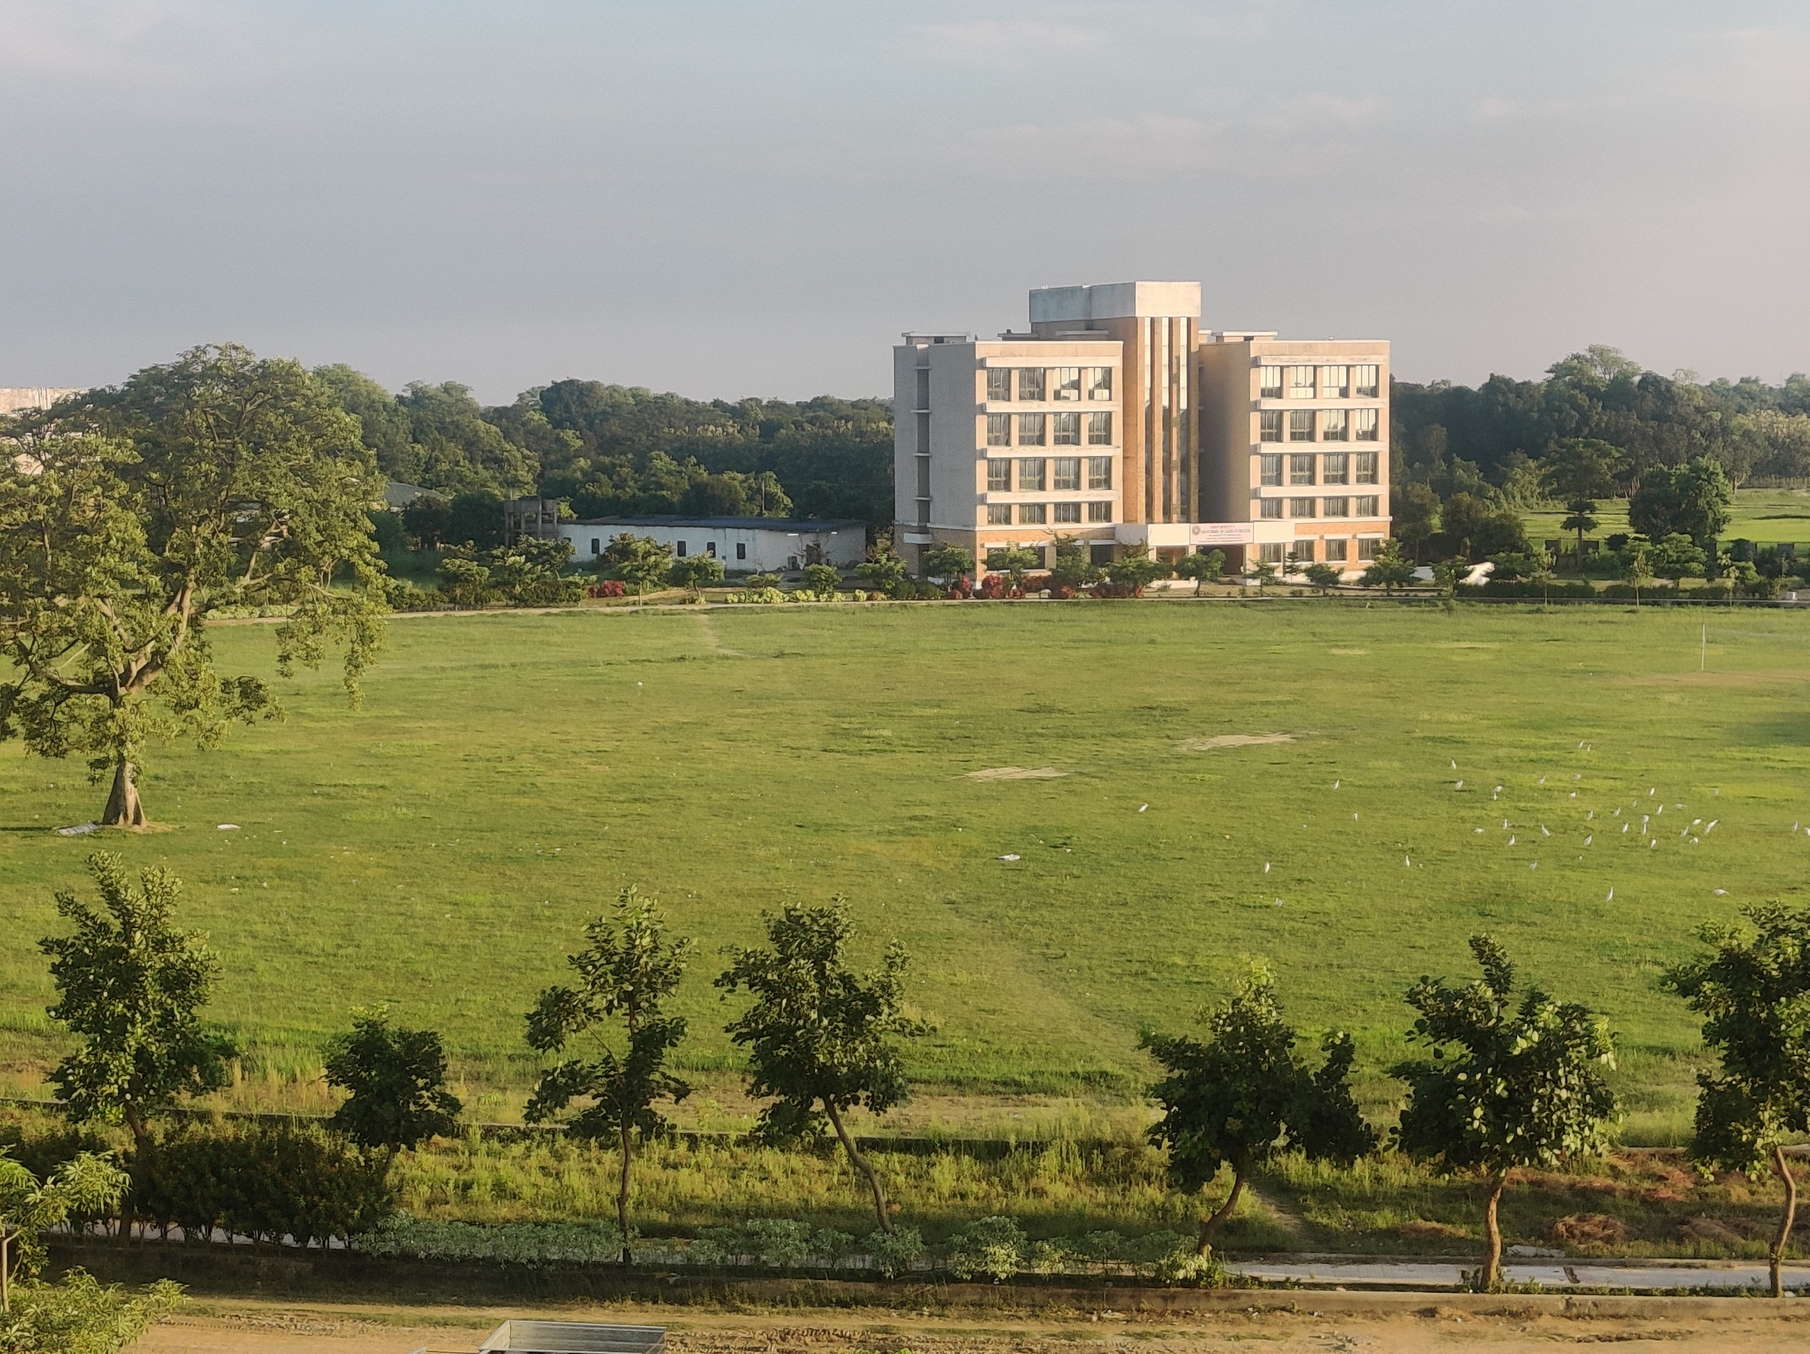
HOSTEL PREMIER LEAGUE
2023
SEASON 2
Venue : Sandip University Ground
Contact : Shubham Anand
(7079672307)
Praveen Jaykar
(9334539036)
First Match on 17-04-23
Starting time: 04:30 PM
Entry Fee : 1250/-

