Slide 1
Capstone Project Patient Management system
Final Presentation

Slide 2
About Amanuel Genetu
Educational background
Bachelor's Degree in Computer Engineering from Bahir Dar Institute of Technology(BIT)
Currently Studying my masters in WSPA University in Poland
Past Experience
Working as a full stack developer at Elda Software P.L.C
Working as a web Application developer at Rensys Engineering P.L.C in Ethiopia

Slide 3
About The Training
We Learn basics in C# and .NET
Develop and design console app
Develop Window form app
Develop web form
And .NET MVC
We also learn
React JS
React Native
JQuery
The Training Helps us to build not only knowledge also build our confidence to do a project professionally
The mid term assessment really helped us on how to do a project with a team
The Capstone project was individual and helped me to see where I am now and it will pushed me to improve my self more and more

Slide 4
Capstone Project Online Bus Booking
Features
Login
Authentication
Authorization
Manage system users
Manage hospitals
Manage patients
Manage Bills
Using React Js to Develop this Website

Slide 5
Capstone Presentation Demo

Slide 6
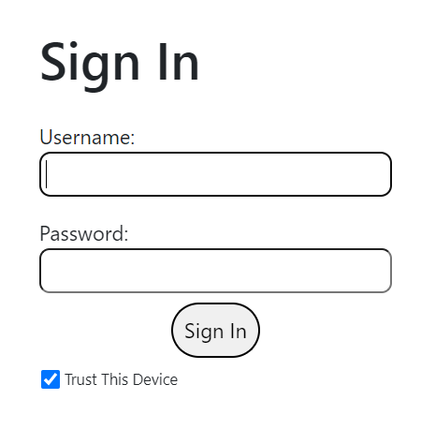

Slide 7
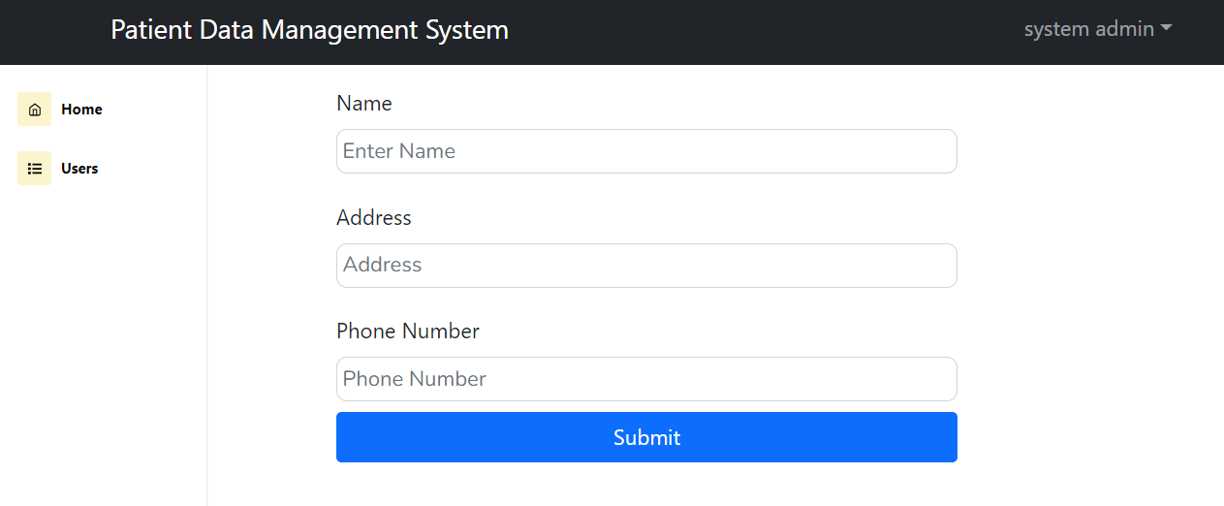

Slide 8
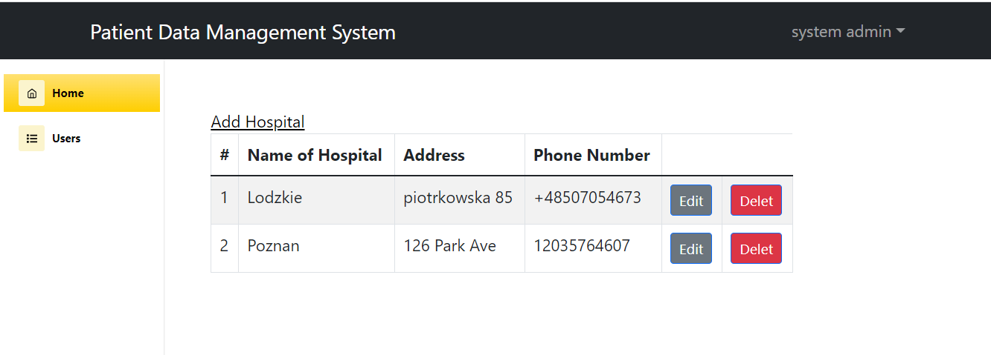

Slide 9
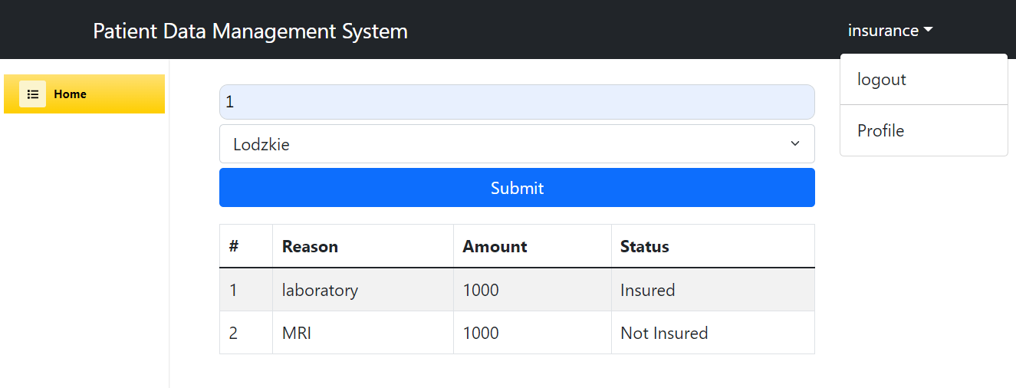

Slide 10
