Slide 1

Multivariate Data Analysis Project
Submission by : Aman Jain (A016)
Submission to : Dr. Shailaja Rego
School of Business Management, NMIMS, Mumbai
**Case study and dataset is taken from TVS CS in a competition organized by GIM Goa.

Slide 2
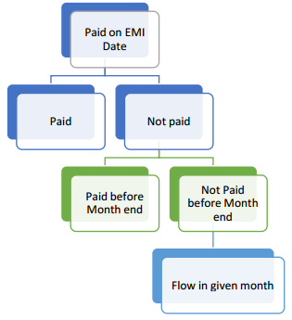
Case study problem description
As Consumer Durable finance is a new business for TVS Credit, it is vital to track customers who don’t pay the debt/EMI in time even until the end of the month (also known as flow customers post default on payment).
Once a customer fails to pay an EMI on particular EMI date (Due date) during presentation, TVS Credit uses different channels to recover money from the customer. After all the efforts if there are still some customers who don’t pay in that month, such customers are said to have moved to Next Bucket* (N+1) i.e. they have defaulted on (N+1) Payments, N being the Opening Bucket of customer (Bucket at start of the month).
** Bucket represents Number of Payments defaulted (e.g. Bucket 1 is 1 payment default, 2 is 2 payments default and so on)
Objective:
To predict which customer is going to flow to N+1 bucket in coming
month based on their past payment history, previous month collection,
demographics, profile, external data etc.

Slide 3
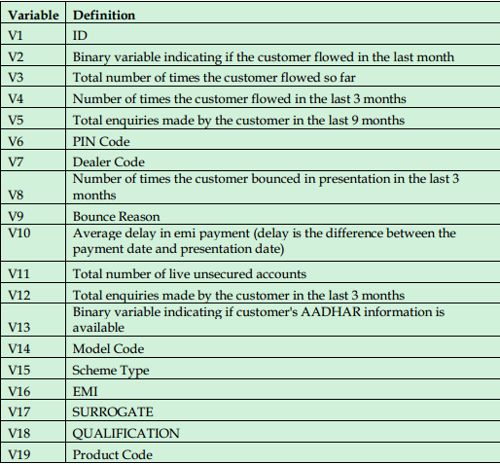
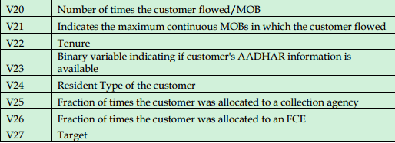
Dataset description
The dataset consists of 26 features from various sources.
Target Variable V27 :
takes value 1 if customer goes to flow and is otherwise 0.
**Dataset .csv file is attached

Slide 4
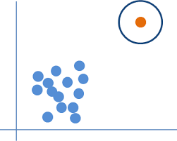


Feature Selection (Categorical)
Feature Selection
(Numeric)
Splitting the dataset
Outlier Analysis
Applying 2 ML Models
1.Logistic Regression
2. Decision Tree
Accuracy Metrics
ROC AUC
F1 score
Recall
Precision
Making Predictions
Cost Saving Metric

Slide 5
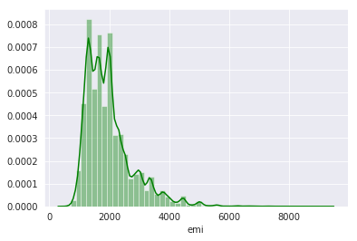
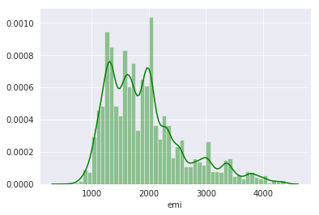
Total rows (customers) in dataset: 60,000 Shuffling the dataset rows and splitting it randomly in 4:1 ratio as follows: Train Set : 80% (48,000 rows) Machine Learning models will be trained only on this Training Dataset Test Set : 20% (12,000 rows) Libraries used: sklearn.model_selection
Splitting Dataset into Training and Test set:
Outlier Analysis
Removing those records falling outside the range of +/- 3 standard deviation from the mean of a column.
EMI (before)
EMI (after)

Slide 6
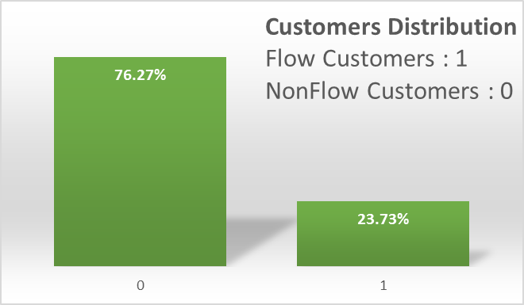
Exploratory Data Analysis
Preliminary Analysis:
Graph on the right shows that the company
has less than 25% Flow customers.
Hence, class imbalance problem also will be addressed.
The next 2 pages shows the percentage of Flow customers is various categories.
For example: It shows the percentage of flow customers) for each Pin Code, Dealer Code, each qualification, resident status wise and other categories.

Slide 7
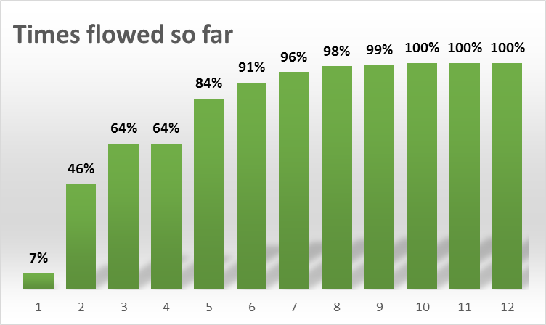
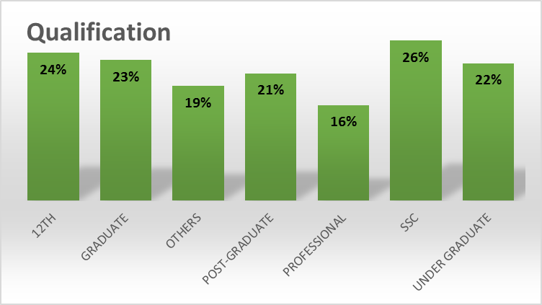
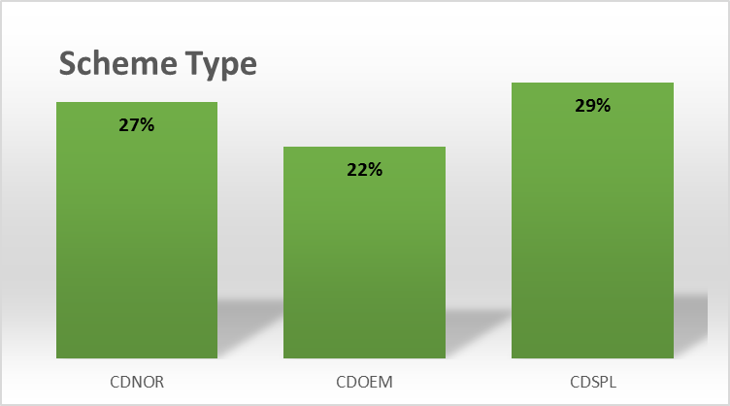
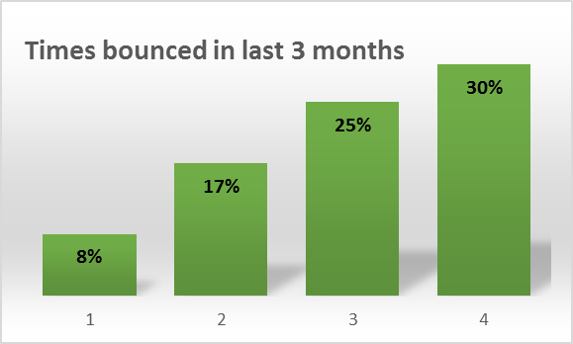
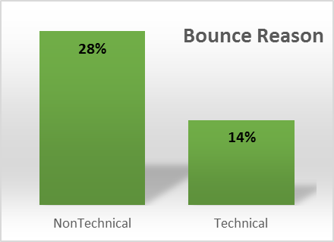
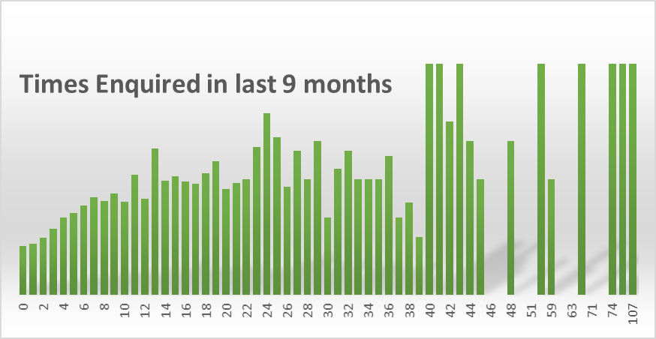
Shows the percentage of Flow customers is various categories
.

Slide 8
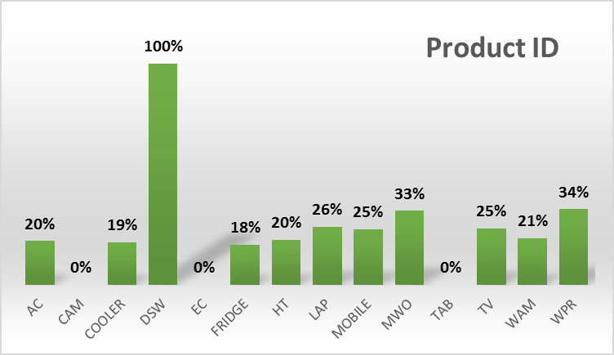
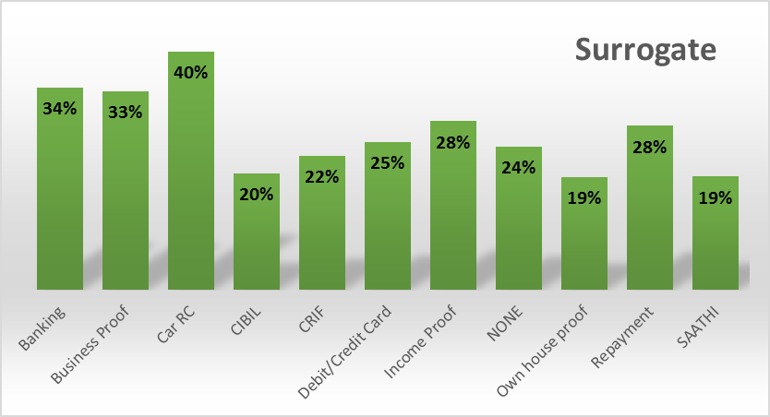
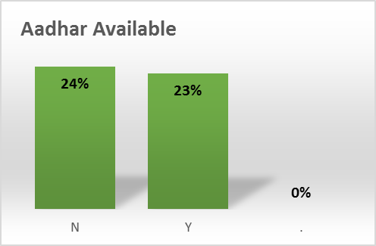
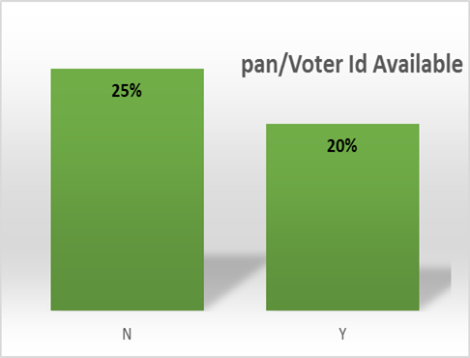
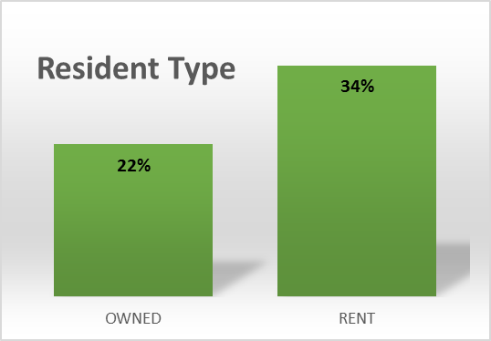
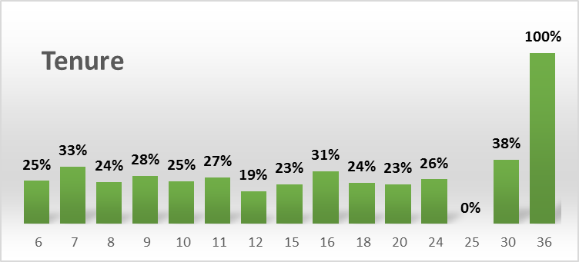
Shows the percentage of Flow customers is various categories
.

Slide 9
Feature Selection (for Numeric features)
Chi-Square : Test of Independence
(alpha = 0.05)
Only 1 column ‘aadharAvailable’ comes out to be not important.
11 good Categorical features
['flowedInLastMonth','pinCode','dealerCode','bounceReason’,’modelCode','schemeType','surrogate','qualification','productCode’, 'panVoteIdAvailable','residentType']
Feature Selection (for Numeric features)
Correlation Matrix
Eliminating Multi-collinearity
if correlation > 0.7 ➔ remove the variable
13 Numeric features → 9 good Numeric features
['timesFlowedTotalbyMOB', 'timesBounced3M', 'averageDelayEMI', 'numberEnquired9M’,
'emi’, 'tenureinMonths', 'allocatedToColAgent', 'allocatedToFC', 'numberLiveUnSecAcc']

Slide 10
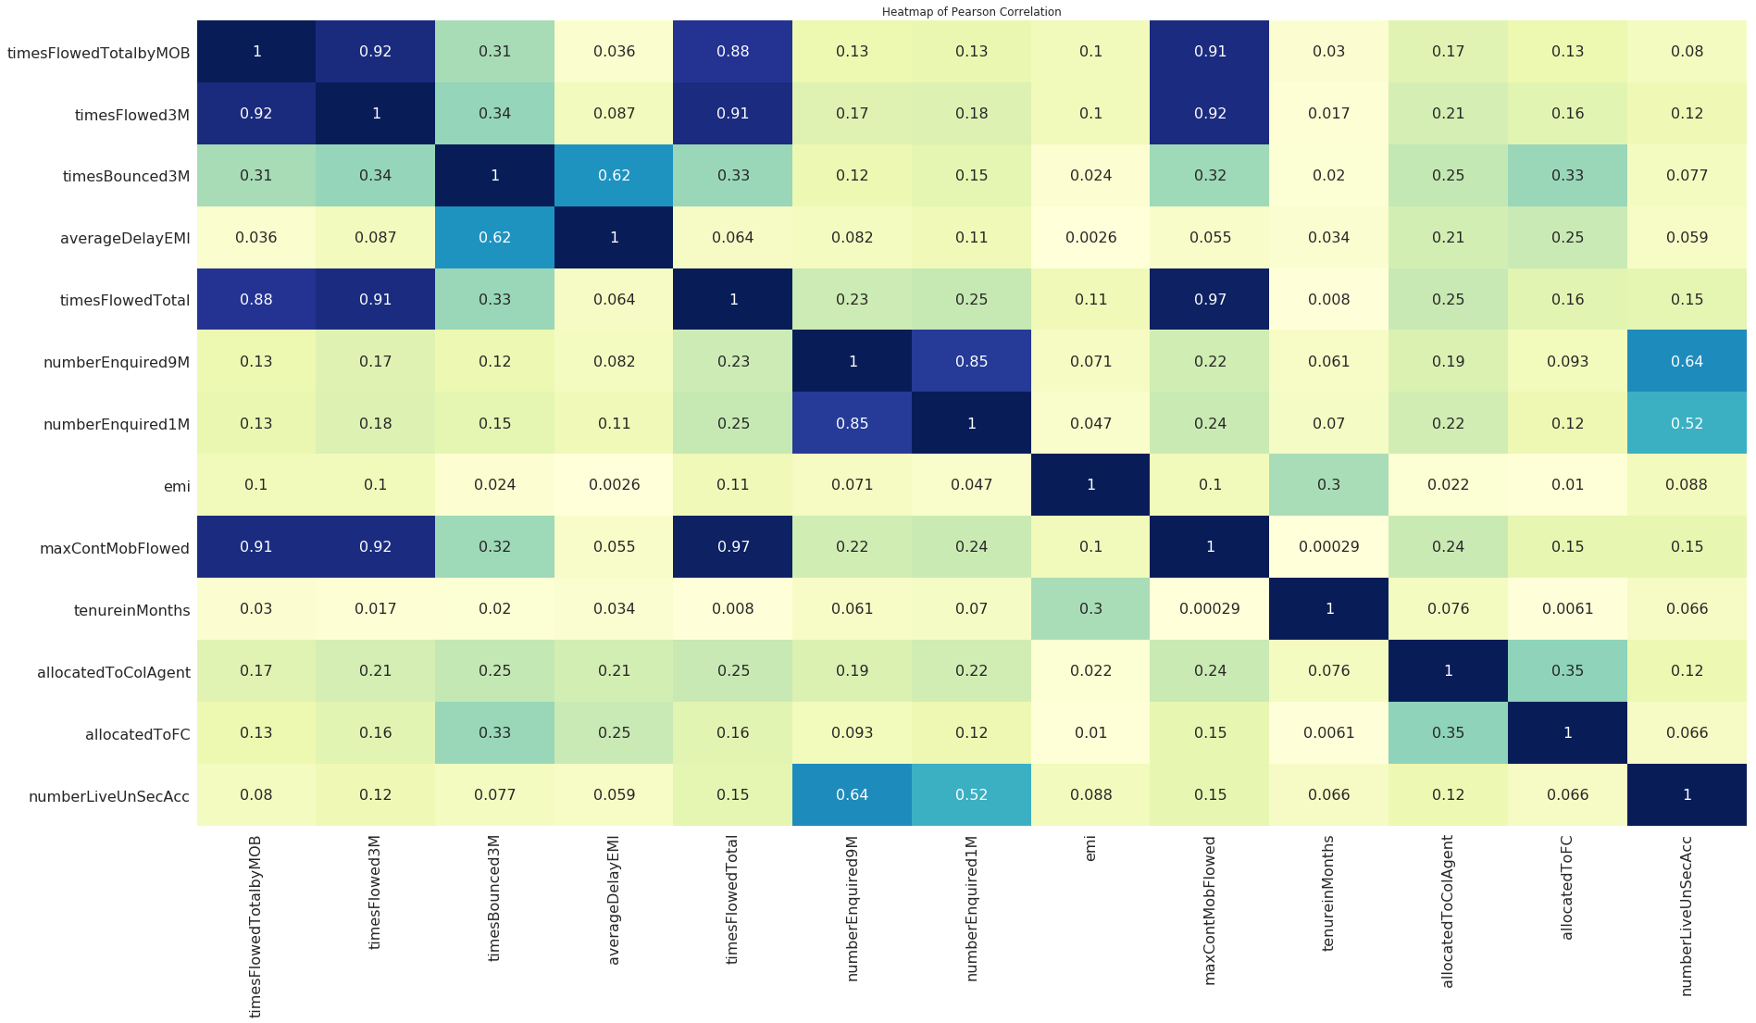
Correlation Matrix

Slide 11
Feature Scaling & Label Encoding
Scaling Numeric Features
Min Max Scaler (0 to 1)
Increases efficiency of distance based model
Speeds up model training time
Label Encoding
Data-type : string to int
Can not use one hot encoding for high cardinality features such as pinCode, dealerCode, etc due to curse of dimensionality
Class Imbalance problem
Solved using model hyperparameters
class weight = balanced (Logistic Regression)
class weight = balanced (Decision Tree)
It solves the problem by oversampling the observations of flow customers to make it a 50-50 ratio.

Slide 12
Accuracy Metrics
Only recall, Only Precision or only confusion matrix accuracy is not the right accuracy metric to check model performance, hence using..
1. ROC AUC
0 = worst & 1 = best. Higher the ROC curve is, better the model is at classifying 1s as 1s & 0s as 0s.
2. Cost Saving Model (next page)
True Positive = Correctly predicted Flow customer True Negative = Correctly predicted non Flow customer False Negative= Actually customer is Flow, but predicted as non Flow (more risky) False Positive = Actually customer is non Flow, but predicted as Flow(less risky)
2 Model performances
S.No. | Machine Learning Model | ROC_AUC | Cost Savings (Rs) (for 12,000 customers) | Recall | Precision | F1 Score
1. | Logistic Regression | 0.8747 | 1,71,325 | 0.8168 | 0.7913 | 0.8025
2. | Decision Tree Classifier | 0.8721 | 1,95,630 | 0.8187 | 0.7738 | 0.7907

Slide 13
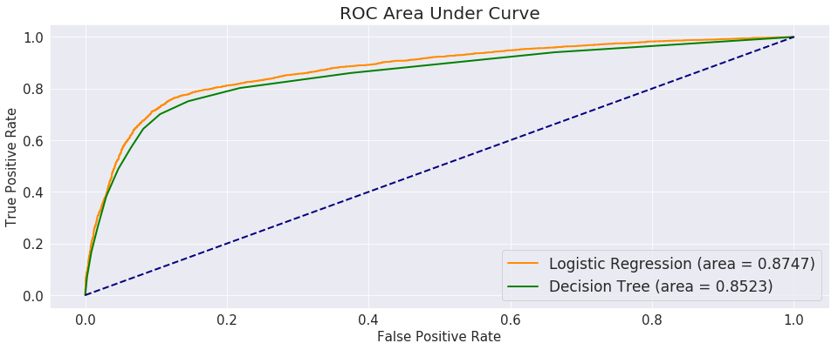
ROC AUC graph

Slide 14
Cost Saving Metric : Business Aspect of model
Predicted
Actual |  | Not Flow | Flow
 | Not Flow | 7989 (TP) | 1227 (FP)
 | Flow | 637 (FN) | 2147 (TN)
Using ML model, we created a per customer cost saving equation:
= saving from correct predictions – loss from incorrect predictions
= (155*TP) + (0*TN) - (180*FN) – (25*FP)
We have to maximize this.
As per TVS CS Annual report 2018-19, Ratio of Financing cost to recovery cost is 7:1
And
cost of finance is 9 %
As per dataset,
Average EMI per customer
= Rs 2000
Hence, Cost to company for delayed payment
= 9 % of Rs 2000 = Rs180
And recovery cost
= 180/7 = Rs 25

Slide 15
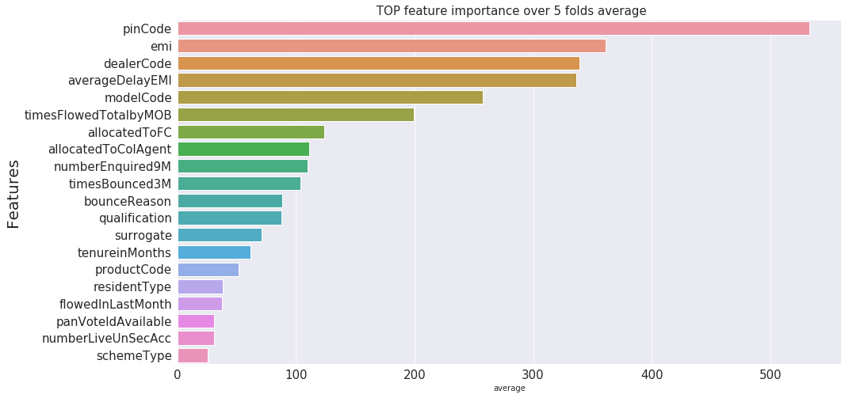
Most to Least important as per Decision Tree Classifier
Feature Importance

Slide 16
Thank you

