Slide 1

Please find Notebook here : kaggle.com/amanacden/blackfriday-av
Feature Engineering
Count of each category
Mean, Max, Min, 25th & 75th percentile of Purchase for each category
One Hot Encoding
Linear Regression
Ridge
Lasso
Elastic Net
Outlier Analysis
Pre-processing
Imputation
Label Encoding
5. Decision Tree Regressor
6. XG Boost 1(eta = 0.05)
7. XG Boost 2(eta = 0.03)
Why XG Boost’s Ensemble Model is the best model ?
As the dataset has many categorical features, Tree-based models are expected to predict better than Linear-models, which is apparent from the R2 & RMSE scores.
Among Tree-based models, taking Decision Tree as the base model, XG boost(extension of DT) minimizes the loss function, and hence always works better than DT.
Thereafter, to improve RMSE further , two XG Boost models with learning-rate of 0.5 and 0.3 respectively and with different set of feature combinations , were applied on test set. As a result, both the XG boost models predicted somewhat different values. And hence, Ensemble Model of both of them further improves RMSE score and makes it the best model.
Evaluating models:
R2 score
RMSE score
(Splitting into Train & Validation
& Hyperparameter tuning)
8. Ensemble Model
Best Model
Predictions on Test set

Slide 2
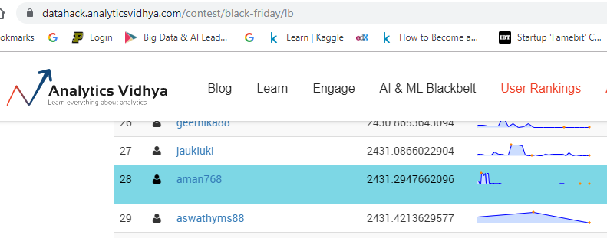
MODELS & Accuracy
Models | R2 Score (on Validation set ) | RMSE Score (on Validation Set) | RMSE (on Test set) – Analytics Vidhya Upload | Insights
Linear Regression | 0.7293 | 2545.47 | 2609.24 | These models perform almost as good on Test set as on Validation set. So, validation set R2 is optimum for each model and models are not much overfitting.
Ridge | 0.7292 | 2545.78 | 2609.38
Lasso | 0.7293 | 2545.53 | 2609.22
Elastic Net | 0.7033 | 2664.80 | 2704.38
Decision Tree | 0.7480 | 2516.27 | 2586.00
XG Boost 1 | 0.7693 | 2407.22 | 2453.47
XG Boost 2 | 0.7676 | 2415.98 | 2440.96
Best Model
Ensemble Model
RMSE : 2431.58
(on Test Set,
Analytics Vidhya)
AV Rank : 28

Slide 3
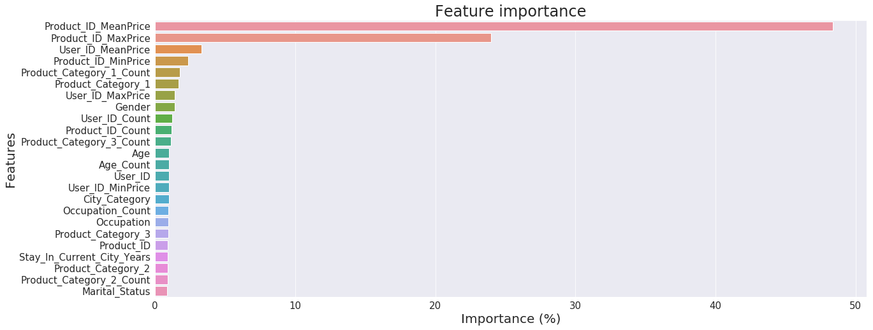
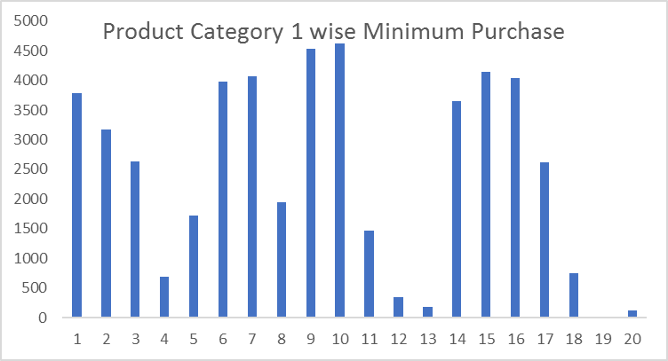
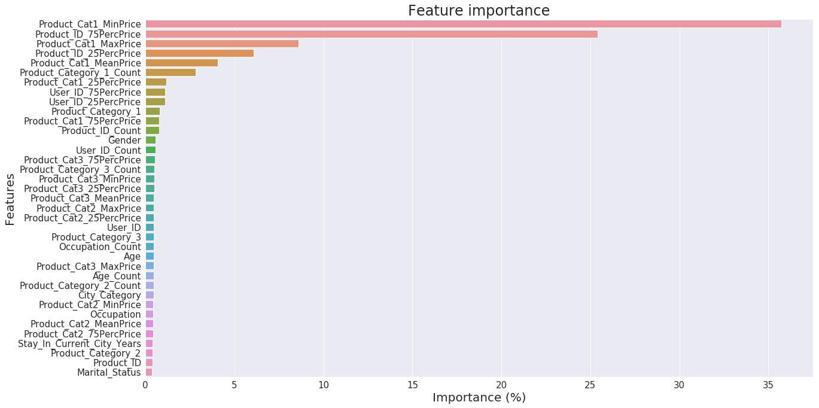
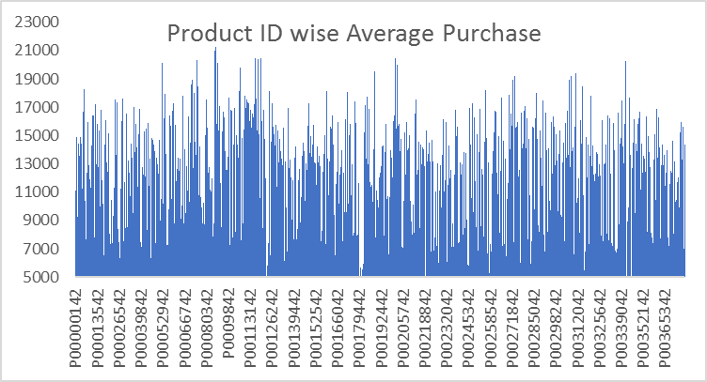
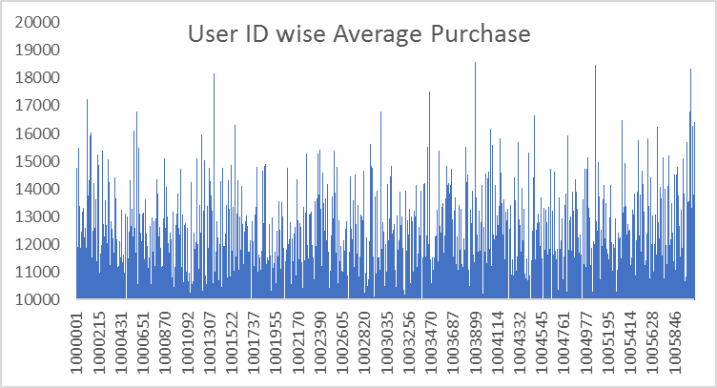
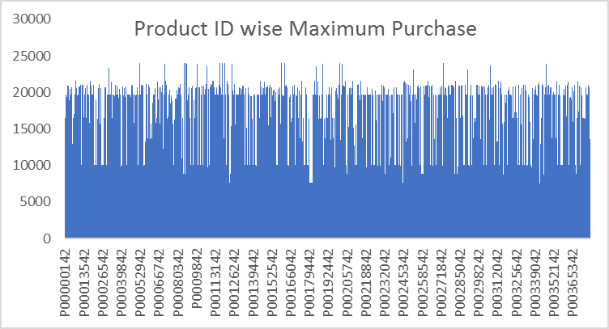
HIGH RANKED FEATURES & their DISTRIBUTIONs
XG BOOST 1
XG BOOST 2

Slide 4
Business USE CASES
ASSUMPTIONS ABOUT THE DATA
In the problem statement, it is mentioned that Product category 2 & 3 might belong to ‘other category’, so I have assumed missing values in these 2 columns as other category, and hence imputed all missing values with any constant say -999.
As it is not given what each ‘Occupation’ number corresponds to, I have assumed it as a categorical (not numeric) feature. Same for all the three product category features.
Meaning :
This is basically about predicting the willingness of a customer to pay how much for a particular product.
Use cases:
create personalized offer (recommendation) for customers against different products like Netflix.
To ensure that businesses do not charge less to those customers who would be willing to pay more, and also to ensure to not charge more so as to not increase the customer churn rate.
It could be useful in sales forecasting so as to access the future profitability of business.
Understanding the customer purchase behavior through this and facilitating marketing strategies such as discounting, and also predicting likelihood for first time buyers.

