Slide 1
Team Name : Abracadata Team Members: Aanchal Arora(TL) : aanchal.arora03@nmims.edu.in , +91 8100316096 Deepasha Gupta : deepasha.gupta17@nmims.edu.in , +91 9914308711 Aman Jain : aman.jain21@nmims.edu.in , +91 8196039193 College : Narsee Monjee Institute of Management Studies, Mumbai

Slide 2
Please use this link to view the well formatted code, visualizations, & output (whole implementation)
www.kaggle.com/amanacden/iitm-krunchh
(In case this link doesn’t work, pdf file of this web page is also attached as a part of submission.)

Slide 3
Contents:
1. Strategy
2. Splitting Dataset into Training and Test set
3. Missing values and Imputation : part 1, part 2, part 3
4. Feature Engineering
5. EDA (Exploratory Data Analysis)
6. Feature Selection (for Numeric & categorical columns)
7. Feature Scaling & One Hot Encoding
8. Accuracy Metrics
9. 5 ML model performances
10. Blending the 5 solutions
11. Feature importance

Slide 4
Strategy : How we used Machine Learning to identify the Self Pay customers
Split the dataset into Train and Test set in 4:1 ratio.
pre-process the Train & Test datasets separately
train the following 5 Machine Learning models on Train dataset.
1.Logistic Regression
2. Random Forrest
3. ANN(Artificial Neural Networks)
4. LightGBM
5. XGBoost
calculate the the weighted average of these 5 ML model predictions to identify the ‘SELF_PAY’ status of customer.
use the all the 5 “trained ML models” to predict the ‘SELF_PAY’ customer status from the Test dataset.

Slide 5
Splitting Dataset into Training and Test set:
437846
437846
437846
Total rows(customers) in dataset: 507,387
Shuffling the dataset rows and splitting it in 4:1 ratio as follows:
Train Set : 80% (437,846 rows)
Machine Learning models will be trained only on this Training Dataset
Test Set : 20% (109,462 rows)
Libraries used: sklearn.model_selection
Splitting Data set and doing further data cleaning & imputation only on Training data, so that effect of imputation on training dataset doesn’t change test data, which will be freshly used to test the performance of machine learning models.

Slide 6
Missing values and Imputation: (part 1)
Considering Training set only, until ML model is
Ready.
If missing values >= 80% ,delete that feature
So, deleting features: VAR0024, VAR0025,
VAR0026, VAR0027
If missing values < 80%, we impute it as follows:
Next slide..
Features having missing values
Feature having missing values | Percentage of Missing values In Training set
VAR0017 | 0.72%
VAR021 | 7.71%
VAR022 | 7.72%
VAR023 | 7.70%
VAR024 | 90.15%
VAR025 | 91.84%
VAR026 | 96.21%
VAR027 | 94.70%
VAR028 | 7.72%

Slide 7
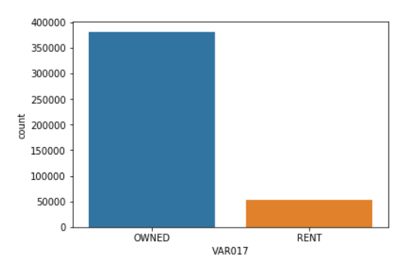
Missing values and Imputation: (part 2)
VAR0017(Resident type):
We substitute the missing values of this
column with “OWNED”.
Reason: As around 87% of the customers
have Resident type – OWNED.
VAR021(Maximum Live Loan Amount - Overall):
We Substitute the value of VAR013(Loan Amount) in VAR021 only for the missing values rows:
Reason: As values of VAR021 is within (+/- 10%) of values VAR013 for around 92% of customers
VAR022(Maximum Live Loan Amount – Unsecured Loans):
Same substitution and Reason as for VAR021

Slide 8
Missing values and Imputation: (part 3 )
VAR023(Time since last loan):
We calculate mean value for the separate product categories and substitute the mean value in the rows containing missing value corresponding to the product that row contains. (mean values in table)
VAR028(Time since first consumer loan):
We calculate mean value for the separate qualification categories and substitute the mean value in the rows containing missing value corresponding to the qualification that row contains. (mean values in table)

Slide 9
Feature Engineering:
VAR002(date of acquisition) :
Calculating the number of days since the date of customer acquisition
VAR002(days) = Date(31 May 2019) – date of acquisition
Later on, VAR002 comes out to be the most important feature in determining the SELF_PAY status of a customer.
VAR010(date of birth) :
Calculating the age of customer from date of birth
VAR010(age in years) = Date(31 May 2019) - date of birth

Slide 10
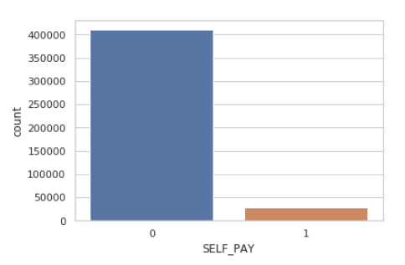
Exploratory Data Analysis (EDA)
Preliminary Analysis:
Graph on the right shows that the company
has less than 10% SELF_PAY customers.
Also, using Countplots, we checked the ratio
of (SELF_PAY/ total customers) for each
product, each qualification, each
of the 5 months, employment and resident
status wise.
(All the graphs can be found through the link
Mentioned on Slide 2)
Dependent Variable : SELF_PAY

Slide 11
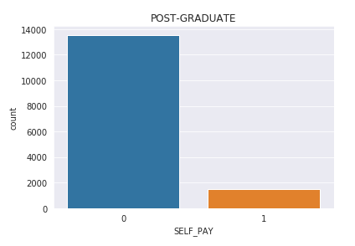
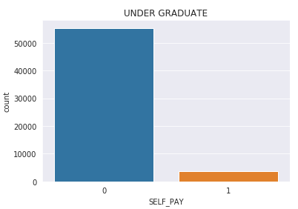
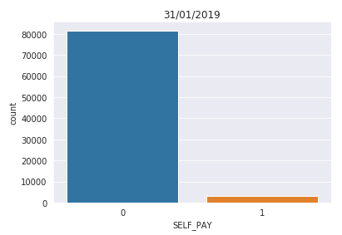
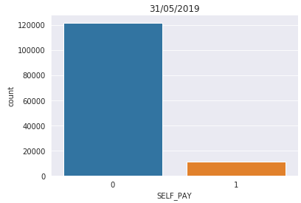
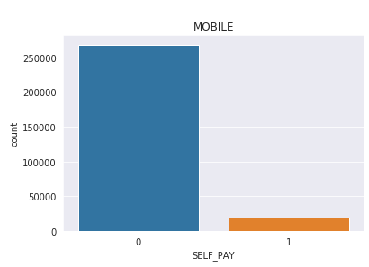
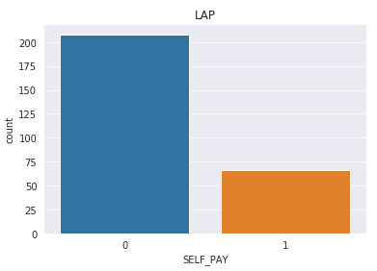
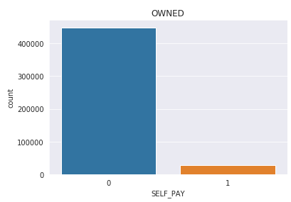
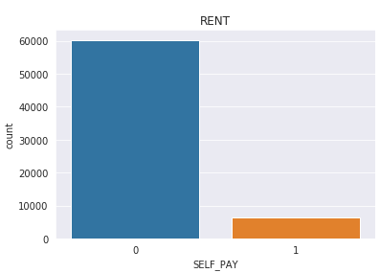

Slide 12
Feature Selection (for Numeric columns)
Initially, we had 16 Numeric variables as shown in next slide.(kindly zoomin by press shift + F5)
We calculate the correlation of every numeric variable with each numeric variable and we get a correlation matrix
Eliminating Multi-collinearity
We eliminate one column out those pairs which show high correlation(greater than 0.7).
Hence, after feature selection, we have following 10 good columns :
['VAR002', 'VAR007', 'VAR008', 'VAR009’, 'VAR010', 'VAR018', 'VAR021',
'VAR022', 'VAR023', 'VAR028']

Slide 13
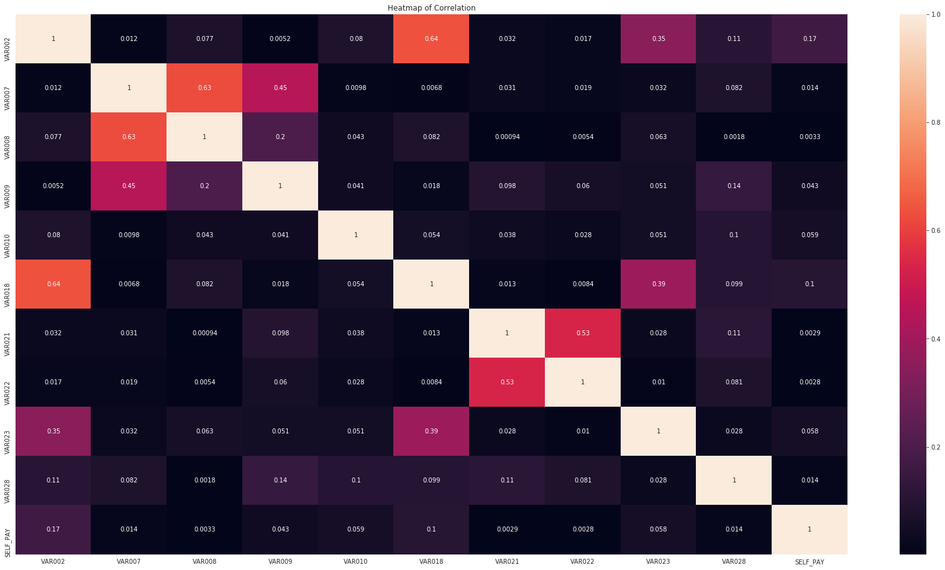

Slide 14
Feature Selection (for Categorical columns)
We select only those categorical features which has not more than 15 unique values.
Reason: As, features with more unique values, will create more features when we apply OneHotEncoding. (more on slide 15) By selecting features having less unique values, we prevent overfitting while fitting the data to ML model.
Accordingly, we select following 6 categorical variables:
VAR001(last date of moth)
VAR003(product type):
VAR006(app download status):
VAR015(qualification):
VAR016(employment type):
VAR017(resident type):
Categorical Features | Unique Values
VAR001 | 5
VAR003 | 13
VAR004 | 5385
VAR005 | 11221
VAR006 | 2
VAR011 | 28
VAR015 | 7
VAR016 | 2
VAR017 | 2

Slide 15
Feature Scaling & One Hot Encoding
We scale the 10 selected Numeric variables (mentioned in slide 12) in the range of 0 to 1 using MinMaxScaler class of sklearn.preprocessing.
Reason: Feature Scaling or Standardization increases the efficiency of Euclidean distance based ML models(e.g. Logistic Regression). Also also it speeds up the model training time.
We One Hot encode 6 selected Categorical variables (mentioned in slide 14) using get_dummies function of pandas library.
Reason: One Hot Encoding transforms the categorical variable into several binary columns which could be interpreted by the ML models. And, we can not use Label Encoding as it treats categories as numbers.

Slide 16
So far now, we have preprocessed the Training set Data which is in 2 following DataFrames as per the link mentioned on Slide 2.
X_train_final, y_train_final
Then, in the same way, we preprocess the Test set data, which is in 2 following DataFrames as per the link mentioned on Slide 2.
X_test_final, y_test_final
And, finally we are set to create Maching Learning models using libraries such as LGBMClassifier, LogisticRegression, etc & fit the Training data on those ML models to make them “trained” ML models.

Slide 17
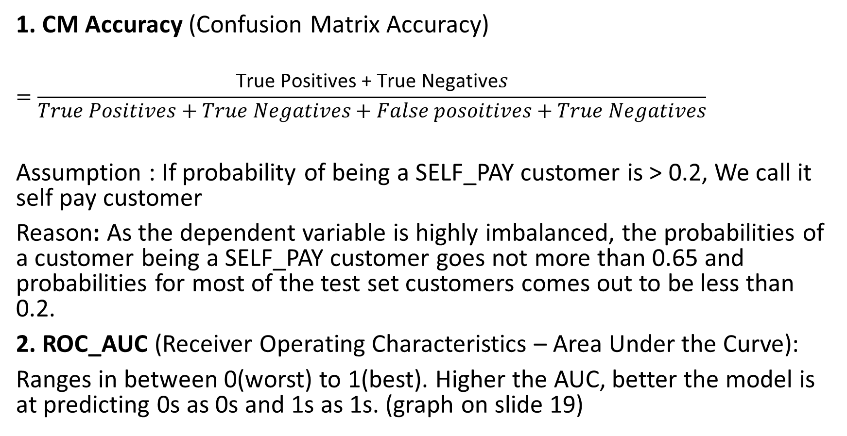
Accuracy Metrics : ROC_AUC & CM Accuracy

Slide 18
5 Model Performances :
S.No. | Machine Learning Model | CM(confusion matrix) Accuracy | ROC_AUC (Area under curve)
1. | Logistic Regression | 0.9187754654583326 | 0.7450908526911565
2. | Random Forest Classifier | 0.8918346092707972 | 0.7505586211705404
3. | Artificial Neural Networks (ANN) | 0.9198626007198846 | 0.7469355841659446
4. | XG Boost Classifier | 0.9120699420803566 | 0.7703251893620582
5. | Light GBM Classifier | 0.9075935027680839 | 0.7878184735999275
Please refer to the link on Slide 2 to check the code for models

Slide 19
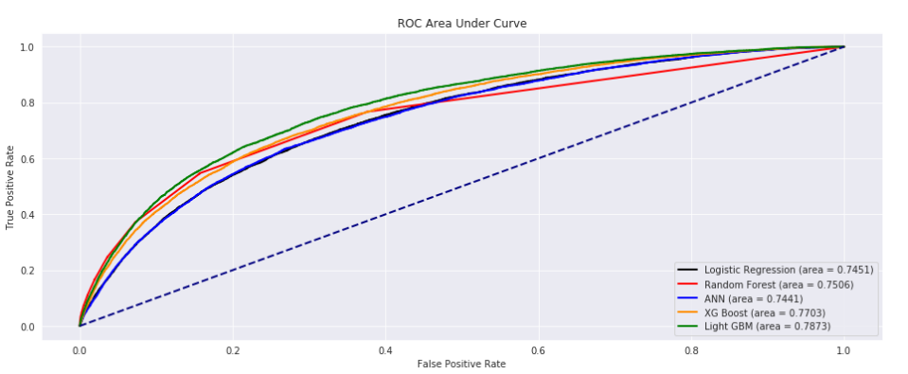
ROC AUC graph As per ROC_AUC criteria, Light GBM(with Accuracy of 0.7873) is the best model to predict the customer’s SELF_PAY status.

Slide 20
Blending the solutions :
We compute the weighted average of probabilities( which were predicted by all the 5 ML models) of a customer being a SELF_PAY customer, where weights are taken as the accuracy of the individual models.
Again, as per the justified assumption mentioned in the slide [x4], If probability of being a SELF_PAY customer is > 0.2, We call it self pay customer
Hence, after blending the 5 solutions, final CM accuracy is 0.9252069211233122

Slide 21
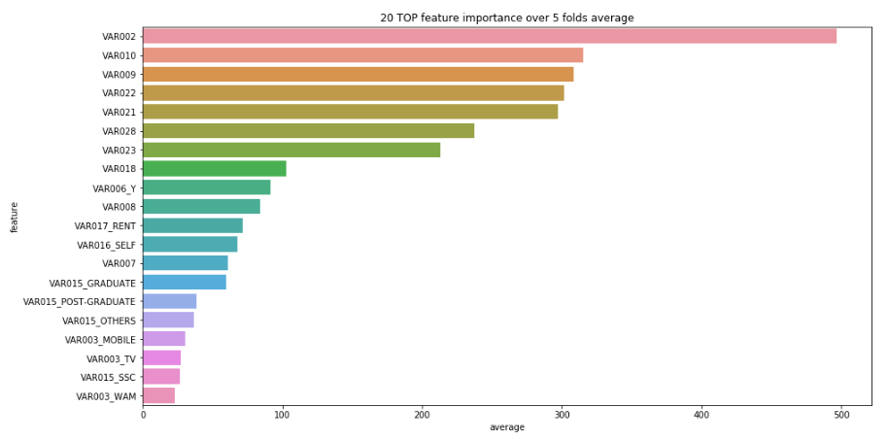
Top 20 Most important features: Using LightGBM’s feature_importance function, we calculated the importance of each variable in determining weather a customer is a SELF_PAY or not. Top 5 Most important ones are : VAR002, VAR010, VAR009, VAR022, VAR021 and others are shown in below chart.

Slide 22
Thank you for giving us an opportunity to learn through this competition.

