Slide 1
Collateral Loans And Risk Assessment
Presented by POD 13
Aman Agarwal
Ankana Basu
Avik Sarkar
Naman Joshi

Slide 2
Purpose Of The Project
The system will help in sanctioning loans and assessing the corresponding risk involved
Benefits
Bank
Finance Companies

Slide 3
Use Case Diagram
Collateral Management Service
Risk Assessment Service
Loan Portal
Authorization Service
Administrator
Loan Management Service

Slide 4
Scope
Service | Description
Authorization Service | This service is used to authenticate the user and maintain the session LOGIN the user VALIDATE the token
Collateral Management Service | This service is getting called by other services to provide the following functionalities: Verify and Save the Collaterals Get Collaterals
Loan Management Service | This service is handlings the loans and performing following functionalities Get the Loan Details Save Collaterals for Sanctioned Loan
Risk Assessment Service | This service is assessing the risk involved Raise Risk based the Collaterals Value based on Market
Loan Portal | A Web Portal that allows an Administrator to perform the following operations Login Get Loan Details based on customer / loan ID Save Collaterals for a sanctioned Loan View Risk Assessment for every Collateral Loans

Slide 5
Flow Chart Of Authorization Service
/login
Enter Username and password
Correct Username and password
Authenticated and Authorised User
Entry Point
Wrong Username and password
Token Generated
When system calls
/validate
Token Passed
Invalid Token
Valid Token

Slide 6
Flow Chart Of Collateral Management Service
Loan id not present
/get Collateral by loan id
Loan Details
Loan Id passed
Loan Id present
Get
Entry Point
Id is already present in database
Valid data with same id
Collateral Details
/save Collateral
Post
Data missing or invalid
Valid data with different id
Collateral Saved

Slide 7
Flow Chart Of Loan Management Service
Loan id not present
/get Loan details
Loan Details
Loan Id passed
Loan Id present
Get
Entry Point
Same id
Id is already present in database
Loan Details
/save Loan details
Post
Loan approved
Check the loan approvable or not
Data missing or invalid
Loan amount<= 1.5 times collateral
Different id
Loan amount> 1.5 times collateral
Eligible amount Exceeded
Re-enter the loan amount

Slide 8
Flow Chart Of Risk Assessment Service
Not Updated
Current Market values not found
/get Collateral Risk
Updated market values
Search for the current market values
Current Market values not found
Get
Entry Point
No loan found
Id not present
/get Collateral Risk/Loan id
Loan id
Get
Update risk according to current market values
Show risk
Id is present

Slide 9
AWS Deployment Structure
Auth- repo
Loan Cluster
Auth-service
Coll-repo
User
Auth-tg
Collateral-service
Loan-lb
Coll-tg
Loan-repo
Loan-tg
Loan-service
Risk-tg
Risk-service
Risk- repo

Slide 10
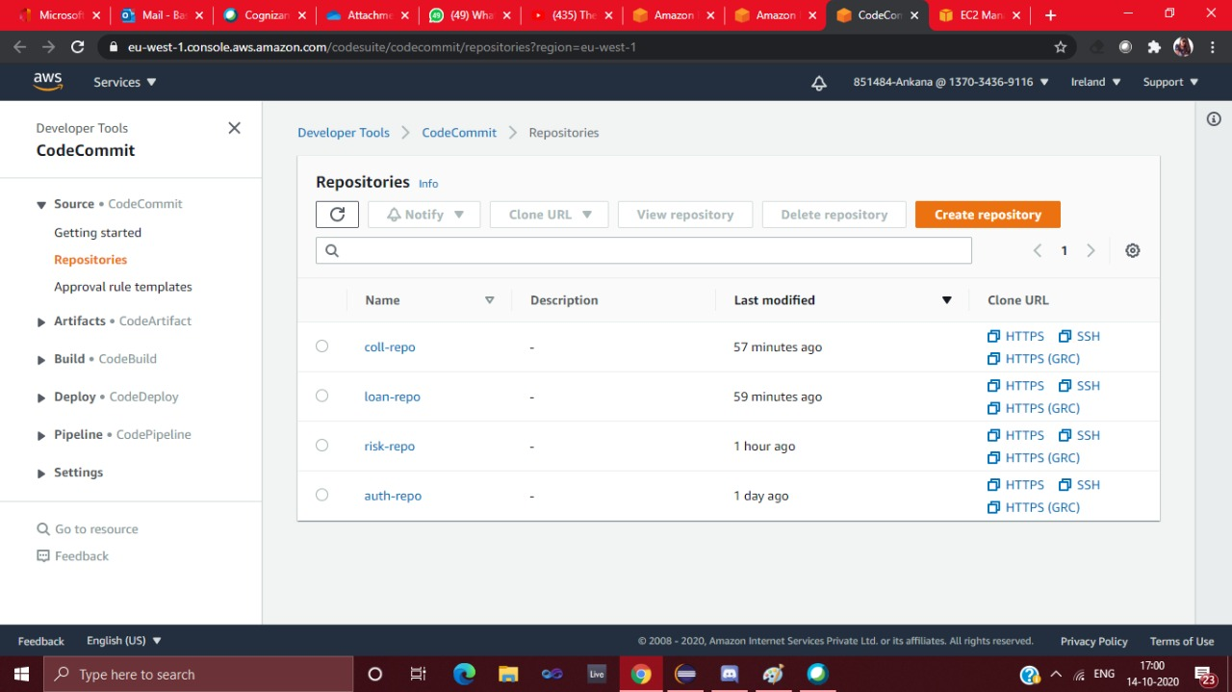
Repositories We have Created Code Commit Repository for different Microservices.

Slide 11
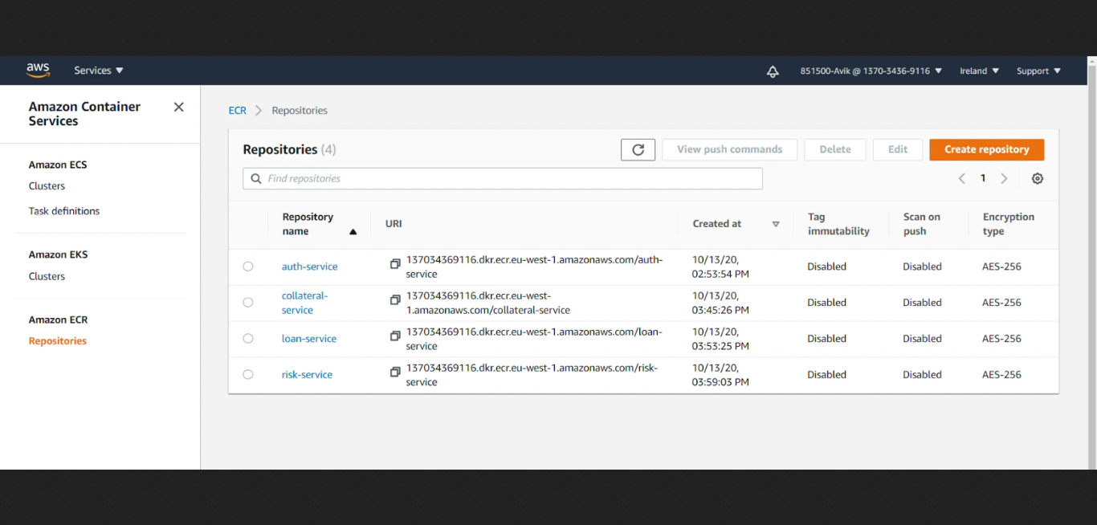
ECR We have Created ECR Repository for different Microservices

Slide 12
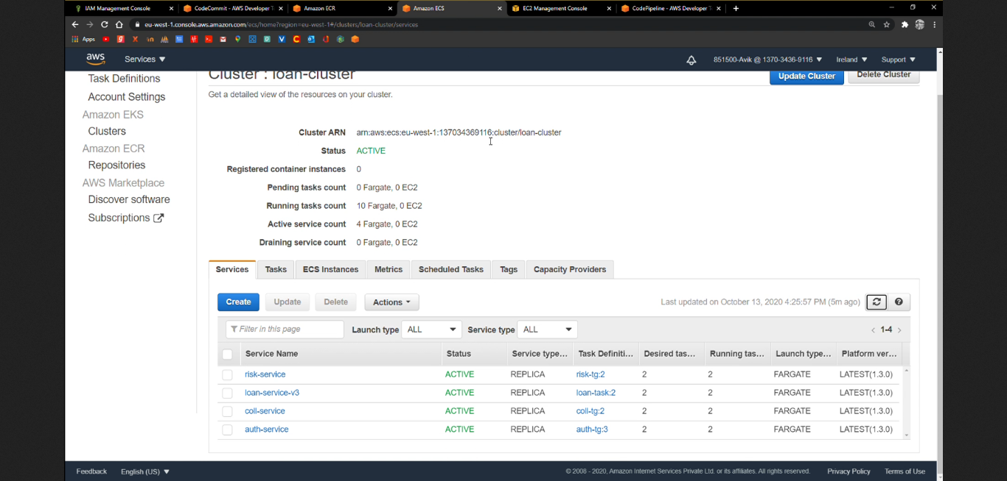
Clusters We have Created one cluster and inside cluster we have created 4 services .

Slide 13
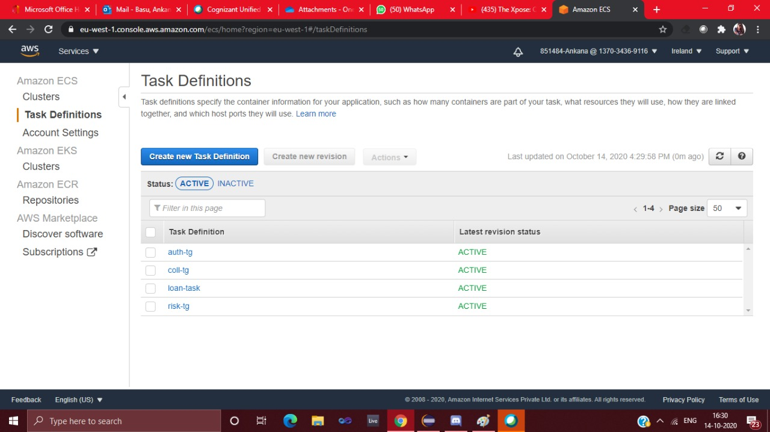
Task Definitions We have Created Task Definitions for different Microservices task

Slide 14
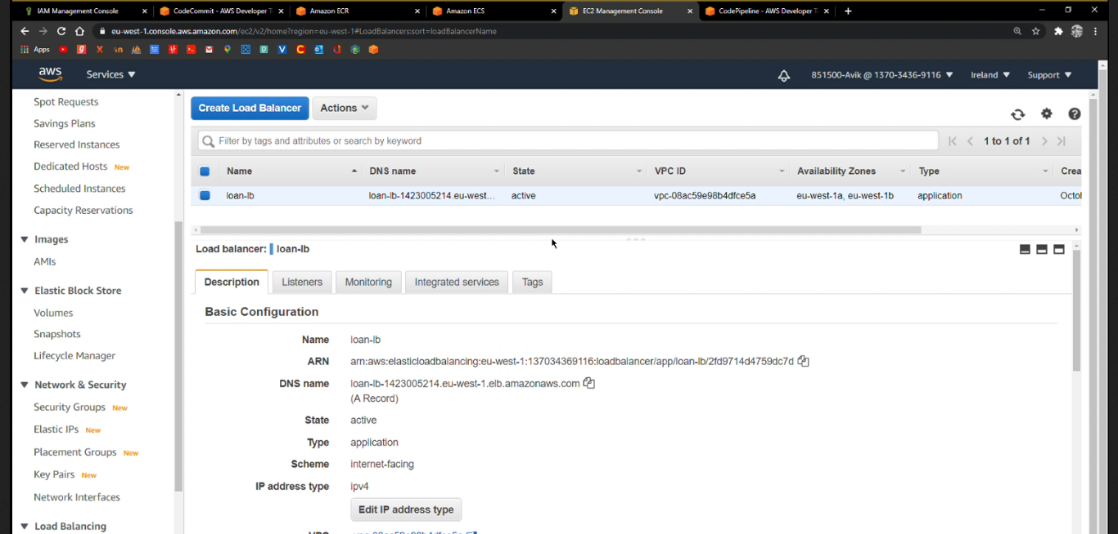
Load Balancer We have created one load balancer for one DNS and different target for different Microservice

Slide 15
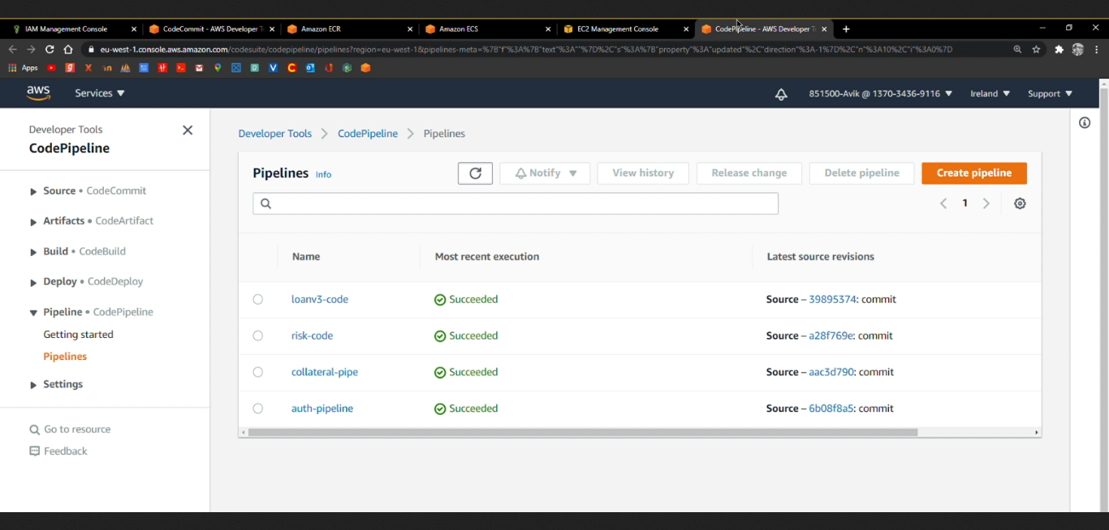
Code Pipeline
We have Created Pipeline for different Microservices

Slide 16
THANK YOU!!

