Slide 1
Recurrences and Running Time
An equation or inequality that describes a function in terms of its value on smaller inputs.
T(n) = T(n-1) + n
Recurrences arise when an algorithm contains recursive calls to itself
What is the actual running time of the algorithm?
Need to solve the recurrence
  Find an explicit formula of the expression
  Bound the recurrence by an expression that involves n

Slide 2
Example Recurrences
T(n) = T(n-1) + n Θ(n²)
  Recursive algorithm that loops through the input to eliminate one item
T(n) = T(n/2) + c Θ(lgn)
  Recursive algorithm that halves the input in one step
T(n) = T(n/2) + n Θ(n)
  Recursive algorithm that halves the input but must examine every item in the input
T(n) = 2T(n/2) + 1 Θ(n)
  Recursive algorithm that splits the input into 2 halves and does a constant amount of other work

Slide 3
Recurrent Algorithms
BINARY-SEARCH
for an ordered array A, finds if x is in the array A[lo…hi]
Alg.: BINARY-SEARCH (A, lo, hi, x)
if (lo > hi)
return FALSE
mid ← ⎣(lo+hi)/2⎦
if x = A[mid]
return TRUE
if ( x < A[mid] )
BINARY-SEARCH (A, lo, mid-1, x)
if ( x > A[mid] )
BINARY-SEARCH (A, mid+1, hi, x)
1
2
3
4
5
6
7
8
2
3
5
7
9
10
11
12
mid
lo
hi

Slide 4
Example
A[8] = {1, 2, 3, 4, 5, 7, 9, 11}
  lo = 1 hi = 8 x = 7
1
2
3
4
5
6
7
8
1
2
3
4
5
7
9
11
mid = 4, lo = 5, hi = 8
5
6
7
8
1
2
3
4
5
7
9
11
mid = 6, A[mid] = x Found!

Slide 5
Another Example
A[8] = {1, 2, 3, 4, 5, 7, 9, 11}
  lo = 1 hi = 8 x = 6
1
2
3
4
5
6
7
8
1
2
3
4
5
7
9
11
mid = 4, lo = 5, hi = 8
low
high
1
2
3
4
5
7
9
11
mid = 6, A[6] = 7, lo = 5, hi = 5
low
high
1
2
3
4
5
7
9
11
mid = 5, A[5] = 5, lo = 6, hi = 5
NOT FOUND!
1
2
3
4
5
7
9
11
high
low

Slide 6
Analysis of BINARY-SEARCH
Alg.: BINARY-SEARCH (A, lo, hi, x)
if (lo > hi)
return FALSE
mid ← ⎣(lo+hi)/2⎦
if x = A[mid]
return TRUE
if ( x < A[mid] )
BINARY-SEARCH (A, lo, mid-1, x)
if ( x > A[mid] )
BINARY-SEARCH (A, mid+1, hi, x)
T(n) = c +
  T(n) – running time for an array of size n
constant time: c₁
constant time: c₂
constant time: c₃
same problem of size n/2
same problem of size n/2
T(n/2)

Slide 7
The Iteration Method
Convert the recurrence into a summation and try to bound it using known series
  Iterate the recurrence until the initial condition is reached.
  Use back-substitution to express the recurrence in terms of n and the initial (boundary) condition.

Slide 8
The Iteration Method
T(n) = c + T(n/2)
T(n) = c + T(n/2)
= c + c + T(n/4)
= c + c + c + T(n/8)
Assume n = 2^{k}
T(n) = c + c + … + c + T(1)
= clgn + T(1)
= Θ(lgn)
T(n/2) = c + T(n/4)
T(n/4) = c + T(n/8)
k times

Slide 9
Iteration Method – Example
T(n) = n + 2T(n/2)
T(n) = n + 2T(n/2)
= n + 2(n/2 + 2T(n/4))
= n + n + 4T(n/4)
= n + n + 4(n/4 + 2T(n/8))
= n + n + n + 8T(n/8)
… = in + 2^{i}T(n/2^{i})
= kn + 2^{k}T(1)
= nlgn + nT(1) = Θ(nlgn)
Assume: n = 2^{k}
T(n/2) = n/2 + 2T(n/4)

Slide 10
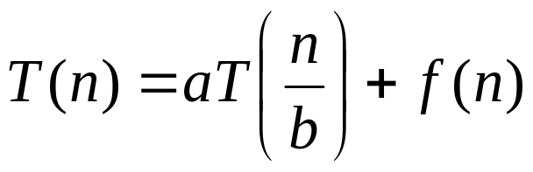
Master’s method
“Cookbook” for solving recurrences of the form:
where, a ≥ 1, b > 1, and f(n) > 0
Idea: compare f(n) with n^{log}_{b}ª
f(n) is asymptotically smaller or larger than n^{log}_{b}ª by a polynomial factor n^{ε}
f(n) is asymptotically equal with n^{log}_{b}ª

Slide 11
Master’s method
“Cookbook” for solving recurrences of the form:
where, a ≥ 1, b > 1, and f(n) > 0
Case 1: if f(n) = O(n^{log}_{b}^{a -ε}) for some ε > 0, then: T(n) = Θ(n^{log}_{b}ª)
Case 2: if f(n) = Θ(n^{log}_{b}ª), then: T(n) = Θ(n^{log}_{b}ª lgn)
Case 3: if f(n) = Ω(n^{log}_{b}^{a +ε}) for some ε > 0, and if
af(n/b) ≤ cf(n) for some c < 1 and all sufficiently large n, then:
T(n) = Θ(f(n))
regularity condition

Slide 12
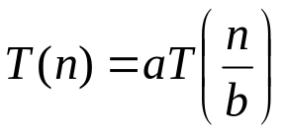
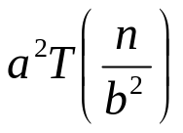
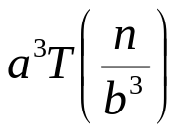
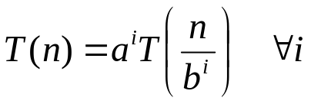
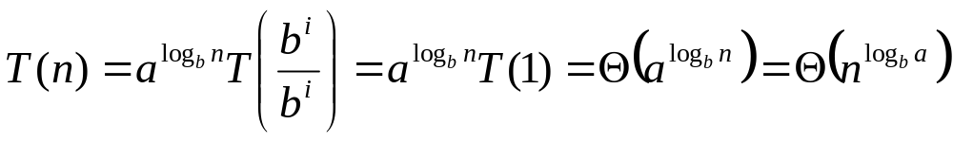
Why n^{log}_{b}ª?
Case 1:
  If f(n) is dominated by n^{log}_{b}ª:
    T(n) = Θ(n^{log}_{b}^{n})
Case 3:
  If f(n) dominates n^{log}_{b}ª:
    T(n) = Θ(f(n))
Case 2:
  If f(n) = Θ(n^{log}_{b}ª):
    T(n) = Θ(n^{log}_{b}ª logn)
Assume n = b^{k} ⇒ k = log_{b}n
At the end of iteration i = k:

Slide 13
Examples
T(n) = 2T(n/2) + n
a = 2, b = 2, log₂2 = 1
Compare n^{log}₂² with f(n) = n
⇒ f(n) = Θ(n) ⇒ Case 2
⇒ T(n) = Θ(nlgn)

Slide 14
Examples
T(n) = 2T(n/2) + n²
a = 2, b = 2, log₂2 = 1
Compare n with f(n) = n²
⇒ f(n) = Ω(n^{1+ε}) Case 3 ⇒ verify regularity cond.
a f(n/b) ≤ c f(n)
⇔ 2 n²/4 ≤ c n² ⇒ c = ½ is a solution (c<1)
⇒ T(n) = Θ(n²)

Slide 15

Examples (cont.)
T(n) = 2T(n/2) +
a = 2, b = 2, log₂2 = 1
Compare n with f(n) = n^{1/2}
⇒ f(n) = O(n^{1-ε}) Case 1
⇒ T(n) = Θ(n)

Slide 16
Examples
T(n) = 3T(n/4) + nlgn
a = 3, b = 4, log₄3 = 0.793
Compare n^{0.793} with f(n) = nlgn
f(n) = Ω(n^{log}₄^{3+ε}) Case 3
Check regularity condition:
3∗(n/4)lg(n/4) ≤ (3/4)nlgn = c ∗f(n), c=3/4
⇒T(n) = Θ(nlgn)

Slide 17
Examples
T(n) = 2T(n/2) + nlgn
a = 2, b = 2, log₂2 = 1
Compare n with f(n) = nlgn
  seems like case 3 should apply
f(n) must be polynomially larger by a factor of n^{ε}
In this case it is only larger by a factor of lgn

