Slide 1
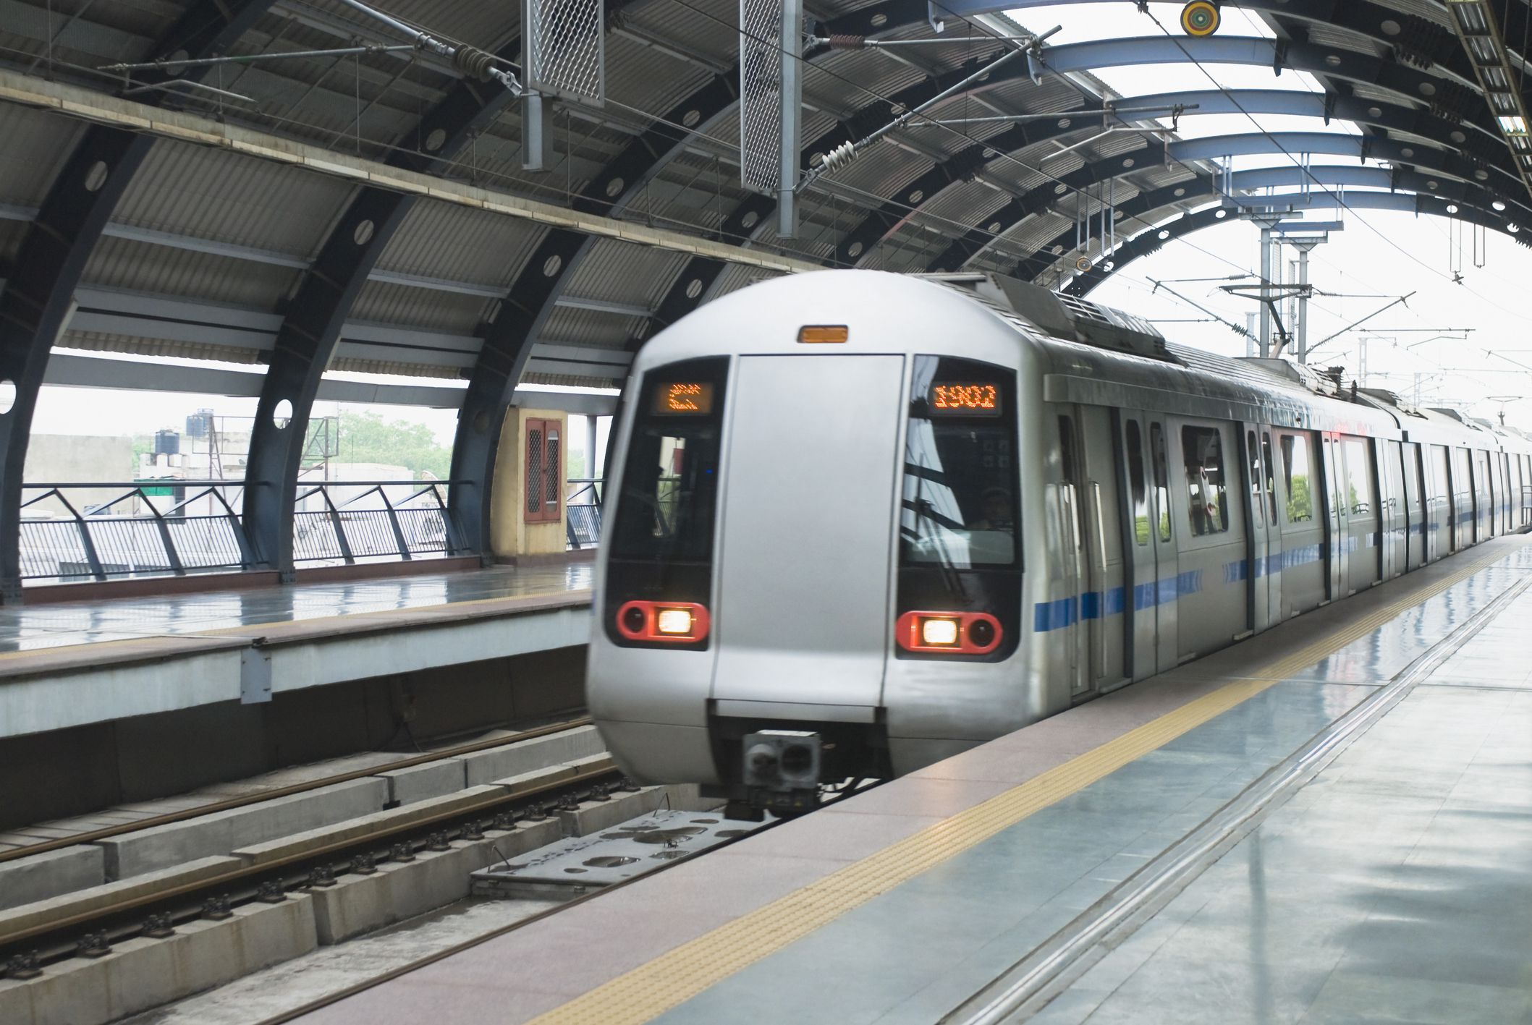
How Metros has improved the lives of people
Dhairya 102115254 Rudhir Pratap Singh 102115258 Shreya Ganotra 102115247

Slide 2
Introduction
The concept of a metro, short for "metropolitan railway" or "metropolitan transit system," originated as a solution to the growing transportation needs of densely populated urban areas. Here's an introduction to metro systems, including their origins, purpose, and development:
HOW IT BEGAN:
India’s First and Asia’s Fifth metro rail was introduced in Kolkata.
It was the first underground metro system in the country and started its operations in 1984. Since then, metro networks have expanded to other major cities across India, including Delhi, Mumbai, Chennai, Bengaluru, Hyderabad, Jaipur, Kochi, and Lucknow.
The second oldest after Kolkata Metro is Delhi Metro, which makes the largest and busiest network of all. With this idea, more than INR 1 trillion was invested in metro projects in the year 2018-19
Literature Review
Research Methodology
Objectives
Data Analysis
Key Findings

Slide 3
Introduction
Dong Lin, Wout Broere, & Jianqiang Cui. (2022). Metro systems and urban development: Impacts and implications. Tunnelling and Underground Space Technology, 125, 104509. https://doi.org/10.1016/j.tust.2022.104509. The article explores the relationship between metro systems and urban development, focusing on their comprehensive impacts on the economic, environmental, and social aspects of cities. The study acknowledges the global trend of cities developing metro systems to address urban challenges and promote sustainable urbanization.
Literature Review
Research Methodology
Objectives
Studies by Jain et al. (2019) and Gupta et al. (2020) have shown that the introduction of metro systems has greatly improved connectivity within cities, reducing travel times and increasing accessibility to different parts of the urban area. The expansion of metro networks has connected previously underserved areas, allowing residents to commute more efficiently for work, education, and leisure activities.
Data Analysis
Key Findings
Studies by Tiwari and Mishra (2017) and Das et al. (2022) have highlighted the economic benefits of metro systems, including increased property values and business opportunities along metro corridors. The presence of metro stations has stimulated commercial and real estate development, leading to enhanced economic activity and job creation in surrounding areas.

Slide 4
Introduction
Literature Review
The research methodology for this topic involves a comprehensive review and analysis of existing literature, empirical data, and case studies related to the impact of metro systems on urban life. This includes a qualitative assessment of the economic, social, and environmental benefits of metros, as well as a quantitative analysis of relevant data to quantify these impacts
Subsequently, a structured survey questionnaire is developed, encompassing both closed-ended and open-ended questions to gather quantitative and qualitative data on commuting behavior, perceived benefits of metro travel, and areas of improvement. The target population is defined to include residents of cities with established metro systems, and a suitable sampling method is employed to ensure the sample's representativeness.
Research
Methodology
Objectives
Data Analysis
Key Findings

Slide 5
Introduction
Literature Review
1. Highlighting Convenience:
Demonstrate how the introduction of metro systems has made commuting easier and more convenient for residents, reducing travel time and congestion on roads.
2. Addressing Environmental Impact:
Discuss findings from the survey regarding the reduction in carbon emissions and pollution due to the shift from private vehicles to metro travel, contributing to a cleaner and healthier environment.
3. Enhancing Safety and Security:
Highlight survey responses indicating perceptions of increased safety and security for commuters, with well-lit stations, surveillance cameras, and regular security patrols contributing to a safer travel experience.
Research Methodology
Objectives
Data Analysis
Key Findings

Slide 6
Introduction
Literature Review
4. Addressing Accessibility and Inclusivity:
Present data on how the metro has improved accessibility for people with disabilities and senior citizens, making cities more inclusive and ensuring equitable access to public transportation.
5. Impact on Real Estate and Property Values:
Discuss survey findings on how the presence of metro stations has led to increased property values and real estate development along metro corridors, benefiting homeowners and investors.
6. Future Expansion and Development:
Conclude by discussing plans for future metro expansion and development based on survey feedback, emphasizing continued efforts to meet the growing transportation needs of urban populations and further improve quality of life.
Research Methodology
Objectives
Data Analysis
Key Findings

Slide 7
Empowering Accessibility For University Students
Lifeline for campuses:
Metro systems offer convenient transportation to and from bustling urban centers where universities are located, easing the challenges of commuting amidst traffic congestion and parking limitations.
Independence boost:
The metro empowers students with newfound independence, allowing them to freely explore the city, attend off-campus events, and pursue internships or job opportunities across different city areas, all without relying on parental assistance or costly transportation options.
Diversity catalyst:
Metro serves as a common mode of transportation, fostering a diverse and inclusive campus community by facilitating easy commutes for students from various backgrounds and neighborhoods. This enriches the university experience with diverse perspectives and cultural exchanges.
Literature Review
Objectives
Data Analysis
Key Findings

Slide 8
Unprecedented growth of personal vehicles
Growing traffic Congestion
Air pollution and traffic accidents has become a major concern
To avoid congestion at peak hours
Time saving
Reduced fuel consumption
Good for wallet
Why is it Needed?

Slide 9
Downtown area: For its dense population and commercial activity.
Major transportation hubs: Such as airports, train stations, and bus terminals.
Universities and colleges: To cater to students and faculty.
Residential suburbs: To connect commuters to the city center.
Industrial zones: To facilitate transportation for workers
Target Areas

Slide 10


Slide 11
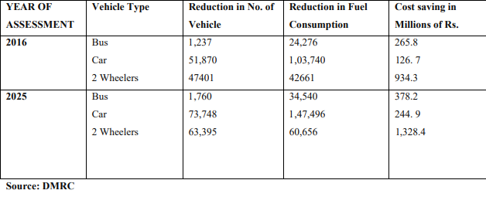
Data Analysis For Cost Cutting
Reduction in fuel consumption
In 2016, a reduction of approximately 170,677 units in fuel consumption was observed.
Expected reduction in fuel consumption by 2025 is projected to reach approximately 242,692 units.
B. Cost savings from metro usage
In 2016, Approximately 1,326 million rupees
Expected reduction in cost saving by 2025 is projected to reach Around
1,951 million rupees

Slide 12
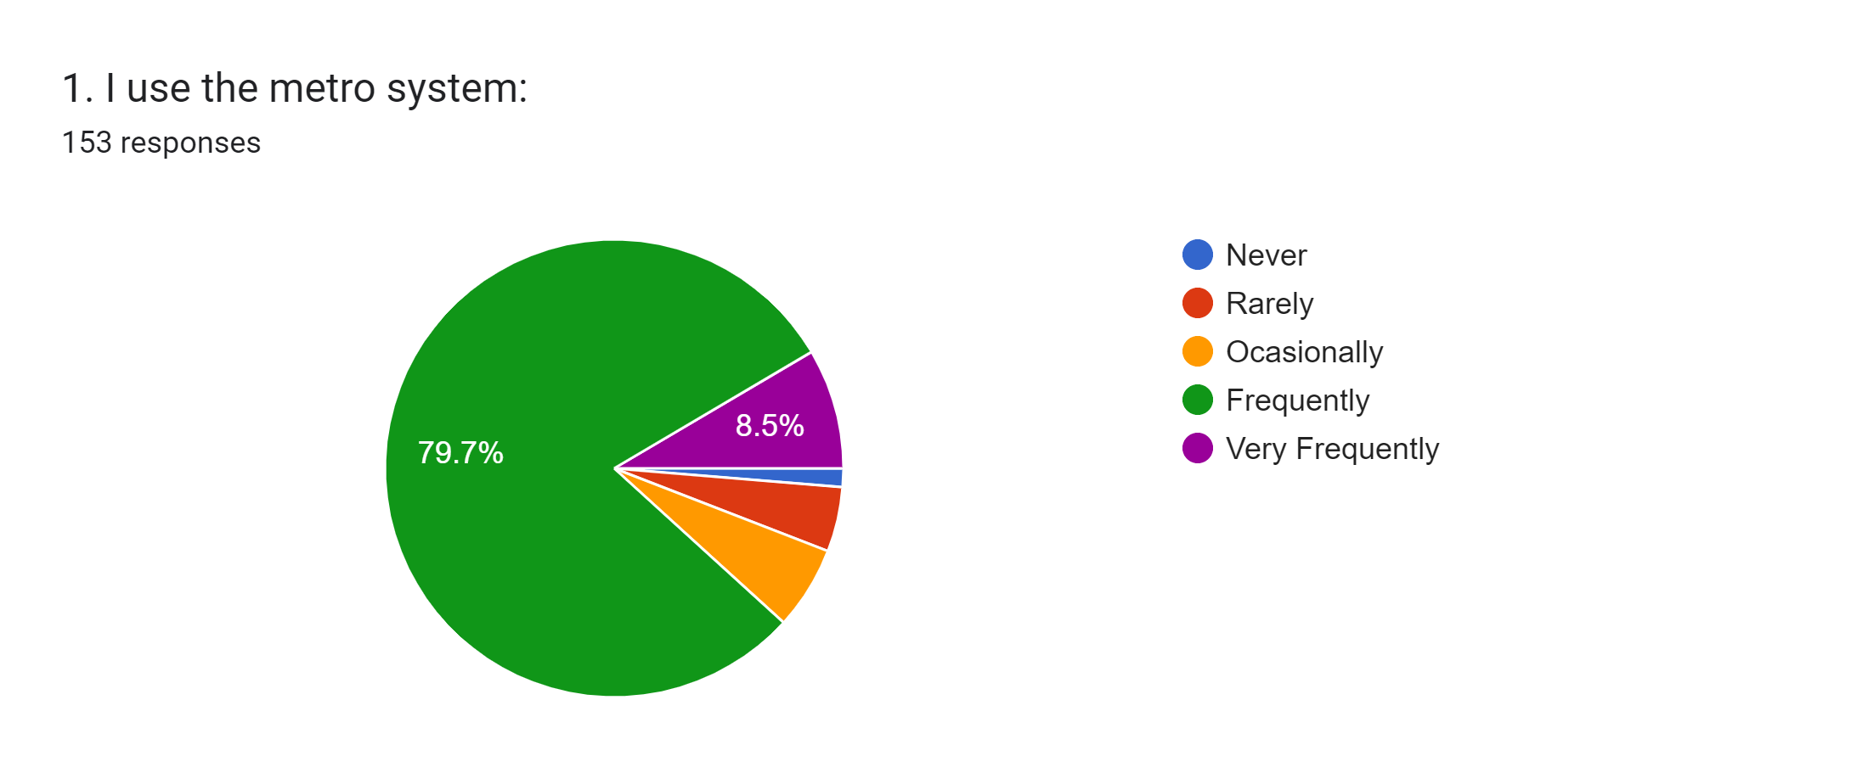
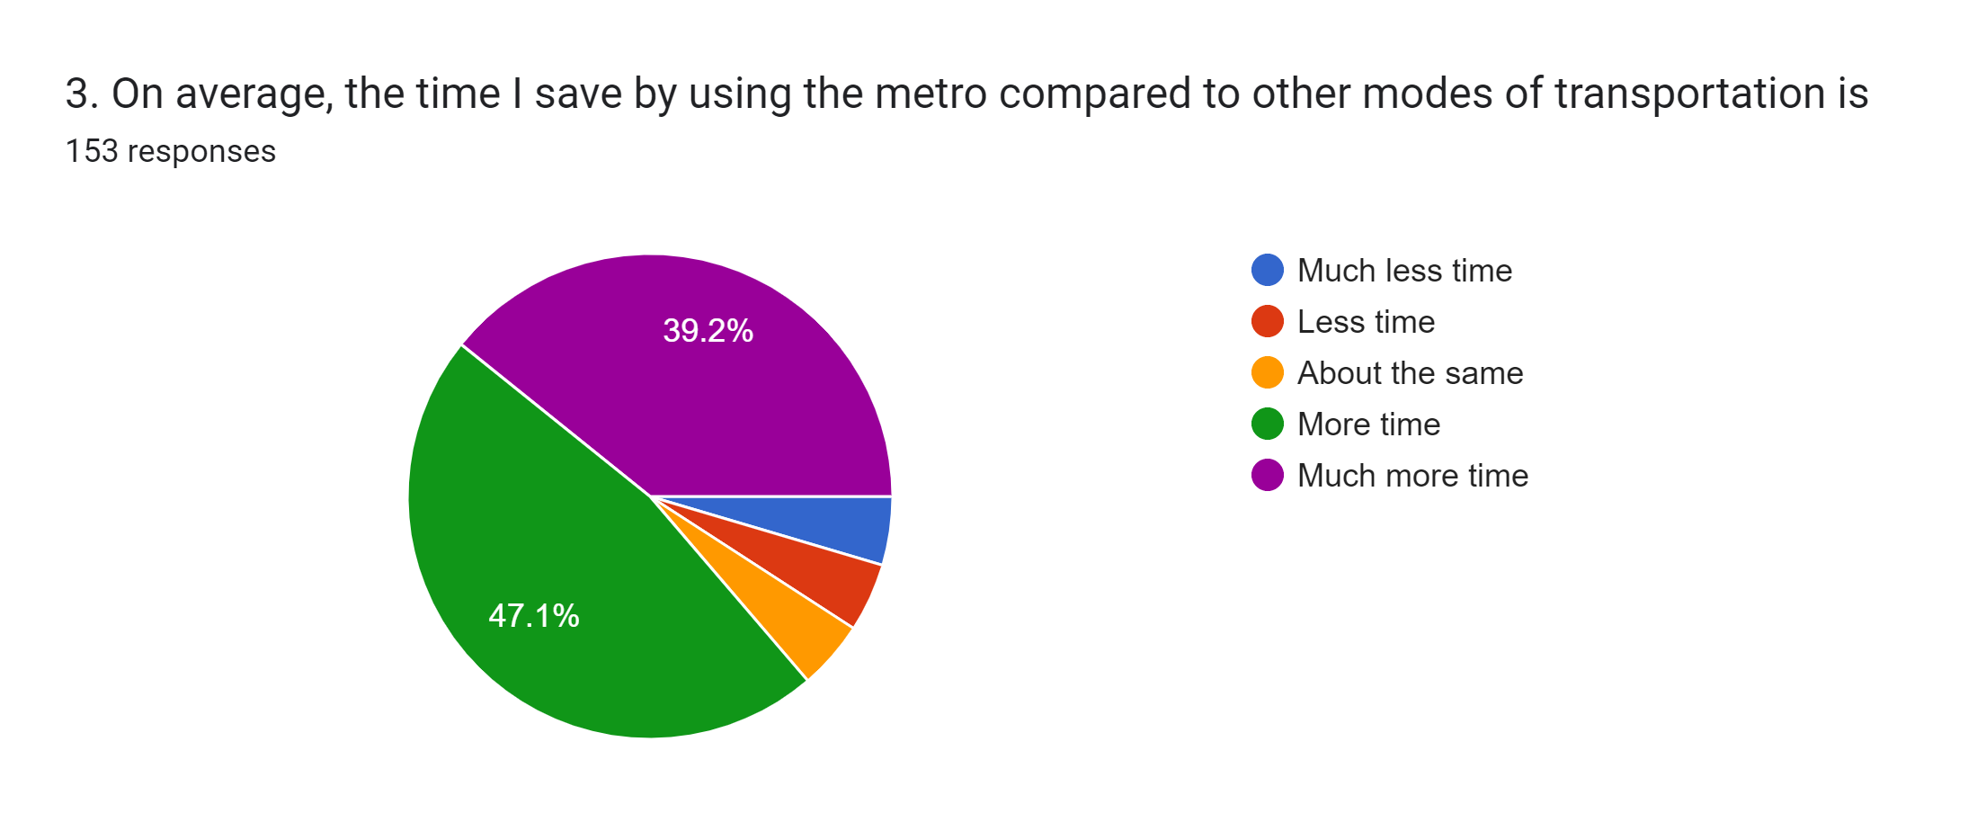
Pie chart suggests that the metro system is a popular mode of transportation for the people surveyed.
Almost 80% of the respondents use it frequently.
This pie chart shows that around 80% people save their time by using the metro compared to other modes of transportation

Slide 13
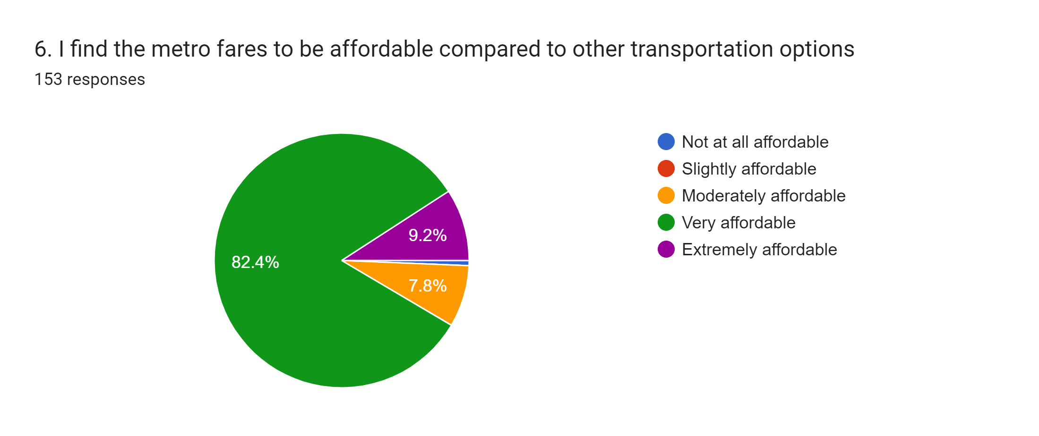
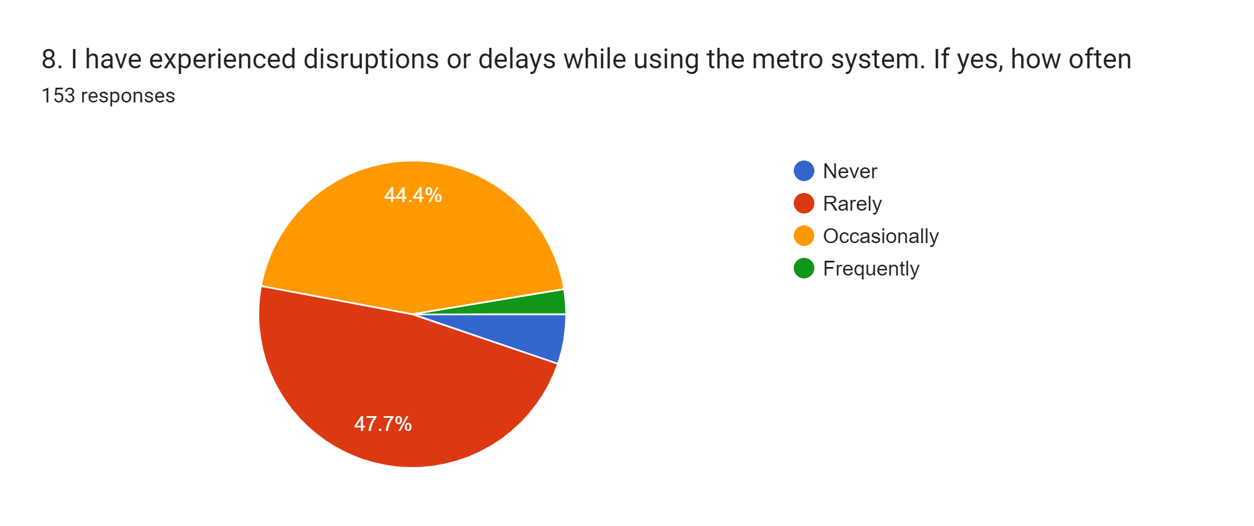
Pie chart suggests that most people who responded to the survey find metro fares to be very affordable compared to other transportation options.
Nearly half (44.4%) of respondents reported experiencing disruptions or delays.
Overall, the pie chart suggests that disruptions or delays are a common problem for people who use the metro system.
scope for improvement

Slide 14
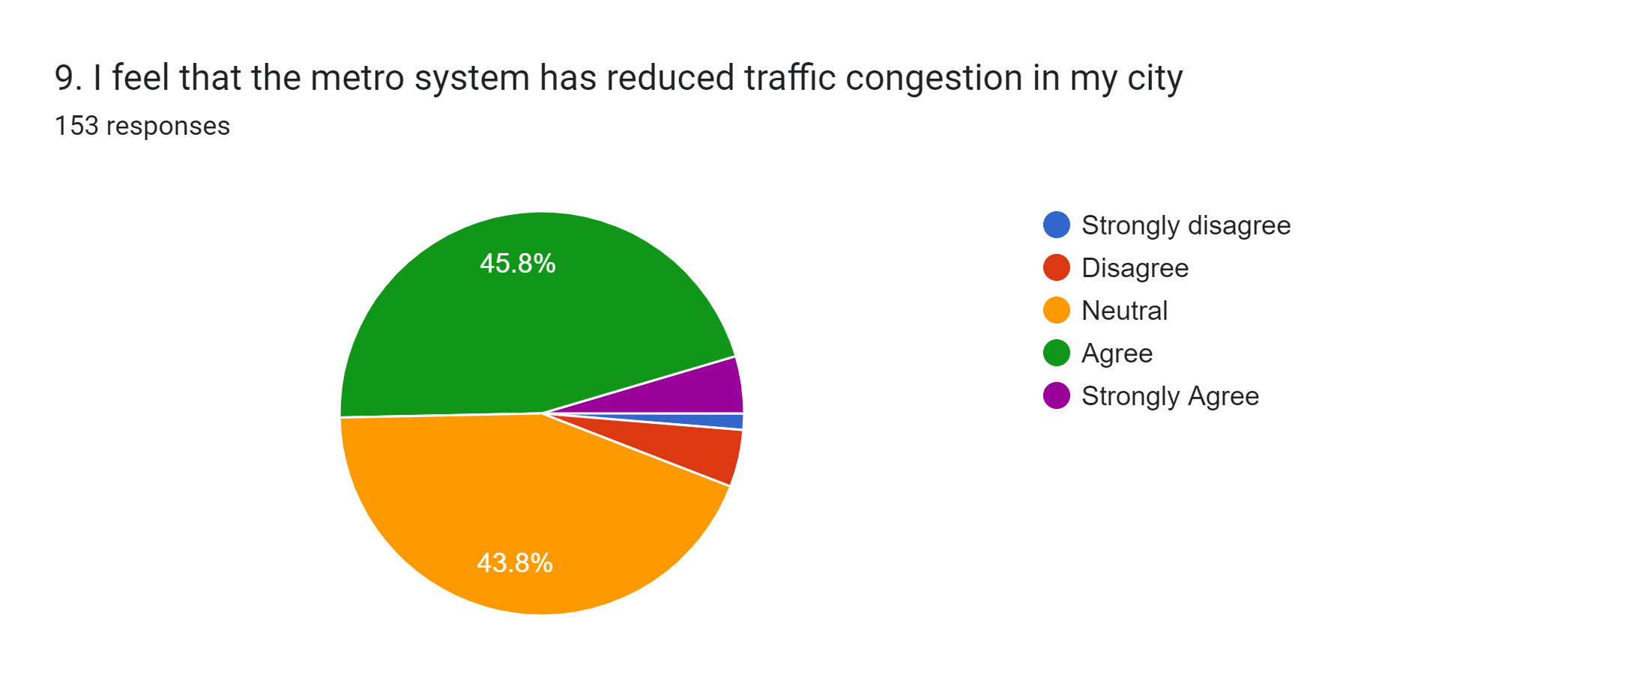
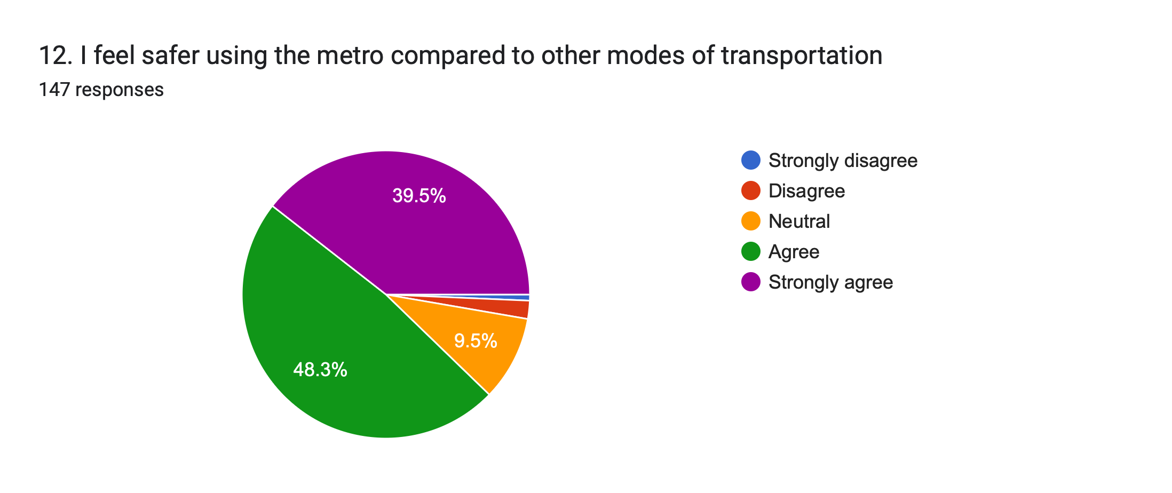
The two largest slices, disagree (45.8%) and agree (43.8%) are nearly the same size, which suggests that people have mixed feelings on the issue.
Scope of improvement
The pie chart shows that more than 90% people feel safer using the metro compared to other modes of transportation.

Slide 15
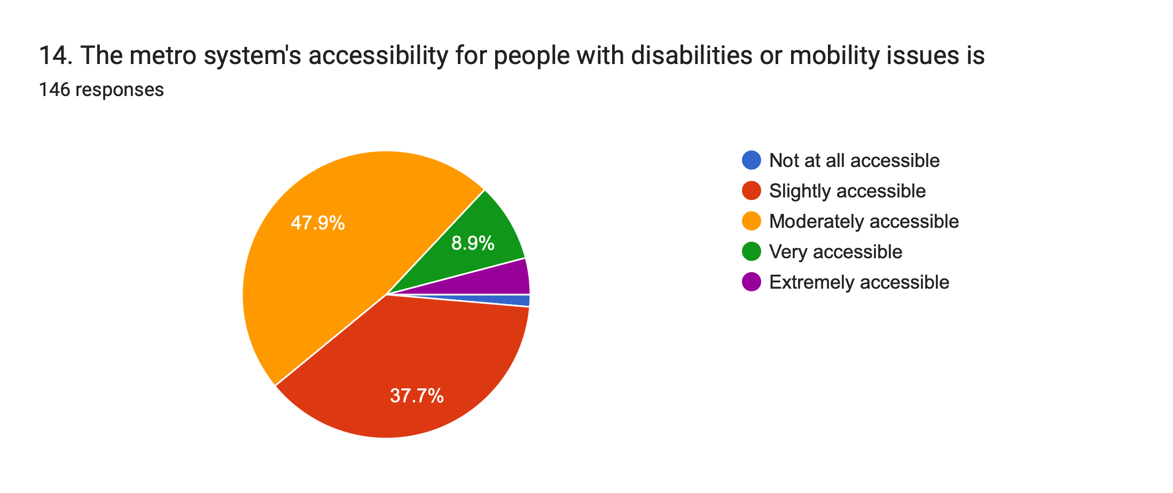
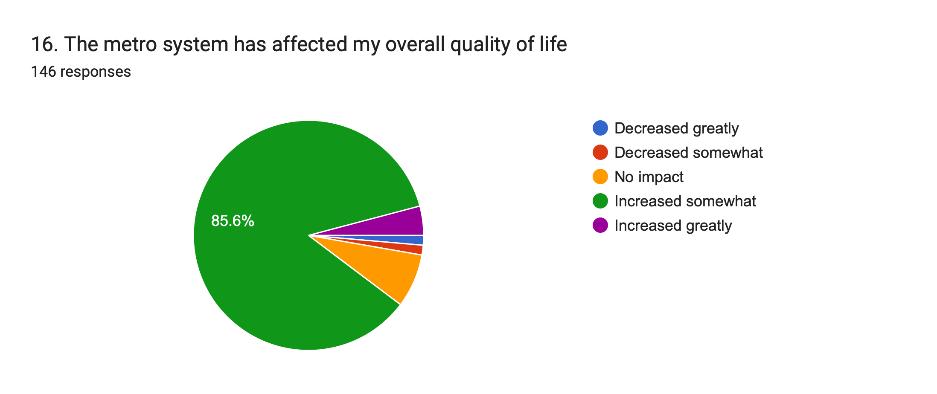
The pie chart suggests that a significant majority of people with disabilities or mobility issues who responded to the survey do not find the metro system to be accessible.
Scope of improvement
The pie chart suggests that the metro system has had a positive impact on the overall quality of life for most of the people who responded to the survey.

Slide 16
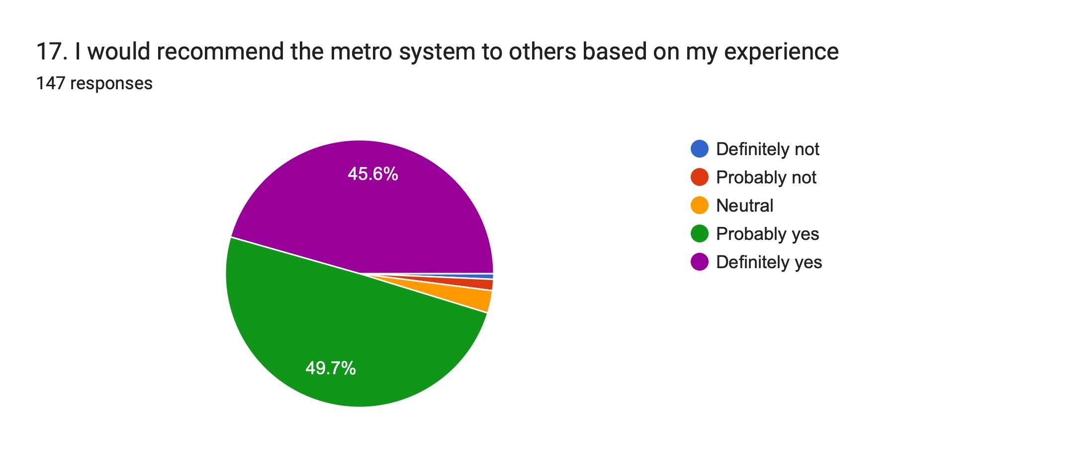

Overall, the pie chart suggests that a higher percentage of people would recommend the metro system than those who would not.
The pie chart suggests that most people who responded to the survey believe the metro system could further contribute to reducing carbon emissions in their city.
However, a significant portion said it could not contribute much more.

Slide 17
Introduction
Literature Review
Economic Impact:
Metros stimulate economic growth by improving access to jobs and businesses. Studies show that for every $1 invested in metros, there is a return of $4 in economic productivity.
Example: Cities like Delhi, Tokyo and London have experienced significant increases in property values and commercial activity around metro stations.
Social Impact:
"Metros enhance social equity by providing affordable and efficient transportation options.
Example: In New York City, the implementation of the metro system reduced travel time for low-income residents by up to 30%, improving their overall quality of life.
Environmental Impact:
Metros are environmentally friendly, reducing greenhouse gas emissions and air pollution. A single metro train can remove up to 700 cars from the road, reducing congestion and improving air quality.
But still people have doubts about it.
Research Methodology
Objectives
Data Analysis
Key Findings

Slide 18
THANK YOU
Feel free to ask any questions

