Slide 1

CULTURAL DIVERSITY AND TEAM CREATIVITY

Slide 2
1
ABSTRACT
Cultural diversity in teams shapes creativity through varied perspectives and problem-solving approaches.
Practical steps like promoting inclusivity and managing conflicts can enhance team creativity in organizations.

Slide 3

2
INTRODUCTION
The importance of cultural diversity in the workplace is undeniable. Embracing different perspectives and experiences can lead to innovative solutions and ideas. This presentation will explore how diverse teams can enhance creativity and drive success.

Slide 4

3
BENEFITS
Cultural diversity brings varied perspectives and creative solutions to the table. It fosters innovation and enhances problem-solving abilities, leading to a competitive edge in the global market.

Slide 5
4
CHALLENGES
While cultural diversity brings many benefits, it also presents challenges such as communication barriers, misunderstandings, and potential conflicts. Understanding and addressing these challenges is crucial for leveraging the full potential of a diverse team.
First Problem
Communication Barriers
Second Problem
Cultural Differences
Third Problem
Misunderstandings

Slide 6
5
OBJECTIVES
Our main goal/objective in this is to identify the challenges and work towards using that to our benefit
increase peoples understanding of how cultural diversity fosters creativity in teams.
Showcase examples of how diverse perspectives lead to innovative solutions.
Bridge the Communication Gap:
Identify potential communication challenges that arise from cultural diversity in teams.
Present strategies to promote open communication and mutual respect within diverse teams..

Slide 7
6
LITERARY REVIEW
1
Diversity and creativity in cross-national teams: The role of team knowledge sharing and inclusive climate
2
Team Creativity/Innovation in Culturally Diverse Teams: A Meta‐Analysis
3
Critical Review of Literature on Cultural Diversity in the Work Place and Organizational Performance: A Research Agenda

Slide 8
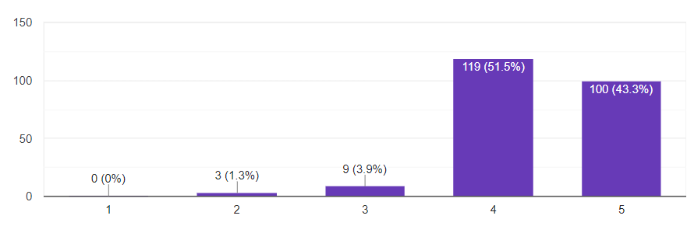
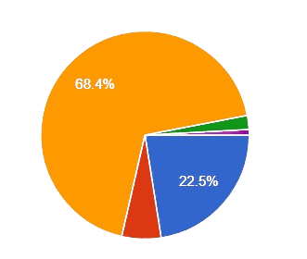
7
DATA ANALYSIS
In your opinion, how much does diversity in cultural backgrounds enhance creativity within a team?
The diversity of cultural values within a team leads to more innovative solutions to problems

Slide 9
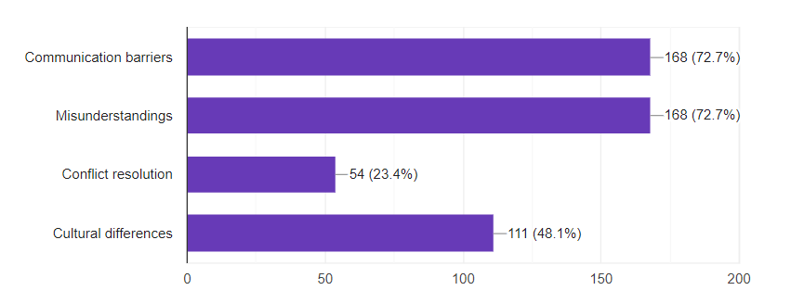
8
DATA ANALYSIS
Communication barriers due to cultural differences negatively impact team’s creative process.
What challenges do you anticipate individuals might face when working in a culturally diverse team?

Slide 10
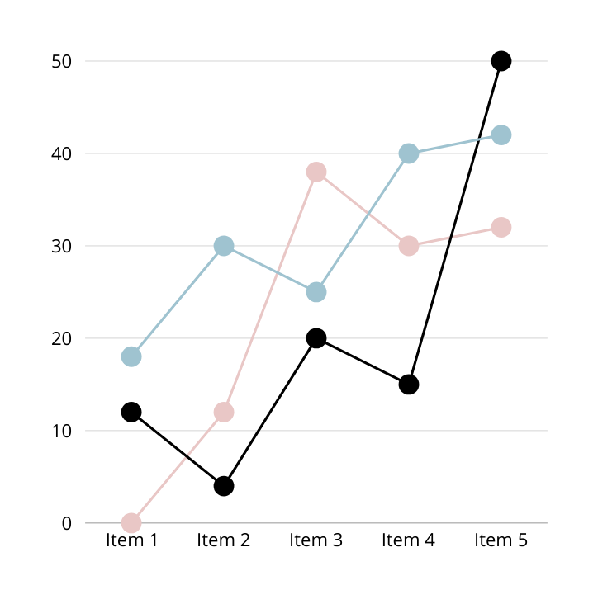
9
﻿RESULT
FROM THE SURVEY WE HAVE REALISED THAT MOST PEOPLE HAVE UNDERSTOOD CREATIVITY TO COEXIST WITH CULTURAL DIVERSITIES,MOST PEOPLE HAVE VOTED INFAVOUR OF THE IMPACT AND VERY FEW PEOPLE HAVE A FEELING THAT IT HAS NO EFFECT OR VERY LESS EFEECT

Slide 11

10
CONCLUSION
Cultural diversity fuels creative teams with fresh ideas, but communication hurdles can hold them back. Fostering open communication and valuing diverse approaches unlocks their true potential for groundbreaking solutions.

Slide 12
THANK YOU
GYM JAO

