Slide 1



EFFECT OF ADVERTISING ON CONSUMER PURCHASING DECISONS
Presented By Khushal Trehan, Krishna Arora, Nimish Sikka

Slide 2

Contents
Table Of Contents
01
Advertising Strategies
03
Research Findings
02
Impact on Consumer Purchasing Decisions
04
Conclusion

Slide 3

Advertising Strategies
01
Emotional Appeals
03
Persuasive Techniques
Utilize emotions to connect with costumers and create a memorable impression
01
03
Employ strategies like scarcity and social proof to encourage consumer action
02
Celebrity Endorsements
02
04
04
Digital Marketing Innovations
Leverage the influence of celebrities to enhance product appeal and credibility
Harness the power of targeted advertising and personalised messaging to engage with consumers effectively in the digital landscape

Slide 4
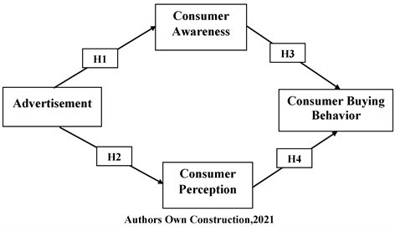
Impact on Consumer Purchasing Decisions
Preferences
Brand Awareness
Connection
Advertising shapes consumer preferences and perceptions, influencing their choices when making purchasing decisions
Effective advertising increases brand awareness and recall, making consumers more likely to consider and choose advertised products over competitors
Advertising can create emotional connections with consumers, leading to impulsive purchases and driving sales

Slide 5
Research Findings
Numerous studies have demonstrated a strong correlation between advertising exposure and consumer purchasing behaviour.
Research indicates that emotionally resonant advertisements are more effective in influencing consumer preferences and purchase intentions.
Studies have shown that targeted advertising based on demographic and psychographic data can significantly increase the likelihood of conversion and purchase.

Slide 6
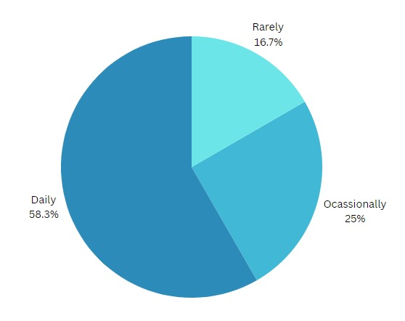
Q. How frequently do you use social media platforms?

Slide 7
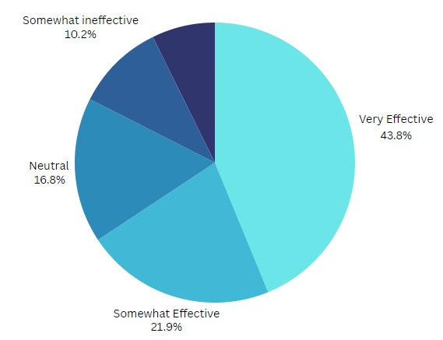
Q. How would you rate the effectiveness of the advertisement in influencing your perception of the product/service?

Slide 8
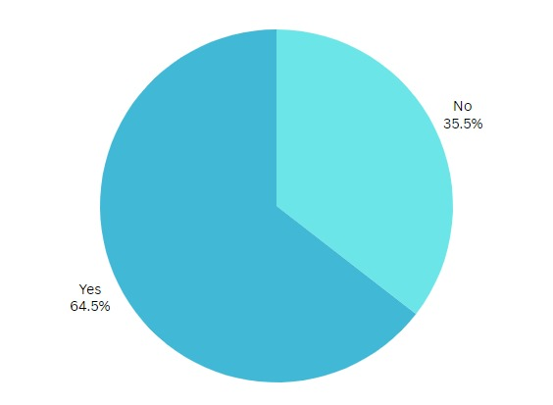
Q. Have you ever made a purchase based on an advertisement you saw or heard?

Slide 9
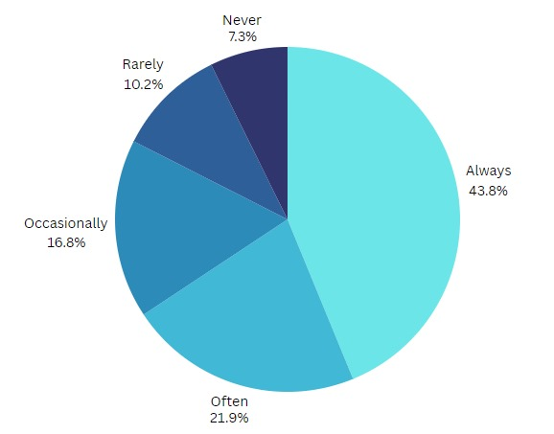
Q. How often do you feel persuaded by advertising to try a new product or service?

Slide 10
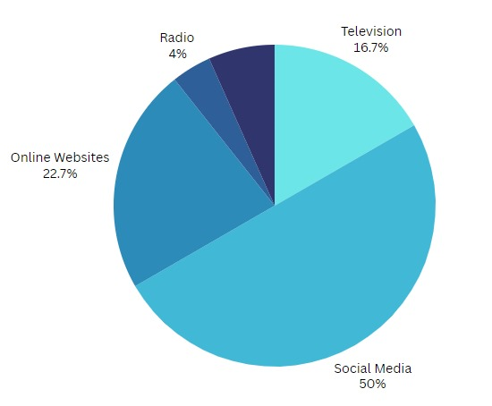
Q. On which platforms do you find advertisements most influential?

Slide 11
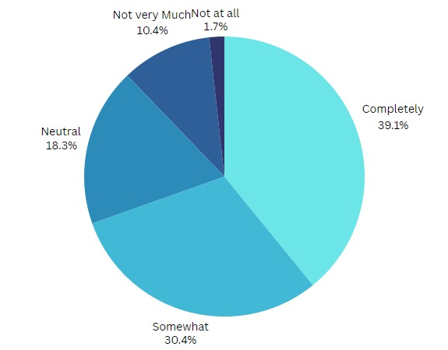
Q. To what extent do you trust the information presented in advertisements?

Slide 12
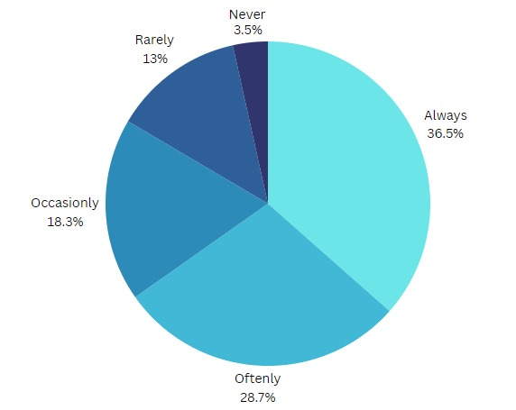
Q. After making a purchase based on an advertisement, do you often reflect on whether the product or service lived up to the advertised claims?

Slide 13
Conclusion
Advertising plays a significant role in influencing consumer behaviour and purchasing decisions, making it a crucial aspect of marketing strategies for businesses.
Understanding the effects of advertising on consumer decision-making can help businesses create more effective and ethical advertising campaigns, ultimately driving sales and fostering .

Slide 14
THANK YOU

