Slide 1
Go/sgbots
AMAN AGRAWAL(CFT-RRR)
SEJAL SANAP(CFT-CRL)
VISHAL SHARMA(CFT-PFX)
RITIKA KUMARI(CFT-TSR)
PRIYANSHU MANDIL(CFT-CRL)
Theme 4: CFT + DDS + GTS + DAI + CTC
Data Anonymization

Slide 2
AGENDA
PROBLEM STATEMENT
BUSINESS OBJECTIVES
FLOWCHART
SOLUTION APPROACH
DIAGRAMS AND MODELS
SCREENSHOTS
FUTURE SCOPE
CONCLUSIONS

Slide 3
PROBLEM STATEMENT
DETECTION OF PERSONAL DATA
Current Status: Data Anonymization is managed inconsistently within individual applications.
Compliance Risk: This leads to a lack of standardization, compliance risks, and operational inefficiencies.

Slide 4
BUsiNESS OBJECTIVES
Use AI models to automatically detect personally identifiable information (PII) in CSV or Parquet files.
Identify columns containing PII, encrypt them, and return the encrypted files to the user.

Slide 5
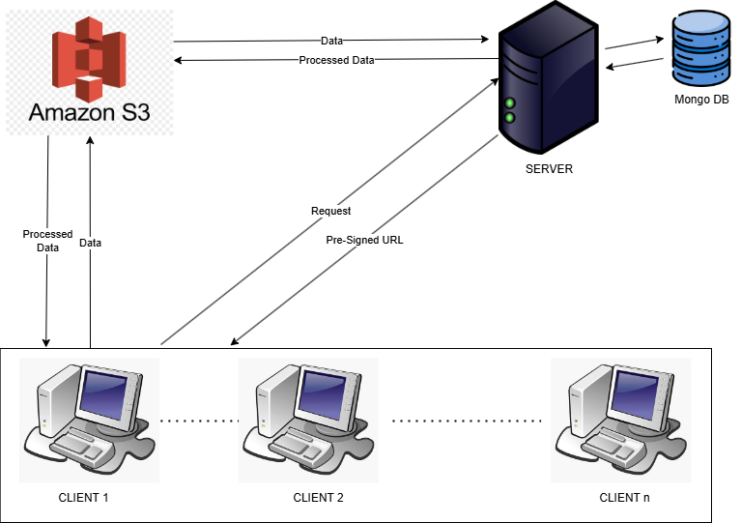
FLOWCHART

Slide 6
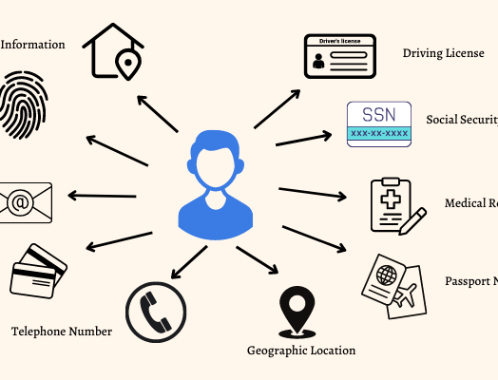
SOLUTION APPROACH
UPLOAD FILES TO SERVER: Uploads to Amazon S3 in chunks
DETECTION: Detects columns containing PII
ENCRYPTION: Encrypts PII columns them in chunks using our model
WRITING BACK TO S3: Writes encrypted files to S3
RETURN FILE TO USER: Return file to user
DECRYPTION: Detects columns that contain PII,
decrypts them in chunks

Slide 7
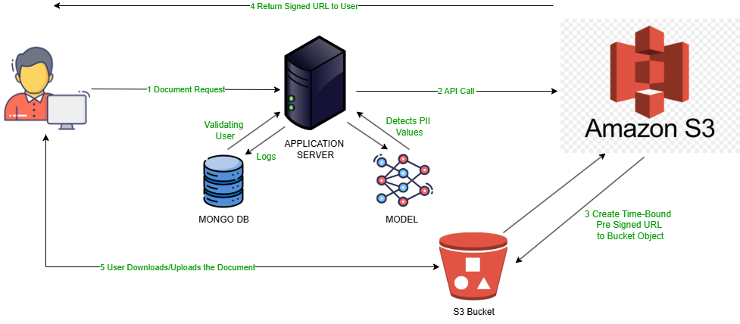
Architecture diagram

Slide 8
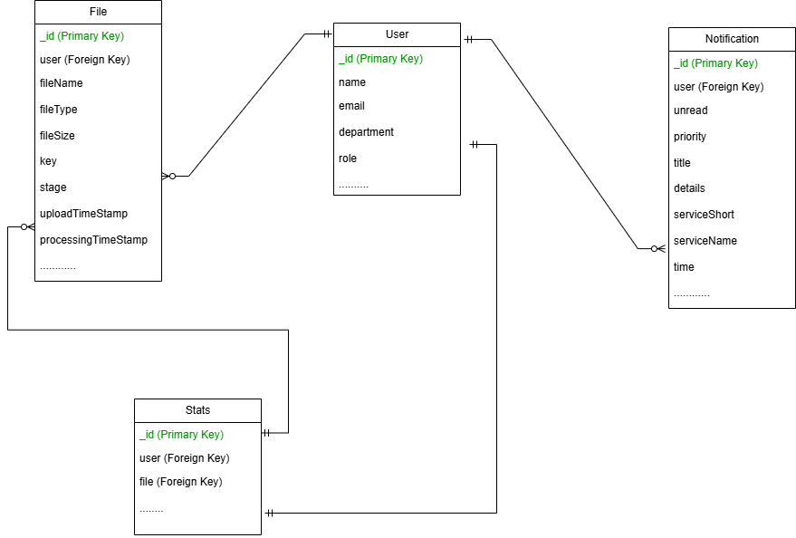
Database schema

Slide 9
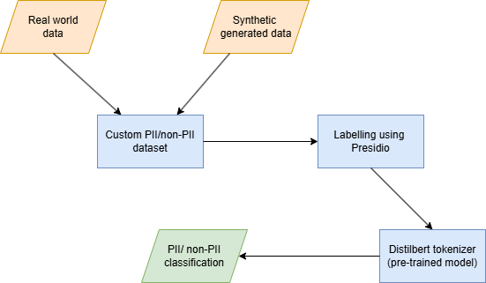
model

Slide 10
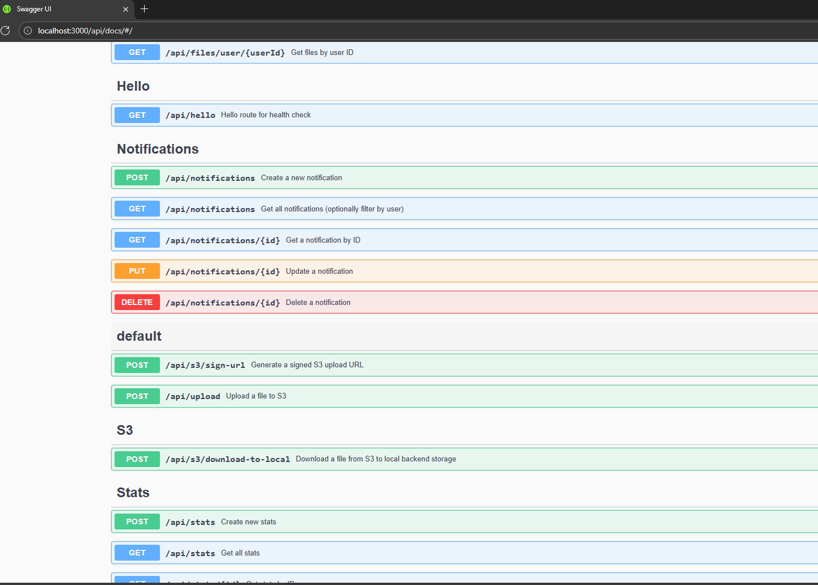
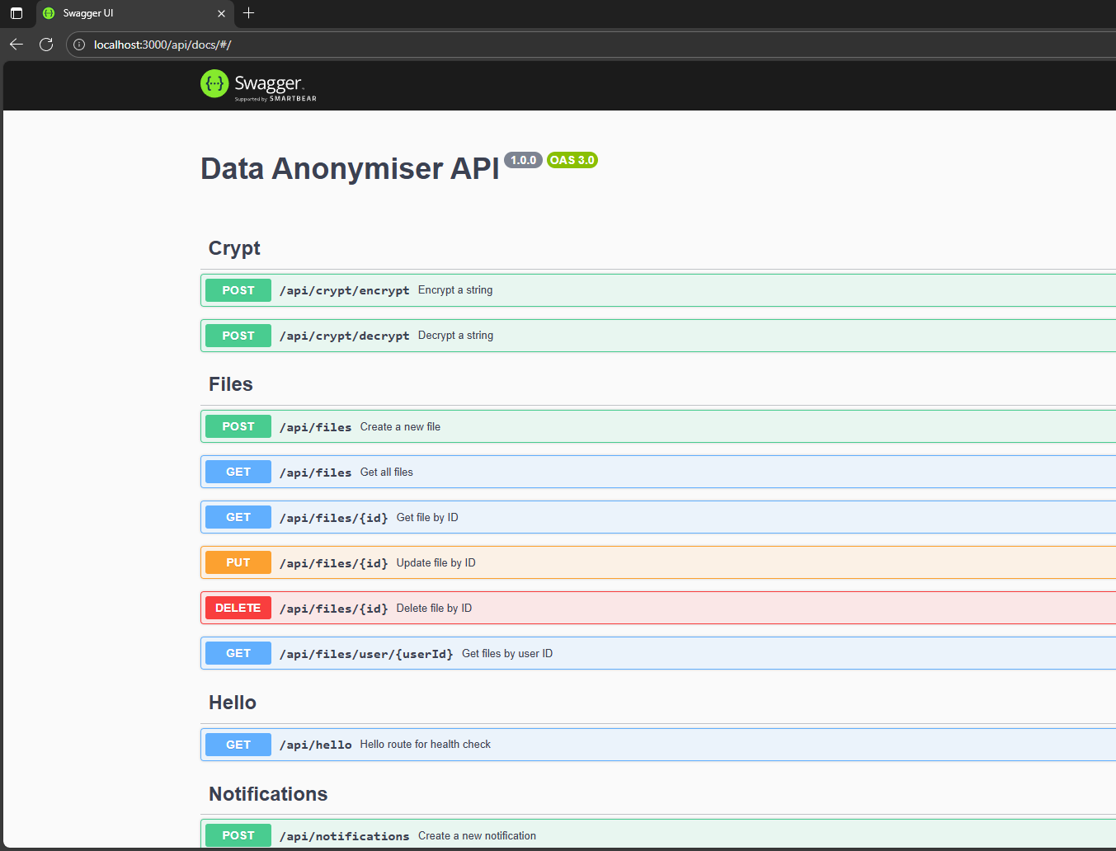
Swagger API

Slide 11
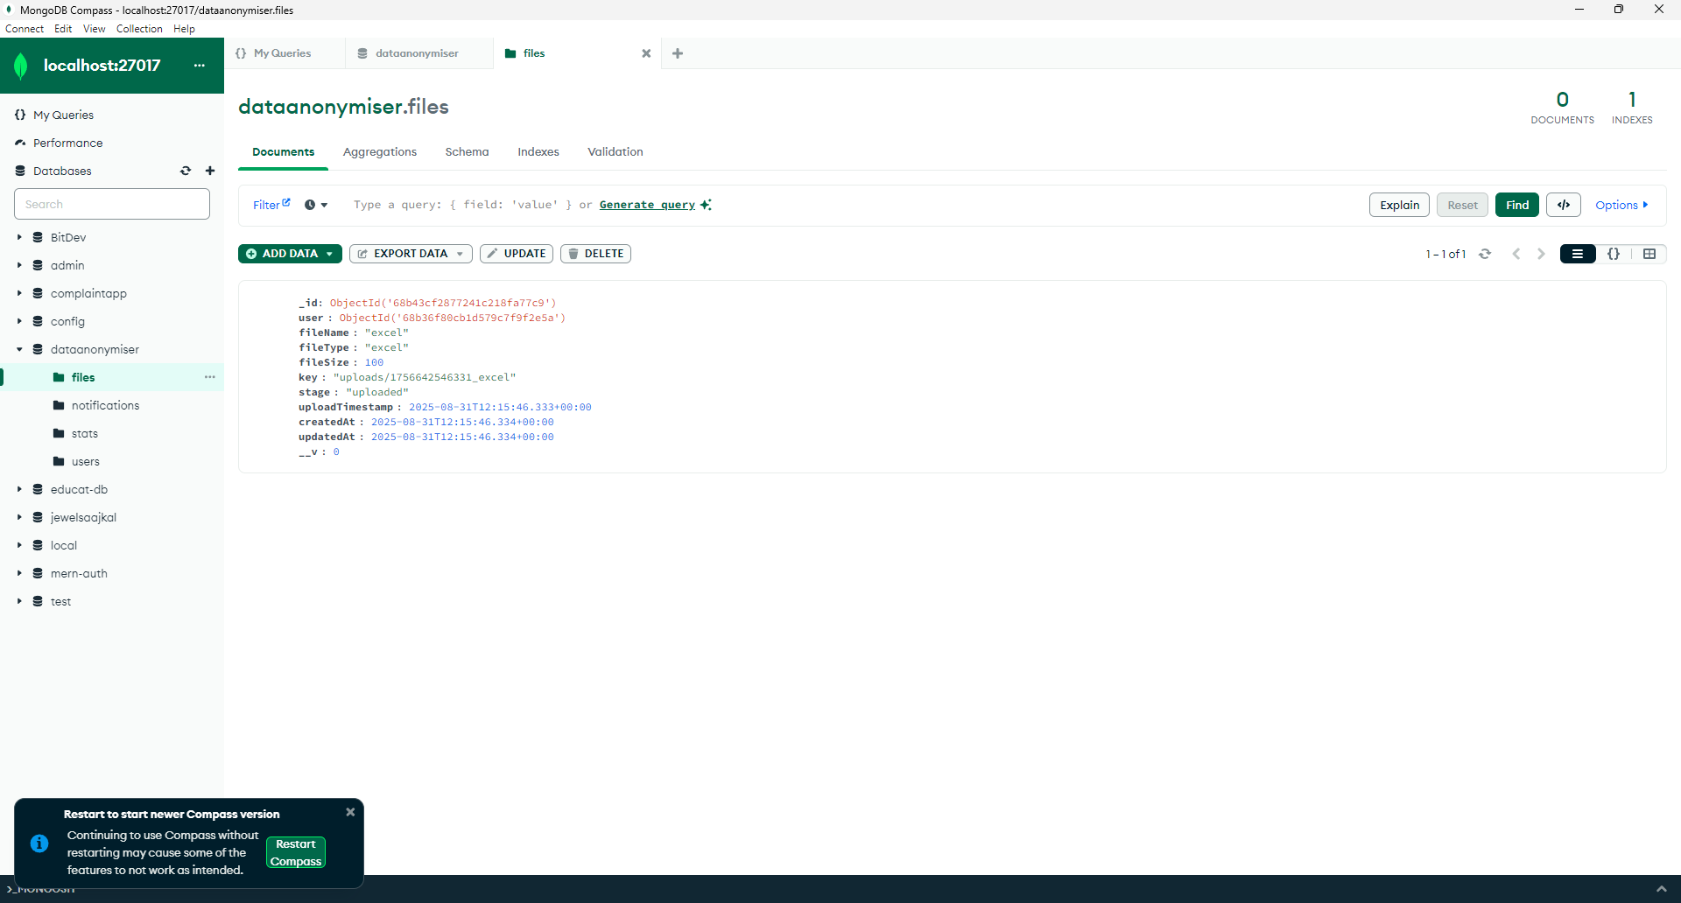
Mongo Db

Slide 12
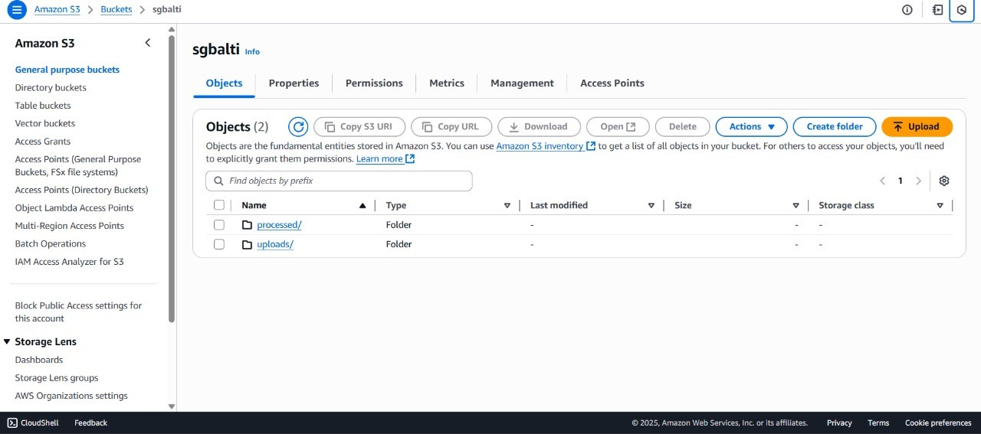
S3 bucket

Slide 13
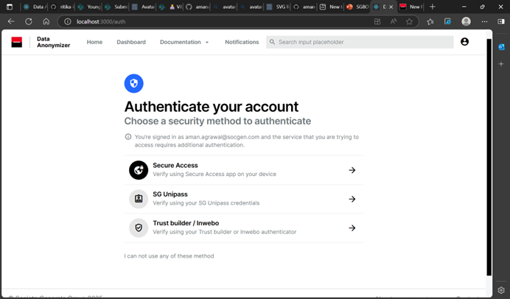
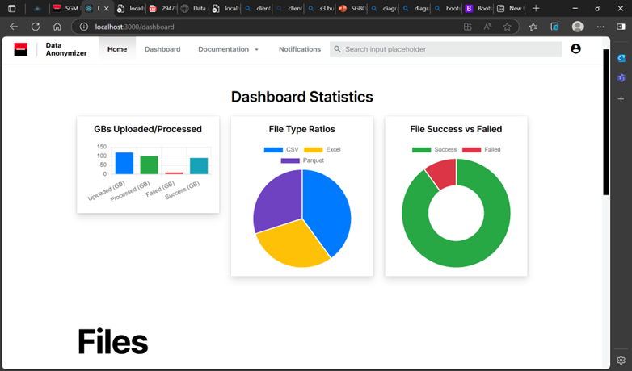
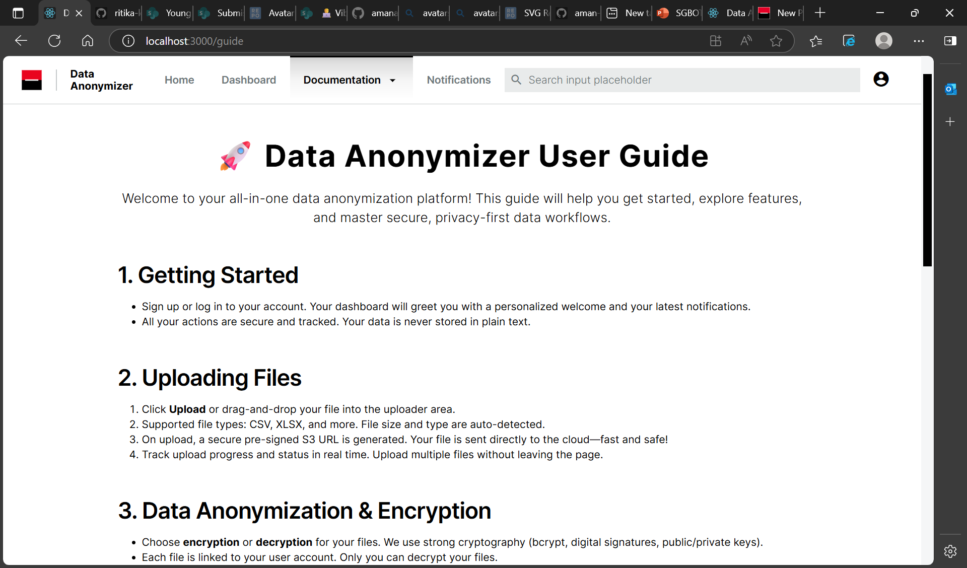
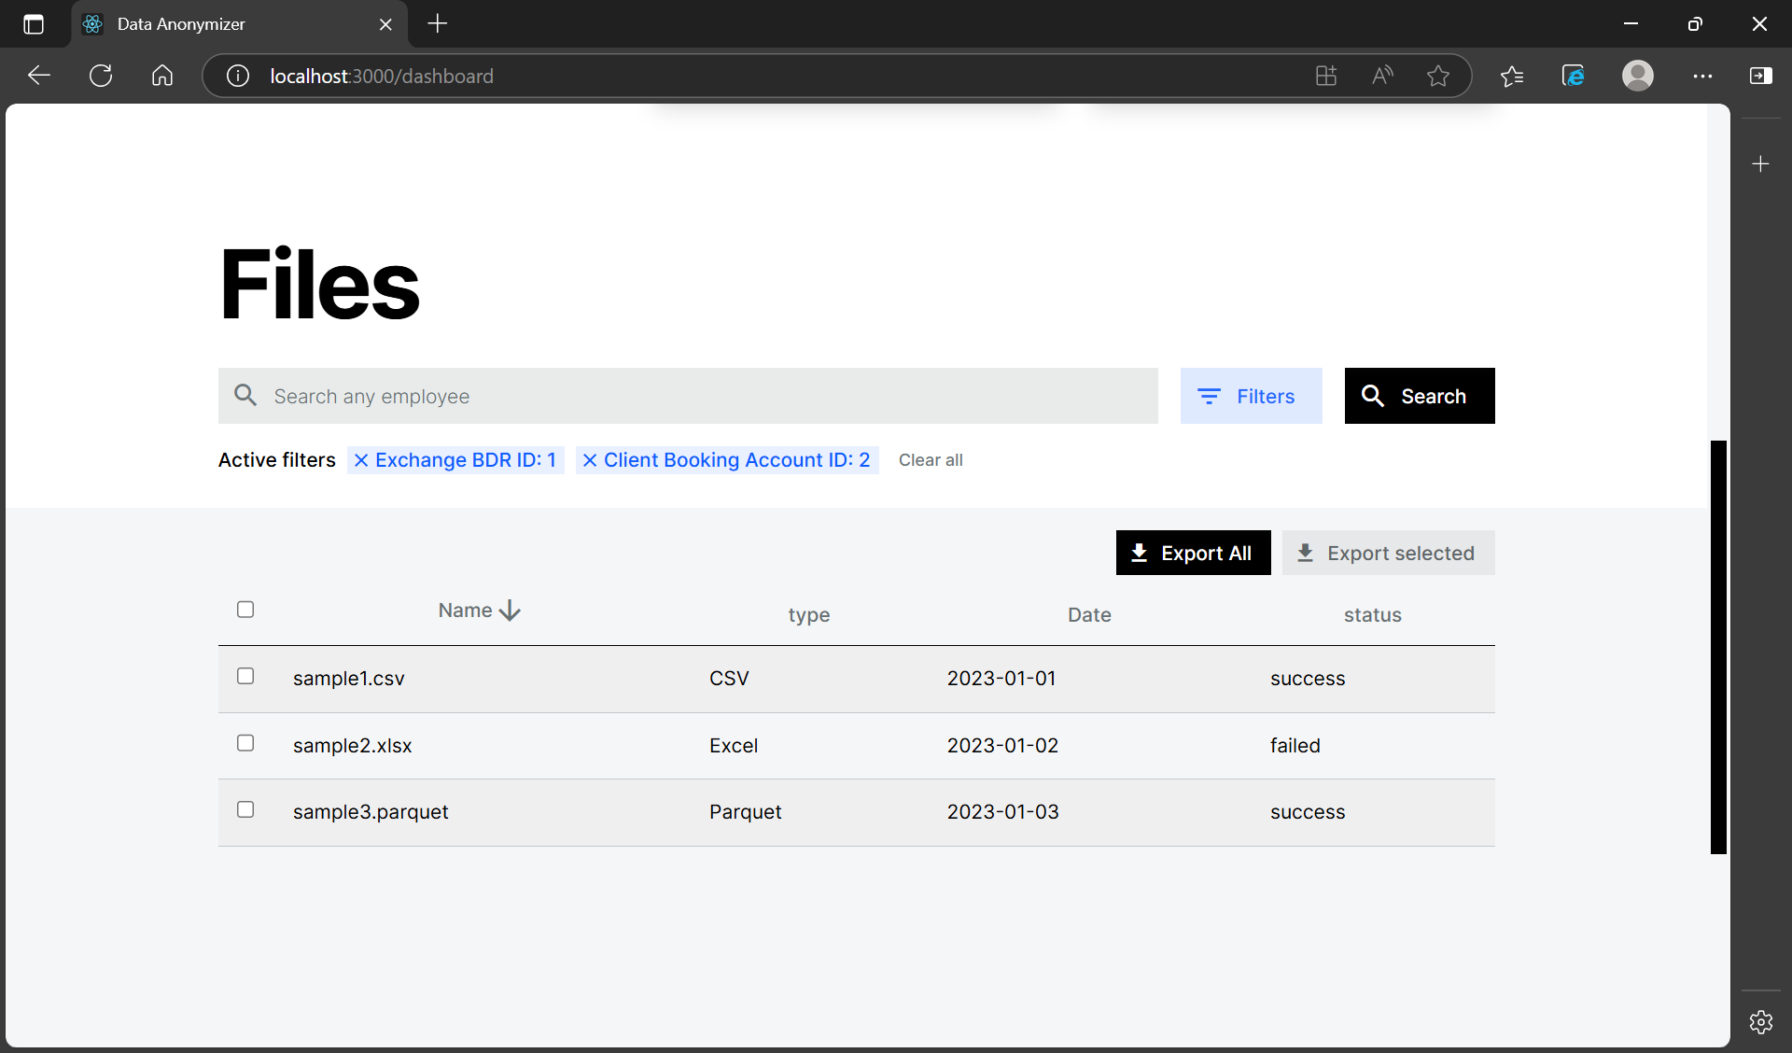
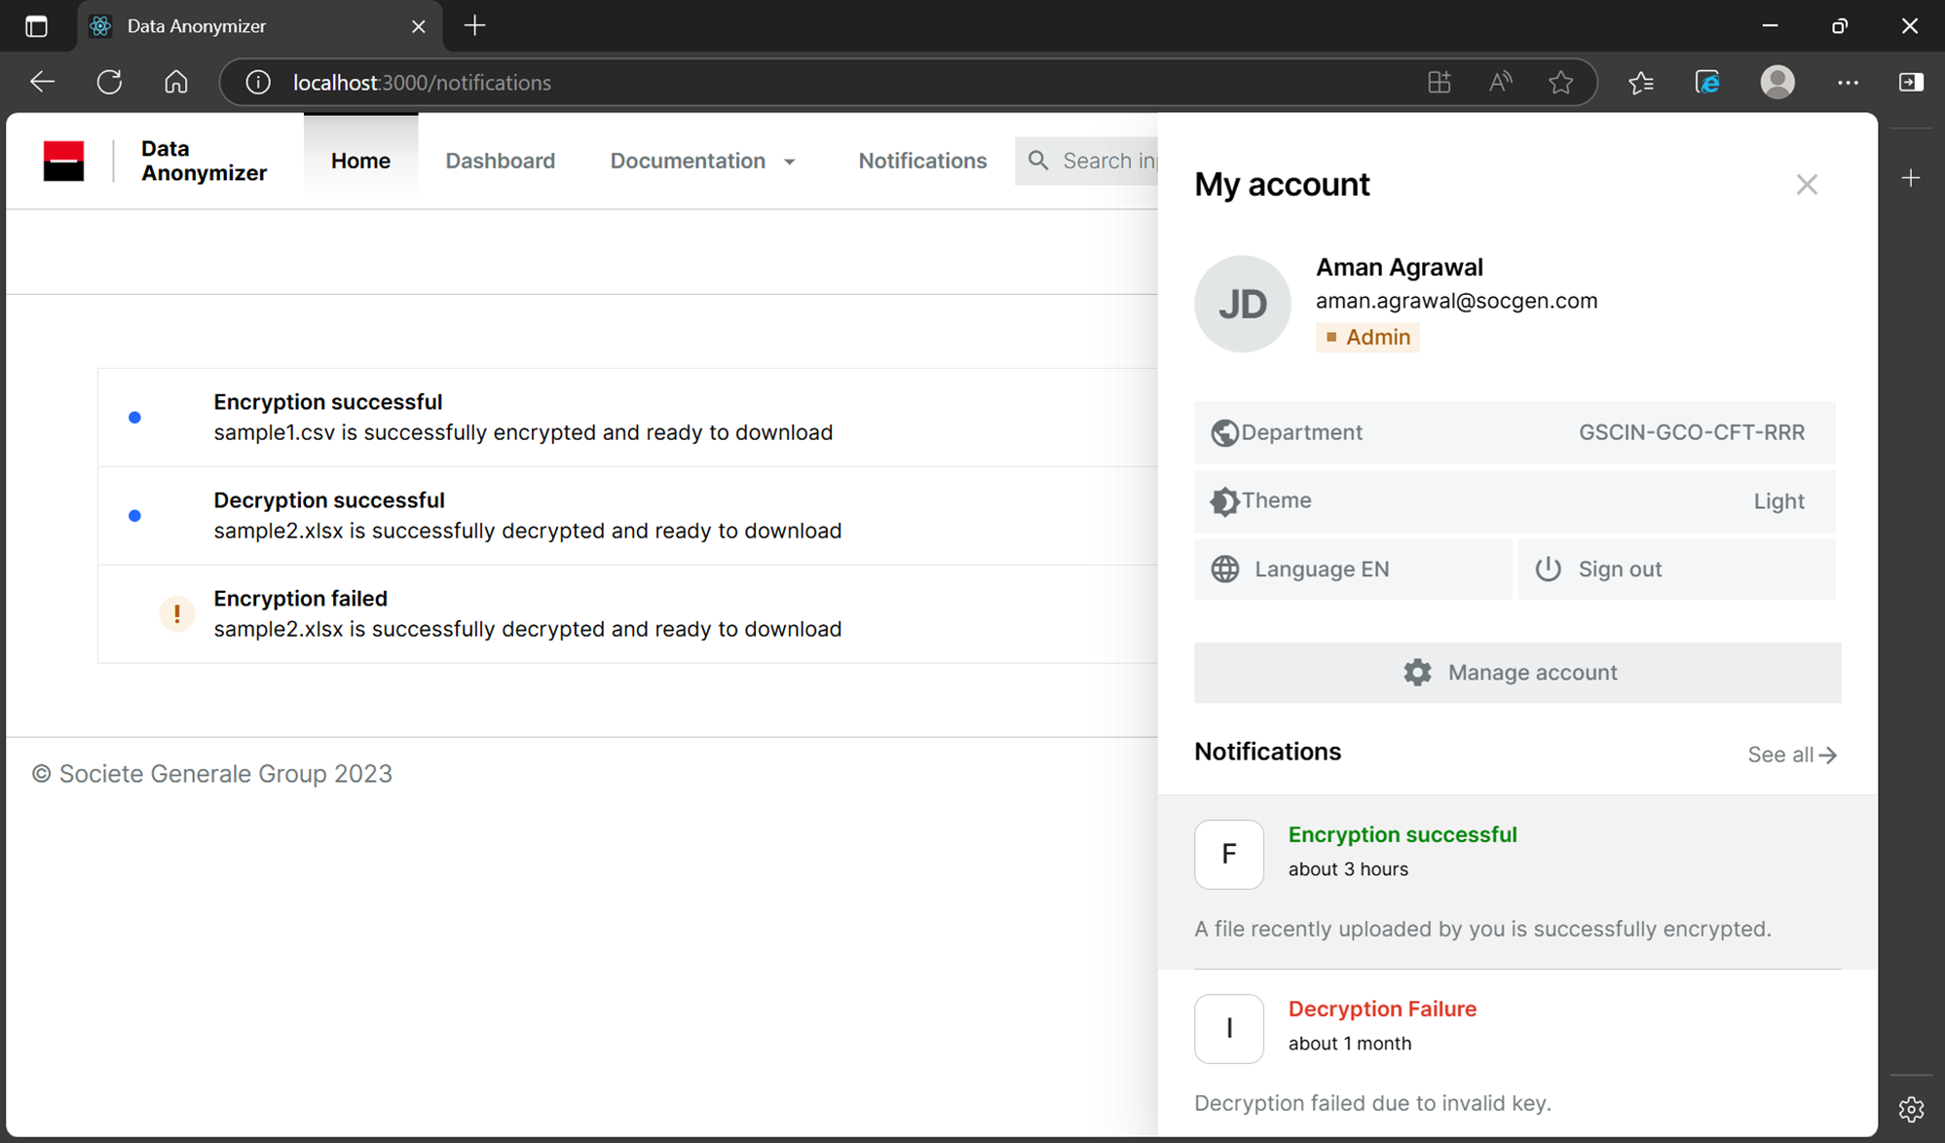
UI snapshots

Slide 14
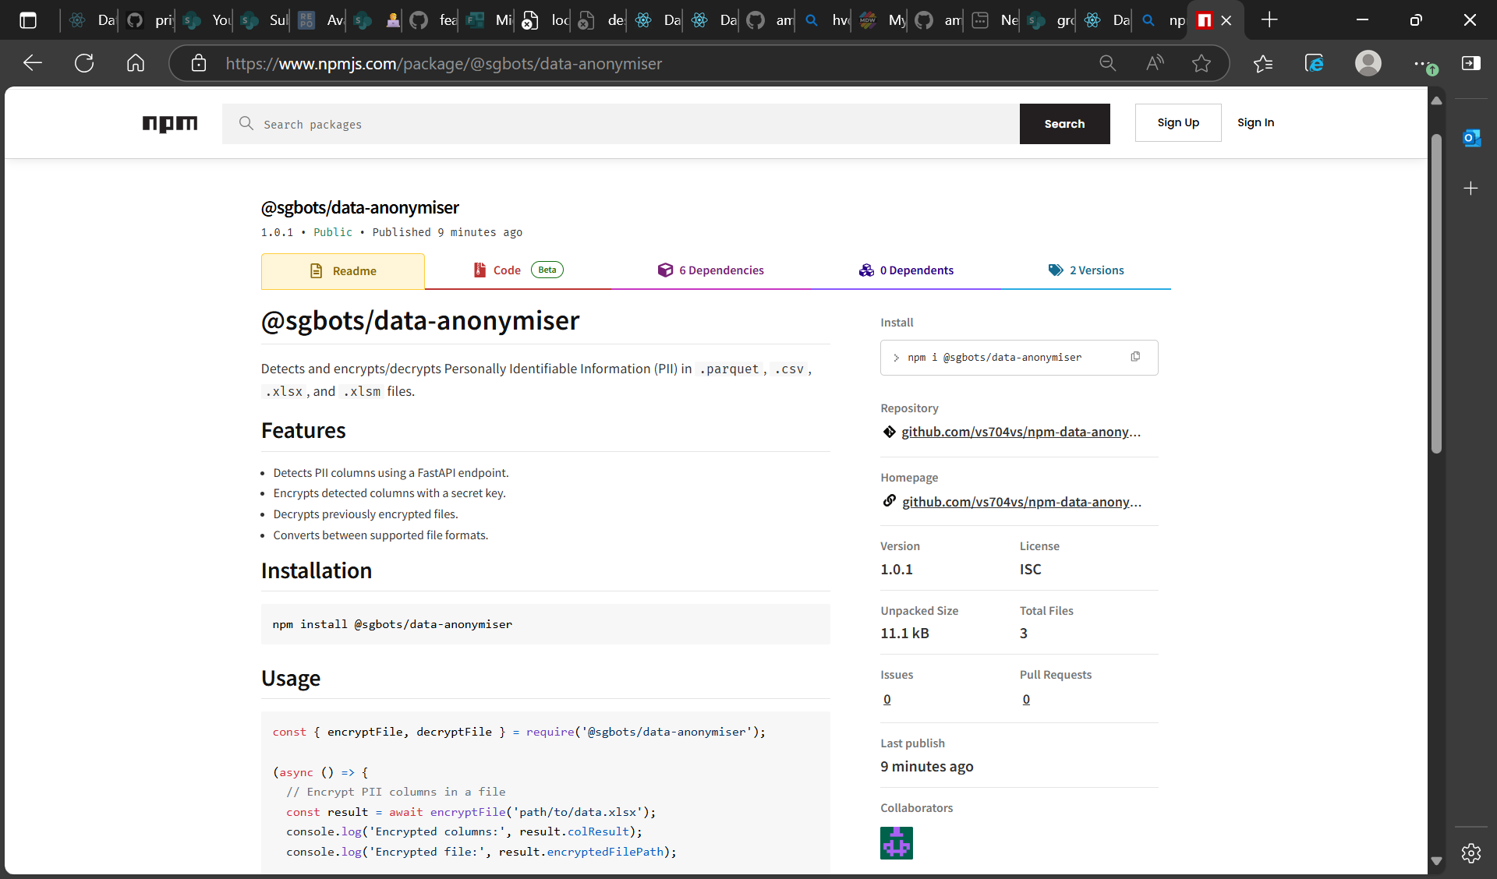
Npm package (@sgbots/data-anonymiser – npm)

Slide 15
What unique do we offer?
End-to-End Data Anonymization: Securely anonymizes sensitive data from upload to storage, ensuring privacy compliance.
Seamless S3 Integration: Direct file uploads and downloads with pre-signed URLs for efficient, scalable storage.
Modular & Extensible Architecture: Easily add new features or integrate with existing systems.
Role-Based Access Control: Fine-grained permissions for admins and users to protect sensitive operations.
Real-Time Notifications: Users receive instant updates on file status, processing, and system events.
Comprehensive API Documentation: Swagger-powered, interactive API docs for easy integration and testing.
User-Friendly Dashboard: Intuitive React frontend with file management, upload progress, and analytics.

Slide 16
TEST RESULTS
True Positive (TP): 540 (26.25%)
True Negative (TN): 1350 (65.6%)
False Positive (FP): 86 (4.18%)
False Negative (FN): 82 (3.98%)
Accuracy: 91.7%
Precision: 86.2%
Recall: 86.8%
Specificity: 94.0%
F1 Score: 86.5%

Slide 17
FUTURE SCOPE
Integration with additional cloud storage providers (Azure Blob, Google Cloud Storage)
Advanced anonymization techniques (differential privacy, AI-based masking)
Audit logging and compliance reporting for regulatory needs
Multi-language support for global adoption
Enhanced analytics and visualization dashboards
Automated data retention and deletion policies

Slide 18
CONCLUSIONS
The data anonymizer provides a secure, scalable, and user-friendly solution for protecting sensitive information.
Its modular design and robust features make it adaptable to diverse organizational needs.
With ongoing enhancements and a focus on privacy, the platform is well-positioned to address future data protection challenges.

