Slide 1
Introduction to JupyterHub
Sungjoon Choi
(sungjoon.choi@cpslab.snu.ac.kr)

Slide 2
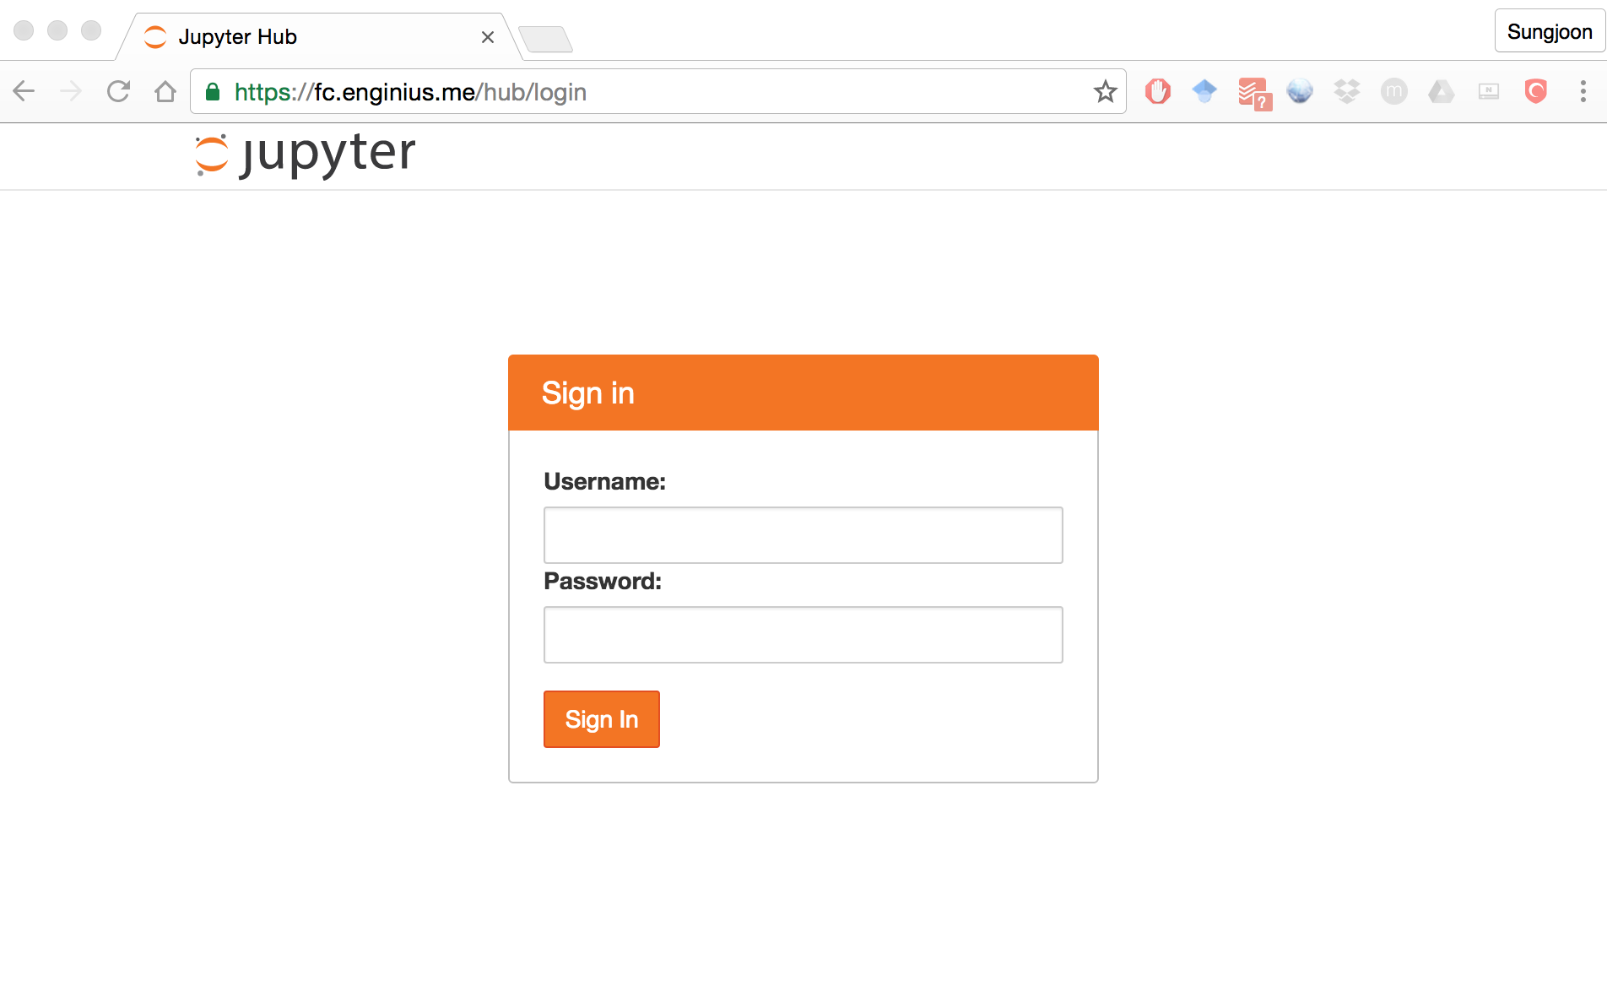
https://fc.enginius.me

Slide 3

https://fc.enginius.me
ksc2016 / 1234

Slide 4
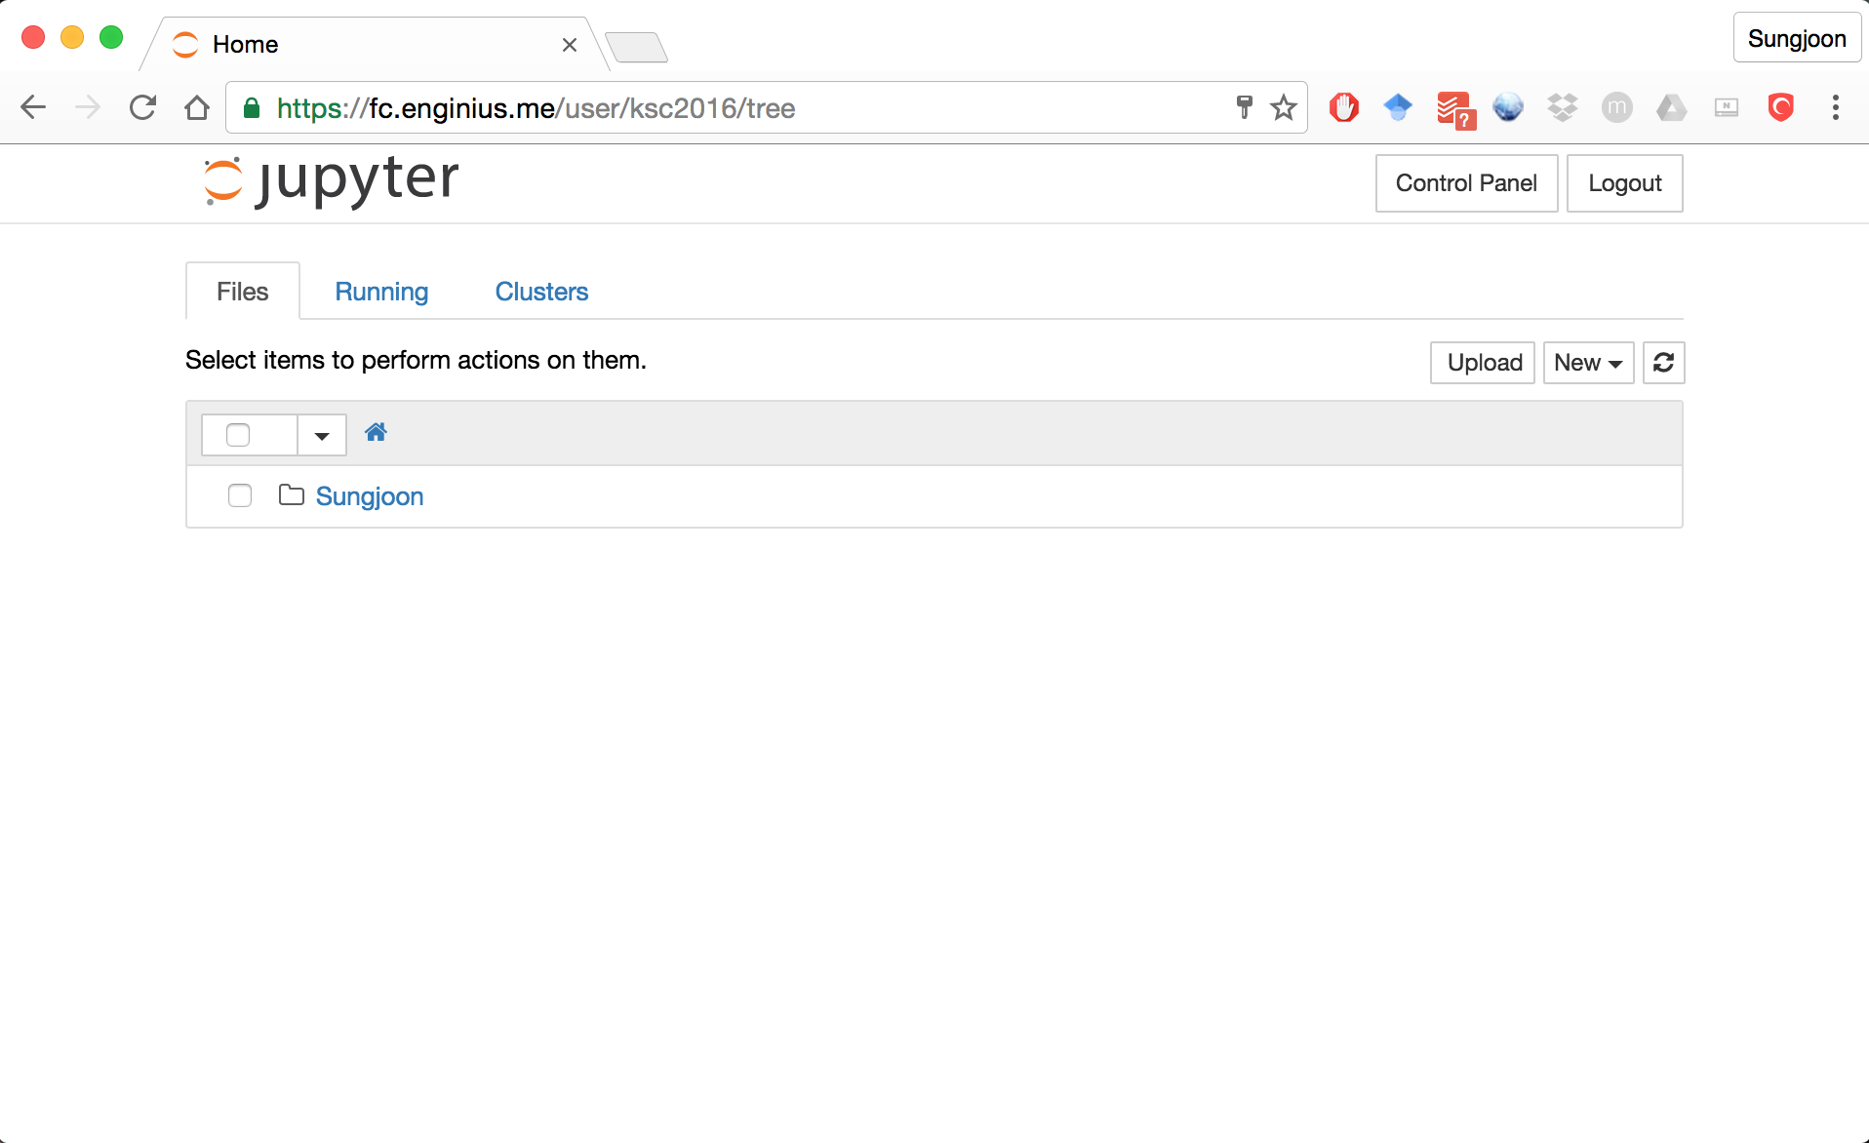

Slide 5
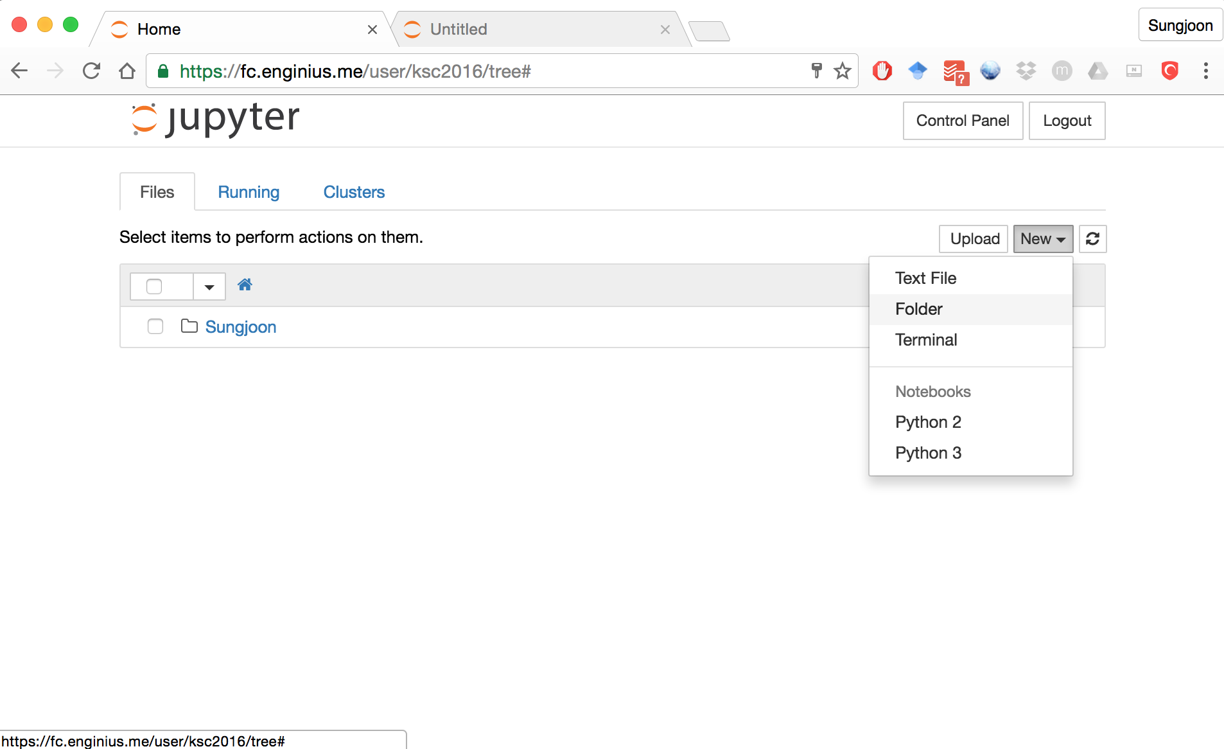

Slide 6
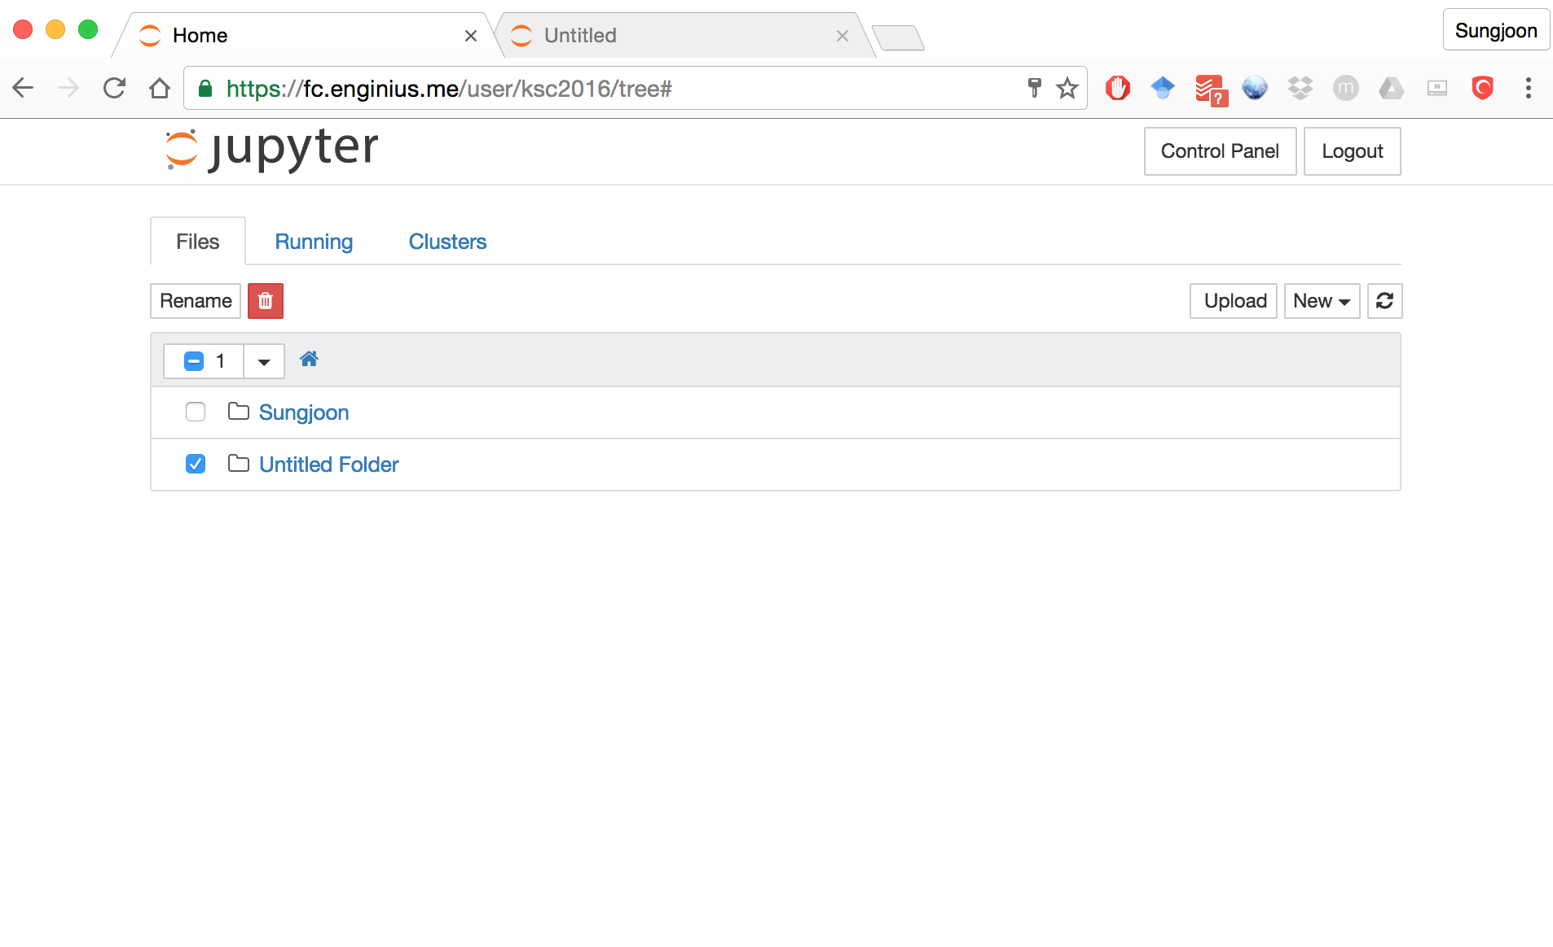

Slide 7
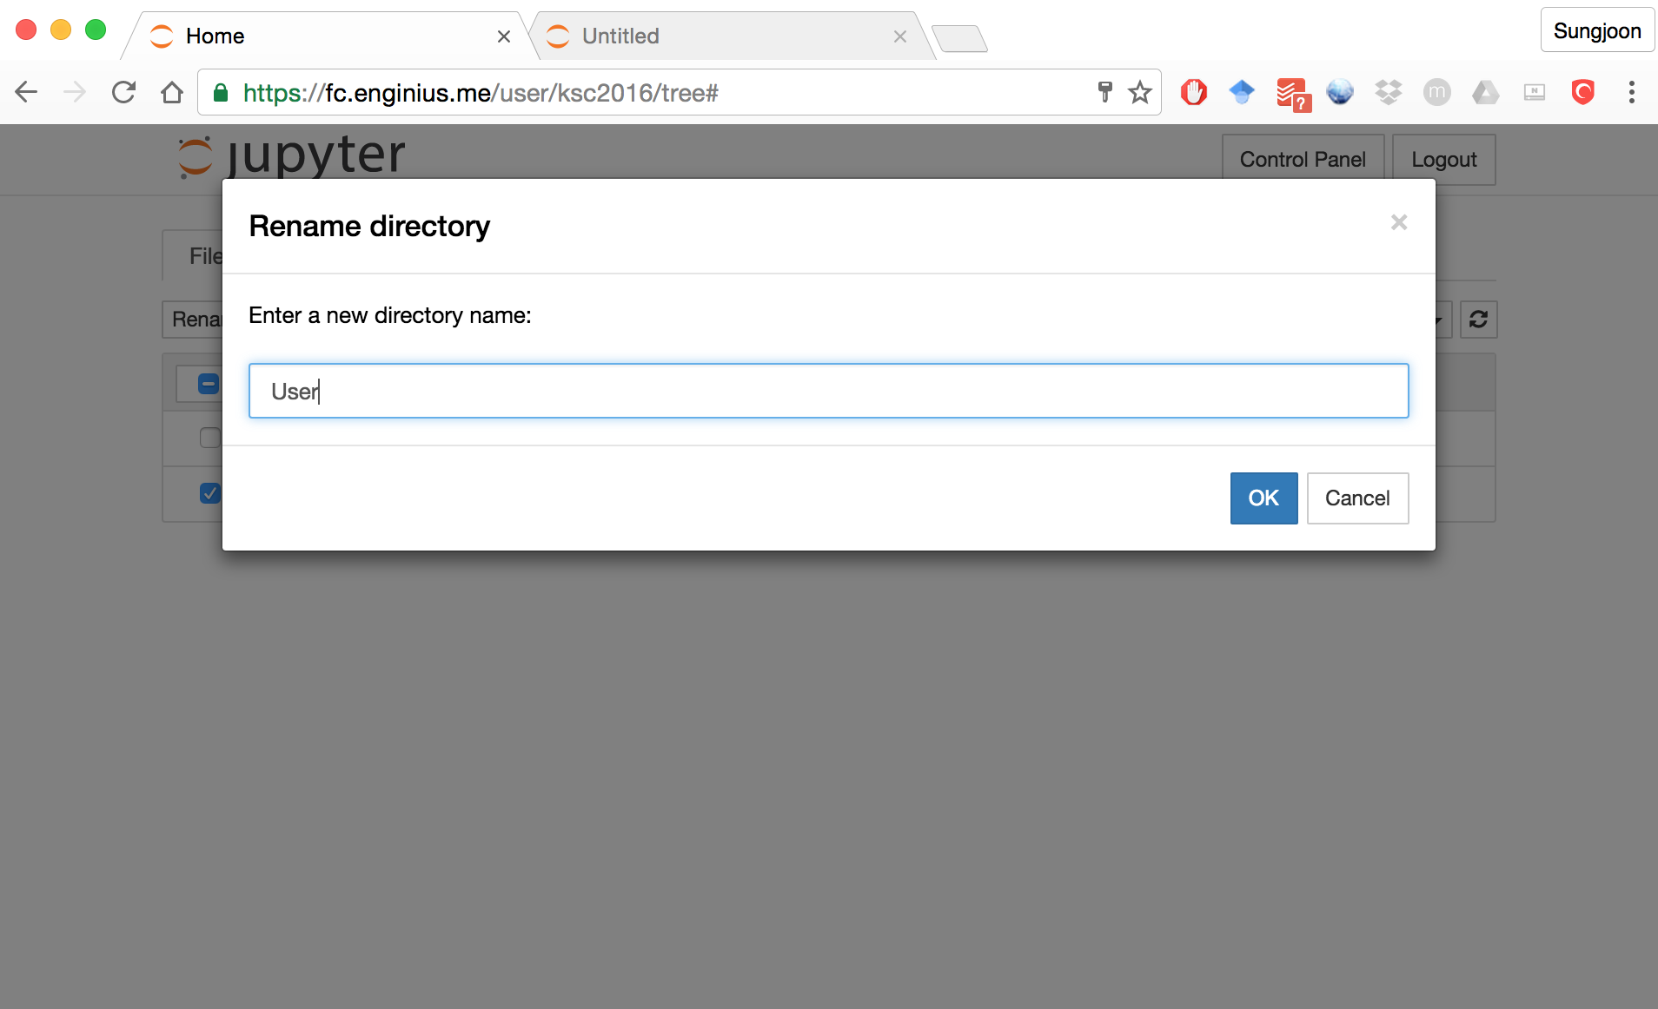

Slide 8
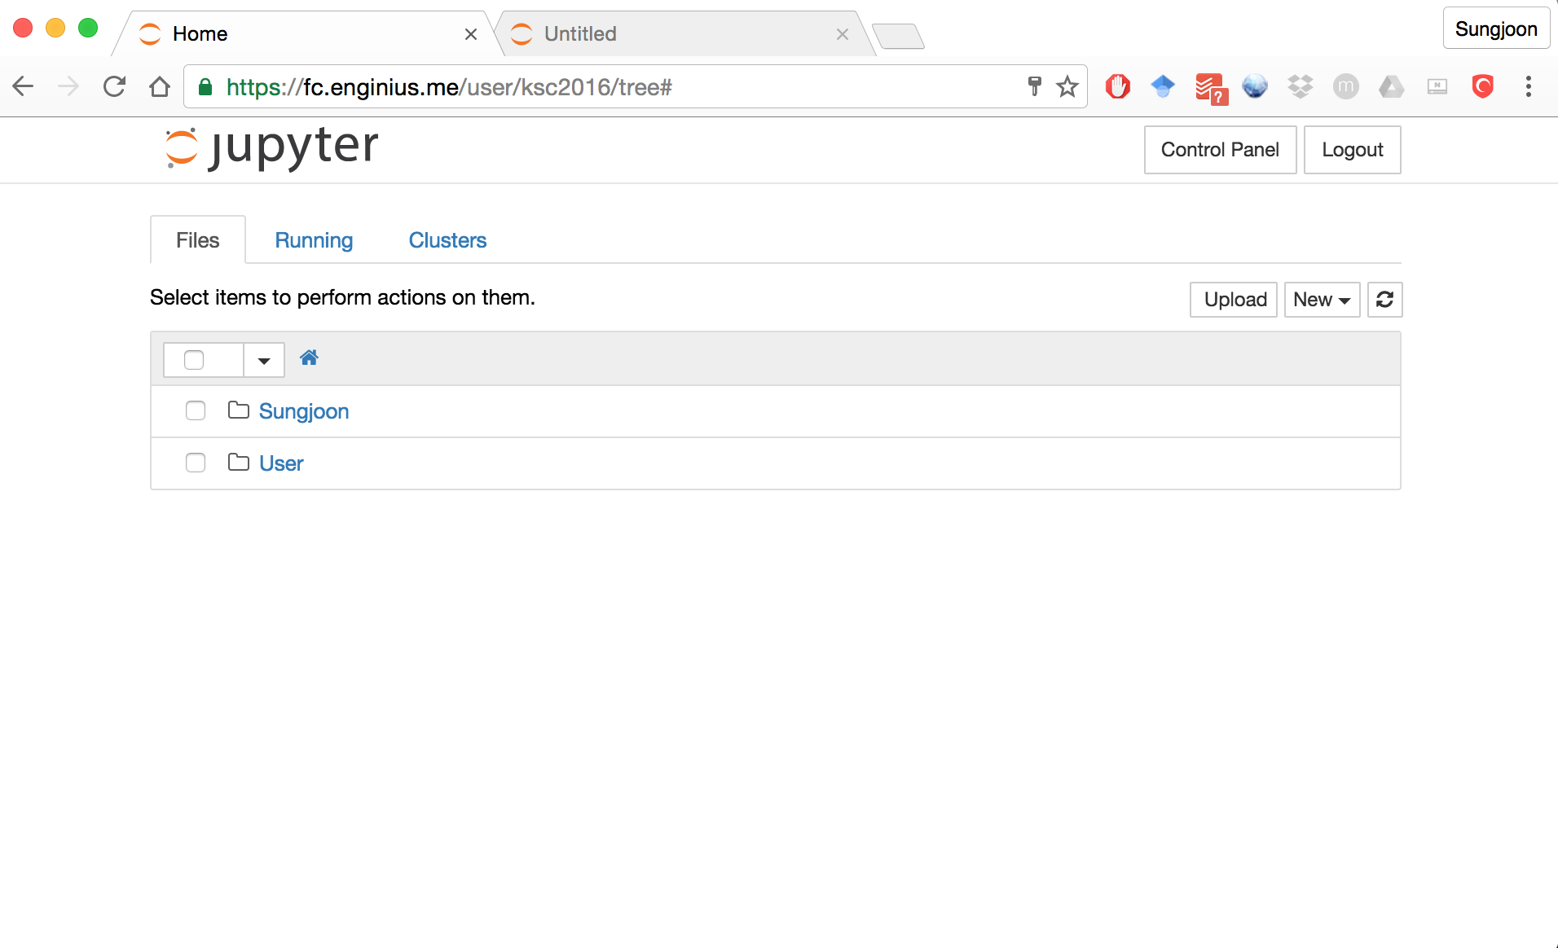

Slide 9
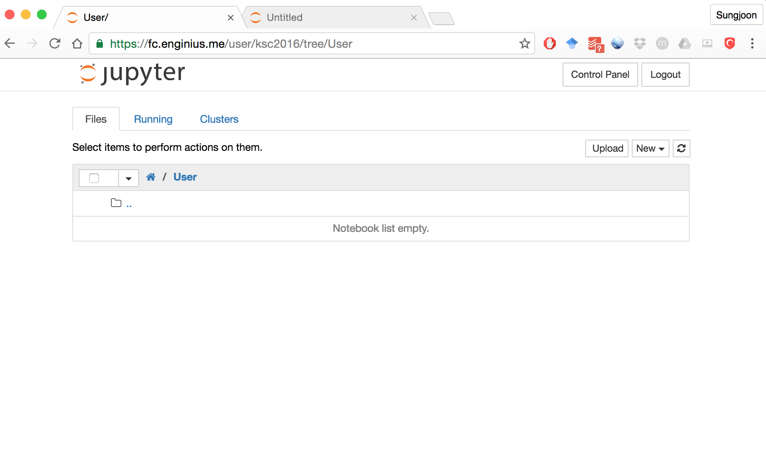

Slide 10
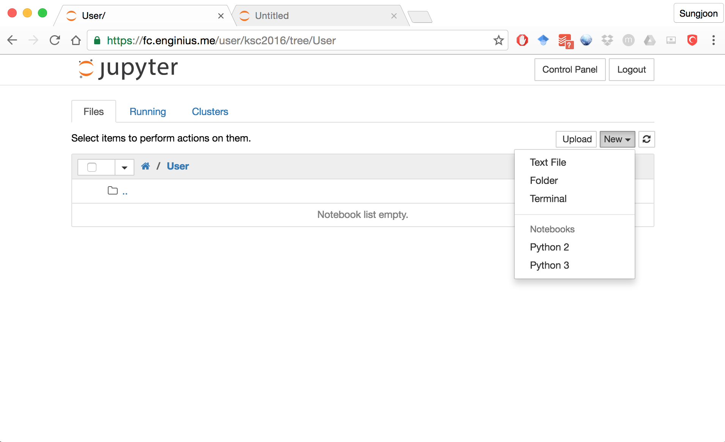

Slide 11
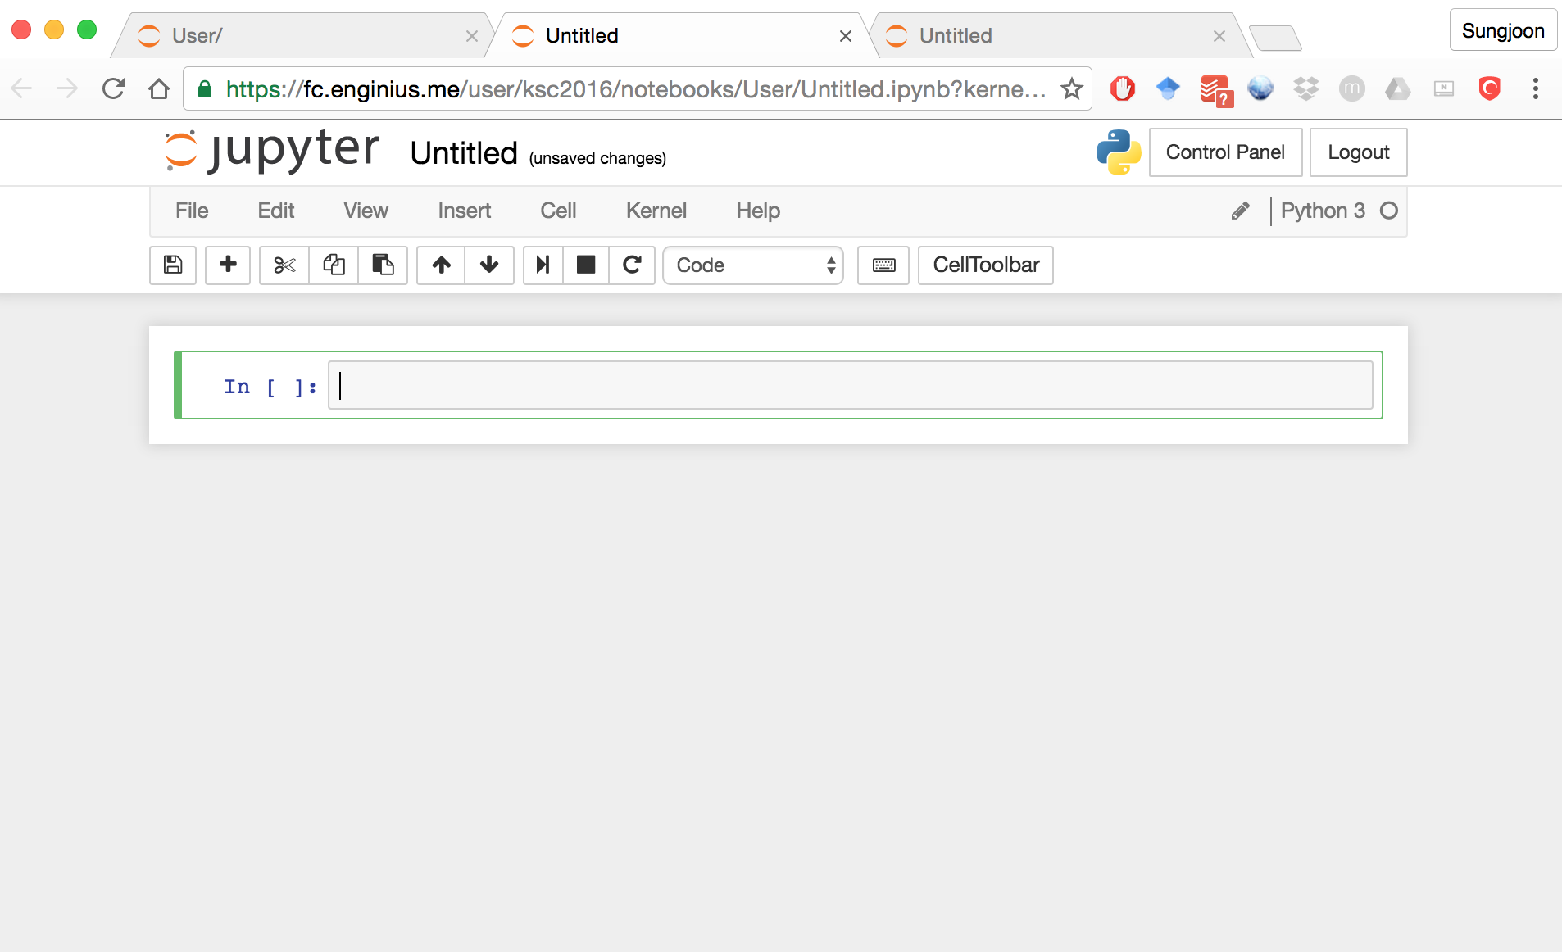

Slide 12
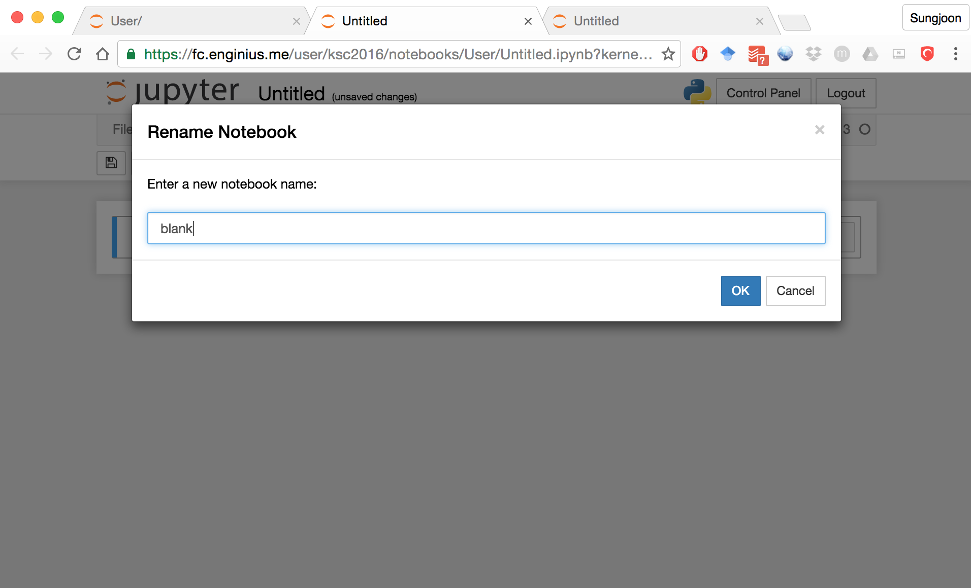

Slide 13
