Slide 1
Microservice Vs Monolithic
A monolithic application is built as a single unified unit while a microservices architecture is a collection of smaller, independently deployable services.
A monolithic architecture is a traditional model of a software program, which is built as a unified unit that is self-contained and independent from other applications. The word “monolith” is often attributed to something large and glacial, which isn’t far from the truth of a monolith architecture for software design. A monolithic architecture is a singular, large computing network with one code base that couples all of the business concerns together

Slide 2
Microservice Vs Monolithic
The advantages of a monolithic architecture include:
Easy deployment – One executable file or directory makes deployment easier.
Development – When an application is built with one code base, it is easier to develop.
Performance – In a centralized code base and repository, one API can often perform the same function that numerous APIs perform with microservices.
Simplified testing – Since a monolithic application is a single, centralized unit, end-to-end testing can be performed faster than with a distributed application. Easy debugging – With all code located in one place, it’s easier to follow a request and find an issue.

Slide 3
Microservice Vs Monolithic
The disadvantages of a monolith include:
Slower development speed – A large, monolithic application makes development more complex and slower.
Scalability – You can’t scale individual components.
Reliability – If there’s an error in any module, it could affect the entire application’s availability.
Barrier to technology adoption – Any changes in the framework or language affects the entire application, making changes often expensive and time-consuming.
Lack of flexibility – A monolith is constrained by the technologies already used in the monolith.

Slide 4
Microservice Vs Monolithic
A microservices architecture, also simply known as microservices, is an architectural method that relies on a series of independently deployable services. These services have their own business logic and database with a specific goal. Updating, testing, deployment, and scaling occur within each service. Microservices decouple major business, domain-specific concerns into separate, independent code bases. Microservices don’t reduce complexity, but they make any complexity visible and more manageable by separating tasks into smaller processes that function independently of each other and contribute to the overall whole.

Slide 5
Microservice Advantage
Agility – Promote agile ways of working with small teams that deploy frequently.
Flexible scaling – If a microservice reaches its load capacity, new instances of that service can rapidly be deployed to the accompanying cluster to help relieve pressure.
Continuous deployment – We now have frequent and faster release cycles. Before we would push out updates once a week and now we can do so about two to three times a day.
Highly maintainable and testable – Teams can experiment with new features and roll back if something doesn’t works. makes it easier to update code and accelerates time-to-market for new features. Plus, it is easy to isolate and fix faults and bugs in individual services.

Slide 6
Microservice disadvantage
Exponential infrastructure costs – Each new microservice can have its own cost for test suite, deployment playbooks, hosting infrastructure, monitoring tools, and more.
Added organizational overhead – Teams need to add another level of communication and collaboration to coordinate updates and interfaces.
Debugging challenges – Each microservice has its own set of logs, which makes debugging more complicated. Plus, a single business process can run across multiple machines, further complicating debugging.

Slide 7
Microservice disadvantage
Lack of standardization – Without a common platform, there can be a proliferation of languages, logging standards, and monitoring.
Lack of clear ownership – As more services are introduced, so are the number of teams running those services. Over time it becomes difficult to know the available services a team can leverage and who to contact for support.

Slide 8
Types of Microservice
Microservices are of two types:
Stateless microservices: Stateless microservices are the building blocks of a distributed system. They don’t maintain a session state between requests. If any service is removed, it won't affect the overall performance logic for the service.
Stateful Microservices Compared to stateless microservices, stateful microservices are less preferred in real life. They maintain session information in the code. And when more than two services interact with each other, they keep a service request state.

Slide 9
Types of projects on Microservice
Under microservices, there are two types of projects.
Brownfield projects —It refers to the development and deployment of a new software system within the context of existing or legacy systems. Therefore, converting a monolithic application to microservices would fall under this project.
Greenfield projects — This involves creating a system from scratch for a completely new environment, without any legacy code to work from. An approach used when you’re starting from scratch with no restrictions or dependencies.

Slide 10
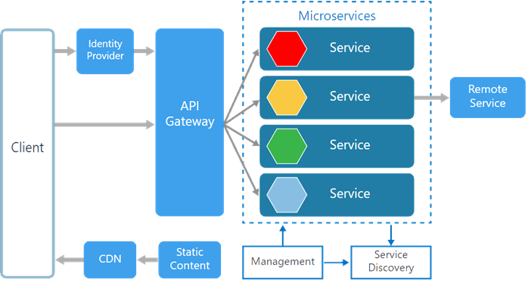
Microservices Architecture

Slide 11
Microservices Architecture
Management. Maintains the nodes for the service.
Identity Provider. Manages the identity information and provides authentication services within a distributed network.
Service Discovery. Keeps track of services and service addresses and endpoints.
API Gateway. Serves as client’s entry point. Single point of contact from the client which in turn returns responses from underlying microservices and sometimes an aggregated response from multiple underlying microservices. Ocelot
CDN. A content delivery network to serve static resources for e.g. pages and web content in a distributed network
Static Content The static resources like pages and web content

Slide 12
Microservices Principles
1. Single Responsibility principle - It states that any class or module in microservices should have a single responsibility. Having multiple responsibilities lead to tight coupling and result in fragile designs that are hard to evolve and can break into unexpected ways upon changing.
2. Loose Coupling - Dependencies between services are minimized through loose coupling.
3. Fault Tolerance - Microservices will be necessarily built fault-tolerant so that failures on the side of its collaborating services will have less impact on its own SLA.
4. Infrastructure automation - In the microservice approach, each service is built by embedding all dependencies and running as standalone.
5.Deployment - Microservices are platform agnostic. It implies the services are designed and deployed independently without affecting others.

Slide 13
Why should design pattern
Why should we follow an design pattern?
Every project’s software development life cycle has 2 opposing forces, the force of doing things and the force of doing things right.
By not following a tried and tested architecture pattern and just trying to get a tangible output asap always leads to rework.

Slide 14
Design Pattern in Microservice
Following are the popular microservices tools used for various functionalities:
Aggregator
API Gateway
Chained or Chain of Responsibility
Asynchronous Messaging
Database or Shared Data
Event Sourcing
Decompose by Business Capability
Stranglar design pattern
Command Query Responsibility Segregator
Circuit Breaker/ Three times Retry Polly

Slide 15
Microservices Tools
1. Docker- An open-source tool that allows building and deploying apps using containers.
2. Hystrix - Hystrix is a fault tolerance library developed to isolate access points to remote systems, services, and 3rd party libraries.
3. AWS Lambda - This AWS Lamda tool supports infrastructure-less servers for microservices builds and users charged on the pay-per-use rate. Mostly, we use this tool for hosting REST or API services in combination with the AWS API gateway.
4. Prometheus - Prometheus - is a monitoring tool used to detect the strange patterns of Microservices.
5. Logstash - Logstash is an open-source tool used for checking the logs. It allows you to stash, centralize, and transform data of microservices.
6. RabbitMQ - This tool employs patterns to interact between microservices and also scales the application simultaneously.
7. Apache Kafka - Apache Kafka is a distributed stream processing platform used for data processing or API calls.

Slide 16
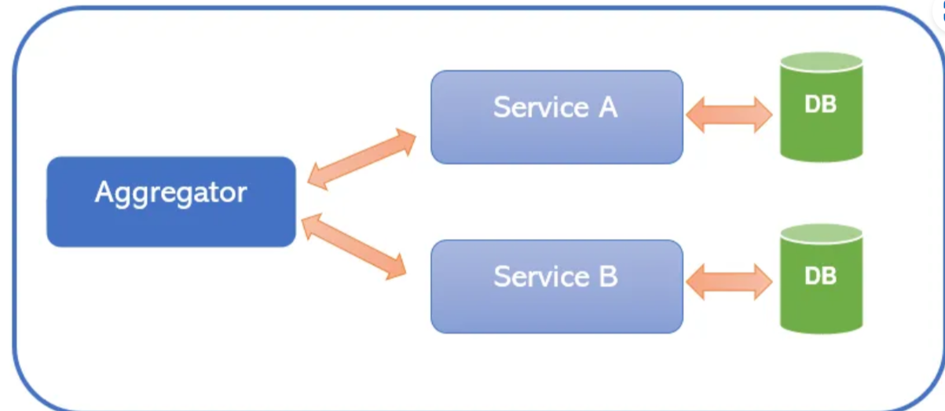
Aggregator Design Pattern
In microservices the Aggregator Design Pattern is a service that receives a request, then makes requests of multiple services, combines the results and responds to the initiating request.

Slide 17
Aggregator Design Pattern
In microservices the Aggregator Design Pattern is a service that receives a request, then makes requests of multiple services, combines the results and responds to the initiating request.
Student Management System
1. A service to get Student Information
2. A service to get Marks & its related Information
3. A service to get Membership Information
4. A service to get Achievements Information

Slide 18
Decompose by business capability pattern
Microservice Architecture Patterns Part 1: Decomposition Patterns | HackerNoon
This approach is based on business capability decomposition, which aims to create microservices aligned with the business needs and can be developed and maintained independently. Business capabilities are the specific functions or processes that an organization performs to deliver value to its customers [3]. It is a high-level concept that describes what a business does rather than how it does it. For example, a banking application might have business capabilities for account management, transaction processing, and loan origination.

Slide 19
Decompose by business capability pattern
Here are some situations in which business capability decomposition may be a good fit:
1. Your team has enough insight into your organization's business units, and you have subject matter experts (SMEs) for each business unit.
2. An application has a large number of interrelated functions or processes, or when those functions or processes are likely to change frequently. By breaking down the application into smaller, more focused services, development teams can iterate and experiment more quickly and easily and respond more effectively to changing business requirements and market conditions.
3. Suppose your organization has multiple business units or departments with distinct areas of functionality and workflows. In that case, business capability decomposition can help to align your application architecture with these capabilities, making it easier to develop and deploy new features and services.

Slide 20
Decompose by business capability pattern
Advantages
Business Alignment: By organizing microservices around business capabilities, aligning software development with business goals and objectives becomes easier. As a result, it also makes it easier to prioritize the most critical business capabilities are addressed first.
Cross-Functional Teams: This pattern encourages cross-functional teams that are focused on specific business capabilities. And this, in turn, can help break down business between different departments and ensure that everyone is working towards a common goal.
Improved User Experience: By focusing on specific business capabilities, microservices can be optimized for the particular needs of end-users. It can result in better user experiences and higher user satisfaction.

Slide 21
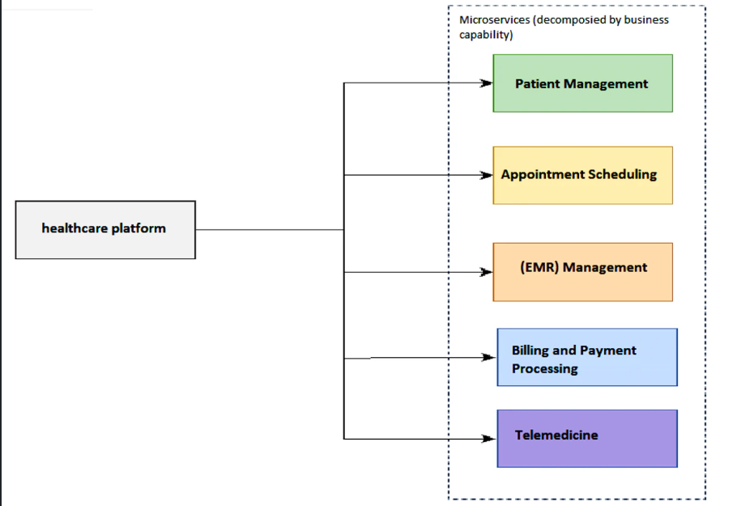
Decompose by business capability pattern

Slide 22
Decompose by Transaction pattern
One popular approach to decomposing microservices is through transaction decomposition, where the system is designed such that each particular transaction belongs to a separate microservice.
This Pattern Is Better to Use If:
This pattern can be reasonable in the following scenarios:
When there are transactional operations that involve multiple components or services.
When there are frequent and complex transactions, such as in e-commerce applications, financial systems, and other transaction-intensive environments.
When there are strict consistency requirements, where it is important to ensure that data is always in a consistent state across all components involved in a transaction.

Slide 23
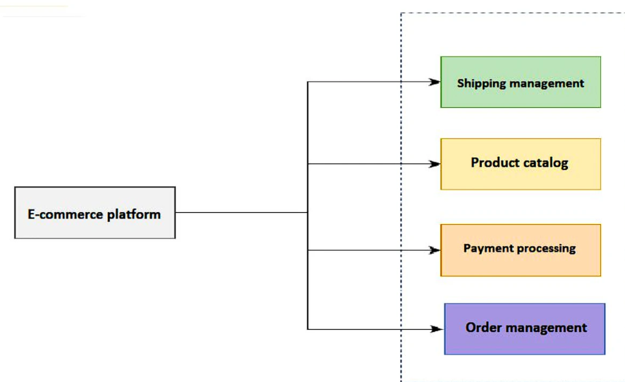
Decompose by Transaction pattern

Slide 24
Decomposition by sub-domain pattern
Microservice decomposition by subdomain is a process of breaking down a monolithic system into smaller, independent microservices based on the corresponding subdomains defined by Domain-Driven Design (DDD). DDD refers to the application's problem space - the business - as the domain, which is comprised of multiple subdomains [8]. The scope of each subdomain's model is called a bounded context, around which microservices are developed. This pattern is suitable for monolithic systems that have clear boundaries between subdomains

Slide 25
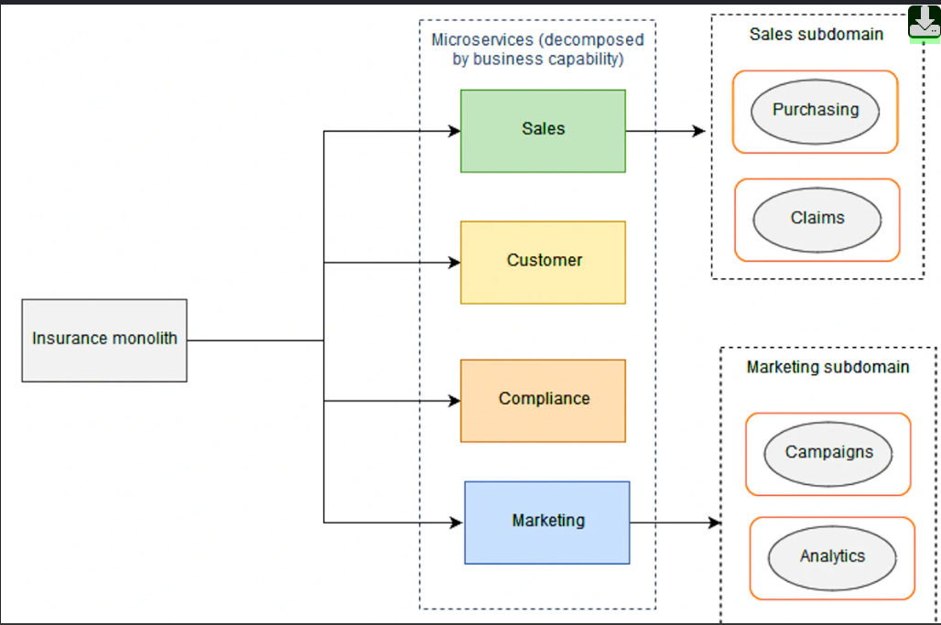
Decomposition by sub-domain pattern

