Slide 1
ENTERPRISE FINANCIAL AUDIT DASHBOARD
Data Reconciliation & Financial Analysis
A Python, SQL & Power BI Analytics Project
Python | SQL | Power BI
Prepared by:
MANASA A
Data Analytics
Financial Data Extraction, Reconciliation & Business Intelligence
2026

Slide 2
Business Scenario & Problem Statement
BUSINESS CONTEXT
A FinTech company needs a reliable financial audit dashboard using data from multiple business systems.
2. CHALLENGE
Financial data was stored across SQL records, unstructured server logs and daily exchange-rate files, requiring extraction, cleaning and reconciliation.
3. OBJECTIVE
Build an efficient Python and SQL data pipeline and create a Power BI dashboard to analyze revenue trends and valuable customers.

Slide 3
DATA SOURCES
1. ENTERPRISE DATABASE:
SQLite Database
• User accounts and historical records
• Multiple status updates per user
• Latest status identified using SQL Window Functions
2. Server Logs:
100,000 Raw Transaction Logs
• Transaction details stored in text
• ERROR records filtered out
• Regex used to extract Date, User ID, Product ID and Euro Value
3. Exchange Rates:
Daily EUR → USD Rates
• 365-day exchange-rate dataset
• Weekend dates were missing
• Forward-fill(ffill) used for temporal reconciliation

Slide 4
Data Processing Pipeline
1. SQL EXTRACTION:
Used SQL Window Functions to identify the latest record for each user and retain only Active users.
2. REGEX EXTRACTION:
Parsed 100,000 raw server logs and extracted Date, User ID, Product ID and Euro Value using Regex.
3. CLEAN & VALIDATE:
Filtered ERROR logs, converted data types and checked the extracted transaction data for missing values.
4. FINANCIAL RECONCILIATION:
Forward-filled missing weekend exchange rates and calculated USD Revenue from EUR transaction values.
5. POWER BI:
Built an interactive dashboard showing monthly revenue trends, total USD revenue and the Top 5 customers.

Slide 5
DATA QUALITY & VALIDATION
100,000
Raw Server Log Rows
94,902
Valid INFO Transactions
5,098
ERROR Logs Filtered
14,183
Latest Active Users
53,899
Final Reconciled Records
0
Duplicate Final Records
“Final dataset validated with no missing User IDs or USD Revenue values.”

Slide 6
FINANCIAL ANALYSIS & KEY RESULTS
148.27M
Total USD Revenue
12.84M
Highest Monthly Revenue
11.44M
Lowest Monthly Revenue
40.05K
Top Customer Revenue
KEY INSIGHTS:
• January recorded the highest monthly revenue at approximately $12.84M.
• February recorded the lowest monthly revenue at approximately $11.44M.
• The Top 5 customers contributed significant individual revenue, with the highest customer generating approximately $40.05K.

Slide 7
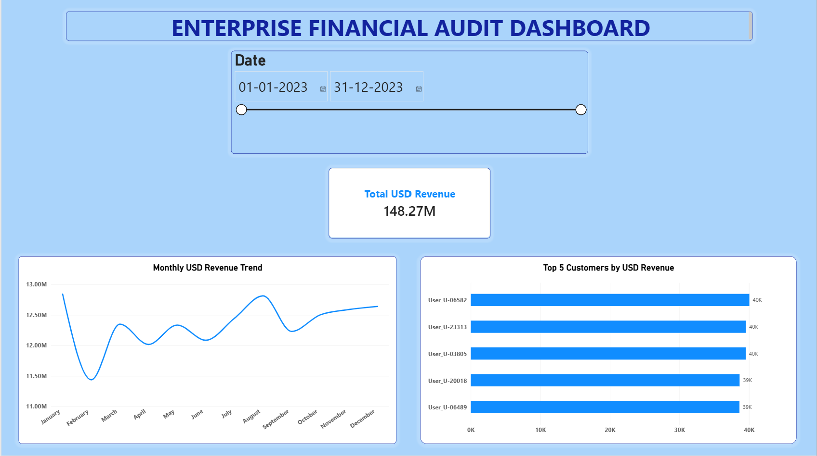
POWER BI FINANCIAL AUDIT DASHBOARD
Interactive dashboard with date filtering, revenue trend analysis and Top 5 customer identification.

Slide 8
BUSINESS INSIGHTS & FINDINGS
REVENUE TREND
“Monthly revenue remained relatively stable throughout the year, with January recording the highest revenue and February the lowest.”
CUSTOMER VALUE
“The Top 5 customers generated substantial individual revenue, helping identify high-value customers for focused retention strategies.”
DATA RECONCILIATION
“Combining transaction logs, customer history and exchange rates produced a reliable reconciled dataset for financial analysis.”
BUSINESS VALUE
“The dashboard enables decision-makers to monitor revenue performance, filter results by date and identify valuable customers quickly.”

Slide 9
TOOLS & TECHNICAL SKILLS
PYTHON
• Pandas & NumPy
• Regex & string parsing
• Data cleaning & transformation
• Data visualization
SQL
• SQLite database
• Window Functions
• ROW_NUMBER()
• Historical record reconciliation
POWER BI
• Data import & modelling
• DAX measures
• Interactive date slicer
• Revenue & customer dashboards
DATA ANALYTICS
• Data validation
• Financial reconciliation
• Aggregation & KPI analysis
• Business insights

Slide 10
PROJECT OUTCOME & CONCLUSION
1. TECHNICAL OUTCOME:
Built an end-to-end data pipeline using Python and SQL to extract, clean, reconcile and transform data from multiple business systems.
2. ANALYTICAL OUTCOME:
Created a reliable financial dataset and identified monthly revenue patterns and high-value customers through data analysis.
3. BUSINESS OUTCOME:
Developed an interactive Power BI dashboard that enables financial performance monitoring and supports data-driven decision-making.
“The project demonstrates the complete journey from raw enterprise data to actionable business intelligence.”

Slide 11
THANK YOU
Questions & Discussion
Enterprise Financial Audit Dashboard Python • SQL • Power BI
MANASA A | 2026

