Slide 1
What is Git?
Git is a version control system.
Git helps you keep track of changes in code.
Git is used to collaborate on code.
Git stands for global information tracker.
What is Github?
Github is code hosting platform for version control and collaboration.
Owned by Microsoft since 2018.

Slide 2
What does Git do?
Manage projects with Repositories
Clone a project to work on a local copy
Control and track changes with Staging and Committing
Branch and Merge to allow for work on different parts and versions of a project
Pull the latest version of the project to a local copy
Push local updates to the main project

Slide 3

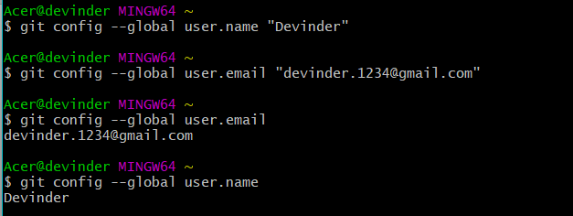
Configure git
git --version: get the current version of git if installed.
git config --global user.name “name”
git config --global user.email “email”

Slide 4
Note: Use global to set the username and e-mail for every repository on your computer.
If you want to set the username/e-mail for just the current repo, you can remove global

Slide 5
Git staging environment

Slide 6
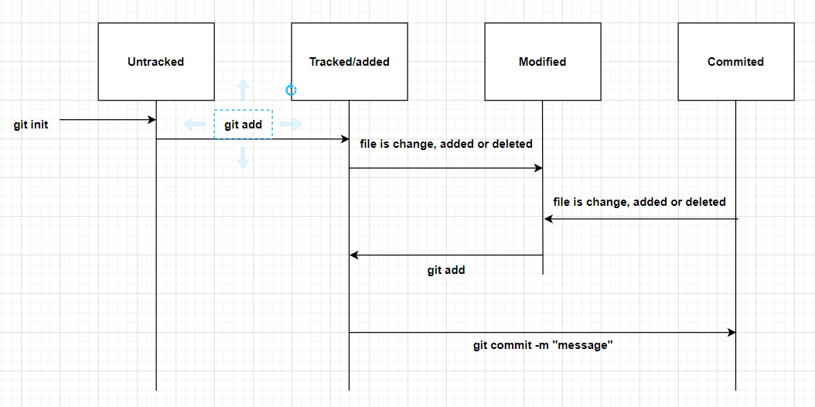
Staging

Slide 7
git status: Used to check the status of file i.e. check which files are present in which stage( untracked, added, committed and modified)
Files in your Git repository folder can be in one of 2 states:
Tracked - files that Git knows about and are added to the repository
Untracked - files that are in your working directory, but not added to the repository
git status --short:
gives short description

Slide 8
Initialize git repository on a folder.
git init
After this git create a hidden folder inside that folder to keep
track of changes.
At this moment no file is tracked by git and are untracked.
Add files to staging area (Tracked file)
git add <file name> : Add specific file to staging area
git add --all or git add –A: Add all files to staging area
Staged files are files that are ready to be committed to the repository you are working on.

Slide 9
3. Modified files:
when a file is modify it comes in modified stage and can not be committed, to commit this file you have to add this file into stage/ tracked/ added area.
4. Committed area:
Adding commits keep track of our progress and changes as we work. Git considers each commit change point or “save point”. It is a point in the project you can go back to if you find a bug, or want to make a change.
git commit -m “message”
-m message: It is description message of commit.
only files which are in staged are can committed

Slide 10
git log: to view the history of commits for a repository, you can use the log command.
git log –p -1: Gives description of last commit.
git <command-name> -help: see all available options for a specific command.
git help --all: see all possible commands.
Enter q to exit when stuck in list of commands.

Slide 11
git checkout <filename>: Matches the content of file with last commit.
git checkout –f: For all files
git rm –cached <filename>: remove the file from staging area. This file is now untracked.
git rm <filename> : deletes the file completely only if the file is in staging area.
git rm –f <filename>: -f stands for force removal.

Slide 12
Git branch
A branch is a new separate version of main repository.
branches all you to work on different parts of project without impacting the main branch.
When the work is complete, a branch can be merged with the main project.
You can switch between branched and work on different projects without them interfacing with each other.
Branching is very lightweight and fast.

Slide 13
git branch <branch-name>: create a branch with specific name
git branch: gives the list of branches.
git checkout <branch-name> : used to move to current branch to one specified branch.
git checkout –b <branch-name>: create a branch with specified name and move to that branch.
git merge <branch-name>: merge the specified branch with the current branch.
git branch –d <branch-name>: delete the specific branch.

