Slide 1

CHAT ANALYZER USING PYTHON DATA SCIENCE LIBRARIES
Presented By
AMAN
Under the Supervision of
PROF. DEBAJYOTI CHATTERJEE
Department of Computer Application
University of Engineering & Management, Jaipur

Slide 2
Contents
Introduction
Abstract
Literature Review
Objectives
Proposed Model
Experimental Setup
Result Analysis
Future Scope
Conclusion
References

Slide 3
What is Chat Analysis?
Chat analysis using Streamlit and Matplotlib involves building interactive visualizations to analyze chat data. Streamlit is a popular Python library for building interactive web applications, while Matplotlib is a widely used data visualization library in Python.
Chat analyzer using Python Streamlit can be used for various purposes, such as:
Chatbot performance analysis: If you're using a chatbot to interact with customers, you can use Streamlit to analyze how well the chatbot is performing. This can include metrics such as response time, accuracy, and user satisfaction.
Chat log analysis: You can use Streamlit to analyze chat logs and identify patterns and trends in customer behavior. This can help you identify common issues that customers are facing and take steps to address them.
Sales analysis: If you're using chat as a sales channel, you can use Streamlit to analyze chat data and identify which products or services are most popular with customers. This can help you optimize your sales strategy and increase revenue.
Overall, chat analyzer using Python Streamlit can be a powerful tool for gaining insights into chat data and using those insights to improve customer experience, optimize sales, and enhance chatbot performance.

Slide 4
ABSTRACT
Using Python Streamlit, Chat Analyzer is a web application that allows users to analyze and visualize chat data in chat and social media. With Streamlit, users can create custom dashboards and interactive visualizations that allow them to explore interactive data, identify patterns and trends, and gain insights into people's consumer behavior and opinions.
Some of the most common uses of Chat Analyzer using Python Streamlit are customer analytics, chatbot performance analysis, interactive analytics, sales analytics, and chatbot training. Streamlit can be used to create interactive visualizations such as line charts, charts, scatter charts, and other types of charts that help users discover and understand interactive information.
Streamlit also provides a variety of interactive widgets that allow users to filter and sort interactive data, adjust visibility and customize dashboards as needed.

Slide 5
Literature Review
Analyzing Customer Feedback with Natural Language Processing using Python" (Ravi et al., 2018): This paper presents an approach for analyzing customer feedback using natural language processing (NLP) techniques in Python. The authors use Python libraries such as NLTK and Scikit-learn to preprocess and analyze customer feedback data..
Overall, this study demonstrates the usefulness of Python for chat analysis tasks such as sentiment analysis, chatbot evaluation, and customer feedback analysis. The studies also highlight the importance of using appropriate Python libraries and techniques for preprocessing and analyzing chat data.

Slide 6
Literature review on Modules:
Streamlit: Streamlit is a free and open-source python framework. We can quickly develop web apps for Machine Learning and Data Science by using Streamlit. Streamlit can easily integrates with other popular python packages such as NumPy, Pandas, Matplotlib, Seaborn. Streamlit provides fastest way to develop and deploy web apps.
Matplotlib: Matplotlib is a popular Python packages used for data visualization. It is a cross-platform library for making plots from data in arrays. It helps in creating static, animated and interactive visualizations in python.
Seaborn: Seaborn is the data visualization library. It is used for making statistical graphs. Visualization is the central part of seaborn. Seaborn provides exploration and better understanding of data. Seaborn closely integrates into the data structures from python.

Slide 7
Literature review on Modules:
Word cloud: Word Cloud is a data visualization library used for representing most frequently used words within a given text. Most frequent and important words are represented in bigger and bolder size.
Pandas: Pandas is an open-source python library. Pandas used to convert string data into Data frame. Data frame is the representation of data into 2-dimensional table of rows and columns. We can work with large data sets using Pandas library. Pandas library has many built-in functions for data analysis, data cleaning, data exploration and data manipulation

Slide 8
Objectives
The objectives of chat analyzer using Python Streamlit and Matplotlib may include:
To analyze chat data: The primary objective of chat analyzer using Python Streamlit and Matplotlib is to analyze chat data and gain insights into customer behavior and sentiment. This can help businesses understand customer needs and preferences, and identify areas for improvement.
To visualize chat data: Streamlit and Matplotlib can be used to create interactive visualizations such as line charts, scatter plots, and bar charts that enable users to explore and understand chat data. These visualizations can help users identify patterns and trends in chat data and communicate findings to others.
To improve customer experience: By analyzing chat data, businesses can identify common issues that customers are facing and take steps to address them. This can help improve customer experience and satisfaction, which can lead to increased loyalty and revenue.

Slide 9
Proposed Model
This proposed model for chat analyzer using Python Streamlit and Matplotlib includes data preprocessing topic modeling, visualization, and chatbot performance analysis. By following this model, businesses can gain insights into chat data and use those insights to improve customer experience, optimize sales.
Data preprocessing: The first step in the model involves preprocessing chat data. This may include tasks such as cleaning the data, removing stopwords, and tokenizing the text. Python libraries such as NLTK and Spacy can be used for this task.
Topic modeling: The next step involves performing topic modeling on the chat data. This can help businesses identify common themes or topics that customers are discussing.
Visualization: The final step involves creating interactive visualizations using Python Streamlit and Matplotlib. These visualizations can help users explore and understand the chat data, and communicate findings to others. Examples of visualizations that can be created include line charts, scatter plots, and bar charts.

Slide 10
Experimental Setup
Data Collection: The first step is to collect chat data from the relevant sources. This may include customer service chat logs, social media chat logs, or chatbot interactions. The data should be stored in a suitable format such as CSV/JSON or TXT file
Data Preprocessing: the next step is to preprocess the chat data as described in the proposed model. This may include cleaning the data, removing stopwords, and tokenizing the text. Python libraries such as NLTK and Spacy can be used for this task.
Model Selection: Topic modeling can be performed on the chat data using Python libraries such as PANDAS, COLLECTIONS. RegEx is used for finding patterns in the text and extract data. This can help identify common topics or themes in the chat messages.
Visualization: Interactive visualizations can be created using Python Streamlit and Matplotlib. This can help users explore and understand the chat data and communicate findings to others..

Slide 11
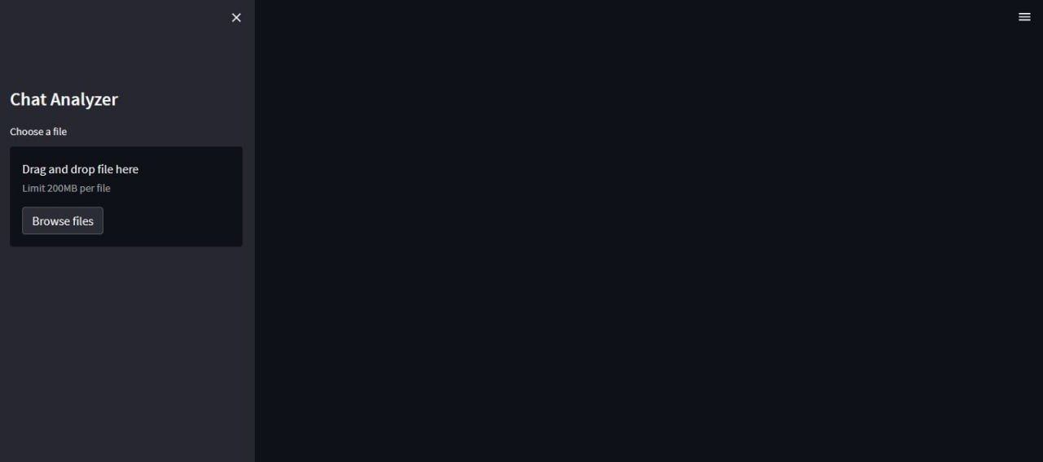
Outputs
RUNNING THE CODE IN VS CODE TERMINAL:
UPLOADING A DATA SOURCE OR TEXT FILE:

Slide 12
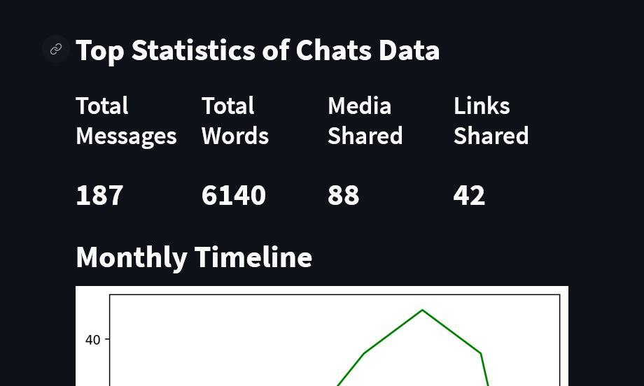
Outputs
VISUALISED DATA AND RESULTS OF PATTERNS IN ANALYZED TEXT:
UPLOADING A DATA SOURCE OR TEXT FILE:

Slide 13
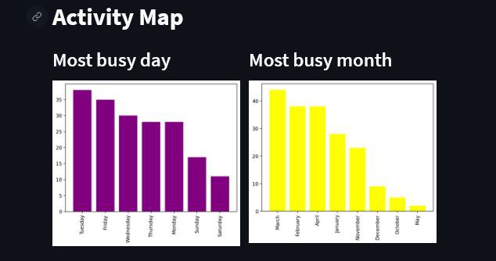
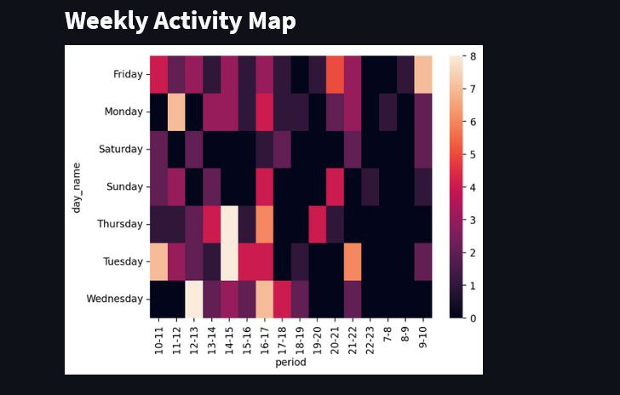
Outputs
OTHER FEATURES AND PATTERNS IN ANALYZED TEXT:

Slide 14
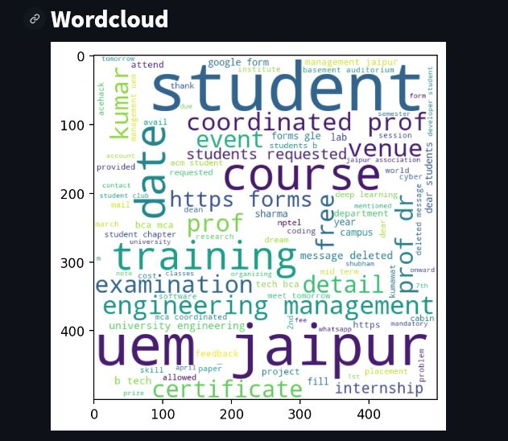
Outputs
WORD CLOUD BASED ON ANALYZED TEXT:

Slide 15
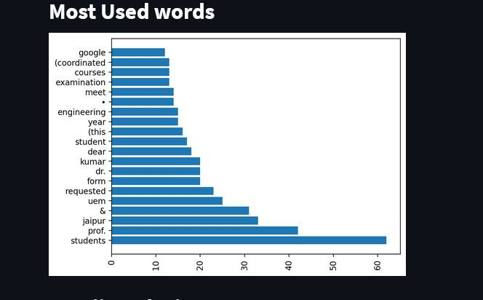
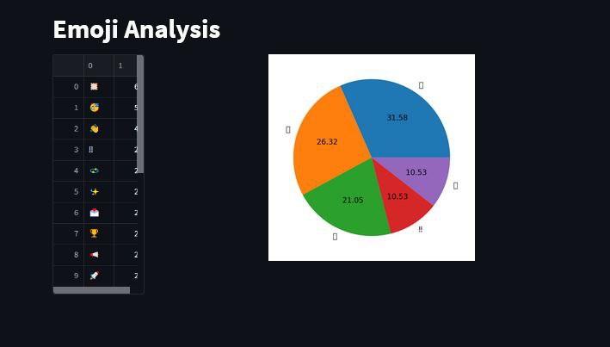
Outputs
SOME OTHER FEATURES IN THE ANALYZED TEXT:

Slide 16
Future Scope
Voice-based chat analysis: As the number of voice assistants and chatbots that utilise speech as their primary communication method rises, it may be possible to create a chat analyst that will examine voice-based chat data and offer insights and suggestions for organisations.
Analysis based on machine learning: A chat analyzer that does more complex analyses on chat data, such as entity recognition, sentiment analysis, and intent detection, could be created.
Integration with other data sources: To give a more comprehensive picture of customer engagement and behaviour, chat analyzer could be combined with other data sources like social media data or website analytics.
Natural Language Generation: Based on the information gathered, Natural Language Generation (NLG) techniques could be utilised to automatically provide answers to client enquiries.

Slide 17
Conclusion
In conclusion, a powerful tool that can be used to analyse conversation data and derive insights that can improve customer experience, maximise sales, and increase chatbot efficiency is a chat analyzer utilising Python Streamlit and Matplotlib. Chat analyzer can discover common themes and sentiments in chat messages by carrying out activities like sentiment analysis and topic modelling, giving organisations with useful information to improve their customer service and engagement initiatives. Businesses may track chatbot performance indicators like response time and user happiness with the use of chat analyzer, which also enables them to spot areas where their chatbot systems need work. Chat analyzer can offer a user-friendly interface with interactive visualisations made with Python Streamlit and Matplotlib that let users explore and comprehend the data.

Slide 18
References
Ravishankara K, Dhanush, Vaisakh, Srajan I S, “International Journal of Engineering Research &
Technology (IJERT)”, ISSN: 2278-0181, Vol. 9 Issue 05, May-2020
[2] https://www.analyticsvidhya.com/blog/2021/06/build-web-app-instantly-for-machine-learningusing-streamlit/
[3] Meng Cai, “PubMed Central”, PMCID: PMC7944036, PMID: 33732917
[4] Dr. D. Lakshminarayanan, S. Prabhakaran, “Dogo Rangsang Research Journal”, UGC Care Group I
Journal, Vol-10 Issue-07 No. 12 July 2020
[5] https://www.interaction-design.org/literature/topics/web-design

Slide 19
Contact Details:
Email:
harshojha5@gmail.com
amanavauem@gmail.com
aniketyadav0890@gmail.com

